Slide 1
A Spatial Analysis of the Atlanta BeltLine’s Effect on Residential Real Estate
Ryan Davis
The Pennsylvania State University
May 6, 2014

Slide 2
Outline
Background: What is the Atlanta BeltLine?
Objectives
Data sources
Methods
Anticipated Results
Proposed Timeline
References
Acknowledgements & Questions
The Atlanta BeltLine’s Eastside Trail

Slide 3
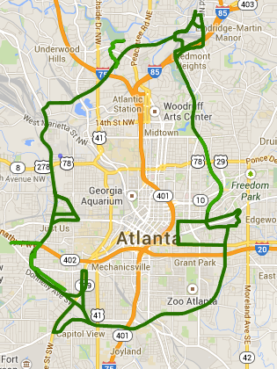
What is the ?
Large-scale urban development project
22-mile ring of paved trails, green space, light rail and public art built along defunct railroad tracks surrounding the city’s core business district
Approximately 3,000 acres of underutilized land set for development
Connects 45 neighborhoods
Expected completion - 2030
BeltLine corridor overlayed on Google Maps. Image retrieved from http://beltline.org/explore/maps/overview-maps/

Slide 4
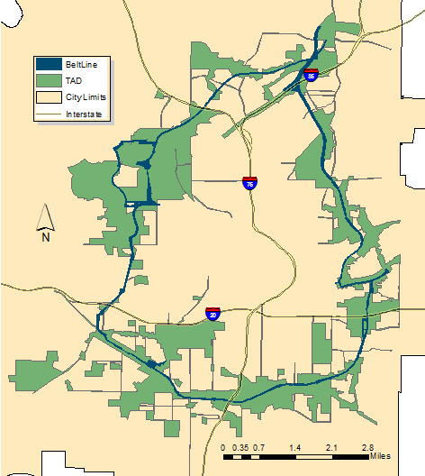
Funding the Project
City established 6,500-acre Tax Allocation District (TAD) in 2005.
8% of city’s land area
All property tax revenues greater than post-2005 level finance bonds.

Slide 5
Project Objectives
The goals of this project are to:
Quantify the impact of the development of the BeltLine on nearby residential property values
Compare the relative impact of BeltLine development on residential property values in different regions and neighborhoods of Atlanta
Create a framework to continually assess effects of BeltLine development at a local level

Slide 6
Data Sources
Real estate listing data
Atlanta BeltLine shapefiles
United States Census Bureau TIGER files

Slide 7
Real Estate Listing Data
Georgia Multiple Listing Service (GAMLS)
SQL database
A multiple listing service:
membership-based service for real estate brokers and agents
share listing information that will ultimately result in a transaction for clients respectively selling and purchasing property.
Listing information is input by real estate agents and their assistants.
Common source for:
real estate appraisals
periodic reports published by the National Association of Realtors

Slide 8
Real Estate Listing Data - cont.
Transactions recorded in an MLS do not represent all real estate transactions in a market.
Each listing record represents a marketing experience for a residential property
Transactions not occurring on open market are omitted.
Includes information not available from tax assessor data.
Variety of attributes available for each listing record
Sales price
Type of residence (detached or attached)
Building area (square footage)
Lot size (acreage)
Date of sale
Latitude and longitude coordinates
Number of bedrooms and bathrooms
Year built
Time on the market

Slide 9
Real Estate Listing Data - cont.
Available sales records span the history of the Atlanta BeltLine.
Year | Total Sold Units | Detached | Attached | Median SP ($) | Median MT
1999 | 3771 | 3124 | 647 | 155000 | 33
2000 | 4131 | 3300 | 831 | 174900 | 39
----- | ----- | ----- | ----- | ----- | -----
2012 | 8449 | 5253 | 3196 | 140000 | 51
2013 | 9059 | 5755 | 3304 | 194999.5 | 40
Summary table of data - Sold residential listings with an Atlanta address; DeKalb & Fulton Counties

Slide 10
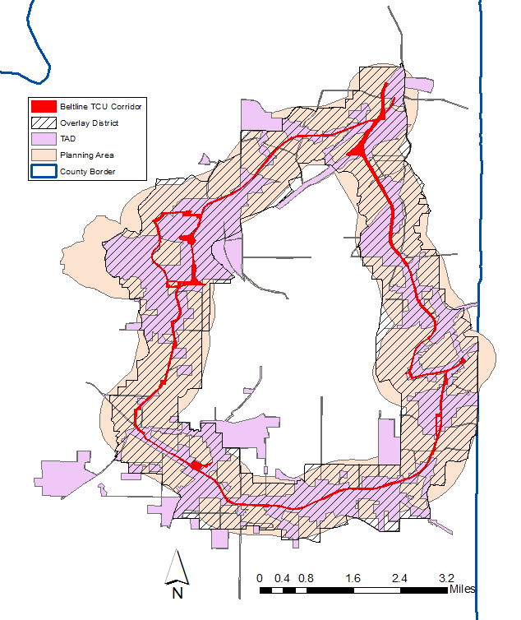
City of Atlanta GIS Data
BeltLine polygon shapefiles
Corridor
Tax Allocation District (TAD)
Planning Area
Overlay district
Data retrieved from http://gis.atlantaga.gov/apps/gislayers/download/

Slide 11
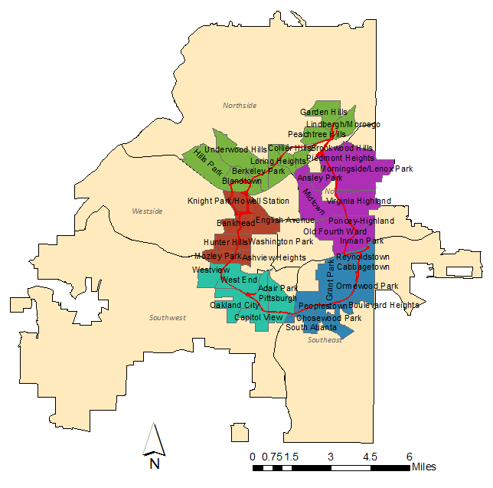
City of Atlanta GIS Data
Polygon shapefiles
City limits
Regional study groups
Neighborhoods
Data retrieved from http://gis.atlantaga.gov/apps/gislayers/download/
The five study regions and their respective neighborhoods that intersect the BeltLine corridor are shown.

Slide 12
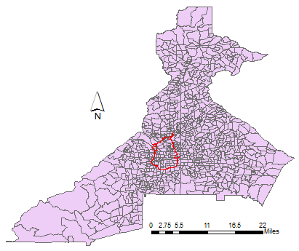
United States Census Bureau
Block groups
Decennial Census (2000, 2010)
Total number of housing units
Occupancy, vacancy rates
American Community Survey
Median income
Employment status
Commute time to/from work
The BeltLine Corridor (red) is overlaid on US Census Block Groups for Fulton and DeKalb Counties.

Slide 13
Methods Hedonic Pricing
Hedonic pricing models decompose a sales price into its individual components.
Traditionally, residential real estate studies have relied upon hedonic pricing models to help explain and predict the mechanics underlying property values.
Basic formula:
P = f(S,E,L)
P = price
S = structural characteristics
E = environmental characteristics
L = location

Slide 14
Methods Multiple Regression Analysis
Commonly used by tax assessors and appraisers for real estate valuation
Breaks down the dependent variable, sales price, into explanatory independent variables
Y_{i} = β₀ + β₁X_{1i} + β₂X_{2i} + n … + β_{n}X_{ni} + ε_{i}
Y_{i} = sales price
X = individual aspects of property
β parameters (coefficients) indicate magnitude of X
ε_{i} = error

Slide 15
Methods Criticism of linear pricing regression
Fail to compensate properly for two key characteristics of housing markets:
spatial dependence
spatial heterogeneity
May result in biased coefficients
submarket segmentation
continuous geographic distribution of real estate values

Slide 16
Methods Geographically Weighted Regression
GWR performs individual regressions at each data sample point in the spirit of Tobler’s first law of geography.
Y_{i}(u) = β₀(u) + β₁(u)X_{1i} + β₂(u)X_{2i} + n … + β_{n}(u)X_{ni} + ε_{i}
Y_{i} = sales price
X = individual aspects of property
β parameters (coefficients) indicate magnitude of X
ε_{i} = error
u = location
(Charlton & Fotheringham, 2009)

Slide 17
Methods Geographically Weighted Regression
Research indicates GWR provides superior explanation in housing markets than traditional hedonic models (Bitter et al., 2007).
The goal is then to measure coefficients associated with proximity to BeltLine.

Slide 18
Methods Utilizing GWR
Perform OLS regression to establish global coefficients.
Determine validity and explanatory power of data attributes for inclusion in models.
Run test GWR models to compare coefficients with the goal of improved R² value for entire study area.
Apply validated global GWR model to five local study regions.
Determine BeltLine-proximity coefficients by region.

Slide 19
Methods Potential software packages
Esri ArcMap - Spatial Statistics extension
R statistical software - spgwr, gwrr packages
GWR 4.0

Slide 20
Anticipated Results
Study area will display vast spatial heterogeneity around the BeltLine development.
Properties closer to the BeltLine will generally display a price premium when compared to similar properties farther away.
BeltLine development will display different levels of regional impacts.

Slide 21
Project Timeline
May - June 2014 Data QA/QC
June - July 2014 Fine tune modeling
June 30, 2014 Call for Presentations due
(GA Geospatial Conference)
August – Sept 2014 Complete analysis and prepare full presentation of findings
October 6-8, 2014 Georgia Geospatial Conference, Athens GA
http://www.geospatialconferencega.com/
December 2014 Anticipated graduation
Notes:
“Project Timeline” cut out the “of”
June – September 2014 Model Creation/Data Analysis
I’d eliminate August 2014 line

Slide 22
Partial List of References
Atlanta BeltLine. (2013). 2030 Strategic Implementation Program: Final Report. Retrieved from http://beltline.org/progress/planning/implementation-plan/
Atlanta BeltLine TAD. (n.d.) beltline.org. Retrieved on March 17, 2014 from http://beltline.org/about/the-atlanta-beltline-project/funding/atlanta-beltline-tad/
Benjamin, J.D., Guttery, R.S., & Sirmans, C.F. (2004). Mass appraisal: An introduction to multiple regression analysis for real estate valuation. Journal of Real Estate Practice and Education, 7(1), 65-77.
Bitter, C., Mulligan, G.F., & Dall’erba, S. (2007). Incorporating spatial variation in housing attribute prices: A comparison of geographically weighted regression and the spatial expansion method. Journal of Geographical Systems, 9, 7-27.
Brunsdon, C.A., Fotheringham, A.S., & Charlton, M.E. (1996). Geographically weighted regression: A method for exploring spatial nonstationarity. Geographical Analysis, 28(4), 281-298.
Charlton, M. & Fotheringham, A.S. (2009). Geographically Weighted Regression [White Paper]. Retrieved from http://gwr.nuim.ie/downloads/GWR_WhitePaper.pdf.
City of Atlanta, GA. (n.d.). City of Atlanta, GA: The Atlanta BeltLine. Retrieved on 4/9/2014 from http://www.atlantaga.gov/index.aspx?page=383.
Du, H. & Mulley, C. (2012). Understanding spatial variations in the impact of accessibility on land value using geographically weighted regression. The Journal of Transport and Land Use, 5(2), 46-59. doi: 10.5198/jtlu.v5i2.225.
Georgia Multiple Listing Service. (2014). [Data set].
Gravel, R. A. (1999). Belt Line - Atlanta: Design of Infrastructure as a Reflection of Public Policy. (Master’s Thesis). Retrieved from http://beltlineorg.wpengine.netdna-cdn.com/wp-content/uploads/2012/04/Ryan-Gravel-Thesis-1999.pdf
Immergluck, D. (2009). Large redevelopment initiatives, housing values and gentrification: The case of the Atlanta Beltline. Urban Studies, 46(8), 1723-1745. doi: 10.1177/0042098009105500. Retrieved from http://usj.sagepub.com/content/46/8/1723.
Long, F., Paez, A., & Farber, S. (2007). “Spatial effects in hedonic price estimation: A case study in the city of Toronto.” Center for Spatial Analysis - Working Paper Series. Retrieved from http://sciwebserver.science.mcmaster.ca/cspa/papers.html.
O'Sullivan, D., & Unwin, D. J. (2010). Geographic Information Analysis. (2 ed.). Hoboken, New Jersey: John Wiley & Sons, Inc.
Yan, S., Delmelle, E., & Duncan, M. (2012). The impact of a new light rail system on single-family property values in Charlotte, North Carolina. The Journal of Transport and Land Use, 5(2), 60-67. doi: 10.5198/jtlu.v5i2.261.
Notes:
I wouldn’t sweat this too much…have a select list here of the most important ones…balance would be in the proposal document…..

Slide 23
Questions?
Acknowledgements:
Dr. Douglas Miller, Advisor
beltline.org
www.georgiamls.com

