Slide 1
Rapid Assessment of Dam Break Flooding using GIS
Eugene Derner
GEOG 596A: Spring 2015

Slide 2
Agenda
Background
Scenario
Dam Break Rules of Thumb
Methodology
Challenges and Opportunities
Project Plan

Slide 3
Background
It is estimated that by 2035, nearly 80 percent of all dams in the United States will have exceeded 50 years of age (Koehler 2008).

Slide 4
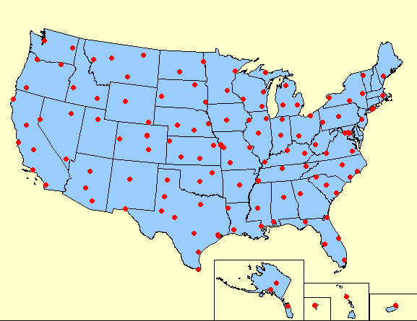
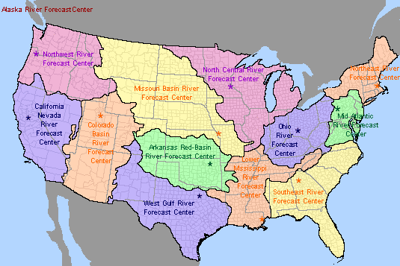
Background
National Weather Service Structure
Image from National Weather Service
Image from National Weather Service
Weather Forecast Offices
Primary Responsibilities:
Weather and flood warnings
Weather forecasting
River Forecast Centers
Primary Responsibilities:
River forecasting
Flash flood modeling and guidance
(includes dam break flooding)
Water supply and snow modeling

Slide 5
Understanding the Warning Process
An imaginary scenario

Slide 6
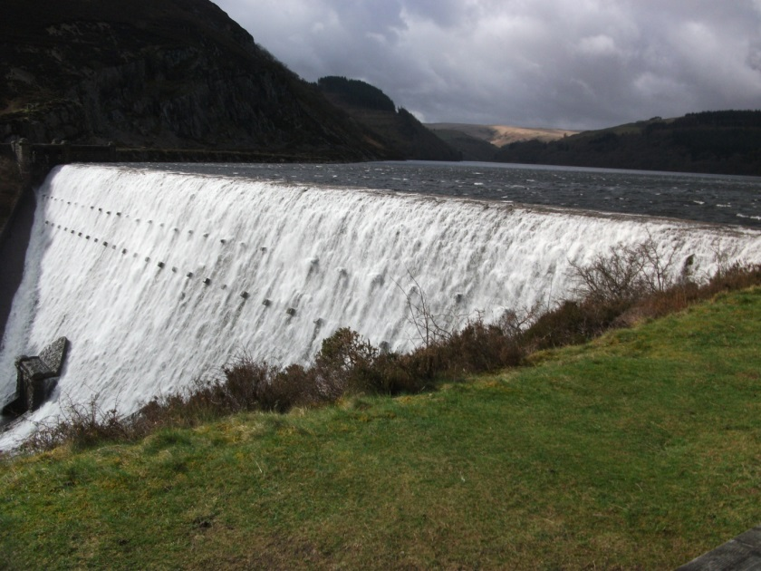
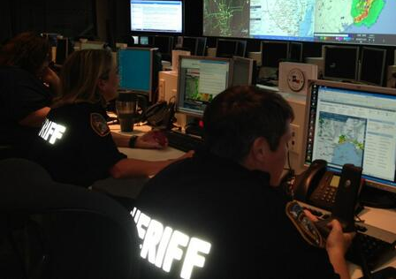
Scenario
Local EM / Law Enforcement
Reports of an imminent dam failure reported to local emergency manager or law enforcement.

Slide 7
Scenario
The clock starts
Time: T=0
Local EM / Law Enforcement
WFO
Information is relayed to the local National Weather Service – Weather Forecast Office (WFO)

Slide 8
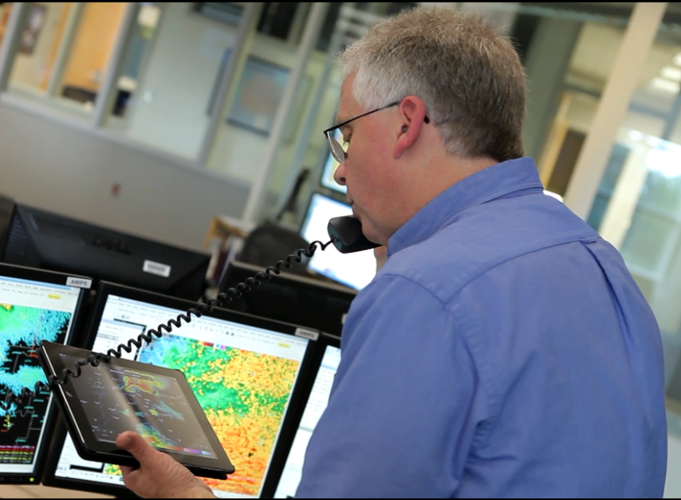
Scenario
Oh geez!... Just what I needed to hear!
WFO
River Forecast
Center (RFC)
“ Hello River Forecast Center. We have received a report of an imminent dam failure. Can you give us guidance, please?”
“ Absolutely! What information do you have for me?”
Need to know:
Name of dam
Where is it?
How high / water height behind dam?
Reservoir volume or surface area?
Anything else

Slide 9
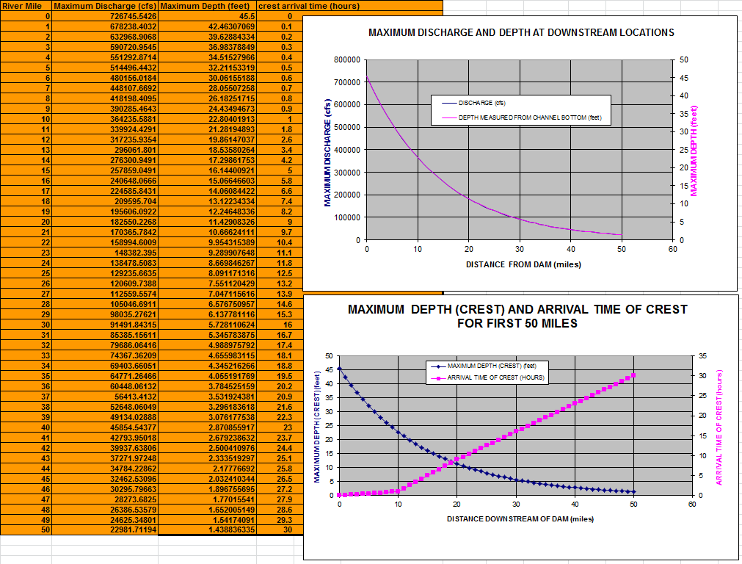
Scenario
While still on the phone with WFO…
RFC
…write down information and run Dam Break Rules of Thumb spreadsheet.
Takes one minute to input numbers and get output table of downstream water depths, travel times, and flows (if known).

Slide 10
Scenario
“Here are some preliminary numbers: ‘x feet at y miles, x₂ feet at y₂ miles, etc.’ Where are points of concern located?”
RFC
WFO
“What river is the dam on?”
“Let’s see if we can figure that out quickly.”
…wasted time…
“Looks like maybe x₁ to x₂ feet of water at river near Anytown, USA., etc. Go with these numbers and get the warning out. We will work up new numbers with our more sophisticated model and get back to you.”
“Thanks for the help! We already issued a flash flood warning!”
Shoot! Are there any roads or campsites to worry about? I forgot to ask.
T= ???

Slide 11
Takeaways
Time is crucial (minutes matter!)
The levels of communication.
Information can be spotty.

Slide 12
What are the “Dam Break Rules of Thumb”?
Background on the Method

Slide 13
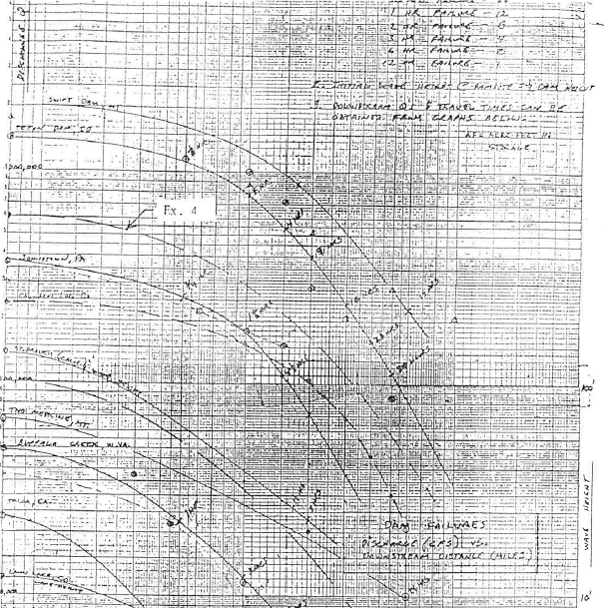
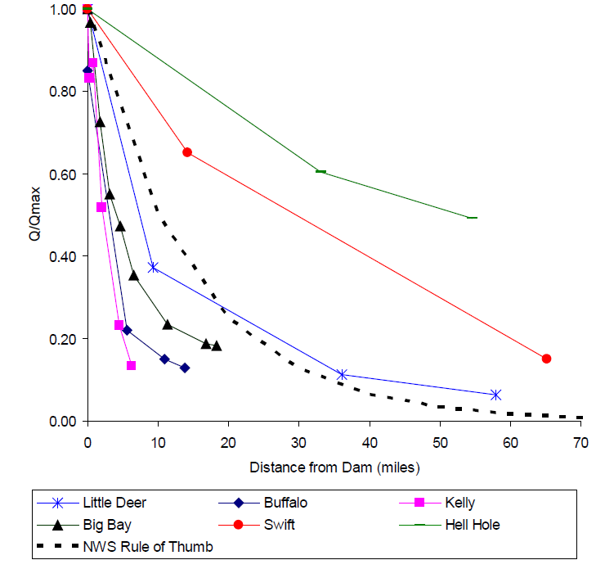
Rules of Thumb
Developed from post event studies of dam failures across the United States.
Courtesy of Larson, 1998
Courtesy of Reed and Halgren, 2011

Slide 14
Rules of Thumb
The Dam Break Rules of Thumb state that:
1.) the initial inundation of water at the toe of the dam will be half of the impounded pool behind the dam, and
2.) the attenuation of the flood wave height, or water flood depth, will be reduced by half for every ten miles of travel downstream.

Slide 15
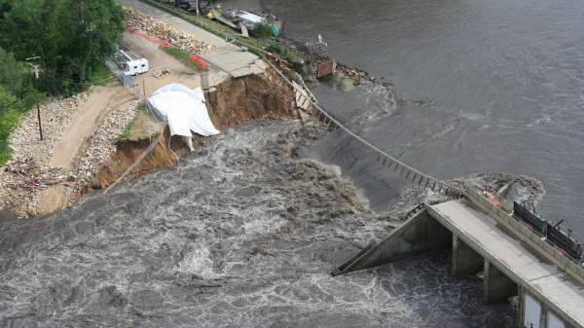
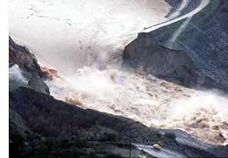
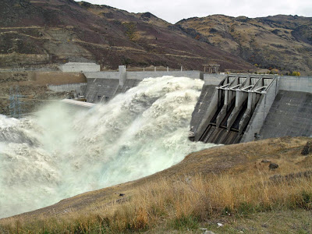
Rules of Thumb
~½
depth
~½
depth
1.) the initial inundation of water at the toe of the dam will be half of the impounded pool behind the dam
?

Slide 16
Rules of Thumb
2.) the attenuation of the flood wave height, or water flood depth, will be reduced by half for every ten miles of travel downstream.

Slide 17
Proposed Methodology
Migrate the Rules of Thumb into a GIS.
Geo-enable the flood depths to give them meaning.
Make it easy to use through automation.

Slide 18
Methodology
Wrapping the Dam Break Rules of Thumb into a GIS
Key Benefit
Besides knowing how deep the water will be, answer the questions of where the water will be and who/what might be affected.
Major Challenges/Questions
Keep usability in check? Introducing GIS brings added complexity versus simple spreadsheet.
We need to get the warning out ASAP! Seconds count! Even in implemented properly, how much time will a GIS Rules of Thumb take to execute?
Keep this thought for later

Slide 19
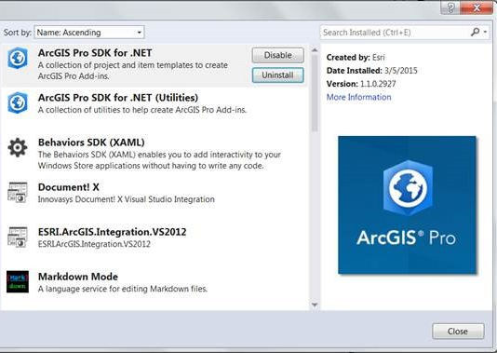
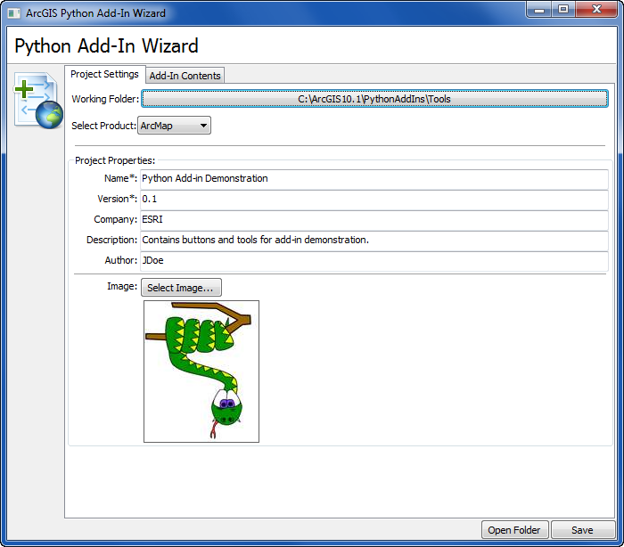
Methodology
Guiding factors: usable and rapid
Extension built in .NET
Python Tool
Javascript (Arcgis.com)
Proposed Workflow…

Slide 20
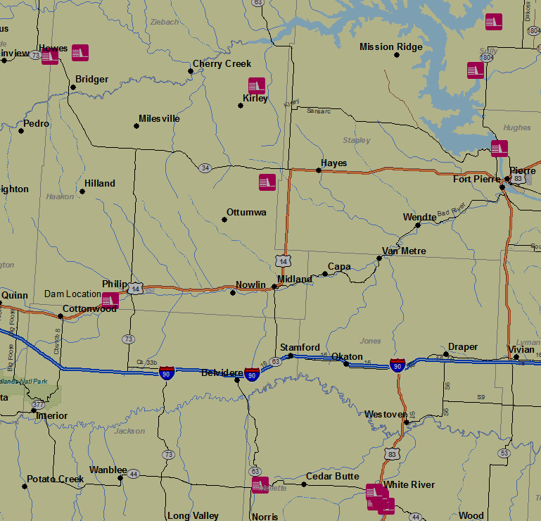
Methodology
Locate Source of Flooding by:
Name

Slide 21
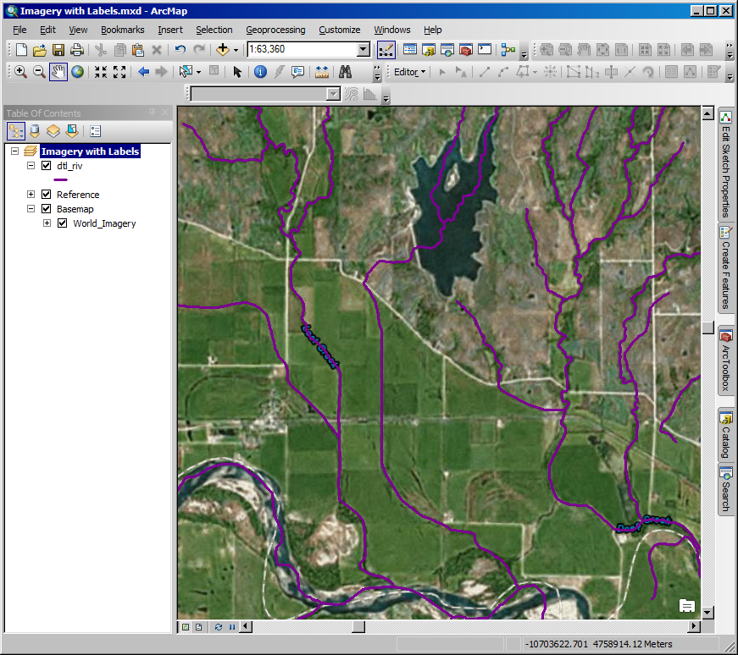
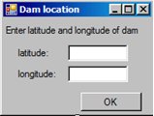
Methodology
If the name of the dam is unknown, locate by: Lat/Lon Coordinates
May be necessary to fine tune the location using imagery data.
Online Service
Locally stored data
Faster
Not dependent on Internet

Slide 22
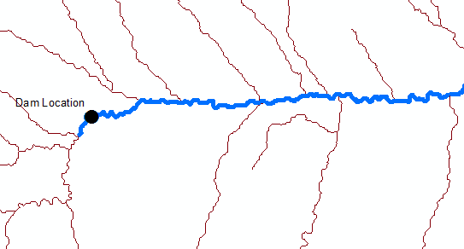
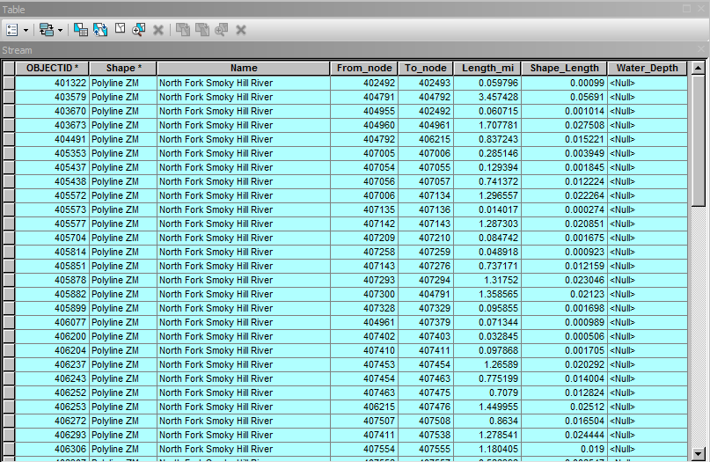
Methodology
Isolate river/stream at source of dam.
Find downstream nodes
Create a river feature segmented at every river mile.

Slide 23
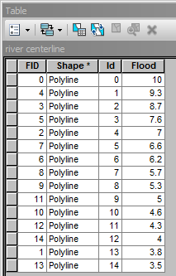
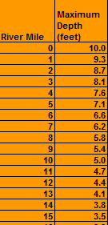
Methodology
Calculate rules of thumb within GIS.

Slide 24
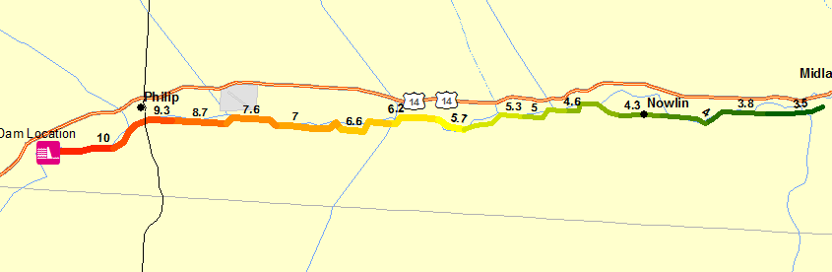
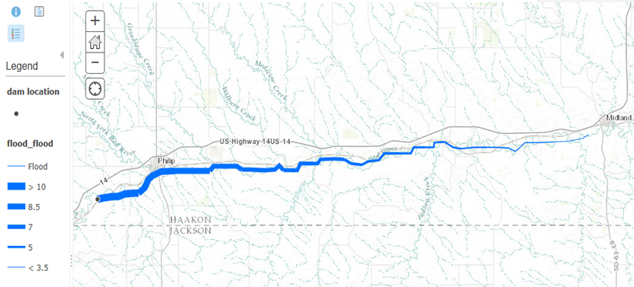
Methodology

Slide 25
Challenges and Opportunities
Time!
It will take longer to run with the added geospatial component.
Goal: less than 5 minutes
However!
Potential to cut out one chain of communication and make up lost time.
With training, give the tool to the WFO to use.
WFO
RFC
Let the GIS, in the hands of the WFO, answer the questions of where and who.

Slide 26
Project Plan
Timeline
April – June 2015
Data Mining
SDK exploration
June – August 2015
Code development
Application testing
Refine tool/code
September 2015
Draft report
October 2015
Finalize report and tool
Date TBD
Present at NWS hydrologic science workshop
NWS National Water Center (newly constructed)
Tuscaloosa, AL

Slide 27
References
Altinakar, Mustafa S, Enrique E Matheu, Marcus Z McGrath, Vijay P Ramalingam, and Jun Z Zou. "Development and Implementation of Web-Based Dam-Break Flood Inundation Analysis Capabilities." n.d. ussdams.com/proceedings/2012Proc/1399.pdf.
Beadenkopf, Edward G. "National Dam Safety Program Technical Seminary No. 22 - Dam Breach Modeling and Consequences Assessment Overview of FEMA Dam Breach Tools." Association of State Dam Safety Officials. February 18, 2015. http://www.damsafety.org/media/Documents/FEMA/TS22_DambreachModeling/09_PRESENTATION.pdf (accessed April 29, 2015).
FEMA. Geospatial Dam Break, Rapid EAP, Consequence and Hazards GIS Toolkit and User Manual. 2015. https://www.fema.gov/media-library/assets/documents/94670 (accessed March 18, 2015).
Koehler, R. Dams and Dam Failure - Module 1: Terminology and Open Channel Hydraulics. March 19, 2008. https://www.meted.ucar.edu/training_module.php?id=469#.VQpWOu9FDX4 (accessed March 18, 2015).
Larson, L. "Dam Break 'Rules of Thumb'." Unpublished NWS Internal Memo. 1998.
Reed, Seann, and James Halgren. "VALIDATION OF A NEW GIS TOOL TO RAPIDLY DEVELOP SIMPLIFIED DAM BREAK MODELS." 2011. http://www.nws.noaa.gov/oh/hrl/hsmb/hydraulics/documents/Validation_of_GeoSMPDBK_2011_07_22_submit_r2.pdf.
U.S. Geological Survey. National Hydrograpy Dataset. January 13, 2014. http://nhd.usgs.gov/ (accessed April 23, 2015).
—. USGS Flood Inundation. March 13, 2015. http://water.usgs.gov/osw/flood_inundation/ (accessed March 13, 2015).
US Army Corps of Engineers. HEC-RAS. 2015. http://www.hec.usace.army.mil/software/hec-ras/ (accessed March 18, 2015).
Wellington College Geography Department. Elevation Cross Section Map. n.d. http://wellyteamgeo.maps.arcgis.com/apps/ElevationsProfile/index.html?appid=4682f0283b1f49e1b6bc92858d306177 (accessed April 27, 2015).
Werner, M. "Impact of grid size in GIS based flood extent mapping using a 1D flow model." PHYSICS AND CHEMISTRY OF THE EARTH PART B-HYDROLOGY OCEANS AND ATMOSPHERE, 2001: 26(7-8), 517-522.

