Slide 1
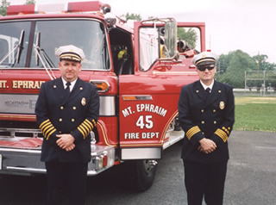
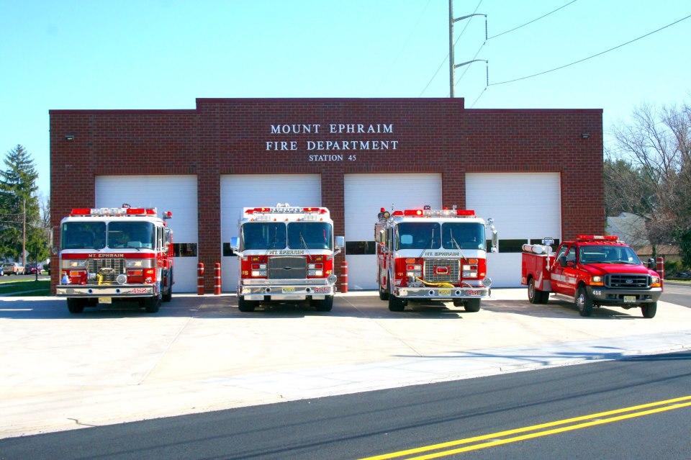

GEOG 596A
Open Source Emergency Response Preplan Application
Francesco DiPaolo
Dr. Jan Oliver Wallgrün
5/09/2016

Slide 2


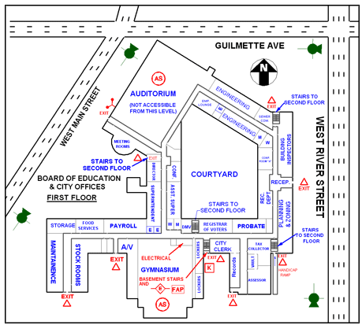
What is a Preplan?
Provides detailed information about property to fire fighters
  Building layouts, rooms, doors, windows
  Location of fire alarms, water supply, fire hydrants
  Special details/hazards about property (i.e. compressed gas on premise)
  Daytime/nighttime occupancy
Allow emergency responders to survey property in normal conditions
  Not completed during an incident
National Fire Protection Agency (NFPA) standard 1620 for preplans
Smaller departments use hard copy, despite technology
Is there an alternative? Yes, goal of project
Notes:
Served on three departments and this is a common problem for smaller, volunteer departments that do not have the funds to invest in newer technology to upgrade preplan programs

Slide 3
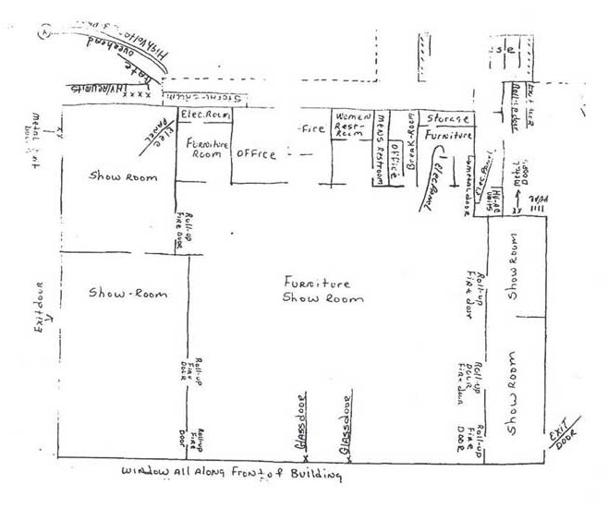
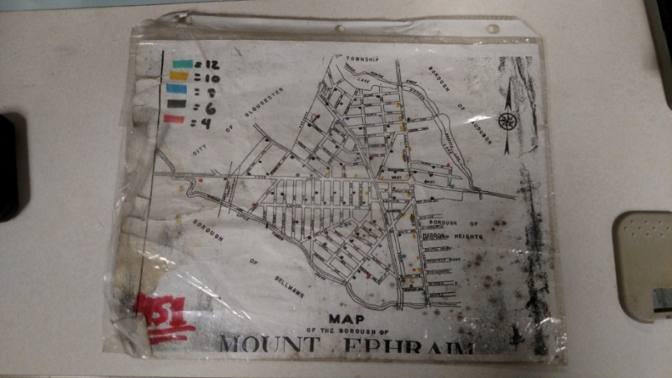
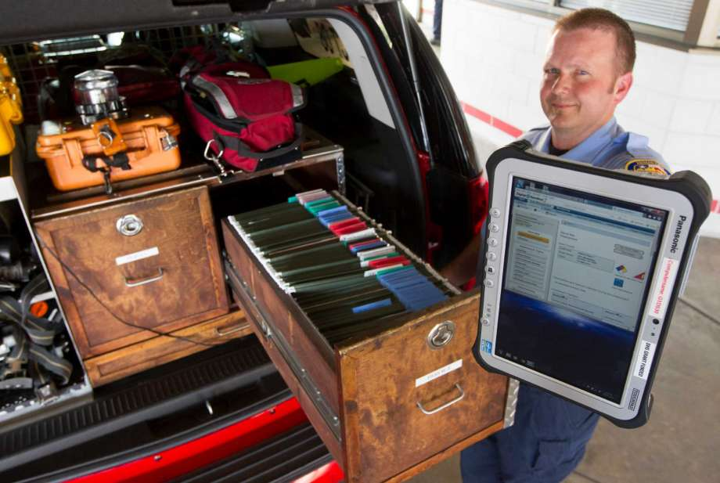
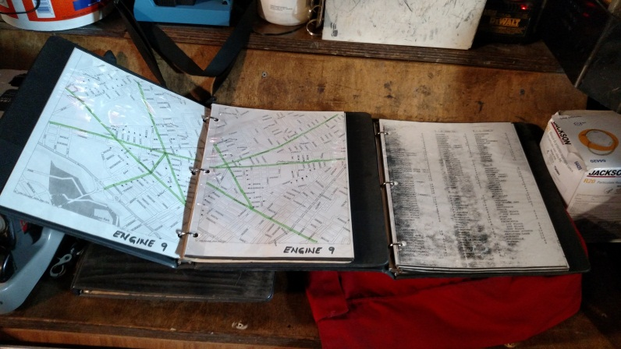
Current State – Personal Experience
Served on three separate fire departments (various parts of country)
  All smaller volunteer departments
  All lack funding and resources to purchase/develop technology
  Grants not guaranteed
Hard Copies
  In Binders
  Hard to sort through & takes time to find
  Not updated often
  Difficult to Read
Hand Drawn Sketch
Our Maps
Old vs. New

Slide 4

Future State – Project Objective
To develop a preplan mapping program using only Free and Open-Source Software (FOSS)
Requires multiple FOSS applications working together
Requires technical resources (me) to configure
Scalable across other departments
Why FOSS?
Commercial products range from $10 - $45K investment over 5 years
  Many vendors don’t include “hidden” costs (hosting services, additional modules for full functionality)
ArcGIS products extremely costly
  ArcGIS server $40K & $10K/year annual maintenance
  Fees for ArcGIS Online accounts and user credits
Several FOSS GIS applications available for GIS stack
FOSS server software to support GIS enterprise
FOSS provides similar functionality to commercial products with no cost

Slide 5

Project Details
Interview department members and mutual aid departments
Research other department programs
Identify needs
  Easy to update and maintain
  More accessible and quickly deployed during an emergency response
  Data quickly and routinely shared across mutual aid departments
  Affordable
Application Details
  Available on any mobile device
  Web based application
  User authentication
  REST services available to other applications
  Common Industry Symbology (NFPA 1620)

Slide 6
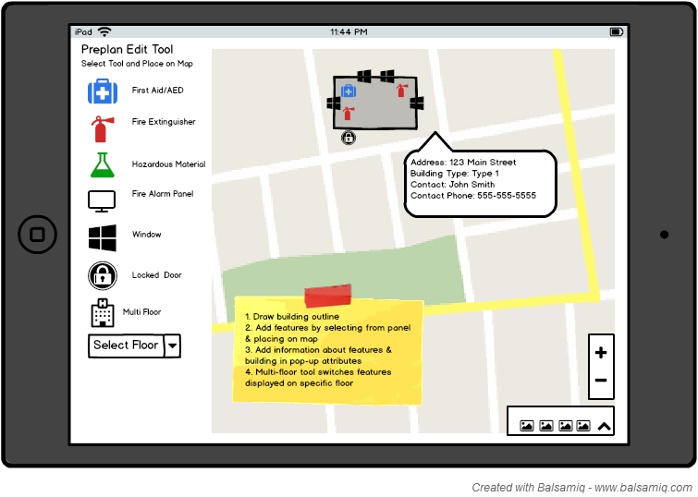
Application Functionality
Preplan Mode – Used to collect preplan information
Edit and update preplan data layers
Dynamic mapping environment (turn layers on and off)
Attach photo(s) to feature
Toggle between preplans floors for multi-level structures

Slide 7
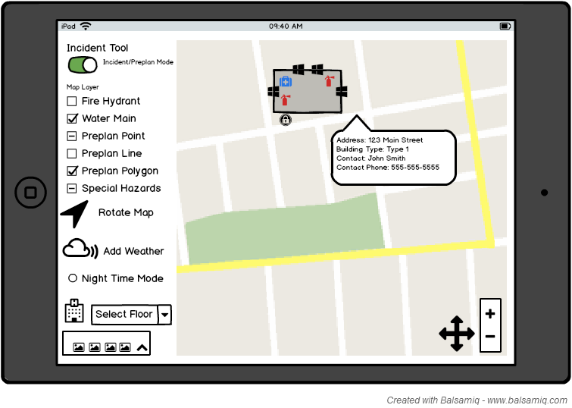
Application Functionality
Incident Mode – Used during incident response
Map rotation
Dynamic mapping environment (turn layers on and off)
View photos
Night time mode
Access to weather data in map
Toggle between preplans floors for multi-level structures

Slide 8

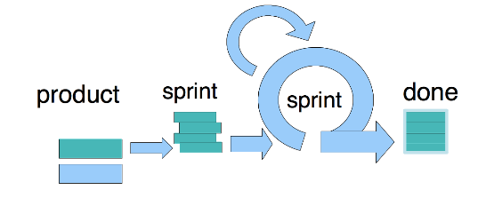
Design Process – Scrum as Foundation
Design without input rushed & may not meet needs (Rosson & Carroll, 2002)
Employ “Scrum” Principles (Shwaber & Sutherland, 2013)
  Iterative & incremental design
  Make decisions on what is known
  Rules of Scrum
    Transparency
    Inspection
    Adaption
End user tests and comments on application throughout design process
Notes:
Split into 2

Slide 9

Design Process - Details
Needs assessment (completed)
Interview/survey end users (completed)
Create user sketch mock-up (completed)
Proof of concept (completed)
Process flow blue printing
Iterative scenario based user acceptance testing
“Live” Pilot Test
Production roll out and deployment
Notes:
Split into 2

Slide 10



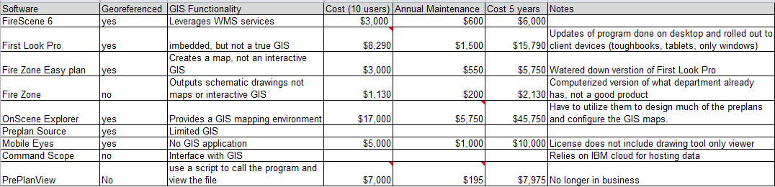
Commercial Product Review
Many commercial products available
Researched and tested several
Criteria developed with department

Slide 11

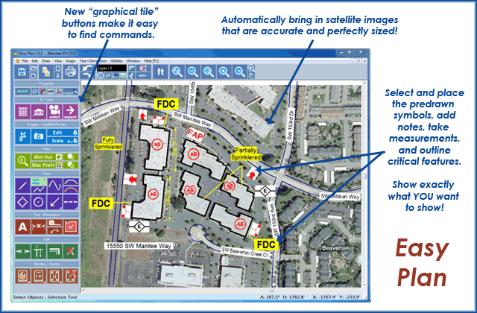
Commercial Product Review Findings:
Many did not meet department needs
Many not true GIS
Required third party hosting of data
Many hidden costs (additional modules needed for full functionality)
Higher rated programs very expensive ~$45,000 over 5 years
  Not including hardware costs
Sounds simple, costs can escalate
Looks like GIS, only graphic/text edit tool
Notes:
Findings on separate slide, show images to illustrate

Slide 12
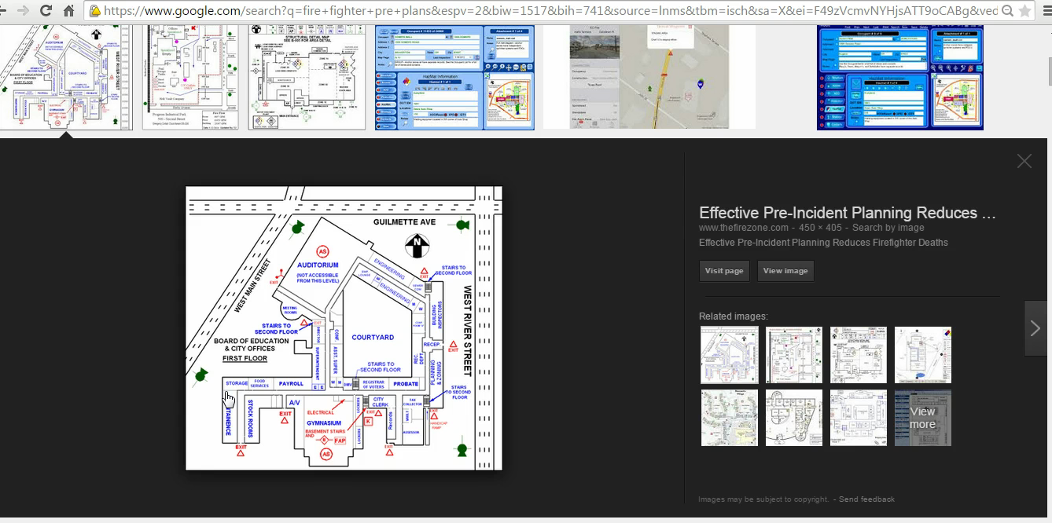
Proof of Concept
Pilot test developed using ESRI products
  ArcGIS Server, ArcMap, ArcGIS Online, Amazon EC2 Cloud
  Too costly for production use
Presented to department for concept approval
Not all proposed functionality developed in pilot

Slide 13

How do we get there?
FOSS Evaluation Matrix
Available FOSS map API’s reviewed to determine best fit for GIS stack
Criteria based on application functionality cases
FOSS to review (not limited too)
  Leaflet
  OpenLayers
  Mapbox
  Google Maps
  CartoDB
  Mapnik
  GeoServer
  MapServer
  PostgreSQL w/PostGIS

Slide 14
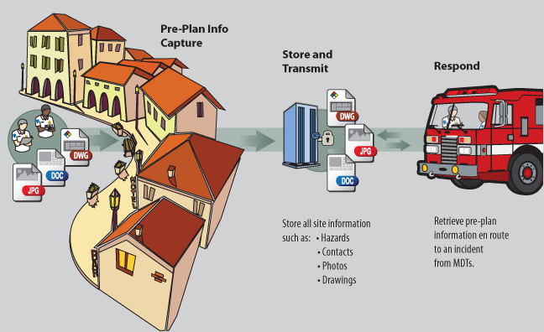
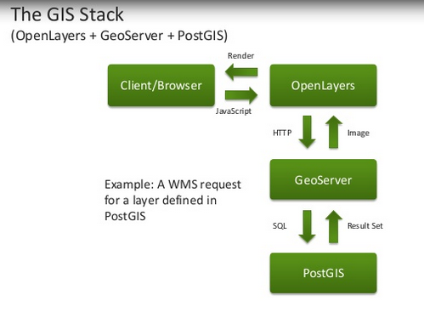
Design Blueprint
Understand data collection workflows
Develop GIS stack (which FOSS)
Configure network architecture
Establish security protocol
Iterative user acceptance testing

Slide 15


Deployment Plan/Timeline
Understand data collection workflows
FOSS Evaluation
5/2016 – 7/2016
Configure Application & Architecture
10/2016 – 2/2017
Production Rollout
4/2017
User Input
User Input
User Input
Blueprint Design Process
8/2016 – 9/2016
“Live” Pilot Testing
3/2017
FOSS4G Conference Presentation
5/2017

Slide 16

Questions
References
NFPA 1620: STANDARD FOR PRE-INCIDENT PLANNING, Current Edition 2015, retrieved on 03/12/2016 from http://www.nfpa.org/codes-and-standards/document-information-pages?mode=code&code=1620
NFPA 170: STANDARD FOR FIRE SAFETY AND EMERGENCY SYMBOLS, Current Edition 2015, retrieved on 03/12/2016 from
http://www.nfpa.org/codes-and-standards/document-information-pages?mode=code&code=170
Rosson M. and Carroll J. (2002). Scenario-Based Design Chapter 53 in J.Jacko & A. Sears (Eds.), The Human-Computer Interaction Handbook: Fundamentals Evolving Technologies and Emerging Applications. (pp 1,3-6)
Schwaber, K. & Sutherland J (2013). The Scrum Guide, The Definitive Guide to Scrum: The Rules of the Game

