Slide 1
Using Geospatial Visualization to Determine Tornado Warning Polygon Accuracy: Can we save more lives?
Frank DiCicco
15 March 2021

Slide 2
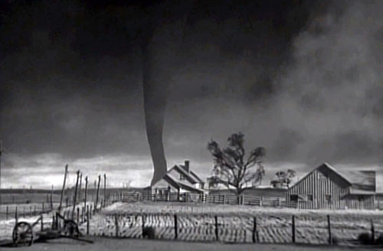
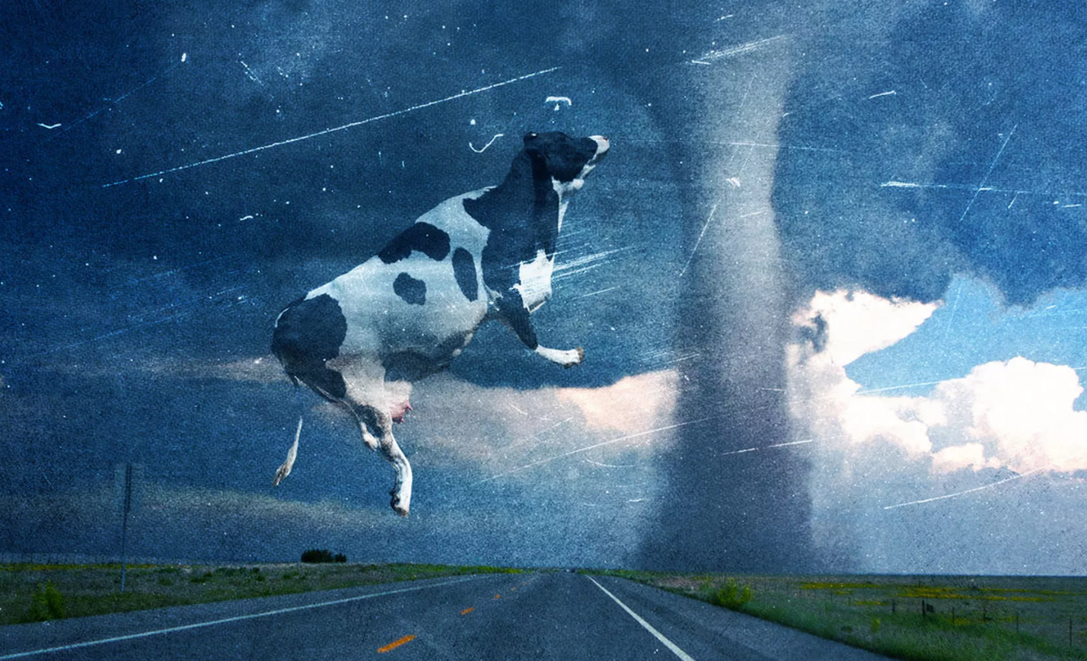
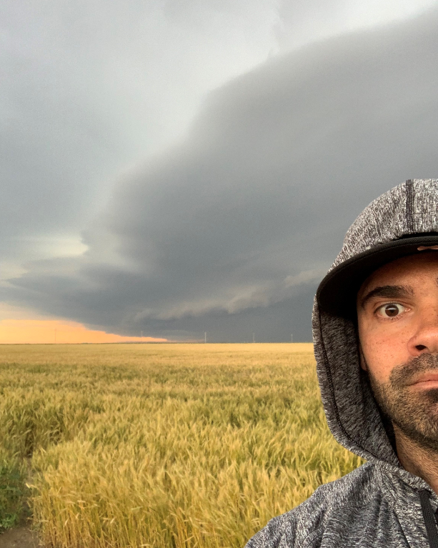
Notes:
So why tornados?
We all have some experience with tornadoes, whether that be from films like the Wizard of Oz or twister, to more up close and personal encounters.
Personally, I have always been enamored with severe weather and tornadoes in particular. This fascination began with watching hours of the weather channel over summer vacation and has morphed into me becoming an amateur storm chaser. While I find severe storms and tornadoes beautiful to behold, it is not lost on me that these are incredibly dangerous and life threatening situations and that it may be possible for tornado forecasts to be more accurate. This is why I decided to analyze tornadoes for my capstone project.

Slide 3
Outline
Tornado background
Human impact of tornadoes
Tornado warning system
Tornado outbreaks
Objectives
Methods
Anticipated Results

Slide 4
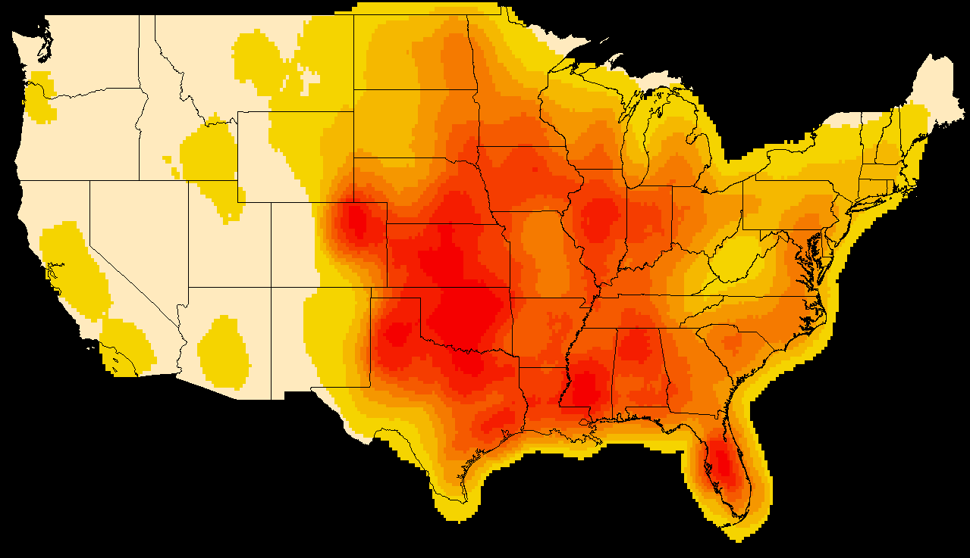
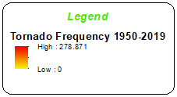
Where are Tornadoes?
NOAA historical tornado points 1950-2019 [1]
Point Density distribution
Notes:
On average, the US experiences about 1,000 tornadoes per year, over 900 more than the next closest country (NOAA, 2020)
Point density distribution of tornadoes between 1950-2019. Highest frequency of tornadoes in the middle of the country concentrated in what is known as tornado alley.
The US is in a unique geographical position where cool dry air from the north collides with warm moist air from the gulf creating the unique recipe for severe storms spawning tornadoes in the area around Kansas, Oklahom and Texas
However, we should note that every State has experienced tornadoes albeit at a much lower frequency and density.

Slide 5
Human Impact of Tornadoes
80 deaths & 1,500 injuries annually
Nearly $400m in property damage annually
Nighttime tornadoes account for twice as many deaths
Injuries and fatalities have decreased over time

Slide 6
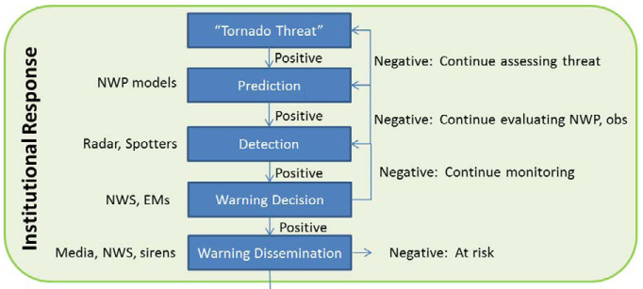
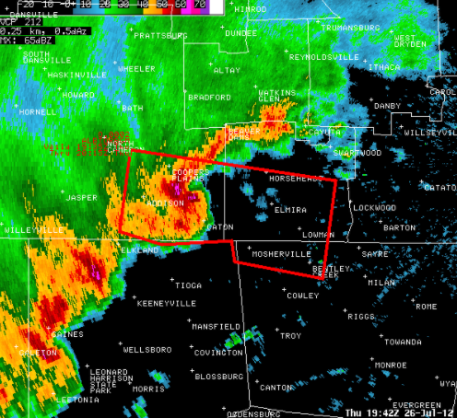
Tornado Warning System
Issued when a tornado is indicated by radar or sighted by spotters
1948 – 2017 warning polygons based on county
Since 2017 warning polygons are storm based polygons
Warnings lead times have improved significantly over time
[2]
[3]

Slide 7
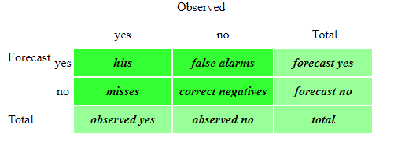
Measuring Warning Accuracy
What does accuracy mean for tornado warnings?
NWS uses Dichotomous statistics
[4]
Notes:
A dichotomous forecast says, "yes, an event will happen", or "no, the event will not happen“
hit - event forecast to occur, and did occur miss - event forecast not to occur, but did occur false alarm - event forecast to occur, but did not occur correct negative - event forecast not to occur, and did not occur

Slide 8
Measuring Warning Accuracy
Two metrics used to determine tornado warning accuracy
FAR – false alarm ratio
Tornado warnings 0.76 FAR
POD - Probability of detection
Could warn every storm – “cry wolf” effect
Best way to warn public?
Gap in large scale study of geospatial accuracy of tornado warning polygons
[6]
[5]
[7]
Notes:
FAR is fraction of predicted events that did not occur
FAR is about 1 in 4 warnings associated with actual tornado touchdown
FAR is much higher for other server weather events, indicating how difficult it is to forecast tornadoes
POD – fraction of observed events were correctly forecast
It is possible to increase POD by issuing a tornado warning for every storm
Should be used together as POD is sensitive to hits, but ignores false alarms while FAR is sensitive to false alarms, but ignores misses.
More complex statistics like Heidke skill score Peirce's skill score

Slide 9
But its complicated…
What constitutes a miss?
Are the scenarios below equal?
Tornadoes move!... (locational fallacy)
Versus
[8]
[9]
Notes:
What is a miss? As seen below, we have two images of a tornado strike. Both would be considered misses. However, on the left we see a tornado observed without a tornado warning polygon. On the right, a warning polygon was issued, but the tornado struck outside of the warning area. Are these misses equal??
It is also important to note that tornadoes move! A tornado could strike an area of an expired warning polygon or move in a direction that misses the warned area completely. Additionally, the timing of warnings is important. Is the warning early or late in relation to the observed tornado?
All this needs to be considered in how complicated it is to forecast tornadoes and predicting their location.

Slide 10
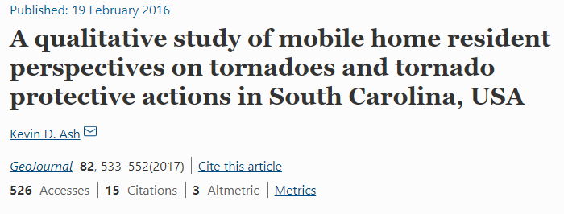
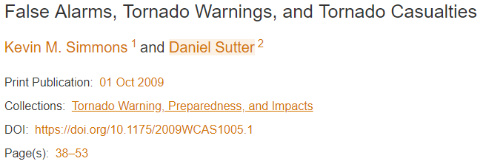
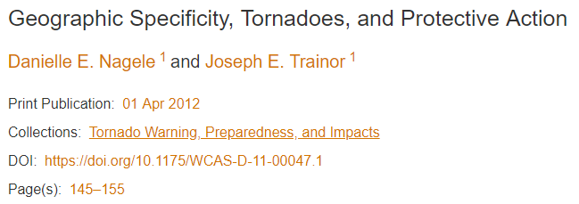
But its complicated…
What constitutes an impactful miss?
What are protective measures taken by the public?
What else matters?
Notes:
We’re doing this to protect people!
Tornadoes in area with no people don’t have the same impact as tornadoes in large metropolitan areas.
As seen there has been significant research around how people react to tornado warnings. There are many factors that influence how people respond including, exposure to false alarms, over-testing of tornado warning siren systems, tribal knowledge of the geographical region (tornadoes never hit here) amongst others.
As mentioned previously, things like time of day are very important in terms of tornado impact. Other factors need to be considered.
All of this means that it is very complicated to assess the human impact of tornadoes!!

Slide 11
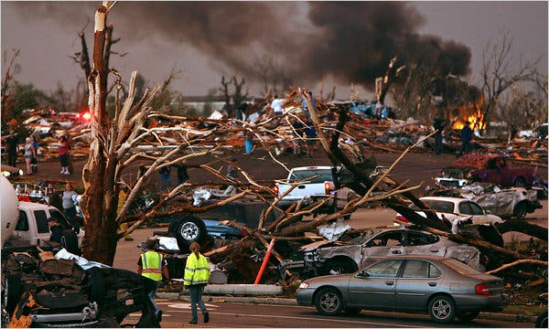
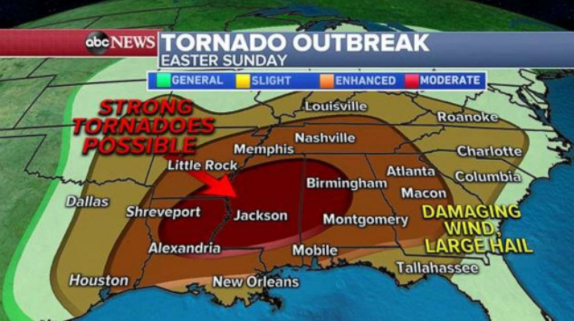
Tornado Outbreaks
No official definition
Multiple tornadoes from the same weather system
Typically greater than 6-10 tornadoes
Outbreaks cause most death and damage?
[10]
[11]

Slide 12
Study Aim: Assess geospatial accuracy of NWS tornado warning polygons during tornado outbreaks & the link to human impacts
Notes:
TAKE A BREATH

Slide 13
Specific Objective
Examine relationship between tornado outbreaks and casualties and damage
Using case studies of tornado outbreaks
Visualize tornadoes, paths and warning polygons
Apply dichotomous statistics to tornado warning polygons in relation to observed tornadoes
Explore link to human impact

Slide 14
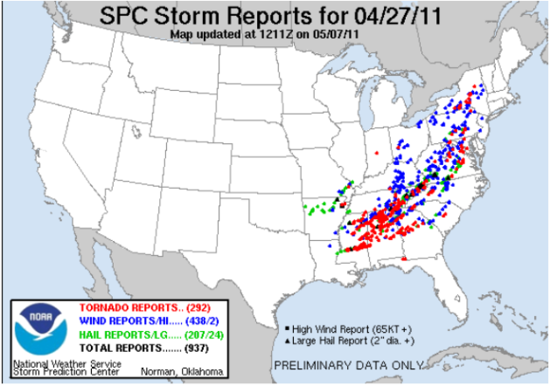
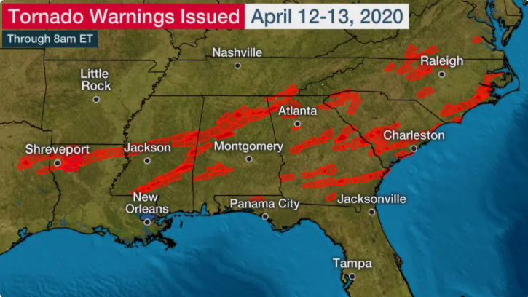
Case Studies
2011 Super Outbreak
2020 Easter Outbreak
May 2011 Outbreak - Joplin Tornado
[12]
[13]

Slide 15
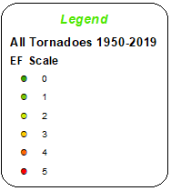
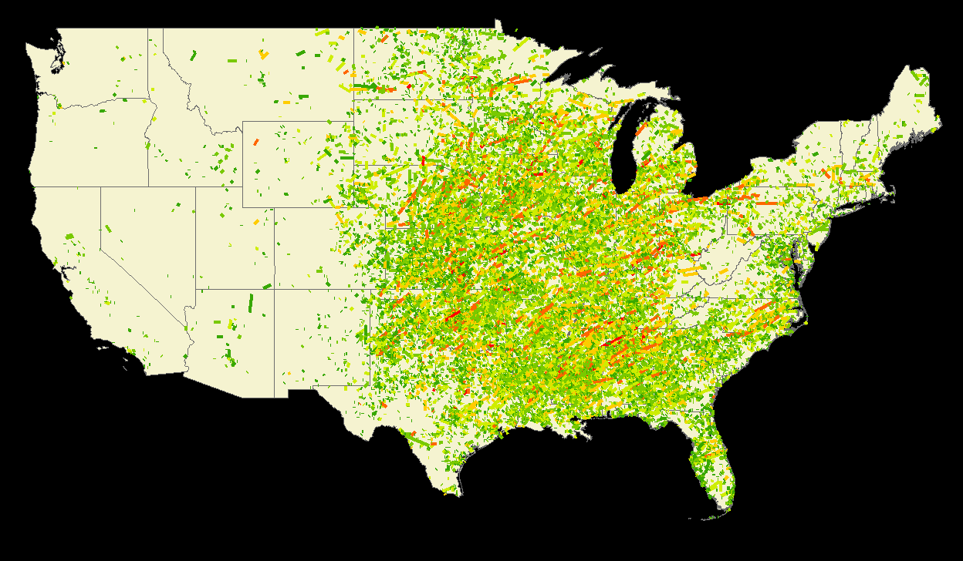
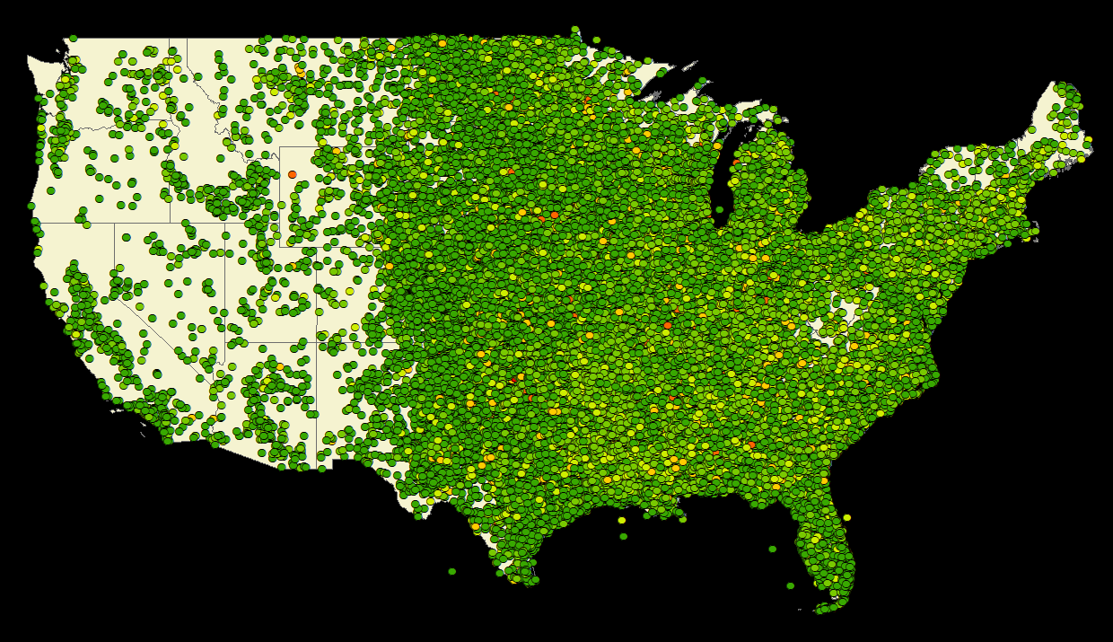
NOAA Historical Tornado Record
Initial tornado touchdown points 1950-2019
Tornado paths 1950-2019
Includes fatalities, magnitude, damage (USD)…
[14]
Notes:
Data has interesting features/trends… increase in lower magnitude tornadoes through the dataset. Unclear if due to spotter network, radar, etc. but this influences NWS statistics!!

Slide 16
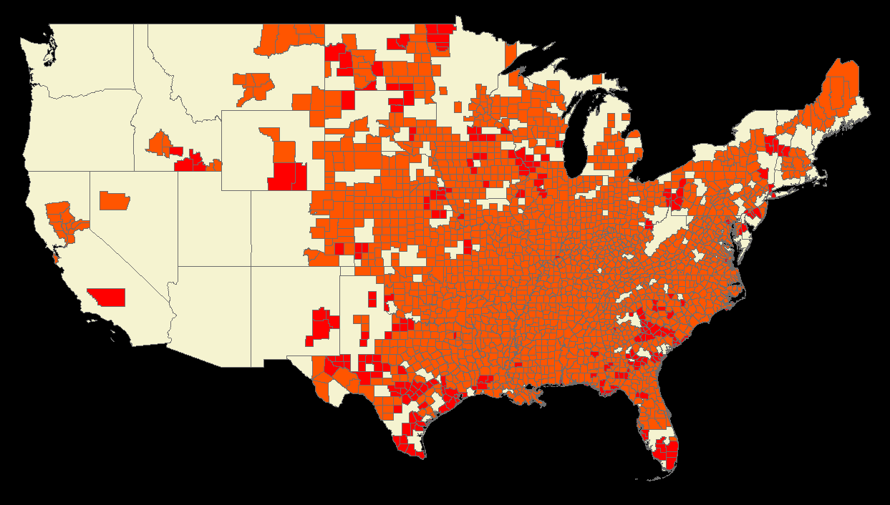
NWS Warning Polygons
Mesonet Tornado warning polygons
Includes Date, time,
closest radar
Also… news reports,
Population, demographics
[15]
Notes:
2011 – county based warning
2020 – storm based warning

Slide 17
Methodology
Notes:
Data gathering is DONE!
No unique data field linking tornadoes and paths to polygons. To solve this we could use a manual process OR use raster overlay method
Add Esri flow like joining data, etc.
Data manipulation
Exploratory analysis – kernel density, point pattern analysis, heat maps, etc.
Extracting outbreaks – not trivial
if this doesn’t work, focus on 3 study areas
Regression against damage vs death
Extract data from case studies
Apply statistics
Create maps for 3 case studies
https://www.lucidchart.com/pages/

Slide 18
Anticipated Results
Exploration of the accuracy of tornado warning polygons during outbreaks for three case studies, and link to human impact
Geospatial display of warned versus unwarned tornadoes, and link to casualties and damage
General analysis of the relationship between tornado outbreaks and casualties

Slide 19
Questions
Notes:
Add tornado picture

Slide 20
References
https://www.spc.noaa.gov/gis/svrgis/
Brotzge, J., & Donner, W. (2013). THE TORNADO WARNING PROCESS: A review of current research, challenges, and opportunities. Bulletin of the American Meteorological Society, 94(11), 1715-1733.
https://www.weather.gov/bgm/severedefinitions
https://www.cawcr.gov.au/projects/verification/
https://www.nytimes.com/2011/05/23/us/23tornado.html
https://abcnews.go.com/US/severe-weather-outbreak-forecasted-monday-potential-strong-tornadoes/story?id=70099504
https://mesonet.agron.iastate.edu/request/gis/watchwarn.phtml

Slide 21
References, cont.
https://www.spc.noaa.gov/climo/online/
https://weather.com/safety/tornado/news/2020-04-12-severe-weather-outbreak-south-east-tornadoes-damaging-winds

