Slide 1
Spatial and Temporal Variation in Snow-Water Equivalent
Using NOAA’s Historical Airborne Gamma Data to Assess Snow Trends from 1980 – 2008
Patrick Didier, LT/NOAA
Advisor:
Thorsten Wagener

Slide 2
Overview
Using NOAA’s airborne snow survey dataset to detect climate patterns for snow-water equivalent (SWE)
30 years of data representing several different climates within United States
Using modern tools (ArcMap, Spatial Analyst, GeoDa) with archived data
Big question: Has there been a significant change in spatial autocorrelation within the last thirty years?
Final Product: Research Paper

Slide 3
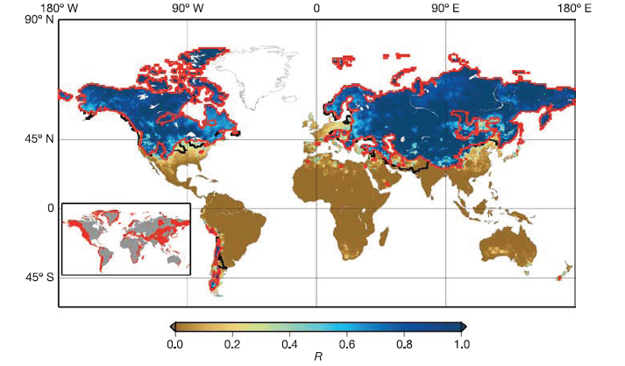
Introduction
Figure 1 – Percentage of average annual snowfall divided by annual runoff. (Barnett 2005)

Slide 4
Current State of Research
Temperature plays a key role in snowmelt dominated regions (Stewart et al 2005)
How is snow measured?
SNOTEL (western US)
Airborne snow surveys
Ground surveys
Coop weather stations
Satellite imagery
Forecasting Techniques
Energy budget vs temp index (Day 2009)
Research done for specific watersheds
Wilamette (Chang et al 2010)

Slide 5
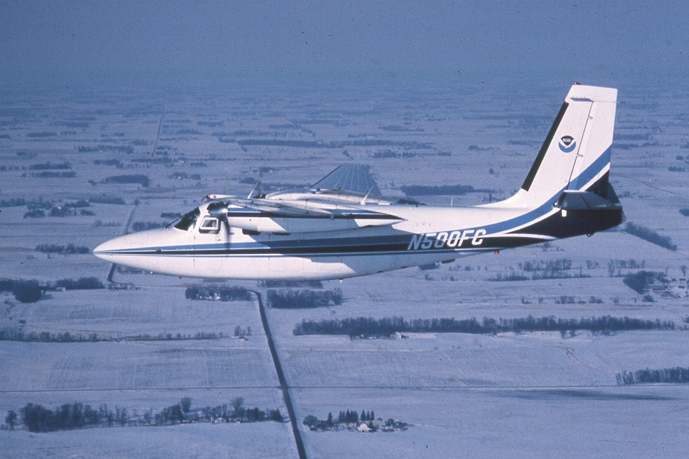
History of NOAA’s Airborne Snow Survey Program
Established in 1978, by Dr Tom Carroll
Measures snow water equivalent (water content of the snow pack)
Attenuation of natural, terrestrial radiation by snow is basis of measurement

Slide 6
Natural Terrestrial Gamma Radiation
Atmospheric Radon
Cosmic Radiation
no snow
Potassium, Uranium, and Thallium

Slide 7
Natural Terrestrial Gamma Radiation
background (no snow) spectrum
RadiationSpectra
40
K
Counts/min
background spectrum is one-time measurement
208
Tl
over snow spectrum
1
2
3
Energy (MeV)

Slide 8
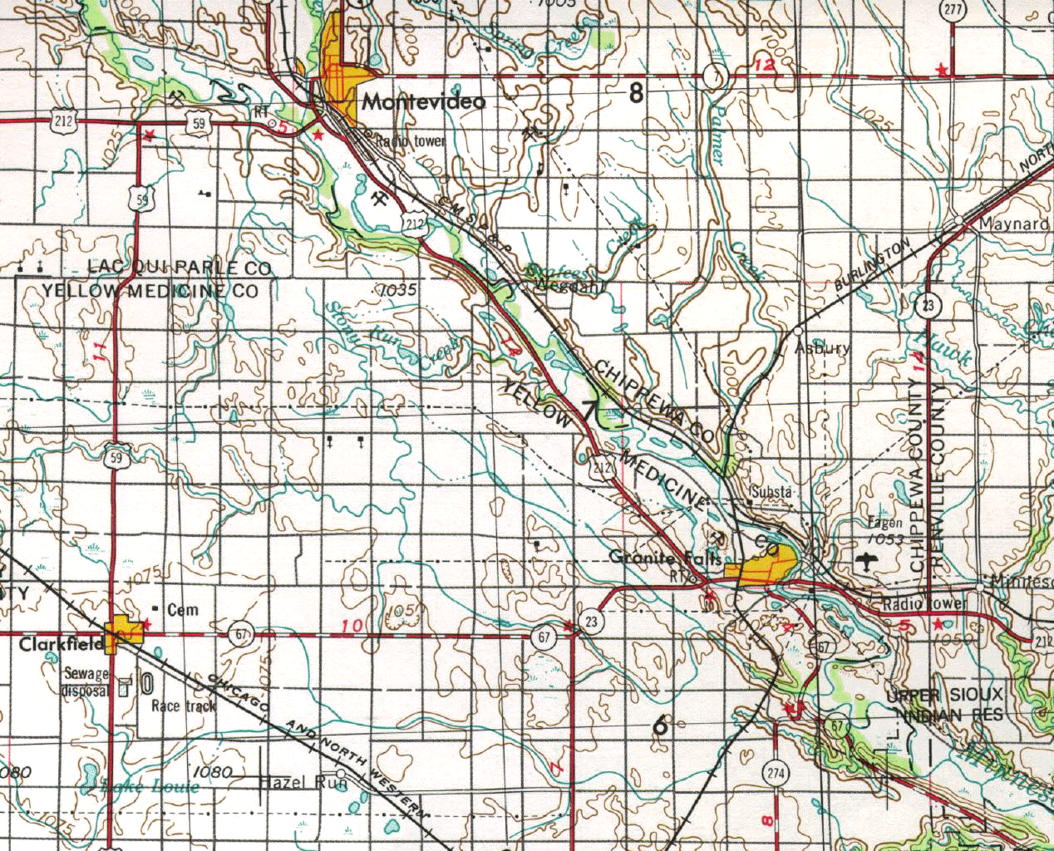
Typical Flight Lines
10 mi long by 1,000 ft wide
(2 mi² area)

Slide 9
Airborne Flight Line History

Slide 10
Airborne Flight Line History

Slide 11
Airborne Flight Line History

Slide 12
Airborne Flight Line History

Slide 13
Airborne Flight Line History

Slide 14
Airborne Flight Line History

Slide 15
Airborne Flight Line History

Slide 16
Airborne Flight Line History

Slide 17
Airborne Flight Line History

Slide 18
Airborne Flight Line History

Slide 19
Airborne Flight Line History

Slide 20
Airborne Flight Line History

Slide 21
Airborne Flight Line History

Slide 22
Airborne Flight Line History

Slide 23
Airborne Flight Line History

Slide 24
Airborne Flight Line History

Slide 25
Airborne Flight Line History

Slide 26
Airborne Flight Line History

Slide 27
Airborne Flight Line History

Slide 28
Airborne Flight Line History

Slide 29
Airborne Flight Line History

Slide 30
Airborne Flight Line History

Slide 31
Airborne Flight Line History

Slide 32
Airborne Flight Line History

Slide 33
Airborne Flight Line History

Slide 34
Airborne Flight Line History

Slide 35
NOAA’s Airborne Flight Line Gamma Database

Slide 36
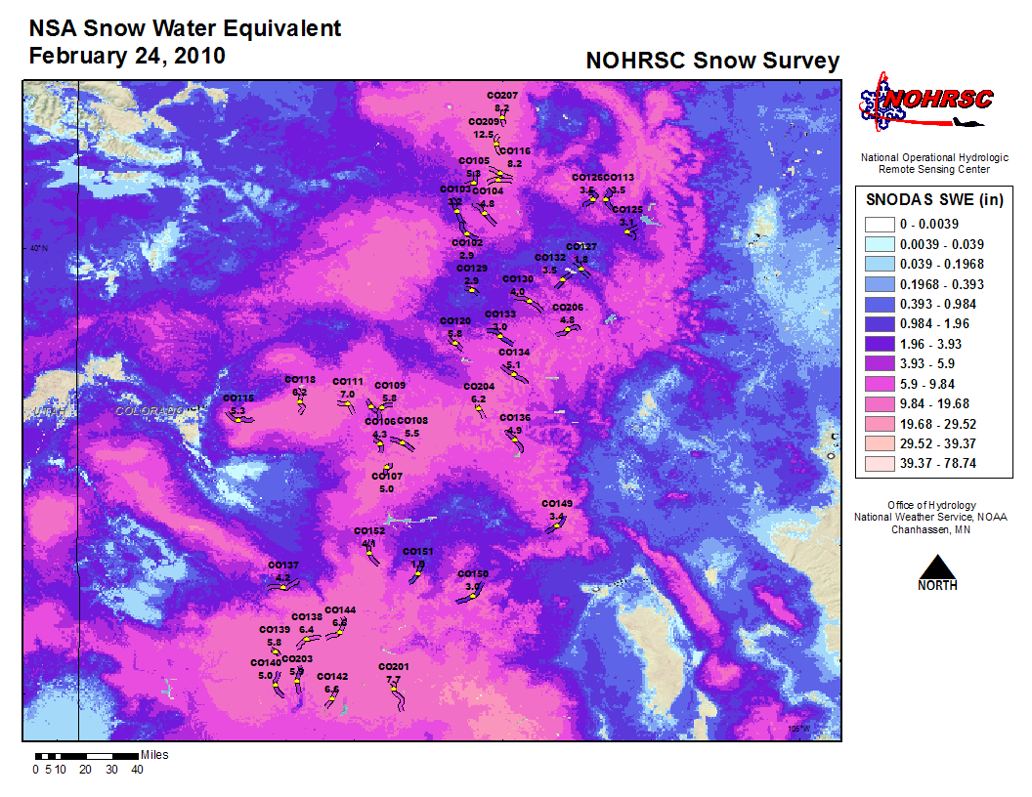

Slide 37
Methods
Assimilate 30 years of flight line data into one standard database (Excel spreadsheet)
Choose flightlines most commonly flown for longest period of time in order to assess both spatial and temporal trends
Evaluate data against ground station and ground survey data
Run flight line data for each survey period in GeoDa to determine spatial relationships
Map out spatial autocorrelation over time for survey regions.

Slide 38
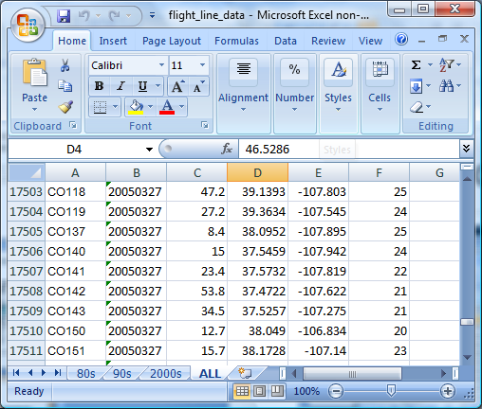
Flight Line Data
Over 20,000 records for flight lines since program began in 1980
Some lines only flown once since they were drawn
Some lines flown as many as 51 times
Database includes flight line, date flown, snow-water equivalent, and lat/lon

Slide 39
Selected Lines
These 260 lines are all 20 years or older, and have each been flown at least twenty times total
They represent “canned” surveys that are flown nearly every year
These surveys are the Colorado Basin, Lake Superior, Northeastern US, St John’s River Basin, and the Red River of the North Surveys
The Cottonwood River in SW Minnesota is flown every year as a calibration survey, but the data are still valid for this project

Slide 40
Assimilation

Slide 41
Data Sources
http://www.weather.gov/geodata/catalog/national/html/province.htm (Canadian Provinces)
US Census TigerLine Data
NCDC for archive historical weather data
NRCS for SNOTEL data in Western US
NOHRSC

Slide 42
Timeline
May 30 – complete literature review
June 30 – acquire all ground station data
July 6 – complete basic outline of article
August 30 – complete analysis of data
September 30 – complete map, begin filling out sections of article with results
October – continue working on article, peer review
Presentation possibilities? (eastern snow conference has student paper competition)

Slide 43
Key Literature/Resources
Adam, J.C., Hamlet, A.F., Lettenmaier, D.P. 2009. Implications of global climate change for snowmelt hydrology in the twenty-first century. Hydrological Processes 23, 962-972.
Barnett ,T.P., Adam J.C., Lettenmaier, D.P. 2005. Potential impacts of a warming climate on water availability in snow-dominated regions. Nature 438, 303-309.
Chang H., Il-Won, J. 2010. Spatial and temporal variation changes in runoff caused by climate change in a complex and large river basin in Oregon. Journal of Hydrology 388, 106-207.
Fortin, R., Sander, L., Nadeau, M., Grasty R.L. 2008. An airborne gamma-ray snow survey in the James Bay Region. Proceedings of the 65th Eastern Snow Conference, Fairlee, Vermont USA 2008. http://www.easternsnow.org/proceedings/2009/fortin_et_al.pdf . Accessed 20 June 2011.
Mote P., Hamlet, A., Salathe, E. 2008. Has Spring snowpack declined in the Washington Cascades? Hydrol. Earth Syst. Sci. 12, 193-206.
Stewart, I.T., Cayan, R.D., Dettinger, M.D. 2005. Changes toward earlier streamflow timing across western North America. Journal of Climate 18, 1136-1155.
Eastern/Western Snow Conference Proceedings

Slide 44
Summary
Using unique dataset to look at spatial relationships of SWE over last 30 years.
What possible factors affect the degree of spatial autocorrelation for a given area?
How has that changed (or not changed) over the last 30 years?

Slide 45
Questions?

