Slide 1
The cops are dirty. …They make you lift up your dress. They pull down your pants. They harass you. They’ll come up on the sidewalk and call me bad names.
(Site 2, survivor 8, survivor of sex trafficking)
“[Service providers] don’t even know a lot of the words we even say. We’ve even offered having a class 101 to teach them some stuff. They weren’t really open up for nothing or anything we had to say”
(Site 2, survivor 8, survivor of sex trafficking)
How Far to Freedom?
A spatial analysis between sex trafficking and post-trauma service providers in the continental United States
Lisa Dilger
“Treat us like human beings. Just because you’re being trafficked doesn’t make you any less of a human
than the police themselves are. Treat us with the same respect that you would treat your mother and
your sister. No one child ever wakes up one day and says, ‘Hey, I wanna be a prostitute and I wanna be
trafficked for the rest of my life.’ No. Nobody says that. Nobody.” (Site 8, survivor 4, survivor of sex
trafficking)

Slide 2
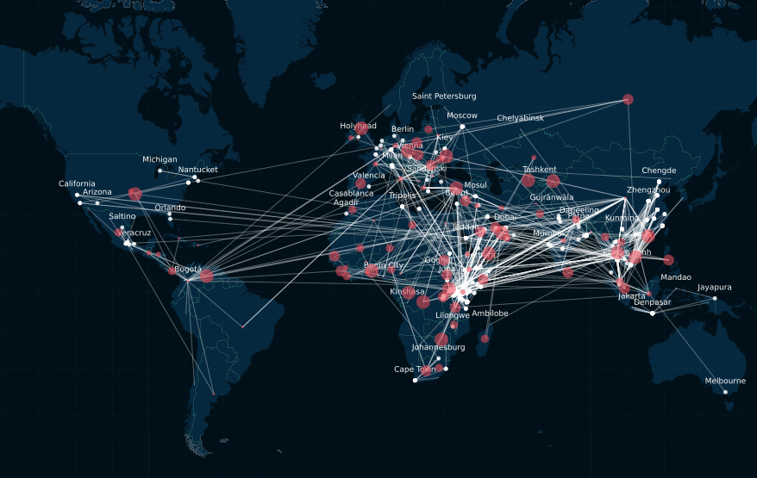
Trafficking global map
Estimated 4,000,000 adult and 1,000,000 children globally in 2016 (UN Internal Labour Organization, 2019)
Estimated global profit: $99,000,000,000 (Internal Labour Organization, 2014)
Map source: Freedom Collaborative

Slide 3
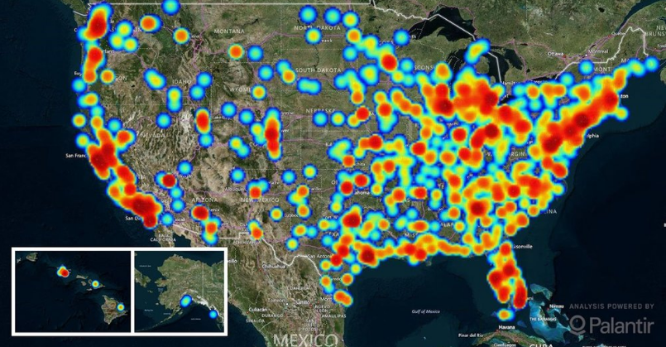
Trafficking US map
2019: 48,326 individual trafficking-related contacts were made to the National Human Trafficking Hotline (Polarisproject.org, 2020)
Currently Polaris Project has 388 registered human trafficking specific resources in their referral guide
Map source: Polaris Project
Map source: Freedom Collaborative

Slide 4
Background
Survivors often without financial freedom, removed or isolated from family and/or social network, have a criminal record, struggle to combat the force, fraud, or coercion element
Survivors often rely on non-profit organizations to meet their immediate safety and emergency needs
The resources often requested:
Temporary housing/emergency shelter
Extraction
Immediate medical assistance
Immigration assistance
Family reunification
Financial assistance.
Ability to vacate their criminal records
Mental health resources
Long-term rehabilitation
US Federal Definition: Human trafficking involves the use of force, fraud, or coercion to obtain some type of labor or commercial sex act
The cops are dirty. …They make you lift up your dress. They pull down your pants. They harass you. They’ll come up on the sidewalk and call me bad names.
(Site 2, survivor 8, survivor of sex trafficking)

Slide 5
Social Spatiality
Sex Trafficking
94,300 peer reviewed studies
14,500 published since 2019
19,300
934,000 peer reviewed studies
17,400 published since 2019
12,100
16,400
73,100
409,000 peer reviewed studies
17,200 published since 2019
Post-Trauma Service Providers

Slide 6
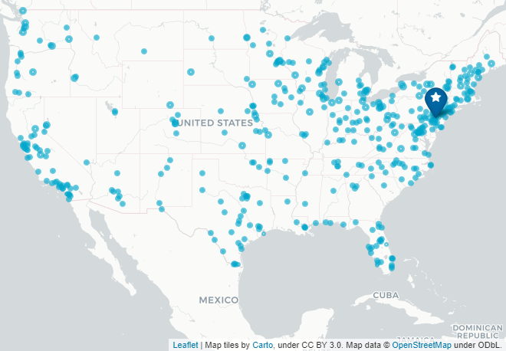
Goals & Objectives
When is “shelter” safe?
Ways forward?
How far does one travel to be safe?
Map source: Polaris Project

Slide 7
Proposed Methodology
Use police Open Data for human trafficking point data
1
Not complete data set
Illicit crimes always under reported
Survivors often charged as criminal
Identify statistical hotspot of human trafficking – kernel density
2
Use geospatial tools to identify the known average, minimum, and maximum distances between statistical hotspots and service providers
3
Utilize survivors and published surveys to put the distance into context
4

Slide 8
Polaris Data
Map source: Polaris Project
Map source: Polaris Project

Slide 9
Anticipated Results
Along the coasts of the US, there are likely a large human trafficking hot spots with multiple service providers
The minimum distance traveled is likely within 5 miles in this area
In the middle and southern US will likely have the largest distances between hot spots and service providers.

Slide 10
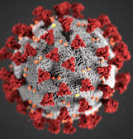
Possible Presentation Venues
Slave Free Today: Journal of Modern Slavery
Anti-Trafficking Review

Slide 11
References
Bales, K., Ph.D, & Lize, S., Ph.D. (n.d.). Trafficking in Persons in the United States (United States, Department of Justice, NCJRS).
Cockbain, E., Bowers, K. Human trafficking for sex, labour and domestic servitude: how do key trafficking types compare and what are their predictors?. Crime Law Soc Change 72, 9–34 (2019). https://doi.org/10.1007/s10611-019-09836-7
Cockbain, E., & Wallis, A. (2019, April 17). The Social, Spatial and Temporal Systems Behind Human Trafficking. Retrieved September 18, 2020, from https://delta87.org/2019/04/social-spatial-temporal-systems-human-trafficking/
Farrell, A., Ph.D, Dank, M., P, Kafafian, M., Lockwood, S., Pfeffer, R., Hughes, A., & Vincent, K., Ph. (2019). Capturing Human Trafficking Victimization Through Crime Reporting (Rep. No. 252520). NCJRS.
Freedom Collaborative. Mapping Victim Journeys Around the World. 2020. Retrieved October 10, 2020 from https://freedomcollaborative.org/victim-journey-data/
Gozdziak, E., Ph.D, & Lowell, L. (2016). After Rescue: Evaluation of Strategies to Stabilize and Integrate Adult Survivors of Human Trafficking to the United States (Rep. No. 249672). NCJRS.
Holzer, J. W. (2010). A spatial analysis of human trafficking in Greater Los Angeles (Doctoral dissertation, Thesis / Dissertation ETD, 2010) (pp. 1-24). Ann Arbor, MI: ProQuest.
Kelly, C. (2019, July 29). “13 sex trafficking statistics that explain the enormity of the global sex trade” Retrieved October 10, 2020 from https://www.usatoday.com/story/news/investigations/2019/07/29/12-trafficking-statistics-enormity-global-sex-trade/1755192001/
Love, H., Hussemann, J., Yu, L., McCoy, E., & Owens, C. (2018). Justice in Their Own Words: Perceptions and Experiences of (In)Justice among Human Trafficking Survivors. Urban Institute.
McCann, M. (2018). Human Trafficking: An Overview of Services and Funding for Survivors. National Conference of State Legislatures.
Mletzko, D., Summers, L., & Arnio, A. N. (2018). Spatial patterns of urban sex trafficking. Journal of Criminal Justice, 58, 87-96.
Polaris Project. (2020) Retrieved October 1, 2020, from https://humantraffickinghotline.org/training-resources/referral-directory
Rothman, E., Bair-Merritt, M., & Farrell, A. (2019). Evaluation of a Service Provision Program for Victims of Sex Trafficking.
Sarrica, F. The Use of Human Trafficking Detection Data for Modelling Static and Dynamic Determinants of Human Trafficking Flows. Eur J Crim Policy Res (2020). https://doi.org/10.1007/s10610-020-09460-5
Weiner, N. A., & Hala, N. (2008, October). Measuring Human Trafficking Lessons from New York City. (United States, Department of Justice). Retrieved September 9, 2020, from https://www.ncjrs.gov/pdffiles1/nij/grants/224391.pdf

