Slide 1
ZDV-3D
A Modern 3D Visualization and Analysis Tool for Denver Air Route Traffic Control Center
Notes:
24:20

Slide 2
Overview
Problem Description
Background
Concepts
Goals & Objectives
Methodology
Anticipated Results
Timeline
Acknowledgements
References
Questions
Denver Air Route Traffic Control Center (ZDV)
Notes:
23:40
As a management program analyst for Denver Air Route Traffic Control Center (Denver Center), I produce aeronautical controller charts and perform air traffic analysis using GIS.
Denver Center is coded as ZDV by the FAA.
Here is an overview of my Capstone Proposal Agenda

Slide 3
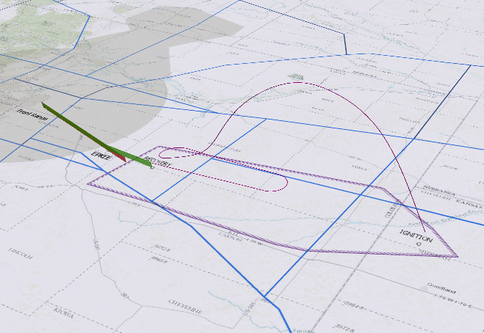
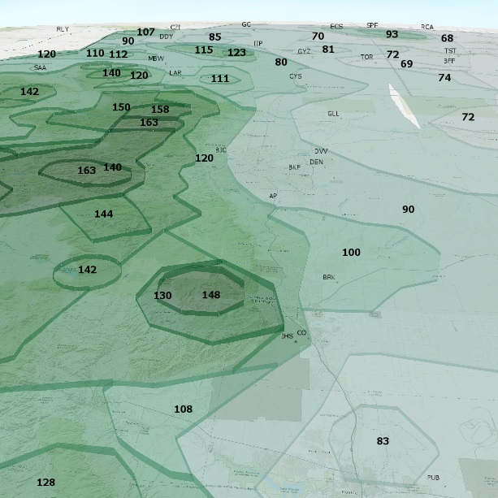
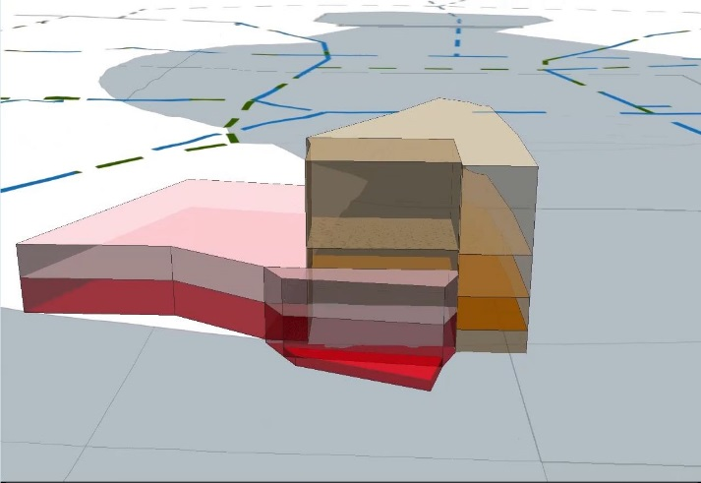
Problem Description
Air Traffic Control needs a modern 3D visualization and analysis tool.
Denver Air Route Traffic Control Center (Denver Center) does not currently have this tool.
Notes:
23:00
To introduce my project, I’ll pose several GIS questions related to Denver Center:
What is the system impact to civilian air traffic when a multi-tiered military airspace complex goes active?
How would Denver International Airport (DIA) departures and arrivals be affected by spaceport launches nearby?
How would a new windmill construction proposal affect how low controllers could safely vector aircraft in the area?
These are just a few of the many questions that could be answered by implementing a comprehensive 3D GIS of Denver Center.
Which air traffic control sectors are affected by UAS (unmanned aircraft systems) activity?
How close does a flight track descend to a mountain peak?
How would a letter of agreement (LOA) routing proposal by an adjacent facility affect coordination procedures between ZDV sectors?

Slide 4
Project Goal (Solution)
Develop ZDV-3D:
A comprehensive and easily accessible 3D representation of ZDV with associated aeronautical features.
3D Digital Twin
Notes:
22:20
This Capstone project proposes to deploy ArcGIS Pro to create ZDV-3D: Denver Center’s digital twin.
The intended output aims to create a three dimensional interactive model of ZDV, incorporating ATC data from a variety of sources.
According to Forbes.com “a digital twin is a virtual model of a process, product or service” (Marr, 2017).

Slide 5
Air Traffic Control Background
ATC provides aircraft separation services
Towers
TRACON (Terminal Radar Approach Control)
En Route Centers
Denver Air Route Traffic Control Center (Denver Center)
Notes:
21:40
To help appreciate what ZDV-3D intends to accomplish, I will provide some ATC background:
The facility providing these ATC services at any given time is determined largely by the aircraft’s phase of flight.
Air Traffic Control Towers provide separation for aircraft taxiing on the ground, during takeoff, local traffic patterns, and final approach
TRACON (Terminal Radar Approach Control) facilities separate aircraft on departure, arrival, and on initial approach.
En Route Centers, or Air Route Traffic Control Centers, normally provide services for aircraft during the cruise portion of flight.
Centers also provide ATC for airports that do not have a Tower and areas without a servicing TRACON.

Slide 6
Denver Center (ZDV)
Notes:
21:00
There are twenty Air Route Traffic Control Centers across the continental United States.
Centers control a significantly larger volume of airspace compared to TRACONs and Towers.
Denver Center controls the airspace above Colorado and surrounding states.
It is one of the largest air route traffic control centers in the U.S., with a footprint of over 265,000 square miles.
ZDV controls the airspace up to 60,000 feet & controls approximately 5,000 flights per day.

Slide 7
Airspace Complexity
Notes:
20:20
When looking up at the vast blue sky, the airspace above appears simple, with a lot of wide-open space.
However, Denver Center handles a complex, closely orchestrated, 3D system of airspace, airways, and procedures not visually apparent.
Air traffic controllers and associated support personnel are often challenged with translating 2D representations (controller charts) of 3D airspace in their minds

Slide 8
Notes:
19:40
En Route Center airspace is composed of areas and sectors.
Major areas are subdivided into smaller sectors.
Each sector is usually managed by one controller, although sectors may be staffed by several controllers or consolidated based on traffic volume.
Each sector has a low, high, or sometimes a ultra-high altitude stratum.
Denver Center Air Traffic Control (ATC) airspace consists of six major areas.
These areas, labeled Areas 1 – 6, are subdivided into smaller sectors, with six to eight sectors per area.
ZDV’s low sectors usually control traffic from the surface to 26,000 ft. MSL (mean sea level) while high sectors manage traffic above 27,000 ft.
Some areas include ultra-high sectors consisting of airspace above 36,000 ft.
Each sector is also given a unique numerical identifier.

Slide 9
TRACONs & Low Altitude Structure
Notes:
19:00
Denver Center overlies several air traffic approach control airspaces, sometimes referred to as Terminal Radar Approach Control (TRACON) or Radar Approach Control (RAPCON), which serve busier arrival and departure areas.
These areas are controlled by civilian and military controllers separate from Denver Center.
Each of these approach airspaces have unique geographic dimensions, with altitude stratums from the surface up to ceilings varying from 12,000 ft. to 23,000 ft. MSL.
Aspen Approach (ASE)
Casper Approach (CPR)
Cheyenne RAPCON (CYS)
Colorado Springs TRACON (COS)
Denver TRACON
Denver Terminal Area (D01)
Grand Junction (JNC)
Pueblo Terminal Area (PUB)
Ellsworth Approach (RCA)

Slide 10
Controlled/Uncontrolled Airspace
Notes:
18:20
In addition to Denver Center and approach airspace, the FAA has established various classes of controlled (and uncontrolled) airspace to regulate safe aircraft equipment requirements and operating procedures.
This airspace is identified as Class A through Class G, with Class A being the most restrictive

Slide 11
ZDV Special Use Airspace (SUA)
Notes:
17:40
Most of the Special Use Airspace (SUA) in Denver Center is used by the military. It includes:
MOAs (Military Operating Areas) – operations below 18,000’ MSL
Restricted Areas
ATCAAS (Air Traffic Control Assigned Airspace) – operations at/above 18,000’ MSL
Air Refueling Anchors/Tracks
Military Training Routes (low level)
Orbit Areas
Soaring Areas
Denver Center keeps non-participating aircraft (airliners and general aviation) clear of active SUAs.

Slide 12
Concepts
Airways
Victor airways
Jet routes
T-routes
Q-routes
Instrument procedures
Standard Terminal Arrivals (STARS)
Standard Instrument Departures (SIDS)
Instrument Approach Procedures
Aeronautical reference data
NAVAIDS (Navigational Aids)
Waypoints & navigational fixes
Communication sites/frequencies
Radar sites
Minimum IFR Altitudes (MIAs)
Obstacle data
Notes:
17:00
Here is an overview of major ATC concepts and components that will be briefly introduced in subsequent slides:

Slide 13
Airways
Victor airways
Jet routes
T-routes
Q-routes
Notes:
16:20
Basically there are high altitude and low altitude airways, categorized as conventional (ground based) and GNSS (GPS).
Victor airways – low altitude ground-based navigational routes (below 18,000’ MSL)
Jet routes – high altitude ground-based navigational routes (at/above 18,000’ MSL) (blue)
T-routes - low altitude GNSS (GPS) navigational routes (below 18,000’ MSL)
Q-routes - high altitude GNSS (GPS) navigational routes (at/above 18,000’ MSL) (blue)

Slide 14
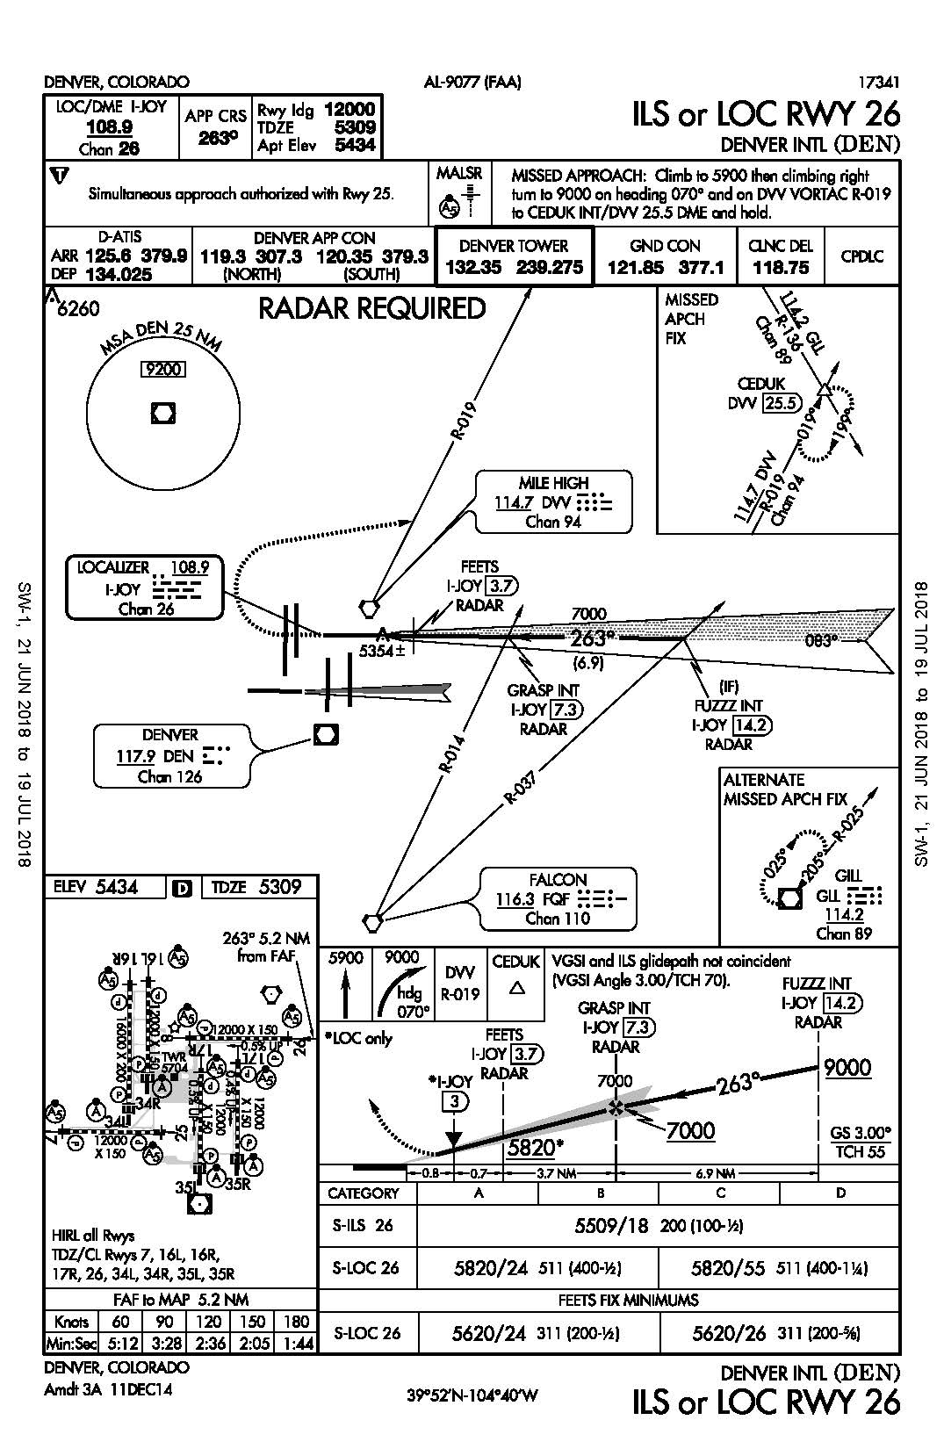
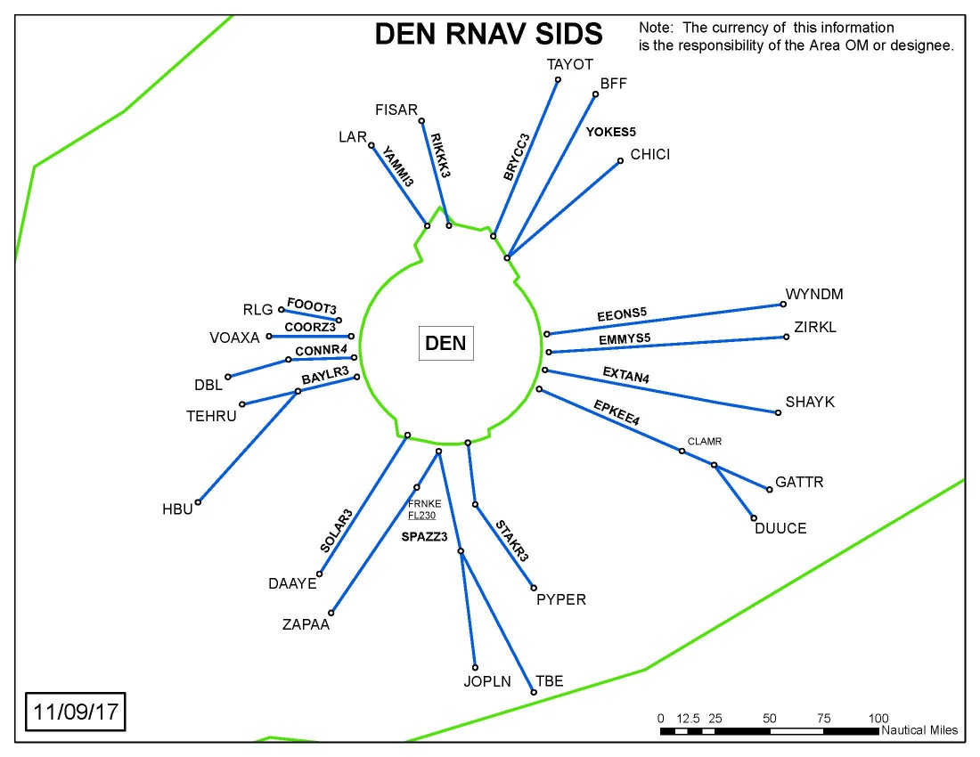
Instrument Procedures
Notes:
15:40
Instrument procedures consist of:
Standard Instrument Departures (SIDS) – departure procedures from major airports
Standard Terminal Arrivals (STARS) – arrival procedures prior to approach
Instrument Approach Procedures – guides aircraft to runway

Slide 15
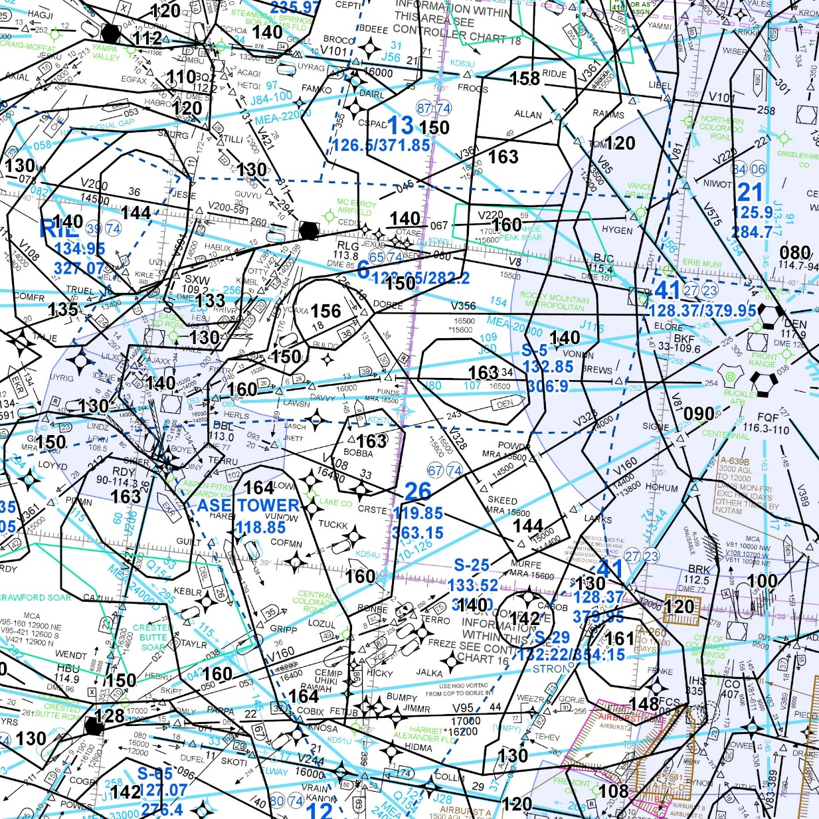
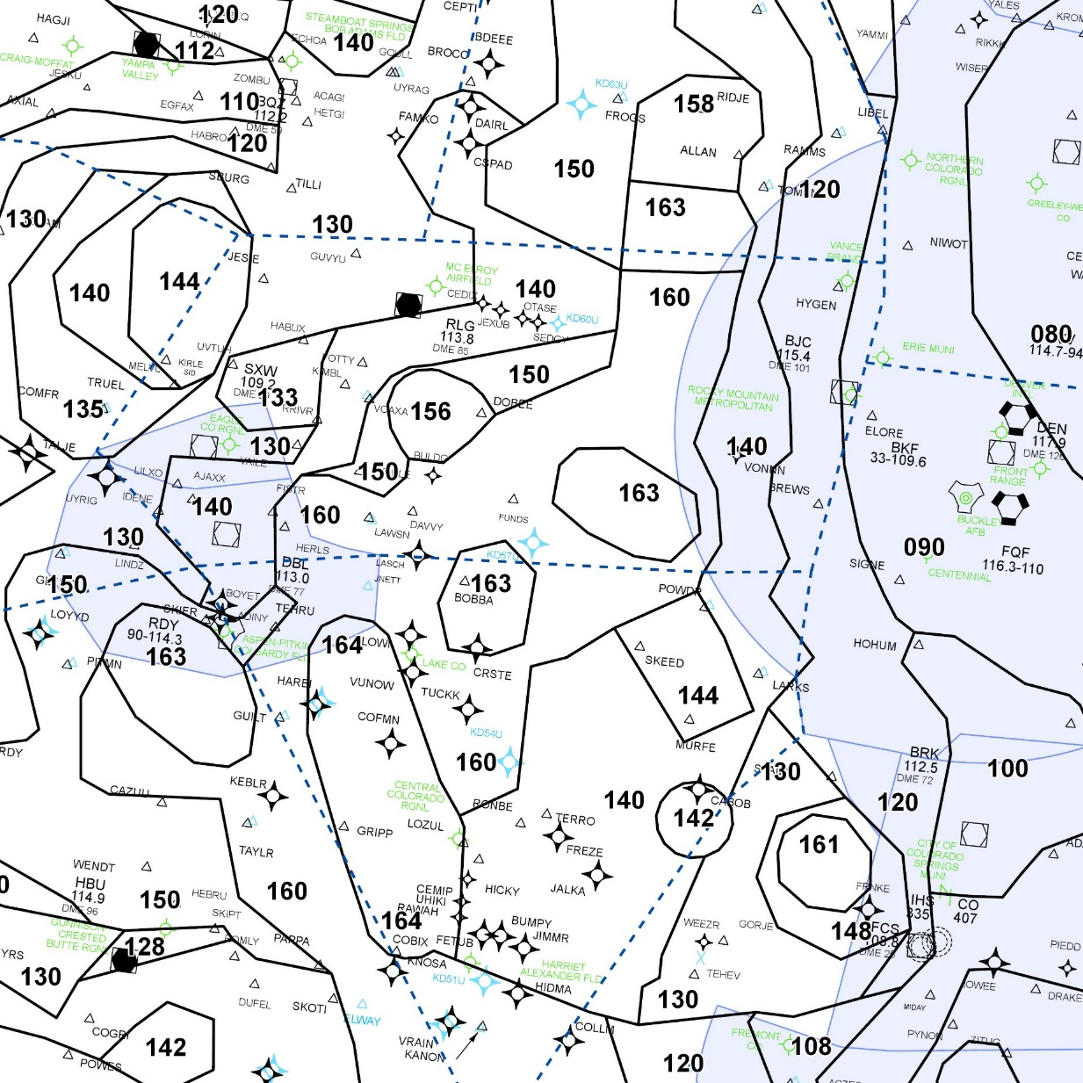
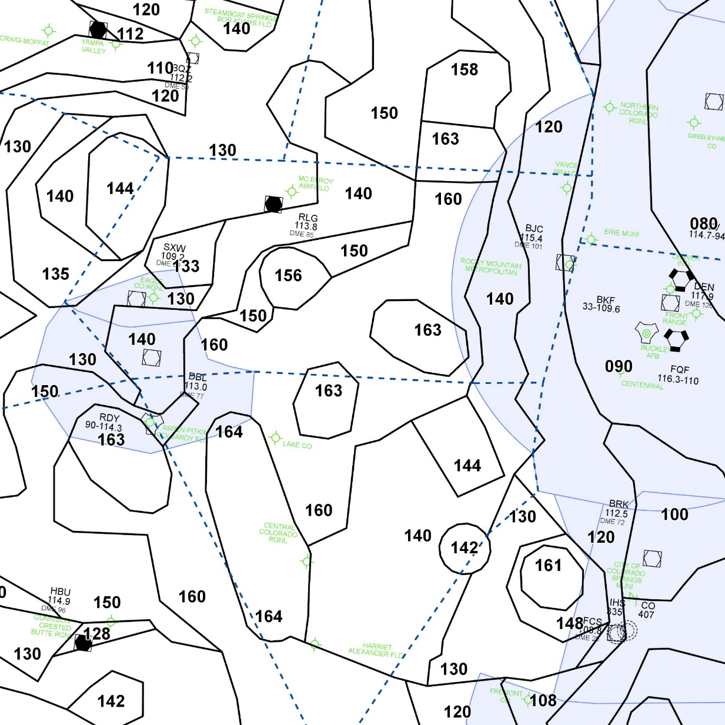
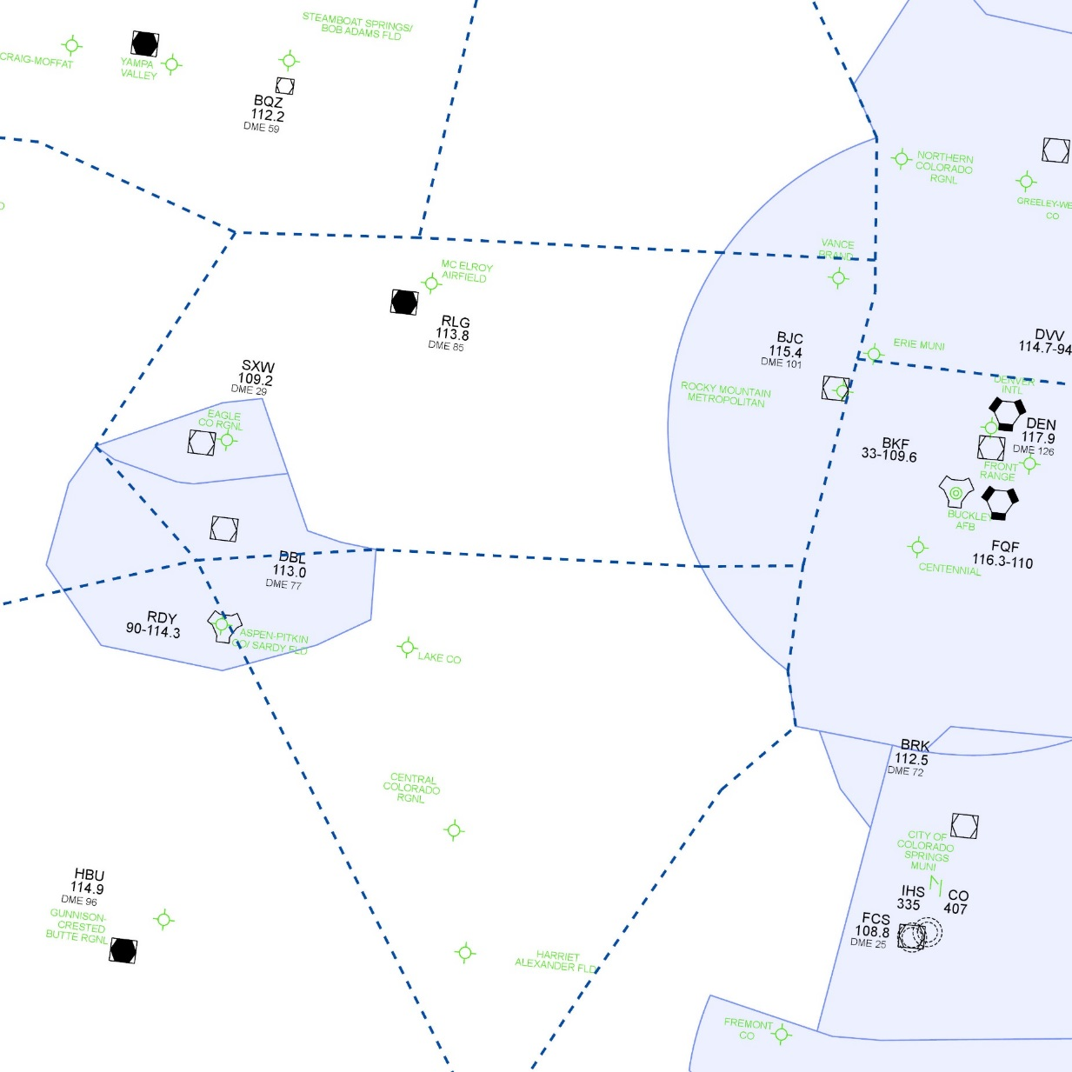
Aeronautical Reference Data
NAVAIDS
Airports
MIAs
Waypoints/fixes
Communication sites/frequencies
Radar sites
Obstacle data
Notes:
15:00
I’d like to provide a quick layering demonstration illustrating how the amount of aeronautical data can quickly become overwhelming (obstacles & radar sites not depicted):
NAVAIDS (Navigational Aids) – ground-based location emitters
Minimum IFR Altitudes (MIAs) – lowest safe instrument flight rule altitude in a particular area
Airports
Waypoints and navigational fixes – locations referred to by pilots and controllers
Communication sites/frequencies – used for pilot-to-controller communications
Radar sites – provides aircraft location information to controllers
Obstacle data – Towers, buildings, windmills, etc. tall enough to impact aviation

Slide 16
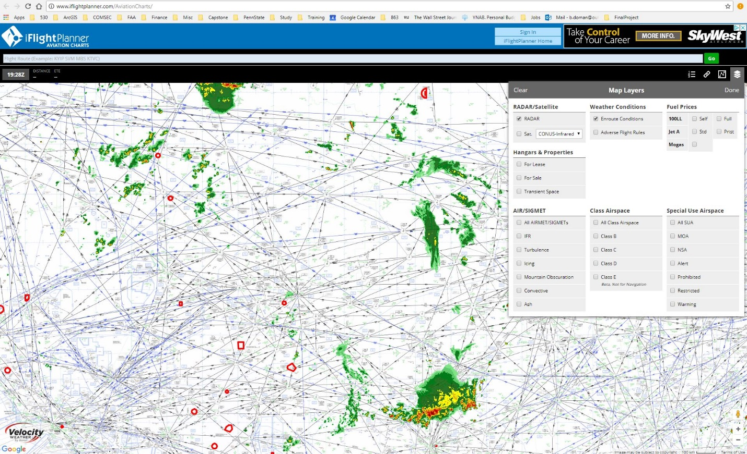
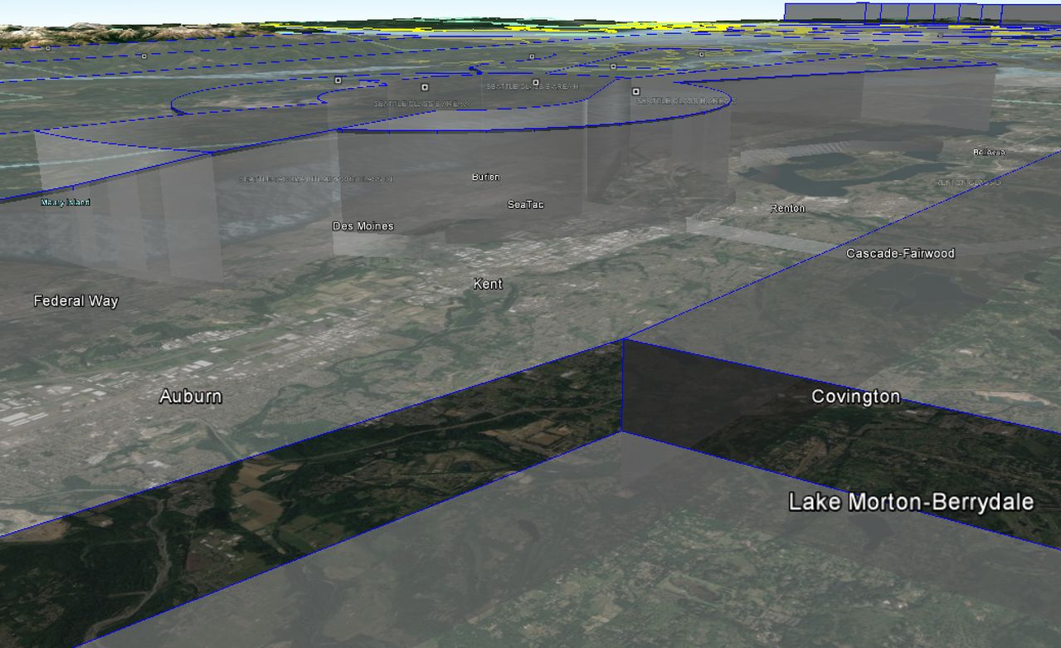
Popular Digital Aeronautical Chart Viewers
Notes:
14:20
With more focus placed on visualization and analysis, I will provide a brief overview of current trends for depicting this aeronautical data.
First, I’ll cover products available to the general public.
Then I’ll review major FAA platforms used at Denver Center.
Skyvector (Skyvector, n.d.), iFlightPlanner Aviation Charts (iFlightPlanner, n.d.), and Google Earth (Google Earth, n.d.) are all popular websites commonly used by aviation enthusiasts to view digital aeronautical charts.
Pilots, controllers, and support personnel are able to access various layers of aeronautical data including real-time feeds.
Of the three, Google Earth is the only one that supports 3D visualization (Ison, 2008).
They are all great quick reference tools and excel at their respective design purposes.
However, they are characteristically limited in areas of custom graphic representation, analysis, basic printing, and export capabilities.
Denver Center requires other tools to accomplish those objectives.

Slide 17
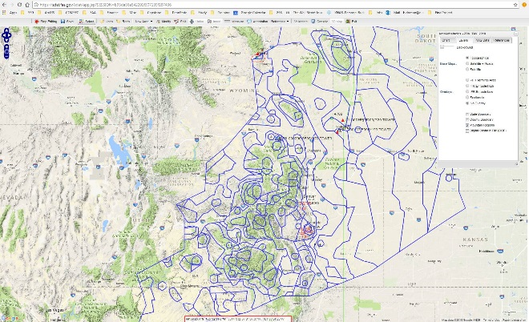
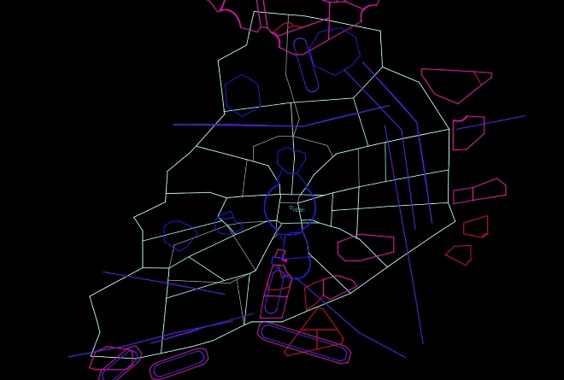
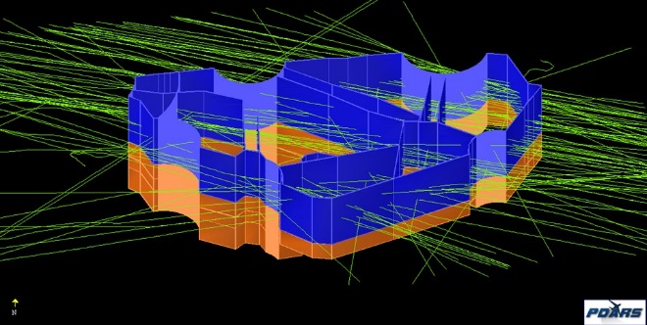
Current Denver Center GIS Platforms
SDAT (Sector Design & Analysis Tool)
PDARS (Performance Data & Reporting System)
TARGETS (Terminal Area Route Generation & Traffic Simulation)
SDAT
PDARS
TARGETS
Notes:
13:40
Bruce Frank, Esri’s ArcGIS for Aviation program manager indicates that “GIS is used across all sectors of aviation, but each sector has unique requirements” (Esri, 2013a).
Denver’s Center’s unique aviation requirements include the ability to visualize and analyze en route traffic control components in 3D.
The FAA provides several products to en route centers to address these needs.
SDAT (Sector Design & Analysis Tool, n.d.), PDARS (Performance Data and Reporting System, n.d.), and TARGETS (Terminal Area Route Generation and Traffic Simulation, 2018b) are three major software programs that Denver Center utilizes for GIS work.
I’ll highlight capabilities and limitations of each of these products available at Denver Center, next.

Slide 18
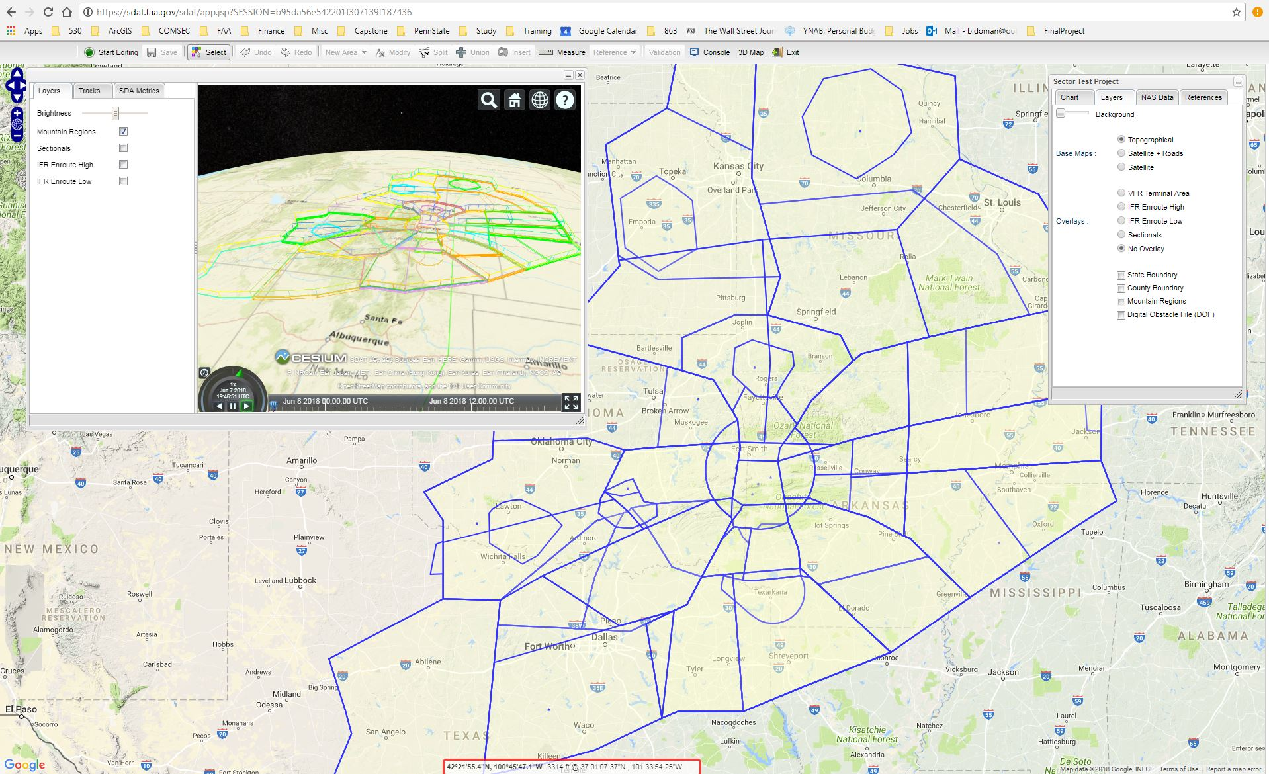
SDAT
Notes:
13:00
SDAT (Sector Design & Analysis Tool)
SDAT is a web-based, SaaS platform owned by the FAA for calculating Center MIAs (Minimum IFR Altitude) and designing air traffic control sectors.
It includes various base maps, aeronautical chart overlays, basic topographical features such as state and county boundaries, and obstacles (FAA, n.d.-b).
It provides the capability to depict aeronautical reference data, such as NAVAIDS, fixes, airports, and certain radar locations.
It also includes the capability to render sectors in 3D, through an external Cesium viewer.
SDAT is a powerful design and analysis tool for creating minimum safe altitude and air traffic control sectors.
However, it does not allow external user data to be imported or printouts to be exported.
While the Cesium add-on supports a pop-up window for 3D viewing of sectors, SDAT is not a native 3D application.
3D visualization is also limited to ATC sectors only (not MIA sectors).

Slide 19
PDARS
Notes:
12:20
PDARS (Performance Data and Reporting System)
PDARS is an FAA Software program designed primarily for air traffic analysis including basic air traffic control sector and airspace modeling.
PDARS also provides traffic replay animation capability.
Many different types of aeronautical data are available within the program including weather, airspace, airports and navigation objects (FAA, 2015).
The currency of this data is updated every chart cycle by ATAC, the FAA contract service provider.
PDARS operates in a native 3D architecture as depicted.
It also features visualization and animation capability including “replays of historical data using 3D and 4D visualization for operational analysis, and flight data filtering” (FAA, 2015).
PDARS works on a closed network connected to ATAC.
While it does provide limited data import/export capability, file format compatibility options are few.
Because of the closed system, all file transfers on and off of the PDARS workstation must be accomplished with removable storage media.
Even though PDARS is one of the only FAA products to provide true 3D visualization and analysis capability, the overall graphics rendering quality is dated by today’s standards.
Options for customizing symbols and labels are also quite limited.

Slide 20
TARGETS
Notes:
11:40
Terminal Area Route Generation Evaluation & Traffic Simulation (TARGETS) is the third major GIS platform used at Denver Center:
It is developed by the MITRE Corporation for the FAA.
It is primarily designed for instrument procedure development.
It also serves as a comprehensive airspace development and aeronautical data viewing tool.
It benefits from an intuitive graphical user interface and offers powerful data import/export capability (including Esri shapefiles).
TARGETS serves as an excellent collaboration tool among stakeholders.
It allows airlines, the FAA, chart makers, and other agencies a common platform and file format to share aeronautical files. It supports:
Procedure design
Flyability assessment
Airspace/procedure surface generation
Obstacle assessment
Noise assessment
Seamless data exchange
TARGETS also allows supports various image layer rendering including topography, terrain, and urban areas.
It incorporates a vast amount of aeronautical information (too numerous to list). These components include:
NAVAIDS
Waypoints
STARS
SIDS
SAAAR (Special Aircraft and Aircrew Authorization Required) procedures
Airways
Runways
Airports
Radars
Radios
ILS
SUA
Sector boundaries
Terminal airspace
Obstructions
Holding patterns (TARGETS Brochure, 2018c)
TARGETS serves principally as a design tool.
It does not provide as many custom symbology or label options as Esri software.
However, due to its ease of use, it is often employed as a visualization medium for creating air traffic control graphics and animations.
Its main drawback is the strictly-2D rendering engine. However, TARGETS exports can be visualized in 3D by other software such as Google Earth.

Slide 21
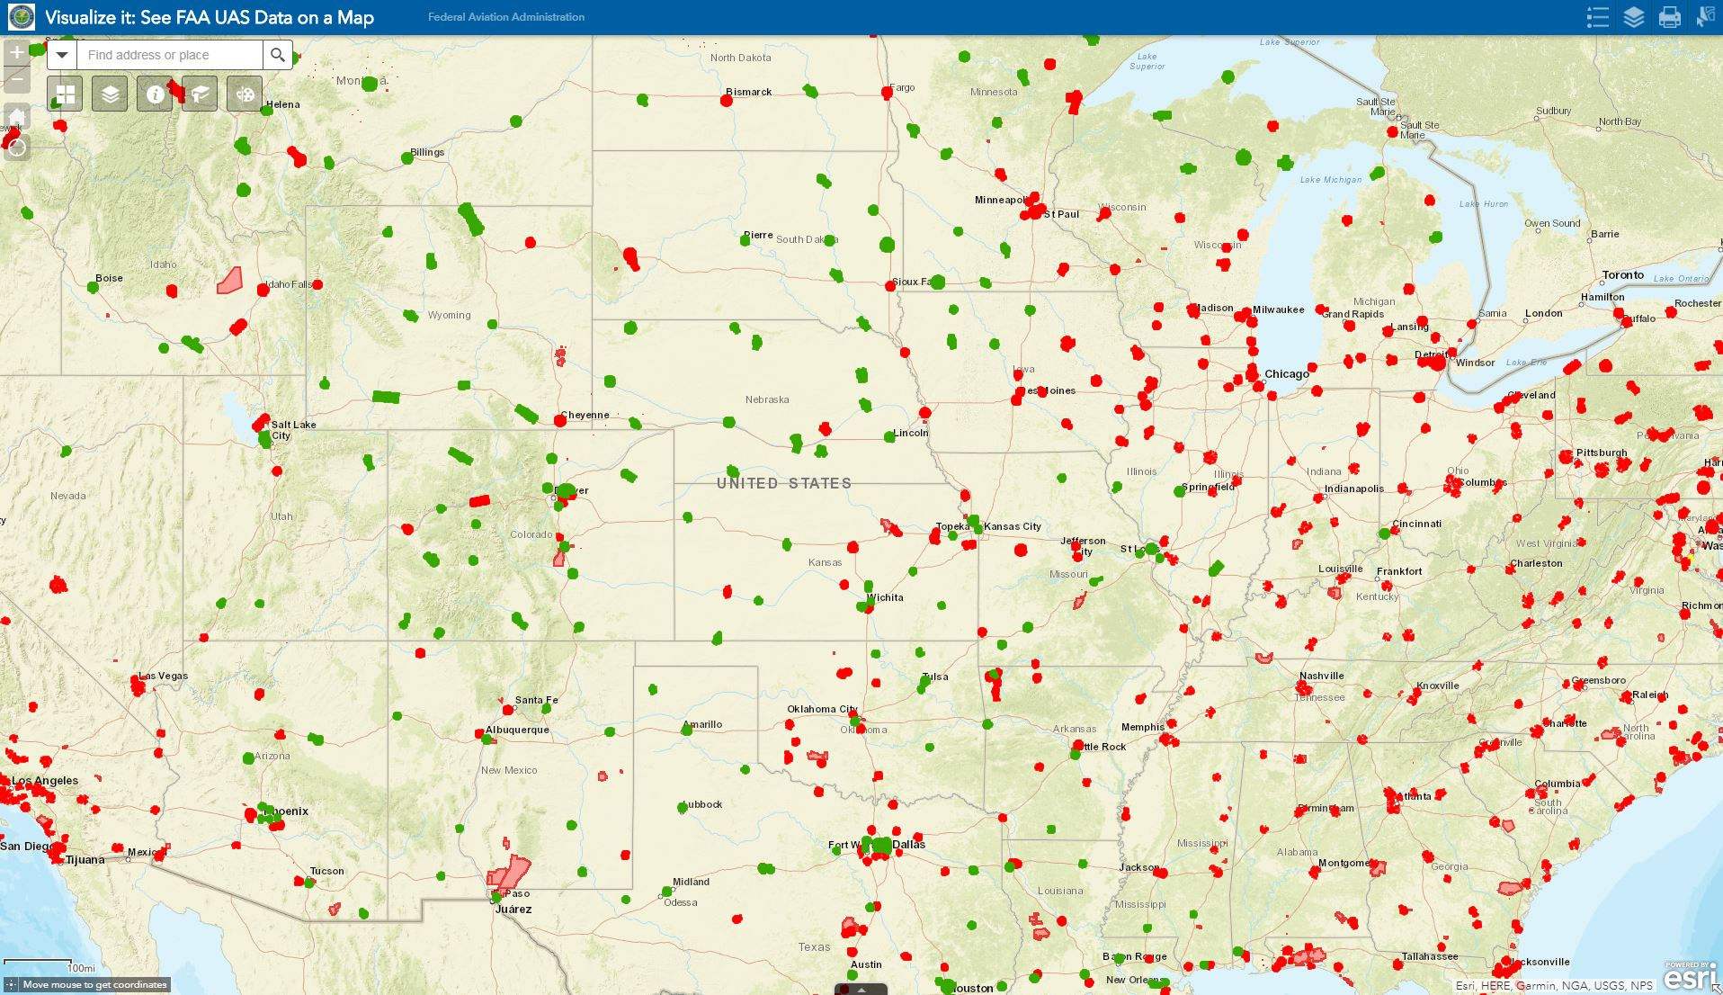
Esri FAA Implementation
Notes:
11:00
The FAA has been involved with Esri ArcGIS products for some time.
I attended an Esri FedGIS Conference in 2017 where national FAA officials demonstrated various applications of this powerful GIS program (which inspired this project).
On a national level:
They have used it for aeronautical data management, both 2D and 3D visualization, as well as optimizing chart update procedures.
They have implemented it as a collaboration tool with other federal agencies including the USGS for sharing map information.
They have geocoded thousands of aeronautical features to streamline GIS integration and locator applications.
They harnessed ArcGIS to develop an open data website, facilitating public aeronautical data access in many formats including kml, shapefiles, and various APIs.
Finally, they have incorporated Esri technology to help integrate UAS into the national airspace system (FAA, 2017).
Esri products are now available to en route traffic control facilities, such as Denver Center.
I am one of very few individuals at Denver Center that uses Esri products. These titles include ArcMap, ArcGIS Pro, ArcGIS Online (AGOL), and ArcGIS Earth. One goal of ZDV-3D is to facilitate ArcGIS access to more Denver Center personnel, especially through AGOL and ArcGIS Earth.

Slide 22
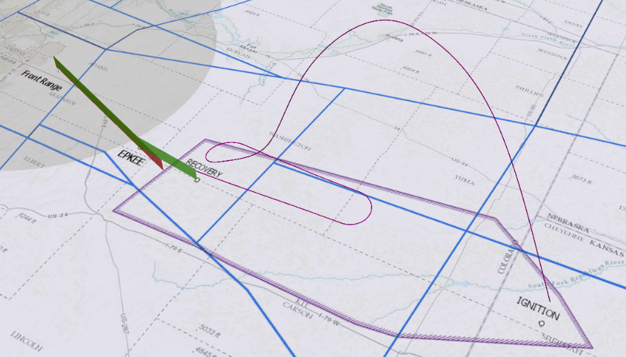
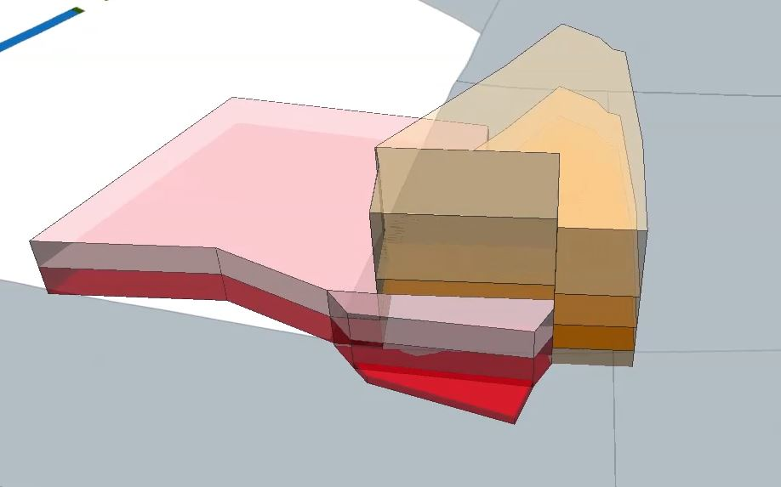
ZDV 3D Rendering Needs
Notes:
10:20
The public and FAA software tools covered so far achieve their respective software design goals.
However, none meet Denver Center’s present need for a modern GIS platform supporting native 3D visualization and analysis.
Here are just a few scenarios where three-dimensional visualization would allow ATC support personnel to better understand complex airspace and procedural interrelationships.

Slide 23
Project Objectives
Utilize existing FAA-funded software:
ArcGIS Pro
ArcGIS Online
ArcGIS Earth
Implement a cloud-based 3D visualization and analysis platform
Integrate aeronautical data from many sources into one location
Notes:
9:40
Project objectives include:
Developing ZDV-3D in ArcGIS Pro
Focus on simple end-user interface accessible via:
ArcGIS Online (AGOL)
ArcGIS Earth
Electronic outputs (.pdfs, .jpgs, etc.)
Hard copy outputs (paper charts, diagrams, etc.)
FAA distributed data (GeoService)
DoD (NGA) data (DVD) – National Geospatial Intelligence Agency
Locally generated data
Manual import from LOAs and other local source documents
ERAM (En Route Automation Modernization) import – local ATC computer adaptation files

Slide 24
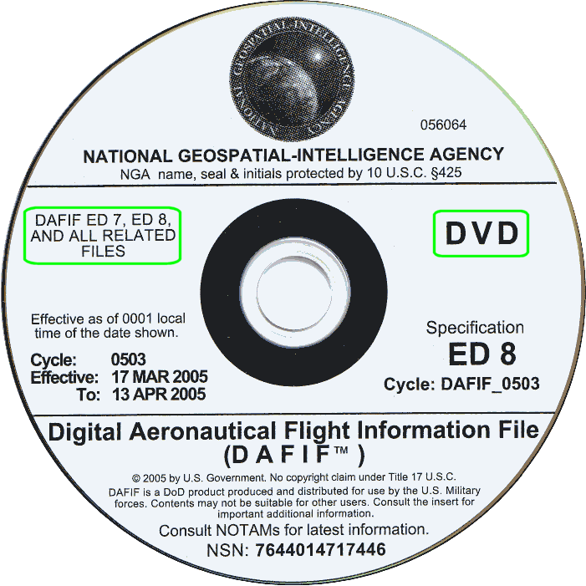
Data Sources
FAA
Aeronautical Data Delivery (Geo)Service
CMAP (Center Mapping Automation Program) CAD Files
NGA/DoD Aeronautical Data DVD (DAFIF)
Local Denver Center Data
Supplementary Resources
Airbus WorldDEM4Ortho
WMS aeronautical IFR/VFR chart basemaps
Notes:
9:00
The data for this project will be obtained from three main providers: the FAA, National Geospatial-Intelligence Agency (NGA), and locally produced data.
The FAA data comes from two sources.
The first is distributed data from the FAA’s Aeronautical Data Delivery Service open data website. This a comprehensive source of information including airports, airways, NAVAIDs, waypoints, controlled airspace, and UAS airspace. “This Aeronautical Data Delivery Service is an FAA-enabled web service that makes data available in CSV, JSON, KML, [and] Shapefile formats…” (FAA, 2016). Much of this data includes 3D attributes. Streamlined access to current aeronautical data is ensured as latest editions, as well as new pending editions, are offered as a GeoService through this public website.
The second FAA data source comes from CMAP, or the Center Mapping Automation Program. These nationally-produced Microstation CAD files are used by Air Traffic Control Center Cartographers to generate controller charts for their respective facilities (FAA, 2018). This digital data is obtained from an internal FAA website which I will convert into a geodatabase for inclusion into ZDV-3D as basemaps or as supplemental reference layers.
The NGA produces Department of Defense (DoD) aeronautical data including aerial refueling tracks, low level training routes, other special use airspace used by the military. It also replicates some FAA aeronautical distributed data including waypoints, airports, and NAVAIDs (NGA, 2018). The latest DoD information is mailed to Denver Center every 28 days on an unclassified DVD. It comes available in shapefile format and will serve primarily as military airspace source data for ZDV-3D.
Denver Center serves as the final major data provider for ZDV-3D. This information includes air traffic control areas and sectors, approach airspace, delegated airspace, reference controller points, MIAs, communication frequencies and locations, radar locations, soaring areas, orbit areas, and other SUA. It originates from local facility documents, LOAs, and ATC computer adaptation files (ERAM).
Supplementary resources will be obtained through Web Map Services (WMS) and the ArcGIS Pro Portal including DEM and aeronautical chart layers. ZDV-3D intents to incorporate Airbus WorldDEM4Ortho global aviation data that is available in ArcGIS Living Atlas of the World (Pratt, 2018). Various FAA aeronautical chart basemaps, including IFR High/Low En route and VFR Sectional Charts will be accessed via an FAA WMS (FAA, n.d.-c).

Slide 25
Incorporate Aviation Reference Data:
Airports
Airways
NAVAIDS (service volume*)
Waypoints/Fixes*
Communication sites* (service volume*)
Radar locations * (service volume*)
Computer adaptation reference (RSC) grids
Obstacle data*
Controlled airspace* (Classes A-E)
UAS airspace (Part 107 3D grids)
Notes:
8:20
ZDV-3D intends to implement some or all of the following reference data based on resources and project complexity (*current vs. future capability):
RSC = Radar Sort Cells

Slide 26
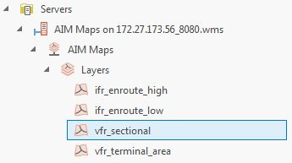
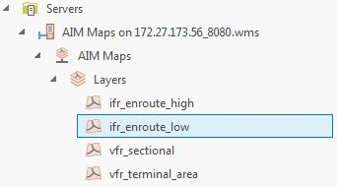
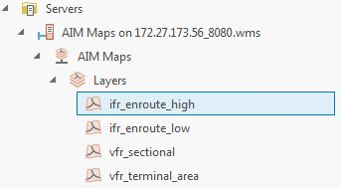
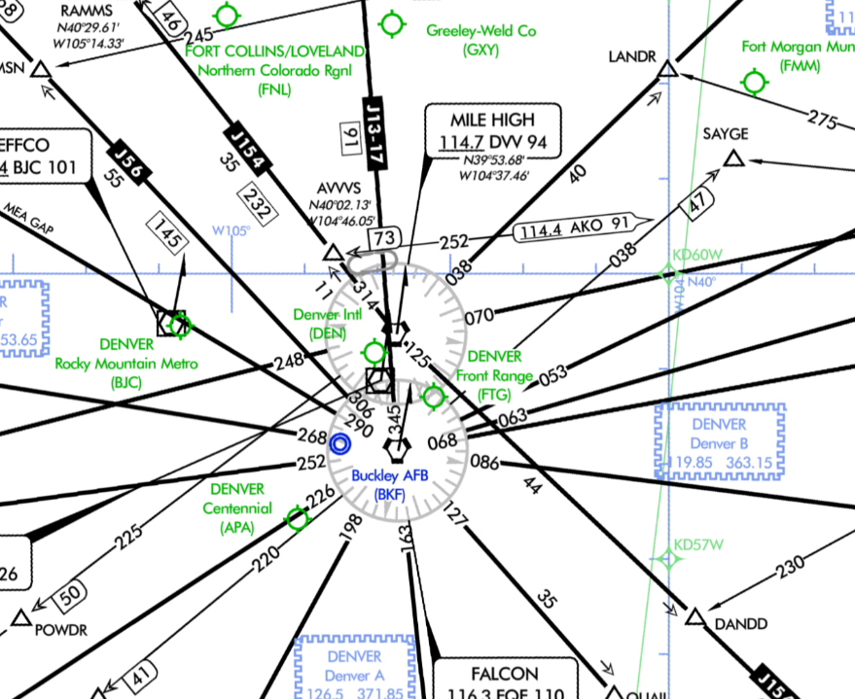
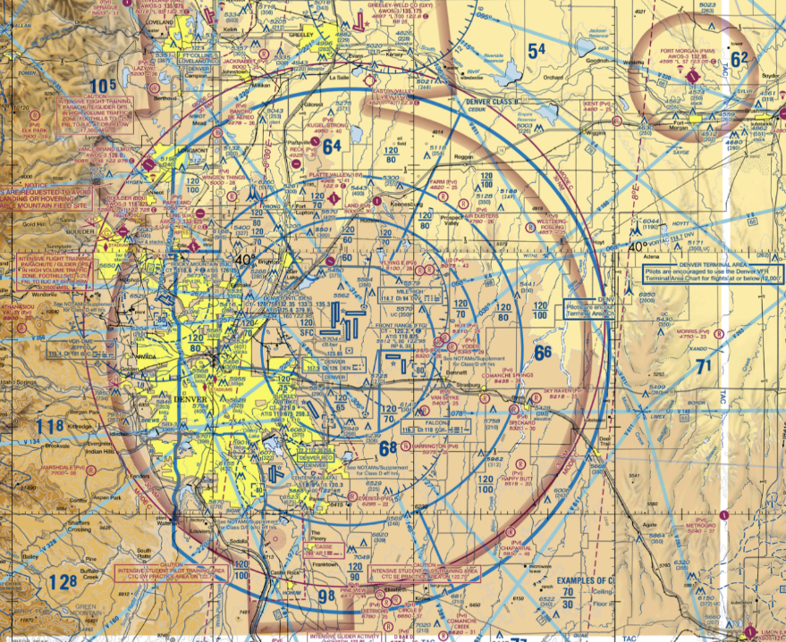
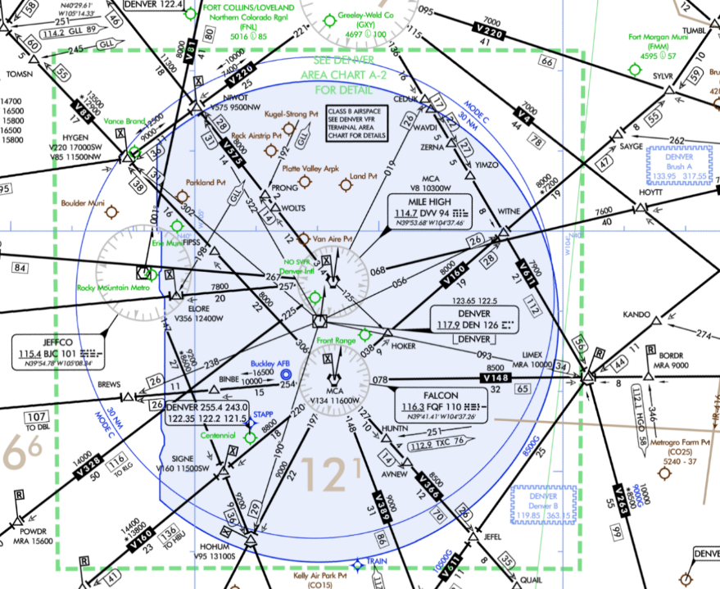
Drape 2D Layers over DEM:
Integrate 3D DEM (Airbus WorldDEM4Ortho)
Low/High Controller charts
IFR En Route charts
VFR Sectionals
Notes:
7:40
Several aeronautical chart WMS layers are planned to be draped over the DEM as demonstrated in this layering demo.

Slide 27
Establish 3D depiction capability for:
ZDV Areas & Sectors
Approach Airspace
Adjacent air traffic control sectors (within 30 miles of ZDV)
SUAs (Special Use Airspace)
MIAs (Minimum IFR Altitudes)
Temporary airspace – TFRs (temporary flight restrictions) for firefighting, airshows, etc.
Airspace proposals (military exercises, space launches, new ATC structure)
STARS (Standard Terminal Arrivals)
SIDS (Standard Instrument Departures)
SIAPs (Standard Instrument Approach Procedures)*
Notes:
7:00
A major objective for ZDV-3D is to establish 3D rendering capability for the following ATC features.

Slide 28
Incorporate ArcGIS Pro Tasks to Facilitate Consuming Data
Notes:
6:20
ArcGIS Tasks will be used to facilitate data consummation procedures. It will also provide:
GIS backfill position redundancy
And allow ZDV-3D data import processes to be deployed more broadly (at other facilities)

Slide 29
Technology
Esri Software
ArcGIS Pro
ArcGIS Online (AGOL)
ArcGIS Earth
Hardware
Dell Precision T3600 workstation
Dell UltraSharp U3011 30-inch monitor
Dell UltraSharp 2407 24-inch monitor
HP Designjet Z6200 42-inch plotter
Notes:
5:40
The following software and hardware technology will be harnessed to implement ZDV-3D:
ArcGIS Pro will serve as the primary development platform, currently using version 2.2.0 (2018).
ZDV-3D outputs will be designed for accessibility in ArcGIS Online (2018) and ArcGIS Earth (n.d.).
Cloud computing technology will be achieved using Esri’s secure cloud integrated into ArcGIS Online.

Slide 30
Development Process
ArcGIS Pro Setup
Import/Clip FAA Data
Import/Clip Military Data
Add Local ZDV Data
Implement Airbus WorldDEM (digital elevation coverage map)
Drape 2D Basemaps
Extract 3D Features
Optimize Visualization
Configure Outputs
AGOL/ArcGIS Earth
Digital Charts
Plotter Outputs
Feature symbols
Labeling/Annotation
Feature elevation attributes
Z-components
Local vs. Global 3D
CMAP Geodatabase
AIM WMS Services
IFR Enroute Charts
VFR Sectional Charts
Areas & Sectors
MIAs
Radar/Comm data
Reduce extent to ZDV + 30 nm boundary
Optimize import/clipping
Reduce extent to ZDV + 30 nm boundary
Optimize import/clipping
ZDV-3D.aprx
New (3D) Scene
Setup file structure/geodatabases
Generalization
Notes:
5:00
Go through headers…
Setup file structure and geodatabases for:
FAA distributed data
FAA CMAP CAD files
Military data
Local data
Establish appropriate projection and coordinate systems (WGS-84 vs. NAD 83)
Optimize import/clipping routines through:
Python scripts
Workflow tasks
Setup rendering properties
Colors
Layer transparency
Consider labeling vs. annotation
Incorporate 3D arcade labeling
Setup appropriate annotation geodatabases

Slide 31
Anticipated Challenges/Limitations
Access Z-component of FAA distributed data
Reduce chart clutter, especially in 3D
Overcome AGOL rendering limitations
Avoid project creep
Optimizing interface performance/map responsiveness
Small scale
Massive amount of aeronautical data
Consider generalization
Balance network services vs. data download
Currency of data
Task workload of downloading & rendering 3D data
Notes:
4:20

Slide 32
Anticipated Results
Create a 3D representation of ZDV airspace
Incorporate data from various sources
Provide intuitive GUI for Denver Center personnel to visualize and analyze aeronautical information
Establish best practice for other FAA facilities
Notes:
3:40

Slide 33
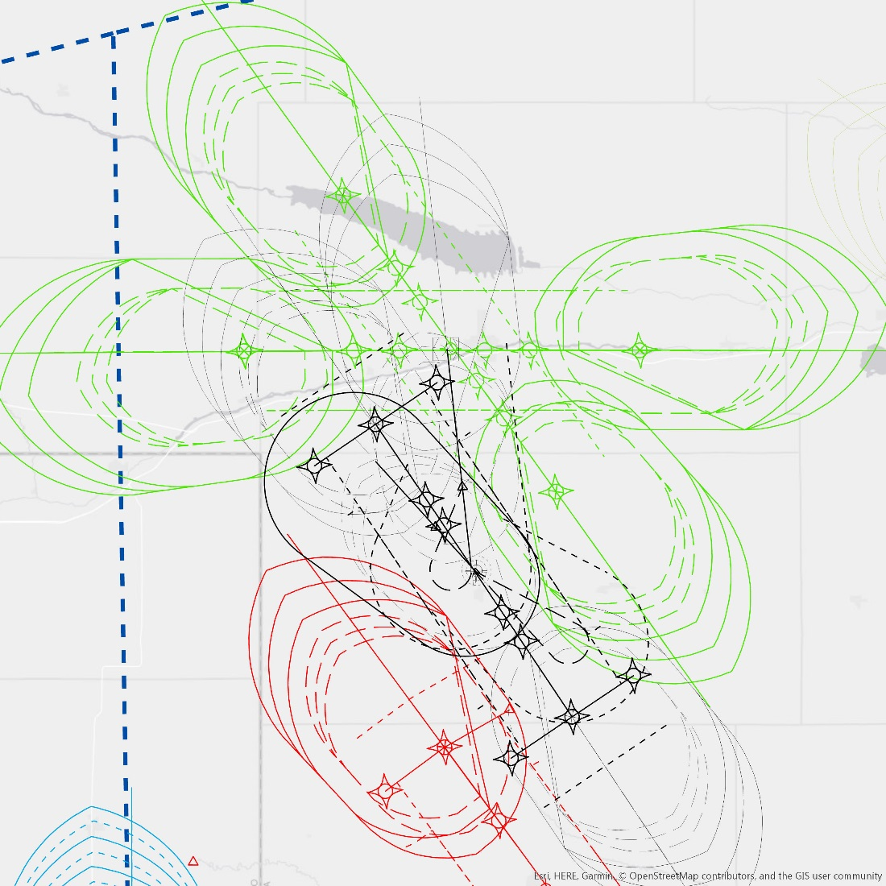
Further Development Potential
Render ZDV instrument procedures for overlapping airspace analysis
Nav/Com service volumes
Web map and/or app development
Cloud sharing with other En Route FAA facilities
Overlapping airspace analysis for proximity instrument procedures
Notes:
3:00
In addition to implementing some of the capabilities and features too complex to initially incorporate...

Slide 34
2018 Timeline
07/25
08/01
08/08
08/15
08/22
08/29
09/05
09/12
09/19
10/03
10/10
10/24
ArcGIS Pro Platform Setup
Import and develop clipping procedures for FAA & Military data
Import and/or manually add local ZDV data
Implement Airbus WorldDEM and drape 2D reference layers
Depict 3D portions of ZDV data
Optimize visualization, feature symbols & labeling
Configure ZDV-3D outputs
Prepare Capstone presentation
Capstone presentation – GIS in the Rockies, Denver, CO (Sep 19th)
Submit draft of final project write-up
Incorporate feedback into final project write-up draft
Submit final written document of Capstone project
Notes:
2:20

Slide 35
Acknowledgments
FAA, Denver Center, Airspace & Procedures
Ryan Baxter, PSU Adviser
Notes:
1:40

Slide 36
References
Aviation Stake Exchange (2016). What is a TRACON (Terminal Radar Approach Control)? [web log comment]. Retrieved from https://aviation.stackexchange.com/questions/25169/what-is-a-tracon
ArcGIS Earth (n.d.). [Online map making and viewing software]. ArcGIS Earth: Maps for Everyone on Earth. Retrieved from http://www.esri.com/software/arcgis-earth
ArcGIS Online (2018). [Online map making and viewing software]. ArcGIS: Mapping Without Limits. Retrieved from https://www.arcgis.com/features/index.html
Esri ArcGIS ArcMap (2017). ZDV aeronautical data. Retrieved June 12, 2018. Maps generated by Berrett Doman using Esri, ArcGIS for Desktop 10.5.1.
Esri ArcGIS Pro (2018). FAA aeronautical data. Retrieved June 12, 2018. Maps generated by Berrett Doman using Esri, ArcGIS Pro.
Esri (2013a). ArcGIS for Aviation Improves Aeronautical Data Management and Chart Production. ArcNews, Winter 2012/2013. Retrieved May 31, 2018, from http://www.esri.com/esri-news/arcnews/winter1213articles/arcgis-for-aviation-improves-aeronautical-data-management-and-chart-production
Federal Aviation Administration (FAA). (2015). Performance Data Analysis and Reporting System (PDARS). Retrieved May 31, 2018, from https://www.faa.gov/about/office_org/headquarters_offices/ato/service_units/systemops/perf_analysis/perf_tools/
Federal Aviation Administration (FAA). (2016). FAA’s Aeronautical Data Delivery Service [Data sets]. Available from http://ais-faa.opendata.arcgis.com/
Federal Aviation Administration (FAA). (2017). FAA - An Enterprise GIS [Video file]. Retrieved May 31, 2018, from http://www.esri.com/videos/watch?videoid=fUAL3LRXtEU&channelid=UC_yE3TatdZKAXvt_TzGJ6mw&title=faa-%E2%80%93-an-enterprise-gis
Federal Aviation Administration (FAA). (2018). Center Mapping Automation Program: Digital Data [FAA intranet data website]. Retrieved June 4, 2018, from http://aerochart.faa.gov/index.asp?xml=digital/cmap
Federal Aviation Administration (FAA). (n.d.-a). [Web application depicting Unmanned Aircraft System (UAS) airspace]. Visualize it: See FAA UAS Data on a Map. Retrieved May 31, 2018 from https://faa.maps.arcgis.com/apps/webappviewer/index.html?id=9c2e4406710048e19806ebf6a06754ad
Federal Aviation Administration (FAA). (n.d.-b). In System Performance Modeling – Sector Design Analysis Tool (SDAT). Retrieved May 31, 2018, from https://www.hf.faa.gov/Workbenchtools/default.aspx?rPage=Tooldetails&subCatId=34&toolID=235
Federal Aviation Administration (FAA). (n.d.-c). AIM (Aeronautical Information Management) Maps: Aeronautical Charts [Web Map Service]. Available from http://172.27.173.56:8080/wms_1.1.1_capabilities_latest.xml
Gentile, F. (2017, April 17). Is there a 3-dimensional airspace viewer? Message posted to https://aviation.stackexchange.com/questions/37244/is-there-a-3-dimensional-airspace-viewer?utm_medium=organic&utm_source=google_rich_qa&utm_campaign=google_rich_qa
Google Earth. (n.d.). In Google Earth. Retrieved June 7, 2018, from https://earth.google.com/web/
iFlightPlanner. (n.d.). In iFlightPlanner Aviation Charts. Retrieved June 1, 2018, from https://www.iflightplanner.com/AviationCharts/
Ison, D. (2008). Google Earth: The Ultimate Preflight Tool, How to view 3D depictions of sectional charts with real-time weather and much more! Plane & Pilot. Retrieved June 1, 2018 from https://www.planeandpilotmag.com/article/google-earth-the-ultimate-preflight-tool/
Marr, B. (2017, March 6). What is Digital Twin Technology – And Why Is It So Important. Forbes.com. Retrieved July 19, 2018 from https://www.forbes.com/sites/bernardmarr/2017/03/06/what-is-digital-twin-technology-and-why-is-it-so-important/#566bcbaf2e2a
National Airspace System. (n.d.). [Diagram of controlled and controlled airspace]. Retrieved from AMA Flight School, Understanding the National Airspace (NAS) website: http://www.fly-robotics.com/amaflightschool/pluginfile.php/134/mod_lesson/page_contents/155/1-1%20Classes%20of%20Airspace.jpg
National Geospatial-Intelligence Agency (NGA). (2018). Digital Aeronautical Flight Information File (DAFIF) [Data DVD]. Arnold, MO: U.S. Government.
PDARS (Performance Data Analysis and Reporting System). (2012). PDARS Version 6.0.11. Maps and analysis performed by Berrett Doman, using ATAC’s PDARS GRADE (Graphical Airspace Design Environment).
Pratt, M. (2018, Spring). Airbus WorldDEM4Ortho in ArcGIS Living Atlas of the World. ArcUser, Vol. 21 No. 2, 6.
Sector Design & Analysis Tool (SDAT). (n.d.). Sector Design & Analysis Tool: SaaS [FAA intranet website]. Retrieved June 7, 2018, from https://sdat.faa.gov/
Skyvector. (n.d.). In SkyVector Aeronautical Charts. Retrieved May 31, 2018, from https://skyvector.com/
TARGETS (Terminal Area Route Generation Evaluation & Traffic Simulation). (2018a) TARGETS Version 5.4.0. Maps and analysis performed by Berrett Doman, using TARGETS.
TARGETS (Terminal Area Route Generation Evaluation & Traffic Simulation). (2018b). In MITRE Technology Transfer. Retrieved May 31, 2018, from https://www.mitre.org/research/technology-transfer/technology-licensing/terminal-area-route-generation-and-traffic
TARGETS-Brochure. (2018c.). Portable Document Format. Retrieved May 31, 2018, from https://targets.cssiinc.com/external/downloads/documents/TARGETS-Brochure.pdf
Notes:
1:00

Slide 37
Questions
Notes:
In conculsion:
Denver Center needs a modern GIS platform to efficiently manage the numerous aeronautical features, system interrelationships, and complexities involved in this massive volume of en route airspace.
ZDV-3D can become this invaluable tool for visualizing and analyzing ATC airspace in 3D.
Extending access to FAA support personnel and management officials through intuitive applications, such as ArcGIS Online, will greatly improve the safe and efficient use of airspace for the flying public.
Questions?

