Slide 1
Location-Based Analysis for Recruitment of United States Border Patrol Agents
Jordan Douthitt
Advisor: Stephen A. Matthews
October 30, 2017

Slide 2
Problem Statement
Background
& Lit. Review
Data
Methodology
Conclusions
Timeline
Problem
& Goal
Need to strategically recruit a large amount of skilled employees (United States Border Patrol Agents) to hard to fill positions in undesirable locations.

Slide 3
Project Goal
Background
& Lit. Review
Data
Methodology
Conclusions
Timeline
Problem
& Goal
Analysis answering two questions
Which Border Patrol Sectors will have the most difficulty recruiting?
Which areas outside of these Border Patrol Sectors should additional recruiting focus on?

Slide 4
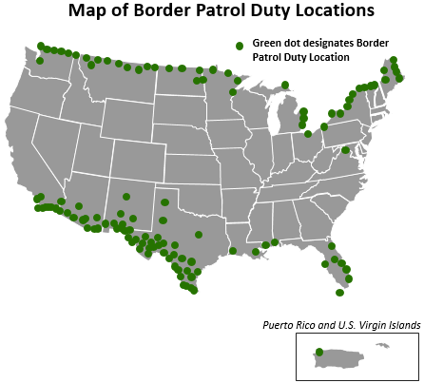
Background Information
Background
& Lit. Review
Data
Methodology
Conclusions
Timeline
Problem
& Goal
Executive Order 13767 on January 25th, 2017
Need to hire 5,000 U.S. Border Patrol Agents along southwestern border above roughly 19,800 current Agents
Immigration & Naturalization Services history of difficulty hiring Agents
Continuing recruitment issues with Customs and Border Protection under the Department of Homeland Security

Slide 5
Literature Review
Background
& Lit. Review
Data
Methodology
Conclusions
Timeline
Problem
& Goal
Factors Affecting Employment & Migration
Border Patrol Agent Requirements
Under age 39
Degree/background in law enforcement
Ability to speak/learn Spanish
Pass background check
Labor Pool Factors
Age
Unemployment level of community of origin
Urban amenities of duty station location
Community of origin size and demography
Distance from community of origin
Salary

Slide 6
Data
Background
& Lit. Review
Data
Methodology
Conclusions
Timeline
Problem
& Goal
Issues with Ideal Data
Duty Station specific data on
Salary, Length of service, Retirement eligibility, age, ethnicity, veteran status, prior residential history, and number and types of separations
Analysis can be performed on which factors make a Border Patrol Recruit more likely to stay longer
Due to sensitivity of individual level, and even duty station specific data, it cannot be used to do analysis in this capstone scenario. I recommend such an analysis be done internally to DHS.

Slide 7
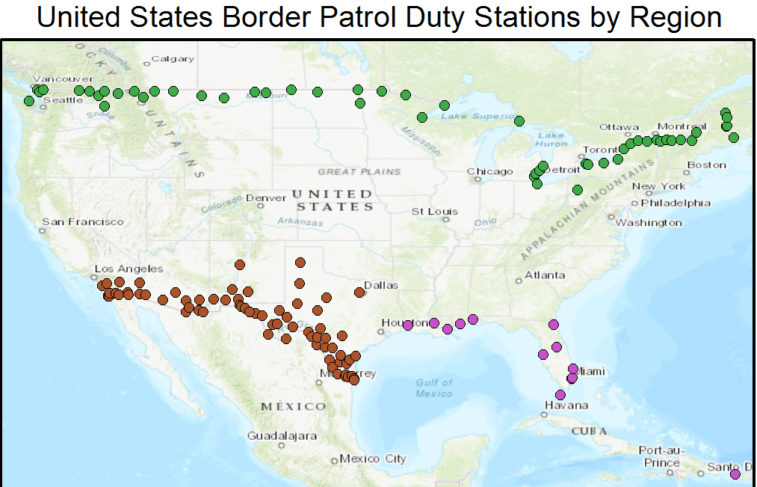
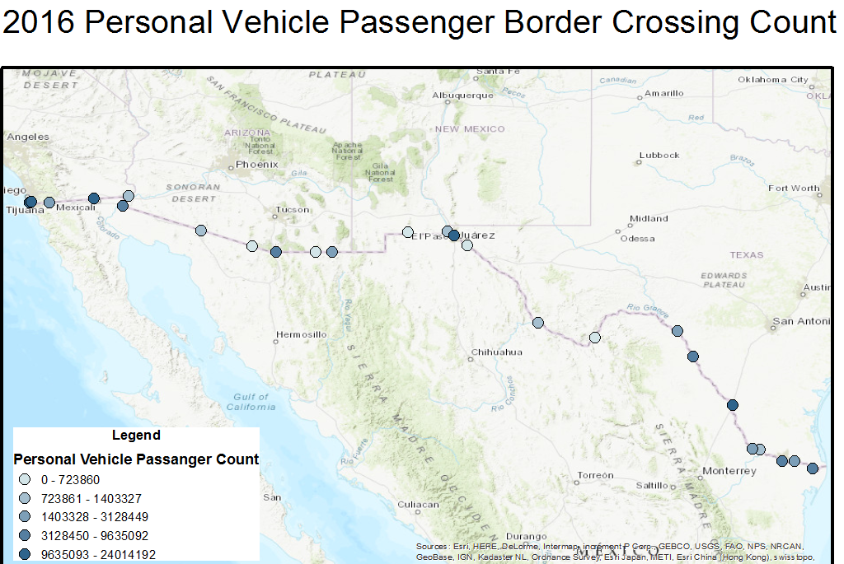
Data
Background
& Lit. Review
Data
Methodology
Conclusions
Timeline
Problem
& Goal
Available Data
Border Patrol Data
Agent Demographics: Age group, Salary, Tenure, Education Level, Gender, Separation type
Organizational Location: Regions, Sectors, Duty Stations
Agent Staffing by Sector
Border Patrol Workload Data
Apprehensions by Sector
Border Crossings by location

Slide 8
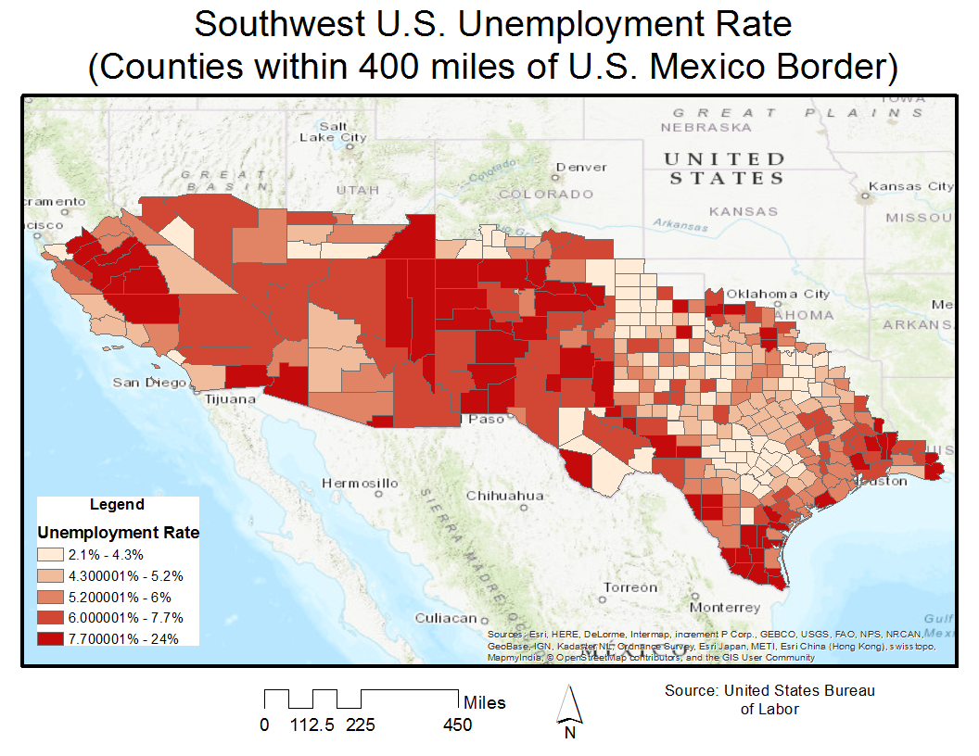
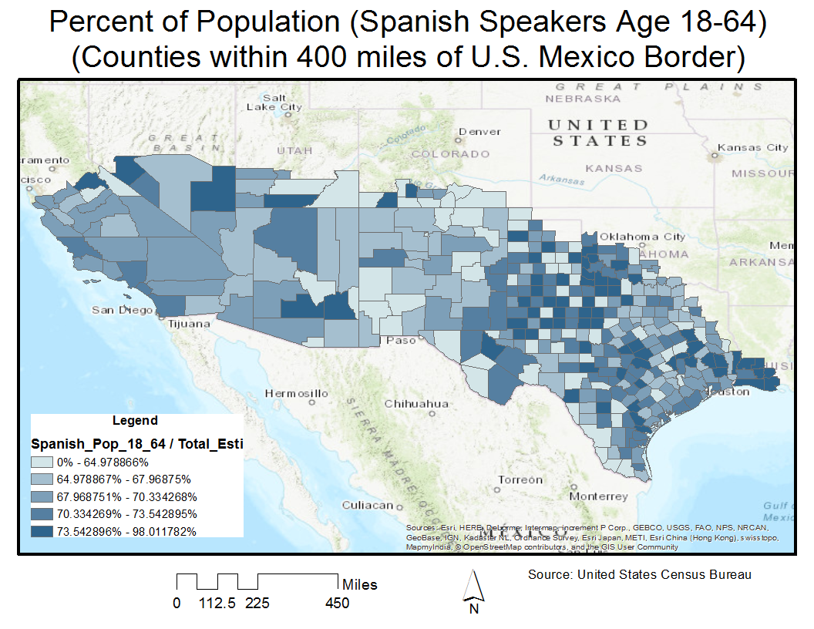
Data
Background
& Lit. Review
Data
Methodology
Conclusions
Timeline
Problem
& Goal
Available Data (Continued)
Employment Data
Protective Services Occupation Data
Population Size & Wages
General Employment Data
Population Demographics
Total Population
Population by Age
Spanish Speaker Population
Veteran Population

Slide 9
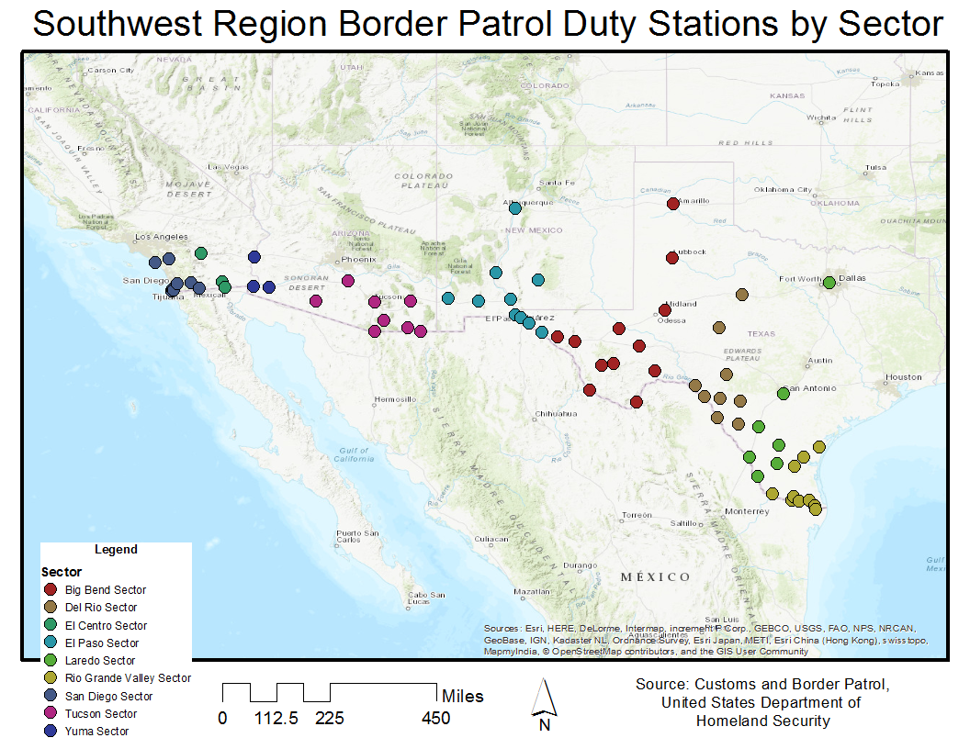
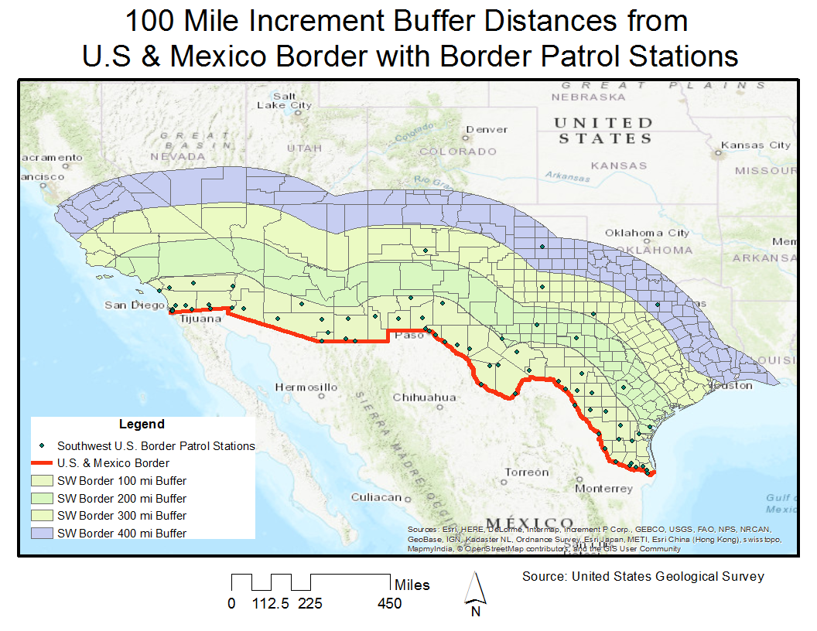
Methodology
Background
& Lit. Review
Data
Methodology
Conclusions
Timeline
Problem
& Goal
Study Areas
Border Patrol Sectors
Labor Pools
400 mile buffer from United States & Mexico Border
356 Counties
84 Combined Statistical Areas

Slide 10
Methodology
Background
& Lit. Review
Data
Methodology
Conclusions
Timeline
Problem
& Goal
Border Patrol Sector Profiles
Calculate current workload of Agents by Sector
Labor Pool Statistics of Sector Areas
Decision on which Sectors will be most difficult to recruit to
Outside Labor Pool Profiles
Factors that make more likely recruits
Decision on which labor pools will be most valuable to focus recruitment within

Slide 11
Anticipated Results & Conclusions
Background
& Lit. Review
Data
Methodology
Conclusions
Timeline
Problem
& Goal
Product: Descriptive Report answering two questions:
Where is there more likely to be trouble recruiting?
Comparison of Border Patrol Sectors
Where can recruitment be focused?
Comparison of Labor Pools
Value to Human Resources Field:
Previously minimal demographic or location-based research performed
Model for focused recruitment of hard to fill positions that can be used in other similar scenarios

Slide 12
Timeline
Background
& Lit. Review
Data
Methodology
Conclusions
Timeline
Problem
& Goal

Slide 13
Thank You
Any Questions?

Slide 14
References
Border Patrol Agent Duty Locations (2017). U.S. Customs and Border Protection Website. Retrieved from https://www.cbp.gov/careers/frontline-careers/bpa/duty-locations on August 21, 2017.
Border Patrol Enforcement Series, 1896 (n.d.) Classification & Qualifications: General Schedule Qualifications Standards. Retrieved from https://www.opm.gov/policy-data-oversight/classification-qualifications/general-schedule-qualification-standards/1800/border-patrol-enforcement-series-1896/ on August 21, 2017.
Cameron, R. (2011). Responding to Australia’s regional skill shortages through regional skilled migration. Journal of Economic and Social Policy, 14(3), Article 4. http://epubs.scu.edu.au/jesp/vol14/iss3/4/
Coates, D., Gindling, T. H. (2013) Is Hispanic population dispersion into rural counties contributing to local economic growth? Contemporary Economic Policy, 31(4), 649-668. http://sk8es4mc2l.search.serialssolutions.com.ezaccess.libraries.psu.edu/?url_ver=Z39.88-2004&rft_val_fmt=info%3Aofi%2Ffmt%3Akev%3Amtx%3Ajournal&rft.genre=article&rft.jtitle=Contemporary%20Economic%20Policy&rft.atitle=IS%20HISPANIC%20POPULATION%20DISPERSION%20INTO%20RURAL%20COUNTIES%20CONTRIBUTING%20TO%20LOCAL%20ECONOMIC%20GROWTH%3F&rft.volume=31&rft.issue=4&rft.spage=649&rft.epage=668&rft.date=2013-10-01&rft.aulast=COATES&rft.aufirst=DENNIS&rft.issn=1074-3529&rft.eissn=1465-7287&rfr_id=info:sid/wiley.com:OnlineLibrary
Halseth, G. (1999). “We came for the work”: Situating employment migration in B.C.’s small, resource-based, communities. The Canadian Geographer, 43(4), 363-381. http://sk8es4mc2l.search.serialssolutions.com/?ctx_ver=Z39.88-2004&ctx_enc=info%3Aofi%2Fenc%3AUTF-8&rfr_id=info%3Asid%2Fsummon.serialssolutions.com&rft_val_fmt=info%3Aofi%2Ffmt%3Akev%3Amtx%3Ajournal&rft.genre=article&rft.atitle=%22WE+CAME+FOR+THE+WORK%22%3A+SITUATING+EMPLOYMENT+MIGRATION+IN+B.C.%27S+SMALL%2C+RESOURCE-BASED%2C+COMMUNITIES&rft.jtitle=The+Canadian+Geographer&rft.au=Halseth%2C+Greg&rft.date=1999-12-22&rft.pub=Canadian+Association+of+Geographers&rft.issn=0008-3658&rft.eissn=1541-0064&rft.volume=43&rft.issue=4&rft.spage=363&rft.externalDBID=BSHEE&rft.externalDocID=68017080&paramdict=en-US

Slide 15
References
Orvis, B. R., Asch, B. J. (2001). Military Recruiting: Trends, Outlook, and Implications. Rand Publications. Santa Monica, CA. Retrieved from https://www.rand.org/pubs/monograph_reports/MR902.html
Playford, D., Larson, A., Wheatland, B. (2006). Going country: Rural student placement factors associated with future rural employment in nursing and allied health. Australian Journal of Rural Health, 14, 14-19. http://onlinelibrary.wiley.com/doi/10.1111/j.1440-1584.2006.00745.x/full
Schwartz, A. (1973). Interpreting the Effect of Distance on Migration. Journal of Political Economy, 81(5), 1153-1169. http://www.jstor.org.ezaccess.libraries.psu.edu/stable/1830643?pq-origsite=summon&seq=1#page_scan_tab_contents
Soutar, G. N., Turner, J. P. (2002). Students’ preferences for university: a conjoint analysis. The International Journal of Education Management, 16(1), 40-45. https://search-proquest-com.ezaccess.libraries.psu.edu/docview/229147546?pq-origsite=summon
Ravenstein, E. G. (1885). The Laws of Migration. Journal of the Statistical Society of London, 48(2), 167-235. http://www.jstor.org.ezaccess.libraries.psu.edu/stable/2979181?pq-origsite=summon&seq=1#page_scan_tab_contents
U.S. Department of Homeland Security (2016a). Written testimony of CBP U.S. Border Patrol Chief Mark Morgan and Deputy Chief Carla Provost for a Senate Committee on Homeland Security and Governmental Affairs hearing titled “Initial Observations of the New Leadership at the U.S. Border Patrol”. Retrieved from https://www.dhs.gov/news/2016/11/30/written-testimony-cbp-senate-committee-homeland-security-and-governmental-affairs on August 21, 2017.
U.S. Department of Homeland Security (2016b). Written testimony of CBP Office of Administration Assistant Commissioner Eugene Shied, CBP Human Resources Management Assistant Commissioner Linda Jacksta, and CBP Office of Field Operations Deputy Assistant Commissioner John Wagner for a House Committee on Homeland Security, Subcommittee on Border and Maritime Security hearing titled “Keeping Pace with Trade, Travel, and Security: How does CBP Prioritize and Improve Staffing Infrastructure?”. Retrieved from https://www.dhs.gov/news/2016/04/19/written-testimony-cbp-house-homeland-security-subcommittee-border-and-maritime on August 21, 2017.
U.S. General Accounting Office (1991). Border Patrol: Southwest Border Enforcement Affected by Mission Expansion and Budget. GAO/GGD-91-72BR. Retrieved from http://www.gao.gov/assets/80/78084.pdf on August 28, 2017.

