Slide 1
Investigating Major League Baseball (MLB) amateur draft patterns pertaining to climate
By Michael Dudkin
Pennsylvania State University
Advisor – Justine Blanford
Special Tanks to Dr. Eliza Richardson Marone

Slide 2
Topic background – Major League Baseball
2015 total revenue approaching US$9.5 billion
15 consecutive years of revenue growth
Increased parity and competition between clubs
Amateur draft held every June to bring new talent under contract from US & Puerto Rico (amateur signed from other locations not subject to draft)
Amateur draft is major source of cost-controlled talent

Slide 3
Amateur draft is source of cost efficiency
Drafted players not eligible for free agency until completion of 6 years service time on MLB roster
Drafted players cost-controlled through minimum salaries (1st through 3rd years) and salary arbitration (next 3 years)
Drafted players who excel in MLB provide performance at fraction of cost of free-agent signees who are paid market salaries on multiyear fully-guaranteed contracts

Slide 4
Measuring player value in major league baseball
Wins Above Replacement (WAR)
A near universal framework within the baseball community to easily summarize a player’s value
Represents the number of wins a player’s performance adds relative to a team composed entirely of “replacement” players – that is, representing a level of performance that can be obtained from any number of available minor league players
It sums a player’s contributions through all aspects of the game, including value added through batting, baserunning, and defense for hitters and run prevention for pitchers.
WAR is a measure of scarcity, and therefore value

Slide 5
WAR scale (over 162-game season)
0 – replacement level (good minor leaguer)
1 – below average, reserve
2 – league average starter
5-7 – All-Star level
7-10 – MVP level
10+ - historically rare feat

Slide 6
Example of efficient talent acquisition through amateur draft
Production vs salary 2010-2012
Jason Heyward (Atlanta Braves, 2007 draft pick)
14.7 WAR
$1,461,500 total salary
Carlos Lee (Houston Astros, free agent signee)
1.5 WAR
$56,500,000 total salary

Slide 7
Research question
to investigate if there is any type of spatial bias in selection of amateur draft picks – in particular, if there is a cold weather effect in the draft positions of prospects, and if cold-weather state prospects are systemically undervalued by teams.
This project will use data points from 30 years of Major League Baseball amateur drafts (1980-2009).

Slide 8
Research question (cont.)
This project attempts to reject the null hypothesis that for any given draft slot or range of slots (e.g. picks 1-5, 6-10 and so on from the 1st through the 10th rounds, the climate associated with a drafted player’s school has no bearing on the likelihood that that player will become a viable major league player (as measured by a career Wins Above Replacement of 3 or greater).

Slide 9
Quantifying climate impacts on draftability
Cold weather prospects face a “cold weather bias” in baseball industry
Such players particularly in heavily populated northeast cannot practice outdoors year round, have a limited schedule, and cannot develop against premier competition in traditional talent hotbed states –e.g. TX, FL, CA
Scouting players in cold weather climates, particularly high school players, is very challenging just because players play so few games leading up to the draft…the fact that 24 selections passed before Mike was drafted does suggest that it is hard to scout in the Northeast.
-Matt Klentak, Angels Assistant GM, to USA Today.
*http://www.usatoday.com/story/sports/mlb/2014/08/04/mike-trout-salary-production/13347167/

Slide 10
Assignment of draft pick hometowns to climate categories
Will use NOAA data to create interpolated climate surface of United States
Draft pick hometowns over first 10 rounds in the 30 study years will be mapped to surface and assigned a value
That value will be assigned to one of 5 climate categories factoring in temperature and annual rainfall for a given location
Will be based on both average temperature and average annual precipitation to better capture effect of limited schedule/practice time, and consequently on quality of competition
NOAA 30-year data
Initial pilot study used 3 climate categories based on average winter temperature only (based on NOAA 30-year averages)

Slide 11
Adjustments to raw data
Once baseline analysis is performed on all players, a subset will be tested
This subset will consist only of high-school draftees who are drafted as position players
The reason is that the dominant factor in pitcher scouting (throwing velocity) is the variable most independent of geography/climate/competitive environment

Slide 12
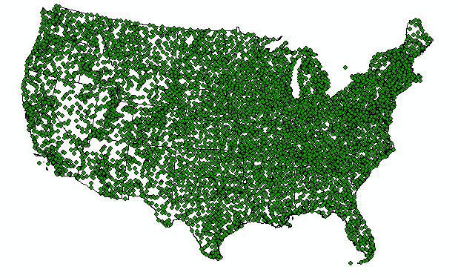
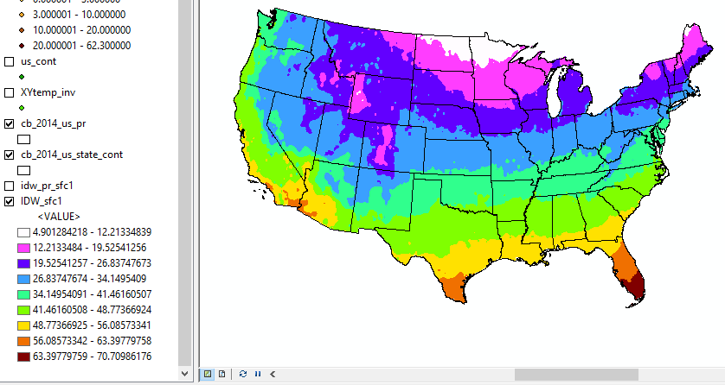
Example of Climate data used to create interpolated surface
Using thousands of data points (each representing avg winter temp) to crate interpolated surface on which draft pick hometowns can be plotted

Slide 13
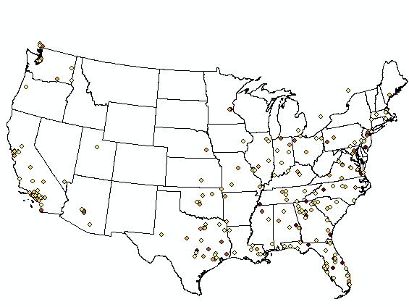
control for population
Map shows geographic distribution of all draftees 2000-2009
Map clearly resembles overall US population density map, with major population centers accounting for more data points

Slide 14
Control for population (cont.)
Prior research on talent distribution among pro athletes demonstrates that talent is not proportional to overall population at any given location
In particular players from smaller cities and towns are overrepresented in pro sports leagues relative to major urban population centers*
ArcGIS mapping tools will be used to create population-corrected visuals to determine overrepresentation effect among MLB draftees, for both the country overall and for warm-weather locations in particular
*MACDONALD, DJ; et al. Place but not Date of Birth Influences the Development and Emergence of Athletic Talent in American Football. Journal of Applied Sport Psychology. 21, 1, 80-90, Jan. 2009.

Slide 15
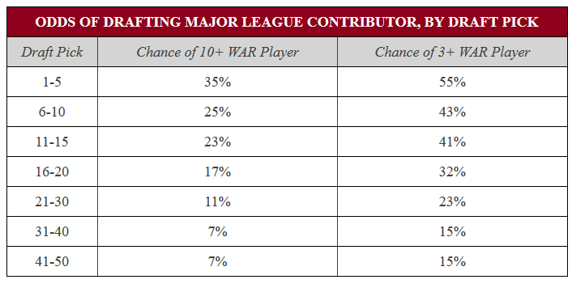
Measure of expected war from each draft position
Value of each draft slot indicated by expected WAR chart crated by baseball researchers who studied what a team can expect over the course of the draft process
Due to normal distribution of talent top of 1st round picks are vastly more valuable than subsequent picks

Slide 16
Chi square analysis
Chi square analysis will quantify differences between observed and expected talent distributions
Derived by summing the squared differences between observed and expected frequencies divided by each expected frequency
Derived value is compared to corresponding value that would be expected from normal distribution – if derived value is higher, null hypothesis can be rejected
Threshold used in this study will be at the 95% confidence level

Slide 17
Chi square analysis
Sample contingency tables from analysis of 1st round draftees 2000-2009
In this analysis chi-square statistic did not exceed the table value, and H0 could not be rejected
This small study divided climate types of draftee hometowns in to very basic Cold/Moderate/Warm “bins” based on avg winter temperature

Slide 18
Summary – conclusions from preliminary study
H0 cannot be rejected
10 draft years (2000-2009), first round picks ONLY
Chi square value to be exceeded 21.026 at p=0.05
Chi square value from study 8.38
Preliminary study (same year/round parameters) but limited to HS draftees only (n=189)
H0 cannot be rejected
12.11 chi square value still does not exceed 21.026 at p=0.05

Slide 19
Summary – pathway for full-scale study
Design 5 concrete climate categories logically consistent with climate and suitability for a baseball environment
Create Climate surface using NOAA data
Isolate high school hitter draftees from dataset
Assign data points into the 5 categories
Assign data points intro draft bins (e.g. round 1 picks 1-10..15-20, Round 2, Round 3 and so on)
Create expected vs observed contingency tables
Calculate chi square value and verify if null hypothesis can be rejected

Slide 20
Selected references
MACDONALD, DJ; et al. Place but not Date of Birth Influences the Development and Emergence of Athletic Talent in American Football. Journal of Applied Sport Psychology. 21, 1, 80-90, Jan. 2009.
Draft Index. (n.d.). Retrieved from Baseball-Reference.com: http://www.baseball-reference.com/draft/
Murphy, M. (2014, May 22). The Net Value of Draft Picks. Retrieved from The Hardball Times: http://www.hardballtimes.com/the-net-value-of-draft-picks/
NOAA National Centers for Environmental Information. (2016). Retrieved from 1981-2010 U.S. Climate Normals: https://www.ncdc.noaa.gov/data-access/land-based-station-data/land-based-datasets/climate-normals/1981-2010-normals-data

