Slide 1
Investigation of Hospital Entropy
Amanda Dulin
May 2014
Advisor: Dr. Stephen Matthews

Slide 2
Overview of Project
What is the impact on patient choice within a planning district for after a new hospital is opened
  Study of market entropy after the introduction of two new facilities
    In 2009 Stafford Hospital Opened
    In 2010 Spotsylvania Regional Medical Center Opened
Hospital composition
History of the area
Demographics
Methodology
Preliminary Analysis
Next steps and Analysis Plan

Slide 3
Context
Planning for healthcare resources is a complex process, including:
  demographic breakouts
  population growth
  changes in medical utilization
  market dynamics
  spatial determinants
Understanding what happened when a new entrant entered the market can help future planning efforts for expansion of services lines as well as de novo construction
The data that are available for research are limited by several factors:
  Only Inpatient data are at the patient level and able to provide market data
  Protections for patient privacy
This project provides a methodology for investigating the current state of services before and after new hospitals or services open

Slide 4
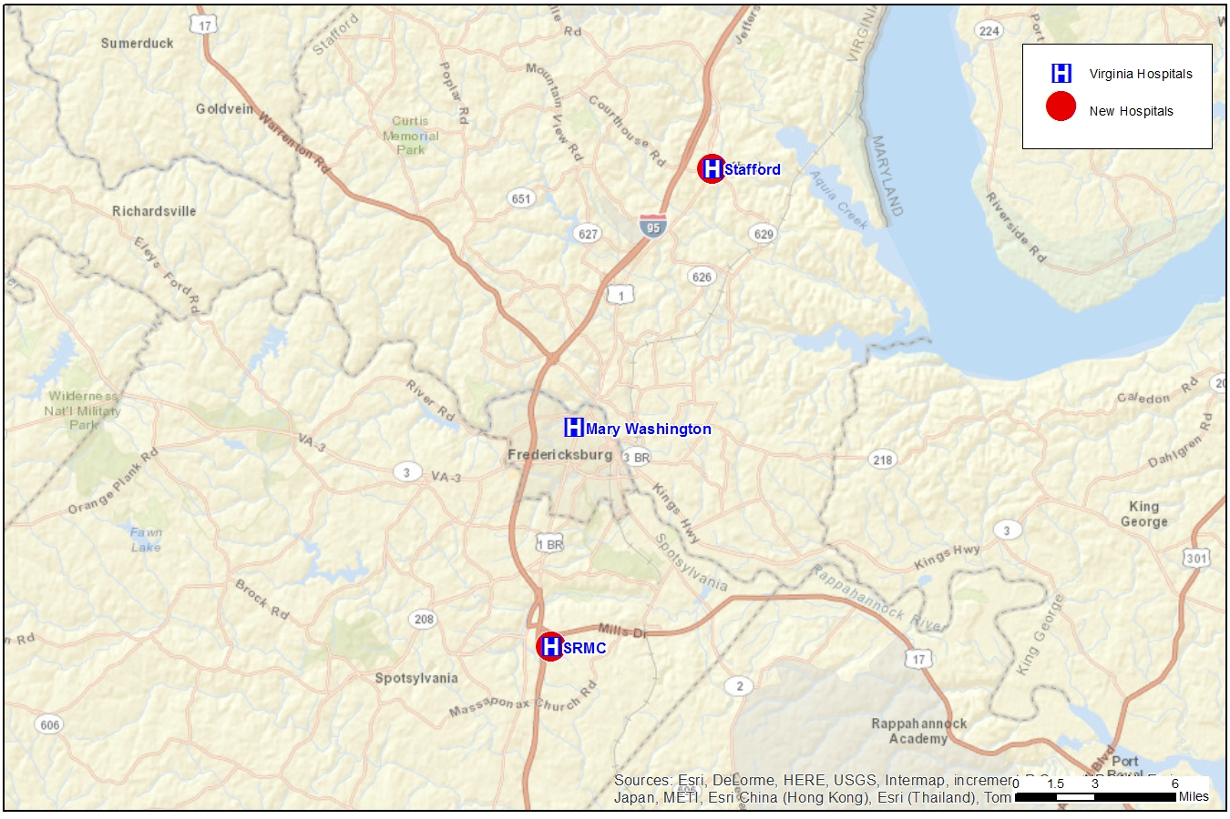
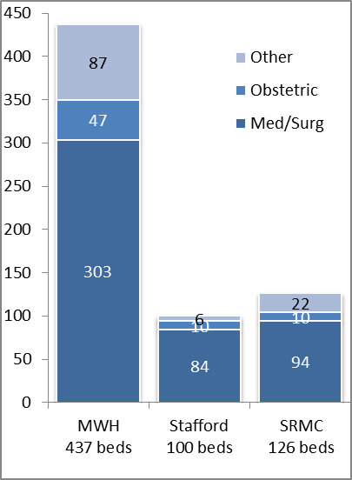
Healthcare resources in the area
All hospitals provide a full range of services, with Mary Washington having the most sophisticate offering of services
Stafford Hospital is part of the Mary Washington Health System. Opened 2009
Mary Washington had been the sole hospital provider in PD16.
SRMC is part of HCA. Opened 2010
Mary Washington is the largest hospital in the area by far

Slide 5
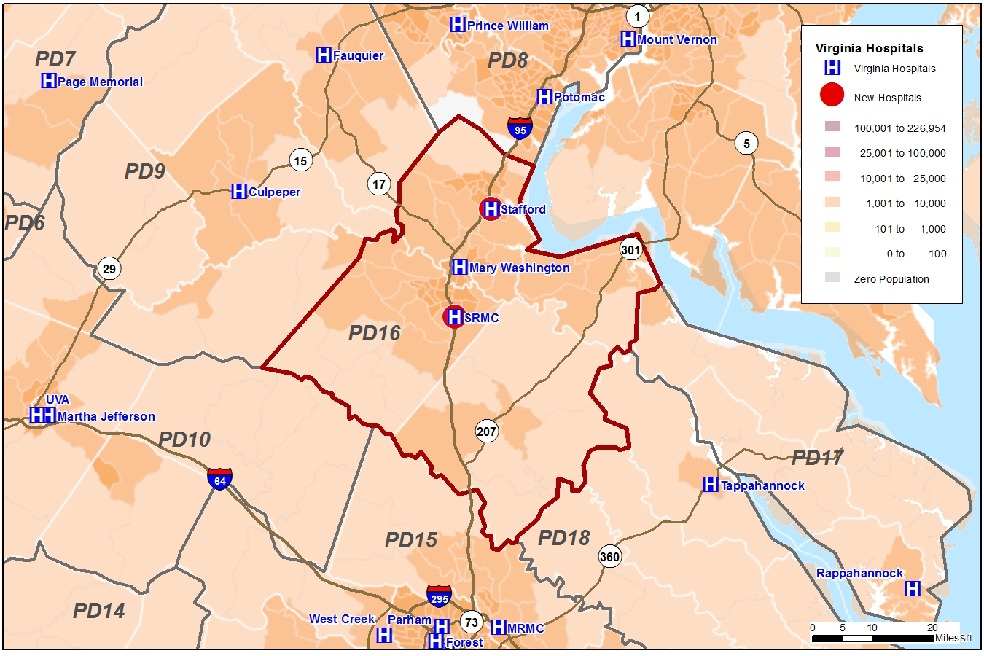
Lay of the land: Planning District 16
PD16 is directly south of Northern Virginia/DC metropolitan area and directly north of Richmond
PD16’s population has grown around the I-95 corridor, connecting Richmond to NoVA
Source: ESRI Public Use Files

Slide 6
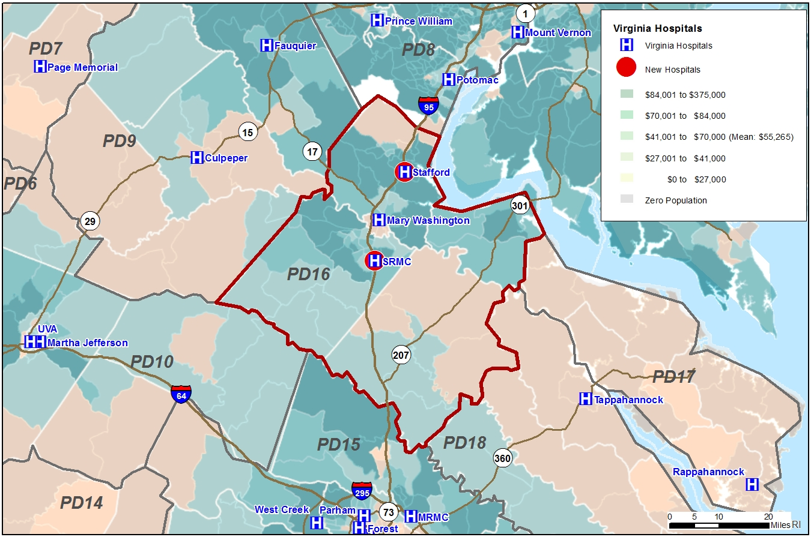
Population Growth
Growth is strong along the I-95 corridor, particularly in the Fredericksburg City surroundings
 |  |  | Area | USA
2013 Total Population |  |  | 333,038 | 314,461,156
2018 Total Population |  |  | 357,395 | 325,835,975
% Change 2013 - 2018 |  |  | 7.31% | 3.62%
2013 Average Household Income |  |  | $97,375 | $71,870
2018 Average Household Income |  |  | $114,707 | $83,625
2013 Median Household Income |  |  | $76,647 | $55,005
2013 Per Capita Household Income |  |  | $33,258 | $27,567
Source: ESRI Public Use Files

Slide 7
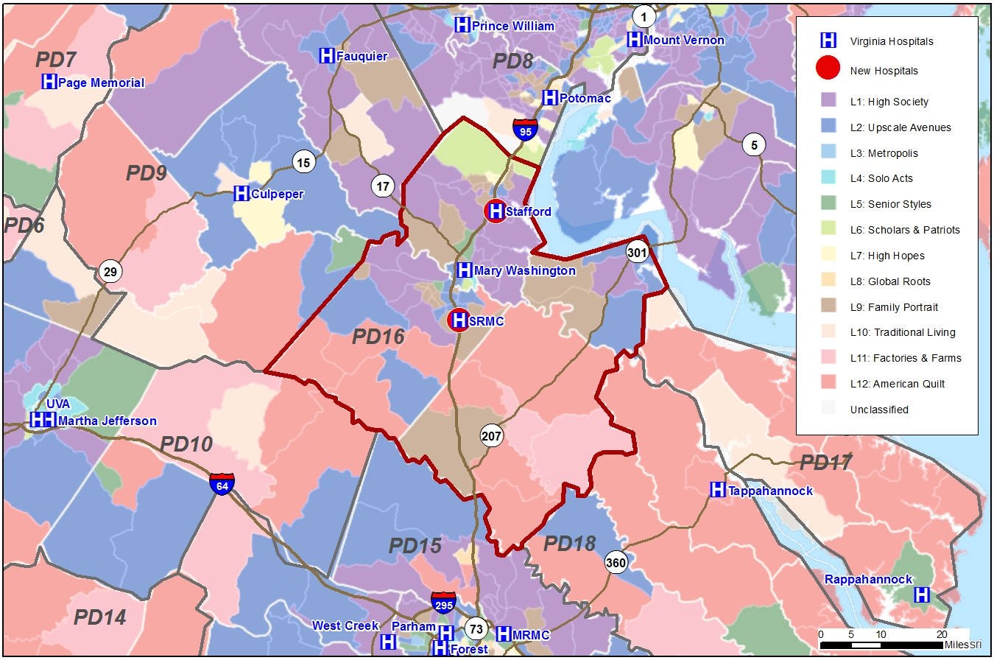
Tapestry
Much of the northern part of PD16 is in the single most affluent tapestry group, ‘High Society’: affluent, well-educated, married-couple homeowners.
The southern part is primary ‘American Quilt’: households in Small Towns and rural areas.
Source: ESRI Public Use Files

Slide 8
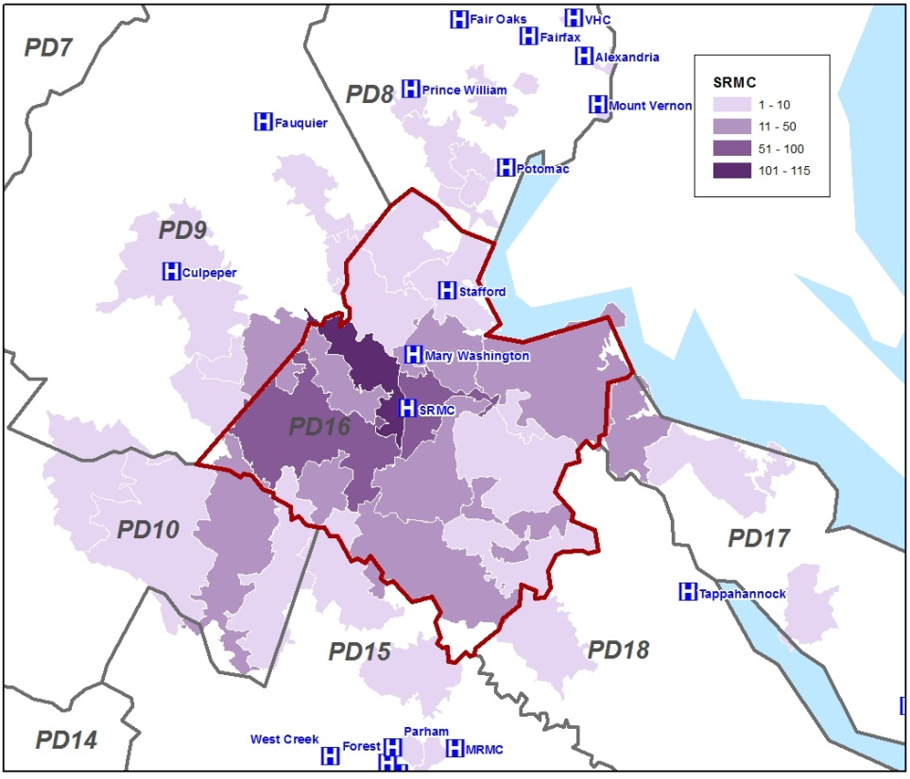
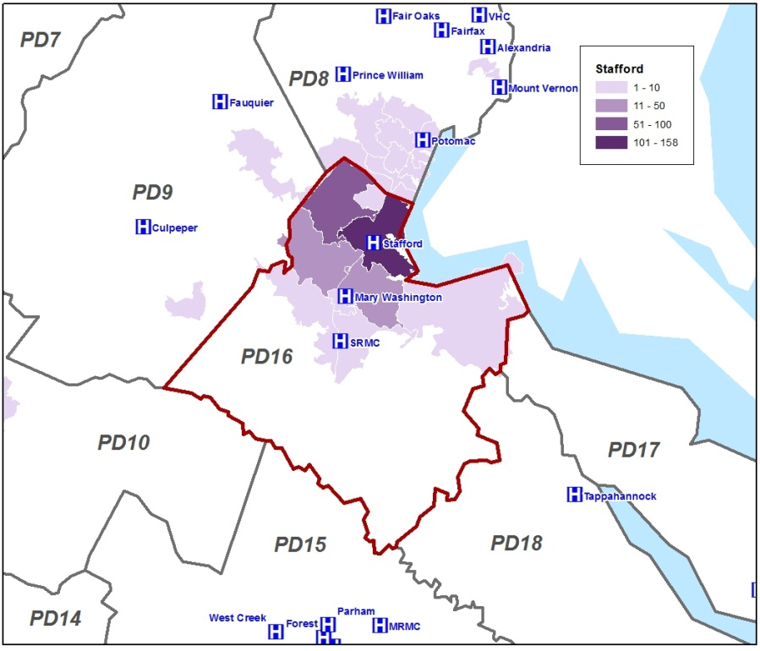
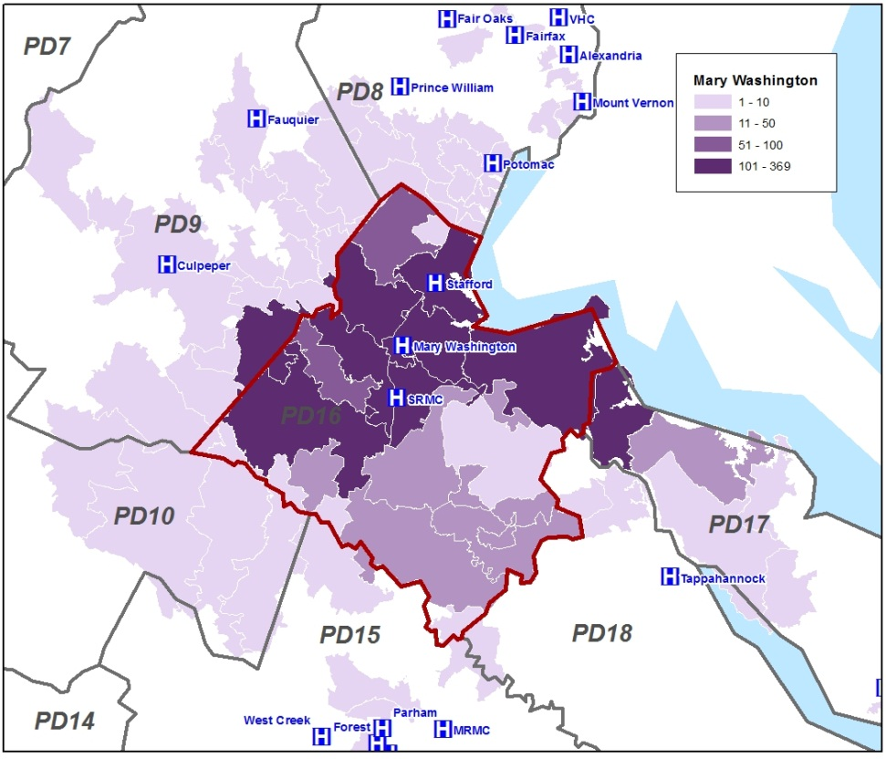
Service Areas RYE2013Q3
SRMC pulls from its home county, Spotsylvania, in greatest numbers
Stafford draws primarily from the northern part of the planning district
Mary Washington pulls primarily from the central part of the PD, but has a strong presence throughout PD16
Source: VHHA patient level data RYE2013Q3

Slide 9
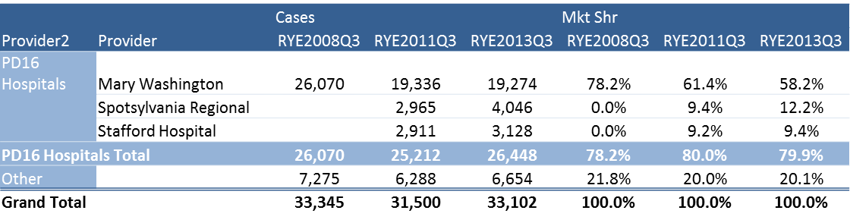
Market Share PD16: 2010 vs 2013
Changes in practice patterns have been primarily within the PD
Though migration out of the area declined slightly from 2008 to 2011, it leveled off
Source: VHHA patient level data, totals excluding NNB

Slide 10
Purpose and Data Limitations
This project provides a methodology for investigating the state of services before and after new hospitals or services open
Understanding the dynamics when a new entrant enters the market can help future planning efforts for expansion of services lines as well as de novo construction
The data that are available for research are limited by several factors:
  Protections for patient privacy
    Patient identifier is blinded
    Patient resident zip code only
  Only Inpatient data are at the patient level

Slide 11
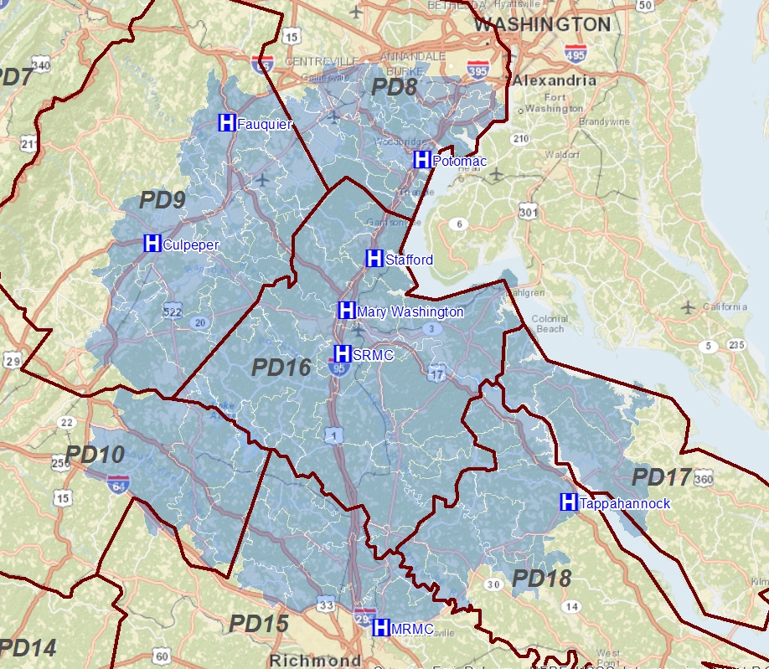
The Study area and Area Hospitals
8 hospitals in and around PD16 were used in the Entropy Calculation
The study area zip codes include all of Planning District 16 (PD16) as well as those zip codes in Virginia that ring the Planning District (PD)
There are 22 Planning Districts in Virginia, they divide the state into distinct population areas for planning purposes

Slide 12
Methodology
  Show how the introduction of two new hospitals impacted healthcare choice for area residents: Understand what is happening over time, by assessing the snapshot of spatial dynamics in given years
  2008: Before the hospitals opened
  2011: Immediate change
  2013: Current status
Service Line breakouts
  Total: all volumes across gender and age groups
  Cardiology: patients skew older (medical patients only, no surgeries)

Slide 13

Entropy Index
Calculation of an Entropy Score (Symbolized by E)
  Equal groups will produce a higher E score, where there is only one hospital provider the E score will be Zero
  The index is formally defined as follows:
    Where pr refers to group r’s proportion of the population in a geographic unit and n signifies the number of groups under consideration
Entropy Score Trend
  what areas have seen improvement in choice for patients since before the hospitals opened in 2008 to most recent year 2013
No Choice Perfect Choice
E Score = 0
only one provider has all the volumes from that zip code
E Score = 1
all providers have the same number of patients

Slide 14
Entropy Index:
Total Cases

Slide 15
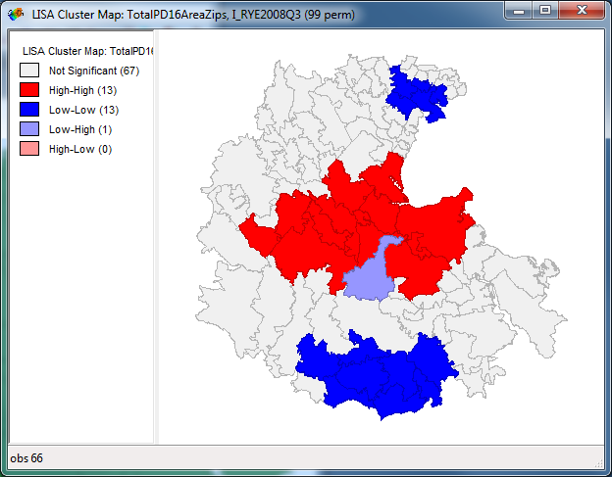
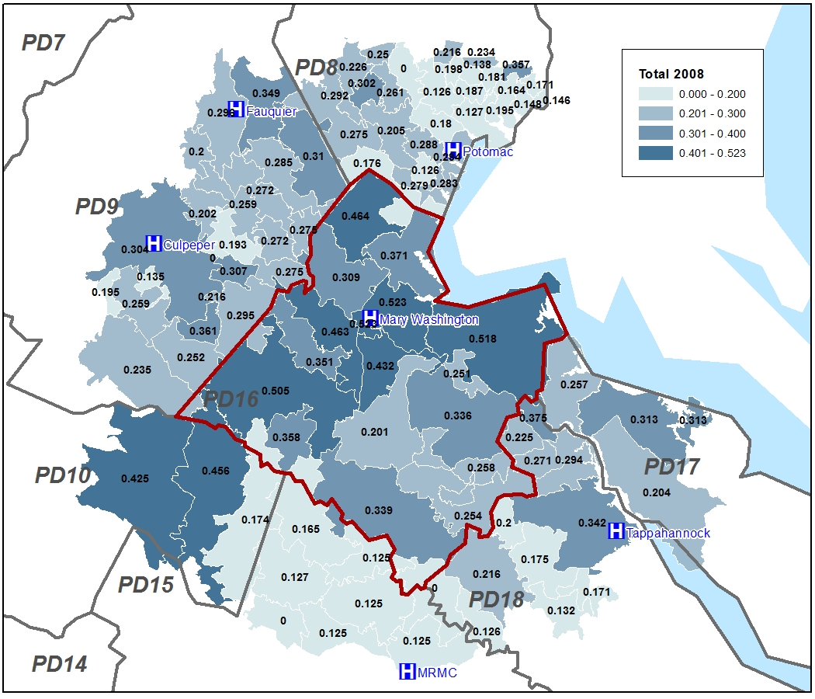
Total Cases Entropy: 2008
PD16 providers only - 8 area hospitals
Red area = choice
Dark Blue Area = alignment with fewer/one provider(s)
Source: VHHA Patient level data Cardiology; RYE2008Q3 – RYE2013Q3
0 = single provider >>>> 1 = equality

Slide 16
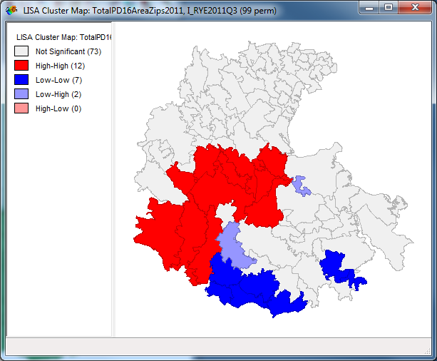
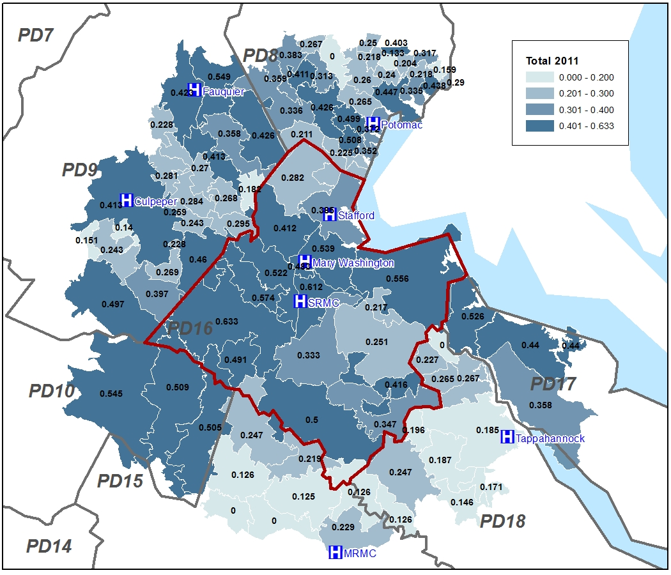
Total Cases Entropy: 2011
PD16 providers only - 8 area hospitals
Source: VHHA Patient level data Cardiology; RYE2008Q3 – RYE2013Q3
0 = single provider >>>> 1 = equality

Slide 17
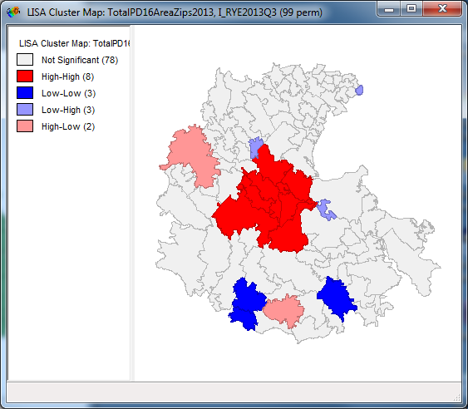
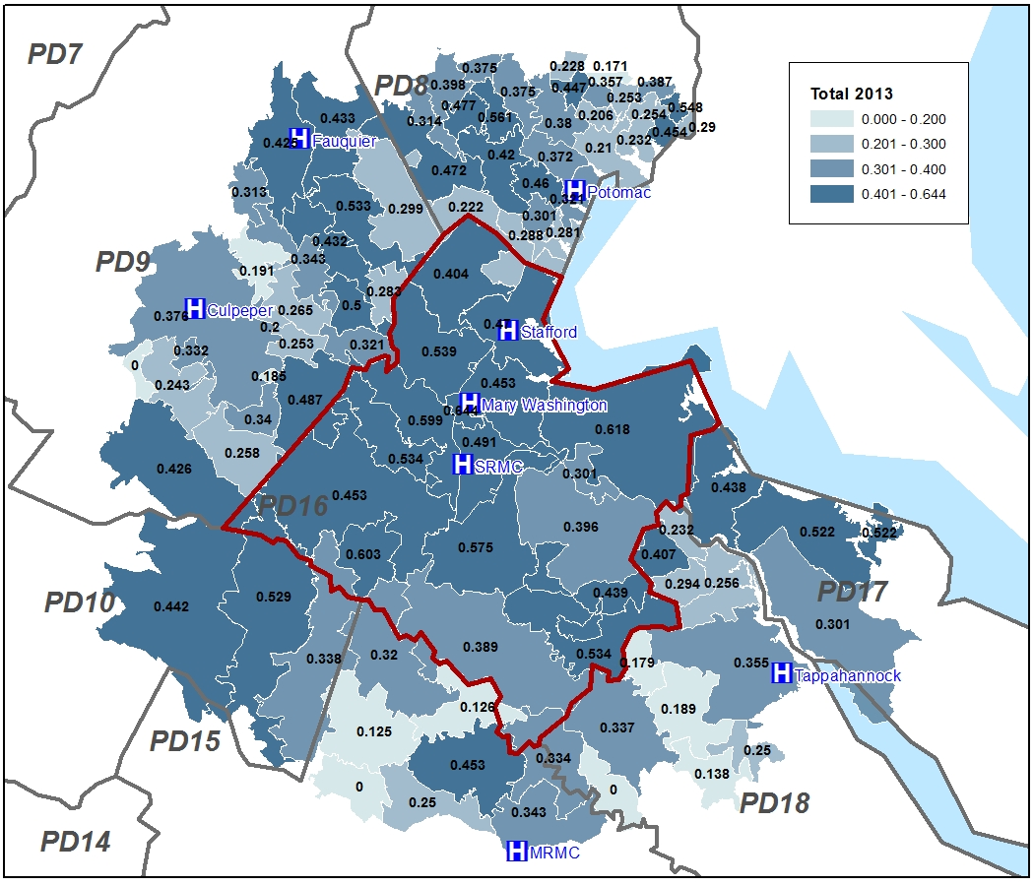
Total Cases Entropy: 2013
PD16 providers only - 8 area hospitals
Source: VHHA Patient level data Cardiology; RYE2008Q3 – RYE2013Q3
0 = single provider >>>> 1 = equality

Slide 18
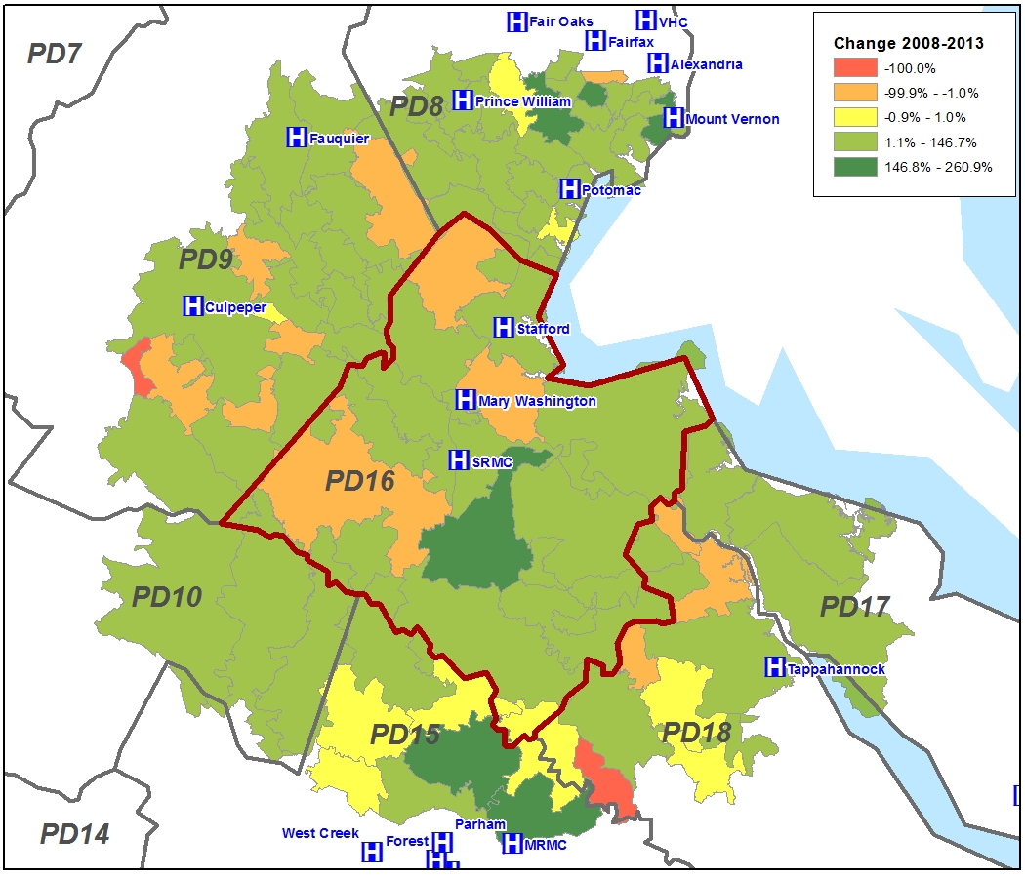
Total Cases Entropy Trend: 2008-2013
PD16 providers only - 8 area hospitals
The green areas have seen an increase in their Entropy score, showing increased choice in those areas since the introduction of the new facilities
Source: VHHA Patient level data Cardiology; RYE2008Q3 – RYE2013Q3

Slide 19
Entropy Index:
Cardiology

Slide 20
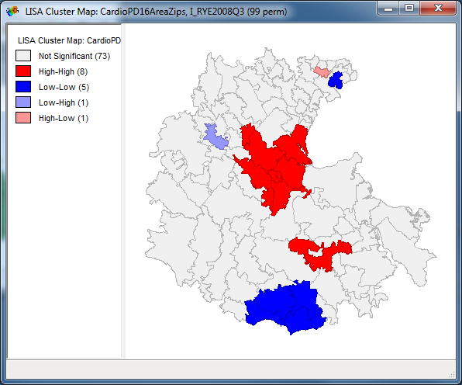
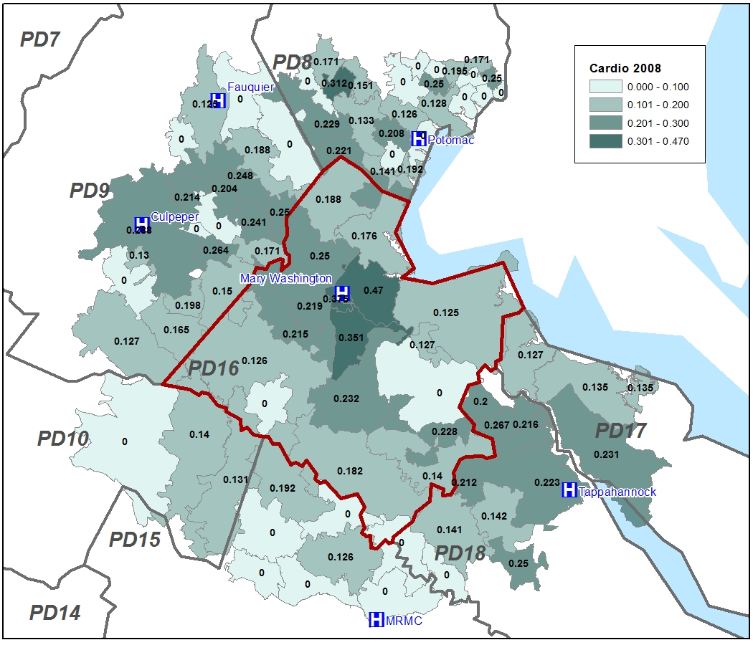
Cardio Cases Entropy: 2008
PD16 providers only - 8 area hospitals
Source: VHHA Patient level data Cardiology; RYE2008Q3 – RYE2013Q3
0 = single provider >>>> 1 = equality

Slide 21
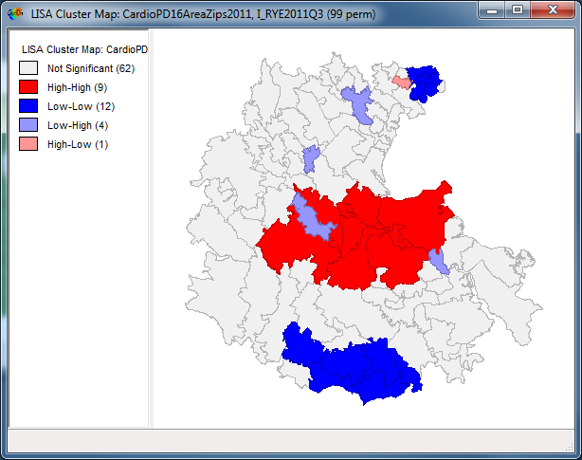
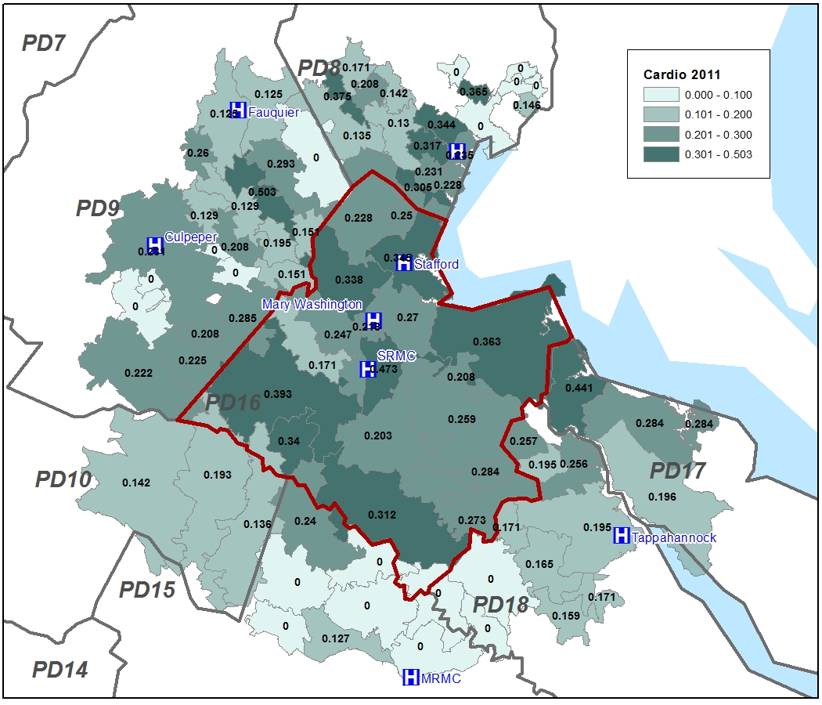
Cardio Cases Entropy: 2011
PD16 providers only - 8 area hospitals
Growing cardiology choice in PD16
Source: VHHA Patient level data Cardiology; RYE2008Q3 – RYE2013Q3
0 = single provider >>>> 1 = equality

Slide 22
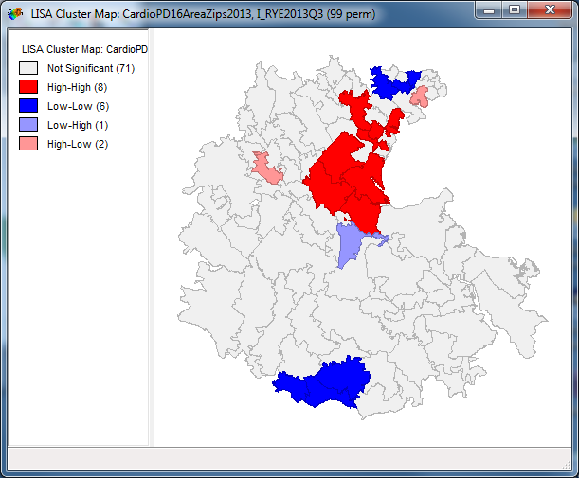
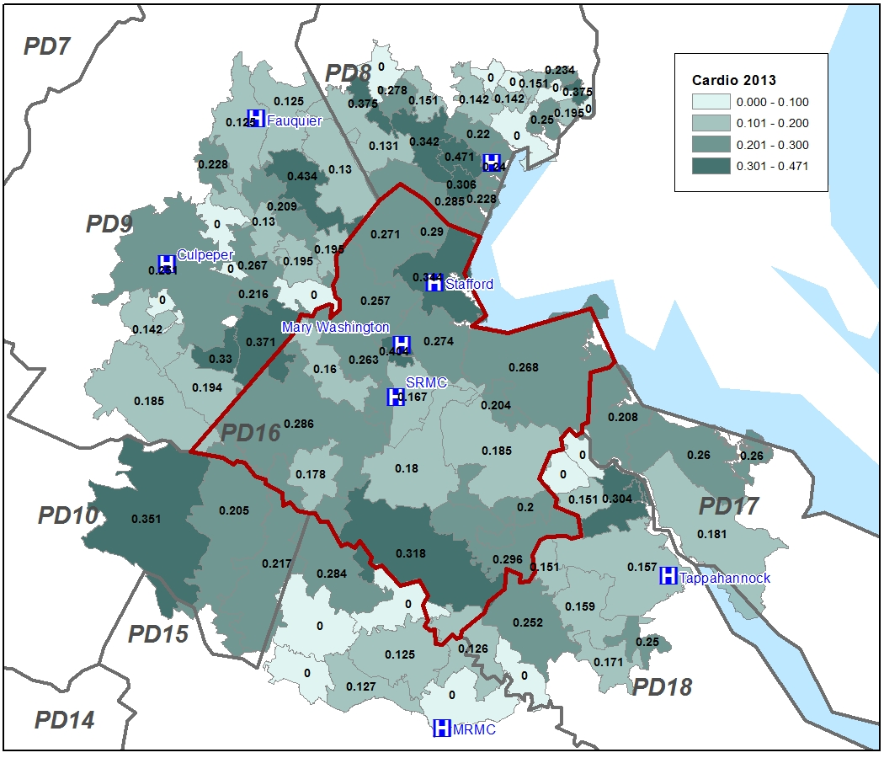
Cardio Cases Entropy: 2013
PD16 providers only - 8 area hospitals
At the heart of PD16, it appears that cardiology patients are realigning with fewer providers
Source: VHHA Patient level data Cardiology; RYE2008Q3 – RYE2013Q3
0 = single provider >>>> 1 = equality

Slide 23
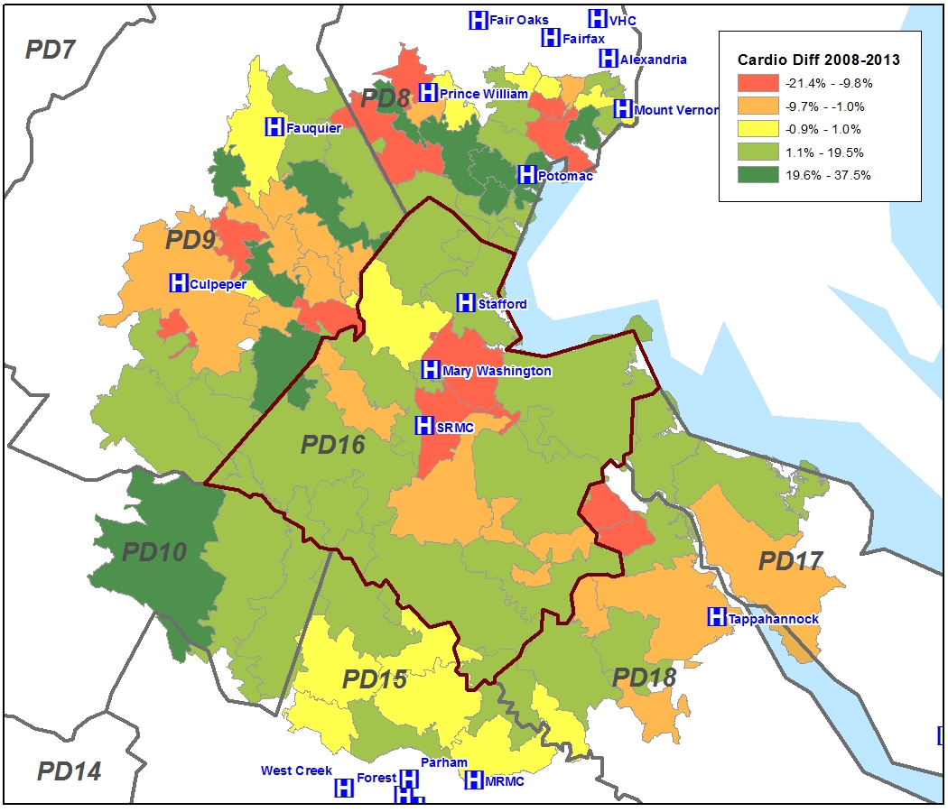
Cardiology Cases Entropy Trend: 2008 - 2013
PD16 providers only - 8 area hospitals
At the heart of PD16, cardiology services have aligned with fewer hospitals than in 2008
Source: VHHA Patient level data Cardiology; RYE2008Q3 – RYE2013Q3

Slide 24
Comparison of Total volumes to Cardiology
Overall patients are enjoying an increased in options for hospital services
The Cardiology environment is more varied, with patients aligning with local providers even though there is area choice

Slide 25
Preliminary Conclusions
As expected, Total IP hospital volumes showed a consistent increase in patients choosing multiple hospitals
  Entropy score rose as Stafford and SRMC ramped up their hospital services
In contrast, Cardiology proved to be more variable
  By 2013 the area around SRMC had become more aligned
  Small numbers
  IP cardiology volumes are trending down due to better medical management
  Ambulance squad preference and Emergency patients

Slide 26
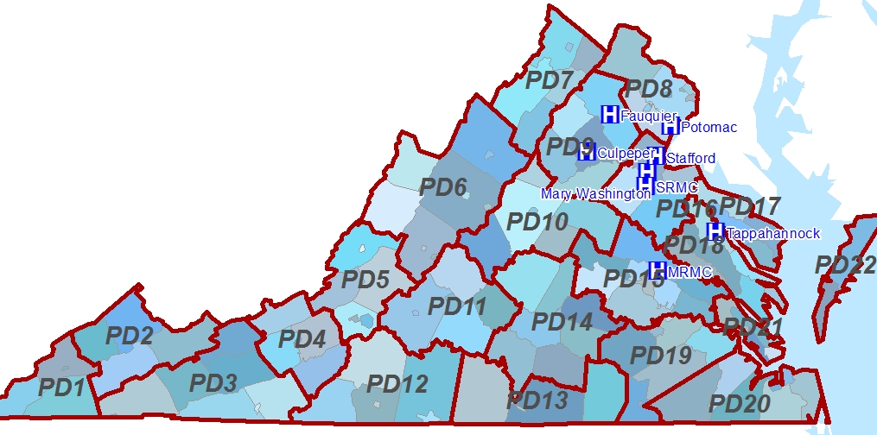
Next Steps
Refined analysis plan
Trade off: type of service vs. geography
  County Level Data for entire state
Service lines for final investigation
  Cardiology
  Obstetrics – Females 15-44
  Orthopedics
    Direct admits vs ED volumes
  Total volumes
    Payer mix analysis
Timeline
May – July: Analysis
Possible Conferences
  VAMLIS
  Annual Richmond GIS User Group meeting

Slide 27
Sources
Bibliography
  Cromley, E. (2002). GIS and Public Health. New York: Guilford Press.
  Kapur, E. a. (2009). Do Patients Bypass Rural Hospitals? Determinants of Inpatient Hospital Choice in Rural California. Econstor, 1-28.
  Matthews, S. A. (2011). Spatial Polygamy and the Heterogeneity of Place. In S. K. L Burton, Communities, Neighborhoods, and Health: Expanding the Boundaries of Place (pp. 35-55). New York, NY: Springer.
  McLafferty, S. (2003). GIS and Health Care. Annual Revue of Public Health, 25-42.
  Ventura, G. a. (2010). Barriers to GIS Use in Planning. American Planning Association, 172-183.
Data
  VHHA inpatient data by service line
  ESRI Public Use Files
Software
  ESRI 10.2
  GeoDa

