Slide 1
A Quantitative Analysis of the Bicycle Infrastructure of Portland, Maine
Christopher Dunn
Advisor: Dr. Alexander Klippel
GEOG 596A
12/16/2014

Slide 2
Introduction
Bicycling is a common mode of transportation for commuting, exercise, and recreation
There are many documented benefits to bicycling regularly
Safety is a major issue for lots of cyclists or potential cyclists
The importance of cycling has been addressed in federal laws and Maine State transportation policies
Notes:
Bicycling is becoming more and more common in cities as people move towards more sustainable lifestyles, and cycling is frequently used by many people as a way to commute, get exercise, or simply to get outside and explore.
There are multiple benefits including those to personal health and environmental sustainability
Despite the benefits, many people are concerned about safety when riding a bicycle and they can be deterred by the risk of getting into an accident, especially with a car
Not only has cycling become a more mainstream activity for the general public, but government guidance documents include cycling guidelines at both the Federal level and, at least in Maine, they have state-specific recommendations as well.

Slide 3
Federal Policy
United States Department of Transportation Policy Statement on Bicycle and Pedestrian Accommodation
  acknowledges importance of cycling as an alternative to driving a car;
  recommends transportation agencies “go beyond the minimum requirements” for incorporating bicycling into long-term planning; and
  recommends other entities, such as state and local governments and planning agencies, adopt similar policies.
Notes:
US DOT has a specific policy statement regarding cycling and pedestrians,
Basically they acknowledge that infrastructure specific to bicycles or pedestrians is equally important as infrastructure for vehicles, and they have minimum recommendations for design features to maximize bicycle and pedestrian safety
Not only that, but they recommend that munincipalities and transportation planners and agencies ‘go beyond the minimum requirements” as a way to ensure that long-term transportation demands can be met

Slide 4
Maine State Policy
Sensible Transportation Policy Act
  requires “an evaluation of a full range of alternatives” before expanding vehicle capacity; and
  incentivizes transportation planning that includes things like bikeways, ride sharing, and public transportation.
Portland Area Comprehensive Transportation System (PACTS) Regional Transportation Plan
  outlines the need for improved and expanded bicycle infrastructure to increase safety and sustainability.
Notes:
At the state level, Maine has the “Sensible Transportation Policy Act” which requires that all options (including things like improving bicycle infrastructure) be considered before a municipality simply improves their vehicle capacity with more lanes, wider lanes, higher speed limits, things like that
It also provides incentives for non-automobile based transportation planning
And at the local level the PACTS regional transportation plan is even more specific, calling for improved and expanded bicycle infrastructure for both safety concerns and for sustainability
Really, in both the Federal and State cases, the policies and recommendations are not just designed for safety, but are to actually help planners find ways to encourage people to use alternative means of transportation as a way to curb vehicle traffic growth and help deal with population grown in a sustainable manner.

Slide 5
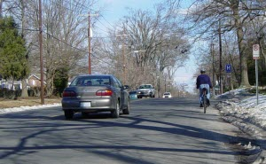
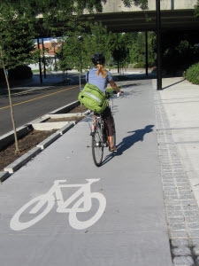
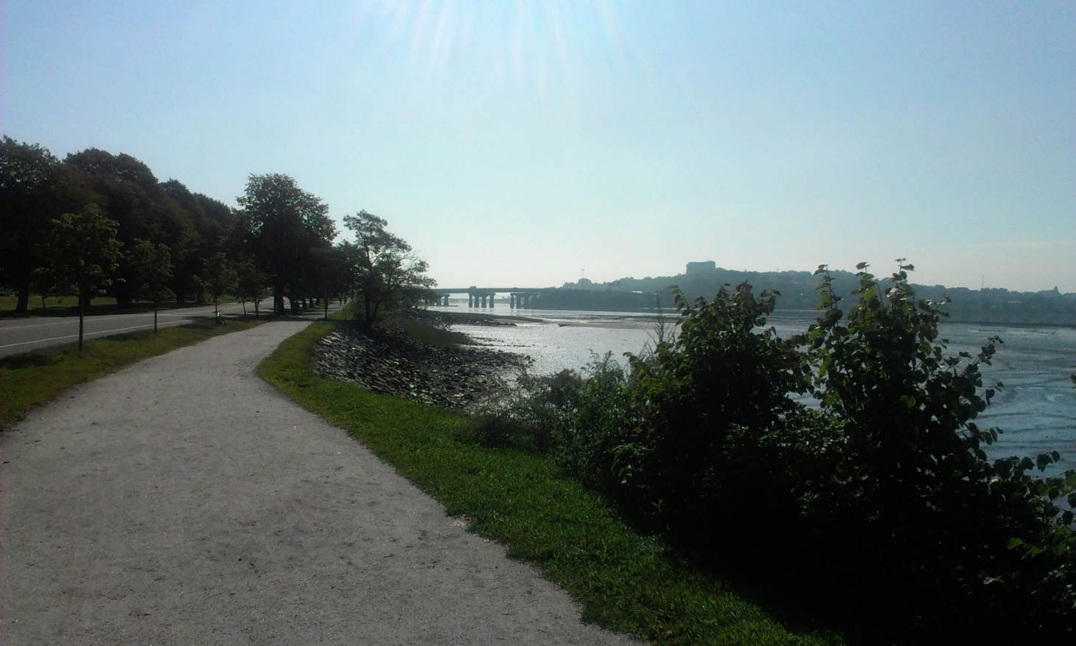
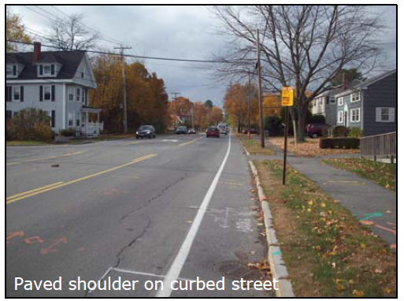
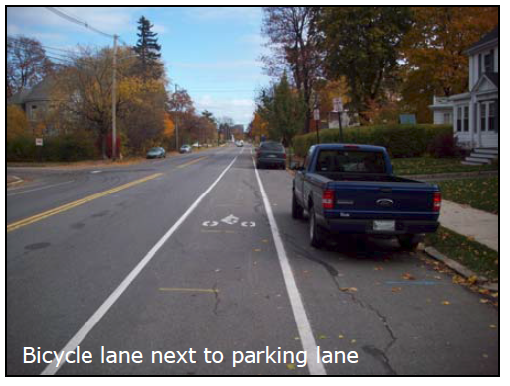
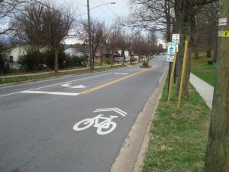
Bicycle Infrastructure
Notes:
Bicycle infrastructure consists of the physical characteristics of a roadway that are intended for use by cyclists as a way to better integrate them with automobile traffic.
Common types of bicycle infrastructure include:
Bike Lanes, which are probably what most people will think of when we talk about bicycle infrastructure. This is a delineated lane intended to be used only by cyclists, most people have probably seen something like this before and we’re all hopefully familiar with them
Paved shoulders, which are areas to the right of a vehicle lane
Shared lanes, frequently denoted by shared use arrows, or “sharrows”. These tend to be used in situations where the road is too narrow for a paved shoulder or a bike lane, and they are frequently accompanied by “share the road” signs or something similar to remind drivers that cyclists have the right to use the entire lane
Mixed-Use Paths – physically separated from the road, provide alternate routes for pedestrians and cyclists. This is a very popular path in Portland called the Back Cove trail which connects many dense residential areas with multiple routes to the downtown area while avoiding major arterials.
Bike Boulevard – slower, smaller, local streets where cycling is encouraged as a way to avoid more dangerous roads. Roads with low amounts of traffic and low speed limits can be given additional signage to indicate that they are ideal bike boulevards
Cycle Track – A bicycle-only lane that is physically separated from the road. They tend to be highly favored by cyclists, and we do not have any in Portland.

Slide 6
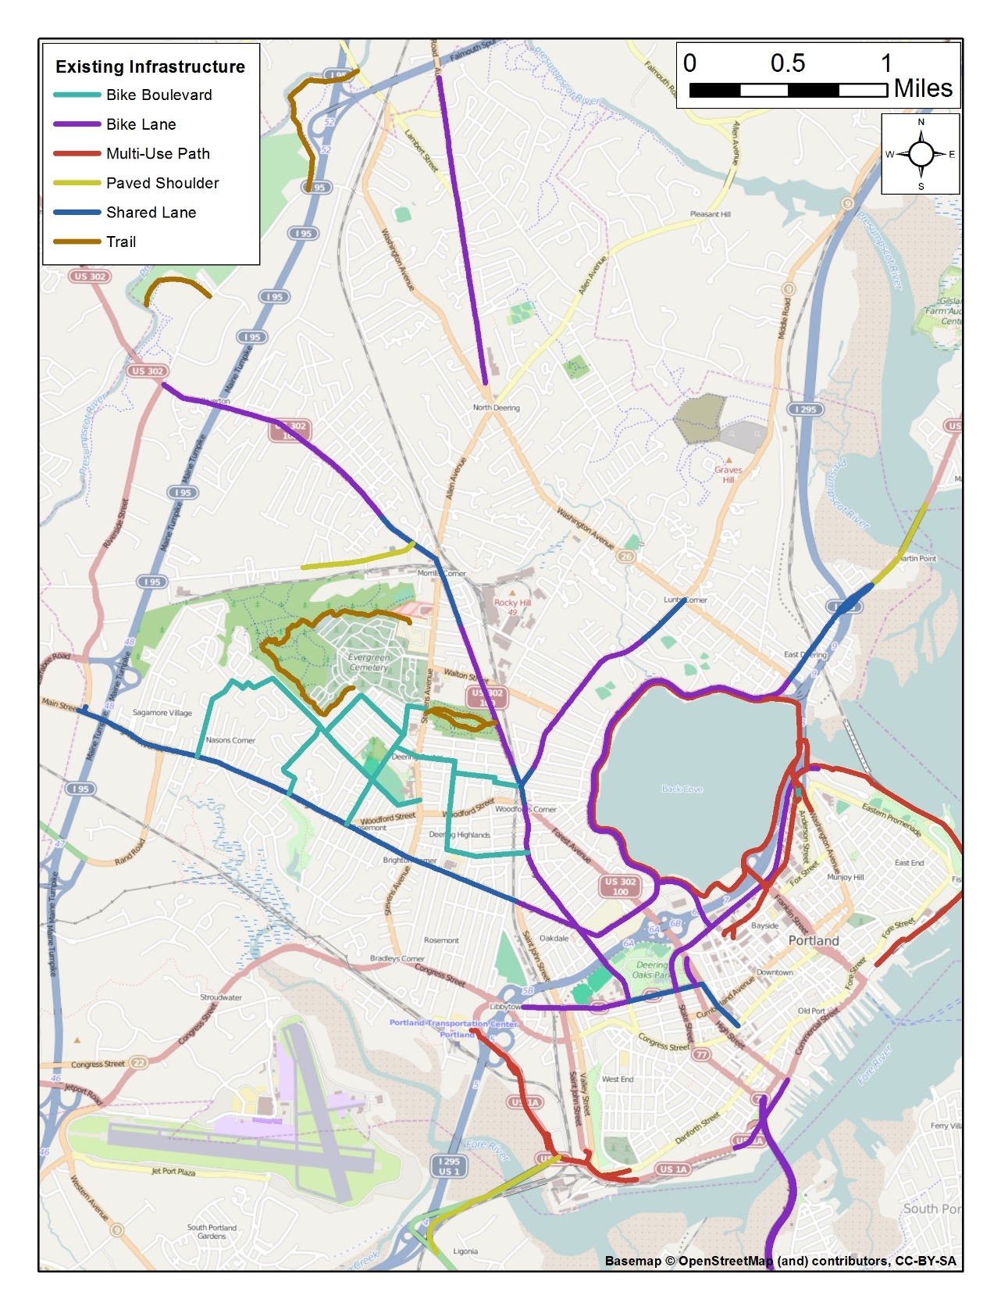
Portland
Bicycle
Infrastructure
Notes:
This is shows the bicycle infrastructure as it currently stands, with bike lanes and sharrows on two of the major arterials and some multi-use paths around the back cove which I showed a picture of earlier and eastern promenade which are popular scenic paths.

Slide 7
Benefits of Cycling
Health and fitness
  Cardiovascular health
  Reduced rates of obesity, diabetes, and related ailments
Financial
  Save money on gas and vehicle maintenance
Sustainability
  Reduce air pollution, congestion, consumption of fossil fuels
Estimated benefits of cycling are “substantially larger” than the associated risks (de Hartog et al. 2010)
Notes:
There are many document benefits of cycling. The personal health and fitness benefits are the most obvious. Cycling can burn a lot of calories and regular exercise helps with cardiovascular health and can greatly reduce rates of obesity and related ailments like diabetes.
If you cycle as an alternative to using your car, such as for commuting or to run errands, then you can save money on gas and car maintenance, or depending on where you live possible give up owning a car altogether.
From an environmental sustainability standpoint, choosing a bicycle over a car will reduce air and noise pollution, lessen the consumption of fossil fuels
One study analyzed the various benefits and risks of cycling and found that the benefits are “substantially larger” than the associated risks.

Slide 8
What are the risks?
Personal injury
  Vehicle/cyclist accidents
  Cyclist/infrastructure accidents
  Cyclist/pedestrian accidents
Exposure to air pollution
  Fine particulate matter is the primary pollutant of concern
  According to the United States Environmental Protection Agency (USEPA), particulate pollution is linked to respiratory problems (asthma, bronchitis, persistent cough), irregular heartbeat, decreased lung function, increased irregular heartbeat
Notes:
So what are the risks?
The first thing to most people’s mind is probably the risk of personal injury due to a crash. That could be with a vehicle, but also with pedestrians, other cyclists, or a stationary object like a fire hydrant or signpost.
While there are health benefits, there are also health risks. Increased exposure to air pollution is a major one, especially fine particulates emitted by automobiles. Particulates are linked to respiratory problems like asthma, and other conditions of the heart and lungs
One study actually found that car drivers are exposed to higher concentrations of particulates, but increased respiration during cycling causes cyclists to inhale more air so the lungs absorb more particulates than if you are driving a car. Presumably the problem of air pollution would be lessened as more and more people choose walking or biking.
Despite these risks, the health benefits of cycling alone have been found to have a net positive benefit to personal health, with additional societal and sustainability benefits on top of that.

Slide 9
Bicycle Use
Buehler and Pucher, 2012
Notes:
Despite the benefits outweighing the risks, cycling rates in the US are very low compared to many other developed countries, especially European countries
Even with the much higher per capita ridership in the Netherlands, fatal accident rates are very similar between the US and the Netherlands, roughly 2 per 100,000. There are many factors that could contribute to this, from infrastructure to public opinion to policy, but what is very clear to me is that the US has a lot of room to increase ridership numbers.

Slide 10
Bicycle Use
The
Netherlands
Denmark
Germany
France
UK
USA
Buehler and Pucher, 2012
Notes:
Despite the benefits outweighing the risks, cycling rates in the US are very low compared to many other developed countries, especially European countries
Even with the much higher per capita ridership in the Netherlands, fatal accident rates are very similar between the US and the Netherlands, roughly 2 per 100,000. There are many factors that could contribute to this, from infrastructure to public opinion to policy, but what is very clear to me is that the US has a lot of room to increase ridership numbers.

Slide 11
Existing Studies
Two key studies relating to bicycle safety:
  Safety in numbers: more walkers and bicyclists, safer walking and bicycling by PL Jacobson. 2003.
  Route Infrastructure and the Risk of Injuries to Bicyclists: A Case-Crossover Study by K Teschke. 2012.
Notes:
In researching this project I was steered towards two key studies that are frequently cited in the world of bicycle research and advocacy.
Safety in numbers: more walkers and bicyclists, safer walking and bicycling by PL Jacobson
And
Route Infrastructure and the Risk of Injuries to Bicyclists: A Case-Crossover Study by K Teschke
These studies are important because they delved into

Slide 12
Jacobson Study
Investigated the nature of the relationship between the number of pedestrians and cyclists and the accident rate for vehicles and nonvehicular traffic
Compared multiple data sets (some population level and some time series)
Discovered a strong inverse relationship between the number of people walking and biking and the accidents involving motorists
In other words – if more people are walking or cycling in an area, it is less likely that they will be injured by motorists and the safer it will be for pedestrians and cyclists.
Notes:
Looked at the relationship between the number of pedestrians and cyclists and the rate of accidents involving cars and non-vehicles
They had several datasets for multiple countries,
And they wanted to find out if increased bicycle and pedestrian traffic resulted in more accidents involving cars and non-cars and
what they actually found was a strong inverse relationship, meaning that as the amount of pedestrians and bicyclists relative to automobile traffic increased, the number of accidents actually went down.
In other words, if more people are walking or cycling in an area, it is less likely that they will be injured by a motorist and the safer it will be for pedestrians and cyclists.
Which is a pretty important conclusion for the world of cycling

Slide 13
Teschke Study
Compared cycling injury risks of 14 types of bicycle infrastructure
Surveyed 690 residents injured while cycling
Compared routes where injuries occurred to randomly selected alternate routes as a control
Calculated relative risk of each type of cycling infrastructure using regression analysis
Notes:
Now, the Teschke study interviewed 690 people who had been injured while cycling to determine the injury risk associated with

Slide 14
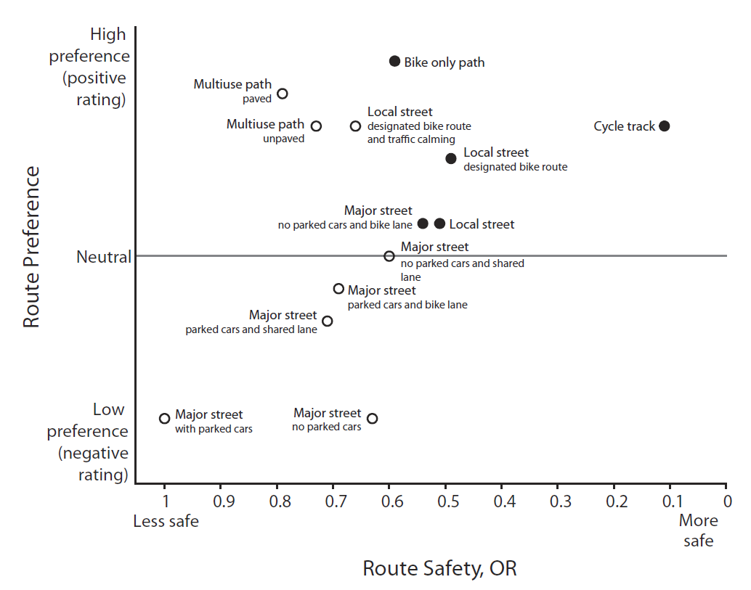
Figure 1, Teschke (2012)
Notes:
This figure from the Teschke study shows the risk associated with each type of bicycle infrastructure and pairs it with route preferences determined in a separate study, highlighting the infrastructure types that are viewed favorably and that are considered more safe based on the Teschke results.
Here you can see Cycle Track being the clear choice for increased safety and for favorability, which would presumably lead to increased ridership, though it is also probably one of the more expensive to create and difficult to work into existing street layouts because it needs to be completely separate from the road.

Slide 15
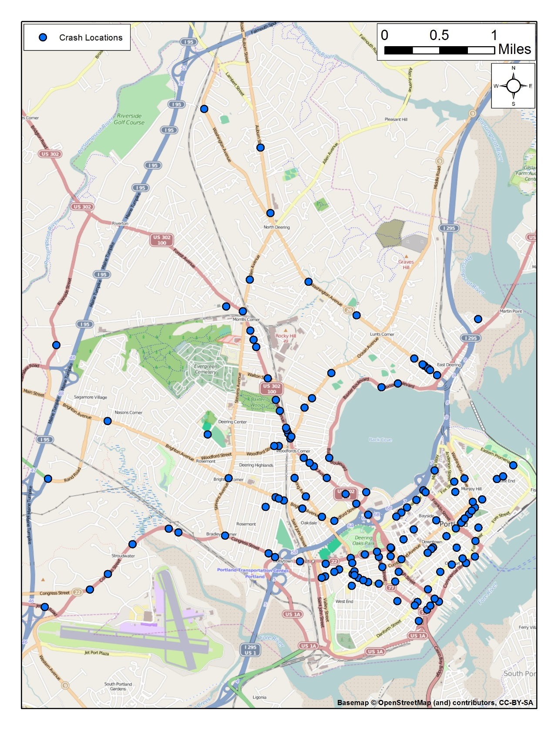
Bike Crash
Locations
2011-2013
n = 155
Notes:
So let’s take a look at what I have for data for my study.
Here are the locations I currently have for bicycle accidents in Portland. I am currently hunting for more data and have requests in at the Portland Police Department and the Maine Department of Transportation. I’m hoping to have a more robust dataset to work with before actually running the analysis.
In order to start developing and understanding of what may be a driving factor in Portland’s crashes I looked at the different attributes that came with the crash data, which includes…

Slide 16
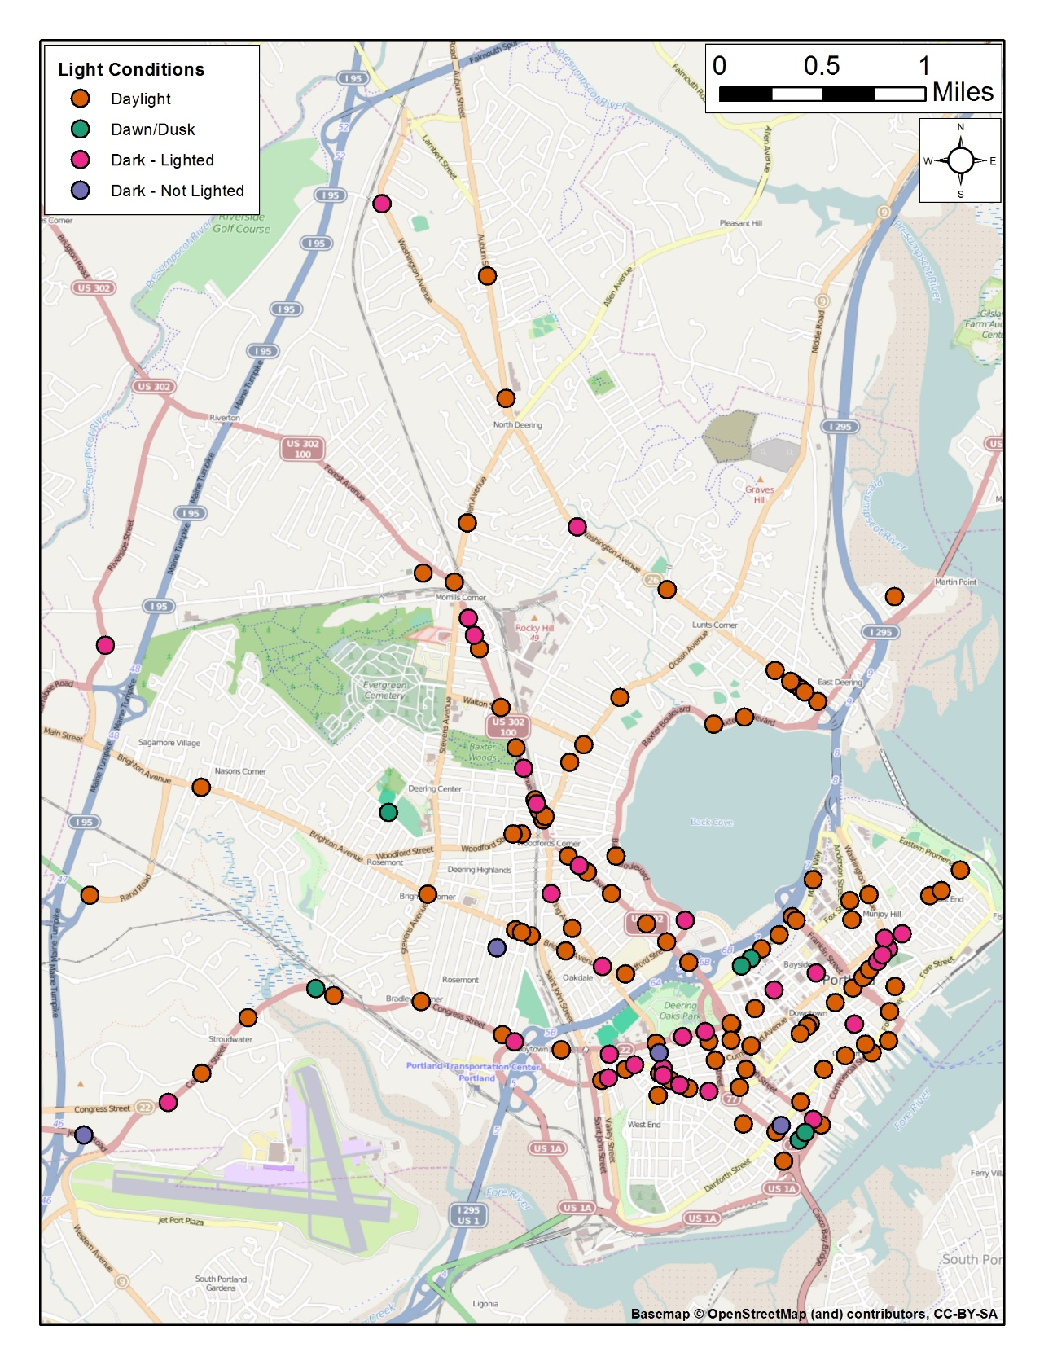
Time of
Day

Slide 17
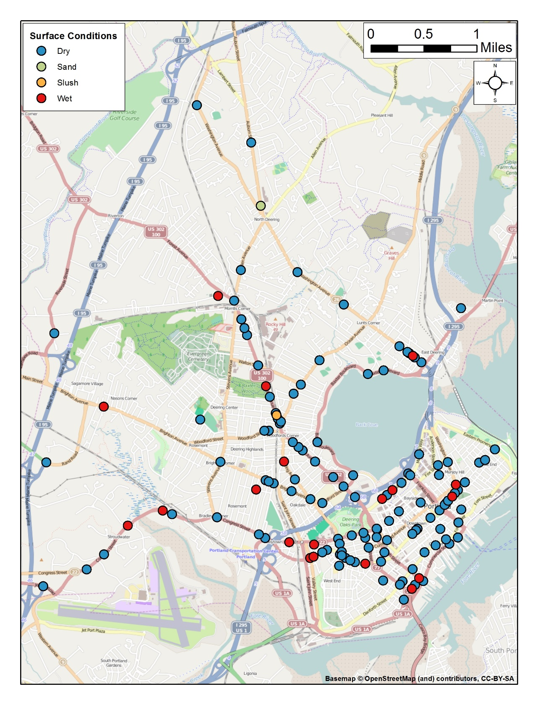
Road
Conditions

Slide 18
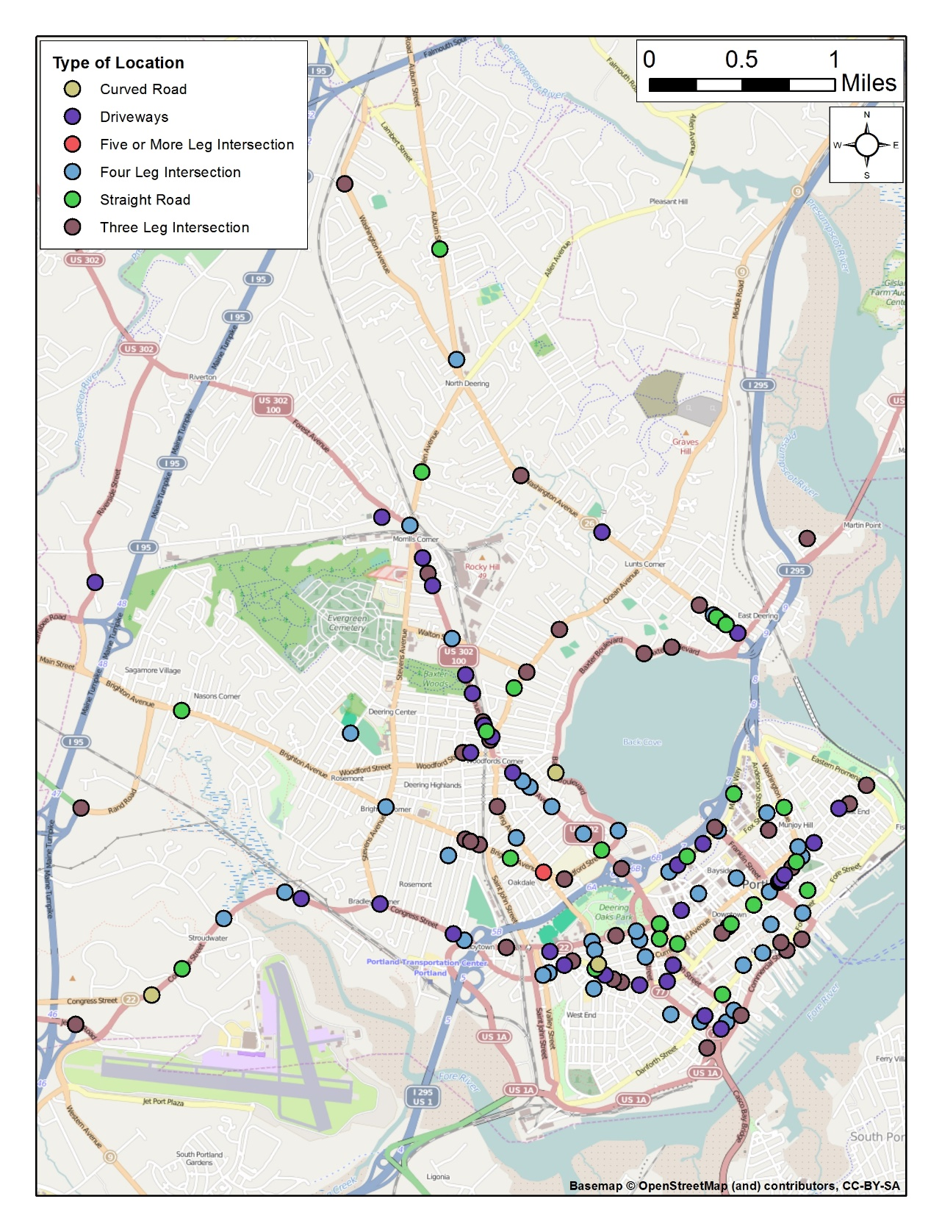
Road/
Intersection
Type

Slide 19
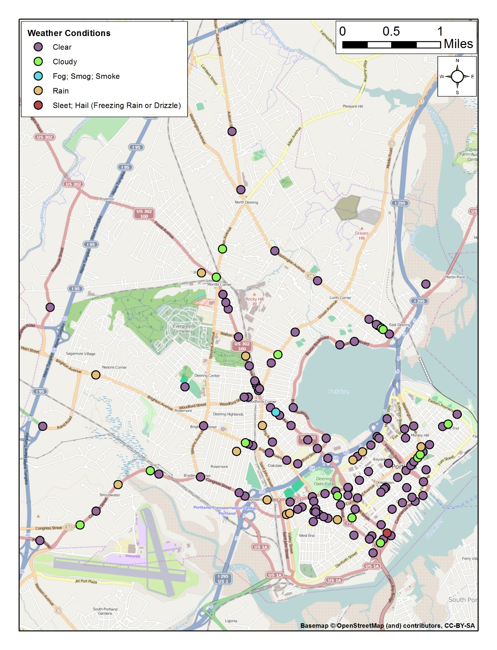
Weather

Slide 20
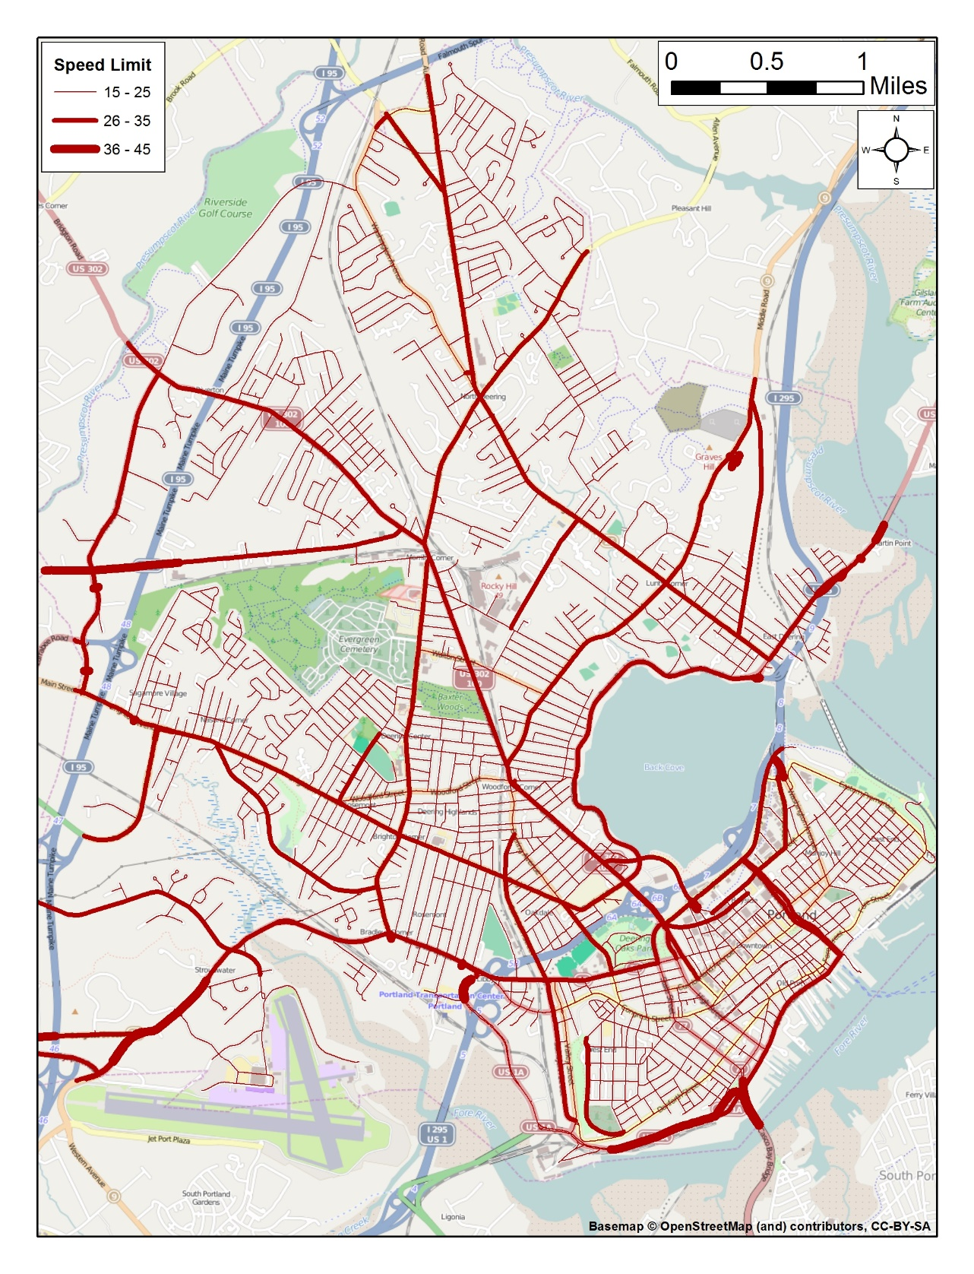
Speed Limits
Notes:
I also have quantitative data associated with each road segment that could be incorporated into the analysis, such as the speed limits depicted here.

Slide 21
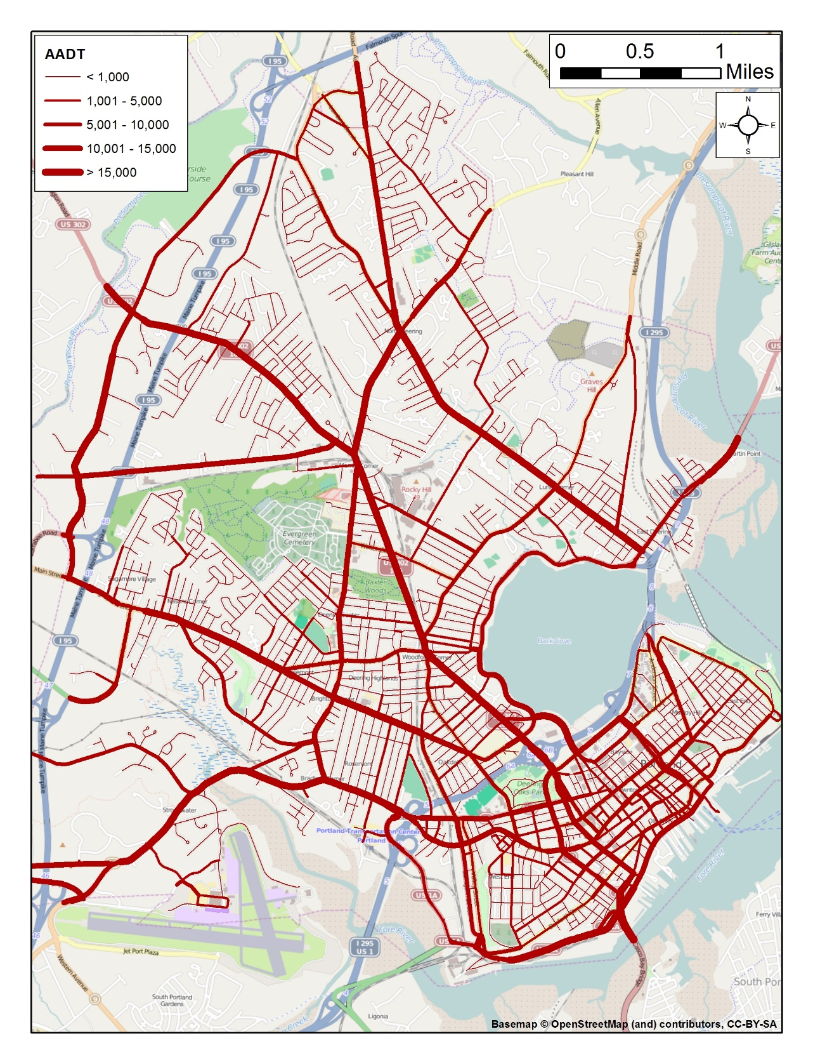
Average
Annual
Daily Traffic

Slide 22
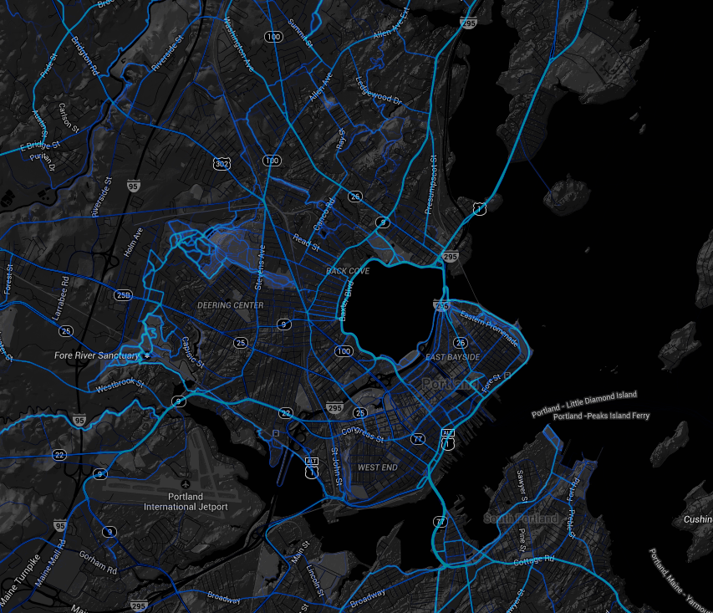
Additional Data
Accident data – more years
Bicycle counts
  Not readily available
  Two automated stations count bikes along Back Cove
  Sporadic data available from the Greater Portland Council of Governments (GPCOG)
  GPCOG is intending to purchase ridership data from Strava.com in January
Calculated data
  Distance to intersection, accident density, population density
Notes:
As I mentioned earlier, I am still on the hunt for more data.
There is more crash data available that I am hoping to acquire very soon.
Along with that, an important piece of the puzzle is ridership data. Having bicycle counts will let us compare the number of cyclists relative to the number of cars which will add some depth to the analysis.
There are two stations that automatically count bicycles along Back Cove, though I haven’t been able to get my hands on the numbers yet.
The Greater Portland Council of Governments has some counts as well, but they are in very few locations and were taken on sporadic days over a few years so those data may not end up being very helpful.
Strava is a company with an app that many cyclists use to plot their routes and they have data available for purchase, and the greater Portland council of governments is intending to buy a dataset from them in January which they have indicated they will share with me, so here’s hoping they follow through on both accounts.
There are also some potential variables that could be calculated from the available data, such as distance to intersections, accident density, or population density

Slide 23
Potential Analysis
Visual analytics
  Hotspots/heatmap
Nonparametric
  Chi-squared
Regression analysis using quantitative factors
Notes:
There are a few different ways I can analyze the data, starting with simple visualizations looking for spatial patterns like hotspot or heatmap analysis
I can also use statistical methods such as the chi-squared test to look for dependence using the qualitative variables such as the time of day, road conditions, and of course the bicycle infrastructure
There is also the possibility of using the quantitative variables such as speed limit, average annual daily traffic, or calculated metrics like crash density for each road segment, as part of a linear regression model.

Slide 24
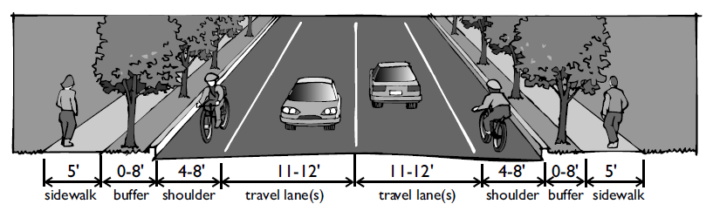
Anticipated Results
Better understanding of factors contributing to safety for bicyclists in Portland
Notes:
The image is from the sensible transportation handbook, showing a potential design for a quiet street with ample bike and pedestrian accomodations

Slide 25
Beyond the final project
Make recommendations for steps that could increase the safety of the current bicycle infrastructure
Assess the safety of the proposed bicycle infrastructure

Slide 26
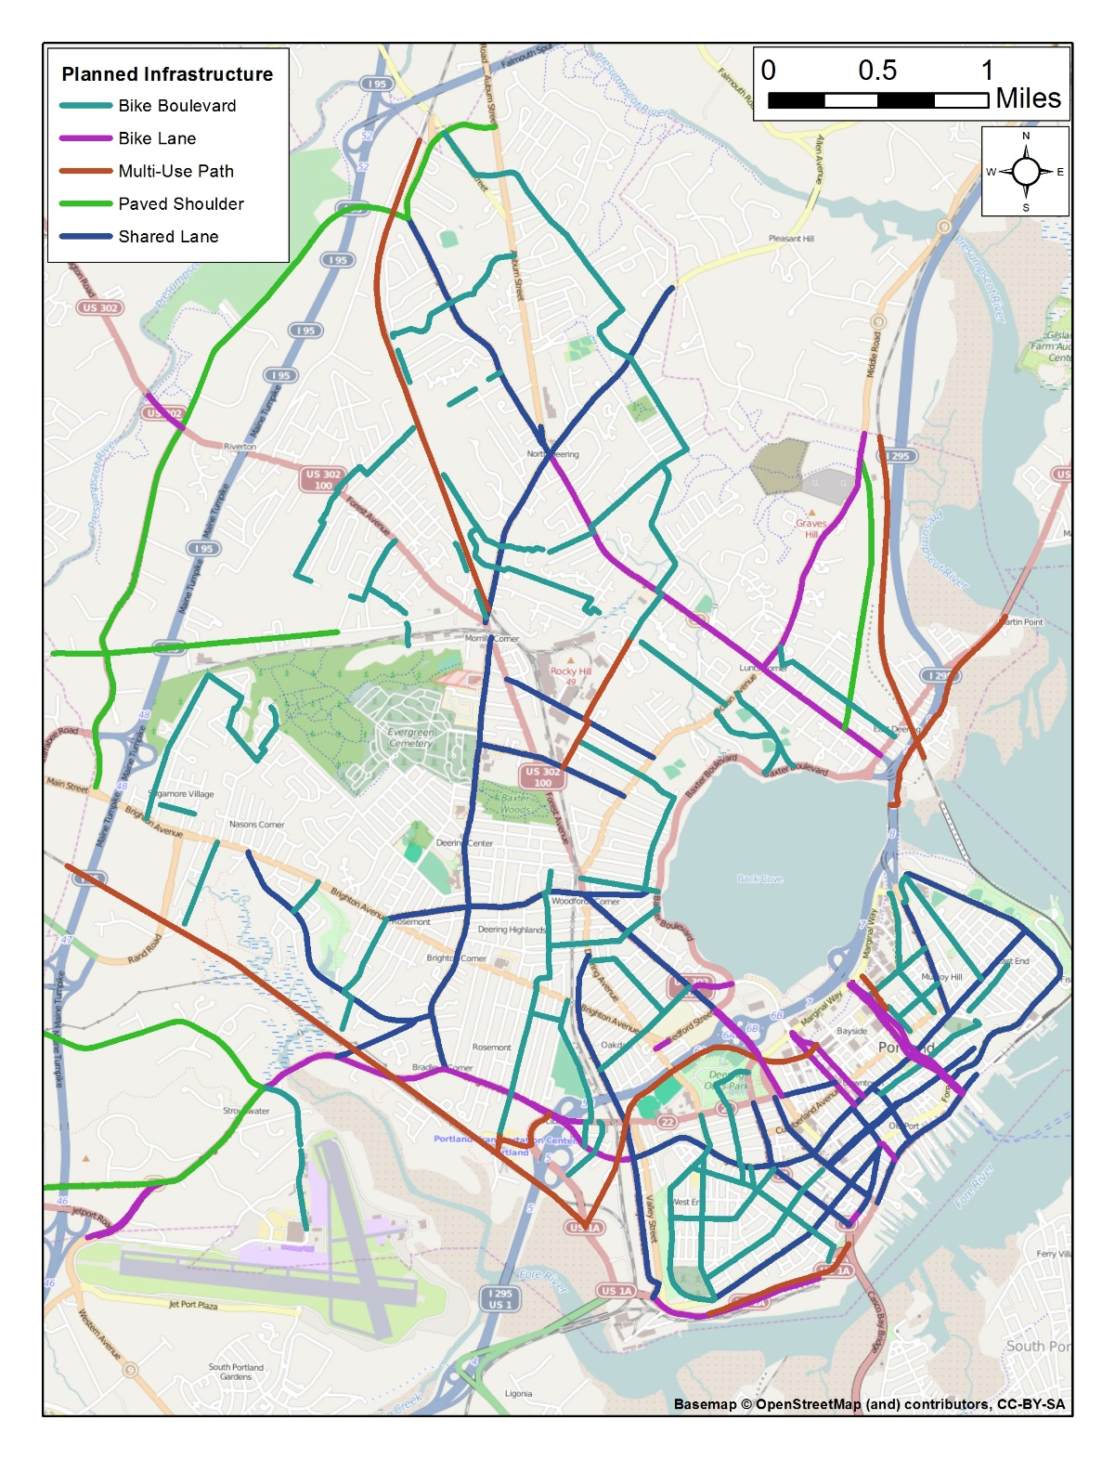
Notes:
And here is the planned bicycle infrastructure, the data were provided by the City of Portland and was prepared as part of the PACTS regional transportation plan

Slide 27
Timeline
December 2014/January 2015 – continue to gather and assess data
February/March 2015 – conduct analysis and summarize results
April 2015 – present at the American Association of Geographers conference in Chicago, IL

Slide 28
References
Buhler, R. and Pucher, J. 2012. Walking and Cycling in Western Europe and the United States: Trends, Policies, and Lessons. TR News. Vol 280. pp 34-42.
De Hartog, J.J., Boogaard, H., Nijland, H., and Hoek, G. 2010. Do the Health Benefits of Cycling Outweigh the Risks? Environmental Health Perspectives. Vol 118. No 8. 1109-1116.
Federal Highway Administration. 2014. Policy Statement on Bicycle and Pedestrian Accommodation Regulations and Recommendations. United States Department of Transportation. Available at http://www.fhwa.dot.gov/environment/bicycle_pedestrian/overview/policy_accom.cfm. Last accessed 12/16/2014.
Jacobson, P.L. 2003. Safety in numbers: more walkers and bicyclists, safer walking and bicycling. Injury Prevention. Vol 9. pp 205-209.
Portland Area Comprehensive Transportation System. 2009. Destination Tomorrow: Regional Bicycle and Pedestrian Plan Update. Available at http://www.pactsplan.org/wp-content/uploads/sites/2/2013/12/PACTSB-PUpdate_Complete_Nov30-09Final.pdf. Last accessed 12/16/2014.
Richert, E., Godfrey, P., Hooper, K., and Morris, C. 2008. Sensible Transportation: A Handbook for Local and Inter-Community Transportation Planning in Maine. Maine Department of Transportation.
Teschke, K., M. Anne Harris, Conor C. O. Reynolds, Meghan Winters, Shelina Babul, Mary Chipman, Michael D. Cusimano, Jeff R. Brubacher, Garth Hunte, Steven M. Friedman, Melody Monro, Hui Shen, Lee Vernich, and Peter A. Cripton. 2012. Route Infrastructure and the Risk of Injuries to Bicyclists: A Case-Crossover Study. American Journal of Public Health. Vol. 102, No. 12, pp. 2336-2343.Jacobson Study
United States Environmental Protection Agency. 2014. Air & Radiation: Six Common Pollutants: Particulate Matter: Health. http://www.epa.gov/pm/health.html. Last accessed 12/16/2014.

Slide 29
Special Thanks:
Alexander Klippel – Penn State
Rick Harbison – Transportation Coordinator, Greater Portland Council of Governments
Jim Tasse – Bicycle Coalition of Maine
Duane Brunell – Maine Department of Transportation

