Slide 1
Prioritizing Areas for Table Mountain Pine Restoration
By: Benjamin Dunphey

Slide 2
Table Mountain Pine: Background
Photo by Tim Menzies distributed under a CC-BY 2.0 license
Photo by USDA Forest Service,
https://www.srs.fs.usda.gov/pubs/misc/ag_654/volume_1/pinus/pungens.htm

Slide 3
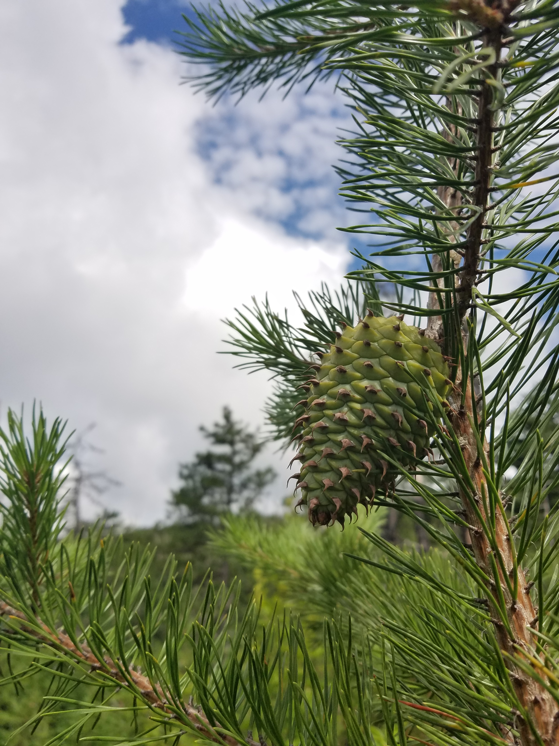
Table Mountain Pine Cones
Photos courtesy of Lane Gibbons, Shenandoah National Park

Slide 4
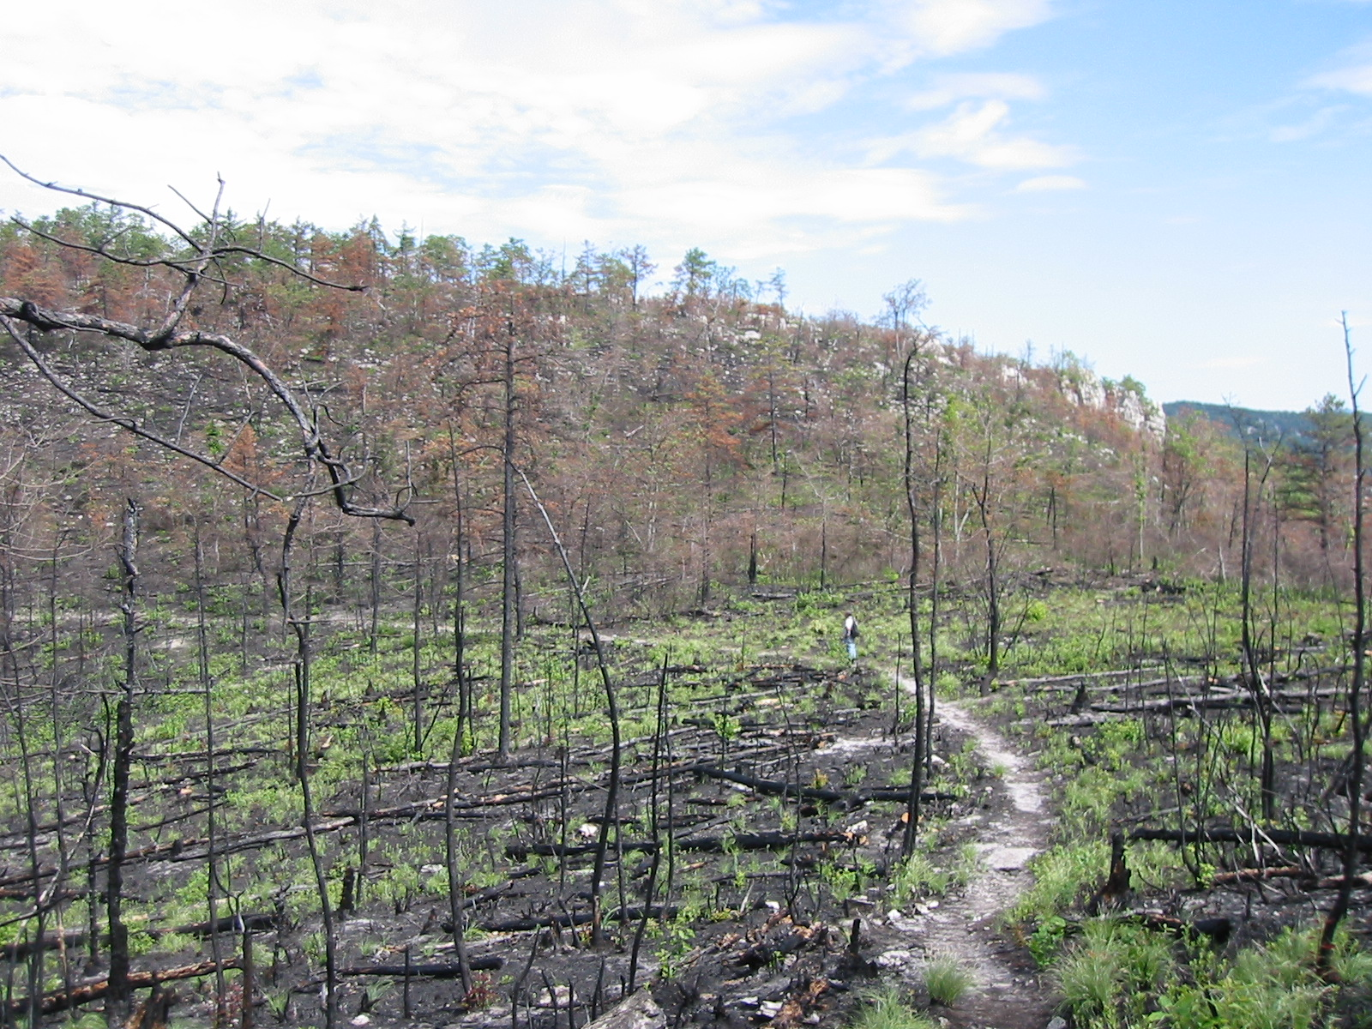
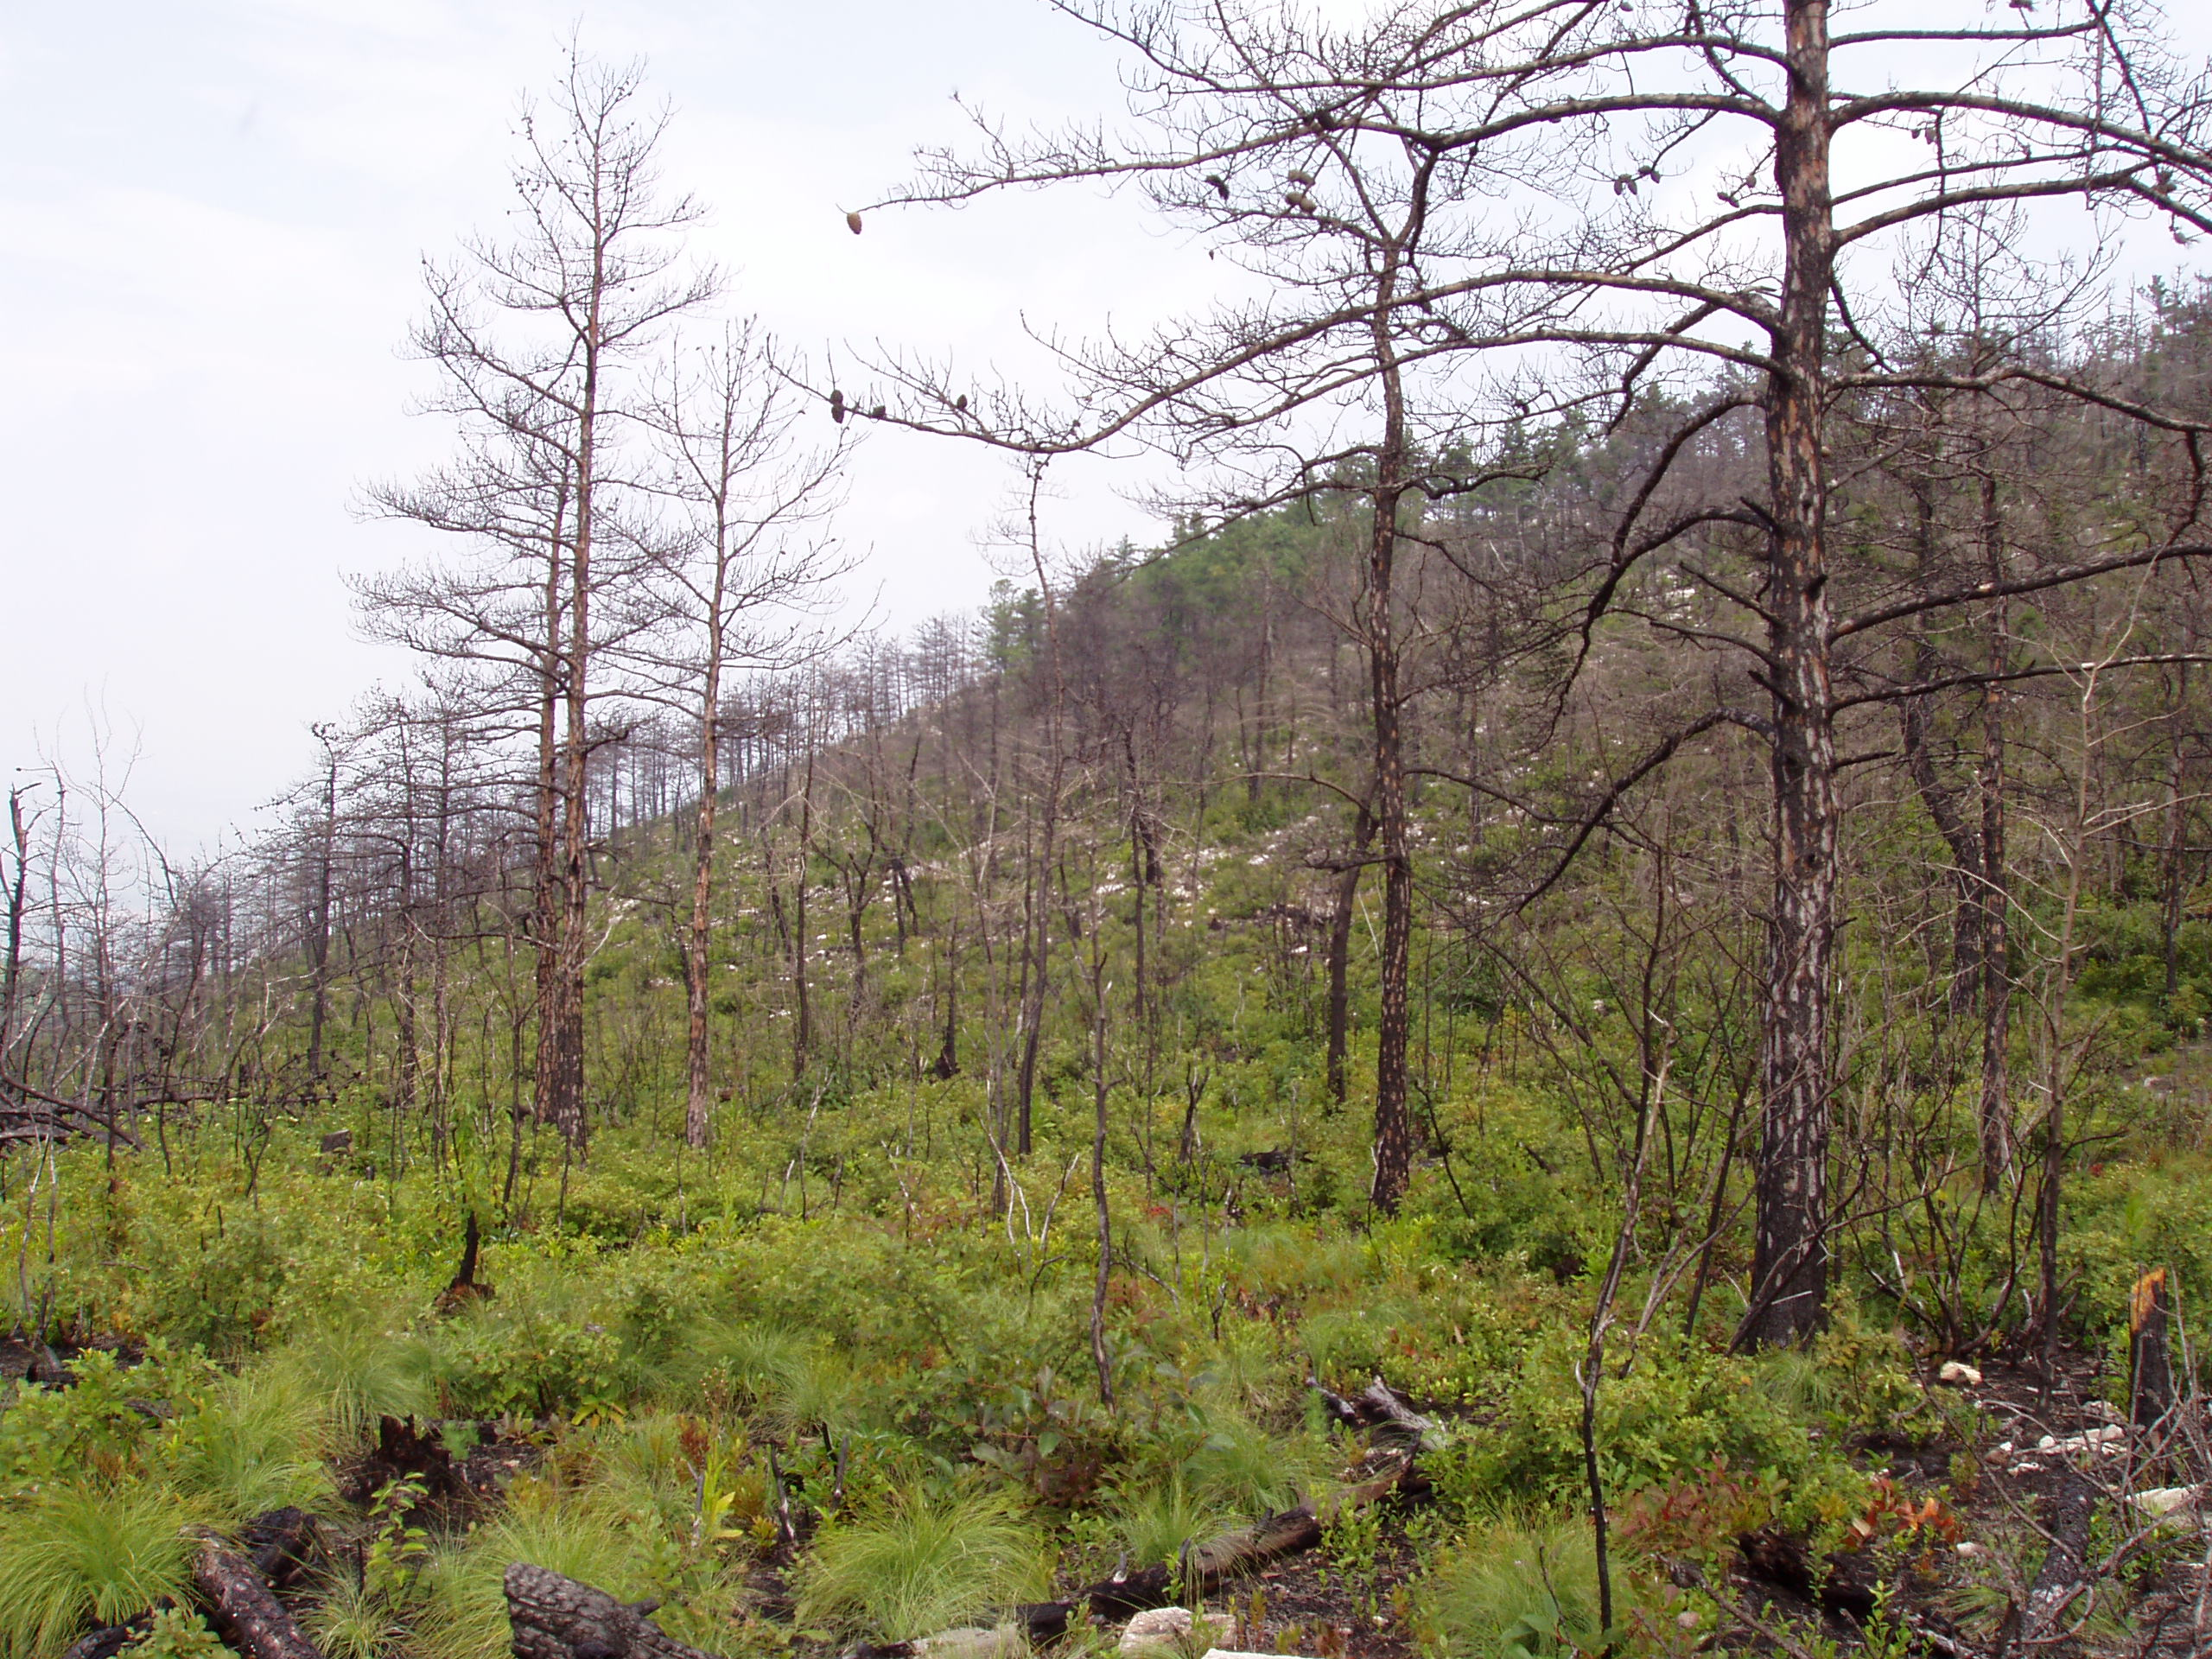
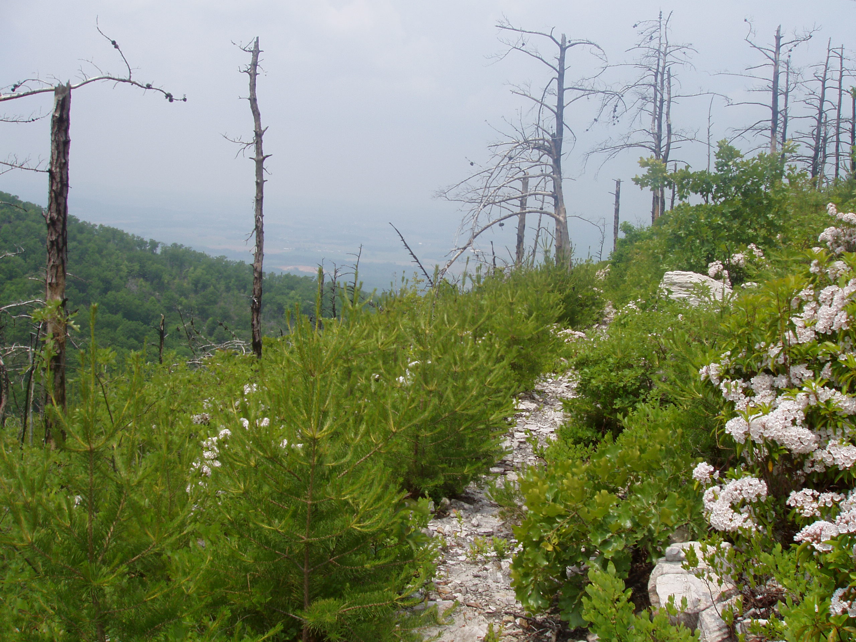
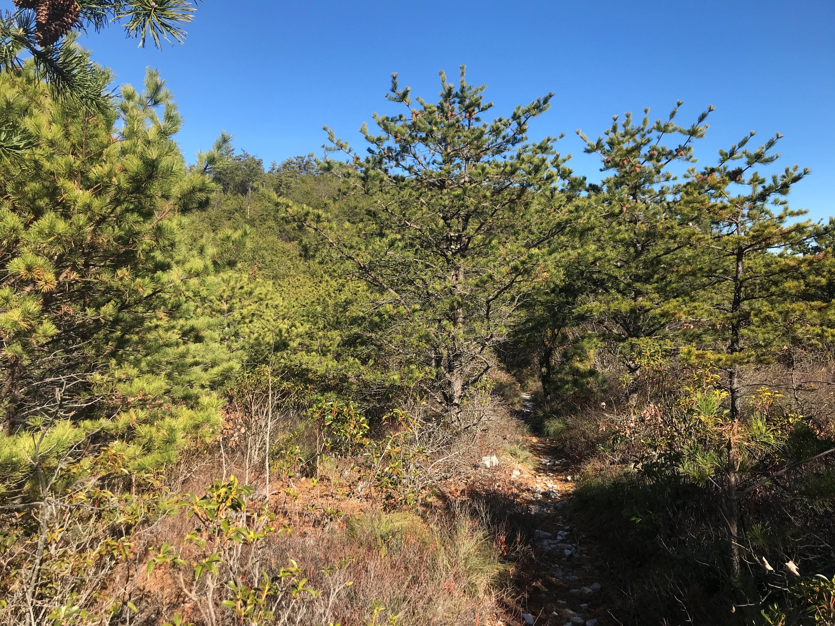
2003
2003
Table Mountain Pine Habitat- Rocky Top Fire
2007
2019
Photos courtesy Lane Gibbons,
Shenandoah National Park

Slide 5
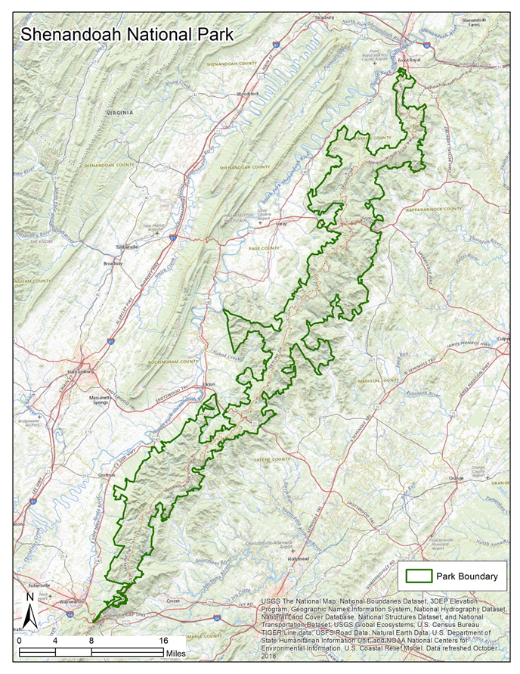
Where is a suitable location to introduce reoccurring fire to help restore of Table Mountain Pine?

Slide 6
Analyses Conducted
Current Prescribe Burn Priority at SHEN
Table Mountain Pine Suitable Habitat
Table Mountain Pine Habitat Burn Priority

Slide 7
Necessary Data
Current Prescribe Burn Priority at SHEN
Fire History
Fire Tolerance
Table Mountain Pine Suitable Habitat
Digital Elevation Model
Aspect
Soils
Summary Data
Landscape Compartment
Landscape Position

Slide 8
Summary Data
Landscape Compartment
Landscape Position

Slide 9
Anticipated Results
A prescribed burn priority map summarized by landscape compartment
A habitat suitability map summarized by landscape compartment and landscape position
A Table Mountain Pine habitat burn priority map summarized by landscape compartment.

Slide 10
Current Prescribe Burn Priority: Analysis
Utilized Fire History and Fire Tolerance as inputs
Output raster was summarized by Landscape Compartment

Slide 11
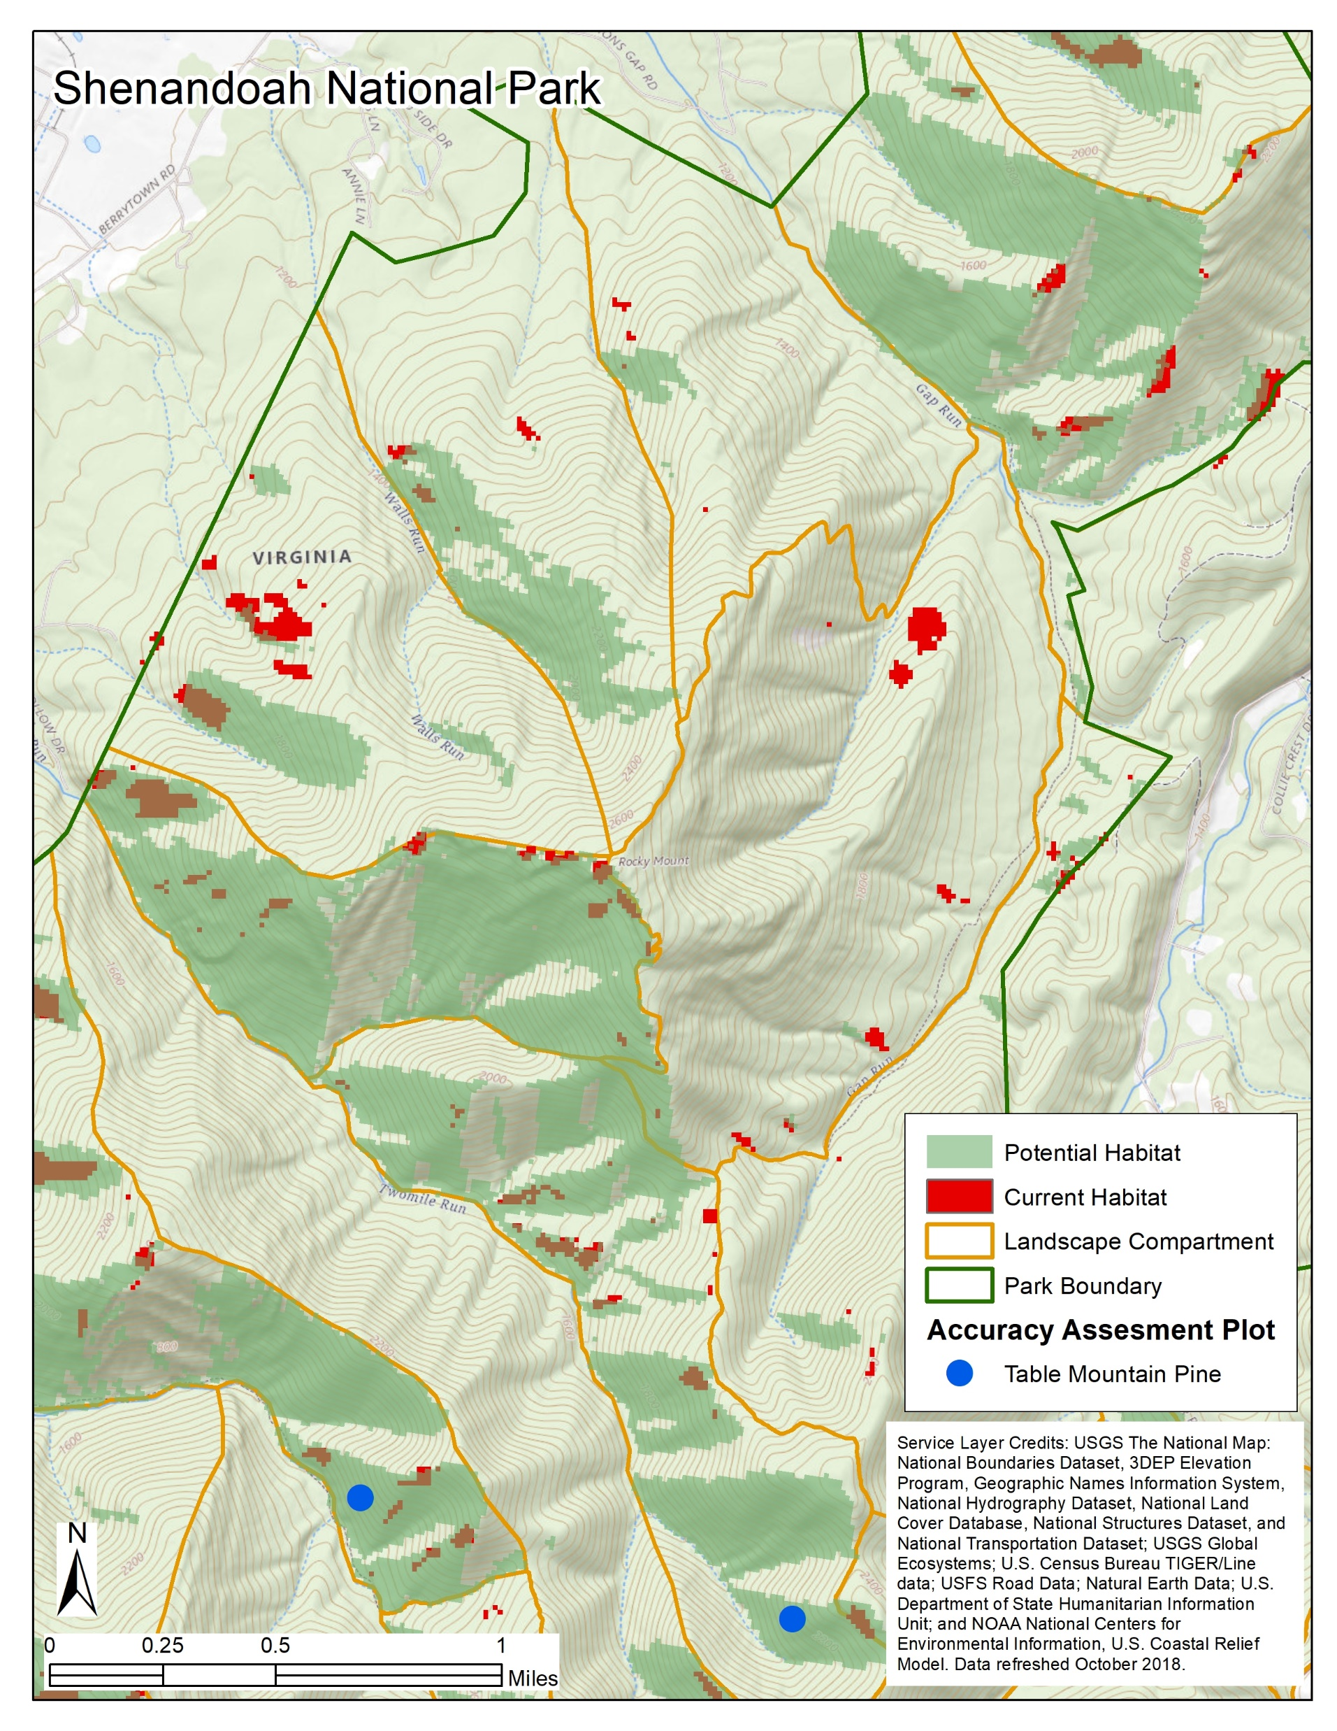
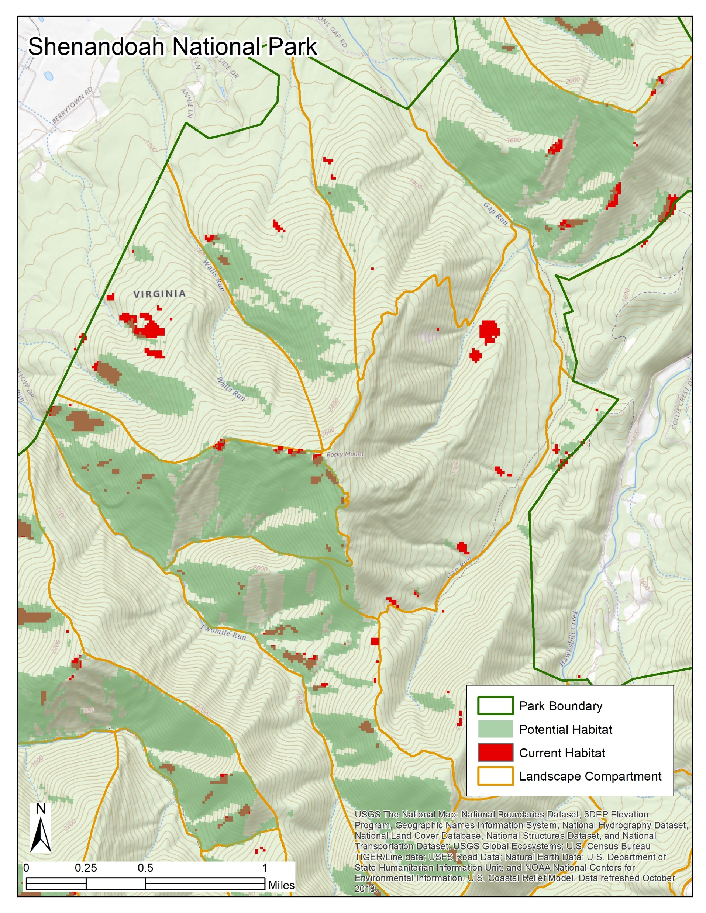
Table Mountain Pine Suitable Habitat: Analysis
Utilized Map Algebra for a Raster Overlay
Used Elevation, Aspect, and Soils as inputs
Output represents Potential habitat for Table Mountain Pine
Notes:
Add Click to card 32

Slide 12
Table Mountain Pine Burn Priority
The Current Prescribe Burn Priority analysis was not intended to identify specific habitat to burn. But rather it was designed to look at areas to burn to meet management priorities.
The Table Mountain Pine Habitat analysis only shows the potential habitat.
So, “where is a suitable location to introduce reoccurring fire to help restore Table Mountain Pine?”

Slide 13
Table Mountain Pine Burn Priority: Weighted Overlay
Utilized input data from other two analyses
Landscape Position was added as a variable
The weights were derived by prioritizing the habitat and the fire tolerance
 | Weight
Aspect | 30%
Fire Tolerance | 28%
Fire History | 20%
Soil | 10%
Landscape Position | 10%
Elevation | 2%

Slide 14
Project Timeline
March – April 2020
Data Acquisition, Conduct Data Analysis
May - September
Summarize Results, Work on Presentation, Write Final Paper
October or November
Present
December
Graduate

Slide 15
Alternative Presentation Venue: Webinar
Blended Approach
Local Staff can attend in person
Individuals from away can attend virtually
Target Audience
Fire Managers
Fire Ecologists
GIS Specialists
Academic
Current list of invitees is about 45 individuals and growing

Slide 16
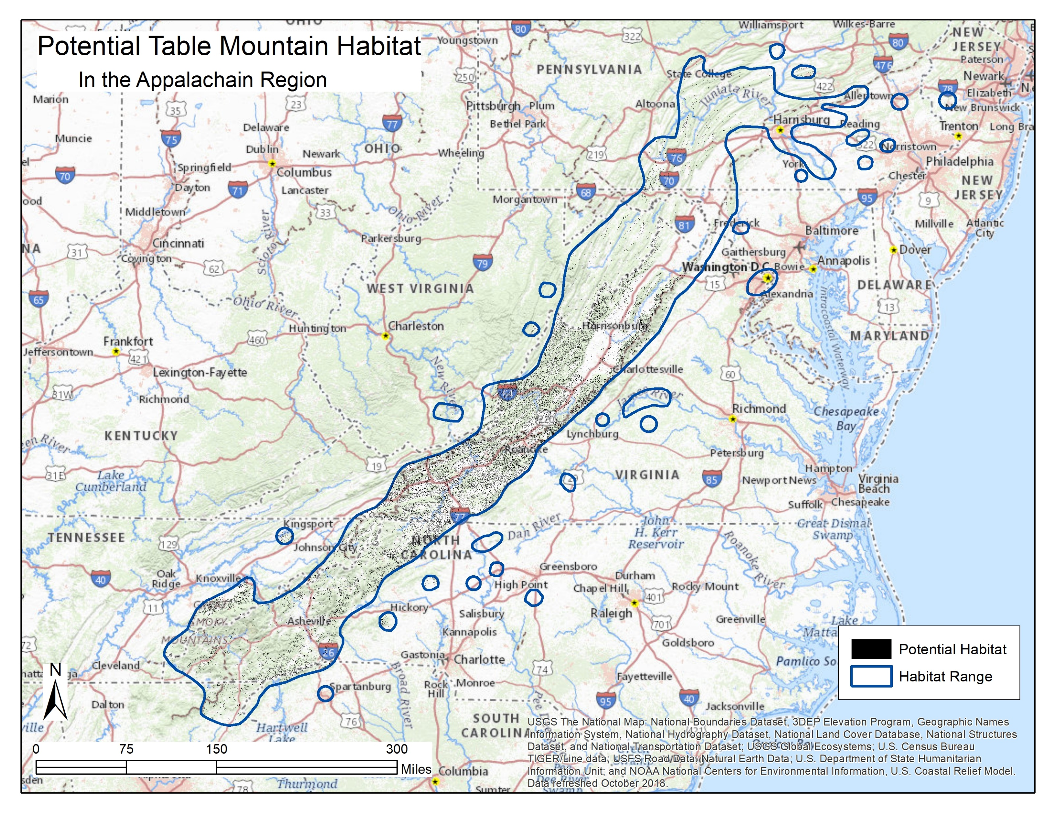
Any Questions?

