Slide 1
Space-Time Visualization of Motor Vehicle Traffic Fatalities and Crashes
Peter A. Durkee
Advisor: Dr. James O’Brien
The Pennsylvania State University
GEOG 596A - Summer 2016
Notes:
I appreciate everyone taking the time to attend my presentation. Good evening, My name is Peter Durkee and the title of my project is Space-Time Visualization of Motor Vehicle Traffic Fatalities and Crashes.

Slide 2
Overview
Background
Goals and Objectives
Methodology
Anticipated Results
Project Timeline
Notes:
Here is an overview of my project.
Background
Goals and Objectives
Methodology
Anticipated Results
Project Timeline

Slide 3
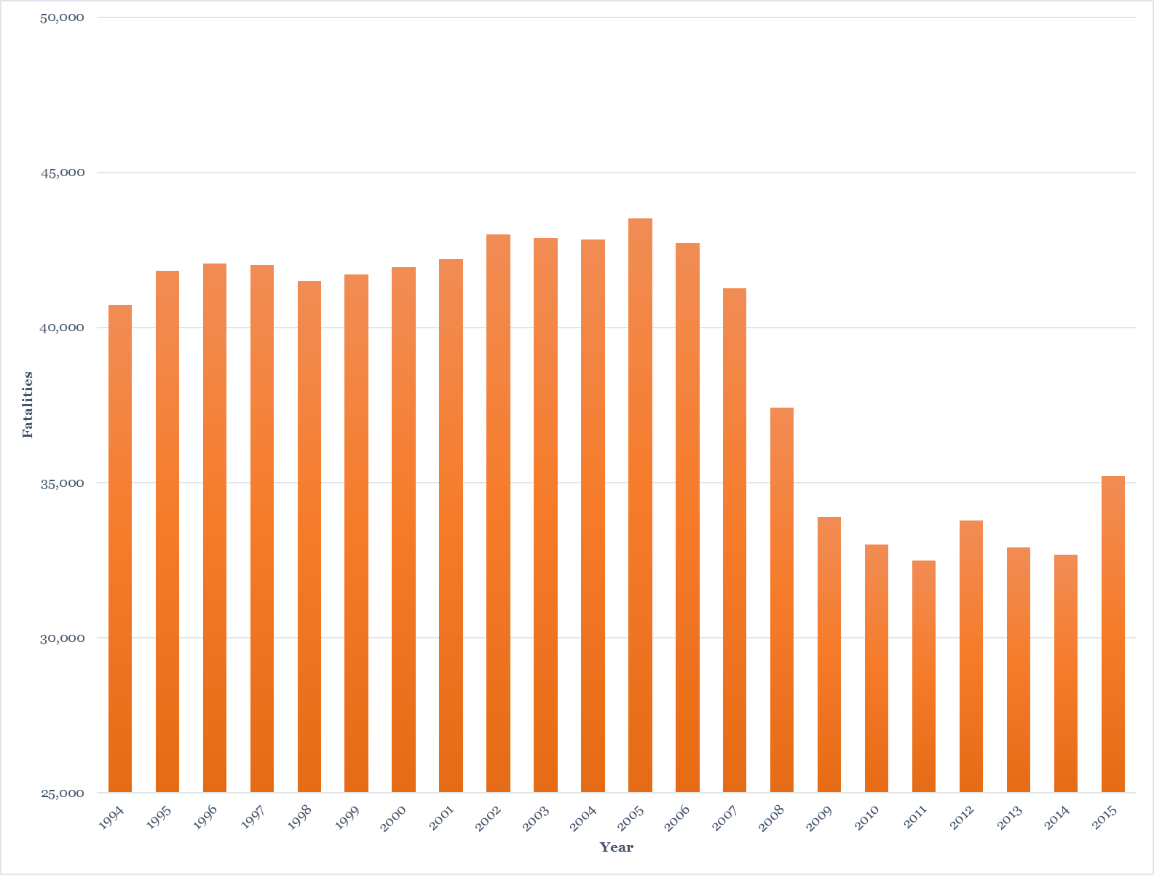
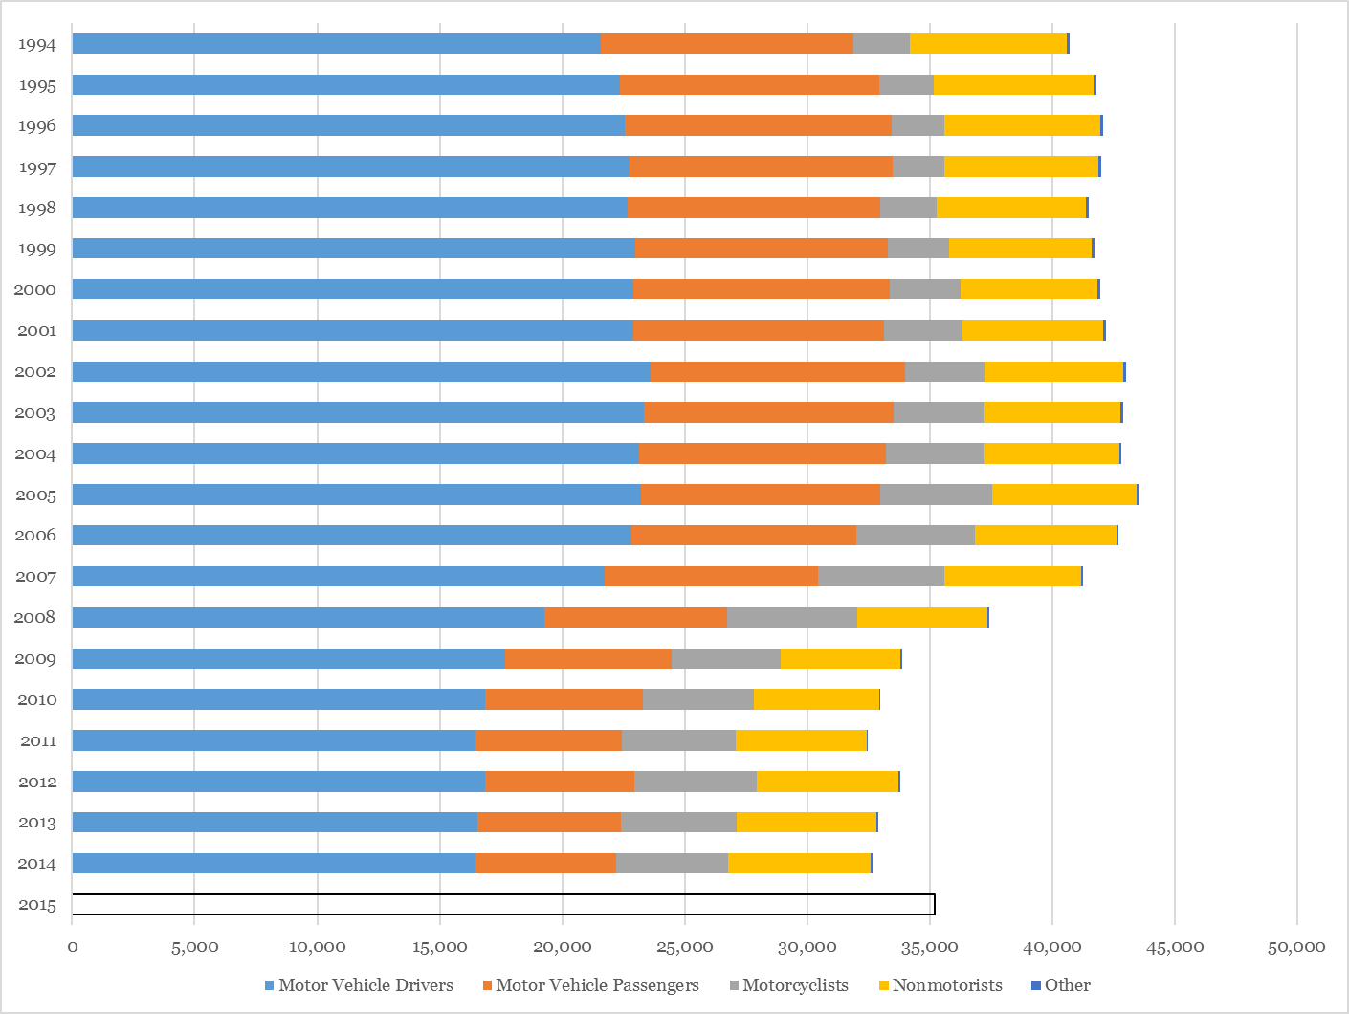
U.S. Fatalities and Injuries Overview
Notes:
Motor vehicle traffic (MTV) fatalities have a significant impact in human and economic loss each year in the United States. In 2014, there were over 32,675 people who lost their lives and over 2.3 million people were injured in crashes (NHTSA, 2016). In 2010, the economic drain was 242 billion and nearly $76.1 billion in property damage alone (Blincoe, Miller, Zaloshnja, & Lawrence, 2014).
I included two graphs to illustrate U.S. motor vehicle fatalities over the past 20 years. If you look at the left image you’ll see that the overall trend continue to follow a general decline. I went ahead and included a 2015 projection based on a report published by the NHTSA.
The second graph of the right shows fatalities by person type (drivers, passengers, motorcyclists and nonmotorists). A nonmotorists would include pedestrians and pedalcyclist.
Driver and passenger decrease

Slide 4
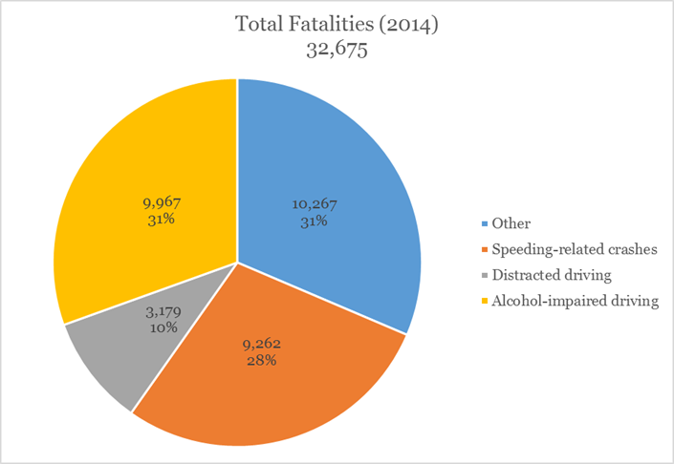
U.S. Fatalities and Injuries Overview Cont.
(NHTSA, 2016)
Notes:
Of the vehicle crashes that occurred in 2014, 69% of all fatalities were the result of three crash-related factors: (1) alcohol-impaired driving (31%), (2) speeding-related crashes (28%) and (3) distracted driving (10%) (NHTSA, 2016).

Slide 5
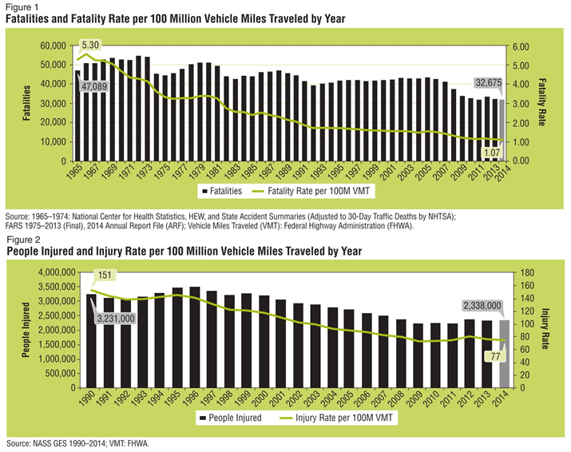
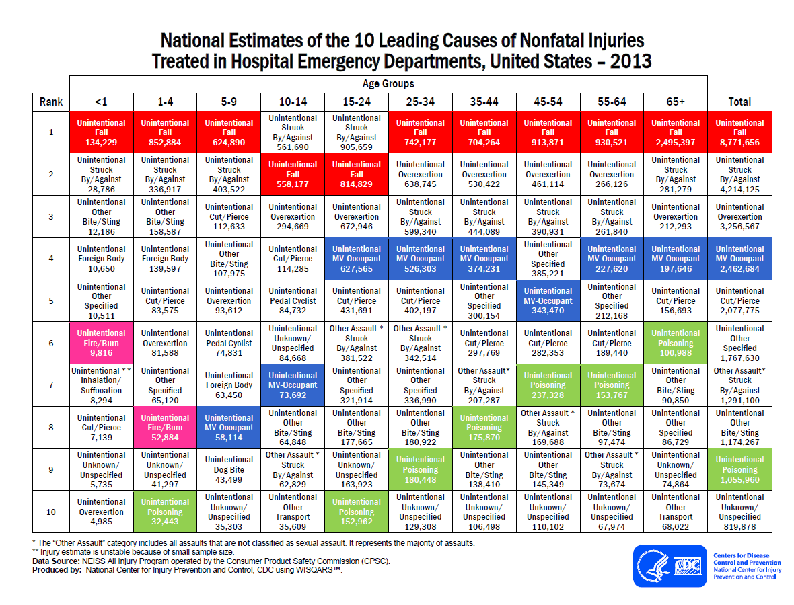
U.S. Fatalities and Injuries Overview Cont.
(NHTSA, 2016)
Source: https://www.cdc.gov/injury/wisqars/images/10LCD-Age-Grp-US-2008-a.gif
Notes:
The image on the left shows fatalities and injuries per 100 million vehicle miles traveled (VMT) The image on the right is from the CDC website and shows the 10 leading causes of nonfatal injuries in 2013 that were treated in the hospital emergency departments. If you look at the blue boxes you will see unintentional mv occupant and where they rank by age group.

Slide 6
Goals and Objectives
Examine where, when and why crashes occur through exploratory data analysis and geovisualization.
Notes:
What I want to do essentially is examine where accidents happen and why they happen through exploratory data analysis and geovisualization. This will be accomplished primarily through the use of Space-Time Cube (STC) and other visualization techniques (graphs) using the FARS and CRIS data from 2010 to 2015.
This could potentially mitigate and reduce crashes and lead to new insights and understanding to where, when and why crashes occur through data visualization and exploration.
What makes this problem unique is the magnitude and complexity of the data. You also have both a spatial and temporal components associated with the data. Also, a lot of variables can influence why crashes. Some examples include environmental conditions and driving behavior.
Examples on literature reviewing crashes by Plainis, Murray, & Pallikaris, (2006), Bergel-Hayat, Debbarh, Antoniou, & Yannis, (2013), Jägerbrand & Sjöbergh, (2016).

Slide 7
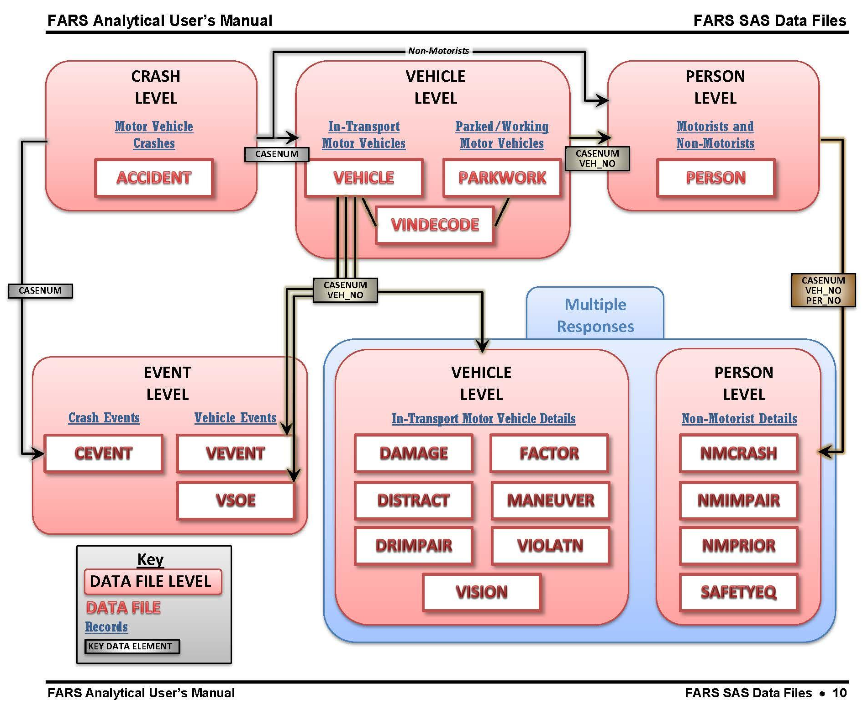
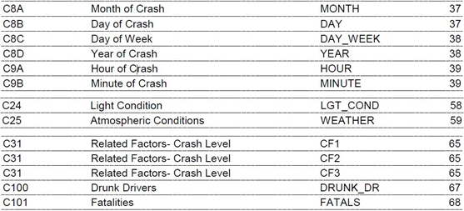
Fatality Analysis Reporting System (FARS)
Source: www-nrd.nhtsa.dot.gov/Pubs/812214.pdf
Notes:
What is FARS?
U.S. Census of motor vehicle crashes that occur on a public roadway and involve a fatality.
19 data files and over 100 data elements and can be obtained from the FARS website or you can download the raw data in .dbf format.
Data is complex!
The purpose of FARS is to “identify highway safety problem areas, provide a basis for regulatory and consumer information initiatives, and form the basis for cost and benefit analyses of highway safety initiatives.”
Accident Data File – contains information about crash characteristics and environmental conditions at the time of the crash.
Vehicle Data File – includes in-transport motor vehicle data as well as driver and precrash data.
Distract Data File – contains information about driver distractions.

Slide 8
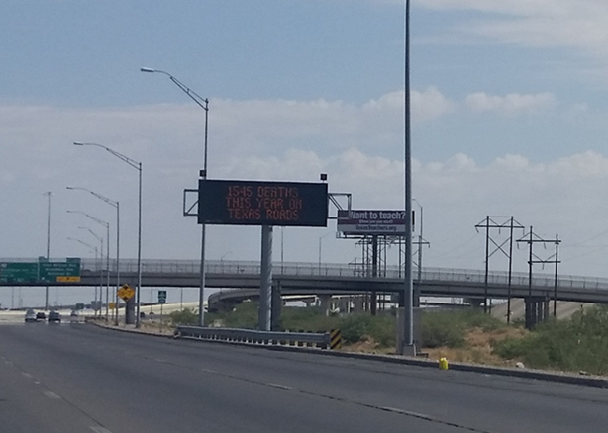
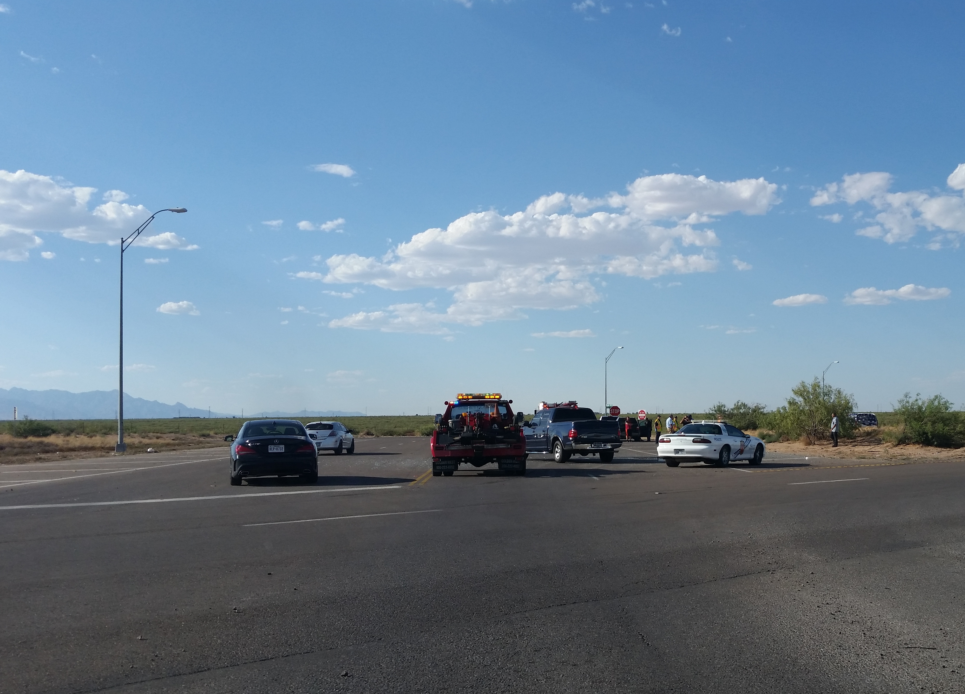
Texas Fatalities and Injuries
1,545 deaths on Texas roads. Image taken on June 26, 2016 at 10:26 AM
A minor crash at the intersection of Mesquite Hill Dr and Hwy 54. Image taken on July 14, 2016 at 5:53 PM.
Notes:
For my proposed project I will narrow my focus to a smaller geographic region.

Slide 9
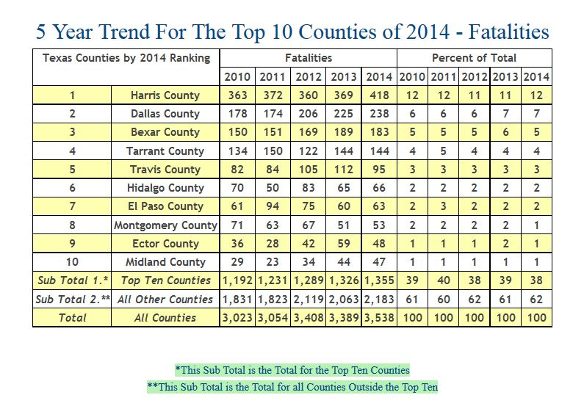
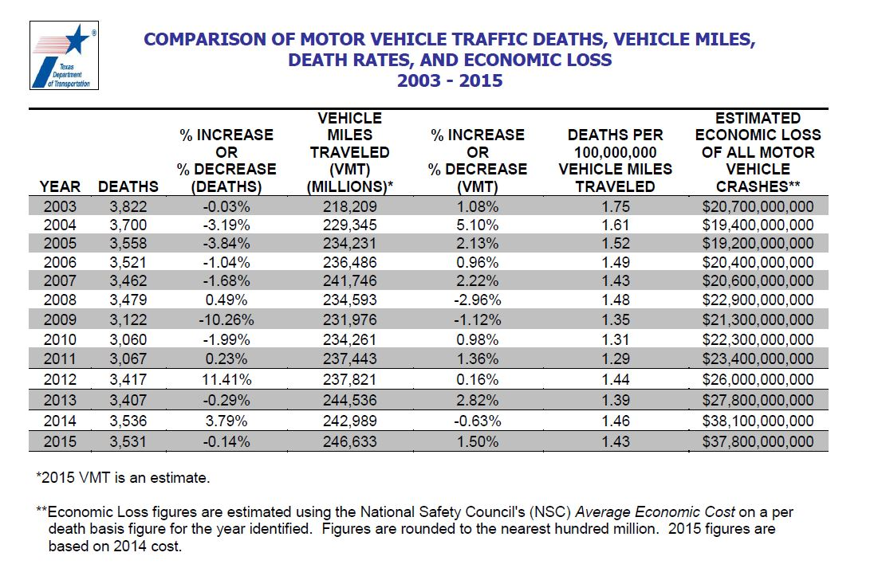
Texas Fatalities and Injuries Cont.
Source: http://www-nrd.nhtsa.dot.gov/departments/nrd-30/ncsa/STSI/48_TX/2014/48_TX_2014.htm
Notes:
Image on the left shows TX fatalities by the top 10 counties and % change. The image on the right shows a comparison of motor vehicle traffic deaths by vehicle miles traveled and the estimated economic loss in crashes. TX GDP is a little over 1.4 trillion. My analysis will focus crashes at the county level.

Slide 10
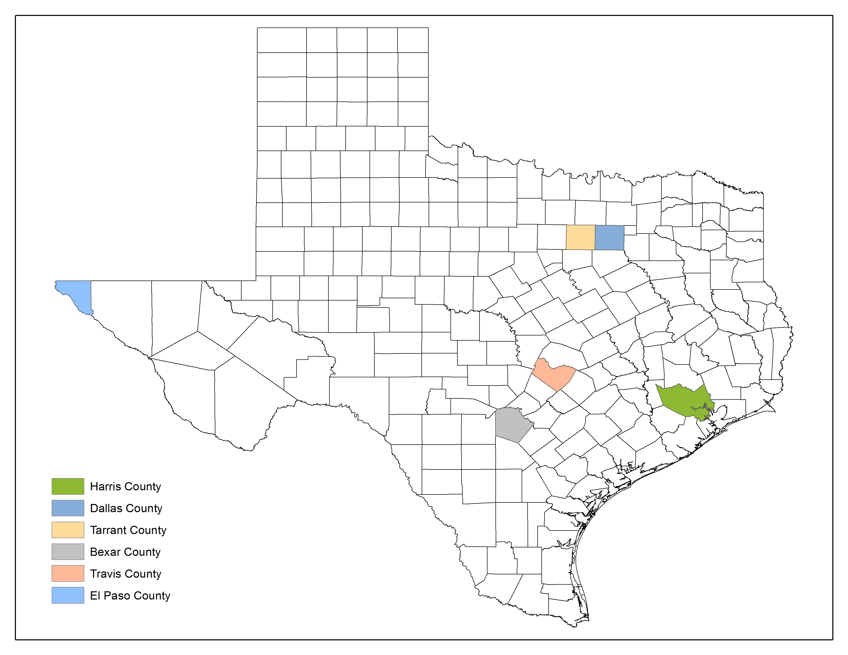
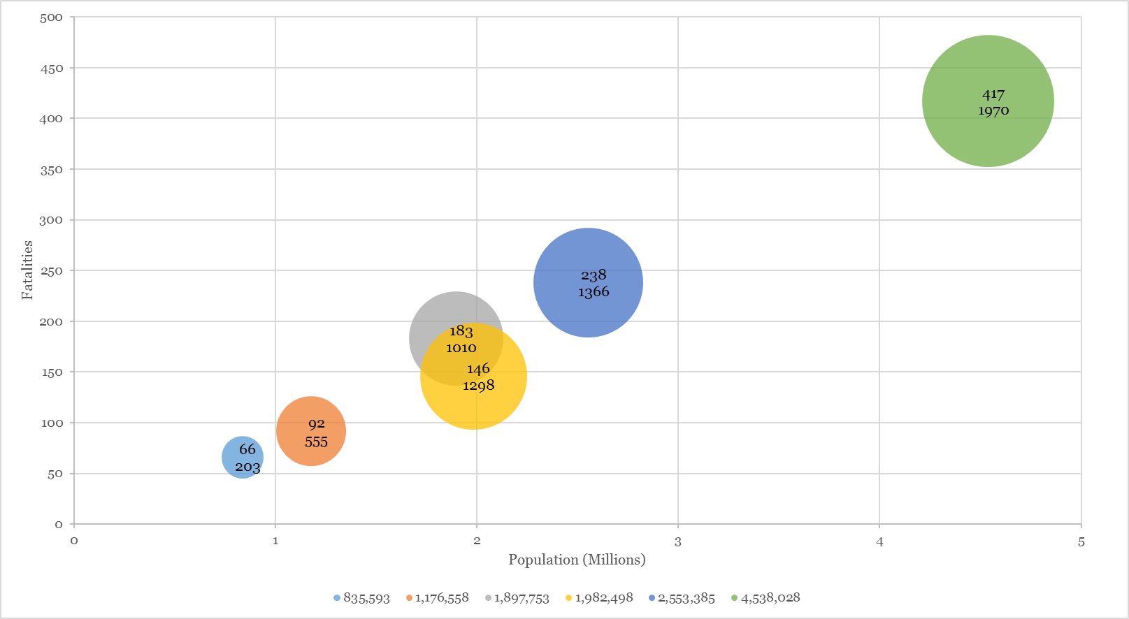
Texas Fatalities and Injuries Cont.
Notes:
Here I’m using the TxDOT CRIS data to look at fatalities and injuries for the top 5 counties. The CRIS data contains the data collected from the Texas Peace Officer’s Crash Report (CR-3). That includes roadway attributes and location specific data.
On the left is a map of TX 6 counties. The number of fatalities is shown on the y-axis and the population on the x-axis. The bubble size is linked to the incapacitating injuries.
Population increases fatalities increase and injuries increase
Incapacitating Injury – prevents the injured person from normally functioning before the injury occurred.

Slide 11
Geovisualization
“…the use of visual geospatial displays to explore data and through that exploration to generate hypotheses, develop problem solutions and construct knowledge (M.-J. Kraak, 2003).
Notes:
Here is a quote on geovisualization by Kraak and a more recent definition. Geovisualization is defined as “…the use of visual geospatial displays to explore data and through that exploration to generate hypotheses, develop problem solutions and construct knowledge (M. J. Kraak, 2003) and, more recently, integration of cartographic principles with other disciplines including “… scientific visualization, image analysis, information visualization, exploratory data analysis, and GIScience (M.-J. Kraak, 2007).

Slide 12
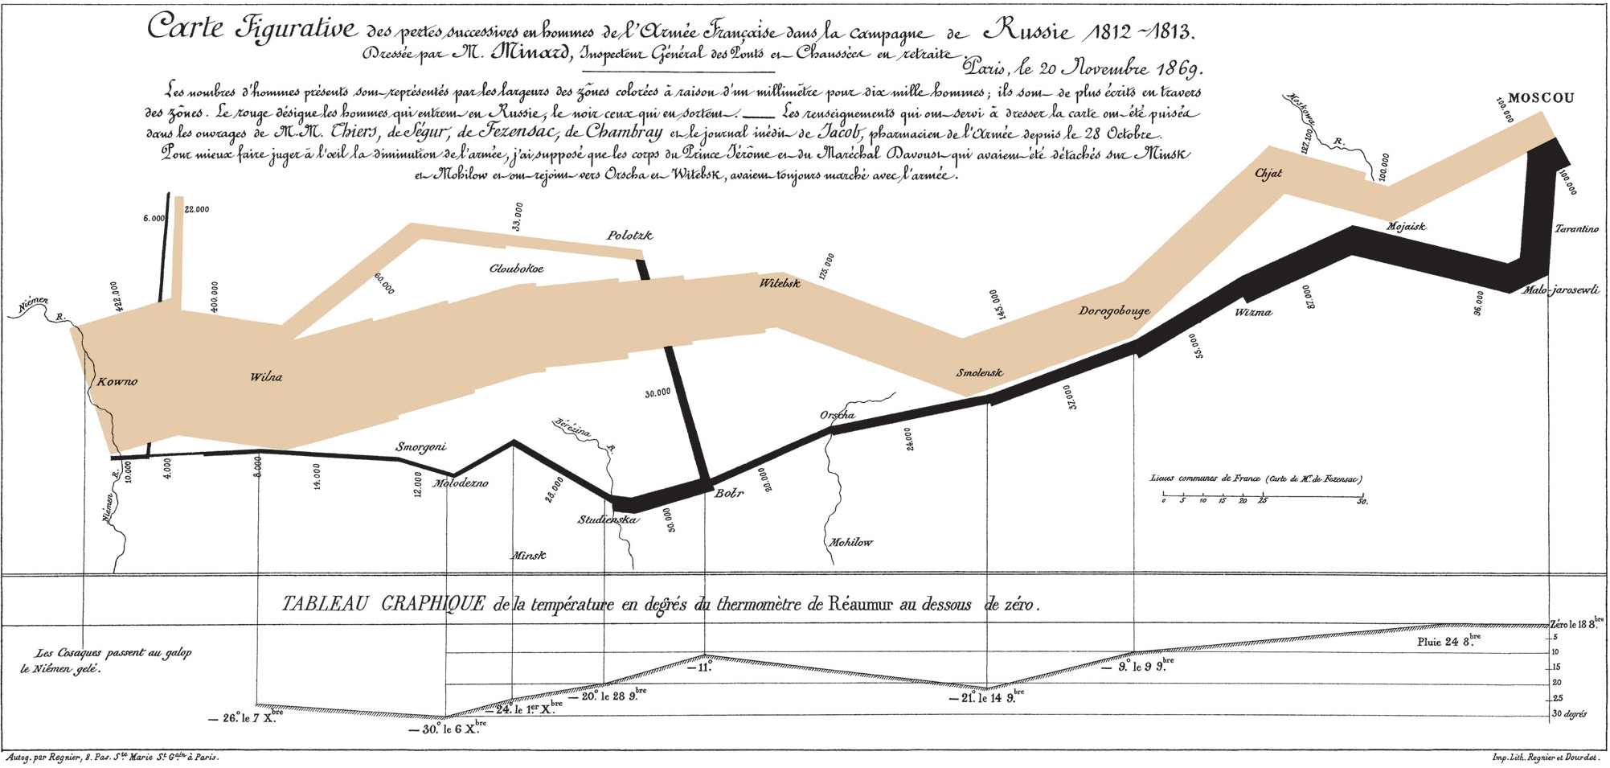
Geovisualization and Minard’s Map
Notes:
Here is Minard’s illustration of Napoleon’s march towards Moscow and the devastating losses he incurred during his campaign. Minard's map is one of the earliest examples of using statistics in a map/visualization that shows 6 types of data in two dimensions.
Research by DiBiase, MacEachren, Krygier, & Reeves (1992), MacEachren & Kraak (2001) and Kraak (2003) examines the benefits and challenges associated with geovisualization.

Slide 13
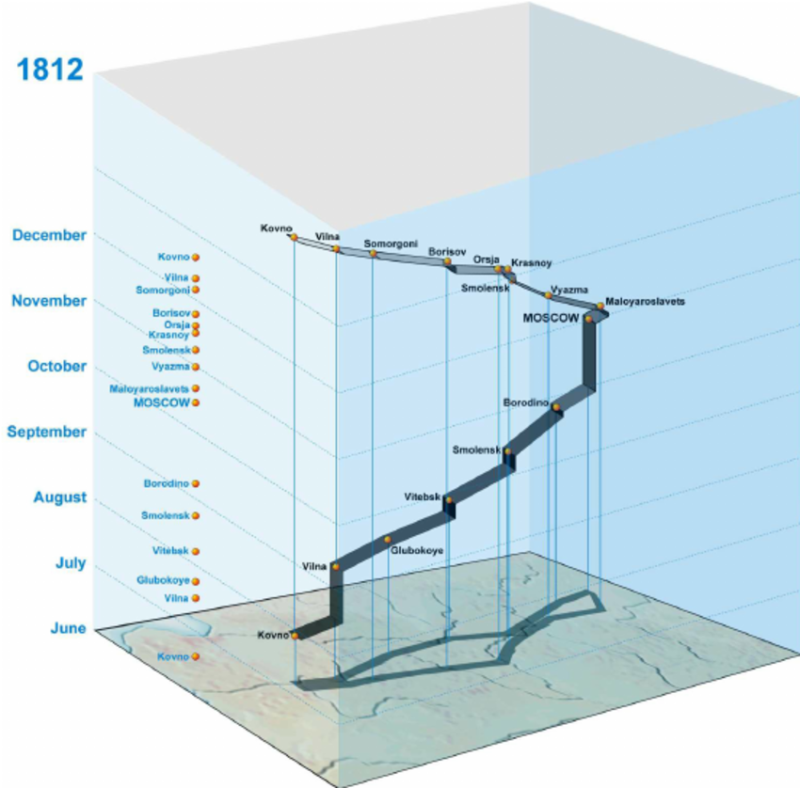
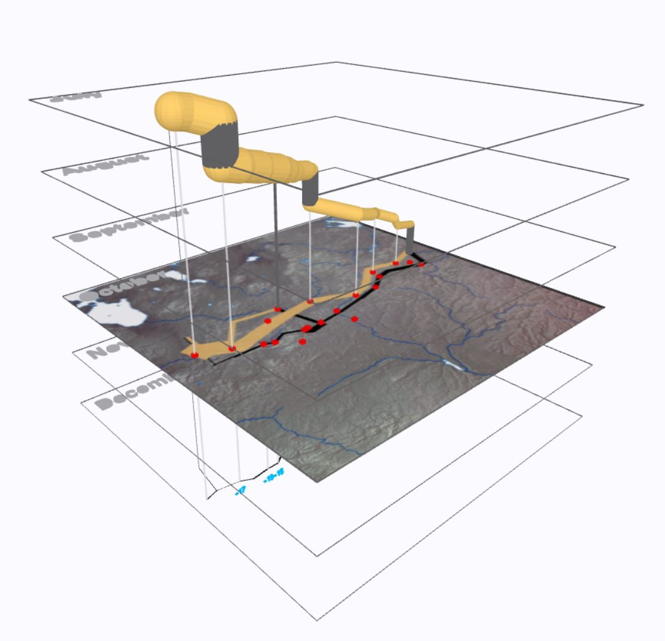
Geovisualization and Minard’s Map Cont.
(M.-J. Kraak, 2003)
(Field, Shepherd, Minard Napoleon's March on Moscow 1812-1813 in 3D, 2013)
Notes:
The image on the left is a recreation of Minard’s map in a STC. The image on the right is a 3D visual of Minard’s map that was created in ArcScene by Field and Shepherd (2013) and is published on ArcGIS Online as a 3D Web Scene. This version offers an interactive and dynamic graphic when compared to a static map.
Minard’s map is an example of what can be done in the STC.
How can I apply this to visualizing crash fatalities?

Slide 14
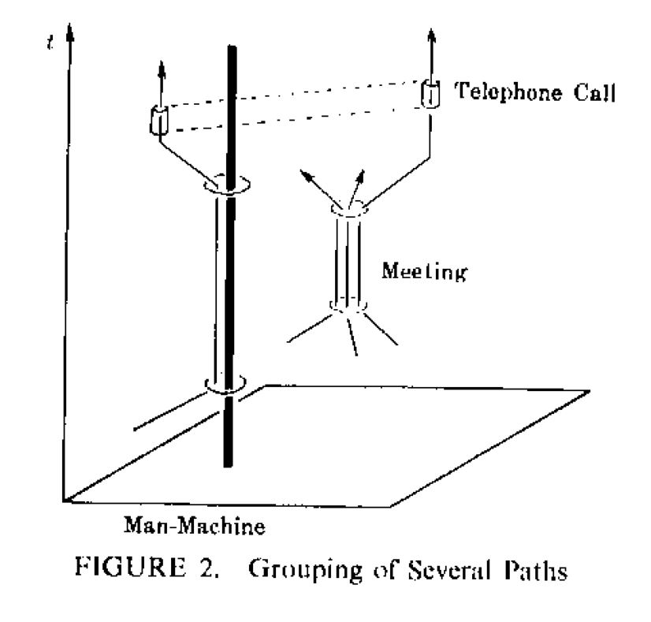
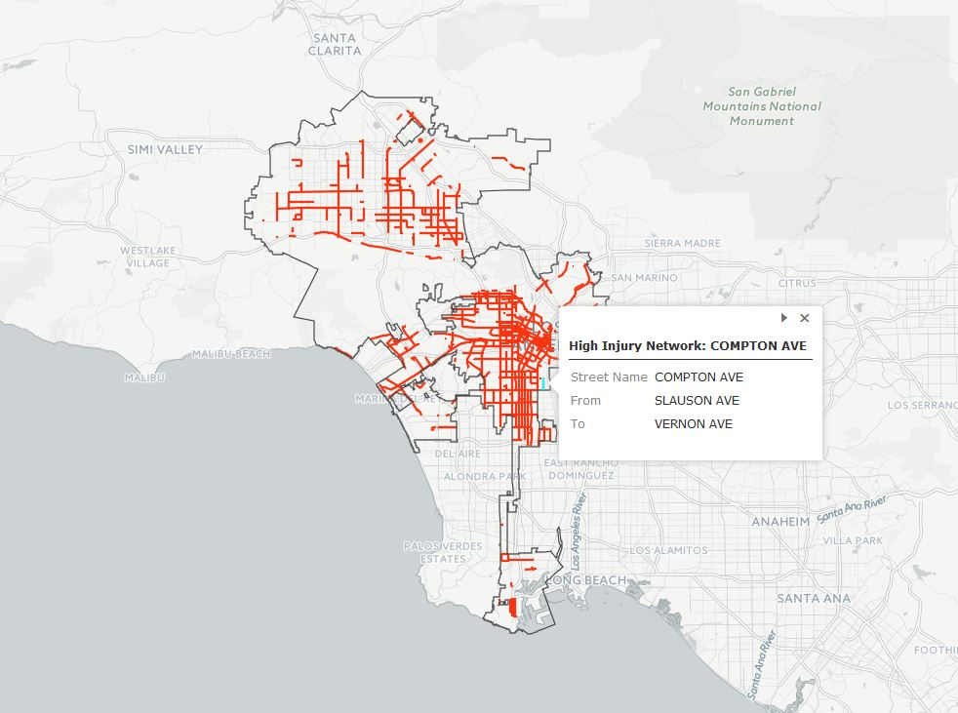
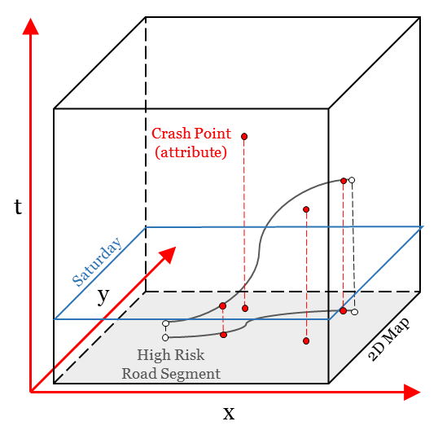
Space-Time Cube (STC) and Crashes
Source: http://ladot.maps.arcgis.com/apps/MapJournal/index.html?appid=488062f00db44ef0a29bf481aa337cb3&webmap=6ad51e9cf42c4ef09817e4b3b4d2eeb0%22
Torsten Hägerstrand’s space-time model
(Hägerstrand, 1970)
Notes:
The image on the left is an illustration of Torsten Hägerstrand’s space-time model. The Space-Time Cube (STC) is a visualization technique to visualize the spatial and temporal dimensions of data. The model consists of spatial coordinates along the x- and y-axis, and a temporal component along the t-axis. There are some advantages to the STC: (1) visualizaing the spatial and temporal data and (2) can reveal and lead to insights and patterns in the data that may not be visible as a 2D representation.
In the context of my proposed project, I want to apply the STC to visualize crash data and look at underlying attributes that contribute to fatalities and injuries. The image on the left illustrates the STC and the integration of the crash data. One potential approach would be to identify road segments with a high incident of MVT fatalities and injuries. This is similar to the Vision Zero initiative by the city of LA who developed a High Injury Network (HIN) dataset by identifying the highest risk streets as part of their strategic safety programs and infrastructure improvements for the city. The image in the center illustrates the HIN dataset. I believe it would be similarly beneficial to identify high risk streets in my proposed study area by combining the FARS and CIRS data.
Alternative graphics might also be required to enhance the understanding of the data.

Slide 15
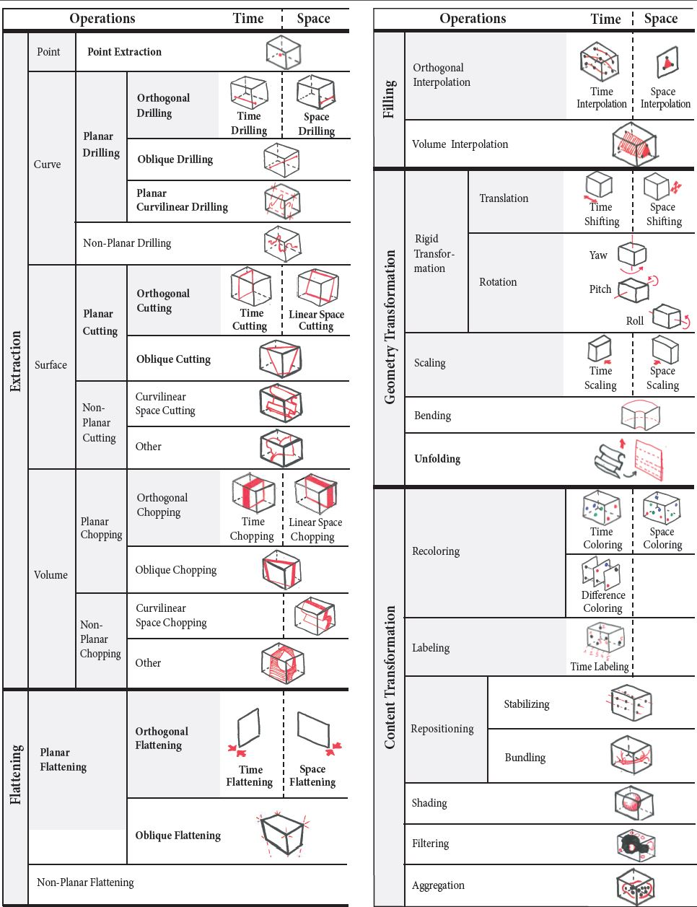
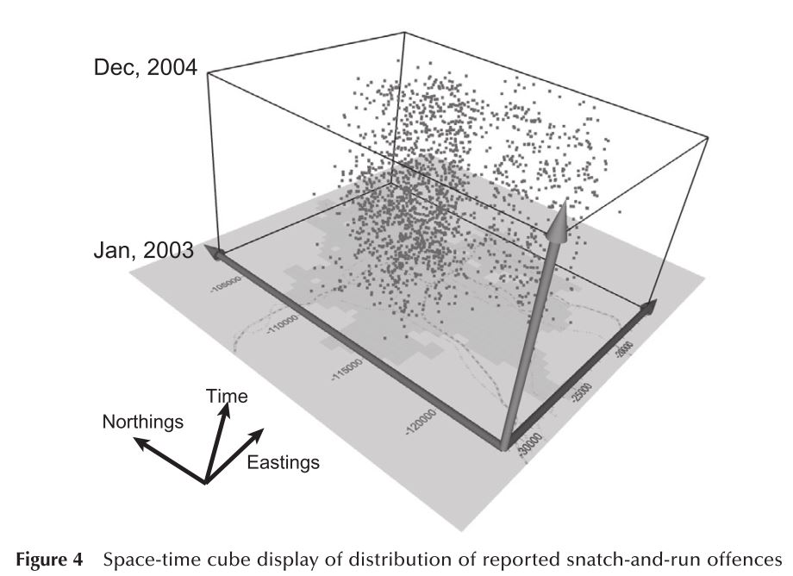
STC Examples
Nakaya & Yano, (2010)
Bach, Dragicevic, Archambault, Hurter, & Carpendale, (2014). Source: spacetimecubevis.com
STC been applied by M.-J. Kraak, (2008), Huisman et al., (2009), Nakaya & Yano, 2010 and Orellana et al. 2012
Notes:
STC been applied by M.-J. Kraak, (2008), Huisman et al., (2009), Nakaya & Yano, (2010) and Orellana et al. (2012). An overview of space-time cube operations by Bach, Dragicevic, Archambault, Hurter, & Carpendale, (2014). More examples at: spacetimecubevis.com

Slide 16
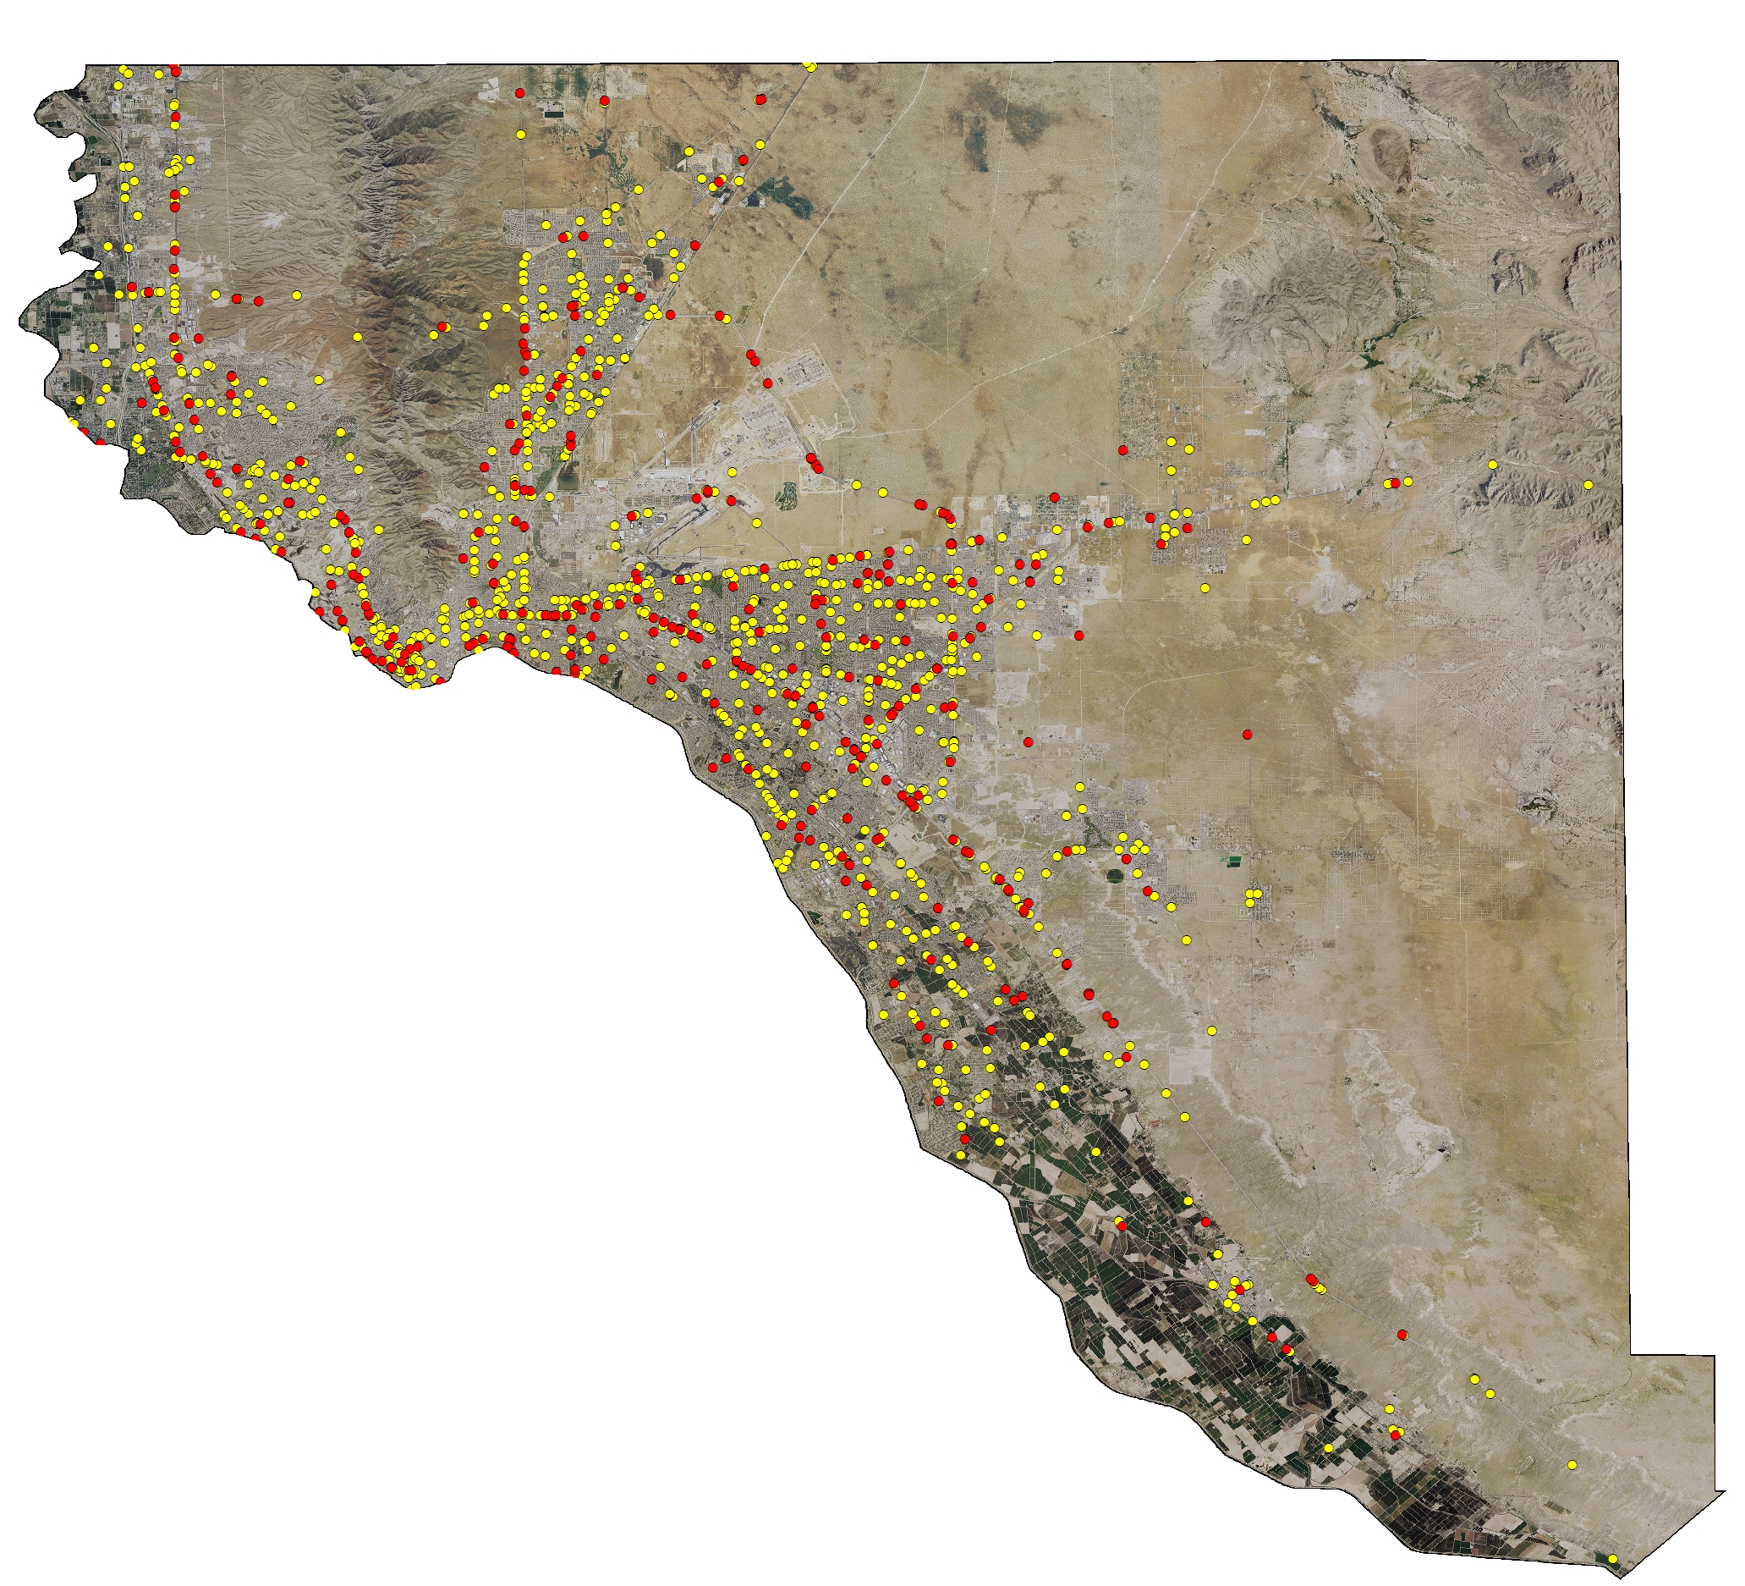
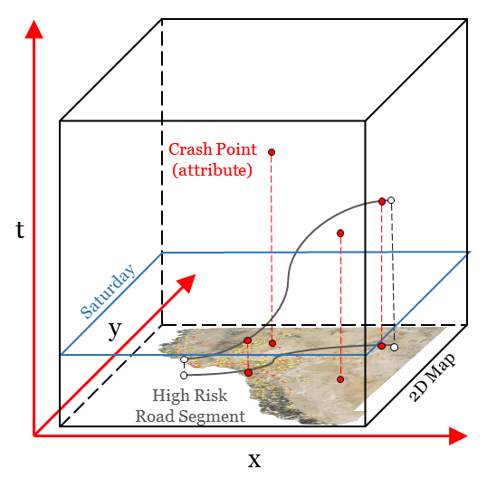
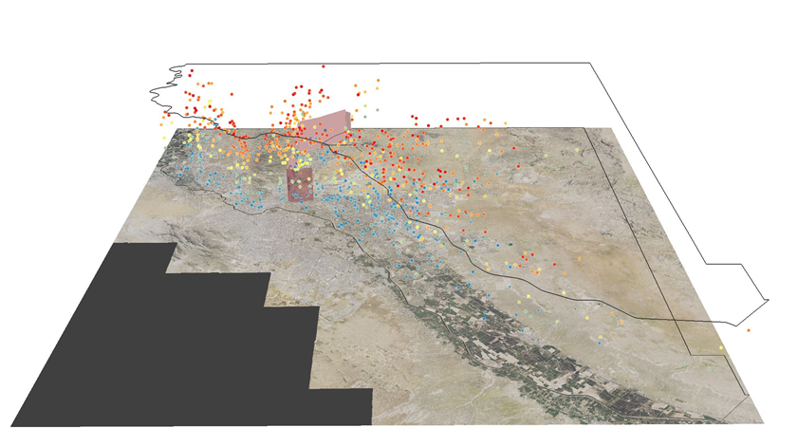
STC Visualization
Notes:
I’ve put together some quick maps showing the crash points and it doesn’t do quite what I want it to do for my analysis. Plotting a large number of points is difficult to visualize as a 2D representation.
Here is a 3D rendering in ArcScene of fatalities (points) and time (hour). In order to represent the (t) dimension, I ended up adding a fixed elevation to the attribute table that was based on the time (hour) field. This is an early version and there is a lot more exploratory stuff to be done. The time (hour) field begins at 0:00am-0:59am (bottom of the map) and ends at 11:00pm-11:59pm (top of the map). I also included two GPS tracks (one at 4 AM and one at 10 AM) in order to visualize a road segment and intersecting fatalities by hour.
One option is to make the STC interactive by moving through different time slices and examining variables against each other.

Slide 17
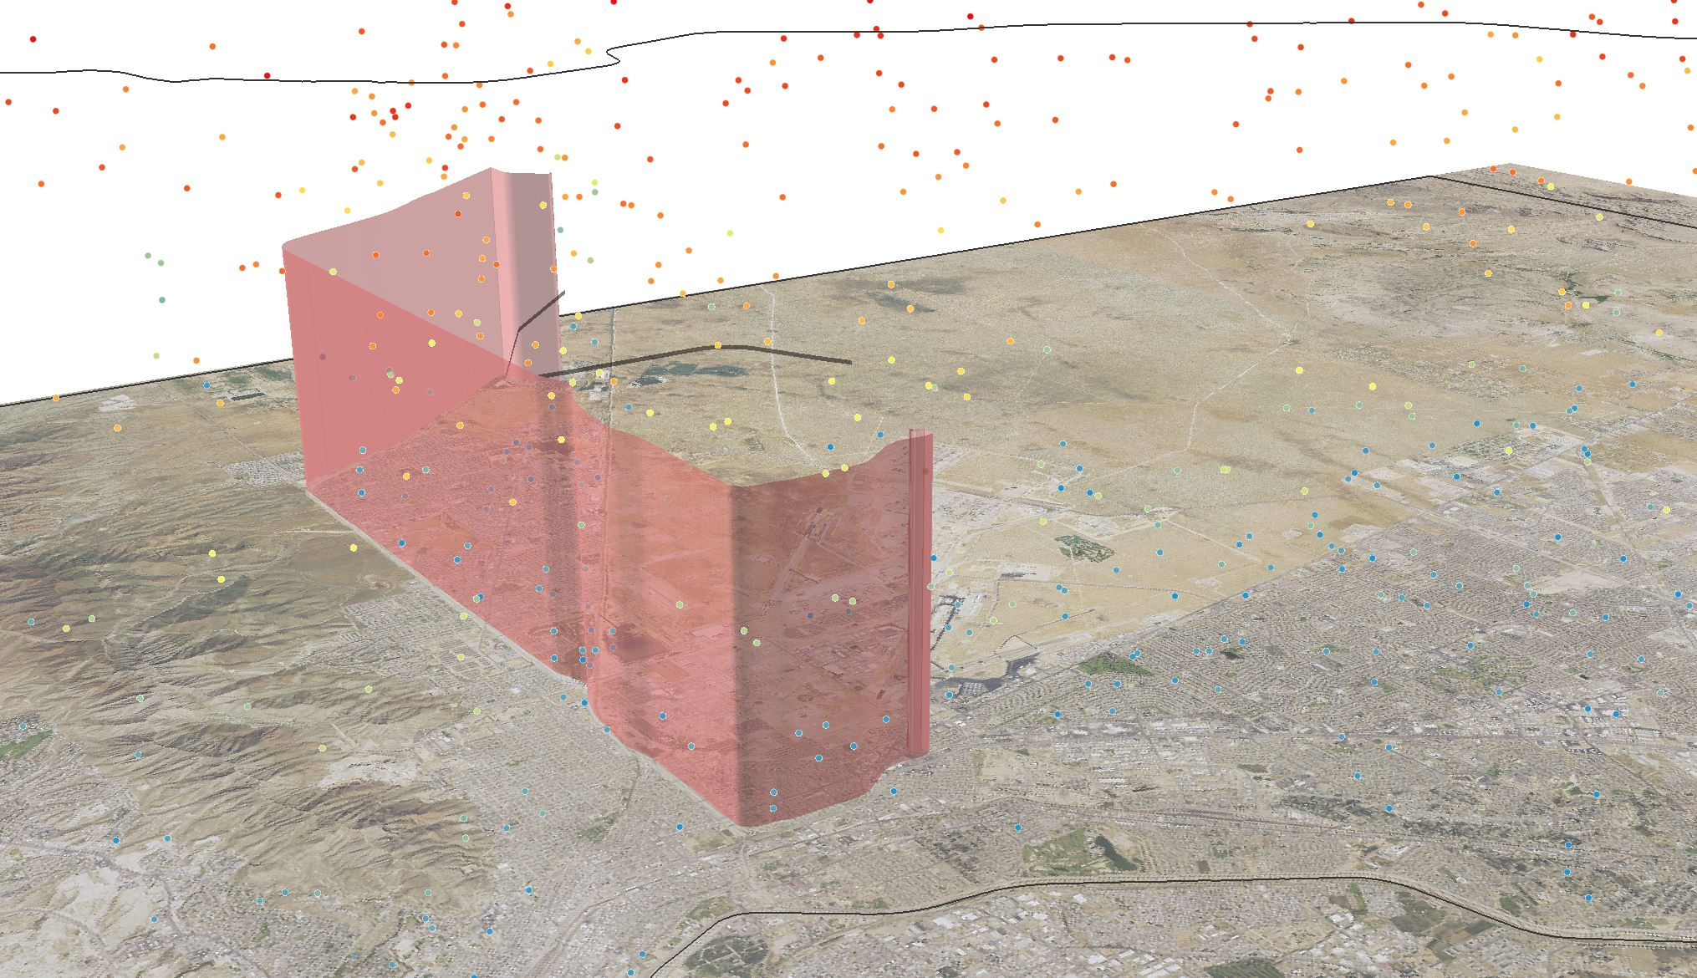
STC Visualization Cont.
Notes:
This slide combines media which can show underlying characteristics when analyzing the crash points. Beginning of a GPX track at 5 AM.

Slide 18
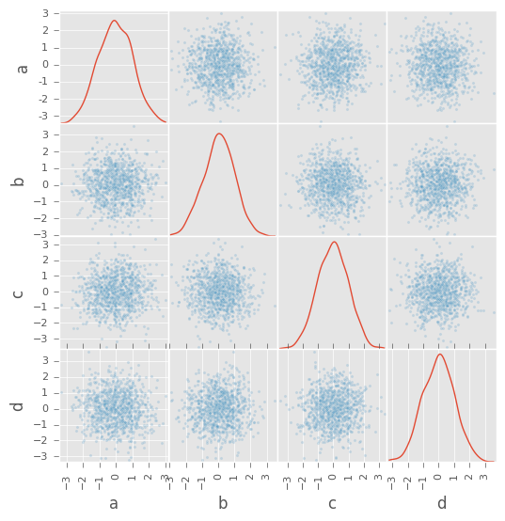
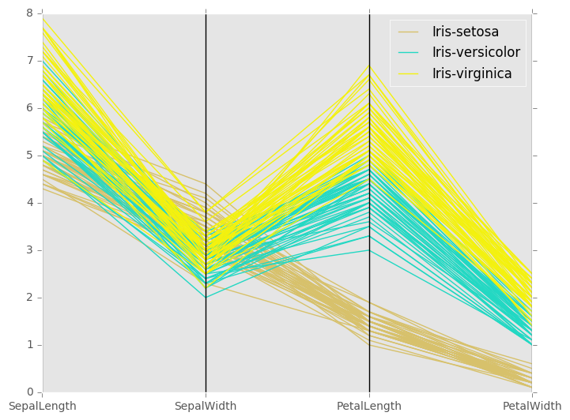
Data Visualization with PANDAS
Source: http://pandas.pydata.org/pandas-docs/stable/visualization.html
Notes:
Alternative graphics might also be required to enhance the understanding of the data.
I’d like to perform data analysis and visualization in Python using the Python Data Analysis Library (PANDAS).
Uses matplotlib API
On the left, I can use scatter plot matrix to look at the correlation between a pair of variables or on the right a parallel coordinate plot to look at the individual attributes.

Slide 19
Methodology
Retrieving Data
Collect data for FARS (2010-14) and TxDOT CRIS (2010-15)
Data Prepossessing
Data cleaning, integration and transformation
Exploratory Spatio-Temporal Data Analysis
Data Model and Space-Time Cube
File Geodatabase for ArcGIS
Explore data and interaction between variables
Visualization techniques (graphs)
3D and 2D data visualization and graphs
Python automation
Notes:
Here is my analytical workflow.
Retrieving data
FARS and TxDOT CRIS data
Data preprocessing
Joining tables and combining data sources
Exploratory Spatio-Temporal Analysis
Understand data and variable interaction.
Data Model and Space-Time Cube

Slide 20
Anticipated Results
3D rending in ArcScene
2D maps and graphs
ESRI Story Map and Web Scene for interactive access to the data
Notes:
My anticipated results. 3D rending in ArcScene, 2D and graph data visualizations and ESRI story map and web scene.

Slide 21
Project Timeline
August 2016 (1 mo.)
September-November (3 mo.)
December 2016 -March 2017
Revise narrative and presentation based on peer review
Complete exploratory spatio-temporal visualization and analysis of crashes
Conference (TBD)
Notes:
Here is my project timeline. In August, I will continue revising my narrative and presentation based on peer review comments. During September-November time frame I will complete the exploratory spatio-temporal visualization and analysis of MVT crashes. This includes the data visualization, 3D rendering in ArcScene and final writeup. Mid-November and NLT December finalize a conference to attend.

Slide 22
References
Bach, B., Dragicevic, P., Archambault, D., Hurter, C., & Carpendale, S. (2014). A Review of Temporal Data Visualizations Based on Space-Time Cube Operations. Eurographics Conference on Visualization (EuroVis), 23–41. http://doi.org/10.2312/eurovisstar.20141171
Bergel-Hayat, R., Debbarh, M., Antoniou, C., & Yannis, G. (2013). Explaining the road accident risk: Weather effects. Accident Analysis and Prevention. http://doi.org/10.1016/j.aap.2013.03.006
Blincoe, L., Miller, T. R., Zaloshnja, E., & Lawrence, B. A. (2014). The Economic and Societal Impact Of Motor Vehicle Crashes, 2010, 2015(May), 306. http://doi.org/10631-052814-v8
DiBiase, D., MacEachren, A. M., Krygier, J. B., & Reeves, C. (1992). Animation and the Role of Map Design in Scientific Visualization. Cartography and Geographic Information Science, 19(4), 201–214. http://doi.org/10.1559/152304092783721295
Field, K., Shepherd, N., & Minard, C. (2013, June 24). Napoleon's March on Moscow 1812-1813 in 3D [Figurative 3D map of the successive loss of French troops during Napoleon's Russian Campaign (1812-1813)]. Retrieved July 08, 2016, from https://www.arcgis.com/home/item.html?id=2b48caaabd0e44028724c5f109f3de97
Hägerstrand, T. (1970). What about people in Regional Science? Papers of the Regional Science Association. http://doi.org/10.1007/BF01936872
Huisman, O., Santiago, I. F., Kraak, M.-J., & Retsios, B. (2009). Developing a Geovisual Analytics Environment for Investigating Archaeological Events: Extending the Space–Time Cube. Cartography and Geographic Information Science, 36(3), 225–236. http://doi.org/10.1559/152304009788988297

Slide 23
References Cont.
Jägerbrand, A. K., & Sjöbergh, J. (2016). Effects of weather conditions, light conditions, and road lighting on vehicle speed. SpringerPlus. http://doi.org/10.1186/s40064-016-2124-6
Kraak, M.-J. (2003). The Space-Time Cube Revisited from a Geovisualization Perspective. 21st International Cartographic Conference (ICC), (August), 10–16. http://doi.org/0-958-46093-0
Kraak, M.-J. (2007). Geovisualization and Visual Analytics. Cartographica: The International Journal for Geographic Information and Geovisualization, 42(2), 115–116. http://doi.org/10.3138/carto.42.2.115
MacEachren, A. M., & Kraak, M.-J. (2001). Research Challenges in Geovisualization. Cartography and Geographic Information Science, 28(1), 3–12. http://doi.org/10.1559/152304001782173970
Nakaya, T., & Yano, K. (2010). Visualising crime clusters in a space-time cube: An exploratory data-analysis approach using space-time kernel density estimation and scan statistics. Transactions in GIS. http://doi.org/10.1111/j.1467-9671.2010.01194.x
Orellana, D., Bregt, A. K., Ligtenberg, A., & Wachowicz, M. (2012). Exploring visitor movement patterns in natural recreational areas. Tourism Management, 33(3), 672–682. http://doi.org/10.1016/j.tourman.2011.07.010
Plainis, S., Murray, I. J., & Pallikaris, I. G. (2006). Road traffic casualties: understanding the night-time death toll. Injury Prevention : Journal of the International Society for Child and Adolescent Injury Prevention, 12(2), 125–8. http://doi.org/10.1136/ip.2005.011056

Slide 24
References Cont.
Yusof, N., Zurita-Milla, R., Kraak, M.-J., & Retsios, B. (2016). Interactive discovery of sequential patterns in time series of wind data. International Journal of Geographical Information Science, 8816(January), 1–21. http://doi.org/10.1080/13658816.2015.1135928

Slide 25
Acknowledgements Dr. James O’Brien Lance Panzer
Notes:
I wanted to give a special thanks to my advisor and a recent master’s graduate Lance Panzer (formally Lance Armstrong).

Slide 26
Questions?
Notes:
This concludes my presentation. I will be happy to answer any questions you may have.

Slide 27
Crash Point
(attribute)
t
t
Saturday
y
y
2D Map
High Risk
Road Segment
x
x

Slide 28
Crash Point
(attribute)
t
Saturday
y
2D Map
High Risk
Road Segment
x

