Slide 1
Using a Web Application to Automate Geospatial Data in Zoos
Libbie Duskin
Advisor – Adrienne Goldsberry
Geog 596A
October 26, 2021

Slide 2
Outline
Importance of Animal Behavior
Location Based Behavioral Studies
Previous Methods of Location Based Behavioral Studies
Studies Using GPS and Accelerometers
Findings & Limitations
Proposed Web Application
Goals & Research Applications
Research Summary & Questions
Methods
Summary
Next Steps

Slide 3
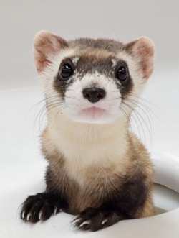
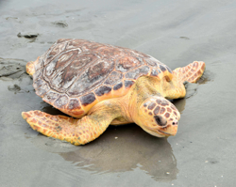
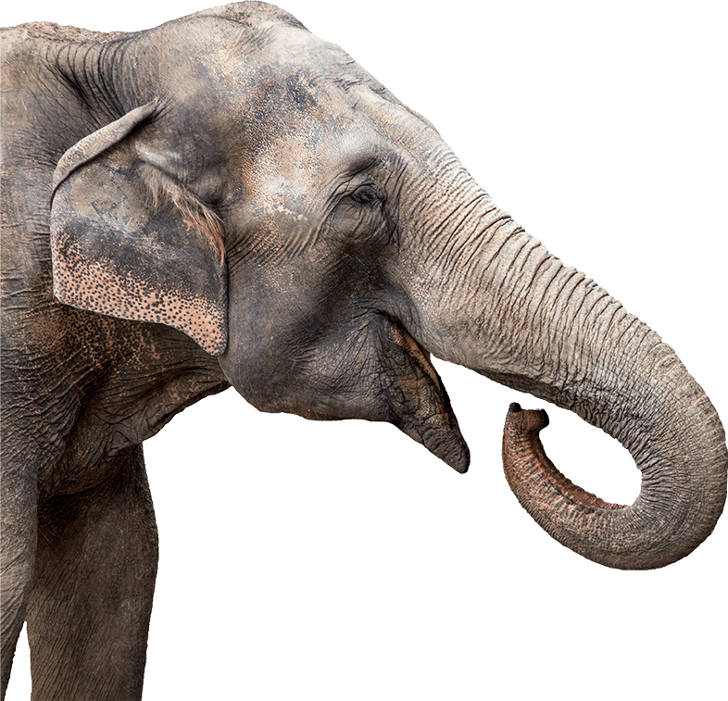
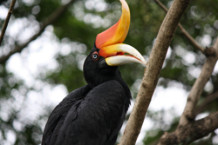
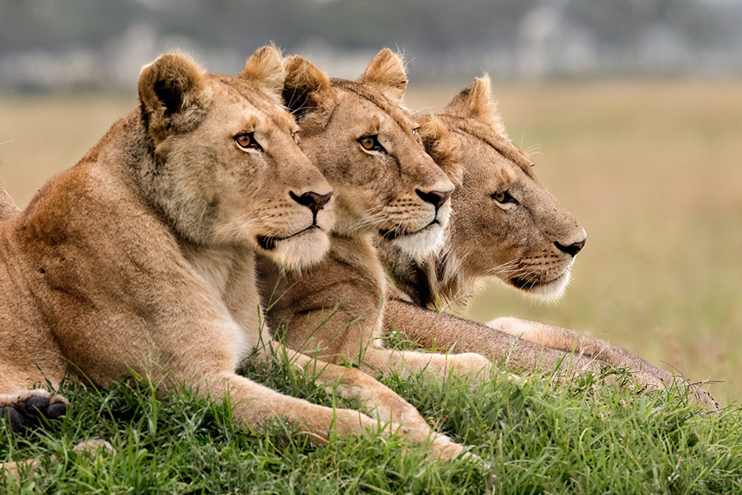
Introduction
Zoological facilities are a resource for:
Research
Rehabilitation
Conservation
All photos courtesy of AZA.org

Slide 4
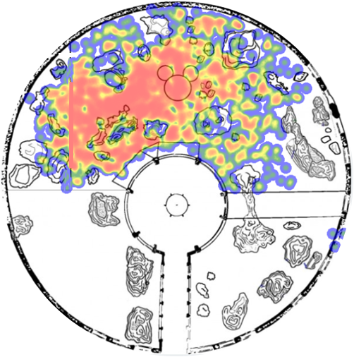
Background

Slide 5
Animal Behavior
Baseline behaviors are important for understanding changes that may indicate:
Medical Issues
This is especially relevant to reproductive behaviors
Diet Changes
Enrichment Needs
Photo courtesy of Utah Hogle Zoo

Slide 6
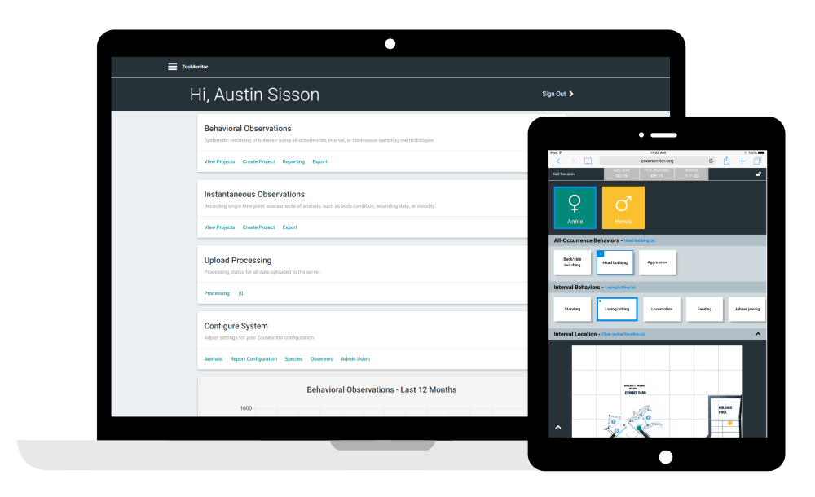
Tracking Location-Based Behavioral Data
Traditionally, facilities have had to track location-based behaviors manually.
These are valuable tools, but they have limitations:
Time
Staffing
Photo courtesy of ZooMonitor.org

Slide 7
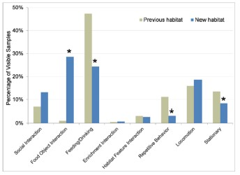
Asian Elephants at the Oregon Zoo – Dr. Sharon Glaeser
Data from Glaeser et al. (2021).

Slide 8
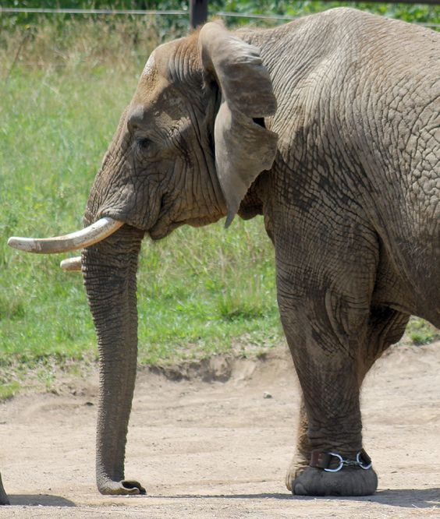
Global Positioning Systems (GPS)
Animal location can be tracked using GPS:
Allows for continuous location monitoring
Can be worn as a collar, bracelet or temporary attachment
No need for human monitoring
Photo courtesy of Indianapolis Zoo
Limitations:
Expensive
Desensitivity Training
Doesn't Track Specific Behaviors
Running
1
2
Walking
1
2

Slide 9
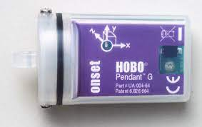
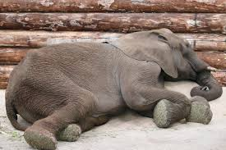
Accelerometers
Orientation can be measured on an XYZ axis:
For elephants, the focus is on recumbence patterns.
Photo courtesy of HOBO Data Loggers
Recumbence is a posture measurement that can be paired with a GPS location.
Photo courtesy of Stackexchange.com
Photo courtesy of Dallas Zoo

Slide 10
Geospatial Role in Understanding Animal Movement & Behaviors
Social dynamics & habitat preferences (Ho et al., 2020)
Critical habitats for wild animals & responses to anthropogenic factors (Katzner et al., 2020)
Frequency, location and social dynamics (Watters et al., 2009)
Animal health & welfare
Stereotypic behaviors (Greco et al., 2017)
Exercise

Slide 11
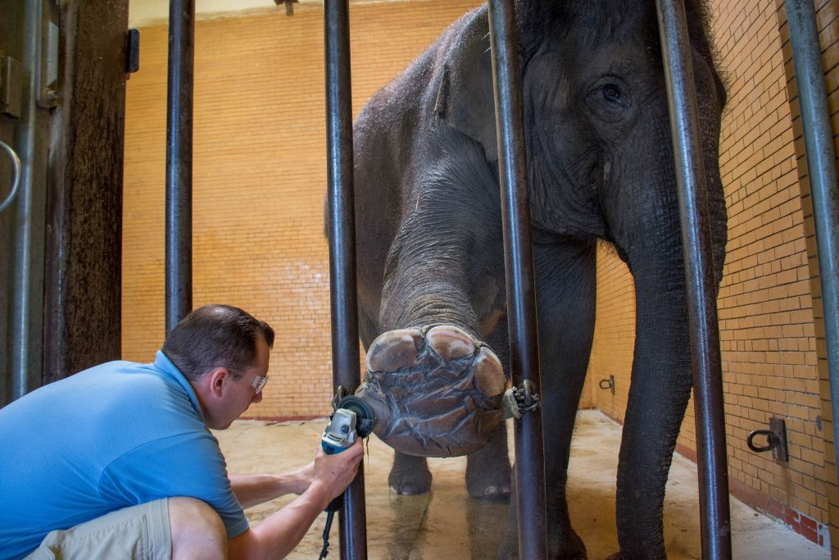
Why Does Location and Position Matter for Elephants?
Exercise
Stereotypic Behaviors
Hoof Health
Recumbence
Photo courtesy of Buffalo Zoo

Slide 12
Limitations for GPS and Accelerometer Data in Zoos
Analysis
Access to technology
Time

Slide 13
Goals & Research Applications
Create a free tool that zoos can utilize to upload their own GPS and accelerometer data and therefore:
Summarize GPS Data
Summarize Accelerometer Data

Slide 14
Research Summary & Questions
ArcGIS Online Web AppBuilder can be used to create an app that summarizes GPS and accelerometer data. This application will be used to recreate GPS summary data from the Oregon Zoo elephants and then analyze previously collected accelerometer data.
What are the recumbence patterns of the elephants from the Oregon Zoo and how did the patterns change during the time they were in their old habitat and transitioning to their new habitat?
What geospatial tools can be used to analyze these patterns?

Slide 15
Web Applications for Automation of Data Analysis - Methods
Acquire data from the Oregon Zoo
Create custom application using ArcGIS Web AppBuilder that allows for data upload
Data Widgets
Identify necessary data formats for upload
Recreate GPS summary outputs of Glaeser et al. 2021 using the application
Analyze accelerometer data to identify recumbence patterns

Slide 16
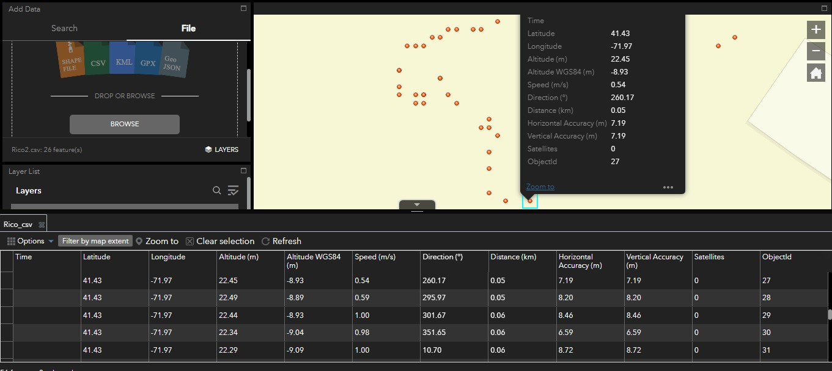
Example Application

Slide 17
Summary
This project will aim to support zoological facilities by providing a free analysis tool for GPS and accelerometer data gathered. This data is valuable for monitoring animal health, welfare, informing species management decisions and therefore species conservation. Analysis and use of this data should not be limited by access, time or knowledge constraints.

Slide 18
Next Steps
Acquire the previously collected GPS and accelerometer data from the Oregon Zoo
Create a Web Application
Test with GPS data from the Oregon Zoo
Modify the application with feedback
Utilize the application to analyze accelerometer data

Slide 19
Citations
Association of Zoos and Aquariums. (n.d.). About Us. Retrieved September 14, 2021, from https://www.aza.org/about-us
Glaeser, S. S., Shepherdson, D., Lewis, K., Prado, N., Brown, J. L., Lee, B., & Wielebnowski, N. (2021). Supporting Zoo Asian Elephant (Elephas maximus) Welfare and Herd Dynamics with a More Complex and Expanded Habitat. Animals, 11(9), 2566.
Greco, B. J., Meehan, C. L., Heinsius, J. L., & Mench, J. A. (2017). Why pace? The influence of social, housing, management, life history, and demographic characteristics on locomotor stereotypy in zoo elephants. Applied Animal Behaviour Science, 194, 104-111.
Holdgate, M. R. (2015). Applying GPS and accelerometers to the study of African Savanna (Loxodonta africana) and Asian elephant (Elephas maximus) welfare in zoos (Doctoral dissertation, Portland State University).
Holdgate, M. R., Meehan, C. L., Hogan, J. N., Miller, L. J., Rushen, J., de Passillé, A. M., ... & Shepherdson, D. J. (2016). Recumbence behavior in zoo elephants: determination of patterns and frequency of recumbent rest and associated environmental and social factors. PLoS One, 11(7), e0153301.
Ho, N. K. P., Duskin, L., Price, C., & Metrione, L. (2020). Visualizing Sand Tiger Shark (Carcharias taurus) Space Use in Aquariums using ZooMonitor and ArcGIS. Drum and Croaker, Volume 51, p. 158.
Katzner, T. E., & Arlettaz, R. (2020). Evaluating contributions of recent tracking-based animal movement ecology to conservation management. Frontiers in ecology and evolution, 7, 519.
Watters, J. V., Margulis, S. W., & Atsalis, S. (2009). Behavioral monitoring in zoos and aquariums: a tool for guiding husbandry and directing research (Vol. 28, No. 1, pp. 35-48). Hoboken: Wiley Subscription Services, Inc., A Wiley Company.

