Slide 1
Evaluating Watershed Delineation Discrepancies Between the HUC 12 Watershed Boundary Dataset and ArcGIS Auto Delineation
Case study: Heavily Mined Landscape in the West Virginia Upper Guyandotte Watershed
Cori Edwards

Slide 2
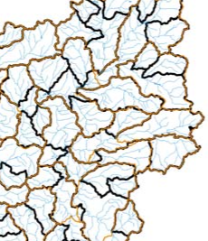
Introduction
Introduction
Purpose
Data
Delineation Process
Analysis
Conclusion
Watershed delineations provide an important basis for environmental study and watershed management.
The National Resources Conservation Service (NRCS) developed the Watershed Boundary Dataset (WBD) requiring 1:24,000 spatial accuracy standards used extensively by scientists and within hydrologic models.
Geographic Information Systems, such as ArcGIS, contain watershed delineation tools producing boundaries for the same areas that vary compared to the NRCS WBD and may impact environmental models.
(Stanton, 2001)

Slide 3
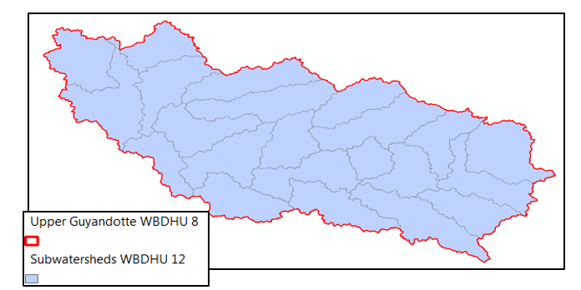
Introduction
Introduction
Purpose
Data
Delineation Process
Analysis
Conclusion
Area of Interest:
Upper Guyandotte HUC 8 containing 22 HUC 12 subwatersheds
Notes:
Logan, Wyoming, and Raleigh Counties in West Virginia
Hierarchical nature of HUCs

Slide 4
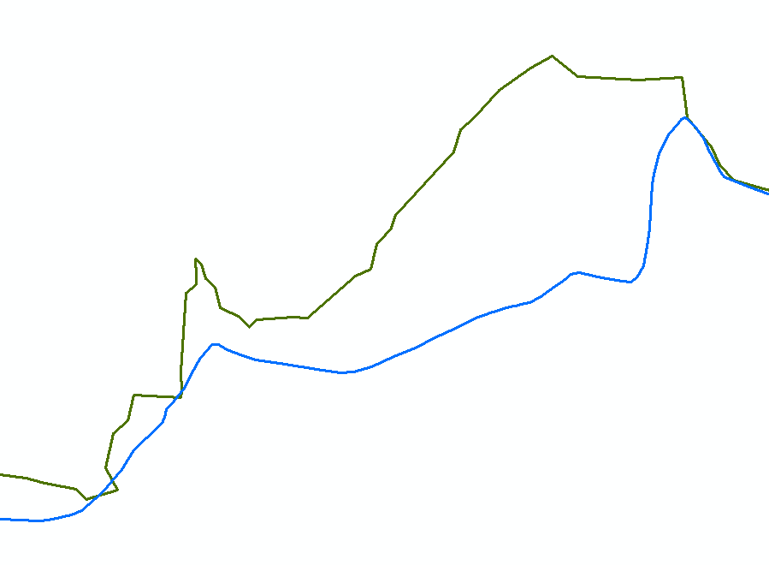
Introduction
Introduction
Purpose
Data
Delineation Process
Analysis
Conclusion
Variance – An area in which the NRCS WBD HUC 12 delineations differ from the ArcGIS delineations by ± 40 feet and encompass at least 5 acres.
NRCS WBD HUC 12
ArcMap Delineation

Slide 5
Purpose
Introduction
Purpose
Data
Delineation Process
Analysis
Conclusion
This project will:
Quantify the magnitude of differences between NRCS WBD HUC 12 delineations and ArcGIS delineations. (Variances)
Determine if patterns exist within Variances and if specific landscape characteristics correlate with these patterns
Explore the relationship between Variances and mountaintop removal mining
Examine the impact of watershed variation on hydrologic model analysis specifically, the watershed lag method of calculating time of concentration.

Slide 6
GIS Data
Introduction
Purpose
Data
Delineation Process
Analysis
Conclusion
Required Downloadable Data
NRCS HUC 12 Watershed Boundaries
NRCS Flowlines
2011 NLCD Land Use
USGS 10 meter NED
WV Sheriff Association Aerial Imagery
USGS Topographical maps
WV TAGIS LiDAR
WV DEP Mining Permitted Boundaries

Slide 7
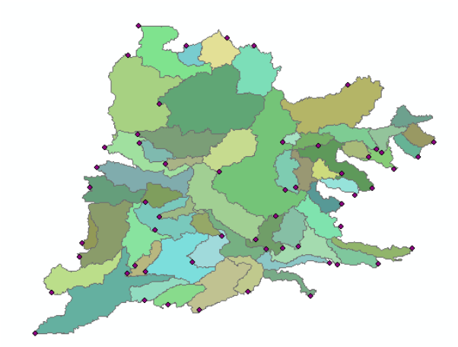
Desktop Delineation
Introduction
Purpose
Data
Delineation Process
Analysis
Conclusion
Create a depression less elevation raster by filling sinks
Create a flow direction raster
Create a flow accumulation raster
Create pour points
Delineate watersheds
Convert watershed rasters to polygons

Slide 8
Quantifying Significant Discrepancies
Introduction
Purpose
Data
Delineation Process
Analysis
Conclusion
Create Variance features:
Auto Delineation varies from NRCS WBD 12 digit HUCs
The variation extends more than 40 feet from the NRCS standard
The variation exceeds 5 acres
NRCS WBD HUC 12
ArcMap Delineation

Slide 9
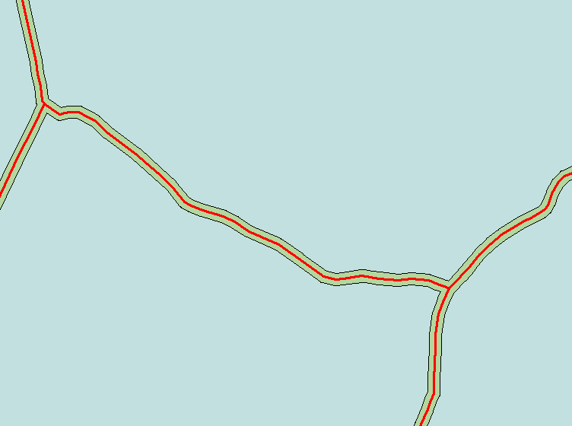
Quantifying Significant Discrepancies
Introduction
Purpose
Data
Delineation Process
Analysis
Conclusion
Apply Buffer:
NRCS WBD HUC 12
± 40 foot Buffer
Restrict to Variances ≥ 5 acres

Slide 10
Quantifying Significant Discrepancies
Introduction
Purpose
Data
Delineation Process
Analysis
Conclusion
Area (acres) NRCS HUC 12
Area (acres) ArcGIS Delineation
Absolute Value Percent Difference
Percent NRCS HUC included in ArcGIS Delineation
Percent NRCS HUC Underestimated by ArcGIS Delineation
Percent NRCS HUC Overestimated by ArcGIS Delineation
Positive Variance Count
Negative Variance Count

Slide 11
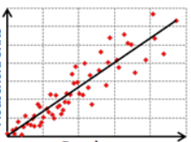
Overall Area Analysis
Is the occurrence of total Variance per HUC related to the overall HUC area? Illustrate the degree of correlation using a scatterplot.
Introduction
Purpose
Data
Delineation Process
Analysis
Conclusion
Example:
Number of Variances within each HUC 12
(http://pro.arcgis.com/en/pro-app/tool-reference/spatial-statistics/regression-analysis-basics.htm)
HUC12 Area

Slide 12
Identifying Patterns
Introduction
Purpose
Data
Delineation Process
Analysis
Conclusion
Quantify Variance Attributes:
Acreage
Mean elevation
Maximum elevation
Minimum elevation
Predominant slope aspect
Average slope
Predominant land use
Presence of mining activities

Slide 13
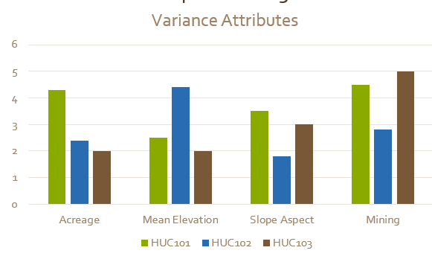
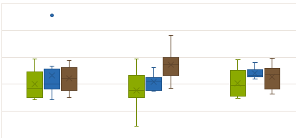
Nominal Data Patterns
Introduction
Purpose
Data
Delineation Process
Analysis
Conclusion
Employ histograms to study data frequency for each Variance attribute.
Incorporate box plots to display the median and interquartile range of measurable data including slope.

Slide 14
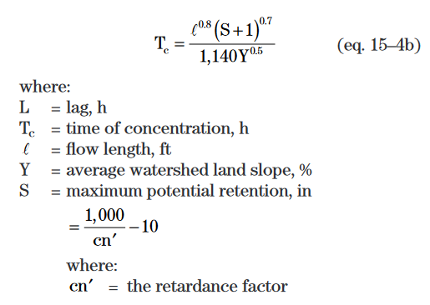
Impact on Time of Concentration Equation
Calculate the longest flow path for all HUC 12 subwatersheds, NRCS and ArcMap delineated.
(NRCS U. , 2010)
Calculate the time of concentration using the watershed lag method for five with the largest difference in longest flowpath to demonstrate the effect watershed delineation has on a practical level.
Introduction
Purpose
Data
Delineation Process
Analysis
Conclusion
Notes:
The difference have to occur in a very specific part of the watershed to impact this calculation? Are you expecting a difference there?

Slide 15
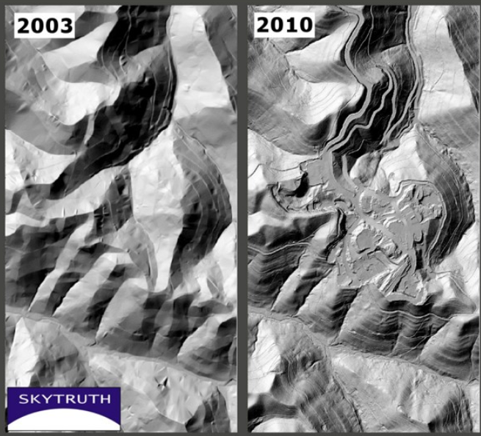
Delineations Affected by Mountaintop Removal
Introduction
Purpose
Data
Delineation Process
Analysis
Conclusion
Highlight the presence and magnitude of Variances within mountaintop removal locations.
(https://www.skytruth.org/issues/mining/#toggle-id-1)
Notes:
3-D terrain analysis of the Spruce #1 Mine in Logan County, depicting the complete rearrangement of the mountain between 2003 and 2010.

Slide 16
Conclusion
Introduction
Purpose
Data
Delineation Process
Analysis
Conclusion
It is hypothesized that:
Discrepancies in auto delineated subwatersheds exceed the 40 foot accuracy standards for over half of the delineations when compared to the HUC 12 boundaries.
Patterns will emerge in the areas of greatest discrepancy corresponding to specific land uses, elevations, slopes, and most especially, mining.
There exists a positive correlation between HUC size and total number of Variances.
Delineation discrepancies produce minor, potentially insignificant, impact on hydrologic analysis and management decisions.

Slide 17
Questions?

Slide 18
References
Council, N. R. (1997). Watershed Research in the U.S. Geological Survey. (T. N. Press, Ed.) Retrieved from https://www.nap.edu/read/5589/chapter/5#27
EnviroAtlas. (2017, November 4). Hydrologic Unit Codes: HUC 4, HUC 8, and HUC 12. Retrieved from EnviroAtlas Fact Sheet: https://enviroatlas.epa.gov/enviroatlas/DataFactSheets/pdf/Supplemental/HUC.pdf
Environmental Systems Research Institute, I. (2016). ArcMap Flow Direction. Retrieved from http://desktop.arcgis.com/en/arcmap/10.3/tools/spatial-analyst-toolbox/flow-direction.htm#I_ESRI_TOOLILLUSTRATION_A258E137E9EF46ECB02641E2FD4462CE
Environmental Systems Research Institute, I. (2016). ArcMap Union. Retrieved from http://desktop.arcgis.com/en/arcmap/10.3/tools/analysis-toolbox/union.htm
NRCS. (2007, June 18). Watersheds, Hydrologic Units, Hydrologic Unit Codes, Watershed Approach, and Rapid Watershed Assessments. Retrieved from https://www.nrcs.usda.gov/Internet/FSE_DOCUMENTS/stelprdb1042207.pdf
NRCS. (n.d.). Watershed Boundary Dataset (WBD) Overview. Retrieved from History of Hydrologic Units and Supporting Documents: https://www.nrcs.usda.gov/wps/portal/nrcs/detail/national/water/watersheds/dataset/?cid=nrcs143_021623
NRCS, U. (2010). National Engineering Handbook. In U. NRCS, National Engineering Handbook. Retrieved December 2, 2017, from https://policy.nrcs.usda.gov/OpenNonWebContent.aspx?content=27002.wba
Sarah Irwin, R. S. (2014). Instruction for Watershed Delineation in an ArcGIS Environment for Regionalization Studies. Water Resources Report, University of Western Ontario, Department of Civil and Environmental Engineering. Retrieved from https://www.eng.uwo.ca/research/iclr/fids/publications/products/87.pdf
Stanton, G. P. (2001). A Comparison of Manual and Computer-Assisted Drainage Delineated Methods for Hydrologic-Unit Map Development . Retrieved from http://topsoil.nserl.purdue.edu/nserlweb-old/isco99/pdf/ISCOdisc/SustainingTheGlobalFarm/P047-Stanton.pdf
Tetra Tech, U. R. (2009, December 11). Loading Simulation Program in C++ (LSPC) Version 3.1 User Manual. Retrieved November 4, 2017, from http://dpw.lacounty.gov/wmd/wmms/docs/LSPC-UserManual.pdf
USGS. (2014, October 20). Hydrography. Retrieved November 4, 2017, from Frequently Asked Questions about the NHD & WBD Datasets: https://nhd.usgs.gov/Frequently+Asked+Questions+about+the+NHD+&+WBD.htm
USGS. (2014, October 20). Hydrography. Retrieved from United States Geological Survey: https://nhd.usgs.gov/Frequently+Asked+Questions+about+the+NHD+&+WBD.htm
USGS. (2017, November 04). Hydrologic Unit Maps. Retrieved from USGS Website: https://water.usgs.gov/GIS/huc.html
Xu, C.-y. (2002). Textbook of Hydrologic Models. Uppsala, Sweden: Uppsala University. Retrieved from http://www.soil.tu-bs.de/lehre/Master.Unsicherheiten/2012/Lit/Hydrology_textbook.pdf

