Slide 1
ArcGIS for Developers Customizing ESRI Web App Builder Public Notification Widget
Laura Emerson
October 24 2018 Advisor James O'Brien

Slide 2
Presentation Outline
Introduction
Examples – What is public notification?
Legal reasons – Why does public notification exist?
Current GIS Platform Solutions
Processes Learned & Implemented at Penn State
Capstone Project Idea
Methods
Software/Data
Timeline
Presentation Venue

Slide 3
Introduction
Family Business 20+ years
Methodology has changed, now Computer Based
Seek new methods to stay relevant
Discovering GIS through Community College
Enrolling in Penn State Certificate Program > MGIS

Slide 4
Glossary of Terms
Parcel Map – a map used to show parcel lines, lot lines. This is provided at the county level, by the county assessor. Originally published as pdf sheets, some of the parcel maps have been digitized by the county and are available in a shapefile format for download. Third party vendors digitize areas where counties lack the resources to do so.
Ownership List – a list of all property owners located in a buffer area. The owner data is obtained at the county level. All property owners on record are published in the assessor roll which is updated at different frequencies depending on the county structure.
Buffer – a radius line that is drawn in a circle around a parcel at a determined distance. The buffer line is used to determine what parcels are located within a public notification distance. The distance is specified at the state level and can be increased at a city level if deemed necessary by a city.
Keying – Using a number system, each parcel number on a map is assigned a unique number which corresponds to the list of parcels on a data report/ownership list. The parcel number from the map is “keyed” to the parcel address on the list. The key number is a guide that helps facilitate fact checking by a processing officer.
Sorting – data can be sorted in numeric order by parcel number. Once the data is sorted, it can then be “keyed”. Most jurisdictions request the ownership list to be formatted and sorted ascending by parcel number

Slide 5
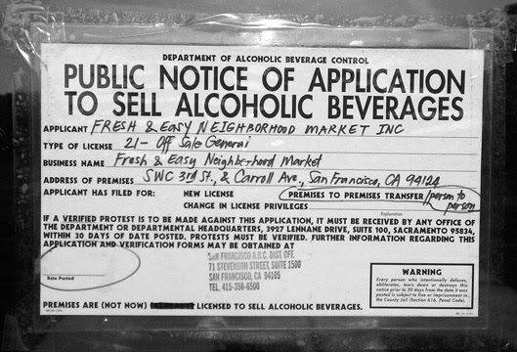
Examples of Public Notification
Air Quality Control District
Alcohol Beverage Control
Road Construction

Slide 6
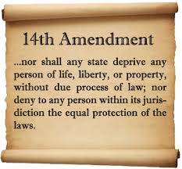
Legal Background
Constitution State Level
The California government code states that public notification should be handled as follows, “(Public) Notice of a hearing shall be mailed or delivered at least 10 days prior to the (public) hearing to all owners of real property as shown on the latest equalized assessment roll within 300 feet of the real property that is the subject of the hearing.”

Slide 7
County of Los Angeles Data Portal
Pros:
- Query parcels
- Measure distance
GIS public resource
Restrictions:
No option to buffer parcels
No option to export data

Slide 8
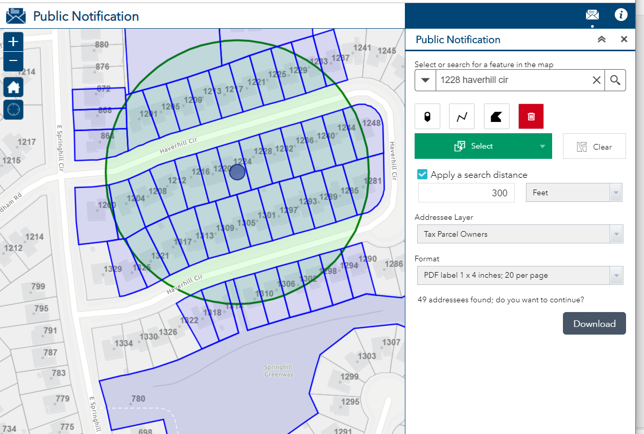
ESRI Public Notification Widget
Pros
Best current solution
Select parcel
Buffer distance
Point/line/polygon/custom shape available
Export data into label format
Limitations
Requires data import/set up
No option to print a map layout
No ability to change parcel properties (ex color, outline)
No option to key the data
No option to export a combined owner & occupant list that eliminates duplicate occupant addresses.
No option to zoom out to map extent once drawing buffer

Slide 9
What I have accomplished so far at Penn State
GEOG 485 Created a Custom Toolbox using Python Code that automated a portion of public notification work flow in ArcMap.
Encouraged to take that a step further…
GEOG 865 Web Server – attempted to ESRI Public Notification App

Slide 10
Capstone – What I want to do
Customize an existing ESRI out of the box application to fit current business needs and support the company workflow.
The application will provide increased functionality that can:
Key parcels
Label parcels
Produce a map PDF exhibit
Sort and eliminate duplicate data
Create custom reports with a header for report information and company logo

Slide 11
Capstone – How I am going to do it
Collect & Format Data – (5) Counties
Download Database City by City to save costs
Download county parcel shapefiles
Standardized Owner Data & APN format with ASAP Utilities in Excel
Create a python script to update data monthly
Create pilot program with City of Costa Mesa occupant data
2. Customize WebApp Widget
Work on custom code in Visual Studio & ArcGIS Developers portal
Determine Hosting Environment (ArcGIS Online or Amazon EC2)

Slide 12
Capstone - Data
Selected by availability in area. The only data sources in our territory are the county, post office, Corelogic and Cole Directories. Data procurement was based on availability and did not go through a proposal stage.
Corelogic – contracted data
County Shapefile parcel outlines – published for public use
USPS – published for public use
Cole Directories – contracted data

Slide 13
Capstone – Software/Applications
Chosen for functionality and current working knowledge.
ESRI ArcGIS Advanced license (ArcMap & ArcPro)
Hosting (ArcGIS Online or Amazon EC2)
Amazon Lambda – consideration for hosting management
Data storage options (Excel, SQL, S3 bucket, EC storage)
Visual Studio for custom coding
ArcGIS for Developers (Public Notification Widget template)

Slide 14
Project Timeline
Month | Deliverables
October | Finish Capstone Proposal Enroll in GEOG 489 (Application Design) Oct 11th Attend ESRI Local Government Meeting Oct 18th Present Proposal to Advisors & Peers Oct 24th
November | Watch Lynda tutorials on Visual Studio Code Watch ESRI tutorials on ArcGIS Developers platform. Start practicing the coding examples to familiarize how to customize the ESRI web app widget Attend Amazon Re-Invent November 26-30th Objectives – to test EC2 hosting, S3 bucket data solutions & Lambda management. Attend ESRI Local Government Meeting Nov 15th
December | Determine hosting environment (Amazon or ArcGIS Online)

Slide 15
Project Timeline Continued
January | Start GEOG 489 Work on customizing web app widget further
February | Finish customization of web app widget Prepare slides and presentation materials for Conference
March | Present at ESRI Developer Summit March 5th - 8th
April | Work on Capstone Paper. Finalize draft, re-write sections for clarity
May | Tentative Graduation

Slide 16
Questions?

