Slide 1


Custom Fleet Management Tracking Using
Presenter: Matthew Erb
Advisor: James O’Brien
Spring 2016
GEOG 596A Capstone Project Peer Review
Penn State University
Master of Geographic Information Systems

Slide 2
Agenda
Define Problem Set
Existing Process
Existing Functionality
Project Requirement Needs and Wants
Cost Analysis
CarChip Connect Setup
CarChip Connect Functionality Demo
CarChip Connect Developer API
Requirement Needs and Wants Met
Timeline

Slide 3
Problem Set
Local Tampa, FL print and copy service company, Dex Imaging
Over 200 service vehicles to track in 5 states in SW U.S.
Two vehicle types to track: Mechanical Techs and Systems Engineers
Currently using US Fleet Tracking but has exorbitant costs and not enough features
Dex Imaging uses separate e-automate database to record service call information
Remote Tech is used as the mobile device interface to e-automate
E-automate and Remote Tech do not completely synch as needed to US Fleet Tracking

Slide 4
Existing Process
Service call placed in E-Automate
Service call data pushed to US Fleet Trackers servers
Dispatch staff looks at map to visually determine closest technician
  Mechanical techs and Systems Engineers receive different call types
    This would need to be mapped from call types in E-Automate

Slide 5
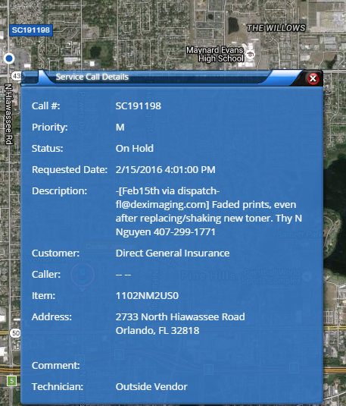
Existing Functionality
Tech is color coded with a unique color
  Techs are grouped by DEX office and tech type: ie: Sarasota Mechanical
  When assigned to a call, the service call and tech are assigned the same color
  Stores as “Position” in E-Automate database on technician record
  Supervisors are red – can be driven by custom property in E-Automate
Click on tech
  Name
  GPS data
  Address
  Arrived – they would like to see this driven from Remote Tech
Click on Service Call (See Screen Shot)

Slide 6
Project Requirement Needs
Significant cost savings of new vendor
Service calls placed in E-Automate must display in fleet management software
Match the color to type of service call/vehicle
Separate display color for field supervisor
Click on tech vehicle to see name, GPS data, and address
No more than 1 minute to update vehicle movement and color code assigned/unassigned
Accurate geocoding
Map filters
  Calls
    Call status
    Territory
  Techs
    Need to review map

Slide 7
Project Requirement Wants
Traffic displayed in GUI
Label or change color of technician when in route or stopped
Fleet management software recommends closest tech to call
Would like hyperlink to Remote Tech when clicking on the fleet management vehicle for attributes to popup

Slide 8

Cost Analysis
Client goal is to reduce costs significantly, no metric
Current US Fleet Tracking costs are $8000 per month
Competing vendor quote is $4500 per month
CarChip Connect quote is $4500 for the first year and $2500 for subsequent years
  Increased first year costs are to pay for the purchase of 200 GPS devices

Slide 9
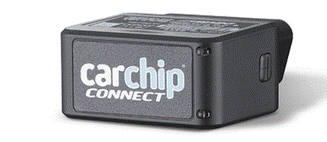
CarChip Connect Setup
Vendor activates hardware
Install hardware on car OBD-II port
LEDs will indicate a connection to the vehicle and cellular network
Login to website to track vehicles

Slide 10
CarChip Connect Functionality Demo
Vehicle
  Street view
  Last trip
Location
Fleet
Location Alerts
Traffic
Manage
Scorecard
Report
  Target Usage Report (slow to load)
Settings

Slide 11
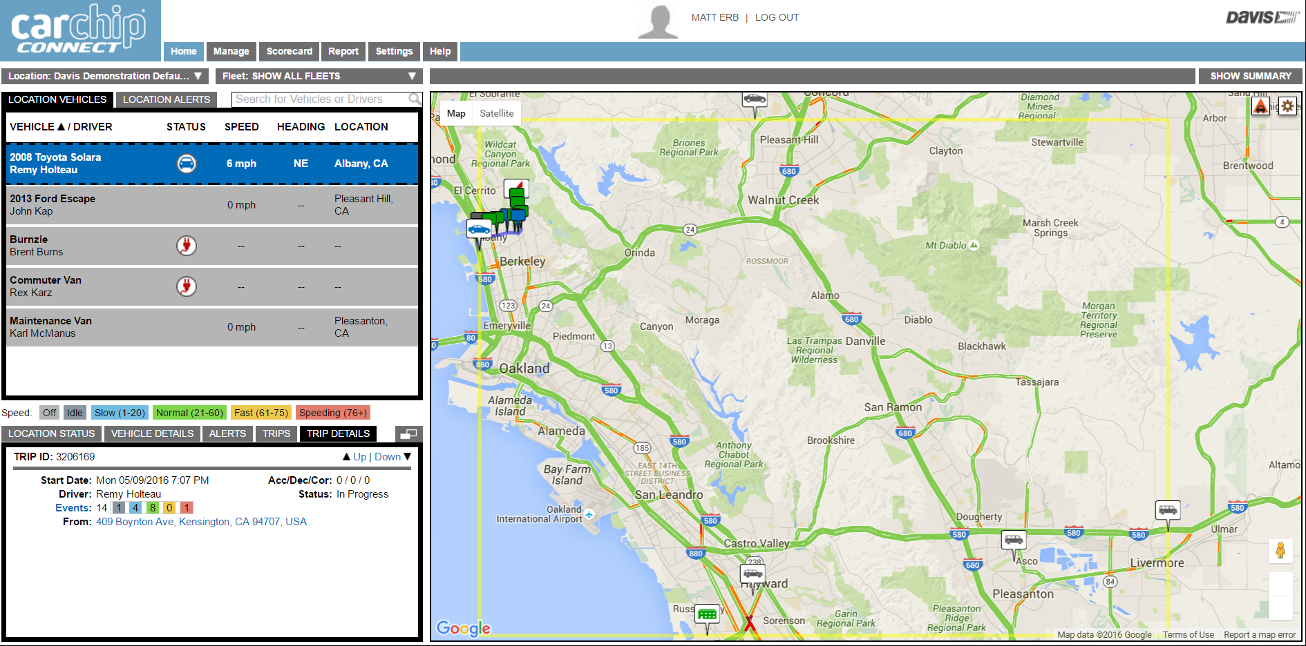
CarChip Connect Main Screen

Slide 12
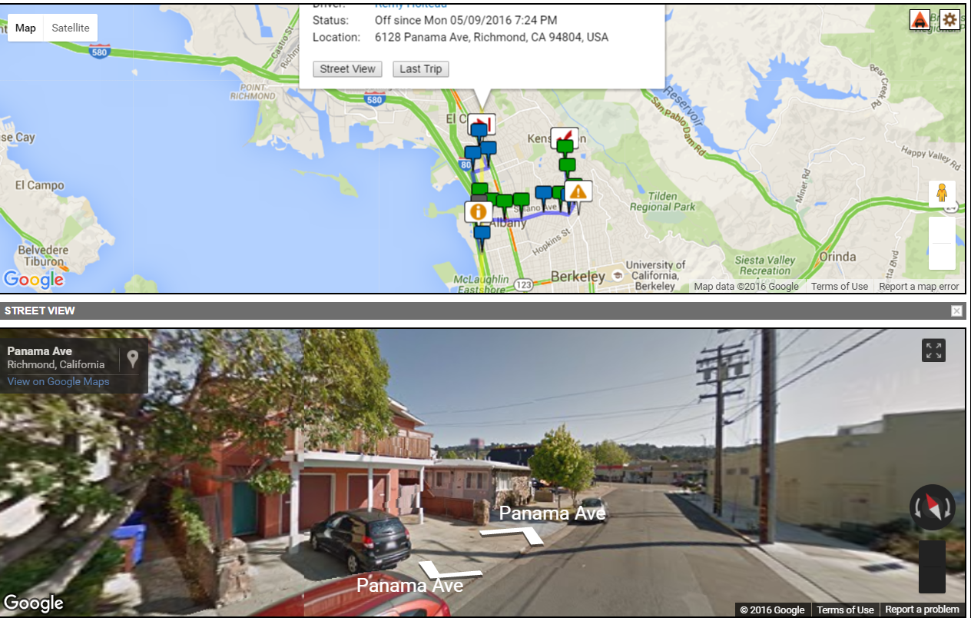
Last Trip and Street View

Slide 13
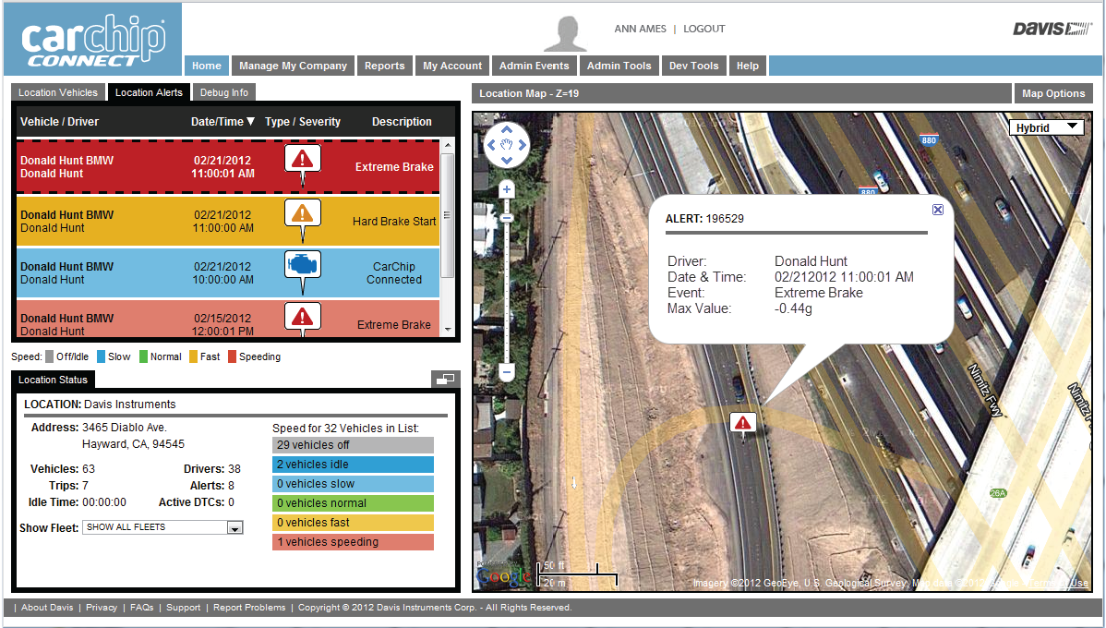
Safety Alerts

Slide 14
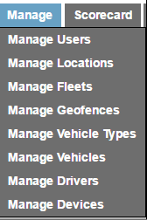
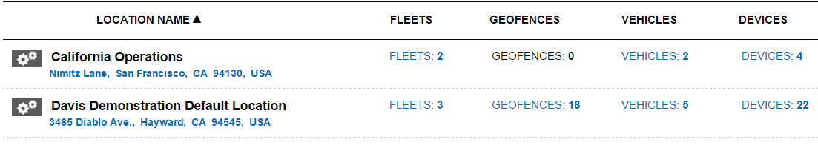
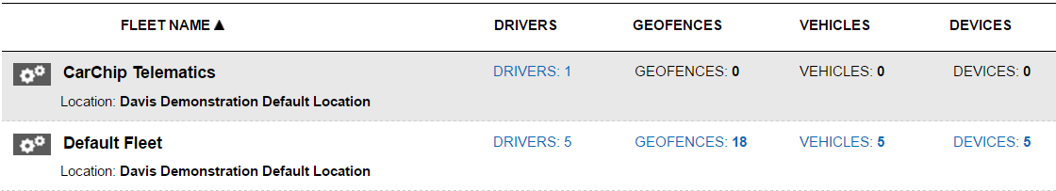
Manage Tab Features

Slide 15
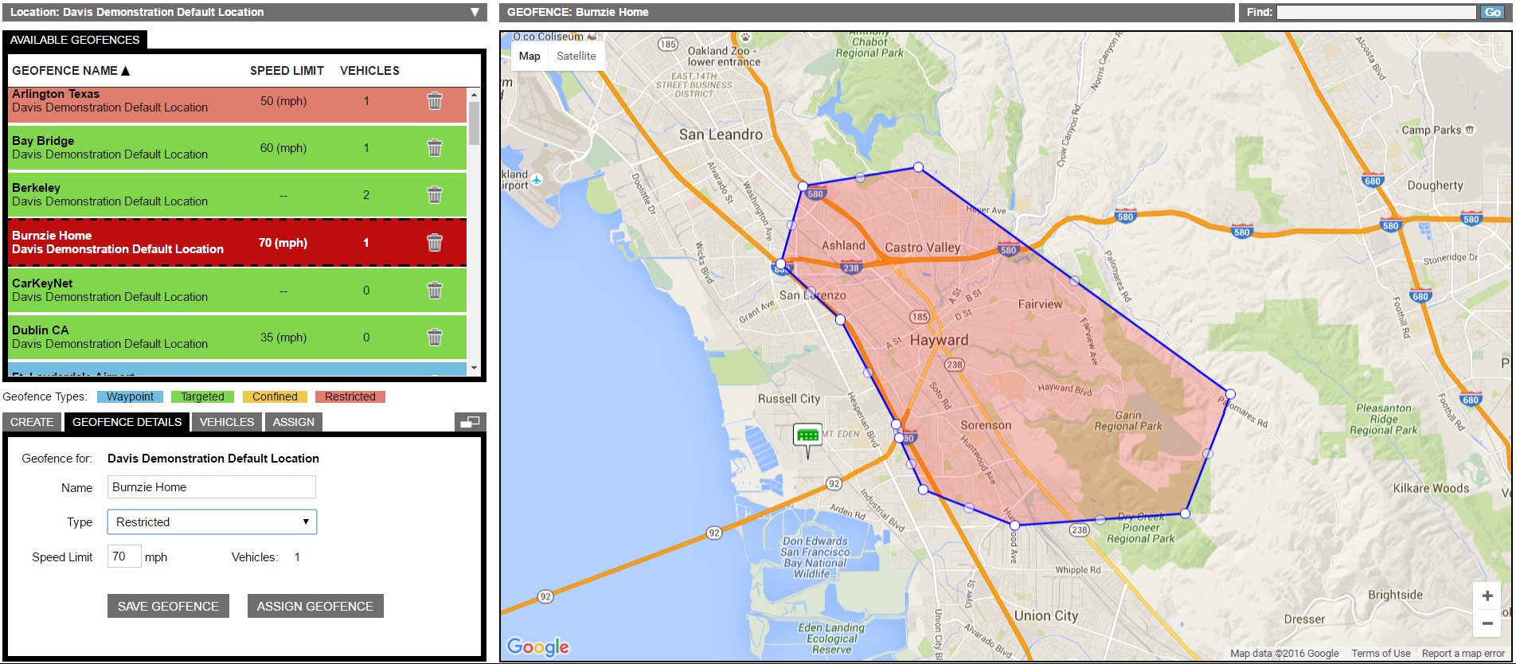
Geofence
User defined
255 definable Geofences
Restricted Zones
Stay out of “red zones”
Confined Zones
Stay within a perimeter
Targeted Zones
Time in specific zones
Waypoint Zones
Informational
Neutral to scoring

Slide 16
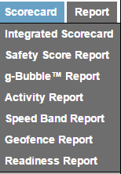
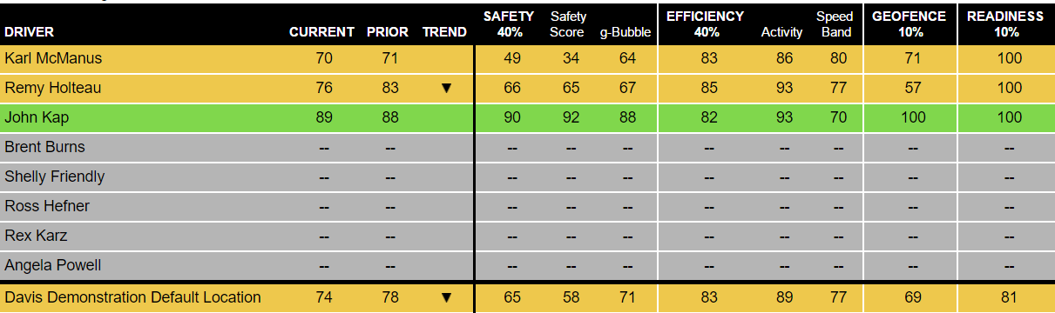
Scorecard

Slide 17
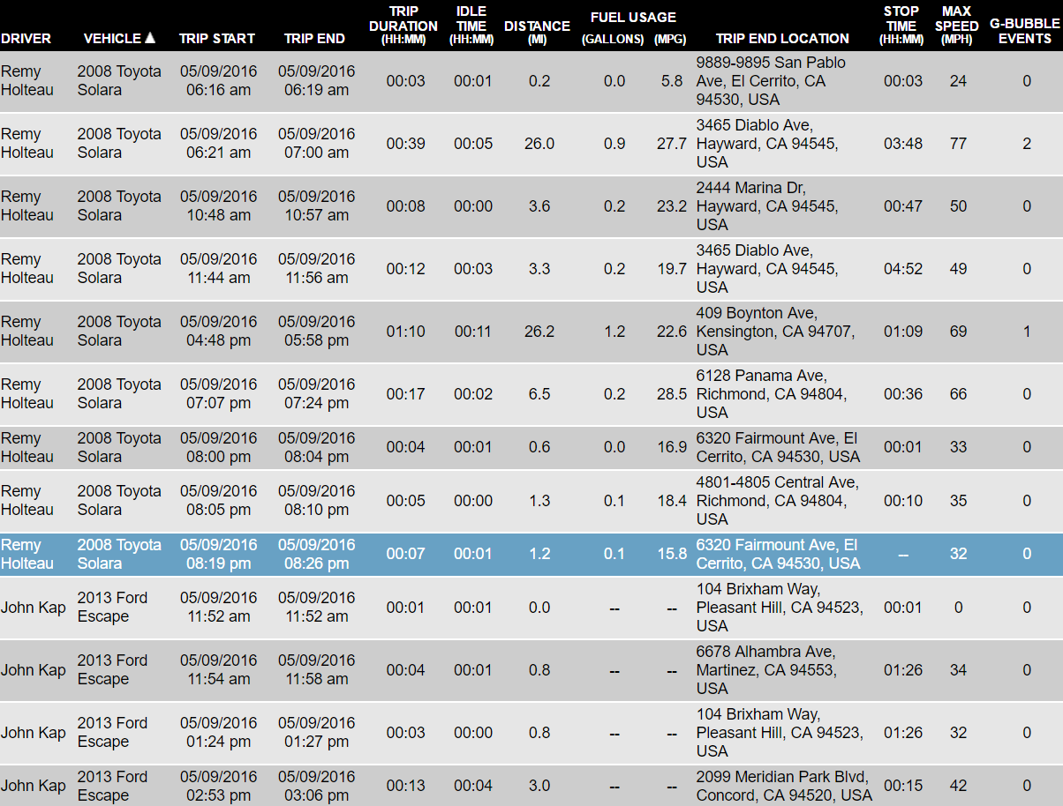
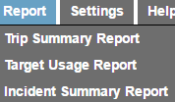
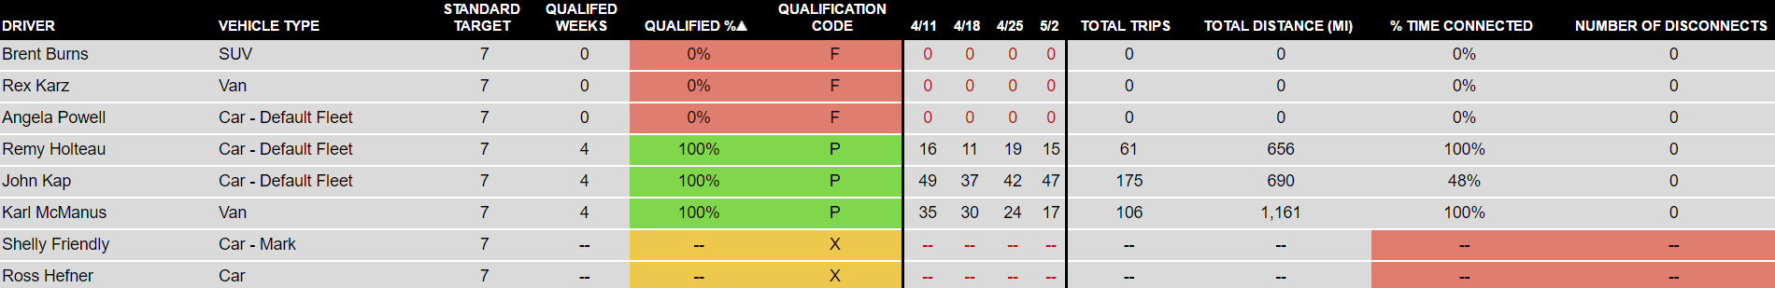
Reports

Slide 18
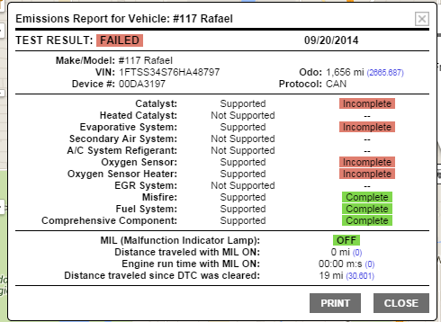
Diagnostics
Regular emissions test
Real time “check engine
light” decoding
On demand reporting
Driver compliance

Slide 19
CarChip Connect Mobile
Drivers Login
  Via website
  Web mobile page
Driver’s Login Tool
  Identify pool vehicle they are driving
  Assign to vehicle via login

Slide 20
CarChip Connect Developer API
CarChip Connect has a developer API mode
The customer can program additional features into CarChip Connect using JSON
Dex Imaging requires additional features that must be programmed with CarChip Connect Developer API

Slide 21
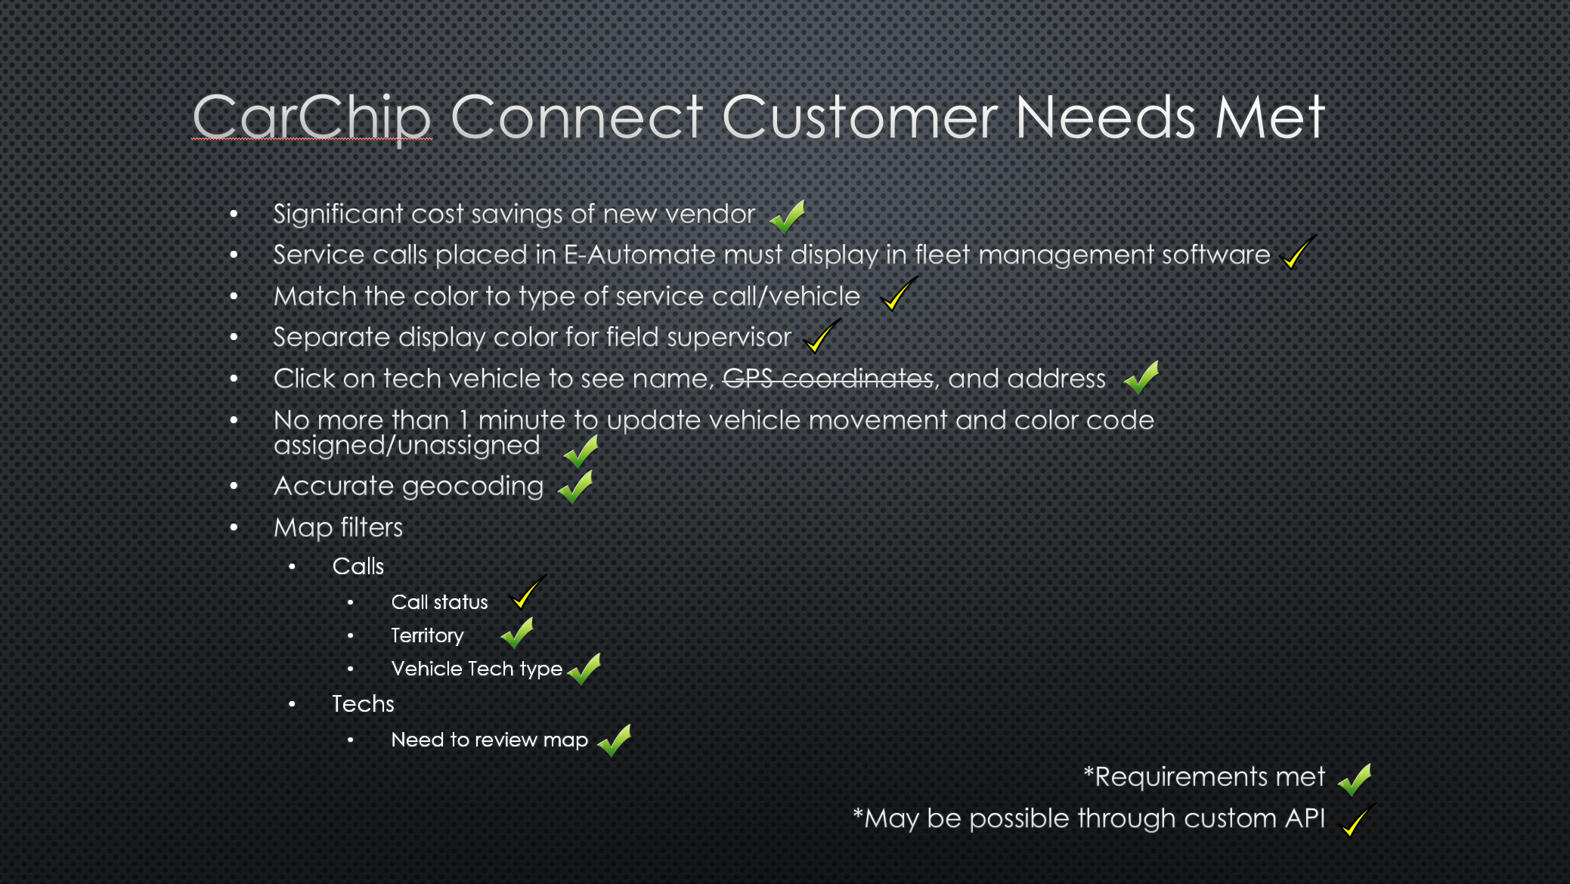


CarChip Connect Customer Needs Met
Significant cost savings of new vendor
Service calls placed in E-Automate must display in fleet management software
Match the color to type of service call/vehicle
Separate display color for field supervisor
Click on tech vehicle to see name, GPS coordinates, and address
No more than 1 minute to update vehicle movement and color code assigned/unassigned
Accurate geocoding
Map filters
  Calls
    Call status
    Territory
    Vehicle Tech type
  Techs
    Need to review map
*Requirements met
*May be possible through custom API

Slide 22
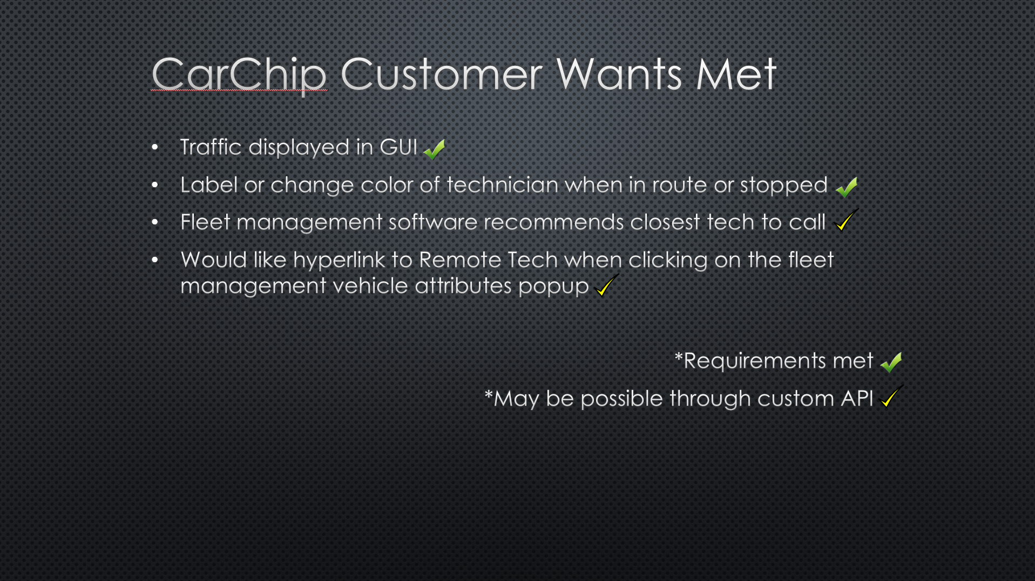
CarChip Customer Wants Met
Traffic displayed in GUI
Label or change color of technician when in route or stopped
Fleet management software recommends closest tech to call
Would like hyperlink to Remote Tech when clicking on the fleet management vehicle attributes popup
*Requirements met
*May be possible through custom API

Slide 23
Timeline
6/1 - Presentation to customer
10/5 – Fall Term 2 Start; activate, install hardware, set up user accounts
10/12 – Develop custom API feature to display e-automate service calls in CarChip Connect
10/19 – Develop custom API feature to color code service call/vehicle type
10/26 – Develop custom API feature to display color code for field supervisors
11/2 – Develop custom API to display GPS coordinates of vehicles
11/9 - Presentation to industry, Tampa Bay GIS Users Group
11/16 – Develop custom API feature to map filter call status
11/23 – Develop custom API feature to create hyperlink from displayed vehicle to Remote Tech
11/30 – Develop custom API feature to recommend closest vehicle to service call
12/14 – Fall Term 2 End; Present results

Slide 24
Acknowledgements
Advisor: James O’Brien, Instructor, Pennsylvania State University
Client: Patrick Adesso, CIO, Dex Imaging
Vendor: Clark Anderson, Sales Manager, Davis Instruments
Questions?

