Slide 1
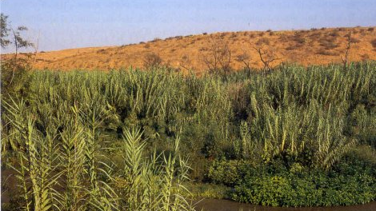
Giant Reed (Arundo Donax)
using the maximum entropy model to predict the Spread of the invasive Giant Reed (Arundo Donax)
Haley Fassett

Slide 2
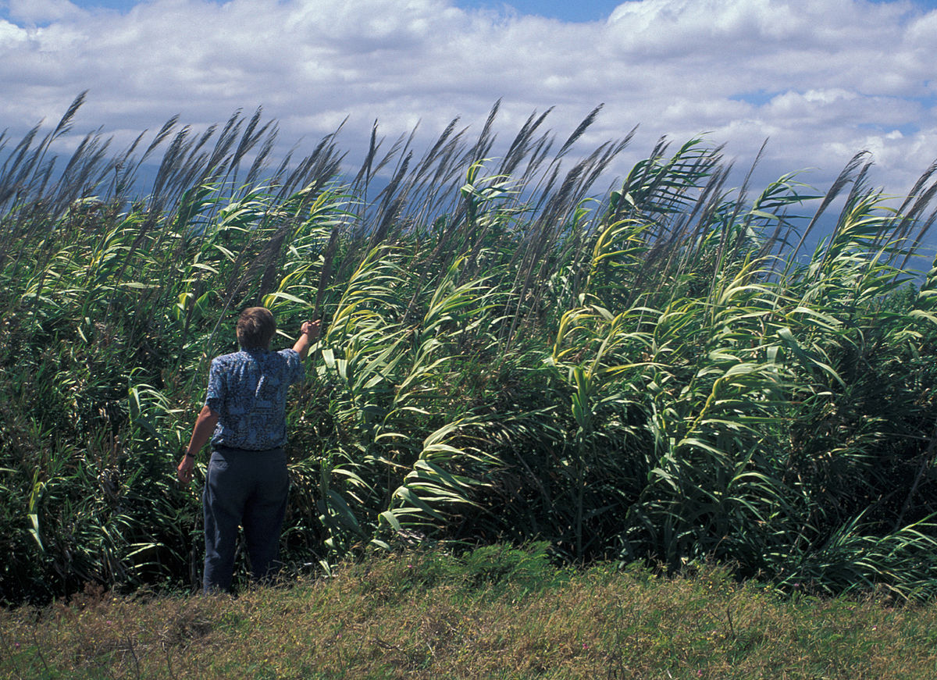
Giant Reed (Arundo Donax) Characteristics
Bamboolike grass
Hydroponic plant
Found in disturbed environments such as riparian areas
Can be found in locations where water tables are near or at soil
Grows to 20 – 30 feet tall
Does best in Mediterranean, Subtropical, and Semiarid clement zones

Slide 3
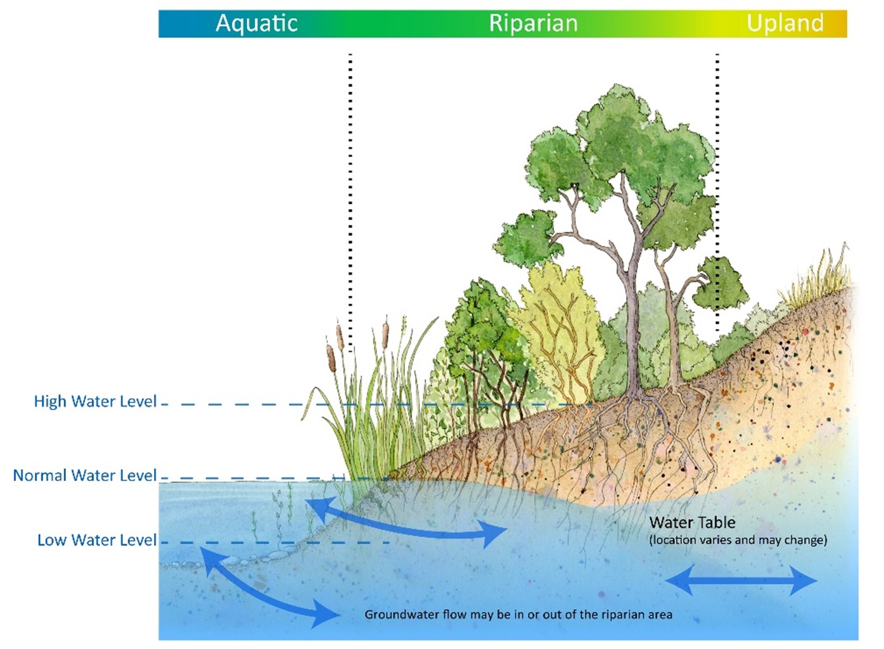
Giant Reed (Arundo Donax) Background
Planted in the 1820s for erosion control in drainage channels. From there it spread into waterways and riparian ecosystems.
This is an invasive noxious weed that is reducing biodiversity in riparian ecosystems.
Proximity to waterways promotes the spread of Giant Reed because the plant moves along them and is deposited downstream.

Slide 4
Why this species is important to monitor
Giant Reed plants can outcompete native woody vegetation for resources like water by creating a monoculture of Giant Reed, thus reducing biodiversity in the ecosystem.
Giant Reed has growth rate that is 3-4 times faster and is about 20 times more productive.
This species is spreading and causing serous impacts on riparian ecosystems.

Slide 5
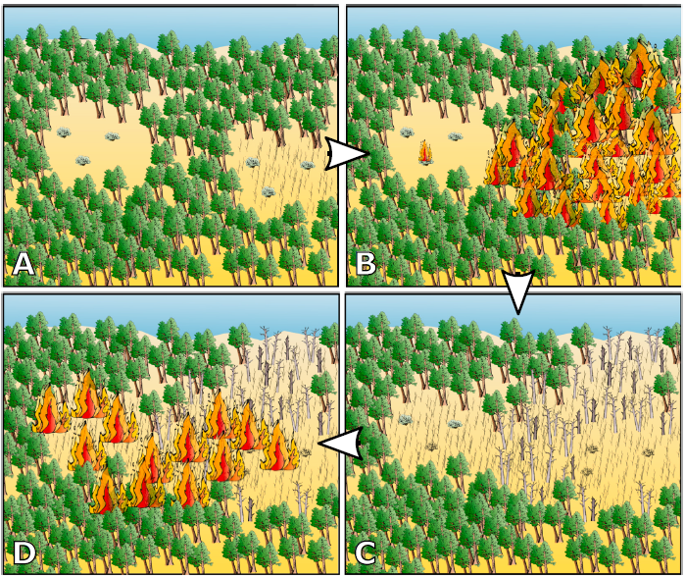
Invasive plant-fire regime cycle
Invasive plant fire regime cycle
In riparian ecosystems the fire regime has been transformed into an invasive plant-fire regime cycle.
2003 wildfire along Santa Clara River – A buildup of Giant Reed burned more intensely and acted as a corridor to spread the wildfire to neighboring shrublands.
This creates a feedback loop that promotes fire because the Giant Reed species are highly flammable, contribute to higher intensity fires, and increase fuel loads.
2003 wildfire along
Santa Clara River

Slide 6
Goals and Objective
To better understand the impacts of Giant Reed it requires knowing which areas are vulnerable to Giant Reed invasions.
This will be accomplished by using the maximum entropy model to predict the spread of the invasive Giant Reed (Arundo Donax)
The results can be used to inform and improve wildfire mitigation, wildlife biodiversity, and riparian restoration efforts.

Slide 7
Study Area
limited to the contiguous United States; focus is on areas that have riparian environments
Reasons:
Introduced at approximately the same time in the early 1820s.
Governing bodies for environmental management and wildfire mitigation are similar throughout
Map is of study area with Giant Reed observation data, which is the primary input dataset for creating a MaxEnt model to determine the spread of Giant Reed

Slide 8
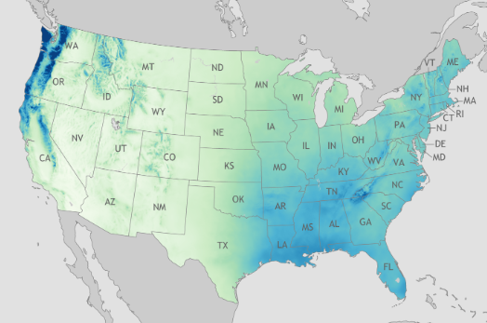
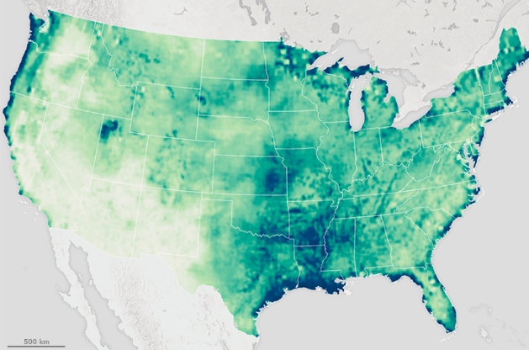
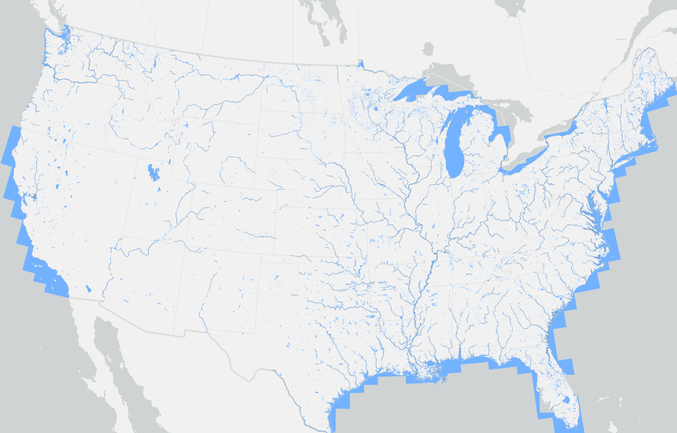
Methods: Giant Reed Habitat Requirements (Water)
Precipitation
Dataset | Data Type | Data Source | Reason for Inclusion
Precipitation | Raster | PRISM | Giant Reed is found in areas with annual precipitation ranging from 12 – 158 inches. Giant Reed requires lots of water to grow and spread efficiently.
Soil Moisture | Post-processed/ compressed into Raster | 2020 – 102 Meter | Grows best where water tables are near or at the soil surface. Giant Reed transpires 56,200 acre-feet of water over the course of a year. Grows well in moist or saturated loose soils of various types. This species utilizes lots of water and is a hydroponic plant.
Waterways river stream | Line, post-processed into proximity distance raster | National Map Viewer for NHD | This plant requires lots of shallow water, so it is usually found within 24 feet of a waterway.
Water features (wetlands, marshland, lakes, ponds, large rivers, and streams) | Polygon; post processed into proximity distance raster | National Map Viewer for NHD | This plant requires lots of shallow water, so it is usually found within 24 feet of a waterway.
Soil Moisture
Waterway Proximity

Slide 9
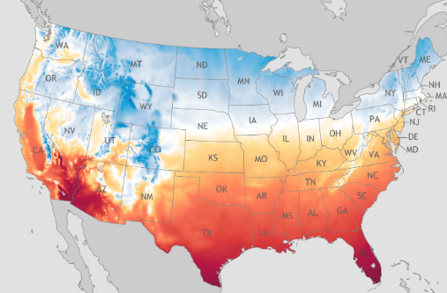
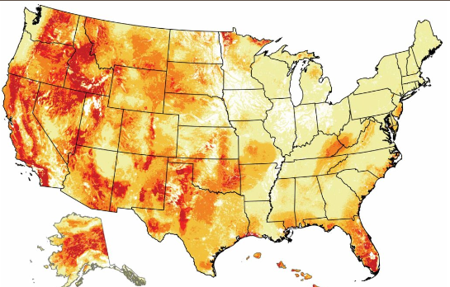
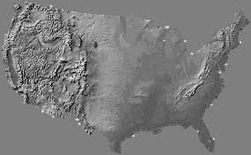
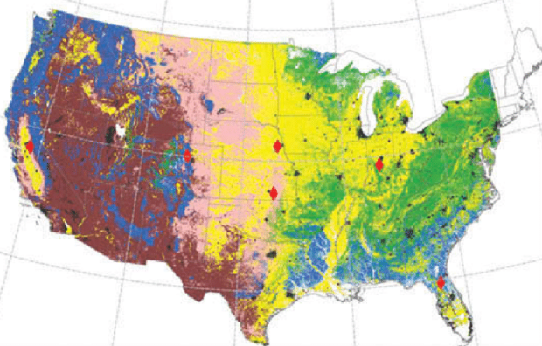
Methods: Giant Reed Habitat Requirements (physical environment)
Dataset | Data Type | Data Source | Reason for Inclusion
Temperature Profile (average, Min, Max, for 2022) | Raster | PRISM | Base growth temperature reported is 7 °C, (44.6 F) with a maximum temperature of 30 °C (86). Climates are Mediterranean, Subtropical, or simi-arid.
Land use Cover | Raster | NLCD | Found in and around sand dunes, wetland or riparian areas, streambanks, desert springs, flood plains, drainages, and irrigation waterways
Elevation | Raster | DEM USGS 1/3 arc-sec (10 meter). Larger cell size used to minimize post processing time and gaps in the data | Limited to areas under 5000 feet in elevations. Elevation ranges vary based on latitude and temperature profile but is not forum above 5000 feet in the contiguous US.
Slope | Raster | DEM USGS 1/3 arc-sec (10 meter) | Typically found in relatively flat slopes average 0 – 30 degrees
Fire Boundary | Polygon that will be rasterized | National Interagency Fire Center | Where fires have previously burned the surface becomes nitrogen rich. Giant Reed can recolonize these areas much faster than native vegetation.
Temperature
Fire Boundary
DEM (Slope and Elevation)
Land Use/ Land Cover

Slide 10
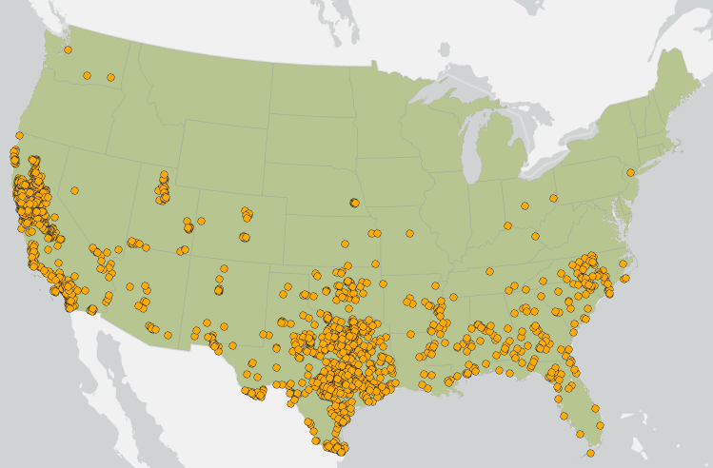
Datasets
Precipitation
Soil Moisture
3 main types of datasets are needed for running MaxEnt model
Observation points or known locations (Giant Reed known presence)
Study Area (Contiguous US)
Explanatory variables (various raster data sets that are relevant to the growth and success of Giant Reed)
Precipitation
Soil moisture
Temperature
Fire Boundary
Land use/landcover
Distance to waterways and standing water features
Elevation
Slope
Temperature
Fire Boundary
Land Use/ Land Cover
Waterway Proximity
DEM (Slope and Elevation)
Giant Reed Locations

Slide 11
Overview of MaxEnt Model
Presence-only Prediction (MaxEnt) model works by using maximum entropy approaches to estimate the probability of presence of a phenomenon
where else could Giant Reed spread to.
Maximum Entropy model is a model that does not require the use of non-present locational data unlike other predictive models.
This model uses machine learning to train the model on the dataset patterns; so, this approach is more robust than a site selection analysis. And the habitue requirements are influential to predicting where Giant Reed could spread to.

Slide 12
Presentation Venue Options
Esri User Conference (July 10th – 14th 2024)
Esri Federal Conference (February 7th – 8th 2024)

Slide 13
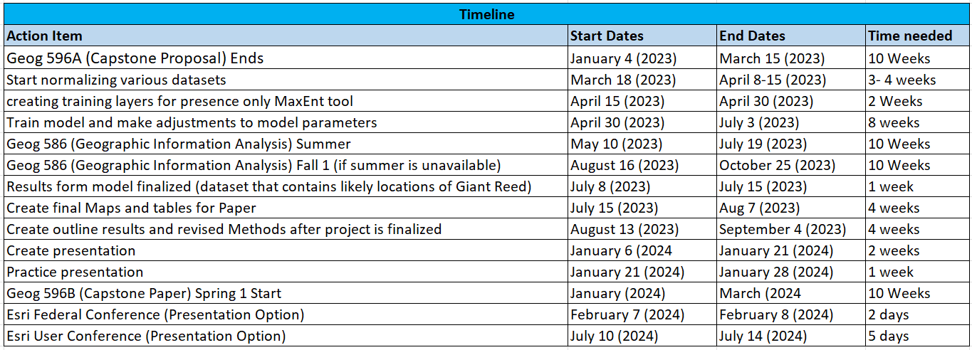
Timeline

Slide 14
Anticipated Results and Conclusion
The result will be a map that predicts the presence of Giant Reed in the United States.
Based on characteristics of Giant Reed I anticipate the largest areas that have Giant Reed will be close to rivers and in the lower states of the United States:
California, Arizona, New Mexico, Texas, Louisiana, Mississippi, Alabama, Georgia, and Florida
higher areas of concentration of Giant Reed in locations that recently experienced wildfires.

Slide 15
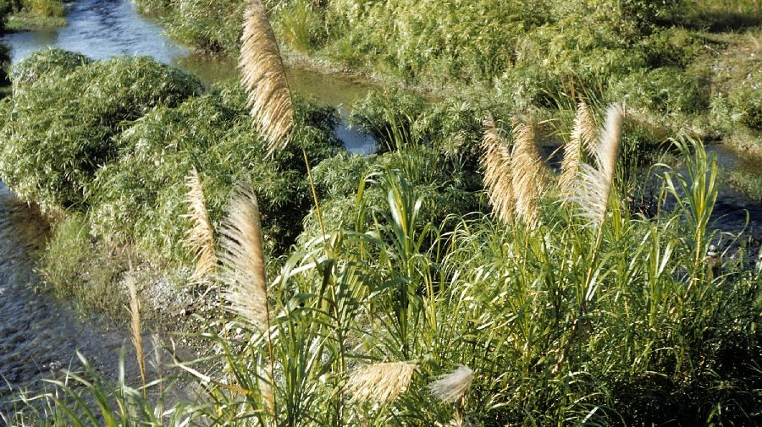
Thank You
Any Questions?

