Slide 1
Weighted Multivariate Rating of Urban Green Spaces
By: Casey Faust

Slide 2
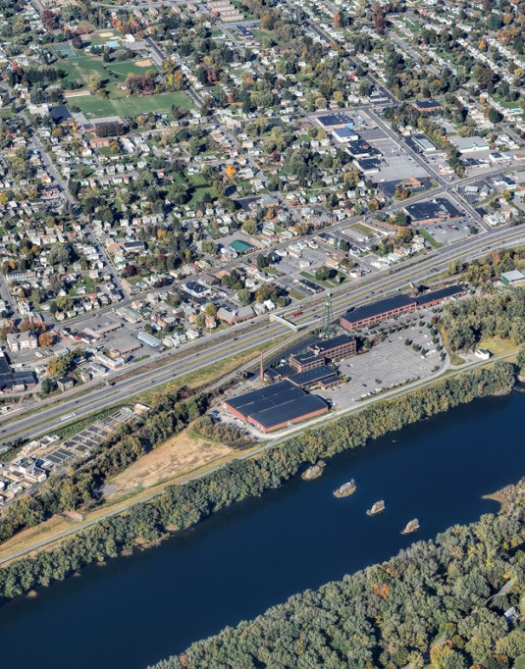
Urban Areas
Increasing number of urban areas
High population density.
Smaller residential plots
High Traffic

Slide 3
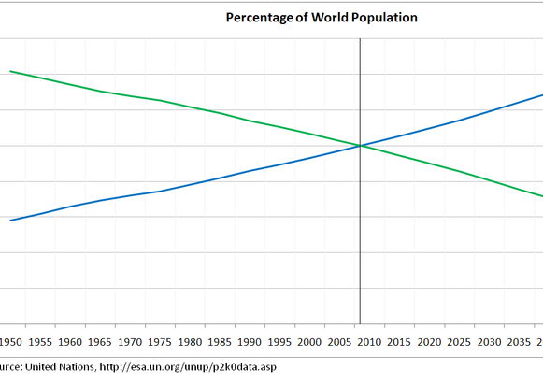
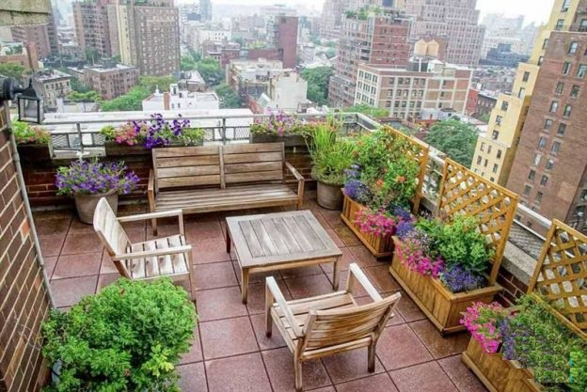
Urbanization Trends

Slide 4
Importance of Green space
Health:
Mental Health
Physical well being
Perceived Health
Other:
Property Values
Business
Reduction in pollution
Reduction in heat island effect

Slide 5
Multiple standards
Netherlands: 60m² per individual of greenspace within a 500 m radius of the household.
UK: 2 hectares within 300 meter distance of a house
World Health Organization 9m² per capita within a 15-minute walk.
Socio-Economic Status is ignored by using set distances / walking time.

Slide 6
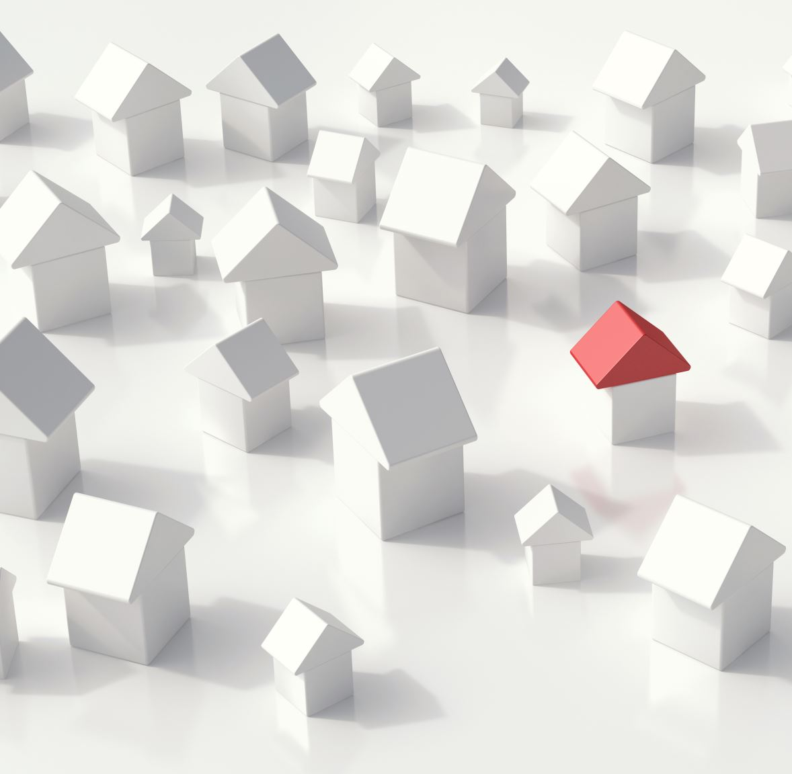
How to create a rating that works with any standard
Commonalities
Area of greenspace
Distance to home
WHO recommends equitable distribution to all residents

Slide 7
Current rating Methods
Area of greenspace per capita
Distance to greenspace

Slide 8
Methodology: Weighted Multivariate Analysis
Availability: 70%
Accessibility: 20%
Equitability: 10%

Slide 9
Data:
American Community Survey
DCNR local park survey
Parkserve park access
PASDA urban boundaries
Individual cities for parcel information

Slide 10
Availability
Total Urban Green Space / Urban Population
Provides area of green space per capita
Area per capita / country standard
Green Space Area: 54,000 m²
Population: 5200 individuals
Country Standard: 9m² green space per individual
54,000 m² / 5200 individuals = 10.38 m²/ind
10.38 m²/ind / 9 m²/ind = 115.38% => 100%

Slide 11
Accessibility
Percentage of residents within it’s country standard for distance.
Population: 5200 individuals
Population within 1000 m: 4400 individuals
4400 ind / 5200 ind = 84.62%

Slide 12
Equitability
Percentage of residents within 25% of the average accessible area of green space.
Gaussian 2-step floating catchment to determine accessible area of green space.
Total population: 5200
Population with average area of green space +/- 25%: 3800
3800 / 5200 = 73.1%

Slide 13
Example final score
Availability: 100% - 70/70
Accessibility: 84.62% - 16.92/20
Equitability: 73.1% - 7.31/10
Total score: 94.23/100

Slide 14
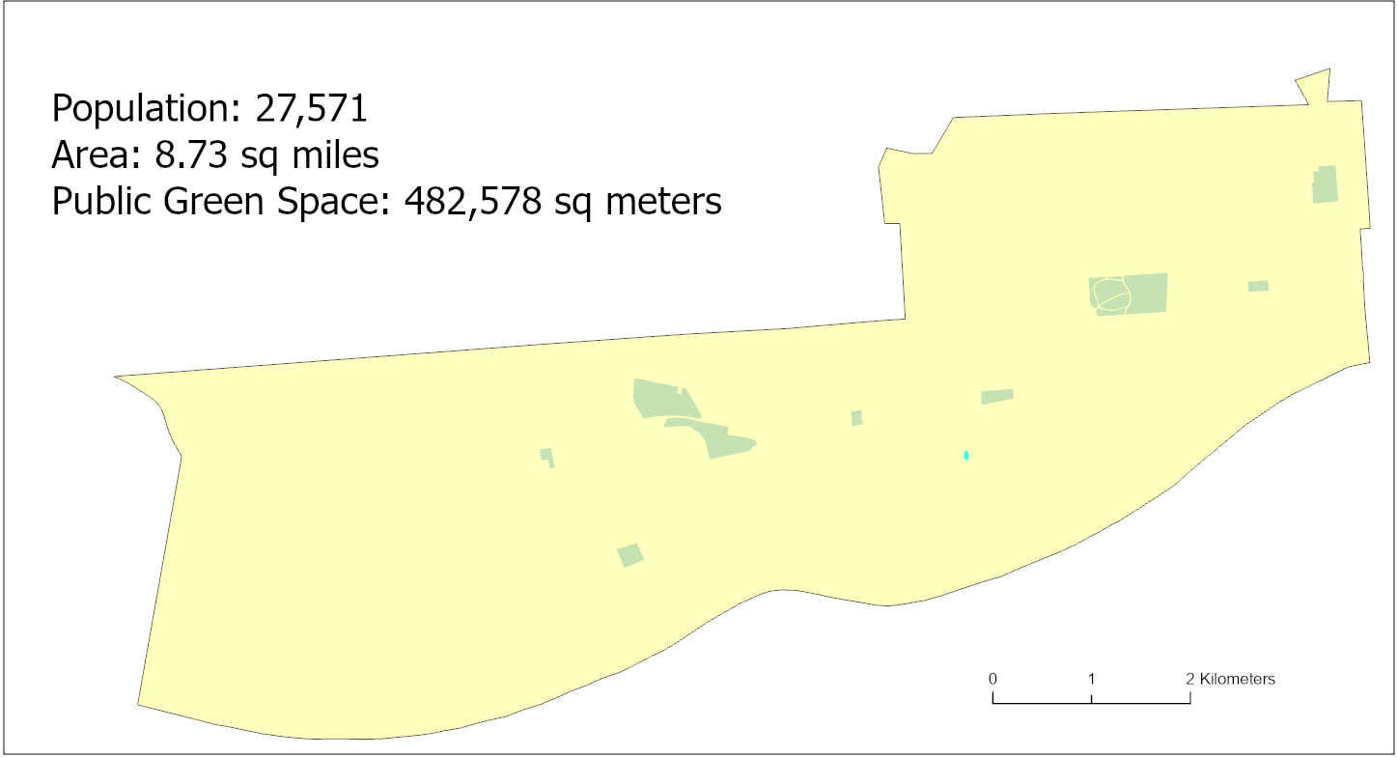
Trial City: Williamsport, PA

Slide 15
Trail City: Bloomsburg, PA

Slide 16
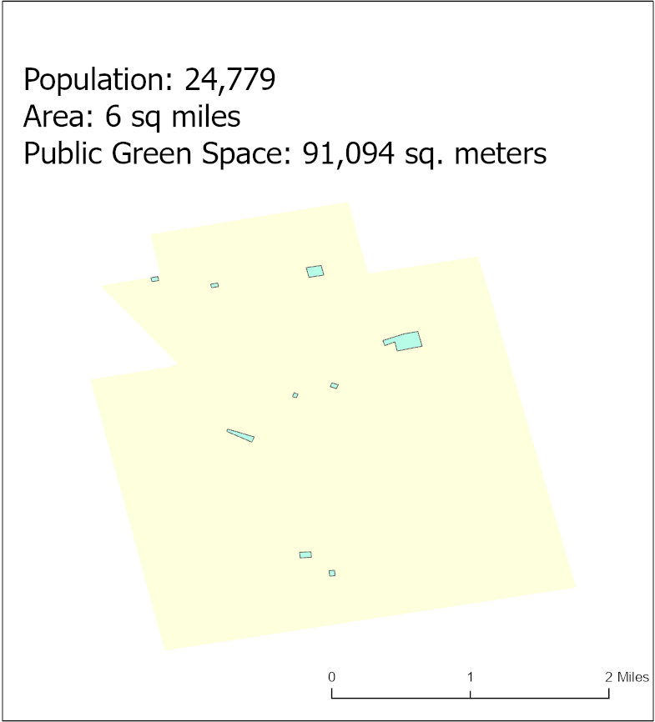
Trial City: Hazleton, PA

Slide 17
Results for Williamsport, PA

Slide 18
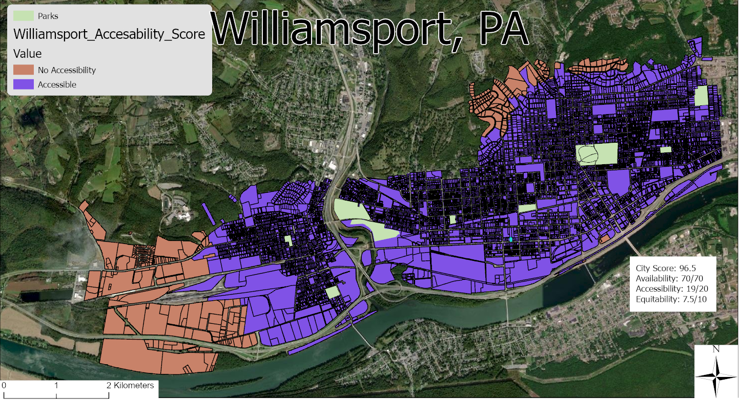
Accessibility

Slide 19
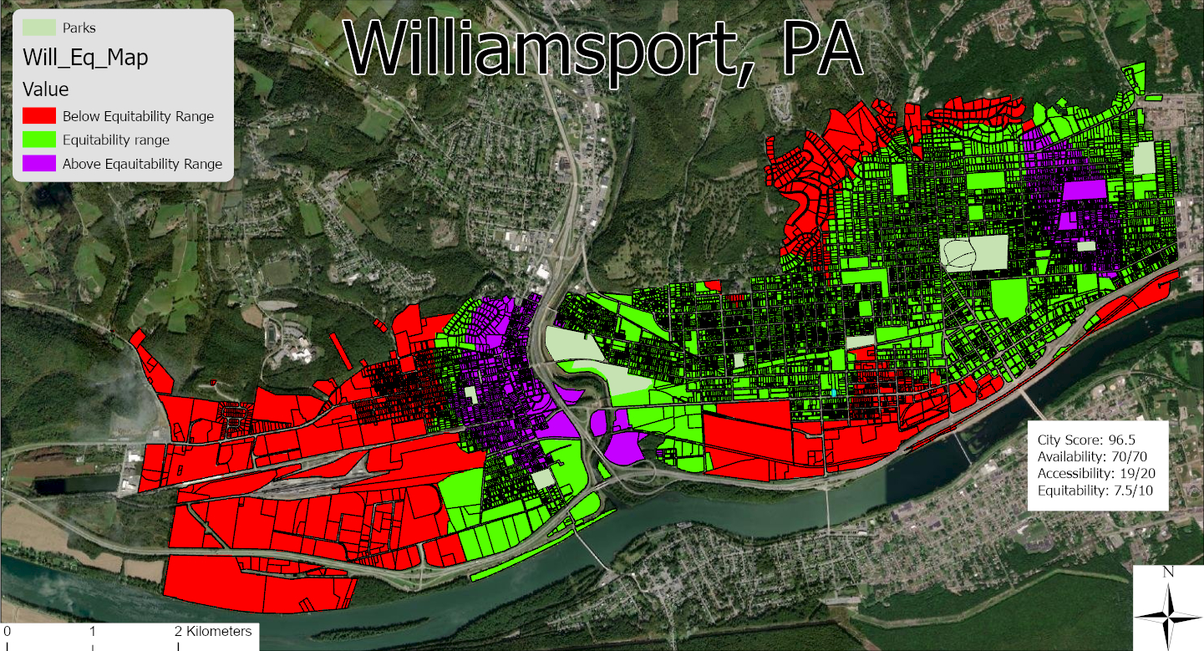
Equitability

Slide 20
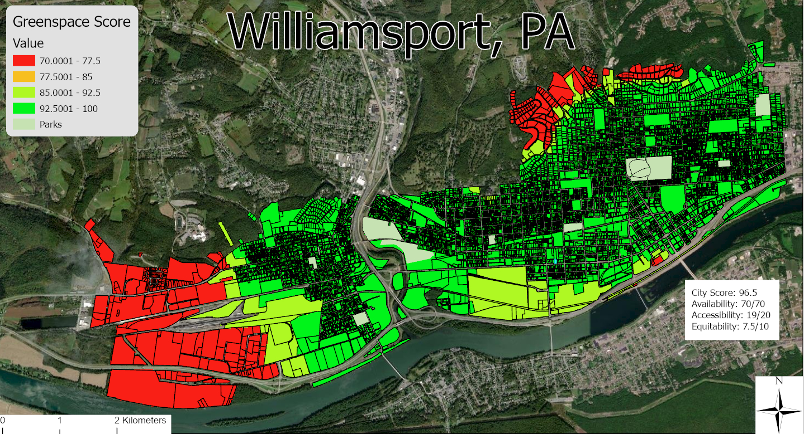
Composite

Slide 21
Timeline
All City ratings to be completed by end of August 2022
Paper completion and revision completed by end of September 2022
Presentation of findings November / December 2022

Slide 22
Resources
Berg, M. v., Poppel, M. v., Smith, G., Triguero-Mas, M., Andrusaityte, S., Kamp, I. v., . . . Maas, J. (2017). Does time spent on visits to green space mediate the associations between the level of residential greenness and mental health? Urban Forestry & Urban Greening, 94-102.
Fritz, S. L., & Lusardi, M. (2009). Walking Speed: The sixth vital sign. Journal of Geriatric Physical Therapy, 46-49.
Ha, J., Kim, H. J., & With, K. A. (2022). Urban green space alone is not enough: A landscape analysis linking the spatial distribution of urban green space to mental health in the city of Chicago. Landscape and Urban Planning, 104309.
Kimpton, A., Corcoran, J., & Wickes, R. (2016). Green space and Crime: An Analysis of Greenspace Types, Neighboring Composition, and the Temporal Dimensions of Crime. Journal of Research in Crime and Delinquency, 303-337.
Lee, M., Kim, S., & Ha, M. (2019). Community greenness and neurobehavioral health in children. Science of the Total Environment, 381-388.
Maas, J., Verheij, R. A., Groenewegen, P. P., Vries, S., & Spreeuwenberg, P. (2006). Green space, urbanity, and health: how strong is the relation? . Journal of Epidemiology and Community Health, 587-592.
Madzia, J., Ryan, P. P., Yolton, K. P., Percy, Z., Newman, N. D., LeMasters, G. P., & Brokamp, C. P. (2018). Residential Greenspace Association with Childhood Behavioral Outcomes. The Journal of Pediatrics, 233-240.
Piaggio, M. (2021). The value of public urban green spaces: Measuring the effects of proximity to and size of urban green spaces on housing market values in San Jos´e, Costa Rica . Land Use Policy, 105656.
Qian, X., & Ming, L. (2020). Measures of Spatial and Demographic Disparities in Access to Urban Green Space in Harbin, China. Complexity.
Shin, J. C., Parab, K. V., An, R., & Grigsby-Toussaint, D. S. (2020). Greenspace exposure and sleep: A systematic review. Environmental Research.
Slawsky, E. D., Hajat, A., Rhew, I. C., Russette, H., Semmens, E. O., Kaufman, J. D., . . . Fitzpatrick, A. L. (2022). Neighborhood greenspace exposure as a protective factor in dementia risk among U.S. adults 75 years or older: a cohort study. Environmental Health.

