Slide 1
The Application of Geospatial Based Operations Research to Optimize Search Strategies for Wilderness Search and Rescue
Don Ferguson
GEOG 596A – MGIS Capstone Proposal
Tuesday, May 9, 2017
College of Earth and mineral sciences – world campus

Slide 2
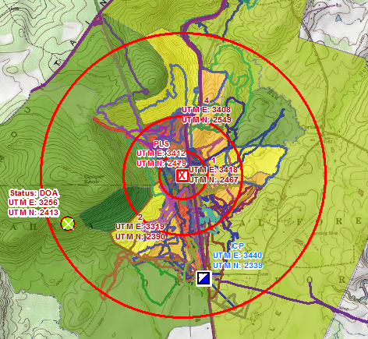
Search is an Inherently Spatial Problem
The issue of “Where” occurs repeatedly throughout WiSAR
  Where was the subject last seen? Where are clues? Where are the search assets? Where do we have wireless communications? Where can we land a helicopter?
  The environment / geography influences
    Subject’s behavior
    Search strategy and tactics
Theoretical POD
Search for missing Dementia subject

Slide 3
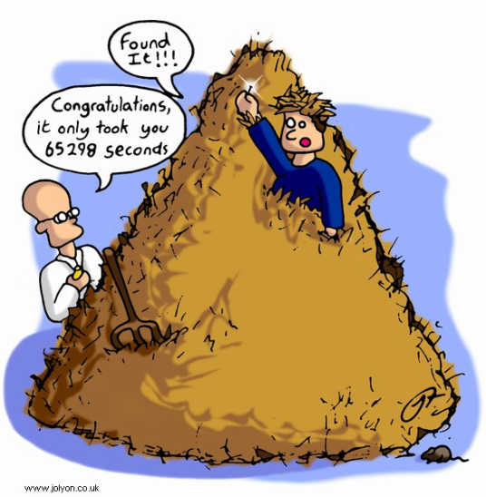
Search is an Emergency!
“Search” for a missing subject could be considered the proverbial “needle in a haystack”
  Time is limited – subject health, clue longevity, search safety and availability.
  Search is “Abstract” with respect to emergency response
    Can not “See” the incident (subject) to know what has happened
    Very little feedback while searching

Slide 4
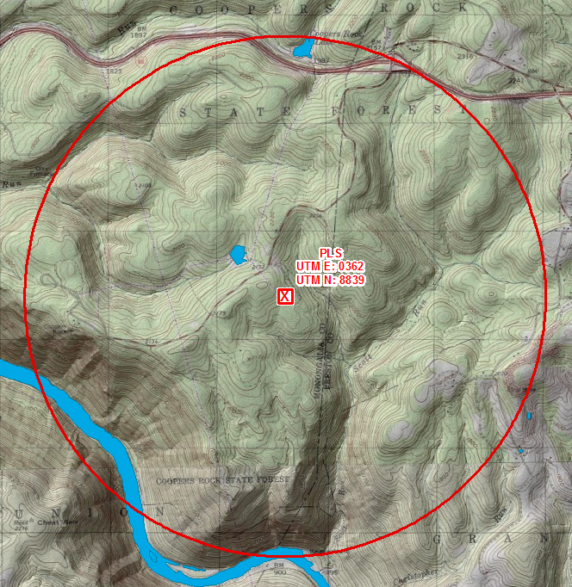
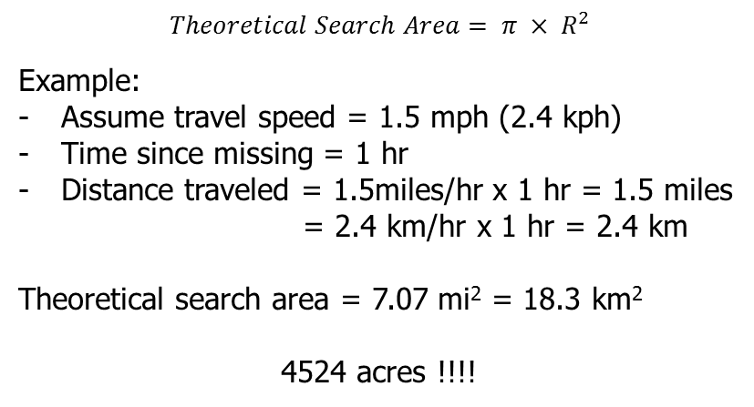
The Need to Optimize
How long of an area to search if the subject had been missing for one hour?
If we assume an average search speed of 1.1 mph (1.8 kph) and a sweep width of 10 ft (~3m) it would take 50 searchers, 68 hours to search this area to a POD of 63%

Slide 5
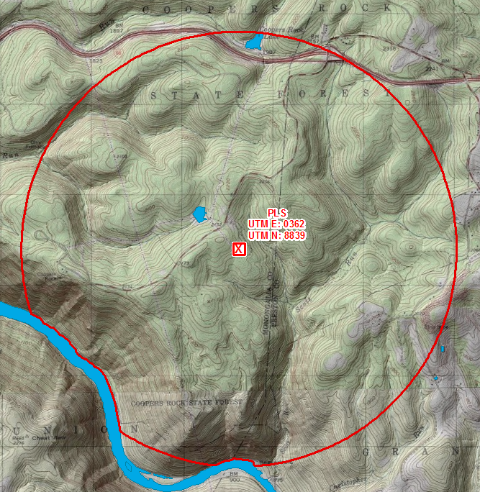
The Need to Optimize
How long of an area to search if the subject had been missing for one hour?
17.69 km²
If we assume an average search speed of 1.1 mph (1.8 kph) and a sweep width of 10 ft (~3m) it would take 50 searchers, 68 hours to search this area to a POD of 63%
4372 Acres
65

Slide 6
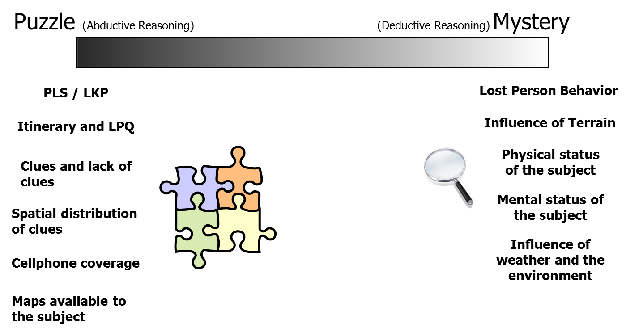
Prioritization of Search Area
Goal: Maximize the Probability of Success at the greatest Rate possible (PSR)
Piece together known / discovered information
Deduce possibilities through experience and research.

Slide 7
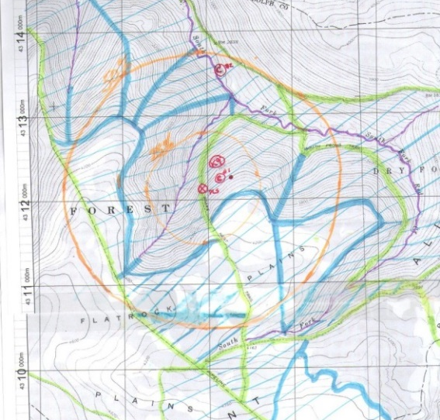
Classical Approach to WiSAR
There are steps to prioritize but optimization is limited
  Steps of Search Planning (NSARC Land SAR Addendum)
  Determine / Estimate the incident location (IPP).
  Estimate the distress person’s movements.
  Estimate the most probable location person(s).
  Define search sub-areas and search patterns for assignment to specific search resources.
  Determine the best way to use the available resources to maximize probable success rate.
  Provide search action plan that includes description of current situation, search object description(s), assigns specific search responsibilities to search resources, on-scene coordination instructions and resource reporting requirements
Maps are an integral part of SAR
  Used to visualize potential subject behavior, establish search area boundaries and prioritize the search area
  Track Planning, Operational and Logistical details.
Layered transparencies placed over map (Onion Skin)
  Each layer represents planning or operational period
  At the end of each operational period overlay are removed and new one added

Slide 8
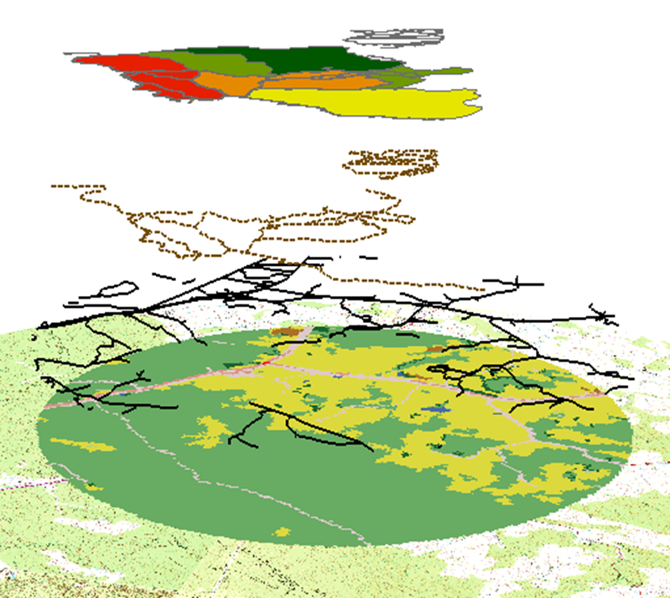
The Application of GIS to WiSAR
Expansion of GIS in WiSAR
  NAPSG WiSAR working group
  Ferguson, D., “GIS for Wilderness Search and Rescue”, ESRI Federal User Conference, Washington, D.C., Feb 20-22, 2008.
  Durkee, G., Glynn-Linaris, V., “Using GIS for Wilderness Search and Rescue”, ESRI Press, July 2012.
  Rose, C., “Mapping Technology in Wilderness Search and Rescue” (Master’s Thesis), University of Wisconsin-Madison, 2015.
  Pfau, L., “Wilderness Search and Rescue: Sources and Uses of Geospatial Infomration” (Master’s Thesis), Penn State University, April 2013.
  Donia, K., “Custom GIS Tools for Enhancing Wilderness Search and Rescue” (Master’s Thesis), University of Redlands, Dec 2009.
  Doherty, P., “The Applications of GISystems to Wilderness Search and Rescue, an Overview Within a GIScience Context and Examples from Yosemite National Park” (Doctoral Dissertation), University of CA – Merced, 2013.
Search Segments
Trails
Roads
Land Cover
Topographic Basemap
Automation
Enhanced Situational Awareness
Analytic tools
Communication of Information

Slide 9
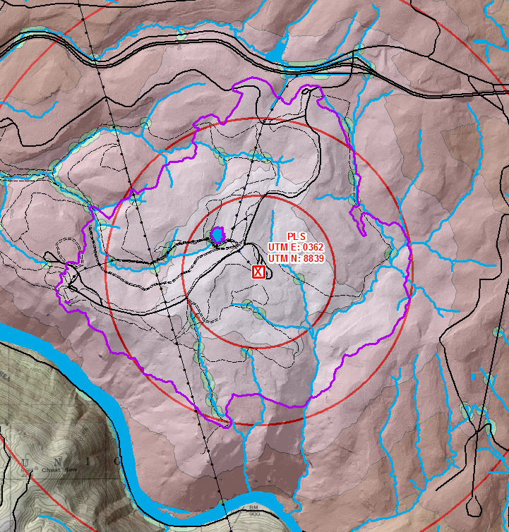
Further Reducing the Search Area
Categorical Search History (Statistical Search Area)
Historical find locations (empirical model)
Cost-Distance Model
  Tobler Hiking Function – Influence of slope.
  Strahler Stream Order, land cover and travel aides.
  1 hr travel at a nominal walking speed of 1.5 kph
    Reduces the search area from 17.69 km² to
      8.11 km²
    Search time: assume an average search speed of 1.1 mph (1.8 kph) and a sweep width of 10 ft (~3m) it would take 50 searchers, 30 hours (original 63 hours) to search this area to a POD of 63%.

Slide 10
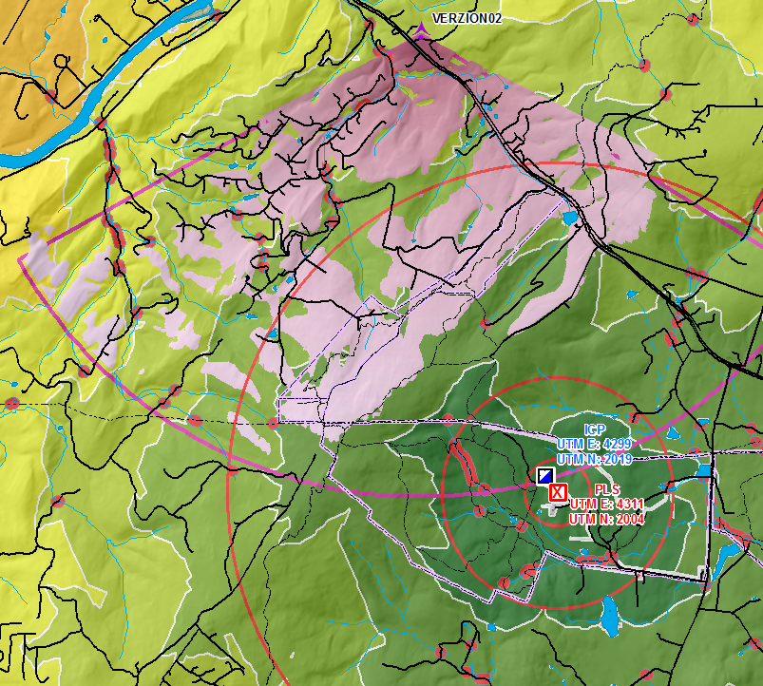
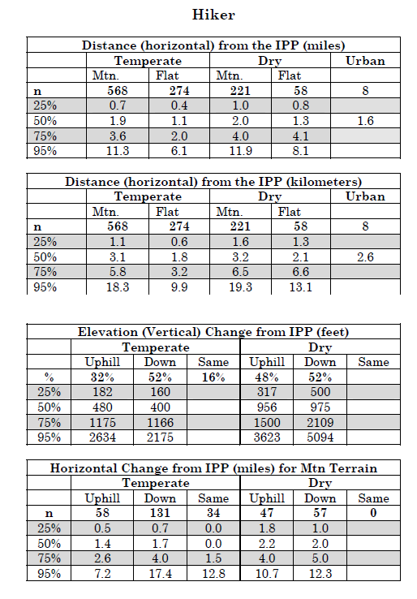
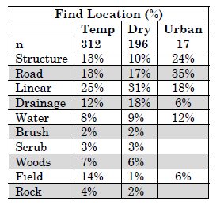
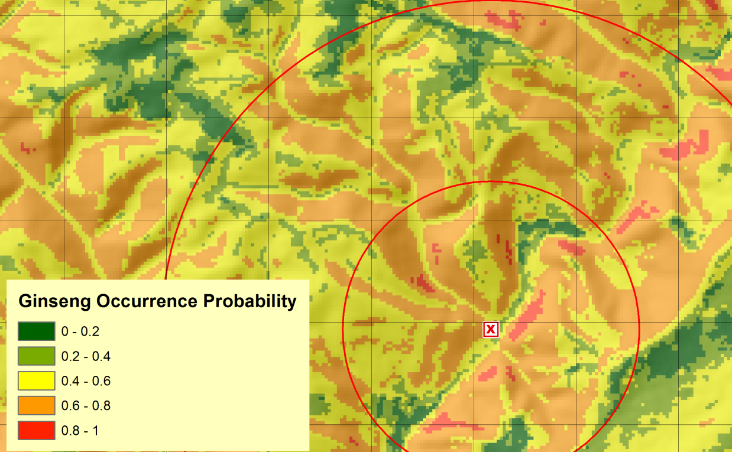
Establishing the Search Area
Combination of historical-categorical subject data
Scenario analysis and geospatial models
Koester, R.J., “Lost Person Behavior: A search and rescue guide on where to look - for land, air and water”, dbS Productions LLC, 2008.

Slide 11
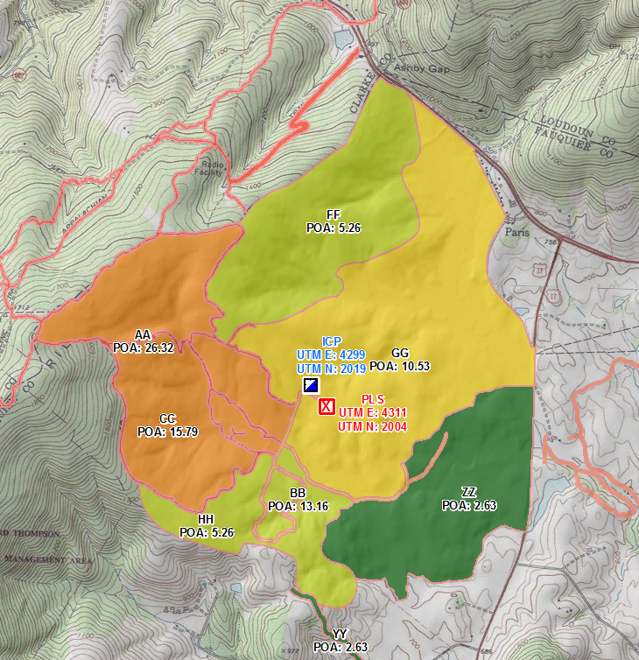
Prioritization of the Search Area
Establish Probability Regions
  A Region is a defined subset of the Search Area within which there is a uniform distribution of the likelihood of containing the search object (Land SAR Addendum to NSS V1.0, Nov 2011)
    Probability Density (Pden) – Probability/Area
  Based only on factors that affect the search object
  How the area is to be searched should not impact Regional boundaries.

Slide 12
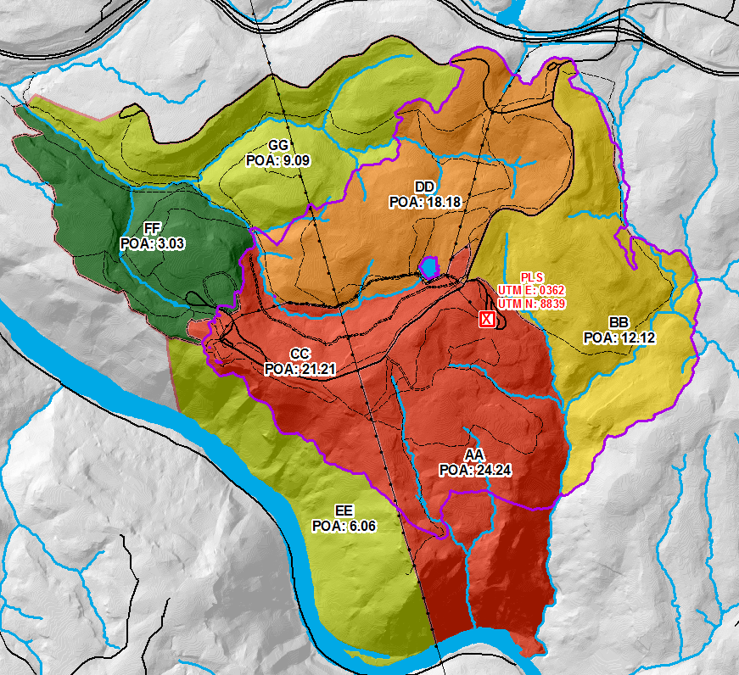
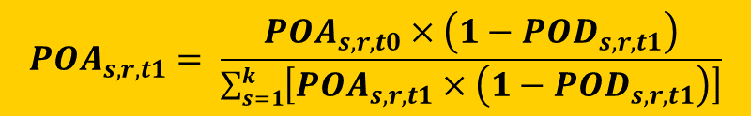

Creating Searchable Segments
Sub-divisions of Probability Regions
  Based on logistical and operational issues associated with conducting the search itself (Land SAR Addendum to NSS V1.0, Nov 2011)
  Based on resource capabilities, not the subject
Probable Success Rate (PSR)
$$PSR=W ∗V∗Pden$$
W - is the effective sweep width.
V - is the search speed.
Pden - is the probability density (POA/Area).

Slide 13
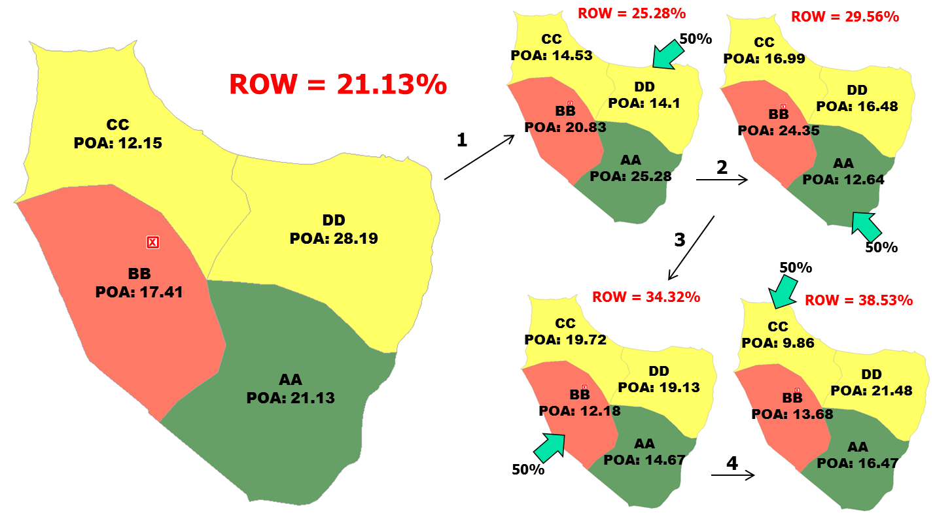
Cumulative Probability
Goal is to drive down POA across the entire search area as quickly as possible.

Slide 14
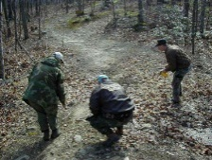
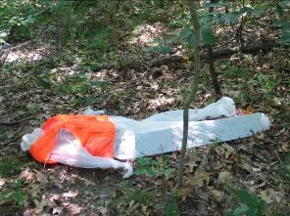
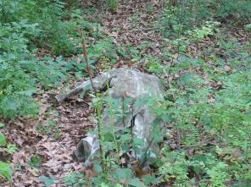
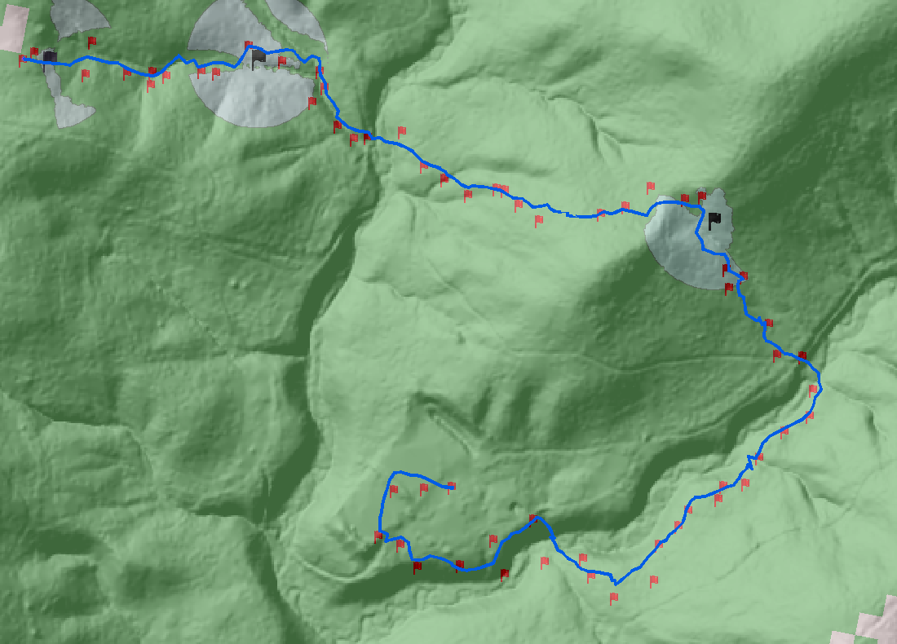
Probability of Detection
How likely the Search Unit was to have detected the subject (or clue, object) if it had been present in the area you were searching?
  Due to Random Search Theory, even a search with 100% coverage only leads to a POD of 63%¹.
  Dependent on Effective Sweep Width
Important for Resource Allocation
  Provide a desired POD, time on station (search time) and resource type
  Predict the number of resources required
High-visibility adult
Low-visibility adult
1. Koopman, B.O., “Search and Screening: General Principles with Historical Applications”, Pergamon Press, New York, 1980., 2003.
POD / ESW Test Course

Slide 15
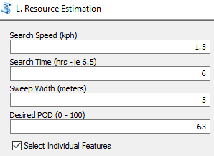
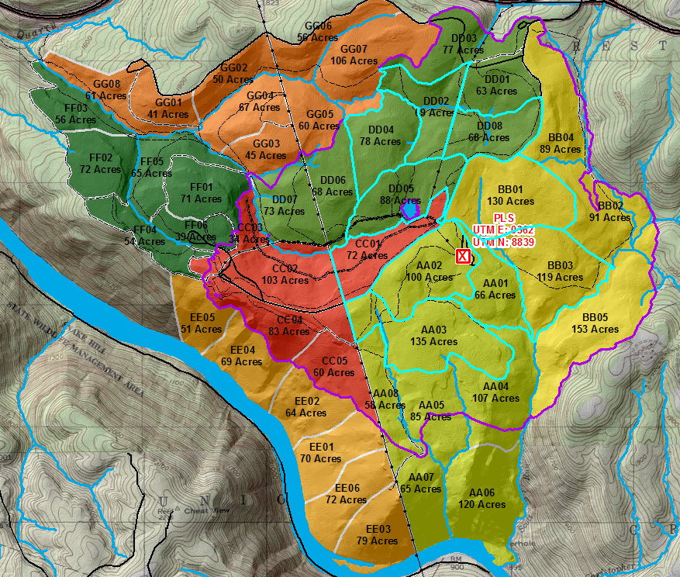
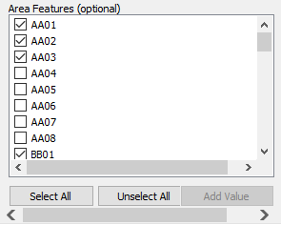
Resource Allocation Example
Segment | # of Searchers Needed
AA01 | 6
AA02 | 9
AA03 | 13
BB01 | 12
BB03 | 11
CC01 | 7
DD02 | 7
DD04 | 7
DD05 | 8
DD08 | 7

Slide 16
Operations Research / Constraint Programming
OR provides framework through the application of advanced analytical methods to aid in decision-making and improve efficiency¹.
  Developed during WWII to improve resource allocation
  Widely used in the business community to improve process efficiency and reduce expenses including resource allocation and scheduling.
CP simultaneously solves a system of equations based on a series of defined variables and constraints
1. Hillier, F., & Lieberman, G. (2005). Introduction to Operations Research (8th Intl.). Boston: McGraw-Hill.

Slide 17



Current Limitations
The current method assumes
  Uniform search speed
  Uniform spacing (Effective Search Width)
  Single resource type
  Specify which Segments to search
  Output is the number of searchers required
Additional desired method
  Specify number and type of resources available
  Method determines which areas to search (POA) in order to maximize Probable Success Rate (PSR)
Also has DOD and emergency response applications

Slide 18
Goals
Develop a methodology that will determine the optimal resource allocation to maximize the Probable Success Rate (PSR) given the following constraints
  Defined set of mixed resources (Helicopter, Tracking K9, Air Scent K9, Ground Team) with fixed (but different) search times.
  Resource specific, space varying search speed (cost-distance Model)
  Resource specific, space varying Effective Sweep Width
  Output is schedule of resource to segments which maximized PSR.

Slide 19
Proposed Methodology
Utilize geospatial data to determine
  Search speed (cost-distance): based on land cover, DEM and vector data layers. This will vary by resource and may require different data layers.
  Effective Sweep Width: Multiple return Lidar, land cover, vector data layers – still may require some approximations.
    Use ESW Field Studies to help anchor approximations. Evaluate geospatial data impacts across ESW field courses.
Constraint Programming (Operations Research)
  Develop algorithm in Python utilizing Multi-Objective Resource Constraint Project Scheduling Problem (MRCPSP)methodology.

Slide 20
Objectives
Utilize ESW Field Test locations to baseline ground and air-scent K9
  Influence of multi-return Lidar, land cover and viewshed analysis on empirical correlations
  Explore available literature to improve assumptions on Helicopter ESW
Modify cost-distance (speed) model to accommodate different resource types
Program CP algorithm in Python for optimized resource allocation integration with geospatial data in ArcGIS
Run multiple test cases and verify accuracy

Slide 21
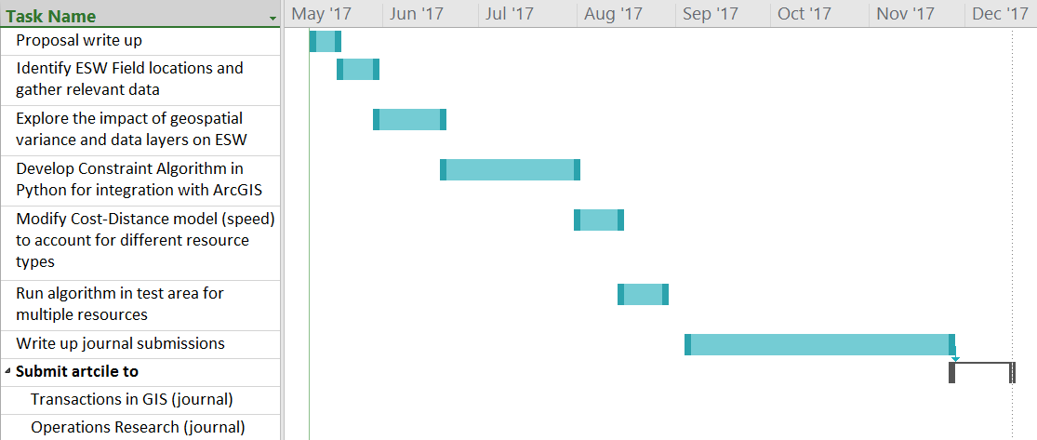
Timeline

Slide 22
Summary
WiSAR is labor and time intensive but must be performed efficiently to maximize subject’s chance for survival.
Prioritization of the search area helps with resource allocations but is limited
Existing methods for resource estimation and allocation are restricted to single resource type, estimated uniform search speeds and ESW
Need for improved methods that account for disparate resource types with different capabilities

Slide 23
Thank You!
Questions?
OFFICE OF THE EXECUTIVE VICE PRESIDENT AND PROVOST
Notes:
I now can take a couple of questions or comments regarding Penn State’s new strategic plan and related topics. Thank you for your attention and for having me join you today. It’s been a pleasure.

