Slide 1
Determining Efficient Water Use
Through the Classification of Urban
Landscapes at the Parcel Level
Pennsylvania State University
Geography 596A
Joshua Ferguson
Advisor: Patrick Kennelly

Slide 2
Overview
Background
Purpose
Work by Others
Objective
Study Area
Data and Software
Landscape Types
Workflow
Quality Control/Quality Assurance
Bibliography

Slide 3
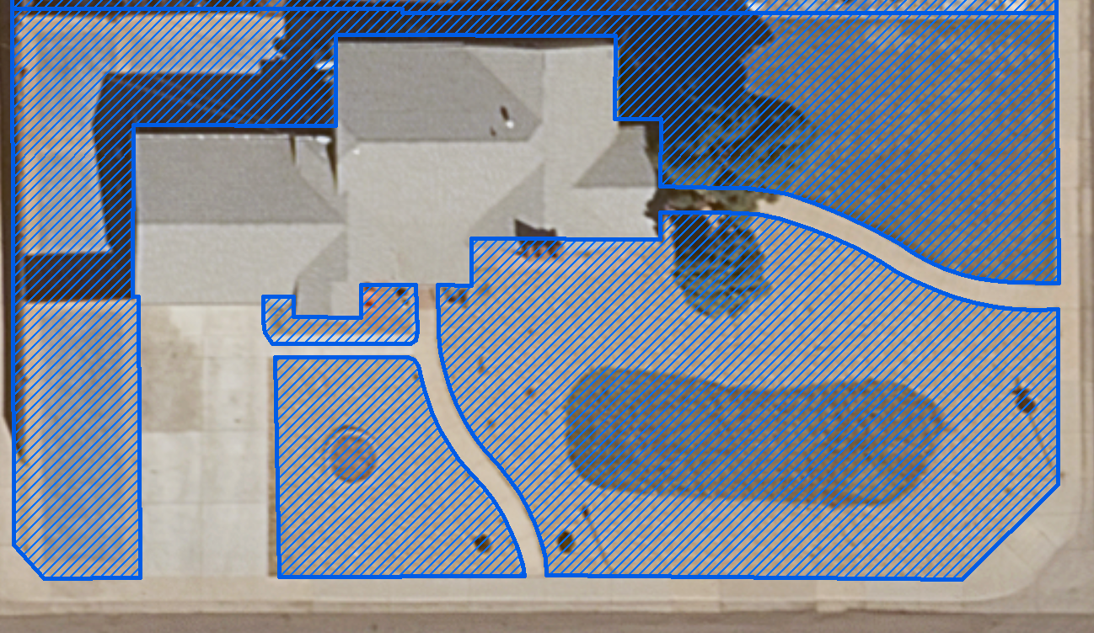
Background
Water demand and efficiency
Non-irrigated land identified as pervious
Classified landscapes
Landscape classification model
Notes:
Insert irrigation stats here. Need to know how much irrigation is taking up as a percent of water use.
Denver Water Demand Model and efficiency numbers based in part on planimetric data.
There are lots of non-irrigated landscapes that are captured as pervious in the planimetric data.
Classified landscapes will help Denver Water better identify true irrigable areas and how their customers use their water.
Since there are approximately 1.2 million customers that Denver Water services, models need to be built to process the features quickly and accurately.

Slide 4
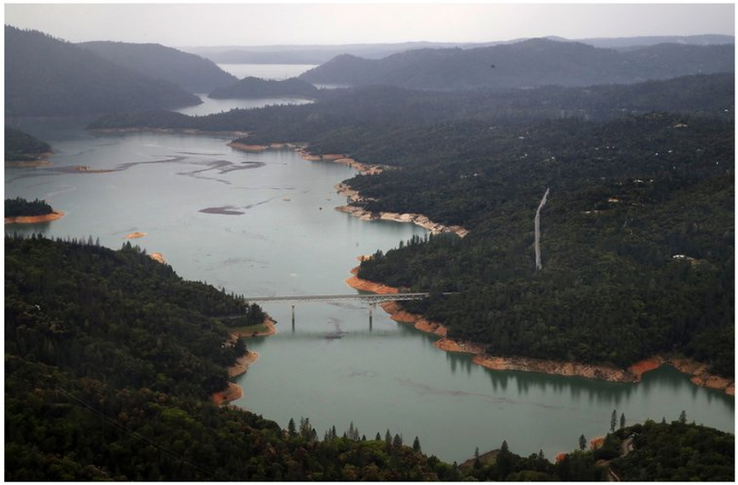
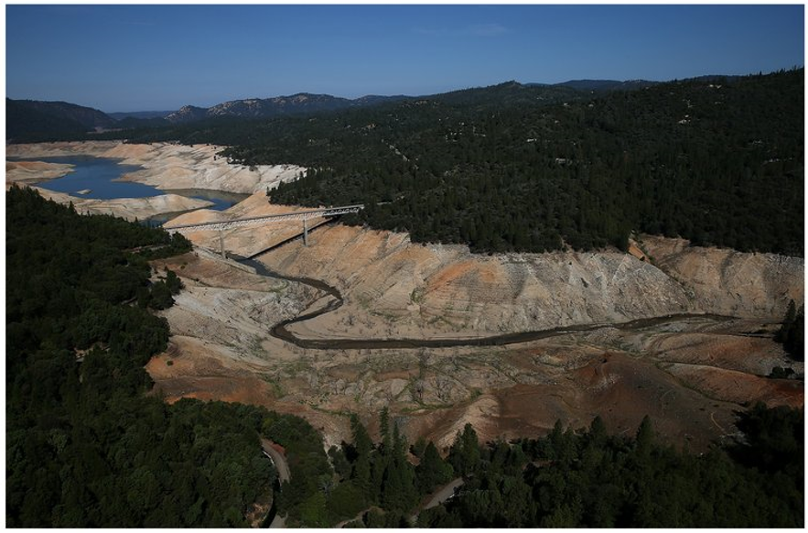
Why efficient water use is important
Sullivan, J (2017, April 7) Before and After Photos of California Drought [Photograph]. http://www.gettyimages.com/articles/news/california-drought-before-and-after
Notes:
Short duration drought as defined by the three-month Standardized Precipitation Index (SPI)
Occur somewhere in Colorado in nearly nine out of every ten years.
Severe, widespread multiyear droughts are much less common. Since the 1893, Colorado has experienced six droughts that are widely considered “severe.” These droughts affected most of the state, involved record-breaking dry spells, and/or lasted for multiple years.
Lake Oroville before and after the California drought of 2015.

Slide 5
Two Examples of Peer Reviewed Research
In 2012 a similar study, “Mapping land cover in urban residential landscapes using very high spatial resolution aerial photographs”, was done in Albuquerque New Mexico. The study looked at the distribution of residential green space and its composition among zip codes. The study used 6-inch imagery and object-oriented supervised classification. The objective wasn’t to use this data strictly for water conservation or demand planning, but was used by city planners to enact ordinances and regulations that govern urban residential landscapes.
Another study performed in 2012, “Water-efficient Urban Landscapes: Integrating Different Water Use Categorizations and Plant Types”, looked at water use by various landscape types. The amount of water used was calculated based on the rate of evapotranspiration (ET_{o}) under well-watered conditions. The objective was to look at various vegetation types, the area they occupy and weather conditions to determine water needs of different landscape types.

Slide 6
Objectives
The objectives of this study are to:
Create a parcel-level land use coverage map.
Create landscape classification models which can be used by other employees looking to due similar types of landscape classification.
Identify where efficient water use is taking place by integrating water use numbers and pervious landscapes.

Slide 7
Notes:
Denver Water Service area which serves water 1.2 million in and around the Denver area.
The two primary neighborhoods of interest which are outlined in red are Stapleton and North Park Hill. Both areas are to the north east of downtown Denver.

Slide 8
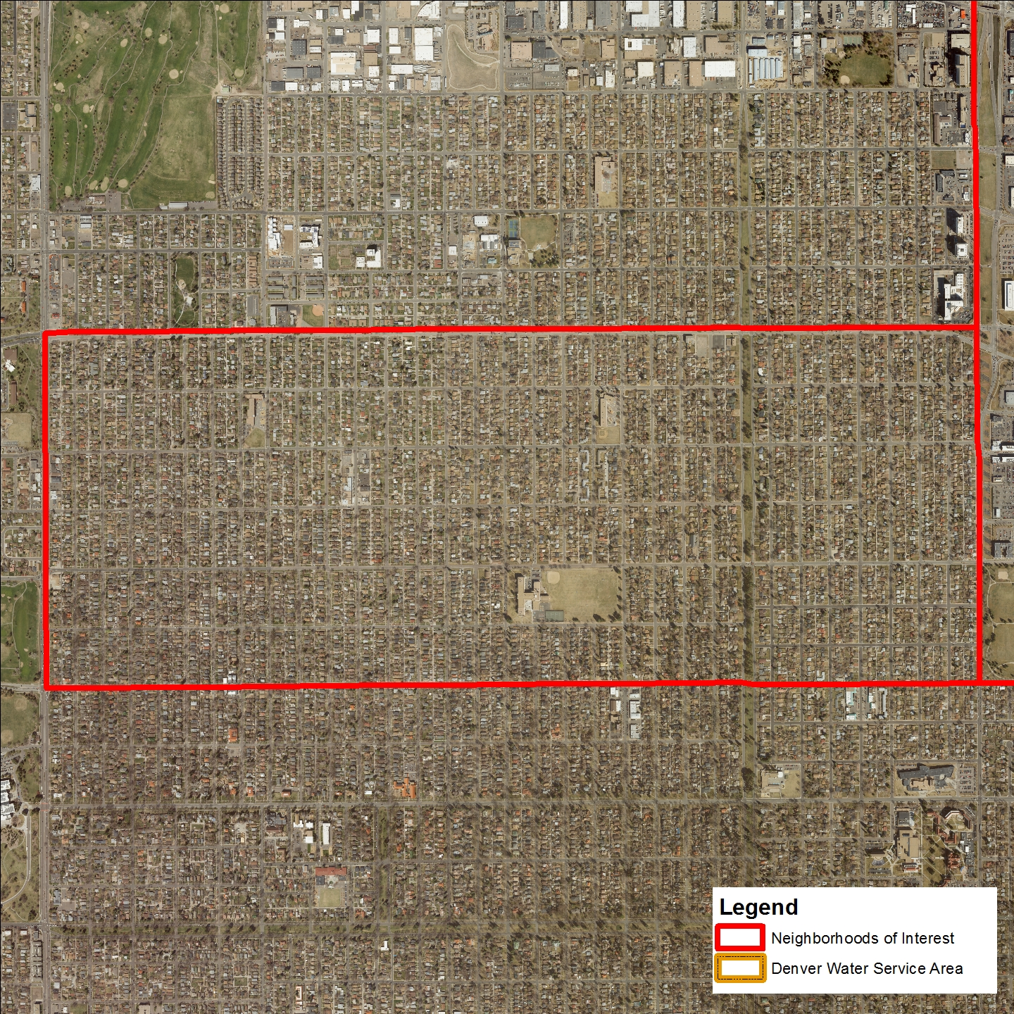
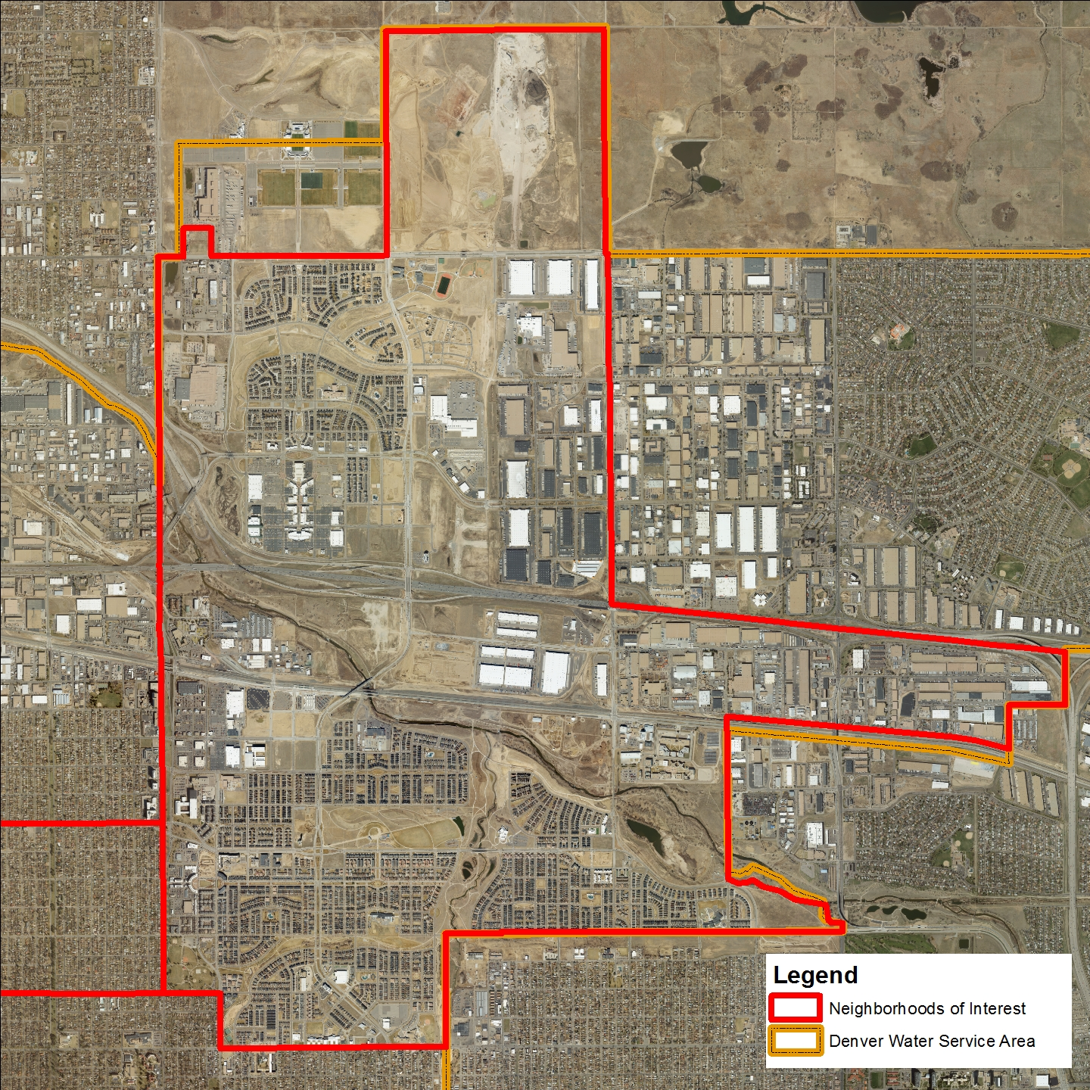
North Park Hill
Stapleton
Notes:
Why Stapleton and North Park Hill?
Stapleton is a relatively new development and models new construction in the Denver area. The neighborhoods are very ‘cookie cutter’ with few trees.
North Park Hill is an example of an older neighborhood which has become gentrified. As the demographics of neighborhoods like North Park Hill change, so do the landscape types. Determining how the landscapes change when these older neighborhoods ‘turnover’ is of particular interest to Denver Water.

Slide 9
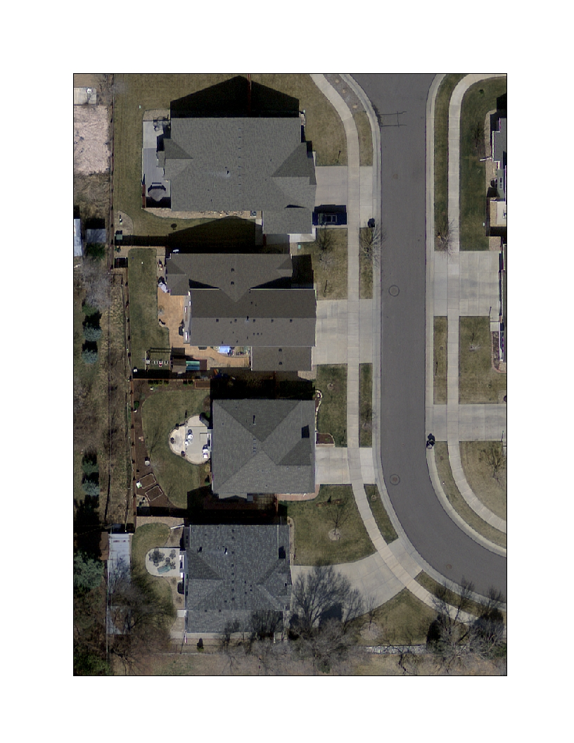
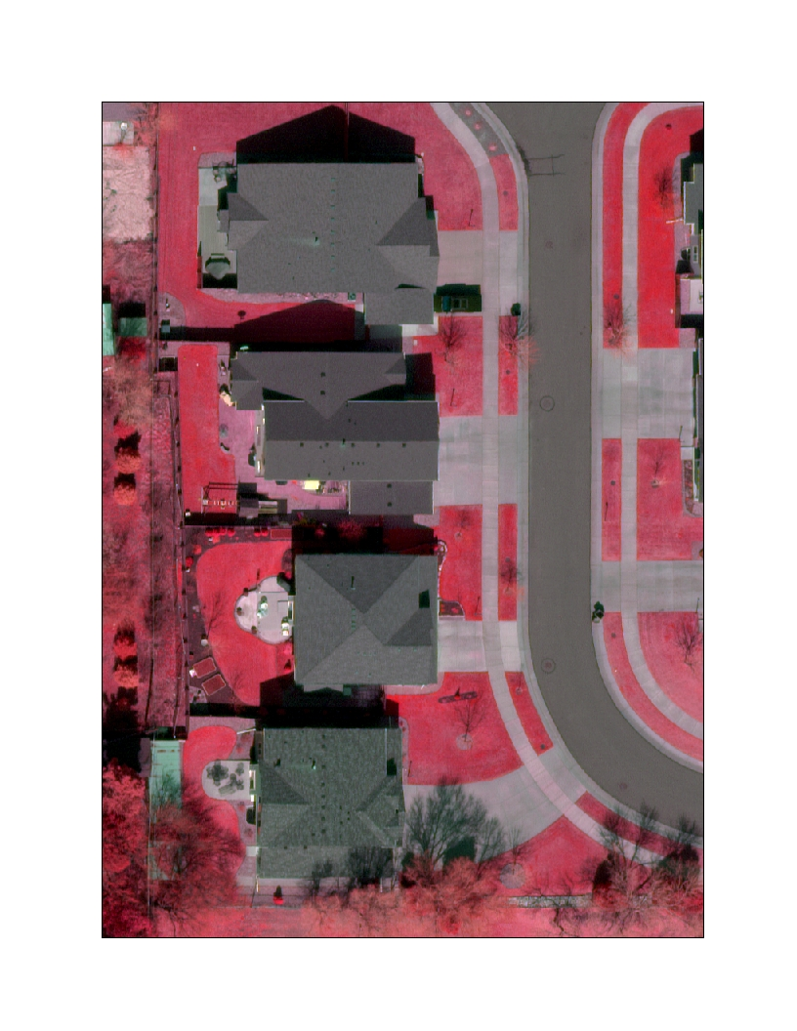
Raster
True Color
False Color Near Infrared
Notes:
Denver Regional Council of Governments(DRCOG) purchases imagery every two years for an area that covers a 6,000- square-mile region. The imagery is collected as part of the Denver Regional Aerial Photography Program (DRAPP). Some of the imagery specifications:
Resolutions 3-inch, 6-inch, 12-inch
Feb/Mar/Apr and June/July flight windows (metro and mountains, respectively)
Accuracy adheres to industry standards for positional accuracy
Quality control is performed on every imagery tile
Aesthetics
Reduced shadows
Reduced building lean
Snow-free and leaf off

Slide 10
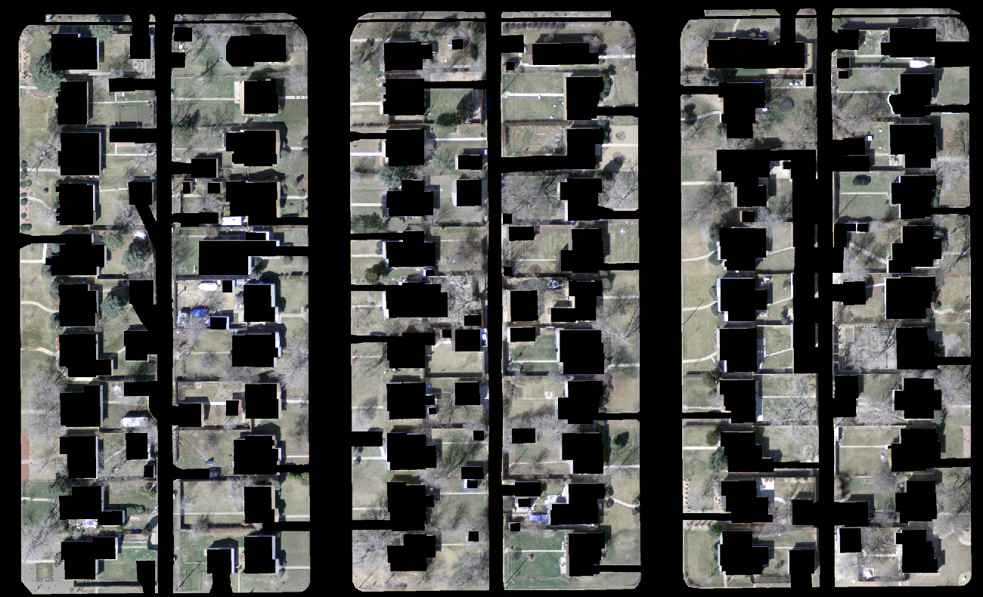
Vector
Notes:
There will be two vector layers used in this project.
Planimetric data which will be used to erase impervious surfaces from the imagery. Sidewalks within a yard will be present and captured in the concrete layer. Planimetric data represents Edge of Pavement (roads), Parking lots, Sidewalks, Driveways, Rooftops
Neighborhood boundary layer which will be downloaded from the U.S. Census. A mask will be created and used to extract a smaller portion of the 6000 square mile imagery.

Slide 11
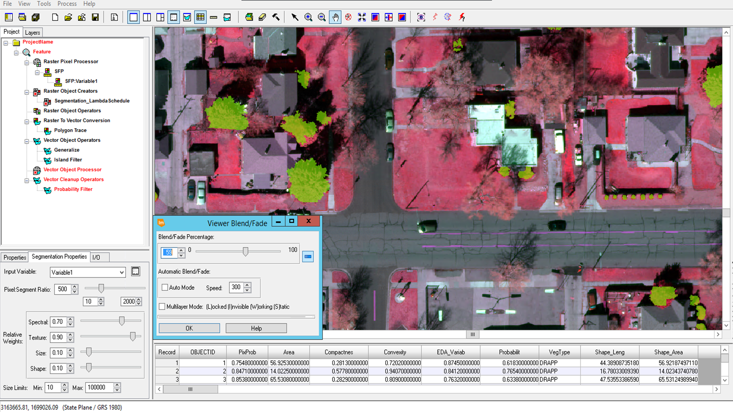
Software Used
Notes:
A Hexagon Geospatial product, ERDAS Imagine Objective, will be used to extract the features from the imagery.
Imagine Objective is an add in to ERDAS Imagine and offers object oriented image classification to segment and classify an image based on its shape and pixel values.
A model will be built for each feature in Imagine Objective to extract the 7 features from the imagery. These features will represent landscape types not represented in the planimetric data which depicts building rooftops, sidewalks, driveways roads. Since these areas are already captured by the planimetric data and are not being irrigated, they fall outside the scope of this project.

Slide 12
Why Imagine Objective?
Offers open, modifiable, and extensible feature models.
Object oriented approach.
Caters to discrete feature.
Integrates with ERDAS IMAGINE.
Uses ancillary layers (data fusion).
Leverages holding of all remotely sensed imagery.
Extracts features and classes.
Notes:
Ability to create and modify models
True object oriented approach which means spectral properties and spatial components are measured and available to the processing engine.
Provides discrete feature extraction, where clean-up operators can be included in the feature model to produce output suitable for merging into a GIS with minimal post-processing (squared-up buildings, smooth gap-less roads, aircraft outlines, etc)
Integrates with ERDAS IMAGINE, providing a full suite of vector editing tools for further clean-up and editing.
Uses ancillary layers (data fusion) – e.g. slope, aspect, texture, etc. – along with the capability inherent with an object based approach to employ shape metrics, proximity, association, thereby leading to increased feature extraction accuracy.
Leverages holding of all remotely sensed imagery, including panchromatic, multispectral, hyperspectral, SAR, LiDAR, etc.
Extracts features and classes that are attributed based on the measures used to identify them, including a final probability of being in that class, enabling quicker validation of final results and analysis of problem areas.

Slide 13
Workflow
Mosaic imagery for neighborhood
Mask out planimetric data
Collect samples for feature model
Refine model
Run object-oriented classification model
Ground truthing
Accuracy Assessment
Perform QA/QC
Finalize and export to shapefile
Intersect classified layers with edge of pavement parcels
Spatially join with consumption data
Calculate efficiency

Slide 14
The different types of landscapes and their descriptions are:
Coniferous - Green plants at time of imagery (spring). Includes shrubs, hedges, other plants, and clusters of bare branches.
Deciduous – Plants and trees with leaf-off at time of imagery.
Concrete – Includes colored concrete, asphalt, brick, stone paths and patios. There is no way to prevent some overlap with the unmaintained layer (e.g. decorative rock).
Unmaintained/Alternative – Includes mulch, decorative rock patches, dirt. There is no way to prevent some overlap with the Concrete layer (i.e. decorative rock).
Turf – Turf in early spring can be green, brown, or patchy.
Shadows – Shadows at day/time imagery was taken.
Unclassified impervious – "everything else" examples include, junk piles, cars, tarps, play toys, etc. Usually the feature(s) captured are on top of a pervious surface.
Notes:
The different types of classifications and their definitions. After several attempts to classify multiple different landscape types, internal stakeholders determined that the current list of landscape types was sufficient for this study.

Slide 15
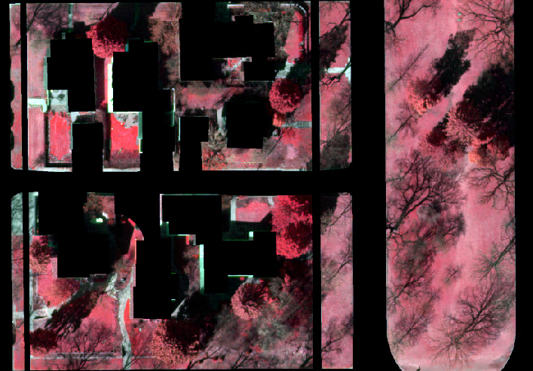
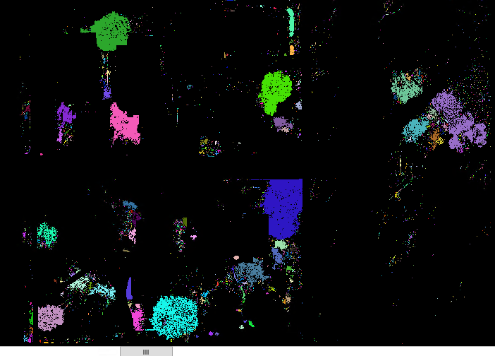
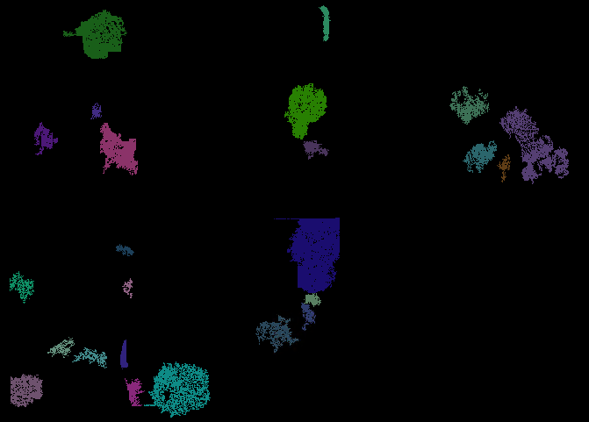
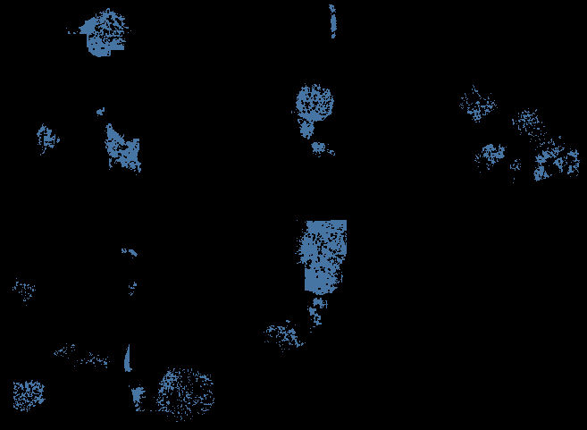
Imagery
RPP
ROC
ROO
RVC
VOO
Notes:
RPP -The Raster Pixel Processor (RPP) node performs pixel level image classification. This is normally the first process node in a feature model. Going from the Imagery to the RPP raster the shadows are picked up easily.
ROC - Raster Object Creation Operators create sets of Raster Objects from input raster data. These operators form groups of pixels from the input raster data, and identify each distinct group of pixels by assignment of a unique output value which identifies the Raster Object.
ROO - Use Raster Object Operators to manipulate the raster objects created by the Raster Object Creator. The Raster Object Operator may perform a variety of functions on the Raster Objects including:
Expand or shrink the existing Raster Objects
Eliminate raster objects that do not meet some criteria
Combine multiple input raster objects into a single raster objects
Split input raster objects into multiple new raster objects
Renumber the raster objects to eliminate gaps after a filtering or eliminating operation
RVC -Raster to Vector Conversion Operators convert sets of raster objects to sets of Vector Objects. The set of Vector Objects produced may be either Polygons or Polylines.
VOC -Use Vector Object Operators to manipulate the vector objects created by the Raster To Vector Conversion. These operators may perform a variety of functions on the vector objects including:
Reshape the existing Vector Objects
Eliminate vector objects that do not meet some criteria
Combine multiple input vector objects into a single vector object
Split vector objects into multiple new vector objects
Convert polygon objects into polylines, and convert polylines into polygon objects
VOP - The Vector Object Processor node performs classification on vector objects. Vector object classification involves specifying one or more cues which are used by an Object Classifier. The cues include metrics which measure some property of vector objects. The Object Classifier uses the cues to assign a probability to each object in a group of vector objects.

Slide 16
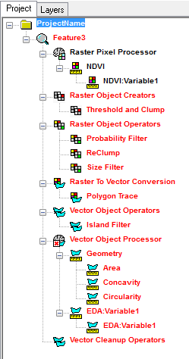
The model for each feature class will be key for this project. Being able to turn out feature layers representing each feature type quickly and efficiently is one of the main focuses for this project.
Each model will used raster and vector processors and creators to step through the model to create an ideal representation of each feature.
Each model will be customized to each feature and made to be usable for any new area of interest so that the process can become more automated.

Slide 17
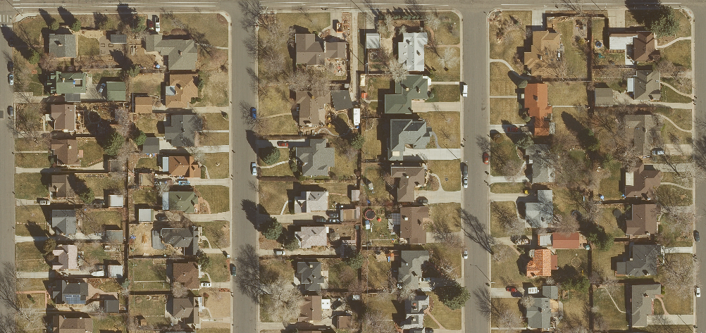

Slide 18
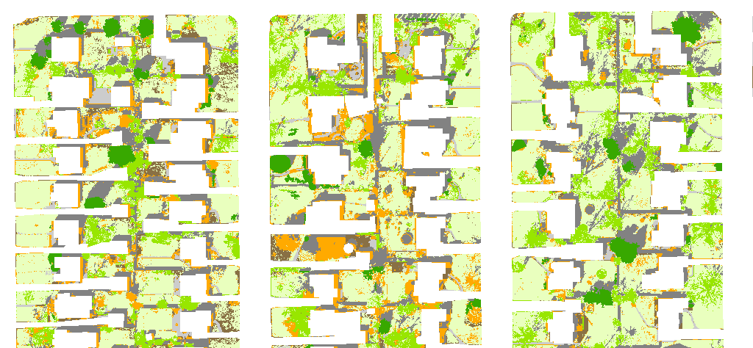
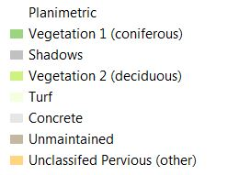
Notes:
An example of the difference classification types overlaid on top of the DRAPP 3-inch imagery.

Slide 19
Water Consumption Volumes By Property With Landscape Types
(Average Monthly Water Use During the Summer Months – Average Water Use During the Winter Months)/Total Pervious Area
If the number calculated is less than 12 gallons per square foot of pervious area, then water use for that location is considered efficient.
If the number calculated is higher than 12 gallons per square of pervious area, then water use for that location is considered inefficient.
Notes:
Why is this important? When utilities like Denver Water expand or improve its infrastructure, one of the strongest factors in determining what that new infrastructure looks like is the demand on the system, especially in the irrigating months between April and November. Whether or not a 12 inch main is installed instead of a 6 inch main has a lot to do with whether or not a high demand is expected. Landscapes and the customers that are using them will tell Denver Water a lot about how they expect a customer to use water when a new building, development, etc. is installed. Classified landscape along with information being generated by the water efficiency team at Denver Water, like the customer model, will help Denver Water determine how certain customers use water based on the irrigable area and the type of land cover that makes up that irritable area. The below graphic depicts what could be the end result for measuring water efficiency. The idea is to take all landscape types except for the tree canopy, multiply that by 12 and measure that against the water consumption total which is measured in terms of thousands of gallons. This is because Denver Water typically considers efficient water use to be 12k gallons of water per square foot.

Slide 20
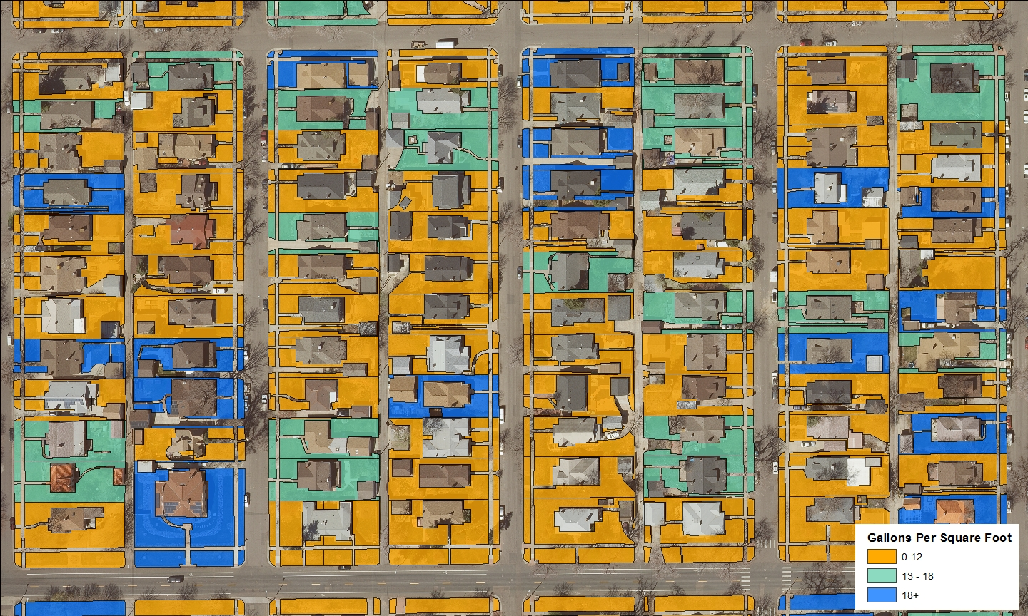
Notes:
One of the goals of this project is to determine water efficiency at the parcel level.
Determining efficiency will help the conservation department at Denver Water understand current trends in water use and help the Demand Planning department determine trends in irrigation water use for future developments.

Slide 21
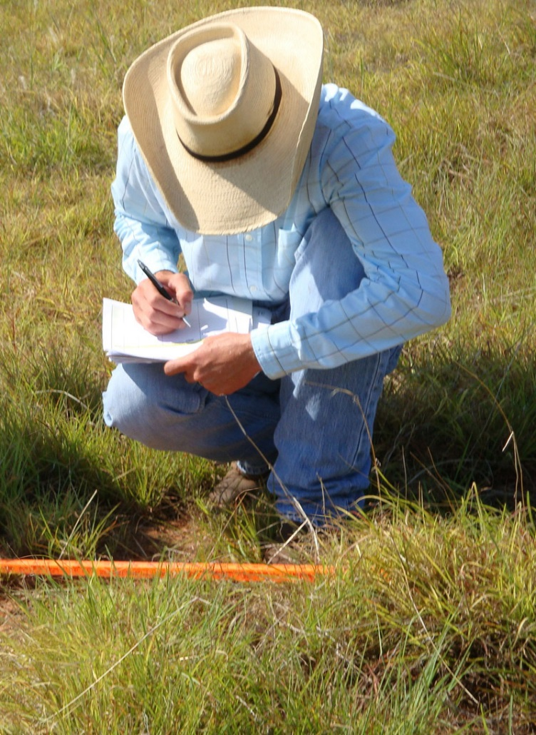
Quality Control
An accuracy assessment will be performed on the results for the seven features types.
Ground-truth of at least a 1000 accessible locations will be used within the neighborhoods being classified.
QA/QC will be performed for obvious misclassifications. Vector objects representing the wrong landscape type will either be reclassified or deleted all together.
Notes:
Quality assurance/Quality Control will be performed via a confusion matrix that will look at the 7 different landscape types. Ideally we’d like to have a 95% accuracy rate. Ground-trothing will be performed in the Denver area neighborhoods where the land is accessible/visible. A final cleanup will be performed that will eliminate or reclassify features that were incorrectly classified.

Slide 22
 | Turf | Deciduous Vegetation | Coniferous Vegetation | Unmaintained | Shadow | Concrete | Unclassified Impervious | Totals
Turf
Deciduous Vegetation
Coniferous Vegetation
Unmaintained
Shadow
Concrete
Unclassified Impervious
Totals
Notes:
Example of a confusion matrix.

Slide 23
Timeline
January – Data prep for both neighborhoods, create areas of interest for features, build and run models.
February, March and April – Quality control via ground truthing
June - Quality control with heads up digitizing and recalibrating of model where needed.
July – Present at Conservation for GIS Conference

Slide 24
Bibliography
Al-Kofahi, S., Steele, C., VanLeeuwen, D., & Hilaire, R. S. (2012). Mapping land cover in urban residential landscapes using very high spatial
resolution aerial photographs. Urban forestry & urban greening, 11(3), 291-301.
Aronoff, S. (2005). Remote sensing for GIS managers. Redlands, Calif.: ESRI Press
Bauer, T., & Steinnocher, K. (2001). Per-parcel land use classification in urban areas applying a rule-based technique. GeoBIT/GIS, 6, 24-27.
Geneletti, D., & Gorte, B. G. H. (2003). A method for object-oriented land cover classification combining Landsat TM data and aerial photographs. International Journal of Remote Sensing, 24(6), 1273-1286.
Jensen, J. R. (2007). Remote sensing of the environment: an earth resource perspective (2nd ed.). Upper Saddle River, NJ: Pearson Prentice Hall.
Lillesand, T. M., & Kiefer, R. W. (2007). Remote sensing and image interpretation(6th ed.). New York: Wiley.​
Sun, H., Kopp, K., & Kjelgren, R. (2012). Water-efficient urban landscapes: Integrating different water use categorizations and
plant types. HortScience, 47(2), 254-263.
Zhou, W., & Troy, A. (2008). An object‐oriented approach for analysing and characterizing urban landscape at the parcel level. International Journal of Remote Sensing, 29(11), 3119-3135.
Zhou, W. (2013). An object-based approach for urban land cover classification: Integrating LiDAR height and intensity data. IEEE Geoscience and Remote Sensing Letters, 10(4), 928-931.

