Slide 1
Implementing the Smart Grid’s most critical technology
A methodology for smart meter collector siting and monitoring
Casey Finedell
Advisor: Kirby Calvert

Slide 2
What is an electric grid? How can it be ‘smart’?
Electrical generation, transmission, and distribution systems
Capable of real-time communication and automated responses to load demands and outage events through advanced technology
Programmed responses to system adversity

Slide 3
Meters make the grid even smarter
Meters:
Revenue information at various points of delivery
Maintain fair and equitable electricity for all
Record total usage and forecast peak demand
Automated Meter Infrastructure (AMI):
Two-way communication between a central server and end consumer
Save time in standard operations
Bring field capabilities to the office

Slide 4
Project overview Why is this project necessary?
Contribute to the planning, siting, and interactivity of AMI
Enable utilities to deploy AMI in (cost) effective ways
Gain full advantage of the benefits of increased monitoring and control

Slide 5
Proposal outline
Benefits of AMI and smart grid technology
Literature on mesh networks and use of GIS in electrical delivery systems
Workplan and expected results
Conclusions

Slide 6
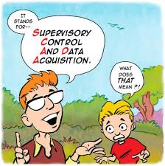
Benefits of AMI SCADA – the backbone of smart grid technology
System Control and Data Acquisition
Network of devices and sensors
Transmit detailed information to a central interface
Providing the same information and control as if the operator is in the field

Slide 7
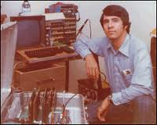
SCADA - Through the years
Simple gauges and switches wired from control rooms onsite at substations
Complex communication
Real-time data
Detailed reporting
Automated response

Slide 8
AMI vs. AMR
Two-way communication
Control for remote disconnect
Trouble reporting for outage management
Provide interface for consumer interaction
Meter to server communication
Collect read information only
No monitoring
No control

Slide 9
AMI and Renewable Energy Are they connected?
Smart grid provides the framework for:
Ability to coordinate multiple generation locations and schedules
Fluctuations in renewable energy production
Evening hours
Low wind
Can be automatically offset and equalized by increasing generation from traditional sources
Local energy to be returned to the grid:
Distributed generation facilities (non-transmission level)
Home renewable energy production

Slide 10
Role of AMI in Outage Management
Self reporting outages
Pinging capabilities for outage assessment
Verification of outage restoration

Slide 11
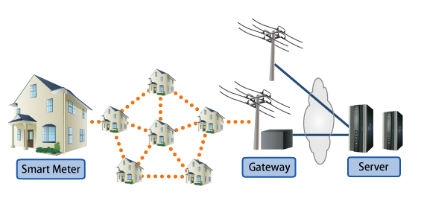
Relevant Literature 900 MHz Mesh Radio Networks
This AMI system uses two communication formats:
Mesh radio network to communicate locally
Cellular technology to interface with central server
http://www.fujitsu.com/global/services/solutions/sensor-network/ami-solution/

Slide 12
Four characteristics of mesh networks
Self-configuring nodes
Multiple routing paths
Use of spread spectrum radios
Broadcast on ISM (instrumentation, scientific and medical) band frequencies
- Capehart and Capehart (2007, 322-323)

Slide 13
Python and ArcGIS
Python is the preferred object-oriented programming language for ArcGIS applications
Runs smoothly with existing mapping system
No additional programs to install to interface with GIS data
Once code is written, it is simple to modify
Python is free and open source
Automates – saving time and increasing accuracy
Only cost is knowledge of the language structure
Zandbergen (2013)

Slide 14
Work Plan Apply script and methodology to meter data
Identify and calculate meter density
Proximity selection using a Python script
Write values of quantity of neighboring meter points meeting parameters – in this case within 1200 feet
Repeat as many times as desired using selected sets for each successive selection – in this case 8 hops
Symbolize in ArcMap based on quantity using quantile classification
Symbolize for each data hop

Slide 15
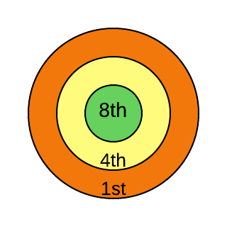
Symbolization
Map symbol used will have a ringed theme
Class symbology for quantity at each threshold
Helps visualize density at each hop

Slide 16
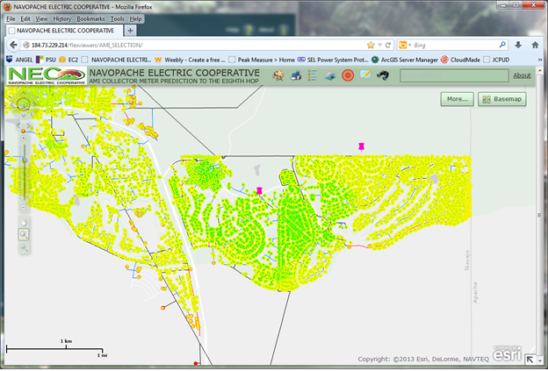
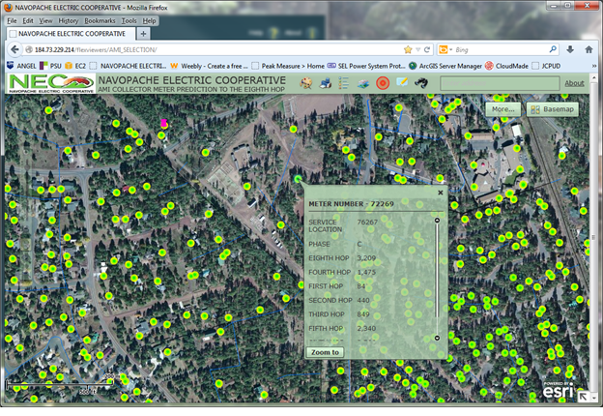
Expected and unexpected areas of communication densities
Using identify function to view hop specific data

Slide 17
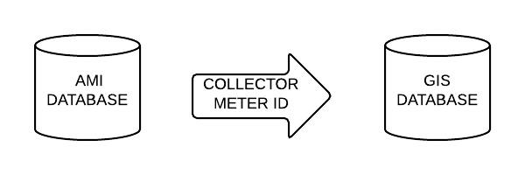
System Snapshot
AMI database contains collector ID and ‘paths’
Once moved to GIS database:
Can symbolize based on collector meter
Can create ‘path’ from endpoint to collector

Slide 18
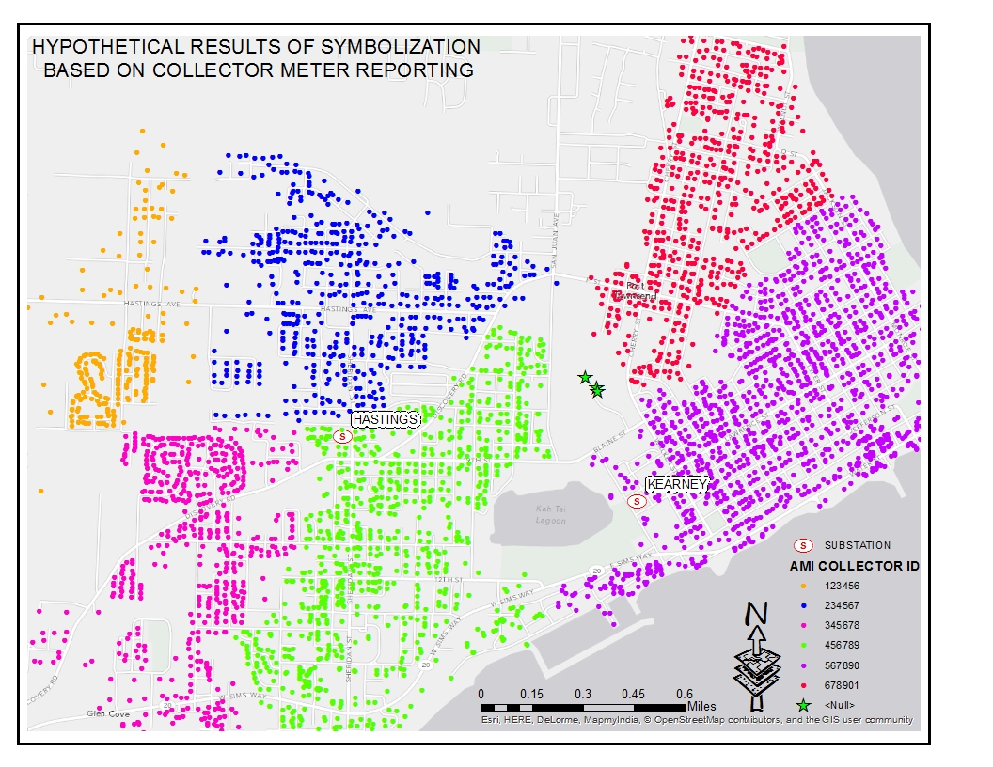

Slide 19
Expected results
Complete methodology for AMI collector siting and visualization
Functional and transferable Python script to calculate meter proximity
Map document - minimal local customization
Network map for creating nightly SQL update
Simple web based map viewer for final results

Slide 20
Conclusion
Planning, installation, and monitoring
Daily tool for metering managers visualization of AMI communication
Scalable and applicable to multiple sizes and industries
Moderate expertise needed to follow methodology and embrace benefits

Slide 21
References
A Brief History of Electric Utility Automation Systems, article by H. Lee Smith. (2010). Retrieved from http://www.electricenergyonline.com/show_article.php?mag=63&article=491
Baird, G. (2011). Expressway to the Future: GIS and Advanced Metering Infrastructure. Journal: American Water Works Association. Volume 103, Issue 1, January 2011, pages 34-39
Capehart, Barney & L. Capehart, Lynne C. (2007). Web Based Enterprise Energy and Building Automation Systems. (pp. 318-328). Fairmont Press, Inc.. Retrieved from: http://app.knovel.com/hotlink/toc/id:kpWBEEBAS1/web-based-enterprise
Carr, N. (2008). The Big Switch: Rewiring the World from Edison to Google. New York, NY: W. W. Norton & Company Ltd.
Cousins, A. (2009) Integrating Automated Metering Infrastructure (AMI) with GIS to Predict Electrical Outages. Spokane, WA: Avista Corporation. Retrieved from: http://proceedings.esri.com/library/userconf/egug2009/papers/tuesday/integr~1.pdf
Electric Power Research Institute. (2011) Estimating the Costs and Benefits of the Smart Grid. Retrieved from: http://ipu.msu.edu/programs/MIGrid2011/presentations/pdfs
Finedell, C. Automated Metering Infrastructure (AMI) Deployment Module. (2013). Retrieved from caseyfinedell.weebly.com
Meehan, B. (2007). Empowering Electric and Gas Utilities with GIS. Redlands, CA: ESRI Press
Patel, S., Scafuto, R., Westrup, W. & Troxell, D. (2009) Deploying AMI Solutions: A Best Practices Approach. AT&T Wireless. Retrieved from: http://smartgridcc.org/wp-content/uploads/2014/01/AMI-White-Paper-ATT.pdf
Rodrigue, C. (2007). Map Symbolism [Lecture notes]. Retrieved from: http://www.csulb.edu/~rodrigue/geog140/lectures/symbolism.html
Sioshansi, Fereidoon P. (2013). Energy Efficiency - Towards the End of Demand Growth. (pp. 430-432). Elsevier. Online version available at: http://app.knovel.com/hotlink/toc/id:kpEETEDG06/energy-efficiency-towards
Zandbergen, P. (2013). Python Scripting for ArcGIS. Redlands, CA: ESRI Press

