Slide 1
Implementing the Smart Grid’s most critical technology
A methodology for smart meter collector siting and monitoring
Casey Finedell
Advisor: Kirby Calvert

Slide 2
Project Outline
Inspiration of project
Benefits of Automated Meter Infrastructure (AMI) and smart grid technology
Overview of mesh networks and application of AMI with GIS in electrical delivery systems
Implementation and results
Conclusions

Slide 3
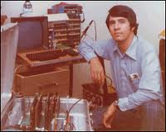
System Control and Data Acquisition (SCADA)
Began with simple gauges and switches wired from control rooms onsite at substations
Network of devices and sensors
Transmit detailed information to a central interface
Providing the same information and control as if the operator is in the field

Slide 4
SCADA and AMI
Getting the most from the two towers of field to office communication networks
How can these communication systems work in tandem to achieve better system views
Areas of overlap
Areas of delineation

Slide 5
Role of GIS in electric utilities
Asset management
Planning – tracking all proposed projects in one concise view
Engineering assessment
Electric flow model creation and analysis
Load Forecasting
Ability to manage data from outside the utility as it relates to the existing electrical system

Slide 6
Role of GIS with AMI in Outage Management
Self reporting outages
Pinging capabilities for outage assessment
Verification of outage restoration

Slide 7
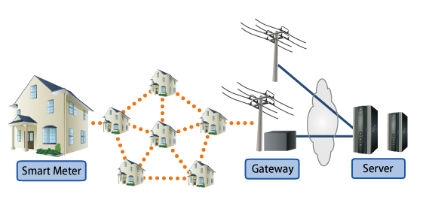
900 MHz Mesh Radio Networks
This AMI system uses two communication formats:
Mesh radio network to communicate locally
Cellular technology to interface with central server
http://www.fujitsu.com/global/services/solutions/sensor-network/ami-solution/

Slide 8
Four characteristics of mesh networks
Self-configuring nodes
Multiple routing paths
Use of spread spectrum radios
Broadcast on ISM (instrumentation, scientific and medical) band frequencies
- Capehart and Capehart (2007, 322-323)

Slide 9
Python and ArcGIS
Python is the preferred object-oriented programming language for ArcGIS applications
Runs smoothly with existing mapping system
No additional programs to install to interface with GIS data
Once code is written, it is simple to modify
Python is free and open source
Automates – saving time and increasing accuracy
Only cost is knowledge of the language structure
Zandbergen (2013)

Slide 11
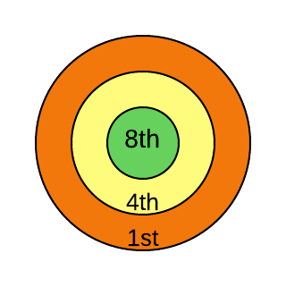
Symbolization
Map symbol used has a ringed theme
Class symbology for quantity at each threshold
Helps visualize density at each hop

Slide 13
Analysis on Jefferson PUD Data Project Website Web Map

Slide 14
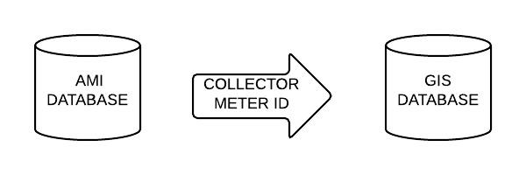
System Snapshot
AMI database contains collector ID that each meter reports to
Once updated to GIS database via SQL query:
Can symbolize based on collector meter
Data is near live after each desired update timeframe

Slide 15
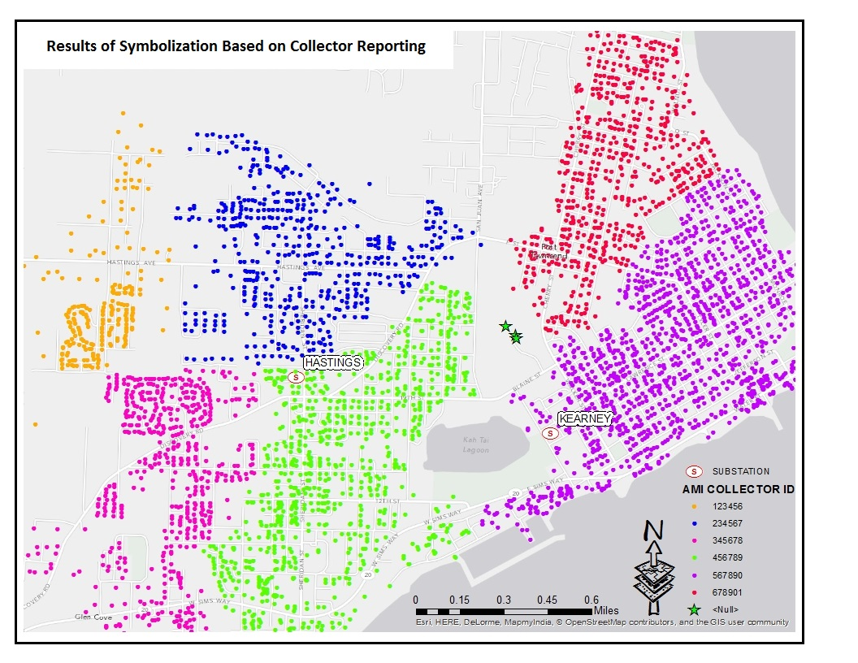

Slide 16
Results – This projected created:
Complete methodology for AMI collector siting and visualization
Functional and transferable Python script to calculate meter proximity
Map document - minimal local customization
Network map for creating nightly SQL update
Simple web based map viewer for final results

Slide 17
Conclusion
Planning, installation, and monitoring
Daily tool for metering managers visualization of AMI communication
Communication and siting concepts also apply to Automated Meter Reading (AMR) projects
Scalable and applicable to multiple sizes and industries
Moderate expertise needed to follow methodology and embrace benefits

Slide 18
References
A Brief History of Electric Utility Automation Systems, article by H. Lee Smith. (2010). Retrieved from http://www.electricenergyonline.com/show_article.php?mag=63&article=491
Baird, G. (2011). Expressway to the Future: GIS and Advanced Metering Infrastructure. Journal: American Water Works Association. Volume 103, Issue 1, January 2011, pages 34-39
Capehart, Barney & L. Capehart, Lynne C. (2007). Web Based Enterprise Energy and Building Automation Systems. (pp. 318-328). Fairmont Press, Inc.. Retrieved from: http://app.knovel.com/hotlink/toc/id:kpWBEEBAS1/web-based-enterprise
Carr, N. (2008). The Big Switch: Rewiring the World from Edison to Google. New York, NY: W. W. Norton & Company Ltd.
Cousins, A. (2009) Integrating Automated Metering Infrastructure (AMI) with GIS to Predict Electrical Outages. Spokane, WA: Avista Corporation. Retrieved from: http://proceedings.esri.com/library/userconf/egug2009/papers/tuesday/integr~1.pdf
Electric Power Research Institute. (2011) Estimating the Costs and Benefits of the Smart Grid. Retrieved from: http://ipu.msu.edu/programs/MIGrid2011/presentations/pdfs
Finedell, C. Automated Metering Infrastructure (AMI) Deployment Module. (2013). Retrieved from caseyfinedell.weebly.com
Meehan, B. (2007). Empowering Electric and Gas Utilities with GIS. Redlands, CA: ESRI Press
Patel, S., Scafuto, R., Westrup, W. & Troxell, D. (2009) Deploying AMI Solutions: A Best Practices Approach. AT&T Wireless. Retrieved from: http://smartgridcc.org/wp-content/uploads/2014/01/AMI-White-Paper-ATT.pdf
Rodrigue, C. (2007). Map Symbolism [Lecture notes]. Retrieved from: http://www.csulb.edu/~rodrigue/geog140/lectures/symbolism.html
Sioshansi, Fereidoon P. (2013). Energy Efficiency - Towards the End of Demand Growth. (pp. 430-432). Elsevier. Online version available at: http://app.knovel.com/hotlink/toc/id:kpEETEDG06/energy-efficiency-towards
Zandbergen, P. (2013). Python Scripting for ArcGIS. Redlands, CA: ESRI Press

