Slide 1
Improving Cadastre: Development of a Workflow Prototype Using ESRI’s Parcel Fabric
Pennsylvania State University – GEOG 596A
Linda M. Foster , MGIS Candidate
Justine Blanford, Advisor
July 2011
Notes:
Slide 1 – Title Slide
My name is Linda Foster and in this talk I am going to be highlighting my capstone project. My project involves developing and testing a workflow prototype using ESRI’s parcel fabric data model to improve cadastral data. This project is also one that I am working on concurrently at my job.
Throughout the talk I will be covering some background and history of the project, the objectives of the project, data that will be used, the development and evaluation of the resulting workflow, and a timeline for completing my project.

Slide 2
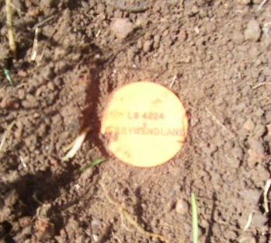
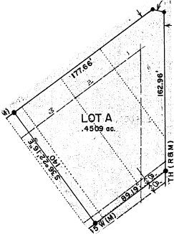
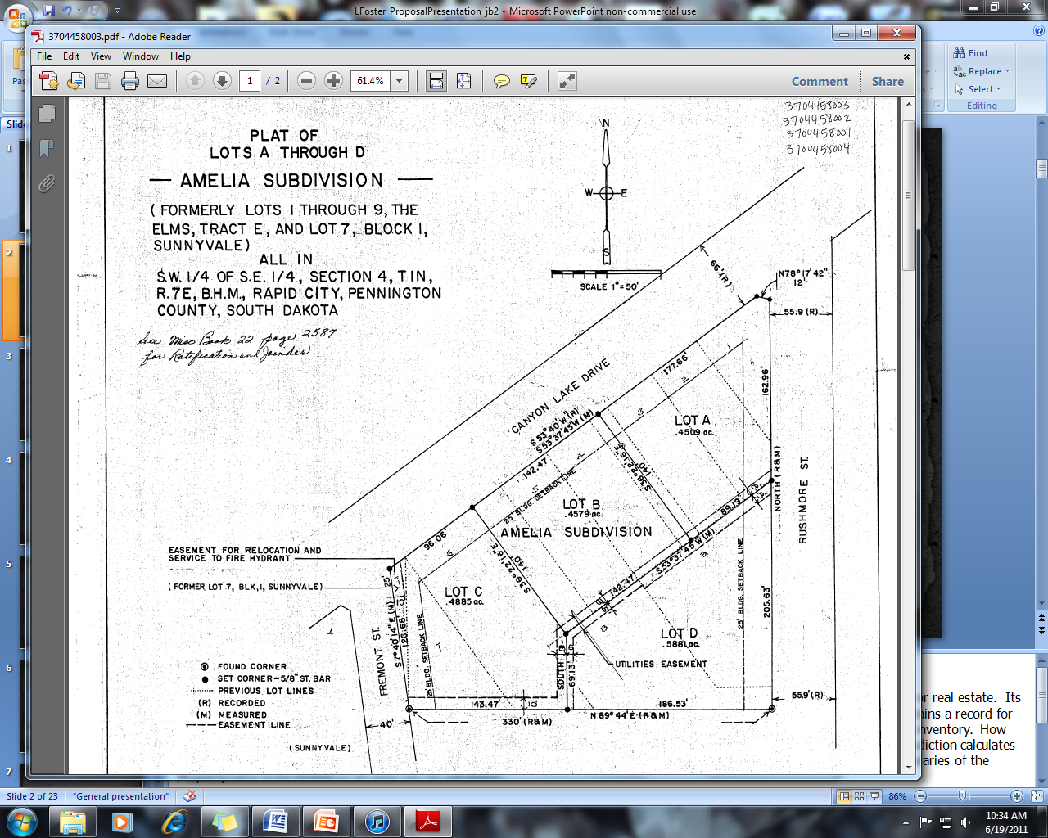
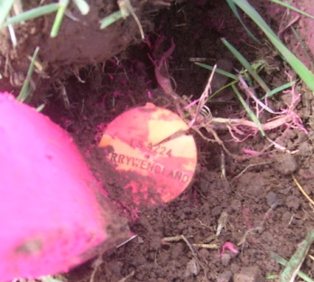
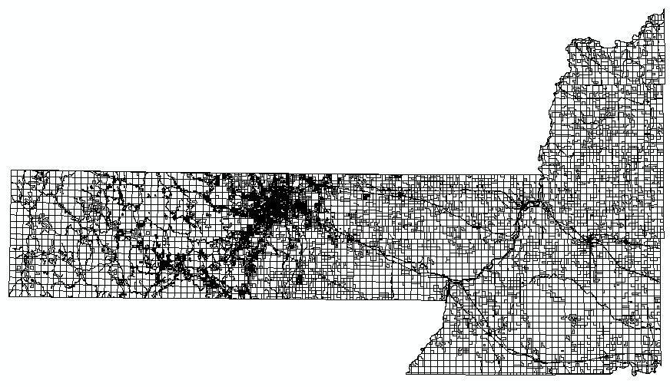
What is a Cadastre?
Notes:
Slide 2 – Background / Description of Cadastre
So what is cadastral data? A cadastre is a register of the quantity, value and ownership of property. Its main purpose is for assessing taxes. So each local jurisdiction, or county when we are talking about the United States, maintains a record for every piece of property (parcel), in its boundary resulting in a cadastre. A simpler way to think about might be to liken it to an inventory. How does this relate to each of us? If you own your own home or another piece of property, the local governing agency in your jurisdiction calculates your tax responsibility based partially on the size of the property you own. In order for this to be calculated, the shape or boundaries of the property have to be known so an area can be calculated.
An example of this is shown on the slide. Property corners, or monuments, are placed in the ground by surveyors when land is divided up. The distance and direction of each line from property corner to property corner is measured and recorded by the surveyor on a document called a plat. These measurements are what describe the configuration and area of the property. The plat document is then recorded by the local taxing authority as part of their permanent record.

Slide 3
Land Records History / Importance
property cadastres /land registration systems date back to 14th century BC in Egypt
a digital cadastre system allows for the
    management of public infrastructure
    response to natural disasters
    homeland security
    economics – (e.g. tax collection and other revenues) currently high property transaction fees & mortgage crisis
in the U.S. land records administered by local governments
Notes:
Slide 3 – History / Purpose of Cadastre
Now that you have an idea of what a cadastre is, let’s talk a little bit about the history and purposes of a cadastre. Although the origins of cadastres and land registration systems can be traced back to the 14th century BC in Egypt and their primary purpose has been for taxation, digital parcel coverages have been emerging for some time. This is because property boundary information is useful for many other things such as managing public infrastructure, responding to natural disasters, securing the homeland, and economics.
Most of the activities listed are obvious, but economics is a bit more elusive. Obviously, cadastres are used primarily for tax collection purposes, but in the United States property transaction fees are high because of the amount of manual research that has to be done. If the records were digitized and readily accessible, these fees could be greatly reduced. Some have also suggested that the mortgage crisis could have been recognized earlier if the U.S. had a national seamless digital parcel fabric or cadastre.
Accomplishing this is a tall order though, because property information is managed and administered on a local (county) government level. The logistics of developing a state-wide seamless digital cadastre are overwhelming enough—imagine tackling a national cadastre!

Slide 4
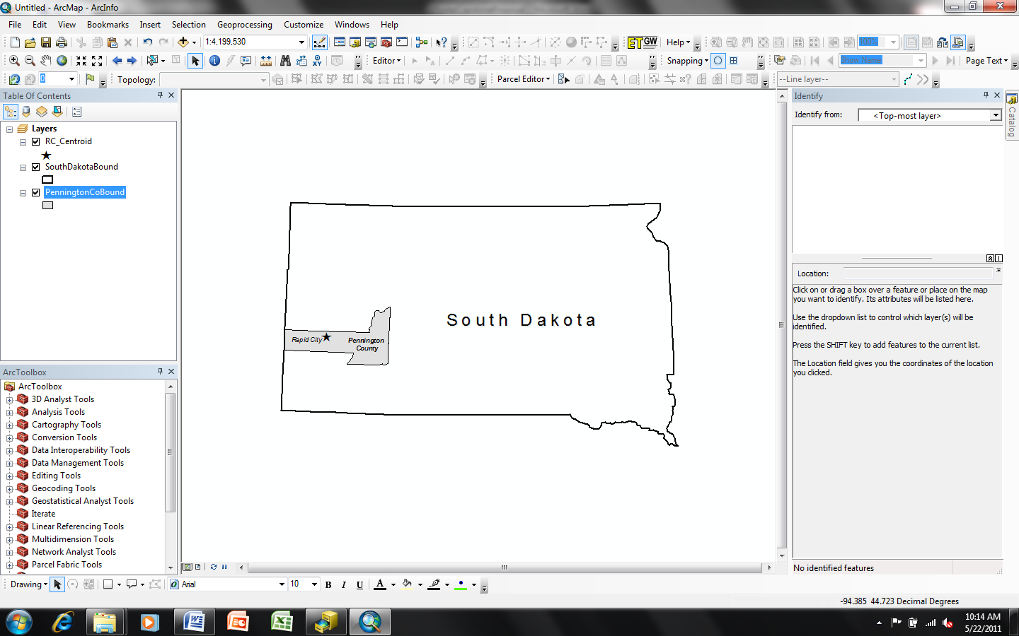
How Rapid City Uses Land Records
maintain ownership and tax information
zoning and planning designations
development of future land use
track annexations
maintain corporate boundaries
planning future transportation routes
Infrastructure Management
sanitary sewer system
water system
other asset management
Notes:
Slide 4 – How Rapid City Uses Land Records
The local government that I am working with for my project is Rapid City, which is located in Pennington County, South Dakota. A county-wide digital cadastre currently exists and is maintained by the Pennington County – Rapid City joint GIS Division. Although the dataset spans the county, I am going to be focusing specifically on how Rapid City uses this information and what their goals are for improving it.
Rapid City’s parcels dataset has been used for maintaining ownership and tax information, recording zoning and future land use planning designations, tracking annexations, maintaining corporate limits and planning future transportation routes. More recently, it has been used in conjunction with managing city assets such as sanitary sewer and water infrastructure.
Some of the more recent mapping and asset management activities are part of what is driving improvement of the parcels dataset.

Slide 5
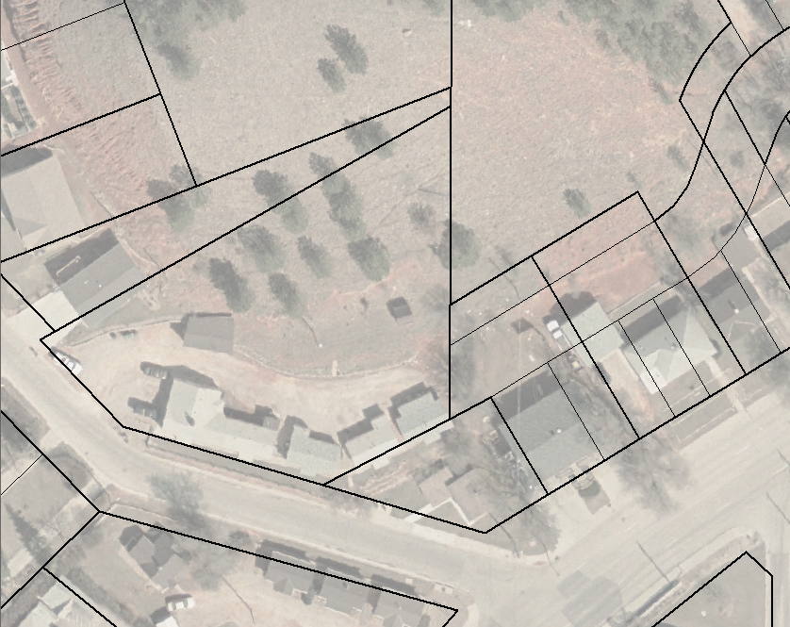
Why is Improvement Needed?
because Rapid City’s parcels dataset accuracy hasn’t kept pace with the accuracy of other basemap layers (i.e. aerial imagery)
Notes:
Slide 5 – Why is Improvement Needed?
Why do Rapid City’s parcels need to be improved? Because newly acquired data, such as aerial imagery and GPS coordinates are of a much higher accuracy than the existing parcels dataset. This is a problem when multiple layers are displayed together in a GIS, as shown in the example on this slide.
Another example is of the City’s sanitary sewer system layer as it relates to the parcels. It was developed recently from RTK GPS survey data. Highly accurate data was necessary when the data was developed because it was incorporated into a whole-pipe engineering model. When the data was added to the City’s GIS, there were assets that appeared to not be located in public rights-of-way because of the inaccuracy of the parcels.
This difference in accuracy is troubling for users who wish to use the data visually (i.e. the City Engineer taking a quick look at an area to get an idea how much additional right-of-way might need to acquired for an upcoming engineering project) and for users who wish to perform geospatial analysis against multiple layers. It is also alarming to citizens at large when they access the City’s online mapping system and note that their property boundary appears to run through the middle of their neighbor’s house!! [It should be noted here that there is an abundance of disclaimers strategically located throughout the site– but we all also know how much attention the average user gives them!]

Slide 6
Rapid City Parcels Dataset History
Parcels digitized from plats
Scales: 1:7,200, 1:2,400, 1:1,200
Control: USGS quadrangle section corners (7.5 minute)
Lines aligned to rectified but not ortho-corrected aerial photos
Microstation CAD
Parcels converted to ESRI ArcInfo Coverage
Control: USGS DLG & DRG (1:24,000)
Lines aligned to USGS DOQQ & Rapid City ortho-photography
ESRI GIS Software
Parcels converted to single county-wide SDE feature class
Maintenance of parcels by COGO input and other editing techniques
ESRI GIS Software
Migrate parcels to parcel fabric
Maintain cadastre and improve accuracy
ESRI GIS Software
1989
2000
2003
2011
Errors: aligning property to aerial photo
Errors: alignment was better in east than in west of county;
removal of tax parcel lines to match DLG section lines
Errors: remain uncorrected
Errors: to reduce errors
Data exist as a representation
Need improved accuracy
Notes:
Slide 6 – Rapid City Parcels Dataset History
So some of you may be wondering why the parcels dataset is not as accurate as other layers in the City’s GIS system. A quick look at the history of the dataset and its original purpose will make this clearer. The figure on this slide outlines some of the major events surrounding the development and maintenance of the data. As you can see, it was originally developed digitally in 1989 in MicrostationCAD and was intended to be a REPRESENTATION of the properties making up the county’s cadastre. It was developed by digitizing from plats at different scales and used USGS 7.5 minute quadrangle section corners as control. Rectified, but not ortho-corrected imagery was also used to help align property boundaries.
In 2000, the dataset was converted to ESRI’s ArcInfo coverage format. The 1:24,000 USGS digital line graph (DLG) section lines served as control for this project. During this effort, the lines were also adjusted visually to the USGS digital orthophoto quarter-quadrangles (DOQQ)s and Rapid City area orthophotography. Sometime after this project was finished, it was discovered that the conversion vendor incorrectly moved section lines in some tax parcels to match the DLG section lines, rather than moving the parcels to the correct section. It was also noted that water boundaries were erroneously incorporated to represent parcel boundaries.
In 2003, another conversion occurred migrating the data from coverage format to a single county-wide SDE feature class. No errors previously introduced into the data were corrected. Maintenance of the dataset continued using COGO input and heads-up digitizing.
Now that you have some idea of the dataset’s history and evolution, you can see why it does not align with data captured using today’s highly accurate methods.

Slide 7
Sources of Error
OBVIOUS
Relevance
Areal Cover
Accessibility
Density of Observations
Age of Data
Format
Map Scale
Cost
Original dataset developed in 1989
Data in .dgn, coverage & ArcSDE formats
Scales used: 1:1,200, 1:2,400, 1:7,200
Cost consideration during development
NATURAL VARIATIONS
Accuracy of Content
Positional Accuracy
Sources of Variations in Data
TYPES OF ERROR
No surveyed control points incorporated
PROCESSING
Numerical Errors
Errors in Topological Analysis
Classification and Generalization of Problems
Digitizing and Geocoding Errors
Different formats = different math solutions
Human interpretation of data
Source: Foote and Huebner (1995)
Notes:
Slide 7 – Sources of Error
In my literature review, I came across a good article by Foote and Huebner. They did a good job of recognizing that many types of error can be introduced into geospatial data and categorized these into three classifications. Each classification is broken down further to represent specific sources. The graphic on this slide illustrates how the errors in Rapid City’s dataset fit into the matrix developed by Foote and Huebner. Factors such as age of the data, format, scale differences, cost to produce, positional accuracy, etc. are applicable to Rapid City’s parcel dataset are highlighted in yellow.

Slide 8
Problems with Error
  current dataset is a representation
  public and city staff use data daily
  problems visually or spatially analyzing features as they relate to property boundaries
Need to Improve Accuracy
  cost prohibitive to hire a consultant to reconstruct
  not enough manpower in the GIS Division to re-build
  need to leave some version of parcels in service at all times
  up until now, no suitable alternative
Notes:
Slide 8 – Problems with Error
To summarize what has been discussed so far:
The current parcels dataset is a representation. However, it is used heavily by city/county staff, consultants and the general public. The fact that the dataset is less accurate than some layers in the City’s GIS is becoming a larger issue, especially as data with higher levels of accuracy are being incorporated into their GIS.
Spatial analysis that is dependent on the property boundaries cannot be carried out with any confidence and decisions have to be made carefully when looking at the property boundaries in their current state.
It is difficult to incorporate improvements in the parcels dataset because so many other layers are related (i.e. zoning and future land use designations) and would also have to be updated. Public perception can also be an issue – for instance, John Doe looks his property up in the online mapping system and sees the boundary intersecting his neighbor’s home!...
All of these issues highlight the need to improve the accuracy of the parcels dataset. However, there are some significant challenges that have stood in the way. It is cost-prohibitive to hire a consultant to perform all of the records research and surveying to reconstruct the dataset. The GIS Division consists of 3 full-time employees – not at all enough manpower to carry out the task themselves. Some version of the parcels needs to be left in place at all times. Up until now, there has not been an alternative that has met the City’s needs.

Slide 9
Key Considerations for Building and Managing Cadastre Data
develop layers with higher spatial accuracy
update and modify cadastral layers continuously, so as to increase accuracy of cadastre with time
store legacy data while constructing the maps from oldest to newest surveys
retrieve easily
Source: Bhowmick et al., 2008
Notes:
Slide 9 – Key Considerations
Some key considerations for building and maintaining cadastral data have been outlined by Bhowmick et al., and parallel Rapid City’s feelings on the matter and include developing layers with higher spatial accuracy, updating and maintaining cadastral layers continuously to increase accuracy over time, storing legacy data and easy retrieval. These are all goals that have been expressed by Rapid City’s staff.

Slide 10
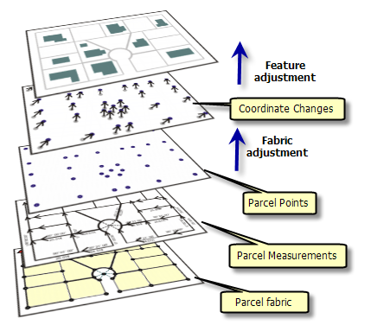
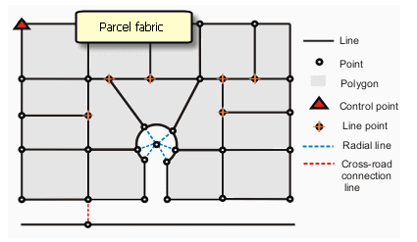
How to Accomplish? use ESRI’s Parcel Fabric
Source: ESRI 2011
Notes:
Slide 10 – How to Accomplish?
So how does an organization such as Rapid City’s GIS Division go about improving their digital cadastre? Ideally by utilizing an out-of-the-box solution that is readily available. That is why for my project I am proposing to explore ESRI’s recently introduced parcel fabric data model that resides in the core of ArcGIS Desktop and claims to do the following:
-allow for the import of existing cadastral data
-store control point information
-perform least squares adjustments in specified areas to improve data over time
-store originally recorded survey information
-apply adjustment vectors to related layers
Note that these features also meet the key considerations outlined by Bhowmick et. al on the previous slide.

Slide 11
About the Parcel Fabric
2000
ESRI Releases Survey Analyst – collaborative effort with Leica Geosystems
1999
ESRI Releases ArcGIS 8 – birth of geodatabase
2007
ESRI Releases Cadastral Fabric – collaborative effort with Geodata of Australia
2010
ESRI Releases ArcGIS 10 with Parcel Fabric in software core
2004
ESRI Releases ArcGIS 9
1992
Geodata Australia developing GeoCadastre
1994
FIG Cadastre 2014 Vision
1999
FGDC Cadastral Standard
2004
ArcGIS Cadastre 2014 Data Model Vision Published
Notes:
Slide 11 – About the Parcel Fabric
Although the parcel fabric was just introduced by ESRI in 2010, it is the result of over two decades of research and development by ESRI and their partners. The parcel fabric was based on a process originally developed by Geodata of Australia called GeoCadastre. This process included migrating a parcel network fabric into the GIS database and then allowing an adjustment and update of survey points and features within the GIS while retaining original survey title data. For ESRI, this was a new data model and concept for storing parcels and took several years of joint product development as ESRI had to incorporate cadastral storage in the geodatabase as defined by points and lines (survey methodology) rather than shape files (GIS/mapping methodology).
Careful consideration given to national and international standards, decades of development and the successful implementation of the GeoCadastre process in other countries signifies that a stable, comprehensive solution has been developed. ESRI committing to this model and incorporating the solution into its software core provides further confidence that this is a solution that was developed with longevity in mind.
Not only does its technical ability seem to meet what Rapid City needs, but the fact that it is included in the core of software and requires no additional licensing is also a bonus.

Slide 12
Project Objectives
Develop and Evaluate a Workflow to:
  improve accuracy of the cadastre & related dataset
    evaluate success of improvement
    test success of workflow
Notes:
Slide 12 – Project Objectives
The objectives of my project are to improve the accuracy of the cadastre dataset, evaluate the success of the improvement and test the success of the workflow used to achieve the improvements.

Slide 13
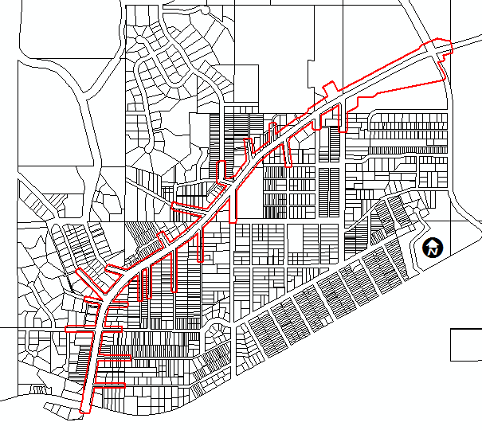
Study Area – Test Data Sample to be Used
Notes:
Slide 13 – Study Area and Test Data Sample to be Used
The data to be used for this study is a small portion of parcels from Rapid City’s existing cadastre. The area was chosen because a major arterial street reconstruction project was recently completed in the area providing an ideal dataset for use in this study. During the design phase of this street project a property layer, more accurate than what the City maintains, had to be put together so properties impacted by construction activities could be identified. Detailed property information was also necessary for developing construction easement documents and acquiring necessary rights-of-way. To develop the property layer, property corners in the project area were located and recorded using a mix of RTK GPS and conventional surveying methods. Plats, easements, deeds and other existing property documentation were retrieved from the county courthouse. A cadastral layer for the project area was then constructed in AutoCAD Civil 3D 2011 using the plats and surveyed property corner information. For this study, having surveyed property corners will give us coordinates to import into the fabric to adjust the existing parcels to. Also, having the independently created cadastral layer will allow for a comparison to see how well the parcel fabric adjusts the City’s existing parcels in the test area.
Our firm designed this particular project and I managed the surveying effort, so I am comfortable with the quality of the data that was produced.

Slide 14
Workflow Development
STEP 1
Building Framework
STEP 2
Preparing and Loading Data
STEP 3
Parcel Adjustment
STEP 4
Accuracy Assessment
STEP 5
Adjustment to associated layer
User
Feedback
Notes:
Slide 14 – Methodology
I have identified five steps that collectively make up the workflow portion of my project. They are:
Building the framework for working with the data
Preparing and loading the existing data
Adjusting the parcels to the surveyed property corner coordinates
Assessing the accuracy of the adjustment
Applying the adjustment to an associated layer
This project has been a collaboration with the client and so has involved delivering a workflow item for each step in the process and gathering feedback from them to make any necessary improvements or adjustments.

Slide 15
STEP 1
Building Framework
review
    ESRI documentation
    other literature
identify steps necessary to use parcel fabric
gather feedback
Notes:
Slide 15 – Step 1 – Building Framework
The first step in the workflow development of this project was reviewing existing documentation to identify the necessary steps required to prepare the data to load into the parcel fabric. This included reviewing ESRI documentation and other available literature (which is limited since this is still a fairly new component) as well as conversing with ESRI personnel. Preliminary work indicates that approximately a dozen steps need to be executed. This includes technical and data-related tasks such as verifying software version, installation of necessary components such as the Curves and Lines tool, creating workspaces and verification of projection and coordinate system information. A workflow item has been delivered to the client and feedback received.

Slide 16
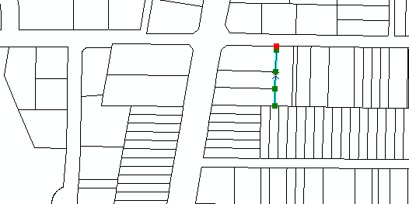
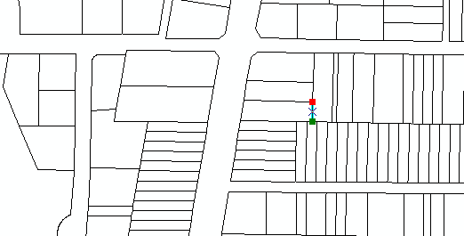
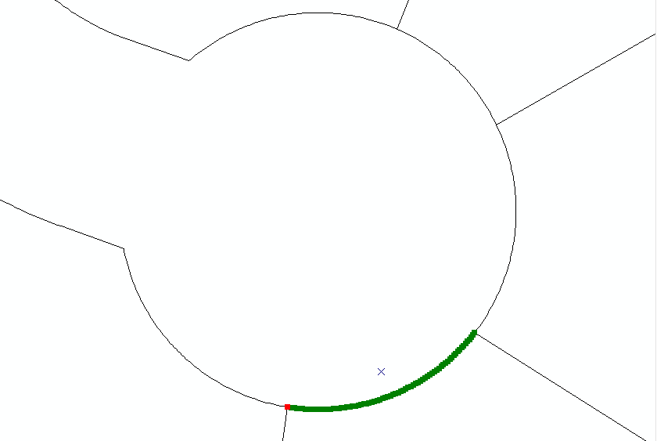
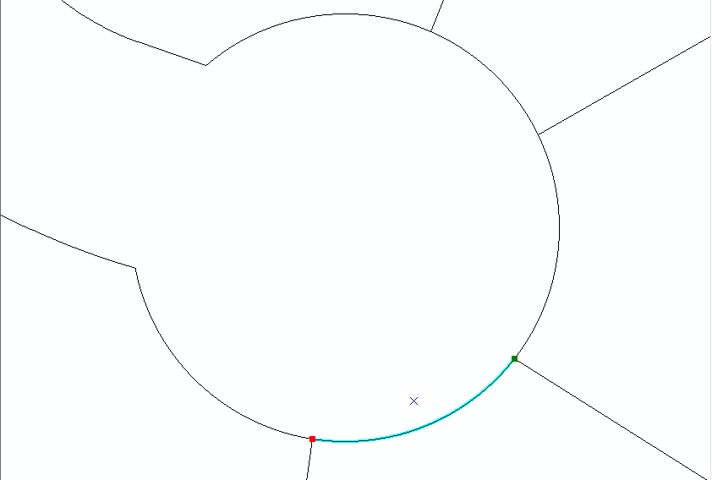
STEP 2
Preparing and Loading Data
prepare data
  planarize lines and curves
  verify topology
load data
  points, lines & polygons
  match control points
capture workflow for client
to repeat
Notes:
Slide 16 – Step 2 – Preparing and Loading Data
Step 2 is preparing and loading existing data to the fabric and is arguably the most important step in the process. After all, if the existing data cannot be successfully loaded to the parcel fabric, the project ends here!
Preliminary work on this step has also been completed and a workflow item developed for this step. An extensive amount of researching documentation and numerous phone calls to ESRI’s Land Records Division were required to successfully complete the process of loading data. As we have all experienced, the three-step process provided by the software vendor turned into several weeks of trial and error and tweaking before success was achieved. Along the way it was discovered that the dataset needed some additional work done to it before it could be loaded. For example, the lines needed to be planarized (or intersections created where there were none) - upper right, and the curves converted from many tiny line segments to a two-point parametric curve (bottom). This took some investigating because the dataset met ESRI’s required topology rules for loading to the parcel fabric before this additional processing was completed.
A visual inspection was then performed to see how much movement occurred in the data after processing– after all, we don’t want to be introducing unacceptable amounts of additional error into a dataset with troubled accuracy. Topology checks were then performed again before loading data to the parcel fabric. The parcels lines and polygons were loaded to the fabric.

Slide 17
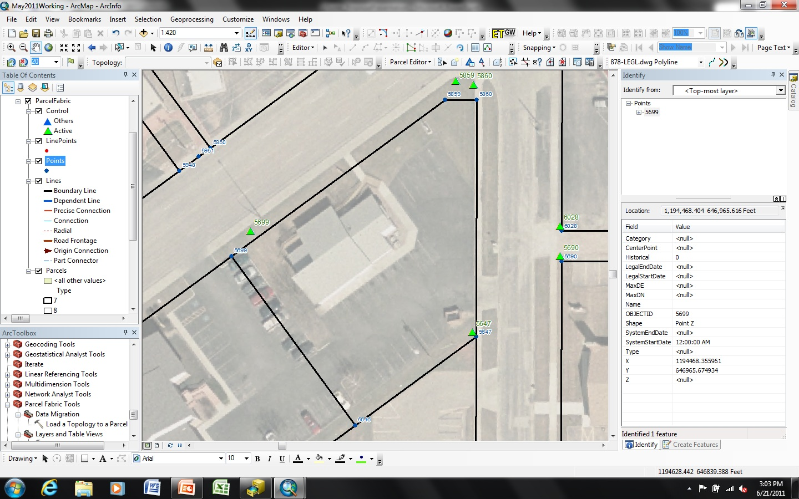
STEP 2
Preparing and Loading Data (Cont.)
bearing & distance
calculated on import
Notes:
Slide 17 – Step 2 (Cont.) – Preparing and Loading Data
Following the parcel lines and polygons, the control points were loaded to the fabric and associated to their corresponding parcel corner points.
Control points define accurate, surveyed x,y,z coordinates for physical features on the surface of the earth. A control point network is added to the parcel fabric so that parcels can be adjusted to the control point network in a fabric least-squares adjustment. The result is parcels that are accurately georeferenced on the surface of the earth. While parcel dimensions (as shown on the slide) accurately define parcel boundaries in relation to each other, control points, when used in a least-squares adjustment, result in accurately defined spatial locations for parcel corner points.
So to recap what is happening in step 2: we are importing an existing parcels dataset that consists of parcel shapes that don’t have any coordinate geometry (COGO) attributes (i.e. bearing and distance of record) and that may not have truly represented the shape of the parcel (too many vertices and line segments making up the curves). We essentially needed to break these shapes down or reverse calculate their components as might be represented on a plat document (i.e. 2-point lines, and parametric curves). That is why we needed to go through the planarizing of lines and simplification of curves step. What we should have once the data is imported into the parcel fabric is a set of lines, points and polygons that closely represent the shape of each piece of property as it was platted.

Slide 18
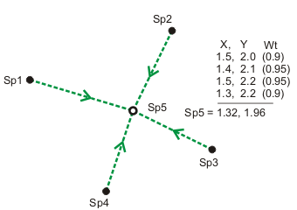
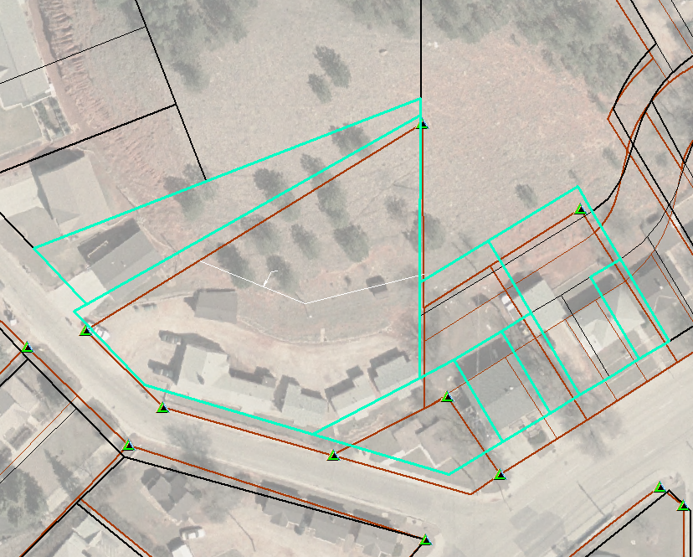
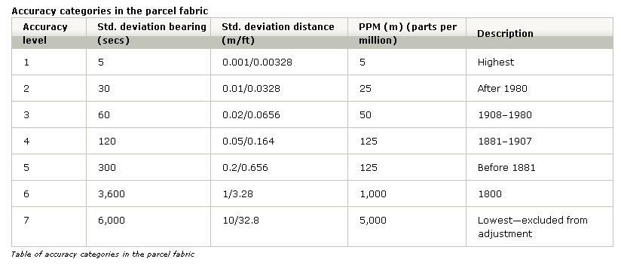
STEP 3
Parcel Adjustment
adjust parcels to surveyed control points
use least-squares adjustment built into parcel fabric
Source: ESRI 2011
Source: ESRI 2011
Notes:
Slide 18 – Step 3 – Parcel Adjustment
The third step in the process is to use the least-squares adjustment built into the parcel fabric to adjust the existing parcels to surveyed control points. In a fabric least-squares adjustment, control point coordinate values are held fixed and the horizontal and vertical coordinate system of the control points is transferred to the parcel fabric. In other words, control points are processed together with recorded dimensions to derive new, more accurate coordinates for parcel corners. Line dimension attributes don’t change, but fabric point coordinates and the parcel shape are updated. The result is an accurate coordinate-based cadastral system.
A least squares adjustment is a mathematical procedure that derives the most likely coordinate location of points based on multiple measurements in a network using the theory of probability. Least squares adjustments are applied to a group of selected parcels and should be in an area that has a reasonably well-balanced geometric shape with redundant measurements and evenly distributed control (figure on the left).
Redundant measurements are multiple observations of the same point as shown in the upper right-hand figure. Repeated observations validate a measurement network and a parcel fabric is a redundant measurement network. Each parcel dimension and thus each parcel in the parcel fabric can have an associated accuracy. This is because parcel dimensions are derived from raw survey measurements which have associated accuracies. By default, accuracy in the parcel fabric is defined by survey date because in general, surveying equipment is more precise today than it was in the past.
Accuracy assignments in the parcel fabric are important in the least-squares adjustment because parcels with a higher accuracy assigned to them will have a higher weight in the adjustment and will adjust less than those parcels with lower accuracies. In other words, low-accuracy parcels will adjust around the more accurate parcels. There are 7 accuracy levels as shown in the table. The data we imported was automatically assigned an accuracy level of 6, which is the lowest that can participate in an adjustment, since the dimensions were calculated and not entered from a plat. If they had been entered off of a plat, then an accuracy level could have been assigned based on the date of the plat.
Prior to running a least-squares adjustment, ESRI recommends checking the fit of control points. The check fit process calculates transformation between the linked fabric point coordinates and the coordinates of the control points. The calculated parameters are then applied to the linked fabric point coordinates to compute temporary new values for the fabric point coordinates. The difference between the newly calculated fabric point values and the original control point values are reported as residuals for each active control point. These residual values can be telling of problems that should be addressed in the network before permanently applying the adjustment. For instance, if you are confident the fabric has good measurement precision, then the there could be a control point that is bad. On the flipside, if your confidence is high in the accuracy of the control points but the residual values are high, then the parcel data probably needs to be scrutinized for problems.
Preliminary work has been done on this step. I am still working with the client to determine what tolerances and residuals are acceptable and then I will need to incorporate their feedback into the workflow item.

Slide 19
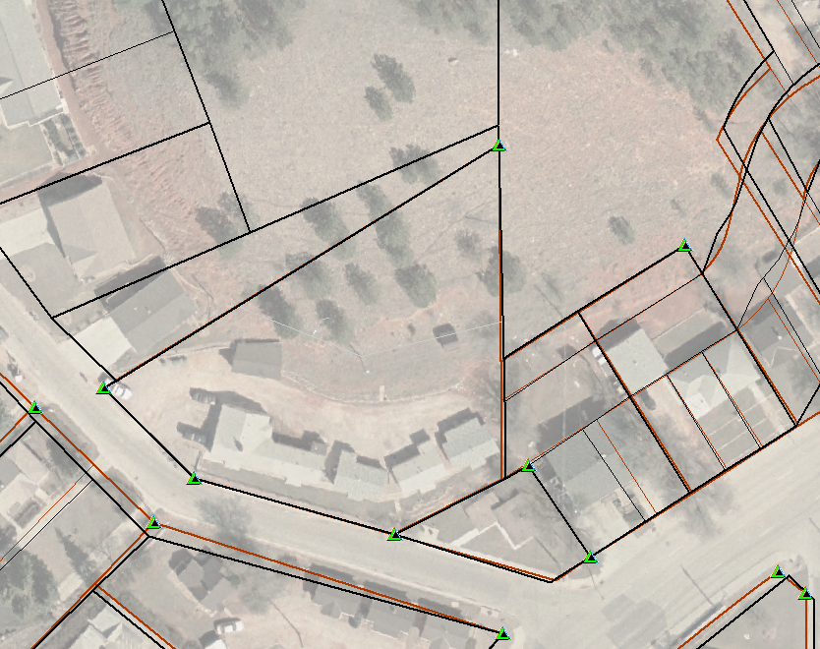
STEP 4
Accuracy assessment
error evaluation
  compare adjusted fabric parcels to independently developed AutoCAD parcels
Notes:
Slide 19 – Step 4 – Accuracy Assessment
The fourth step is to evaluate the results of the adjustment. In our case, we have an AutoCAD layer that was independently constructed using the original plat documents and survey control. Visual inspection is going to provide a good indication of whether or not the adjustment performed well. In areas where there is no independent work to check against, a visual inspection against the aerial photography will provide some verification of the success of the adjustment. This would be considered a qualitative assessment of the accuracy.
Another marker for adjustment success is the residual values that are returned when the adjustment or check fit is run. I am planning on running adjustments on several different areas in the study extent where we have the independently created parcels to check against to see if I can help our client develop a range of acceptable values. I think this would be very helpful for them when there are areas that don’t have anything much available for visual verification. This is a quantitative assessment of the adjustment accuracy.
Preliminary adjustments have been executed with a range of results. Some areas, like the one shown above, adjusted very well. As you can see, the adjusted lines are much closer than they were before and come very close to fitting the independently created parcels. Other areas that I adjusted did not fare as well. In one instance, the residuals were high and I was never able to get a solution anywhere near zero in both directions which is the desired result. I looked at the control points and they were well distributed. I then compared the existing parcels with the independently created ones and noticed that a couple of them did not seem to have the correct shape. In this instance, if the shape is bad, no matter how many times an adjustment is run, it is never going to reach and optimum fit. The shape should be re-created using the original plat document and re-joined to the fabric so the adjustment can be run again.

Slide 20
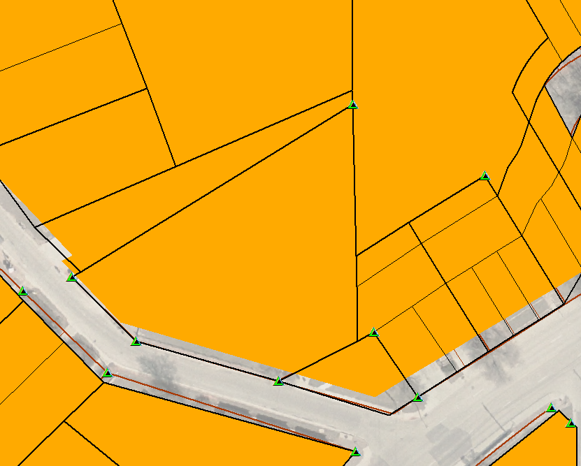

STEP 5
Adjusting an associated layer
apply adjustment to associated layer – zoning
Notes:
Slide 20 – Step 5 – Adjusting an Associated Layer
The fifth step in the process is to apply the parcel adjustment to an associated layer. The results of some preliminary work are shown on this slide. The adjustment performed on parcels shown in the previous two slides was applied to an associated layer – zoning. As you can see, the zoning now aligns with the parcels that were moved. Seeing this happen successfully was a big victory because one of the biggest challenges the City faced adjusting parcels in the past was how to efficiently and accurately apply these improvements to related layers.

Slide 21
Workflow Evaluation
work with City GIS Division staff to test usability of the workflow
incorporate their feedback into the workflow
Notes:
Slide 21 – Workflow Usability Evaluation
So far I have talked about two out of three of my project objectives– improving the accuracy of the cadastre dataset and evaluating the success of the improvement.
The third objective of my project is testing the success of the workflow that was developed. I mentioned previously that this project is very much a collaborative effort between the client and myself. At the conclusion of each step a written workflow process is provided to the client. Verbal communication commences as the client is testing the step and their feedback is incorporated back into the workflow. All workflow steps have been tested by at least one staff member of the GIS Division for usability. A survey will be provided to formally document their feedback for all steps included in the workflow.

Slide 22
Summary of Results
evaluate the project for pitfalls, lessons learned, best practices and if the objectives were met
Notes:
Slide 22 – Summary of Results

Slide 23
Project Timeline
July 7, 2011 – Proposal Presentation / Proposal Submittal
June 22 – July 31, 2011 – Refine workflow, gather and incorporate client feedback, finish testing
July 31 – August 30, 2011 – finish paper and prepare final presentation
September 1, 2011 –Present work at GIS in the Rockies Conference, Denver CO
Notes:
Slide 23 – Project Timeline

Slide 24
Acknowledgements
Pennsylvania State University – Justine Blanford
Ferber Engineering Company
Rapid City/Pennington County GIS Division – Don Jarvinen
ESRI Land Records Division – Chris Buscaglia
Notes:
Slide 24 – Acknowledgements

Slide 25
References
Bhowmick, A., Bodnar, N., Farmer, D., Tirunagari, P., & Van Pelt, D. (2008). Cadastre Management the GIS Way. Professional Surveyor Magazine, Volume 28, Issue 8. Retrieved April 8, 2001 from http://www.profsurv.com/magazine/article.aspx?i=2198
ESRI (2011). Desktop 10 Help. ArcGIS Resource Center Desktop 10. Retrieved May 18, 2011 from http://help.arcgis.com/en/arcgisdesktop/10.0/help/index.html
Foote, K. & Huebner, D. (2000). Error, Accuracy, and Precision. The Geographer’s Craft. Retrieved from http://www.colorado.edu/geography/gcraft/notes/error/error_f.html
Rapid City GIS Division. (2009). Rapid City Corporate Limits [metadata]. City of Rapid City, South Dakota: GIS Division.
Notes:
Slide 24 – References

Slide 26
Thank You!
Questions?
Notes:
Slide 24 – Thank You!

