Slide 1
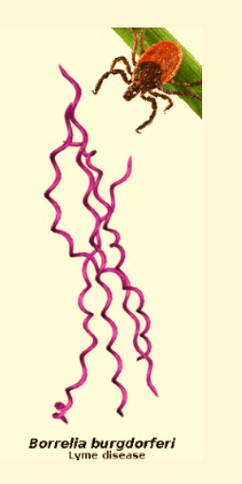
Using Geographic Information System to Identify Lyme Disease
Risk Components
Wayne Frad
GEOG 596A Capstone Proposal
Penn State MGIS Program
Advisor: Dr. Alexis R. Santos
Notes:
My Project Proposal is using spatial and temporal statistical tools to identify risk components within the environment spatial as well as residential clustering of humans along other environmental factors that may influence Lyme disease distribution patterns.

Slide 2
Agenda
Application of GIS in Epidemiology
Lyme disease Issues
Objective
Study Area
Sources & Methods
Data Analysis
Preliminary Results
Discussion of Application
Lyme Disease Issues and Facts
Timeline and Conferences
References
Question and Comments
Notes:
This will be topics to be discussed today we will start with the use of GIS in regards to Epidemiology and its history then cover topics covering my research including objectives the study area sources and methods as well analysis preliminary results and applications of these results.

Slide 3
Practical Application of GIS in Epidemiology
Historical Examples that Location Matters
Hippocrates 3rd century BC physicians observed disease occurred some places and not in others
1854 Dr. John Snow used geospatial information to analyze cholera deaths and found clustering around water pumps in London
Spatial Data Management
Spatial Analysis
Overlaying (Visualization)
Buffer Analysis
Location-allocation Analysis
Exploratory Spatial Analysis
Spatial Statistical Modeling
Spatial Interaction Model
Spatial Diffusion Models
Notes:
The knowledge that location and disease are correlated dates back to 3rd century BC with Hippocrates with the observance that disease effects some people and places and not others a spatial observance. A classical example in spatial epideimoligy is the geospatial analysis of John Snow used it in the 1850s to discover the source of the cholera outbreak in London by using a cluster analysis . Geographic Information Systems lend itself to use in infectious disease study because it has elements of way to manage the data, visualize the data and then analyze the data.

Slide 4
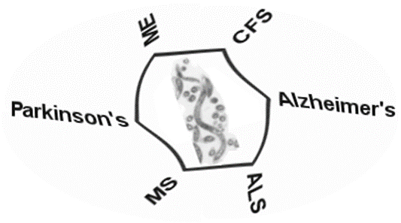

Why Worry About Lyme disease?
Lyme disease caused by Borrelia burgdorferi is the most prevalent vector-borne disease in the United States 240-300 thousand treated cases per year.
First discovered by Dr. Alan Steere in 1977.
Spread to humans by Ixodes scapularis (deer tick or western blacklegged tick).
Ticks get the bacterial species from the skin and blood of hosts such as White-tailed deer and other small mammals.
Symptoms include a bull’s-eye rash, fever, chills, headache, fatigue and joint pain.
Lyme disease costs the US health care system between $712 million to 1.3 billion a year (Johns Hopkins School of Public Health, 2015).
Long Term effect can lead to neurological diseases, meningitis, Bell’s palsy, heart problems and arthritis.
Notes:
Lyme disease is caused by the spirochete bacteria Borrelia burdorferi and is most prevalent but unknown vector-borne disease in the US with many cases being underreported as other debilitating ailments. Due to underreporting a study done by estimates that between 240-300 thousand cases are contracted annually. I say unknown because most exposure are given to the new virus such as West Nile or now Zika. The person to the right is Dr. Steere who discovered the virus in 1977. It first was origninally thought to be juvenile rheumatoid arthritis that had inflicted members of the community of Lyme, Connetticutt. It is spread by the deer ticks that carry the bacteria from infected rodents and mammals. Symptoms include very common fever with chills fatigue and headache but a distinct bull-eye rash is most distinct trademark. The real cost of Lyme disease other than the human toll is that it drains our Health system of 712 -1.3 billion dollars a year. The lasting effect can be physically and mentally devastating without immediate treatment.

Slide 5
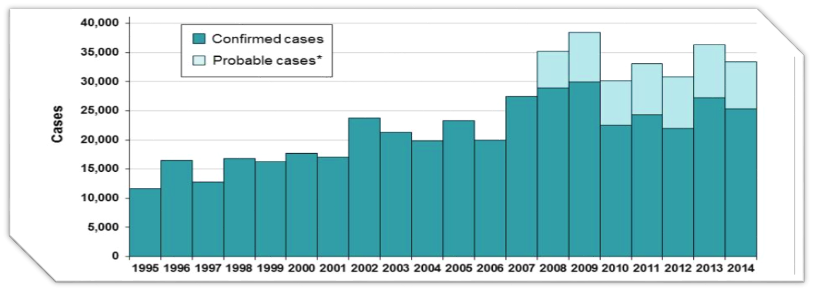
Confirmed Cases of Lyme disease 1995-2010 in US
Source: Centers for Disease Control and Prevention http://www.cdc.gov/lyme/stats/index.html
Notes:
This chart shows the uptick of Lyme Cases confirmed and probable by the CDC since 1995. By the late 2000s over 30,000 cases annually. These are actual reported cases and highlights the vast amount of actual cases that are misdiagnosed.

Slide 6
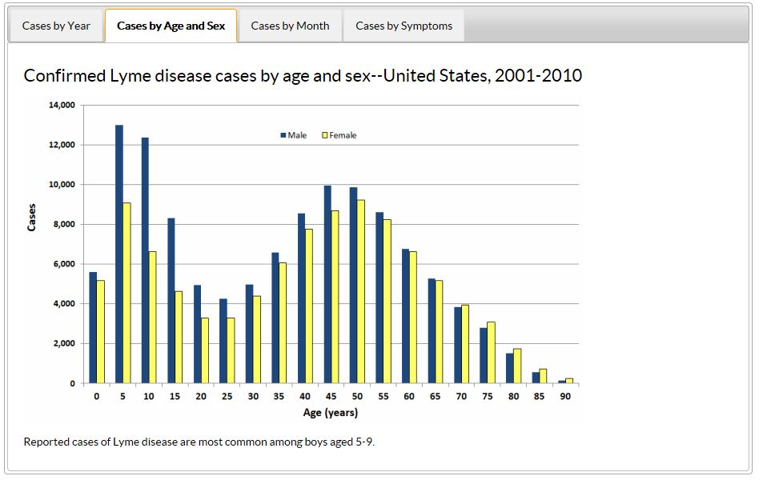
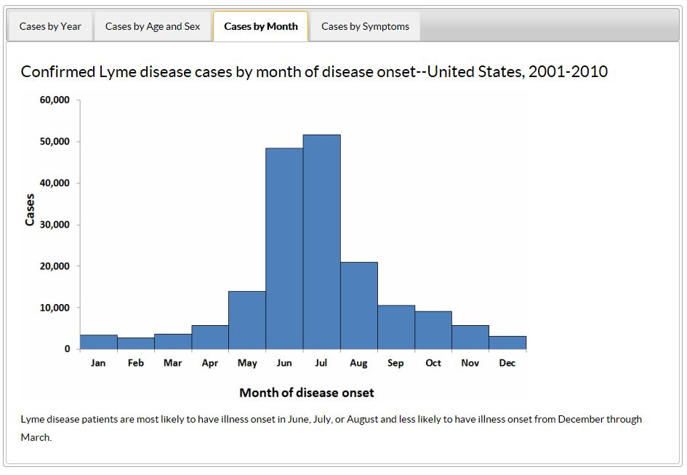
Lyme Disease Facts
Commonly infects boys Age 5-9 years
Incidence is higher between May and August
Sources: Centers for Disease Control and Prevention http://www.cdc.gov/lyme/stats/index.html
Notes:
Who does it effect and when? On average mostly boys aged 5-9 and within that age group more boys than girls. The bites follow the life cycle of ticks which is 2 years and nymphs who have contracted Lyme as larvae are the biggest risk to humans. They are small and become active after winter dormancy. This occurs May to September. The problem with climate change as winters get less harsh and summer months get longer this increase the survival of more larvae to get Lyme and spread to areas further north.

Slide 7
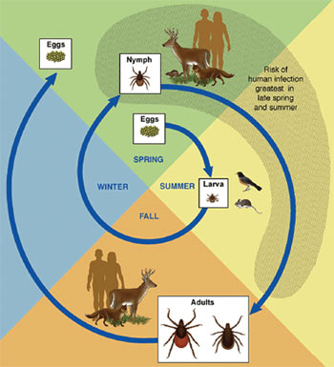
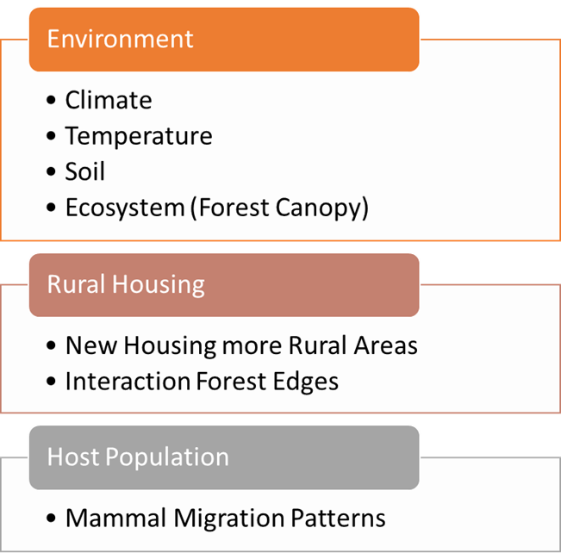
Objective
To Compare differences in Lyme disease cases by county in a ten year period.
To study environmental and population factors associated with Lyme disease incidence
Notes:
The objective of my project is to statistically link the factors to the right to Lyme disease cases. These factors include the habitat, effects of rural housing and host animal ranges. The cases will be examined spatially at a regional county level and temporally over a ten year time frame. The case data is from Center of Disease Control. The image contains the 2 year lifecycle for the Blacklegged tick from egg to Adult. You can see the larva and nymph cycle in spring and summer to get a blood meal and are dormant in winter months.

Slide 8
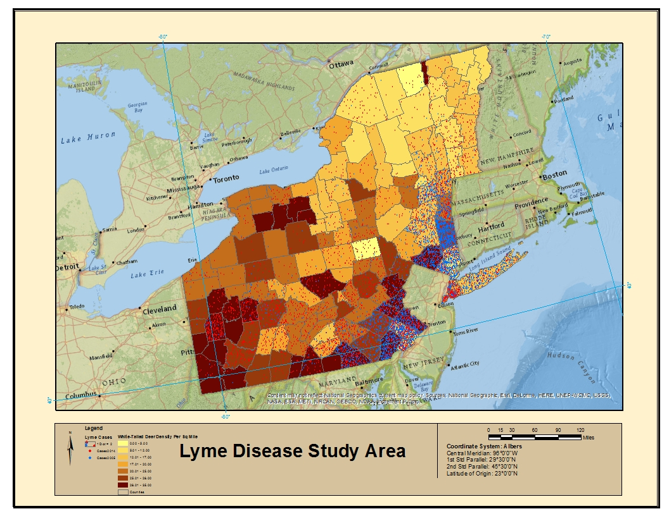
Study Area
Tristate region of New York, Vermont and Pennsylvania consisting of 143 counties
County level analysis
CDC Data uses home address. The assumption made that most people are near home when infected.
States chosen have high rates of infection and have similar ecosystems lend itself to spatial observation.
Notes:
The study area is the NE tri state area of Vermont New York and Pennsylvania consisting of 143 counties. These cases provided for Lyme disease data is at the home address and assumes most people contract a tick infection nearby a home. The map to the right shows expansion of blue cases in 2005 to red cases in 2014 for the region. What is the factors that have allowed for this expansion north and west?

Slide 9
Data Sources
Raw Count Lyme disease cases
Rural Housing and Metro Communities
Soils, Climate and Temperature Data
Population and County Data
NDVI Data
Deer Density Migration Data
Statistical Analyst
and Maps
Notes:
My data sources as I mentioned earlier is the CDC for Lyme disease data for the last ten years. Other sources of data include USDA, USGS, Census Bureau, NOAA, USDA Forest Service. I was able to use the mapping and statistical tools and mapping tools provided by Esri's ArcMap.

Slide 10
Spatial Analytical Methods
Cluster Analysis
(Spatial Auto-Correlation)
Gets Indication of Lyme disease distribution over region.
Regression Analysis (OLS + GWR)
Effects of Multiple Independent Variables on Dependent Variable
Defines Strength of relationship and predictive value
Look at variables related to environment, housing and host white tailed deer populations relating to dependent variable of Lyme disease cases
Are Lyme disease cases are randomly distributed or is clustering observed?
Low Negative Z Score + Small P Value = Cold Spot
High Z Score +Small P = Hot Spot
Local Indicators of Spatial Association (LISA)
Analyze study area for cold or hot areas of activity
Determine relationship of points and vector polygons (County)
Notes:
The process I will use to analyze this data and factors related to Lyme disease includes a Cluster Analysis to analyze whether the data does in fact show significant spatial clustering or randomness and indication of patterns. Then a Hot Spot Analysis will be done to determine of the clustered areas what areas show hot or cold activity. Finally for the analysis a regression of multiple independent variables found can be checked for relationship to the dependent variable Lyme cases at a county level. This will allow for a value of these variables as predictive values for Lyme cases.

Slide 11
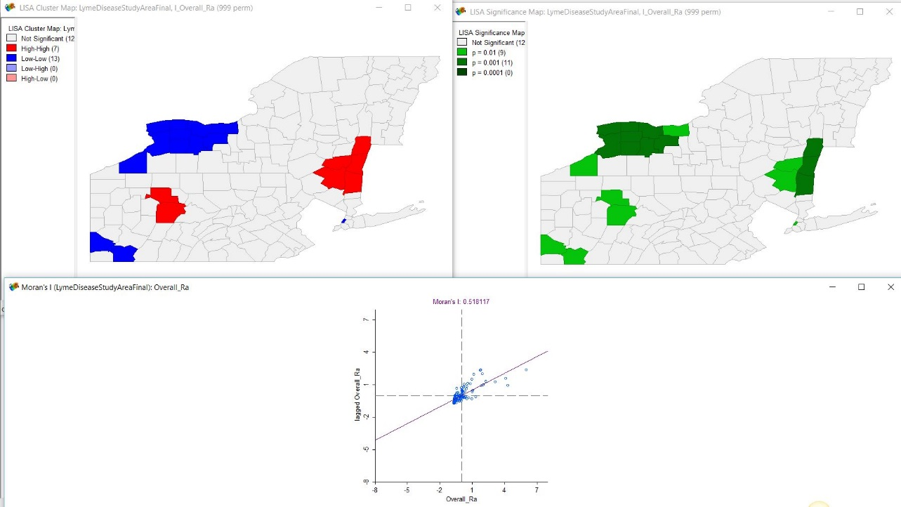
Local Indicators of Spatial Association Analysis
  Evaluate areas of high and low density clustering.
  Conduct Hot Spot analysis to define areas of significance.
Notes:
The Local Indicators of Spatial Association or LISA evaluates high or low clustering areas in the Study region. By joining your point data to county polygons you can check and define areas of significance at the county level. It has proven to be a useful tool in criminal and disease mapping. The results in my initial study show in red areas of high clustering that are statistically significant and in blue area that are lower than expected areas. This data was created using GeoDa (Yoda). This same data is presented in the right using a kernel density tool in ArcMap. The initial results show high clustering in the Hudson River Valley of New York and Jefferson and Forest Counties in Pennsylvania. The counties along the Great Lakes seem to show lower levels of Lyme case clustering. These Lisa tools can define areas of significance for further research.

Slide 12
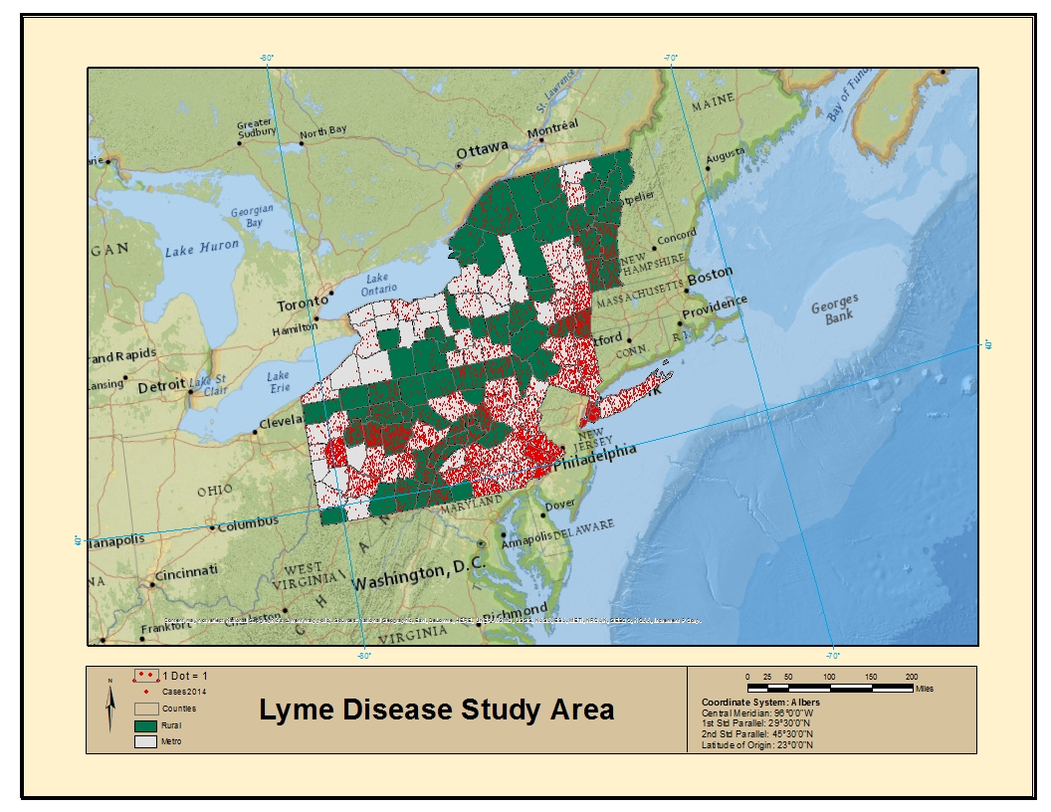
Regression Analysis
Urban or Rural County
Total Population
White-tailed Deer Densities
Canopy Cover % using NDVI data
Minimum Temperature
Type of Ecosystem
Precipitation
Relative Humidity
Type of Soil
Slope
Elevation
Notes:
These are independent factors I want to check for correlation with Lyme disease cases in the counties. The map to the right shows an overlay of one of these factors counties rural versus non rural and 2014 Lyme disease cases.

Slide 13
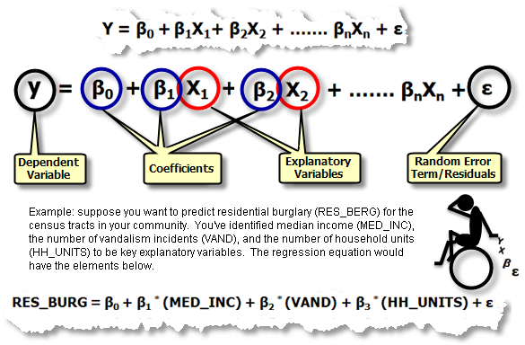
Regression Analysis II
Find independent variables in nature and spatial geography to associate with dependent variable.
Do relationships add and perform as expected?
Careful consideration will be given to Regression analysis assumptions.
A higher Adjust R-Squared and lower Aikake’s Information Criterion (AIC).
Notes:
The use of regression analysis verifies how well a model explains outcomes of dependent variables. In this case explaining Lyme disease cases in the Northeastern US. Six factors to look for in your model are listed. The actual formula takes independent variable and statistically tests how well they perform in predicting dependent variables outcomes. The higher the Adjusted R squared the better the model performs.

Slide 14
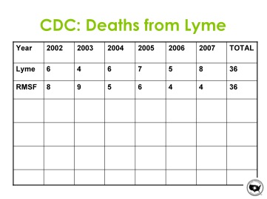
Anticipated Outcomes
Environmental and habitat variables found.
  Deer Density
  Climate Change
  Temperature
  Rural Housing
Statistically significant factors will be discussed in terms of the implications for the population.
Use models to map and identify future risk areas.
Use Results to recommend warning zones to the public and public health agencies.
Deaths do occur from Lyme Disease
Notes:
These are some of the outcomes I anticipate will occur. I think that these independent variables will effect Lyme disease outcomes. I want to check if climate changes and temperature factors of later summers and more temperate winters can explain to the evident rise of Lyme disease cases trending to the NE. I want to be able to use these variables to create risk areas and use these to suggest some countermeasures that may be effective at combating the rise of new annual Lyme disease cases

Slide 15
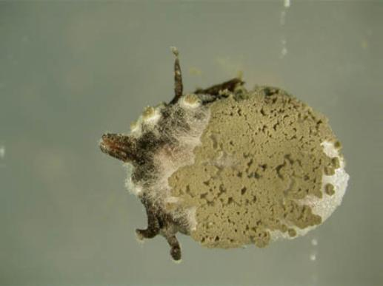
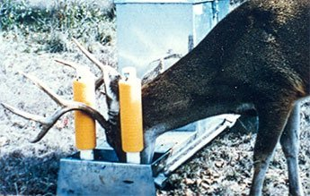
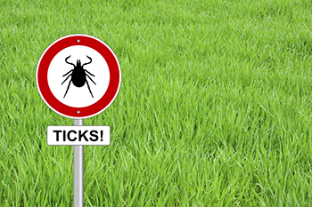

Discussion of Application
Create web applications that outline risk areas that tie to hiking trails applications.
Create Signs in High Danger areas for tick infestation.
The push to more rural neighborhoods areas put humans at higher risk for infections.
Use counter measures such as fungus that kill ticks or control ticks on deer populations.
Lyme disease vaccines or bait vaccinations of rodents.
Increase resources and facilities that treat Lyme disease now very few resources available for size of the epidemic.
Notes:
Some of counter measures that could be effective include having a national Lyme disease map created that links to hiking applications or is a stand alone application for people who enjoy outdoor wilderness activities. Create signs to post in these higher risk areas with signs or deer treatment troughs as shown below. The need to push to rural living away from cities puts more Americans at risk with contact with ticks carrying Lyme disease. The need to spray or create clearance areas is needed. Another area of effective control would be to increase research funding for Lyme disease vaccines or rodent bait vaccines against white footed mice who infect over 75% of larval ticks with the disease causing bacteria. Another source of great promise is the development of a natural pesticide made our of fungus spores called Tick-ex commercially available with a 74% effective rate and safer pets and the environment as an organic option.

Slide 16
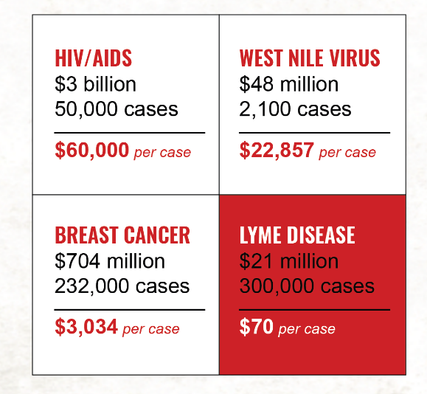
Treatment Costs and Lack of Resources
Small Numbers of physicians diagnose and treat Lyme disease (Fear of sanctions by medical boards decrease those practice while those do treat Lyme are swamped and cannot accept new patients).
285 primary care physicians surveyed 2% treat Lyme and 50% don’t believe chronic infection of Borrelia burgdorferi exists (MedPage Today, 2010).
Disparity in spending gap for prevention measures for mosquito-borne and tick not related to actual cases.
Lack of agreement for standardized Lyme treatments with antibiotics.
New Laws in New York by Governor Cuomo (2015) offer hope Lyme Doctor Protection Act give medical providers the ability try alternative and new methods or use long term antibiotic regiments.
Source: http://www.ilads.org/lyme/lyme-quickfacts.php
Notes:
These are the issues face people who contract Lyme disease. Smaller number doctors who specialize in treatment of the disease only 2% in a poll conducted in Connecticut of 285 doctors. Research spending as shown in box shows cost per case spent in prevention in the US. Lack of a standard treatment plan and agreement to chronic nature of Lyme disease.

Slide 17
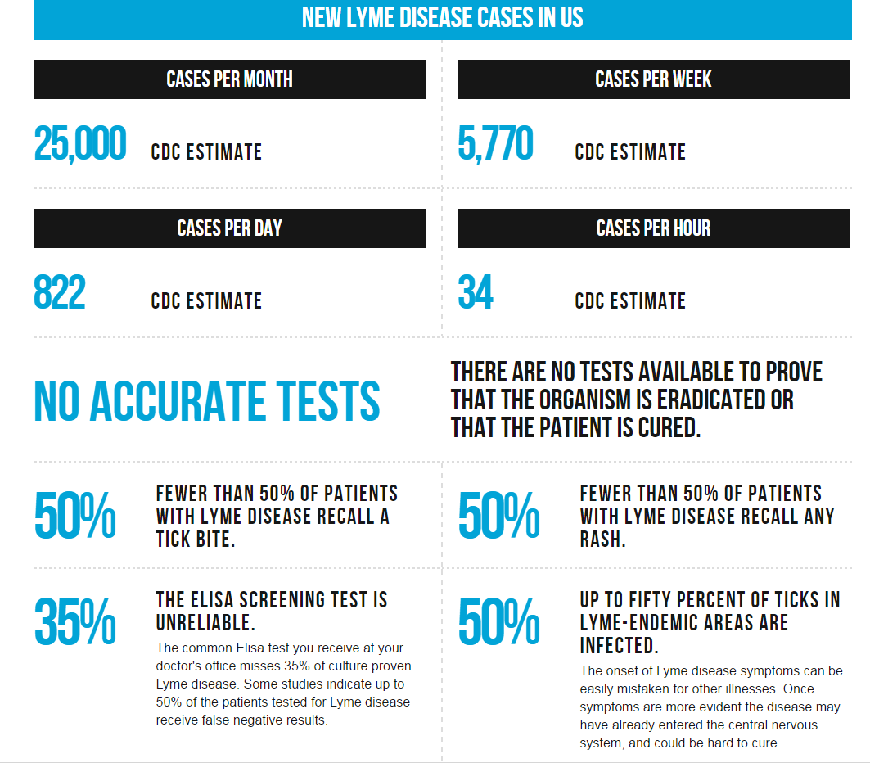
Treatment Costs and Lack of Resources
Source: http://www.ilads.org/lyme/lyme-quickfacts.php
Notes:
Breaking down Lyme disease cases in US further by month day and week and hour can see this is a growing epidemic. The scary part is there are no accurate test for the disease and then nature of amount of ticks that carry the bacteria in effected areas is high. So without a early warning system in place treatment lags until the disease becomes chronic in patients.

Slide 18
Timeline
Aug
Sept
Oct
Nov
Dec
Jul
Project Submit Final Paper and Capstone Presentation
12/14/2016
Peer Review Presentation Feedback
7/28/2016
Edit and Make Revision based on Feedback
8/10/2016
Applied Geography Conference 10/26-29/2016 Louisville, KY
Spring Term 2
Geog 596A Capstone Proposal
Fall Term 1
Geog 591
GIS for Health Analysis
8/17/2016-10/26/2016
Fall Term 2
Geog 596B
Capstone Project
10/5/2016-12/14/2016
Notes:
The timeline I have toward completing my Capstone project is to finish this course and incorporate feedback from my peers and advisors. Review my data and methods and create paper and PowerPoint to use for a conference presentation. Submit my Abstract for the Applied Geography Conference in Louisville Kentucky in October. Apply and complete my remaining two courses in the Fall for my MGIS requirements. I will be taking my Health Analysis course in Fall 1 followed by my final Capstone Project Course in Fall 2. I hope to complete my presentation and coursework by December and be able to graduate May 2017.

Slide 19
References
Becker, Levin Arielle. (2010) Few state physicians treat chronic Lyme disease, survey says, The CT Mirror, Retrieved June 20, 2016 http://ctmirror.org/2010/09/17/few-state-physicians-treat-chronic-lyme-disease-survey-says.html
Brownstein, J., et al. (2003) A Climate-Based Model Predicts the Spatial Distribution of the Lyme Disease Vectors Ixodes scapularis in the United States, Environmental Health Perspectives Vol 111 Number 9 July 2003. Retrieved February 12, 2016 http://www.ncbi.nlm.nih.gov/pubmed/12842766
Centers for Disease Control and Prevention (CDC) (2016) Retrieved March 6, 2016 http://www.cdc.gov/lyme/stats/index.html
Cawley, M. (2010) The Incidence of Lyme Disease in Southeastern Pennsylvania Retrieved on February 22, 2016 at http://www.goglobalgis.com/uploads/1/3/7/7/13770996/the_incidence_of_lyme_disease_in_se_pa.pdf
D Chen, H Wong, P Belanger, K Moore (2015) Analyzing the Correlation between Deer Habitat and the Component of the Risk for Lyme Disease in Eastern Ontario, Canada: A GIS-Based Approach. - … International Journal of Medicine, - http://www.mdpi.com/2220-9964/4/1/105/htm
Department of Natural Resources (2016) Retrieved February 20, 2016 at http://www.the-whitetail-deer.com/StateFishWildlifeConservationLinks.html
Estrada-Pena, A. (2002) Increasing habitat suitability in the United States for the tick that transmits Lyme disease: A remote sensing approach. Environ. Health Perspect. 2002, 110, 635–640. http://www.ncbi.nlm.nih.gov/pmc/articles/PMC1240908/
Guilford, Gwynn. (2015) Stop Blaming the Deer, Lyme disease is spreading faster than ever and humans are partly to blame, Retrieved July 1, 2016 from http://qz.com/441583/lyme-disease-is-spreading-faster-than-ever-and-humans-are-partly-to-blame/
Notes:
These are sources that I used for background and thoughts about this capstone project.

Slide 20
References
Glass, et al. (1995) Environmental Risk Factors for Lyme Disease Identified with Geographic Information Systems. American Journal of Public Health July 1995 Vol. 85 No 7. Retrieved May 23, 2016 from http://www.ncbi.nlm.nih.gov/pubmed/7604918
Koryos, 2014 White-Tailed Deer Overpopulation in the United States http://www.koryoswrites.com/nonfiction/white-tailed-deer-overpopulation-in-the-united-states/
Singh, Vinti March 3, 2012. Fungus kills Lyme disease-carrying ticks Connecticut Post.com Retrieved July 5, 2016 http://www.ctpost.com/local/article/Fungus-kills-Lyme-disease-carrying-ticks-3379407.php
Szonyi et al. 2015. Exploratory Spatial Analysis of Lyme disease in Texas-what can we learn from reported cases? BMC Public Health 15:924 Retrieved February 3, 2016 at http://bmcpublichealth.biomedcentral.com/articles/10.1186/s12889-015-2286-0
National Oceanic and Atmospheric Administration (2016). Retrieved on March 6, 2016 http://www.noaa.gov/
U.S. Department of the Interior, Fish and Wildlife Service, and U.S. Department of Commerce, U.S. Census Bureau. 2006. National Survey of Fishing, Hunting, and Wildlife-Associated Recreation.
US Geologic Survey 2016. Retrieved on March 6, 2016 http://www.usgs.gov/ecosystems/genetics_genomics/epidemiology_fish_wildlife_diseases_mammals.html
Weisberger, Mindy. (2016) Ticks That Can Carry Lyme Disease Are Spreading Across the US. Live Science http://www.livescience.com/53447-lyme-ticks-range-spreading.html
Yale School of Public Health. 2016. Epidemiology of Microbial Diseases, http://publichealth.yale.edu/emd/research/zoonosis/projects/tick.aspx

Slide 21

Acknowledgements
A great appreciation to the facility of Penn State World Campus and my advisor Dr. Justine Blanford and Dr. Alexis R. Santos for their advice and input into my capstone project.
Notes:
I just want to thank Penn State University and the MGIS program. I would especially like to acknowledge my advisor Dr. Blanford and Santos for their guidance and direction in this process and journey.

Slide 22

Questions or Comments
Notes:
Are there any questions or feedback anyone has?

