Slide 1
A Spatiotemporal Analysis of Crime Occurrences in Minneapolis in Relation to the Murder of George Floyd
Cullen Williams-Freier, MGIS Candidate
GEOG596A
Capstone Project Peer Review Presentation
Capstone Advisor: Fritz Kessler

Slide 2
Overview of Presentation:
Background
Statement of Research Question
Summary of Literature Review
Data & Materials
Goals & Objectives
Technology
Analysis & Methods
Anticipated Results
Timeline
Conclusion & Questions

Slide 3
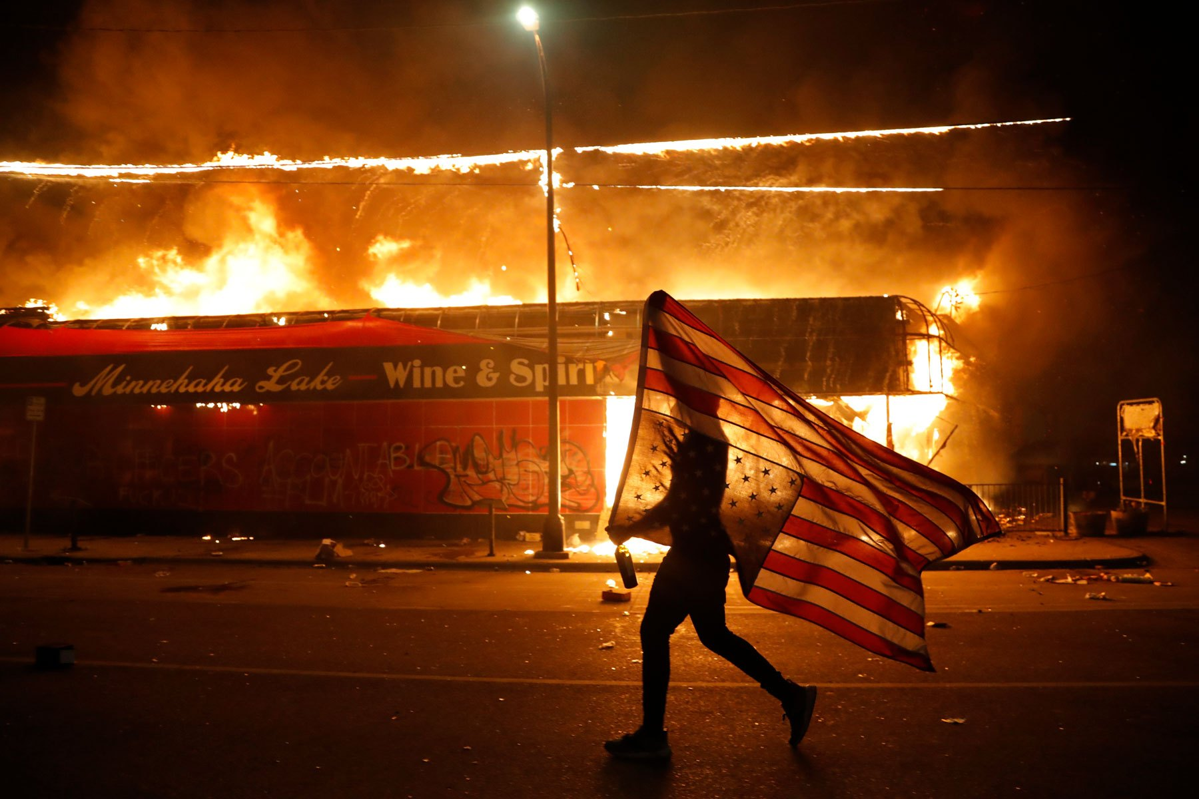
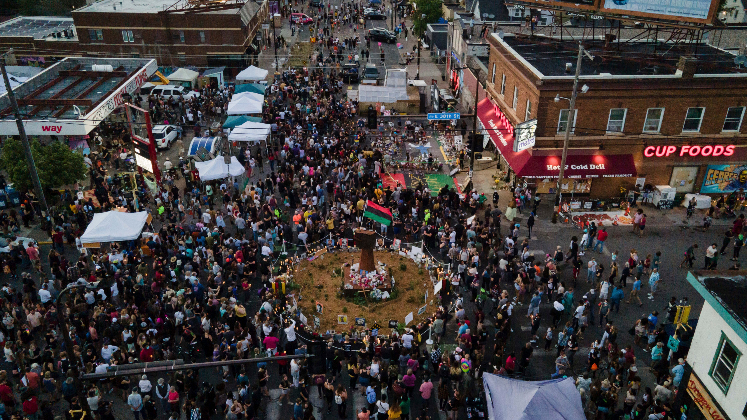
Background
May 25, 2020, George Floyd was murdered by Minneapolis police officer Derek Chauvin
In response, a nationwide reinvigoration in the Black Lives Matter (BLM) movement
Simultaneously, Minneapolis and St. Paul saw an increase in violent crime occurrence
Possible contributing forces:
Murder of George Floyd
Lack of trust/faith in the policing community
The “Ferguson Effect”
Unrest due to COVID-19
Images retrieved July 10, 2021, from https://kstp.com/kstpImages/repository/2020-06/Floyd-memorial.jpg, https://www.wfla.com/wp-content/uploads/sites/71/2021/06/d23c923462584781b481186257d0d1f9.jpg?w=2560&h=1440&crop=1, https://www.rollingstone.com/wp-content/uploads/2020/05/Protests.jpg?resize=1800,1200&w=1800

Slide 4
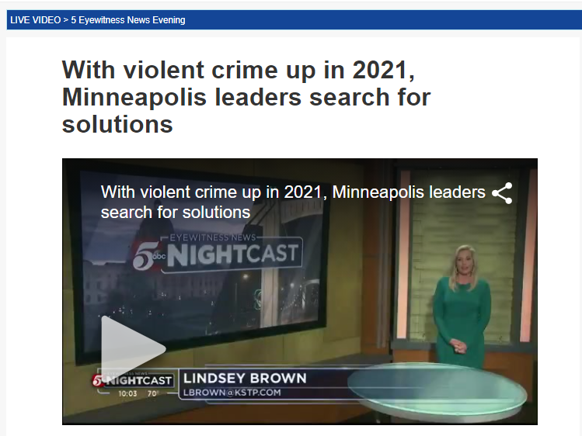
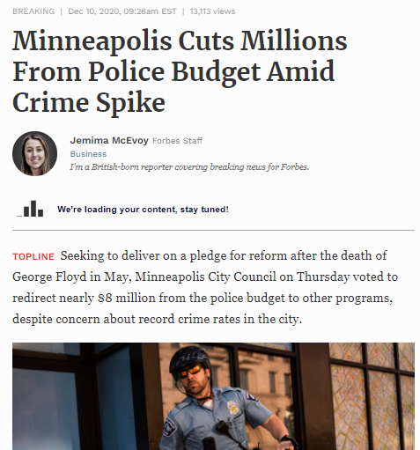
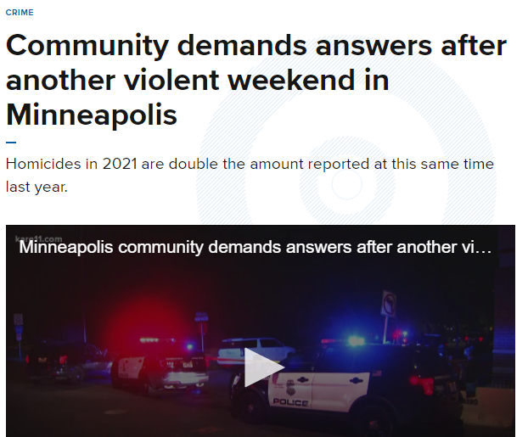
Research Question
Has the frequency of crime within Minneapolis following the murder of George Floyd changed in comparison to the past ten years?
Have the spatiotemporal distributions of three violent crimes (murder, robbery, assault) in Minneapolis, following George Floyd’s murder, changed? If so, how?
How do different subsets of Minneapolis crime data perform in comparison to each other when used to predict crime occurrence?
Notes:
The research question focuses on the changes in frequency and spatial distributions of crime occurrence within Minneapolis. Specifically, this research aims to clarify any ambiguity around the occurrence frequency, distribution, and potential future occurrences of three significant crime types within Minneapolis (murder, robbery, and assault). The research will address this general question by leveraging the city of Minneapolis’ open data portal, which contains yearly point shapefiles, with each point representing one incidence of a crime, beginning in 2010 and carrying through to present day. Using this data will allow me to depict crime occurrence through space and time within the city of Minneapolis and its neighborhoods.

Slide 5
Summary of Literature Review
Black Lives Matter:
BLM (n.d.)
Clayton (2018)
The Ferguson Effect:
Pyrooz et al. (2016)
Skoy (2021)
Nix and Pickett (2017)
Spatial Analysis Methods:
Haberman (2017)
Perry (2013)
Chung & Kim (2019)
Yang (2019)
Zhang et al. (2020)

Slide 6
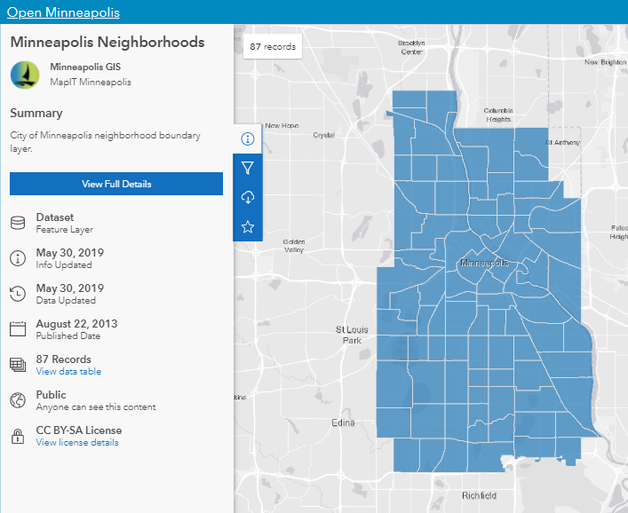
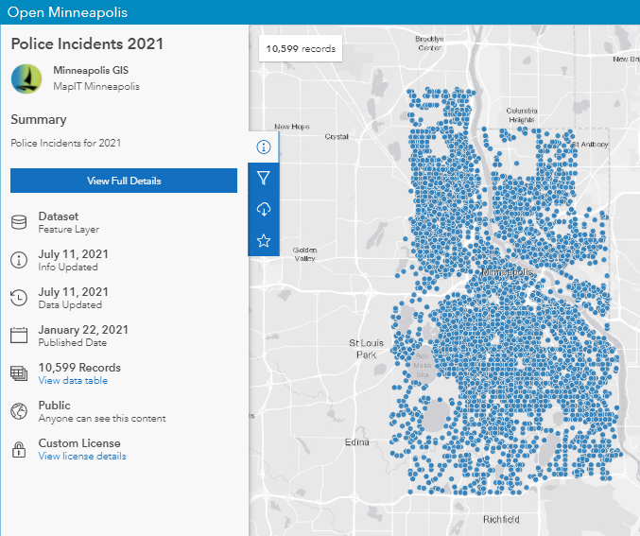
Data & Materials
Data sourced from the city of Minneapolis’ open data portal (https://opendata.minneapolismn.gov/)
Point shapefiles of crime occurrences of murder, assault, and robbery, one shapefile for each calendar year (2010 through present day)
Official neighborhood boundaries

Slide 7
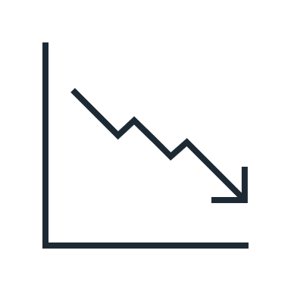
Goals & Objectives
The project will be split into two parts:
Part 1: Crime dataset visualization, trends, temporal distributions, and spatial hotspots. Then, t-test analysis to determine statistical significance
Part 2: Use results of t-test to inform space time cube creation, which will successively be used to compute emerging hotspots and forecast crime occurrence.

Slide 8
Technology

Slide 9
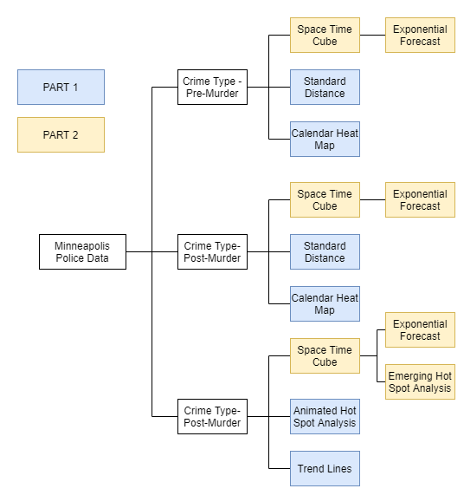
Analysis & Methods – Overview

Slide 10
Analysis & Methods – Trend Lines

Slide 11
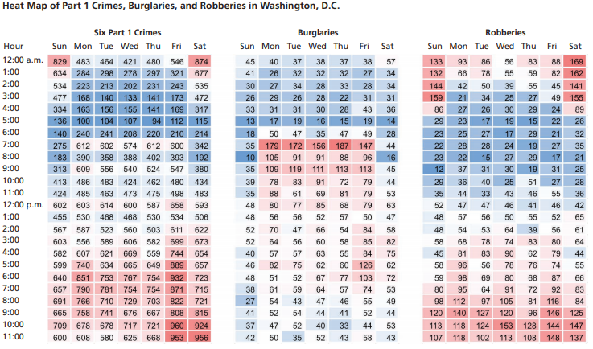
Analysis & Methods – Calendar Heat Maps
Borrowed from Perry (2013).

Slide 12
Analysis & Methods – Hot Spot Analyses

Slide 13
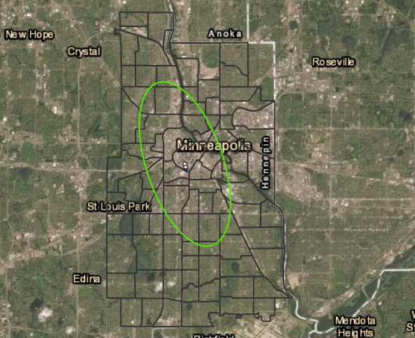
Analysis & Methods – Center & Dispersion

Slide 14
Analysis & Methods – Space Time Cubes
Borrowed from ESRI (n.d.).

Slide 15
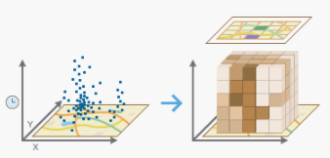
Analysis & Methods – Emerging Hot Spots

Slide 16
Analysis & Methods – Forecast

Slide 17
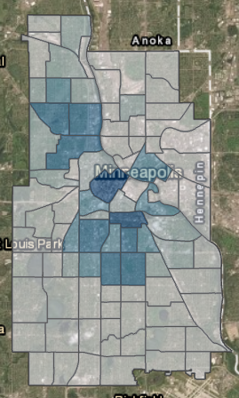
Analysis & Methods – Crime Data Collection

Slide 18
Timeline
July 19, 2021 – Peer review presentation
July 22, 2021 – Begin Part 1 (data visualization, t-test analysis)
July 29, 2021 – Begin Part 2 (utilizing time series forecasting toolkit)
August 5, 2021 – Pause analysis for one month to collect crime occurrence data
September 6, 2021 – Review newly collected data from the past month, begin final report
October 27, 2021 – final project report and summary due

Slide 19
Acknowledgements & Sources
ESRI. (n.d.a.). ArcGIS pro. Retrieved July 15, 2021, from https://www.esri.com/en-us/arcgis/products/arcgis-pro/overview.
ESRI. (n.d.b.). Create space time cube by aggregating points (space time pattern mining). Retrieved July 11, 202, from https://pro.arcgis.com/en/pro-app/latest/tool-reference/space-time-pattern-mining/create-space-time-cube.htm.
Henry, B. May 20, 2021. With violent crime up in 2021, Minneapolis leaders search for solutions. Retrieved July 10, 2021, from https://kstp.com/news/with-violent-crime-up-in-2021-minneapolis-leaders-search-for-solutions/6116301/.
McEvoy, J. December 10, 2020. Minneapolis cuts millions from police budget amid crime spike. Retrieved July 10, 2021, from https://www.forbes.com/sites/jemimamcevoy/2020/12/10/minneapolis-cuts-millions-from-police-budget-amid-crime-spike/?sh=12c745d8701e.
McLaughlin, S. June 25, 2021. Minneapolis responds to New York Times writer’s ‘dystopian ghost city’ claim. Retrieved July 10, 2021, from https://bringmethenews.com/minnesota-lifestyle/minneapolis-responds-to-new-york-times-writers-dystopian-ghost-city-claim.
Open Minneapolis. 2021. Find Data. Retrieved July 11, 2021, https://opendata.minneapolismn.gov/.
Open Minneapolis. 2021. Minneapolis Neighborhoods. Retrieved July 11, 2021, from https://opendata.minneapolismn.gov/datasets/minneapolis-neighborhoods/explore?location=44.967401%2C-93.124621%2C11.85.
Open Minneapolis. 2021. Poiice Incidents 2021. Retrieved July 11, 2021, from https://opendata.minneapolismn.gov/datasets/police-incidents-2021/explore?location=44.964575%2C-93.119342%2C11.85.
Spewak, D. May 10, 2021. Community demands answers after another violent weekend in Minneapolis. Retrieved July 10, 2021, from https://www.kare11.com/article/news/crime/community-demands-answers-after-another-violent-weekend-in-minneapolis/89-7011df48-d70b-45cb-8292-e85fc4dd32e3.
Tableau. (n.d.). Meet the world’s leading analytics platform. Retrieved July 15, 2021, from https://www.tableau.com/.

Slide 20
Questions?

