Slide 1
Counting Calories Spatially: Optimizing Cross-US Running Routes
Pennsylvania State University
Geography 596A Peer Review
Andrew Furne
Advisor: Dr. Todd Bacastow

Slide 2
Table of Contents
Background
Study Factors
Research Objectives
Issues
Data Sources
Proposed Methodology
Projected Timeline
Anticipated Results
Summary
Notes:
This presentation will go over the following:

Slide 3
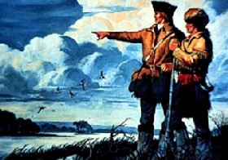
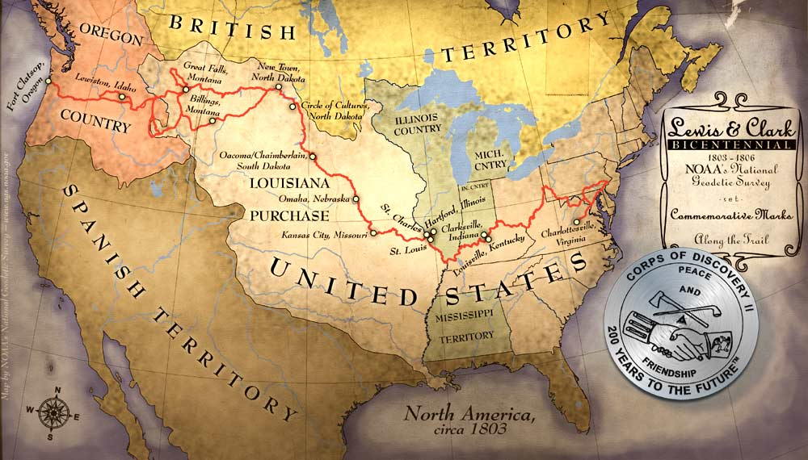
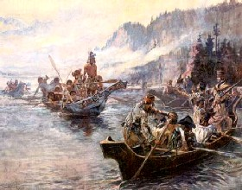
Background: Explorers
http://www.legendsofamerica.com/ah-lewisclark.html
http://www.ngs.noaa.gov/LewisAndClark/images/map.jpg
Notes:
Since the 1800s, explorers have been traveling across the United States. Lewis and Clark began their exploration in 1803. Of course, it wasn’t always the United States and explorers normally didn’t travel completely by foot. They definitely didn’t run, unless being chased by wild animals or hostile natives.

Slide 4
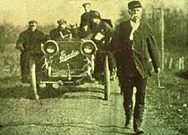
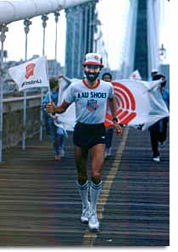
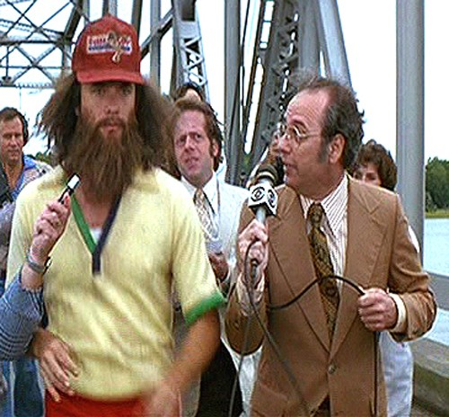
Background: Walkers and Runners
http://www.goyaasma.com/testimonials.html
Notes:
In 1909, Edward Payson Weston completed the first documented walk across the United States for 3,895 miles in 105 days from New York City to San Francisco. Since then, there have been more than 230 documented runners to make the trek. Presently in 2011, there are 17 runners on the road making the journey. Many of these runs are for charitable causes with the start and ending cities varying based on personal choice. Such is the case of David Kanazes, who is even being televised and tracked by Regis and Kelly on their show. Direction of travel also varies with some traveling east to west and others west to east
The fastest time recorded for the trip was made by Frank Giannino in 1980 at 46 days, 8 hours and 36 minutes from San Francisco to New York City. Frank actually made the run twice, once in each direction and is alleged to be the inspiration for the running scene in the movie Forest Gump.
In October 2010, I was discussing GIS with Geoff Weber, a Navy Lieutenant. He had recently attempted to break the World Record unassisted earlier that year. I couldn’t believe it. Unfortunately, he was unable to complete the run due to legal issues with being on the Interstate and the Highway patrol. Since we were discussing GIS, he mentioned how it could probably be used to determine a better route. As the animated character Gru of Universal Pictures’ Despicable Me put it, “Light-Bulb.”

Slide 5
Background: Research Questions
What criteria would be required to determine the optimal route?
Is the shortest distance necessarily optimal?
How can GIS be used to determine the optimal route across the United States by foot?
Notes:
This got me thinking. Not just a better route, the optimal route! I needed a capstone project. Why not this? If so, …

Slide 6
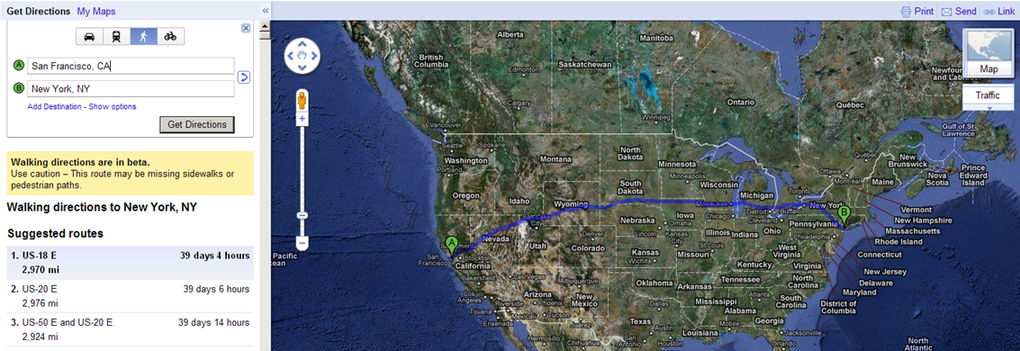
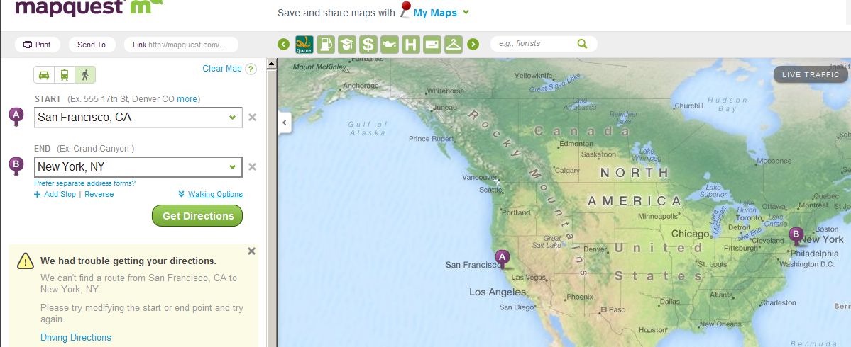
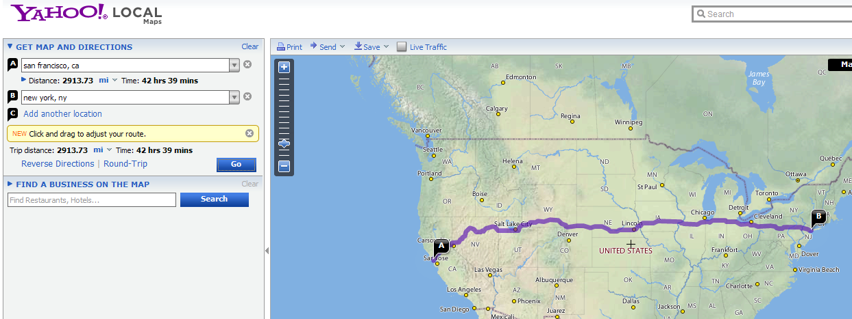
Background: Web Services
2970 miles at 39 days and 4 hours
Walking Directions but an Error
No Walking Directions. Driving Directions:
2913.73 miles at 42 hours s and 39 minutes
Notes:
Although, most people would not pick running as a choice of transportation, web-based services, such as Google Maps can provide directions and determine the shortest route from place to place by walking. Although a warning reveals that these directions are in beta and to use caution. According to Google Maps, the shortest walking route from San Francisco to New York is 2970 miles and will take 39 days and 4 hours. I researched how Google Maps determined this distance but could not find anything online. This must assume that the individual will be required to walk 24 hours a day, since this time beats the World Record by about 7 days. However, the route uses ferries and crosses into Canada, so it would obviously not be a legitimate for setting a world record. Although Google Maps driving directions has an option to avoid tolls and ferries, the walking directions do not.
Map quest had a walking function but it returned an error.
There was no walking directions option from Yahoo! Maps. According to Yahoo! Maps, the shortest driving route from San Francisco to New York is approximately 2914 miles long and will take 42 hours and 39 minutes.
All of these web services determine routes based on the shortest distance or time between two points. When crossing the United States by foot, is the shortest distance the optimal? Besides getting to the destination on time, how can a route be defined as optimal?
Perhaps, the optimal route not only gets you to your destination on time but is also the most energy efficient?

Slide 7
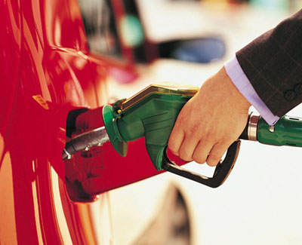
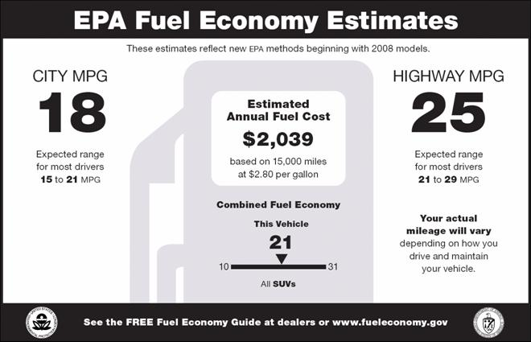
Background: Fuel Efficiency
http://onemansblog.com/2007/12/12/tips-on-pumping-gas/
Notes:
In a motorized vehicle, efficiency is normally based on fuel expenditures. Vehicles are rated for the number of miles that can be attained on a gallon of fuel. Of course the miles per gallon (mpg) can be affected by various factors inside and outside the vehicle. There are also mpg ratings for city driving and for the highway. When the vehicle is out of fuel, the driver simply pulls into a gas station and refills.

Slide 8
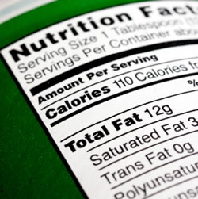
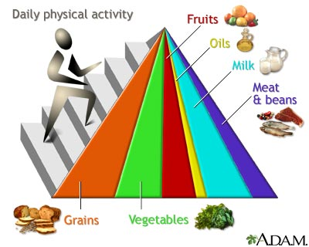
Background: Food Energy
http://gailcons.wordpress.com/
http://health.allrefer.com/pictures-images/food-guide-pyramid-1.html
Notes:
Unfortunately, the human body does not work like that and requires food energy for fuel. This energy is measured in calories. Normally, nutritionists use kilocalories (kcal) or 1000 calories as the unit of measure for food energy. According to a 2005 study at Georgia State University, 2000 kilocalories is equivalent to .0644 gallons of gasoline. So how are the number of calories for running determined?

Slide 9
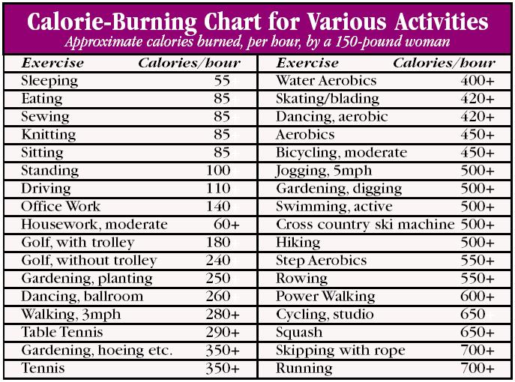
Background: Counting Calories
http://www.todayhealthtips.com/calorie-burning-chart.html
Notes:
There are several calorie counters and charts available online. The primary inputs that are used to determine calories burned are weight, gender and age. The amount of effort is also a factor. These factors are all inherent to the runner. This study will also analyze the external factors that affect running.

Slide 10
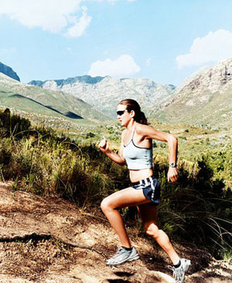
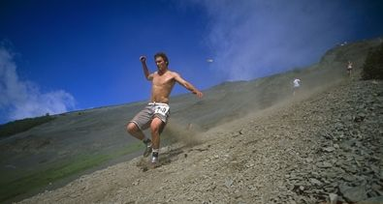
Study Factor: Gradient (Uphill and Downhill)
http://munfitnessblog.com/why-should-you-do-hill-training-and-8-great-tips-for-beginner/
http://www.madetorun.com/training/running-workouts/hill-running/
Notes:
Anyone that has ever gone running understands that there is a difference in effort between running on a flat surface and running up or down a hill. This difference in effort affects the calories burned over the same distance. Since the run across the United States will not be on a flat surface, the gradient of the surface must be accounted for in the calories burned. Most treadmills allow the user to change the gradient or incline during use and adjust the calories burned based on the gradient change.

Slide 11
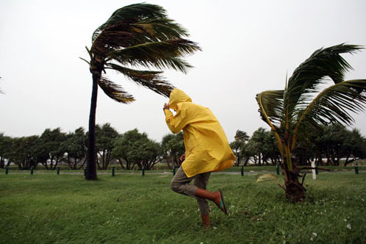
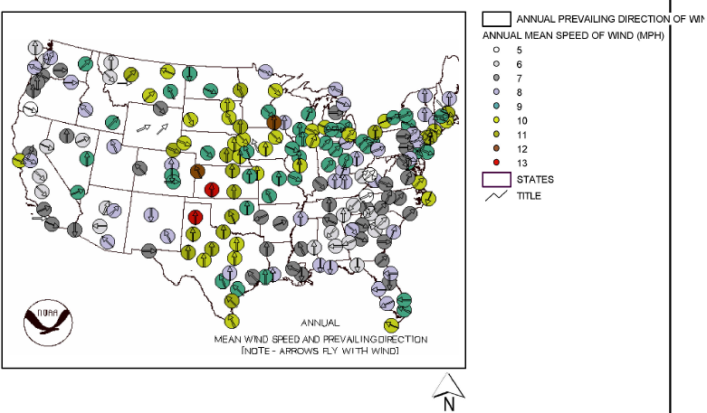
Study Factor: Wind (Headwinds / Tailwinds)
http://marksvo2.wordpress.com/2009/09/11/running-with-the-wind/
Notes:
Another factor that can affect a runner is the wind speed and direction. Running into a headwind reduces a runner’s speed thus requiring a longer time for the same distance. This additional time equates to more calories burned. There have been studies that determine how a wind affects runners on a track and different running routes. Although not a constant affect, there are areas of the United States that regularly receive winds in a certain direction and speed. This will be incorporated into the study as effectively as possible.

Slide 12
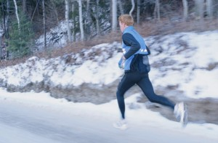
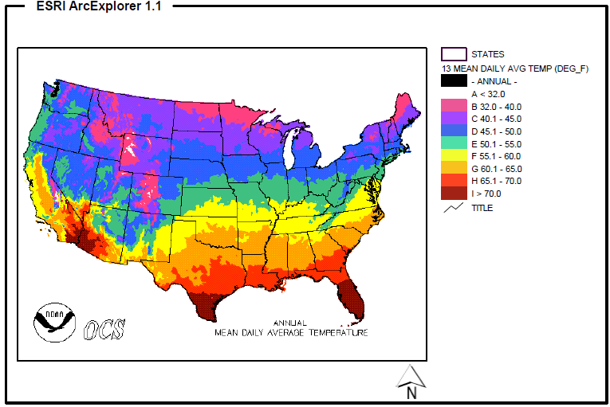
Study Factors: Temperature (Internal / External)
http://wellandgoodnyc.com/2010/06/28/todays-psa-exercise-with-caution-in-todays-inferno/#axzz1HNiKtNhv
http://www.infobarrel.com/Cold_Weather_Running_Safety_Tips
Notes:
The final factor that may affect a runner is temperature. As the body exerts energy the internal temperature increases. Increased or decreased temperatures may lead to increased energy (kilocalories) consumption. External temperatures may affect the body’s temperature. The temperature across the United States changes with the elevation and latitude. Similar to wind, this effect is also not a constant. Since the fastest documented run across the United States took more than a month and a half of running, there may be optimum times of the year for running across the United States, especially if the goal is to beat the world record.

Slide 13
Research Objectives
What is the optimal route, based on energy (kilocalories) consumption, from San Diego to Virginia Beach?
Is the shortest walking route determined by Google Maps more energy efficient?
Does the direction of travel across the United States (East to West / West to East) make a difference?
Is the World Record running route across the United States more efficient than the determined route?
Notes:
Geoff Weber still plans to beat the world record but wants to run from San Diego, California to Virginia Beach, Virginia. The reasons for these two locations are personal and symbolic. Since Geoff is a Lieutenant in the Navy, he wants to connect the two continental naval fleets: Second Fleet on the Atlantic Ocean and Third Fleet on the Pacific Ocean.
This project will study the effects of gradient, wind and temperature on an individual’s energy consumption to answer the following research objectives:

Slide 14
Issues
Criteria Inaccuracies
Temporal Conditions
Large Data Sets
Bridges
Uphill/Downhill
Data Quality
Road Surface
Legal Restrictions
Spatial Reference
Weight Reduction
Data Availability
Data Currency
Notes:
There are several issues with this project. I will highlight a few of the major ones.
Criteria Inaccuracies: This study attempts to access the affects of multiple internal and external affects on a human running. Many of the external factors are difficult to account for accurately. However, this study will make use of available research to account for these factors as accurately as possible.
Temporal Conditions: Since the runs will require close to two months, there will be varying conditions for factors like temperature and wind. This is one issue that will most affect the choice of run direction.
Large Data Sets: Of course, this project will require a lot of data since the study encompasses a majority of the United States. Some of the data, such as elevation data can be very large files.
Bridges: Bridges connect gaps in terrain that would otherwise return high gradient values. These will need to be accounted for to keep gradient affects accurate. Normally bridges are flat, however some have gradients of their own.
Uphill/Downhill: As already mentioned this makes a difference. This will most affect the direction of travel.

Slide 15
Data Sources
Google Maps
U.S. Census Bureau
U.S. Department of Agriculture (USDA)
National Oceanic and Atmospheric Administration (NOAA)
Frank Giannino (World Record Holder)
Geoff Weber (Future World Record Holder)
Crowd Sourcing (2011 Runners)
Presently in contact with 4

Slide 16
Proposed Methodology
Data Acquisition
Data Preparation
Mosaic Data
Buffer Road/Trail Network
Clip Data
Convert to Raster
Data Analysis
Determine Criteria
Slope Analysis
Combine Data
Determine Best Route

Slide 17
Projected Timeline
Data Acquisition. 4 weeks
Data Preparation. 4 weeks
Data Analysis. 6 weeks
Presentation. 6 weeks
Notes:
I began data acquisition during this proposal. Large data sets, such as NED, required hours to download and in small portions. I still don’t have all of the required data but know where to get it. It’s just a matter of time to download it all.
I plan to have this project completed by the end of GEOG 596B. I

Slide 18
Anticipated Results
The optimal route from San Diego to Virginia Beach will not be the same as the Google Maps shortest walking route.
The energy (kilocalories) consumption for the optimal GIS route will be lower than the Google Maps route.
The direction of travel for the same route makes a difference in energy (kilocalories) consumption.
The optimal GIS route is more energy efficient than the World Record route.

Slide 19
Summary
Background
Study Factors
Research Objectives
Issues
Data Sources
Proposed Methodology
Projected Timeline
Anticipated Results
Notes:
Depending on the results of the study, I may create a web service.

