Slide 1
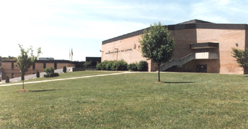
GIS Curriculum for High School Earth and Environmental Science Peer Review Brief
William Gallaway
6 May 2013

Slide 2
Outline
Project Description
Project Goals
Background
Scope
Deliverables
Methodologies
Sample Course Modules
Challenges and Conclusions

Slide 3
Project Description
Design GIS course modules tailored for Prince William County, Virginia High School ‘Earth and Environmental Science’ curriculum.
Notes:
There are 14 high schools in the district.
- ‘Magnet School’ of 2600 students, grades 9-12 (A public school offering a specialized curriculum, often with high academic standards, to a student body representing a cross section of the community).

Slide 4
Project Goals
Introduce high school teachers and students to GIS technologies and methodologies to:
Enhance the learning environment ()
Expose students to technology and tools used by professionals
Introduce web-based research and datasets
“…After data are mapped, pattern-seeking and analysis inquiries (collectively known as spatial thinking) can help students draw conclusions, solve problems, make decisions, and consider areas of further research .”
- Sarah Bednarz, GeoJournal 2004

Slide 5
Background
Why GIS?
“ (1) Key tool to analyze the environment and solve problems
(2) Enhances student interest
(3) Motivates students to career in science and engineering”
- NCGIA Core Curriculum, 1990
Studies of effectiveness
Boulder High School, 2000
West Covina High School, 2004
Notes:
The Effectiveness of GIS in High School Education (http://proceedings.esri.com/library/userconf/proc99/proceed/papers/pap203/p203.htm)
Doctoral candidate at University of Colorado wrote in the ESRI Proceedings in 2000 of research conducted to study:
Does GIS alter the manner of study in the classroom; yes! Creativity and open-ended learning occurred with time to experiment with data
Instructional methods of teachers using GIS more closely aligned with tenets of modern educational reform; poses real-world questions in a problem-solving environment where the teacher is the facilitator
2004 – Study conducted on the effectiveness of a semester-long GIS course
(http://scholarworks.csun.edu/handle/10211.2/2761)
Conducted a study of students taking a GIS course. Determined by survey the effectiveness in two areas; geography skills and GIS skills.
Possesed skills to analyze and present data based on geographic research and where to find geographic data
Understood applications of gis, could apply it to other study areas, and useful in many career paths
“The educative argument for GIS is that it helps students to learn geography by practicing spatial thinking. The argument goes like this: GIS models the processes of spatial thinking. By mirroring these processes, doing GIS (following its procedures and steps to produce maps) demonstrates for students the cognitive strategies used in spatial thinking (Bednaz, 2004).”
“Students benefit from using a GIS to produce maps, it is argued, because it practices and sharpens their cognitive mapping skills, such as assessing similarity and proximity, and their spatial thinking skills, such as associating and correlating spatially distributed phenomena (Bednaz, 2004).”

Slide 6
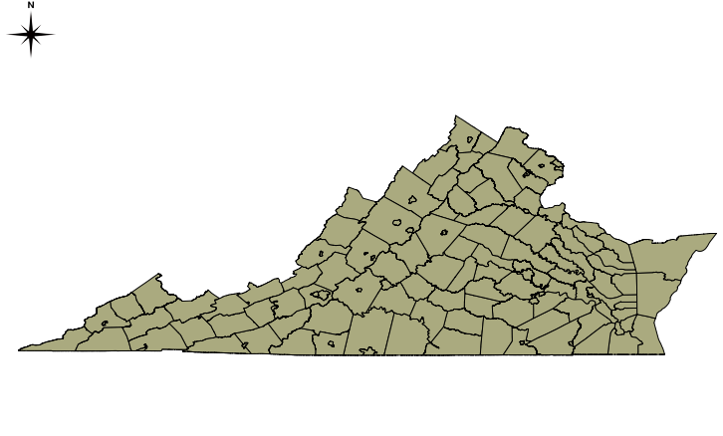
Scope
Matched to school curriculum
14 total blocks of instruction
for Earth and environmental
sciences
GIS modules will augment
three main areas
2-3 days instruction per
module (scalable)
Uses open source and state and federal GIS data sources
Focuses on Virginia and mid-Atlantic regions
Notes:
Block of Instruction from 2012-2013 Pacing Guide:
Science Process Skills (Basic)
Characteristics of the Earth and the Solar System
Cosmology
Science Process Skills (Mapping - Oct 22 – 31)
Minerals
Rocks
Freshwater Resources and Soils
Geology Processes (Jan 31 – Feb 28)
Historical Geology
Renewable and Non-Renewable Resources (Mar 13 – 18)
Atmosphere
Weather
Oceans

Slide 7
Deliverables
Three instructional modules for teachers
1. Introduction to GIS (Mapping Block)
2. Earthquake Risks (Geology Processes Block)
Wind Power (Renewable Resources Block)
Data Sets
Shapefiles, raster files
Solution sets

Slide 8
Methodologies
‘Train the Trainer’
Work with High School and School District representatives
Determine what is feasible
Match to District goals
Iterative Development
Select and Learn Software
Review Curriculum
Develop Modules
Present to Instructor
Train Instructors
Present at District Conf.
Nov ‘12
Nov ‘12
Dec ‘12– Apr ‘13
Apr ‘13
May – July ‘13
Aug ‘13
Notes:
‘My’ Workflow:
Meet with Staff – determine areas most appropriate for augmentation
Determine school goals and scope
Select Appropriate Software (OQIS, FalconView, Arc? Online?)
LEARN Software (!)
Develop modules geared toward school curriculum and within scope
Deliverables
Present to District Science Advisor
Refine

Slide 9
Module One – Intro to GIS
Terminal learning objectives:
Introduce students to GIS discipline, concepts and uses
Introduce software (QGIS)
Enabling learning objectives:
Familiarization with basic GIS concepts
Basic Tools (Add files, View Spatial properties, etc…)

Slide 10
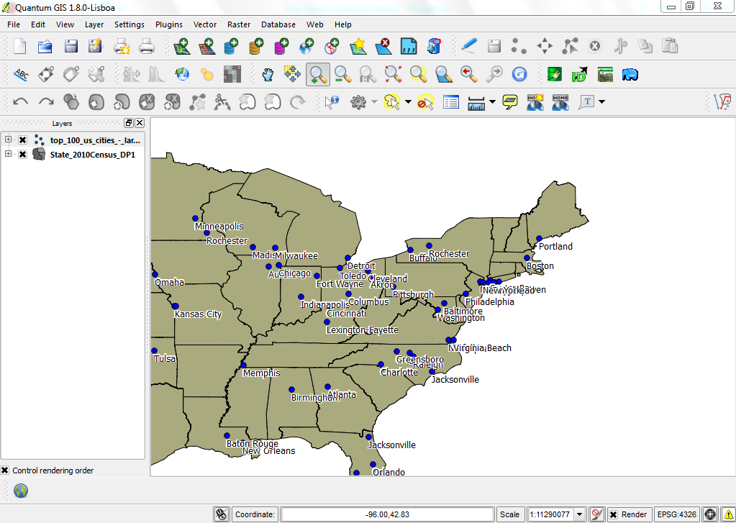
Module One – Intro to GIS

Slide 11
Module Two – Earthquake Risks
Terminal learning objectives
Demonstrate basic GIS analysis
Familiarize with government sources of GIS data
Enabling learning objectives
Research, create and download earthquake data and population data
Create heat map
Determine Virginia counties at highest risk for earthquake hazards

Slide 12
Module Two – Earthquake Risks
Student Workflow
USGS Earthquake Hazards
US Census Bureau
Heat Map
Intersect Earthquakes with Population
Final Output
Notes:
Student Workflow –
Terminal Learning Objective: Find VA counties at highest risk for earthquake activity.
Enabling Learning Objective: Familiarize with USGS website and tools, .create shapefile from .csv data, perform basic GIS analyses such at heat map creation, polygon drawing and intersection.
1 – Review USGS website and download earthquakes from a circle search area around Woodbridge High. Create .csv and upload into QGIS.
2 – Add county data from US Census Bureau for VA.
3 – Create heat map for earthquake densities
4 – Using polygons around the most dense regions, intersect with populations

Slide 13
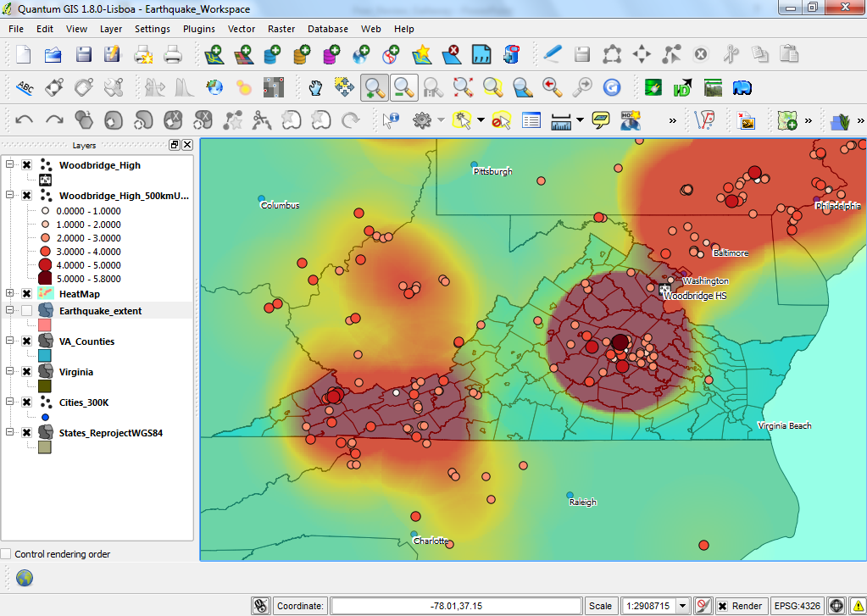
Module Two – Earthquake Risks

Slide 14
Module Three – Wind Power
Terminal learning objectives
Demonstrate basic GIS analysis using vector and raster data
Familiarization with government sources of GIS data
Enabling learning objectives
Select areas meeting minimum wind power class criteria for electricity generation
Buffer locales around population centers
Create slope map from elevation data
Find final locale for wind power generation in a given area based on above criteria

Slide 15
Module Three – Wind Power
Student Workflow
US DOE
NREL Data
US Census Bureau
USGS Elevation Data
Create Slope Map
Final Output
Notes:
Student Workflow –
Terminal Learning Objective: Find land-based areas in VA suitable for wind power generation.
Enabling Learning Objective: Familiarize with NREL and USGS website and tools, conduct basic GIS analysis using raster files (slope), conduct basic GIS analysis using buffer and intersect tools.
1 – Review DOE NREL website and download shapefiles for Wind Power Class data.
2 – Add county and city data from US Census Bureau for VA. Buffer for 15km around cities.
3 – Download USGS Elevation data (DTED) – create slope map and select for 10 degrees slope.
4 – Determine final site selection from WPC, slope and distance from populated areas.

Slide 16
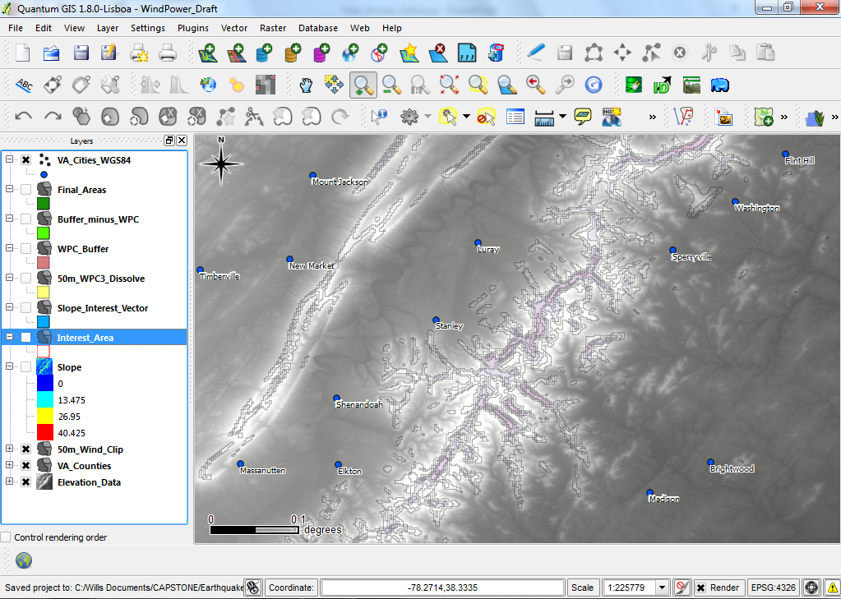
Module Three – Wind Power

Slide 17
Challenges
Learning new software
Many online resources, well-documented and openly supported
Scale of Project
Scheduling
School syllabus leaves little room for new material
Teacher availability for training
Information Assurance
Need to safely incorporate open source program

Slide 18
Conclusion
GIS has a place in high school school education
Enhances learning
Exposes the discipline

