Slide 1
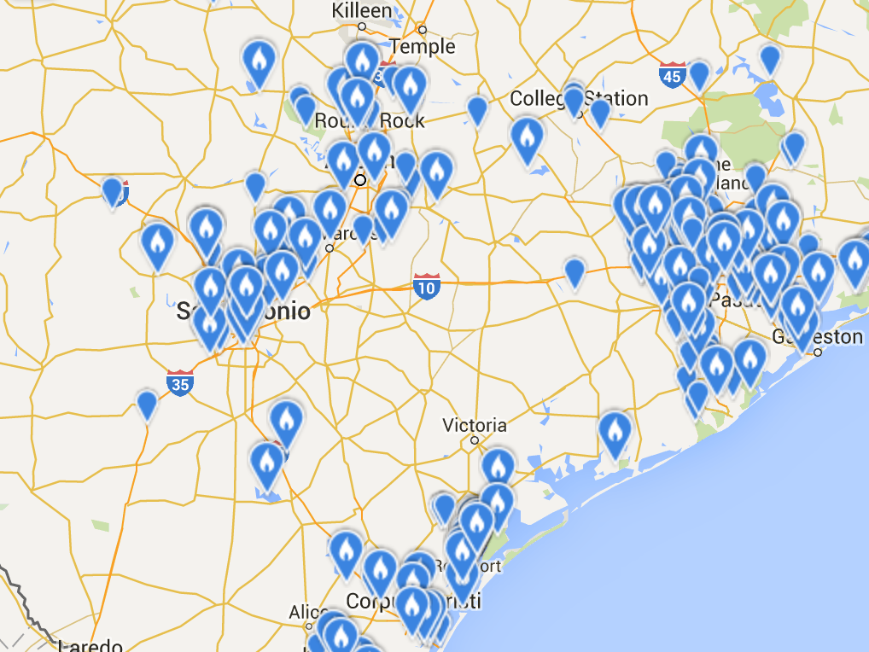
Transforming Citizen Science Point Data
Into Informative Range Maps
Laura B. Gast, DrPH MPH CPH
Penn State MGIS Program Capstone Proposal
Advisor: Nathan Piekielek, PhD
May 12, 2016

Slide 2
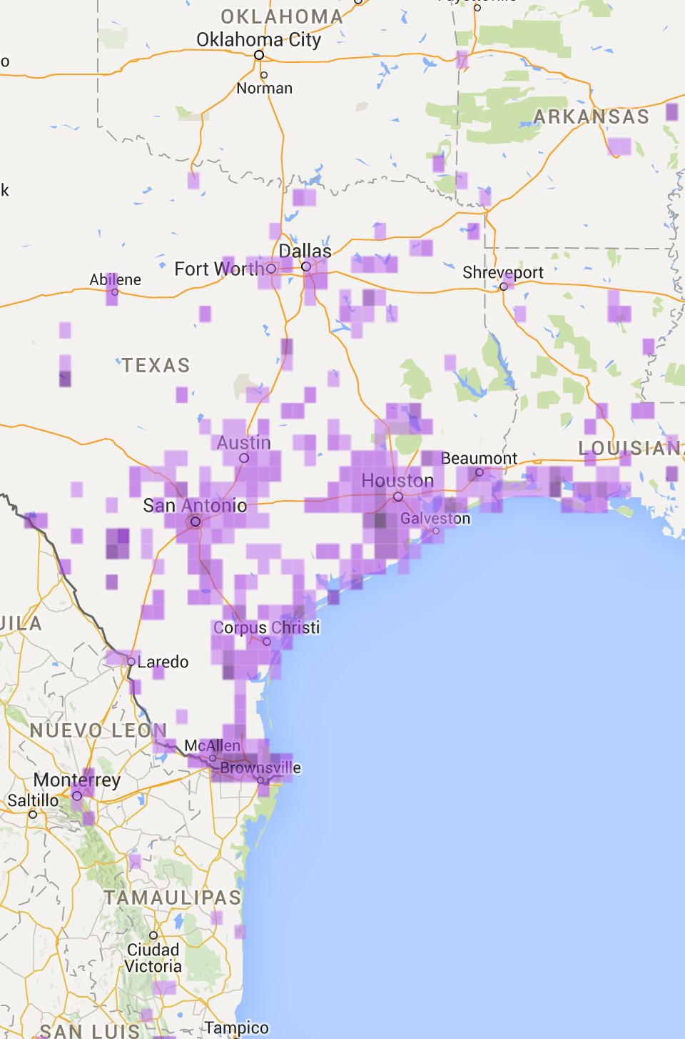
Overview
Introduction
Background
  citizen science
  black-bellied whistling ducks
Materials
Methods
  model choices
  cartographic choices
Results / Questions
Timeline
References

Slide 3
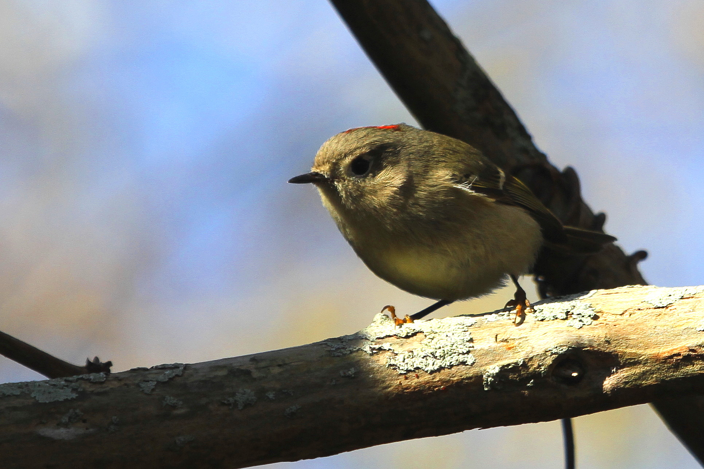
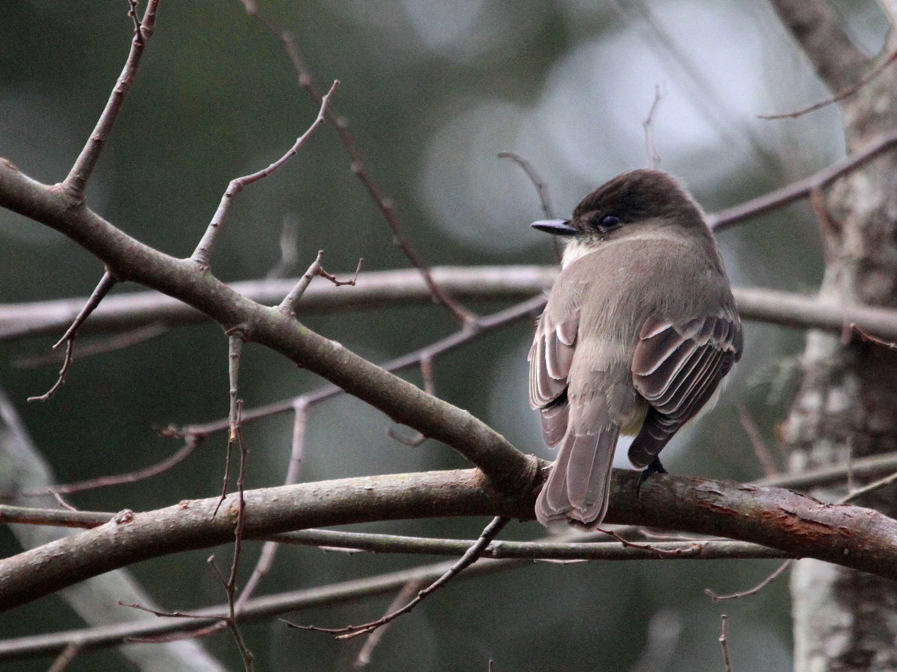
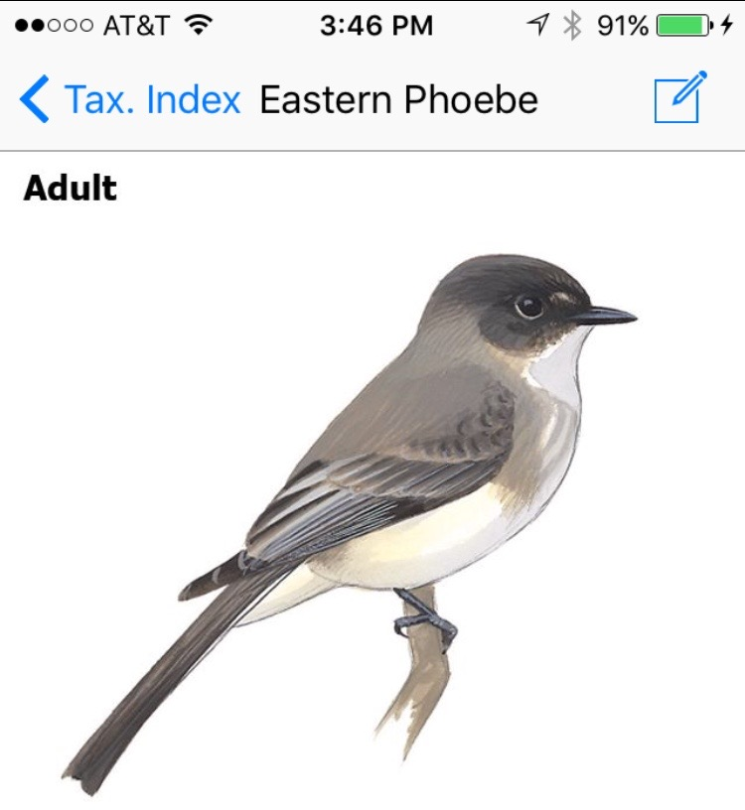
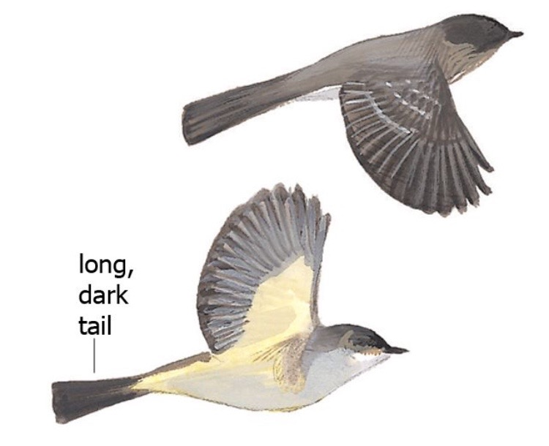
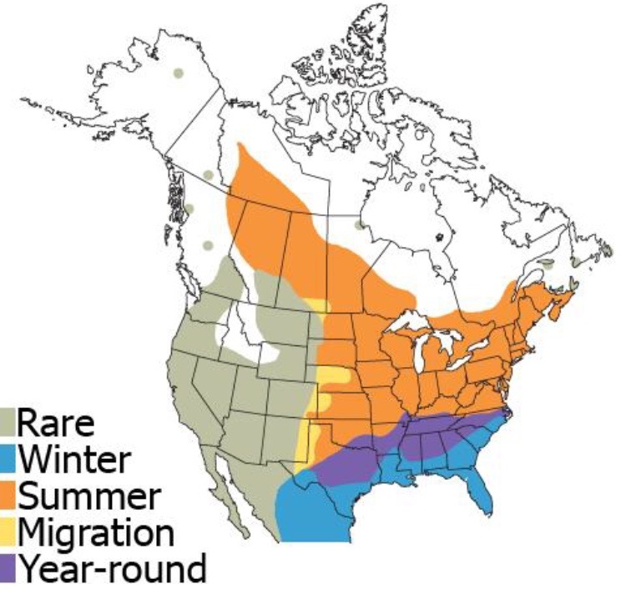

Slide 4
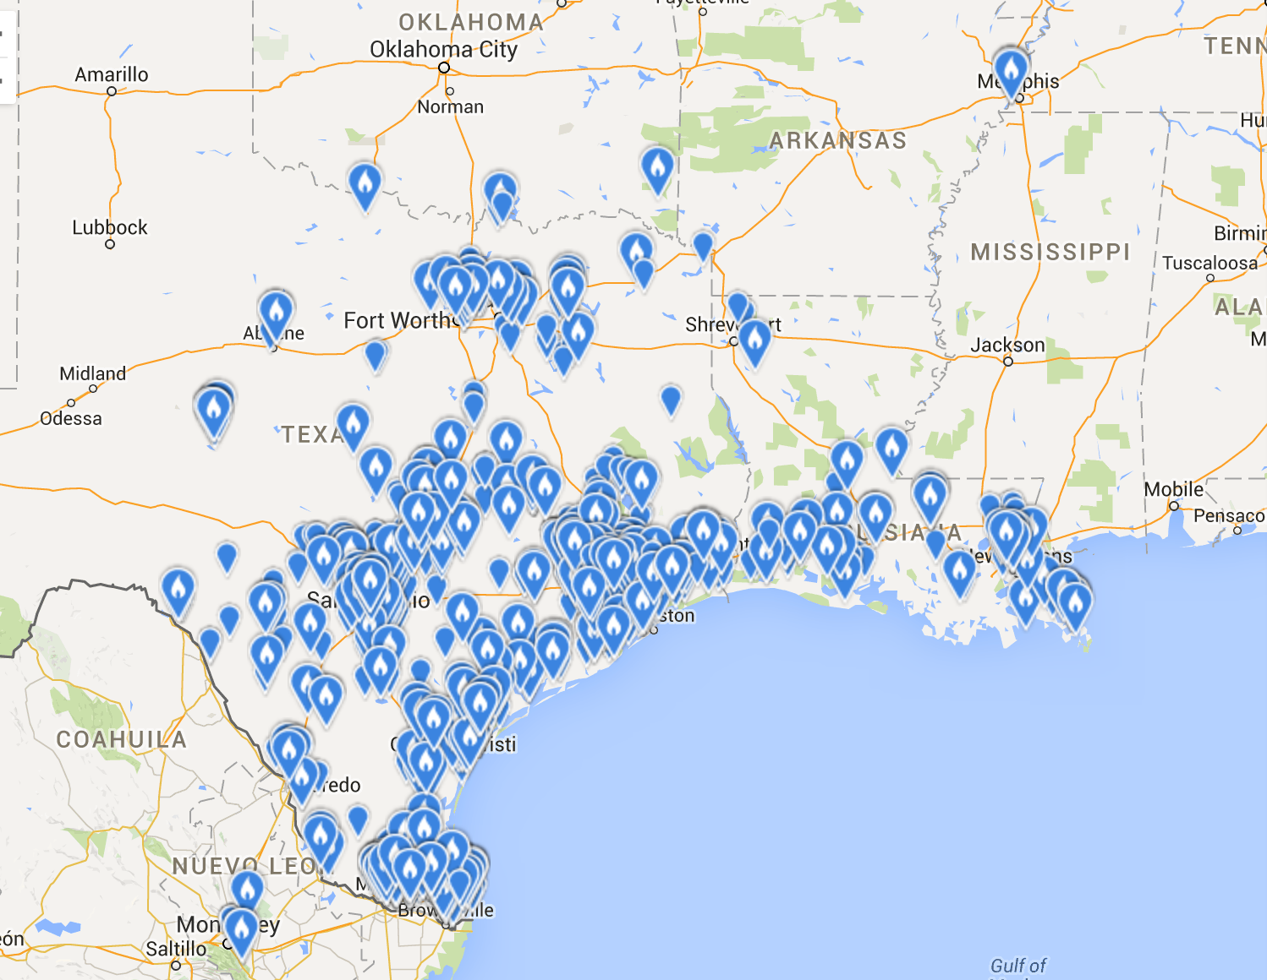
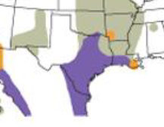
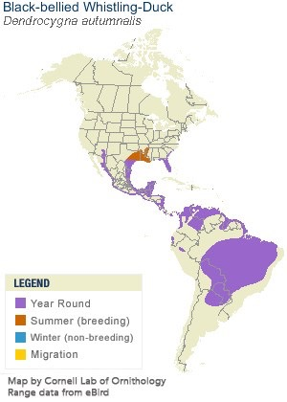
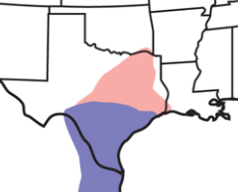
eBird Points
December & January
last 5 years
Sibley Guide Phone App
Cornell Ornithology Lab
Audubon Online Guide
Winter
Summer

Slide 5
Why?
Real range change
  climate change?
  urbanization?
Modeling choices
Cartographic choices
Input data

Slide 6
Goal:
use an example species to better understand the impacts of model and cartographic choices on resulting range maps
make recommendations for better communication of range to citizen scientists

Slide 7
citizen science refers to research collaborations between scientists and volunteers, particularly… to expand opportunities for scientific data collection and to provide access to scientific information for community members
-National Audubon Society

Slide 8
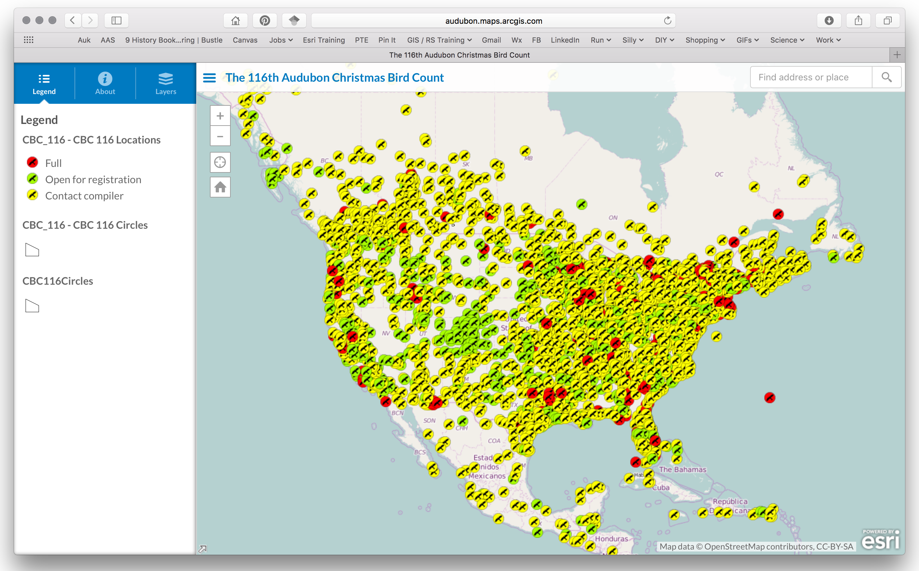
Audubon Christmas Bird Count
longest running & largest citizen science census in the world

Slide 9
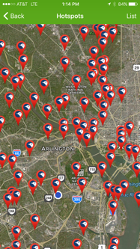
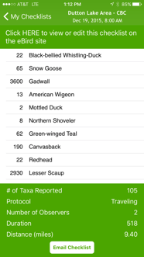
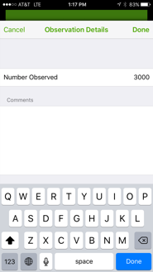
launched in 2002 for the smart phone age
real-time online checklist program

Slide 10
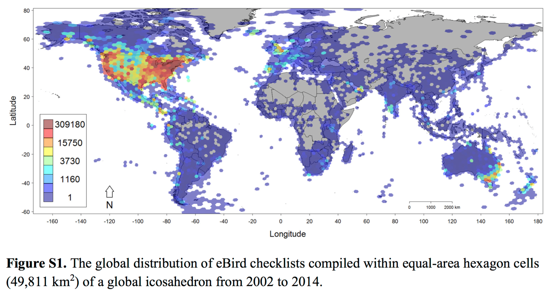

Slide 11
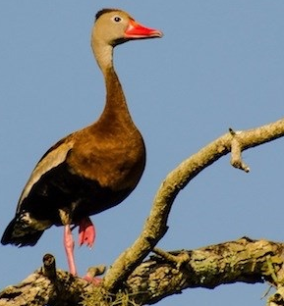
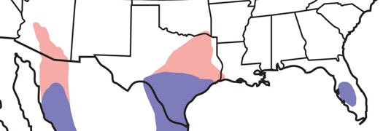
Black-Bellied
Whistling Duck
mostly non-migratory
conspicuous (noisy and tame)
habitat is quiet, shallow, freshwater ponds, lakes, marshes and cultivated reservoirs
Three US populations
population is “known” to be expanding
  how to define range?
  how to communicate range?

Slide 12
eBird Points
December & January
last 5 years
Sibley Guide Phone App
Cornell Ornithology Lab
Audubon Online Guide
Winter
Summer

Slide 13
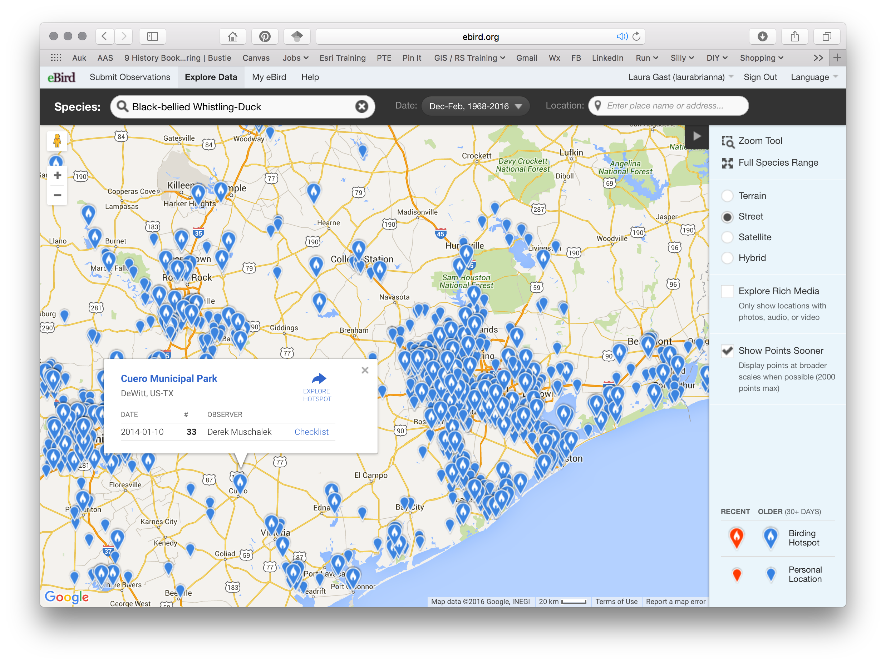
Materials
eBird data for BBWD
some digitized guidebook ranges
purposefully not including any biological niche modeling data

Slide 14
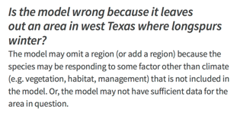
Methods - Model Choices
Preliminary options
  how to define “presence” versus “absence” of a species?
  how do various guide books make maps?
  citizen science point data versus ecological niche modeling

Slide 15
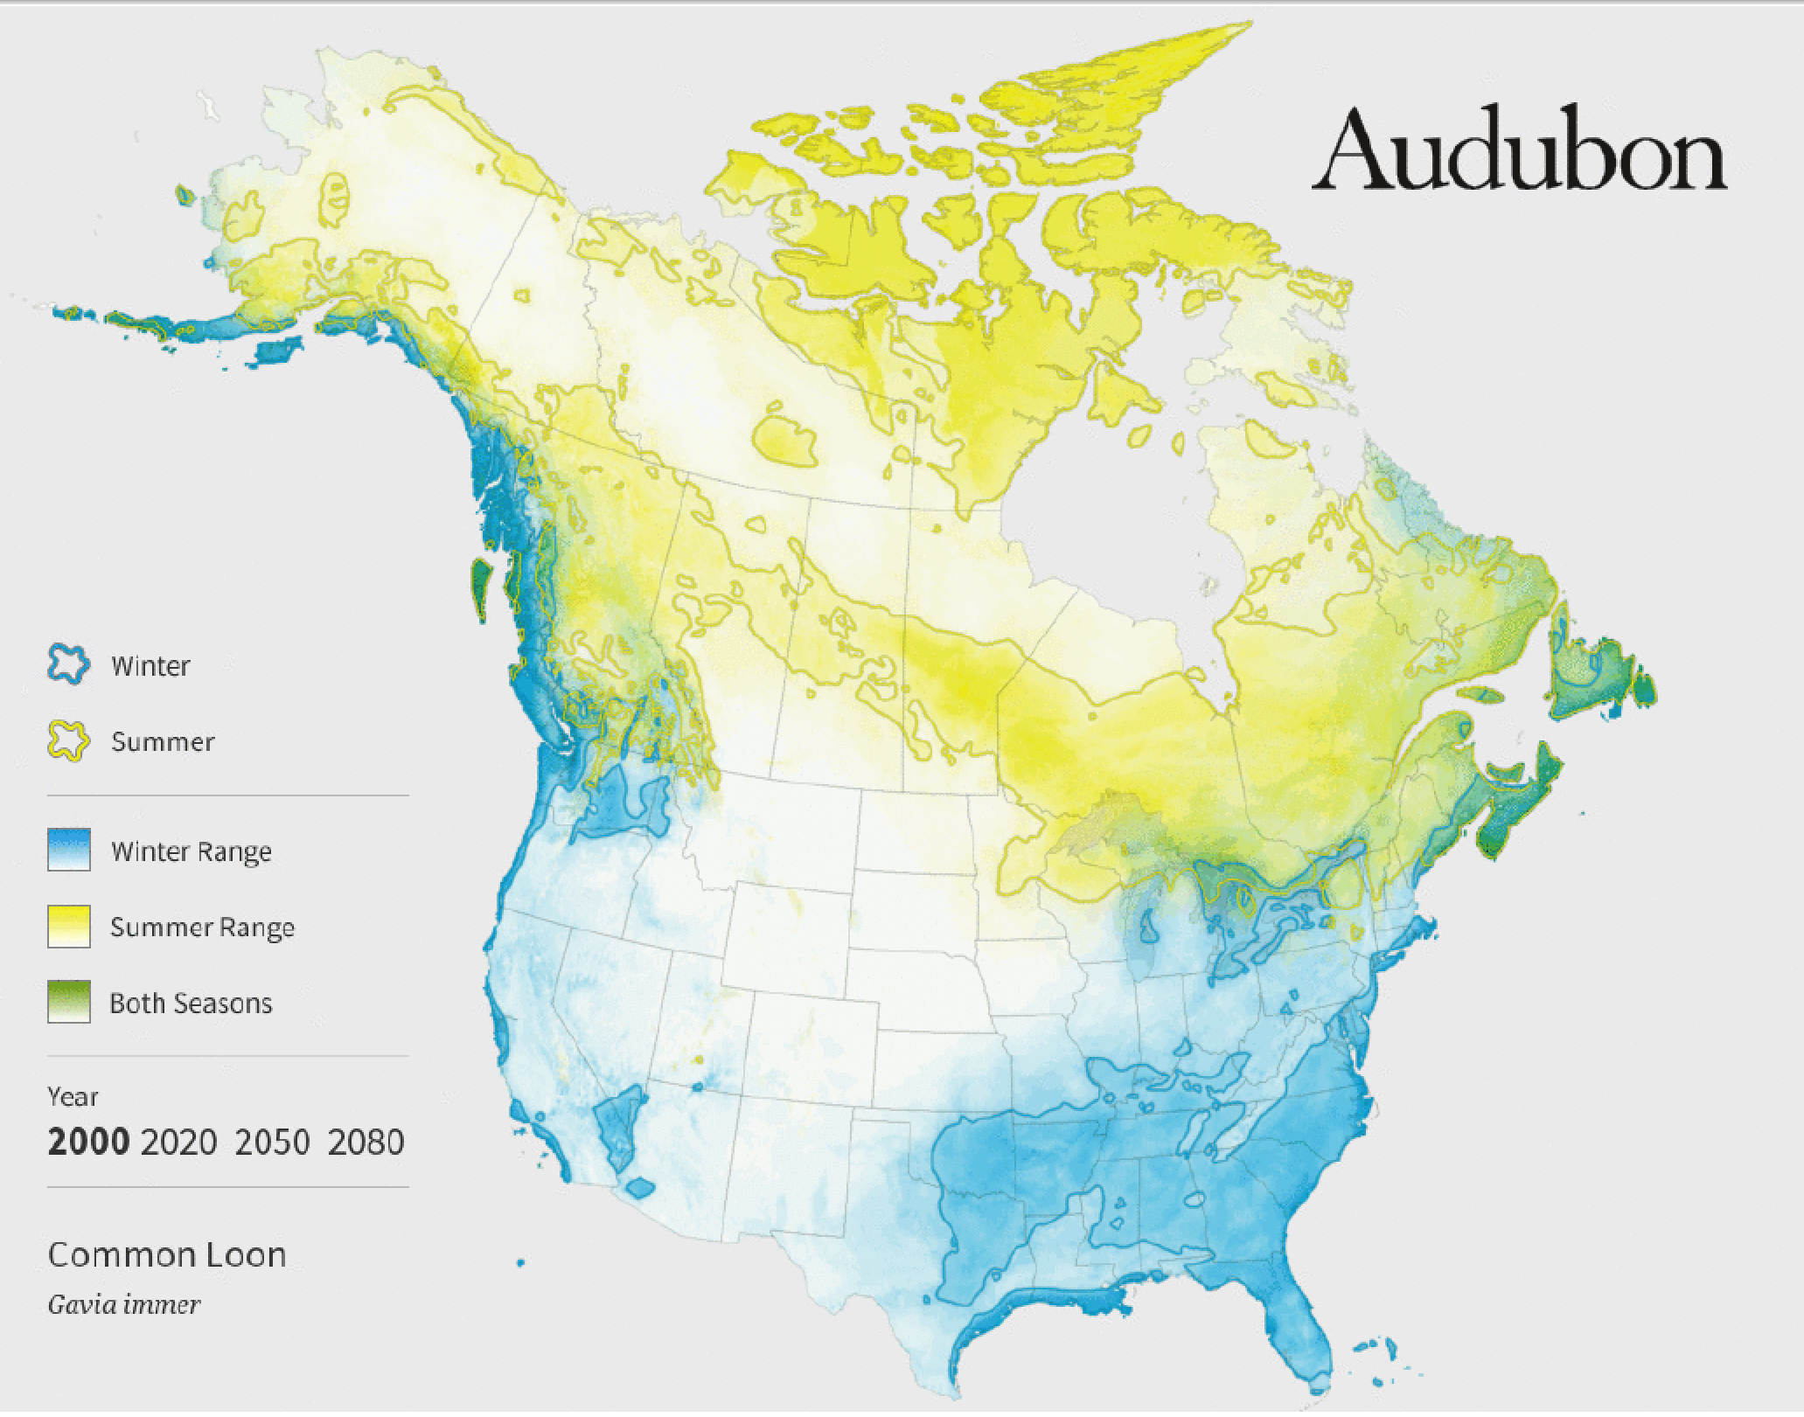
Methods - Cartographic Choices
Weighing simplicity versus scientific accuracy
  Simple yes/no? Hot spot gradients?
  grids versus points?
  How to display migration paths (N-S not same as S-N)
Discuss benefits and drawbacks of each choice

Slide 16
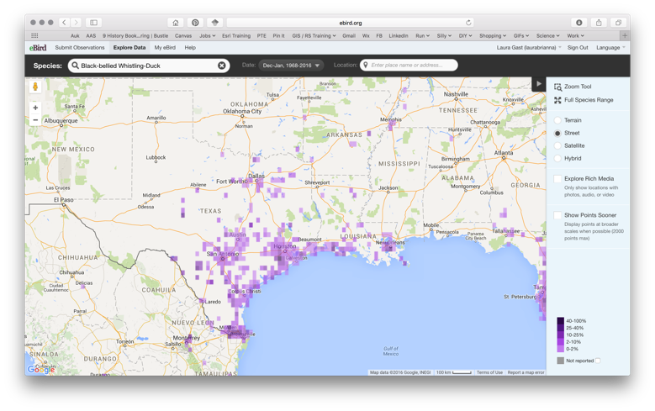
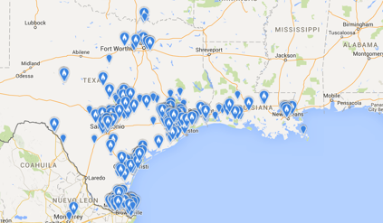
Methods - Cartographic Choices
Weighing simplicity versus scientific accuracy
  Simple yes/no? Hot spot gradients?
  grids versus points?
  How to display migration paths (N-S
Discuss benefits and drawbacks of each

Slide 17
Methods - Cartographic Choices
Weighing simplicity versus scientific accuracy
  Simple yes/no? Hot spot gradients?
  grids versus points?
  How to display migration paths (N-S not same as S-N)
Discuss benefits and drawbacks of each choice

Slide 18
Questions / results
How are groups defining range for a particular species?
  datasets & assumptions?
  updates?
How are species ranges defined and communicated?
  citizen scientists and the public
  scientists
How do model choices effect resulting range maps?
How do all these choices change the narrative of effects of climate change on the range of various avian species?

Slide 19
TimeLine
MAY
Data acquisition (eBird & CBC)
Interviews with guide book scientists
JUNE
Data analysis
Continue interviews
JULY
AUGUST
Prepare presentation
Present at North American Ornithological Society Conference (Smithsonian, Washington, DC, Aug 19-21)
SEPT
Develop paper for submission (TBD)
OCT
Submit paper for submission (TBD)
Complete MGIS Program end of Fall1, 2016

Slide 20
References
eBird Basic Dataset. Version: EBD_relMay-2013. Cornell Lab of Ornithology, Ithaca, New York. May 2013.
Kaufman, K. 2005. Lives of North American Birds. Houghton Mifflin Co: Boston.
La Sorte, F.A., Daniel Fink, Wesley M Hochachka, Steve Kelling. Convergence of broad-scale migration strategies in terrestrial birds. Proc R Soc B. 283:1823.
National Audubon Society. 2015. Audubon’s Birds and Climate Change Report: A Primer for Practitioners. National Audubon Society, New York. Contributors: Gary Langham, Justin Schuetz, Candan Soykan, Chad Wilsey, Tom Auer, Geoff LeBaron, Connie Sanchez, Trish Distler. Version 1.3.
Rodewald, P. (Editor). 2015. The Birds of North America Online: http://bna.birds.cornell.edu/BNA/. Cornell Laboratory of Ornithology, Ithaca, NY.
Sibley, D. A. 2014, The Sibley Guide to the Birds of North America, Second Edition. Knopf: New York, NY.
Sullivan, B.L., C.L. Wood, M.J. Iliff, R.E. Bonney, D. Fink, S. Kelling. 2009. eBird: a citizen-based bird observation network in the biological sciences. Biological Conservation 142:2282-2292.

