Slide 1
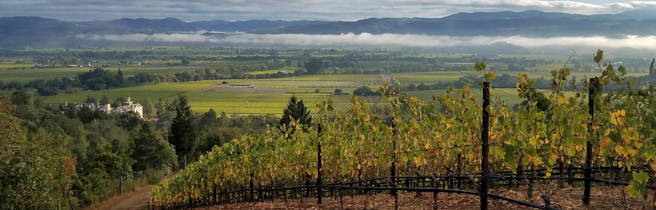
USING GEOLOCATED PROXY SENSOR SYSTEMS TO ASSESS SPATIOTEMPORAL STABILITY OF SEASONAL WOOD BIOMASS IN NORTHERN CALIFORNIA VINEYARDS
Philip Gauthier
Advisor: Michela Centinari, PhD
GEOG 596A

Slide 2
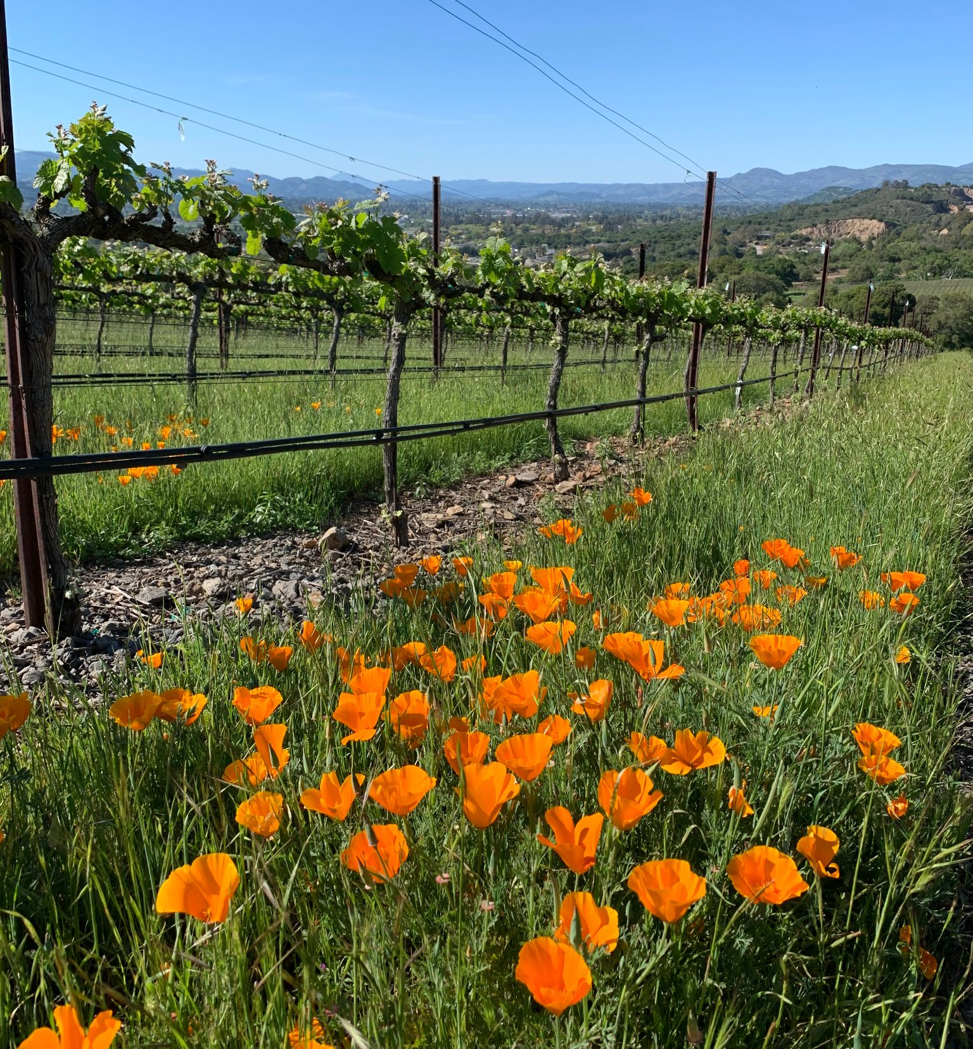
The California
Wine Economy
California produces approximately 81% of all wine in the United States
Fourth largest wine producer in the world
Nearly 650,000 acres of wine grape vineyards throughout the state
A California vineyard in spring. ©2020 Philip Gauthier.
https://discovercaliforniawines.com/media-trade/statistics/

Slide 3
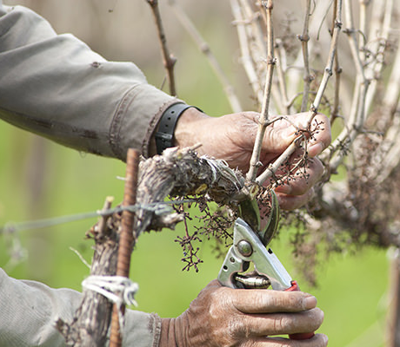
Managing Vine Size
image of a vine or vine balance triangle
Quantifying the size of vines helps growers understand performance
Measurements guide management decisions like pruning
Can also be used to predict future performance
“Pruning Inside.” ©2016 Vinepair. Reproduced here for educational purposes only.

Slide 4
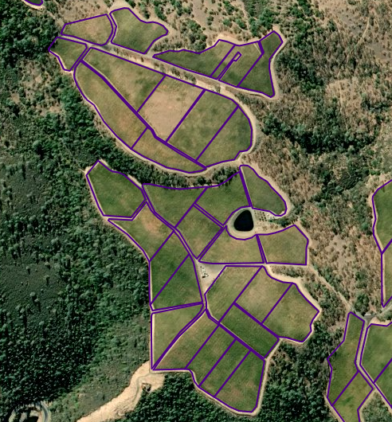
Vineyard Establishment and Management
Vineyard properties greater than a few acres are often divided into “blocks”
Blocks typically represent a management unit for a vineyard
Can be designated with different grape varieties, soil types, rootstocks, and more
A vineyard with block boundaries. ©2021 Fruition Sciences, Inc. Reproduced here for educational purposes only.

Slide 5
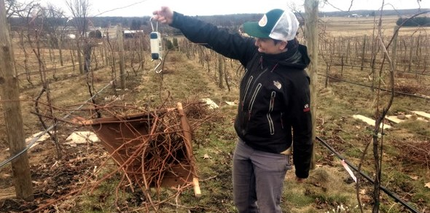
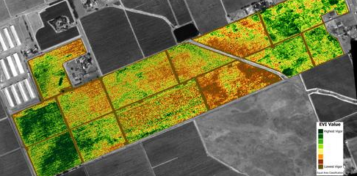
Vine Size Assessment Methods
Pruning Weight
Simple measurements
Well-established guidelines for most vine varieties
Requires manual trimming of wood and measurement of weight
NDVI
Obtained by satellite, airplane, drone, or terrestrial vehicle
Index helps show variations of vine vigor and relative strong/weak zones
Not as useful for measuring absolute vine size
Left: Manually measuring pruning weight. Michela Centinari. Reproduced here for educational purposes only.
Right: NDVI imagery of a vineyard. ©2021 Sangiacomo Vineyards. Reproduced here for educational purposes only.

Slide 6
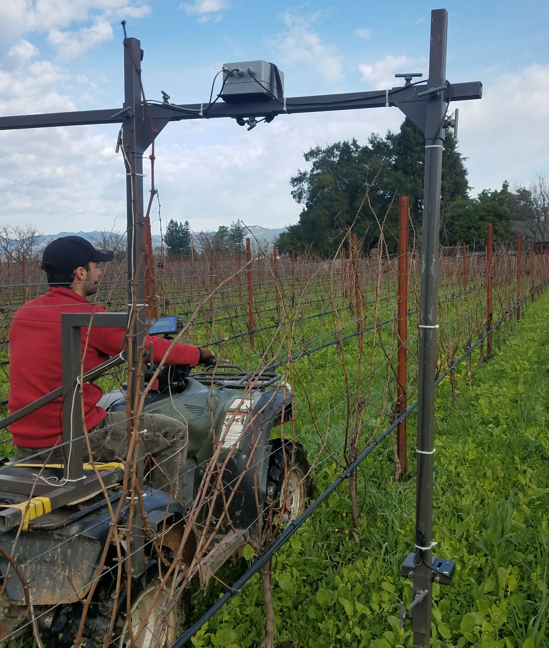
The Physiocap® System
Geolocated measurements of vine shoots using lasers
System attaches to any farm vehicle
Rapid data collection over large geographic areas
Wood biomass calculated from measurements
sum mm² of shoot area per m² of vineyard
Physiocap in operation mounted to an ATV. ©2021 Fruition Sciences, Inc.
Reproduced here for educational purposes only.

Slide 7
Previous Research
01
02
03
Tisseyre et al., 2008
Measured pruning weight in 30 point zones of a Syrah vineyard over 7 years.
Interpolation and assessment of data using non-spatial statistical methods.
Values varied significantly over space and over time while demonstrating Temporal Stability of Within Field Variation (TSWFV)
Taylor & Bates, 2013
Measured pruning weight of over 1200 individual Concord vines for three years.
Demonstrated results consistent with the findings of Tisseyre
Large variations are seen over space and time while patterns and zones are generally preserved.
Demsestihas et al., 2018
Preliminary results of a study on Physiocap measurements in Champagne, France.
Data for each block was examined in the context of block parameters like variety, row spacing, soil type, cover crop, and climate.
Marked variations in typical Physiocap response per parameter.

Slide 8
Project Goals, Part One
Process and analyze multiple years of Physiocap data to assess vine size variations in three aspects:
The degree of spatial variation within a block
The degree of annual variation of block-level averages
The degree of annual stability of intra-block spatial variation

Slide 9
Project Goals, Part Two
Examine the results of part one in the context of block-specific parameters from the available blocks geodatabase:
Grape variety
Rootstock variety
Vine spacing
Local climatic parameters
Potentially others

Slide 10
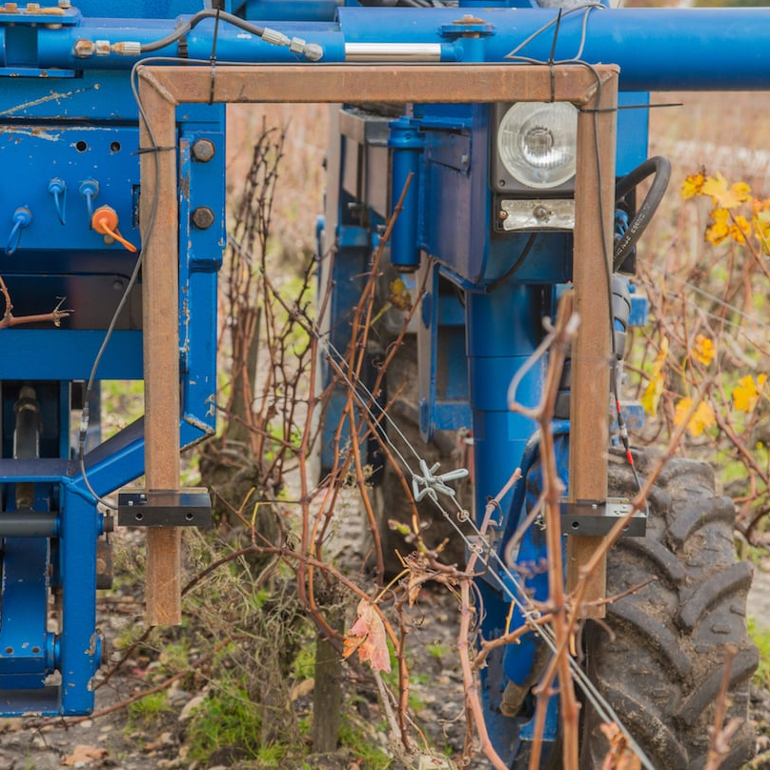
Tools: Physiocap
Developed by Interprofessional Committee for Champagne Wine (CIVC)
Laser micrometer measures shoot diameters
Shoots are counted and geolocated
System measures vehicle speed & GPS quality
Physiocap mounted to a tractor. ©2021 Fruition Sciences, Inc.
Reproduced here for educational purposes only.

Slide 11
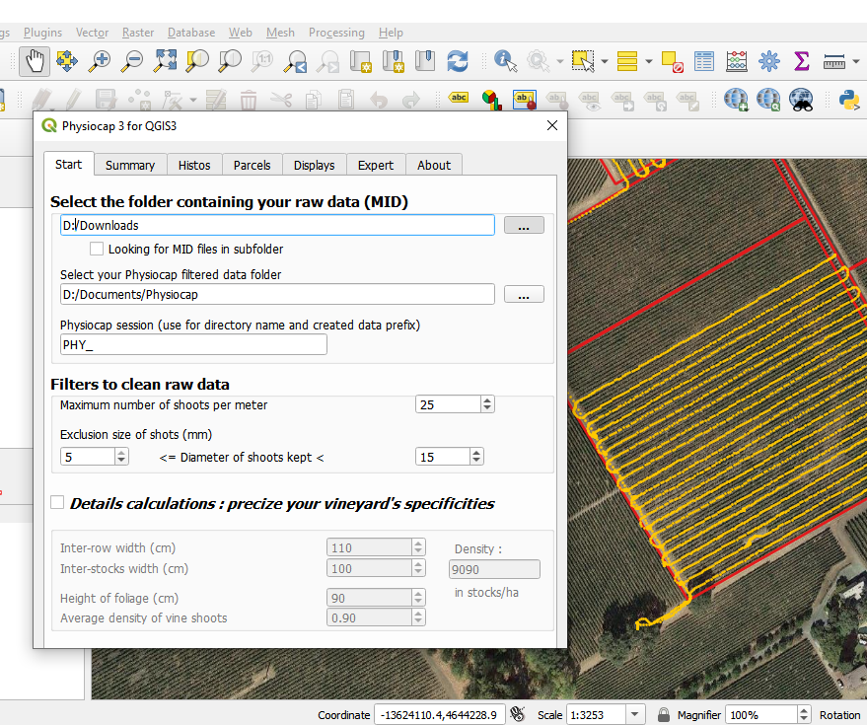
Tools: QGIS
QGIS used for all data manipulation
Physiocap plugin for QGIS is used to process raw data points into interpolated raster images
Rasters are compiled and analyzed in QGIS desktop
The open-source QGIS plugin for Physiocap processing. 2021 QGIS.
Reproduced here for educational purposes only.

Slide 12
Available Datasets
Physiocap measurements
Annual average of 450 acres of data collected in Northern California
Data collected from 2016 – 2021
Vineyard block information
Geodatabase owned by Fruition Sciences, Inc
Block boundaries and information for all scanned blocks
Grape variety & rootstock
Vine spacing
Additional sources
Napa County orthoimages
Public weather station data

Slide 13
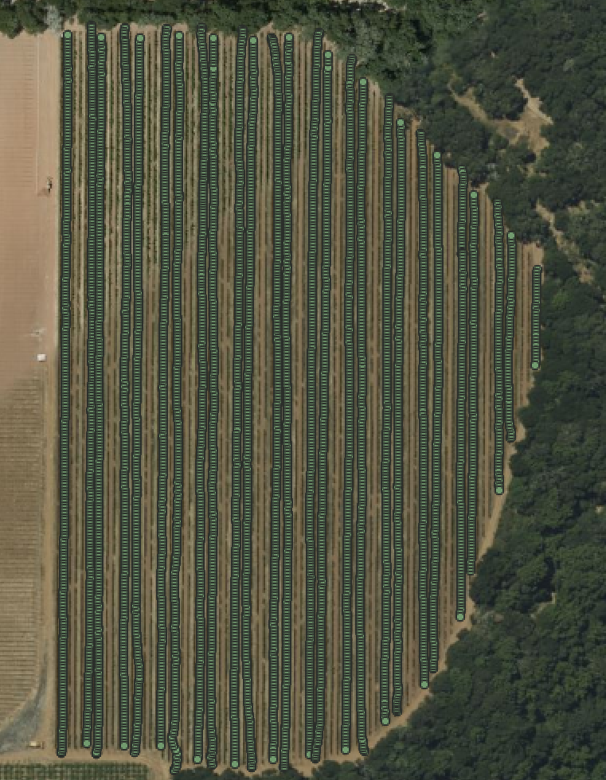
Methods: Raw Data
Download raw .MIF and .MID data into desktop file structure
Combine with block geodatabase
Use QGIS to assess raw data and determine data coverage
Perform basic analysis of data
Count points in polygon
Calculate fields
Block acreage
Points per acre
Mean diameter
Raw Physiocap point data. ©2021 Fruition Sciences, Inc. Reproduced here for educational purposes only.

Slide 14
Processing Raw Data
Physiocap plugin allows for filtering in multiple capacities
min/max shoot diameter
max shoots per meter
poor GPS quality
outside polygon (block) boundaries
IDW interpolation used in processing
Interpolated rasters are clipped to polygon (block) boundaries
Biomass calculations
Shoots per linear meter (# shoots per point/vehicle speed)
Shoots per vine calculated using vine spacing
Biomass calculated from diameter and shoot count
mm² of wood biomass per m² of vineyard area

Slide 15
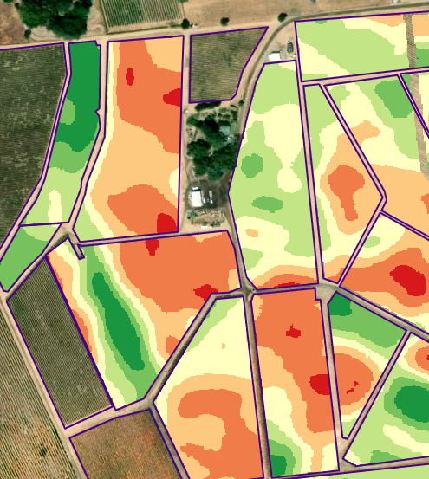
Interpolated Raster Analysis
Statistical analysis of wood index raster layers
Spatial variance of each block/year
Temporal variance of block-level means values
Temporal stability of spatial variation
An interpolated Physiocap Wood Index (biomass) raster layer. ©2021 Fruition Sciences, Inc. Reproduced here for educational purposes only.

Slide 16
Interpret results in block-specific context
Measurements of spatial variance, temporal variance of block means, and temporal stability of spatial variation will be joined with the initial block geodatabase using QGIS
Attribute table of block geodatabase will be exported to Microsoft Excel or another spreadsheet software
Basic statistical functions to assess relationship between block parameters and measured variance
Analytic methods will vary depending on the block parameter being interpreted

Slide 17
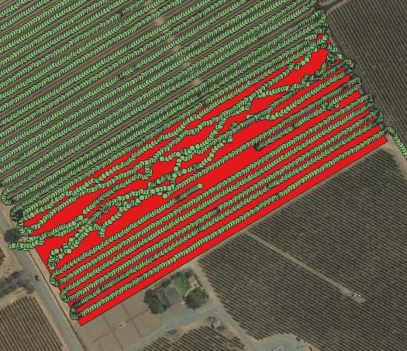
Limitations and Challenges
Grower manipulation of crops
Major outliers will be discussed with vineyard managers or removed from the final dataset
Measurement error
Data filtered during processing
Sparsely collected datasets
Blocks with limited data will be excluded
Raw Physiocap point data with GPS errors. ©2021 Fruition Sciences, Inc. Reproduced here for educational purposes only.

Slide 18
Anticipated Results
Biomass values will show large spatial variation within blocks
Block averages of biomass will show large variations between years
Spatial patterns will generally be preserved, with high & low biomass areas remaining constant over time
These values listed above, at a block level, will vary strongly depending on grape variety or terroir of each block
Some varieties may show higher spatial variation than others
Vineyards with a particular soil type may show more stability over time

Slide 19
Questions?

