Slide 1
Review of the City of South Bend Fire Service.
By: Cory M. Gehring
December 8, 2022

Slide 2
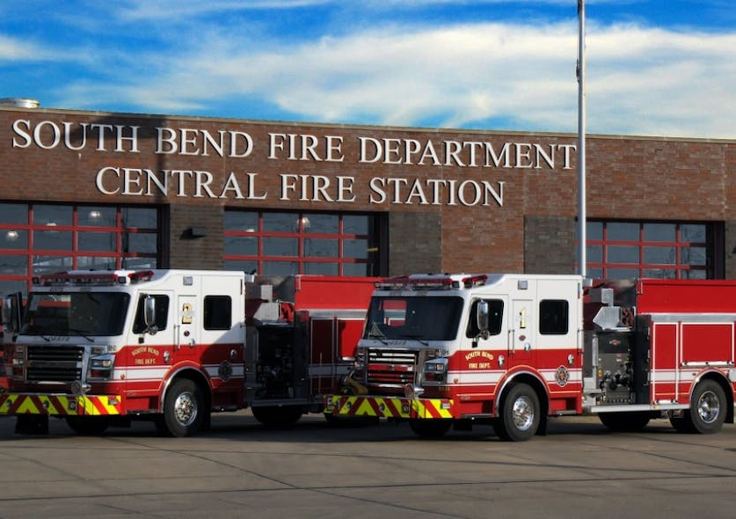
Introduction
Conduct a geospatial analysis of the city’s fire assets to allow the fire service to see if those assets are being utilized to their best potential.
The intention of the study is to highlight strengths or identify deficiencies.
Notes:
Adequate fire service and emergency response are a crucial part of city infrastructure. The fire assets of a city such as South Bend IN should be able to respond in a timely manner and with the proper assets to handle most emergency situations. To evaluate the fire service an assessment of the city’s current assets is worthwhile. A cursory investigation into the existing assets available for the city’s fire service revealed an approximate 20-year gap since the last time a review was conducted. This made it clear there was a need for an updated review to help the South Bend Fire Department (SBFD) visualize their current assets and determine if there was a need for change. This study will conduct a geospatial analysis of the current assets and call data to create a visual display of the fire services to see if they are meeting the needs of the population. The methodology will be a mix of qualitative and quantitative information displayed using choropleth, heat, and hot spot maps. It is presumed that the city is utilizing their fire service assets to their best ability, but that some of those may be overburdened, thus indicating the need for a new fire station or more assets.

Slide 3
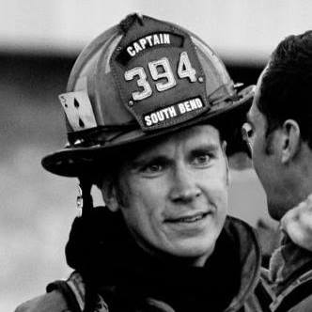
Background
It has been 20 years…
When you call 911…
Location technology via 911 & E911
Clusters of calls.
Visualize assets.
Photo courtesy Capt. David Schackow
Notes:
When you call 911, you are not cognitively thinking about how long it will take …
E911 or Enhanced 911 service, uses technology to geolocate your cell phone or device when you activate the 911 call…
clusters in fire districts can be helpful in determining what stations respond …
benefit of seeing this data in map form can identify areas that may be underserved.

Slide 4
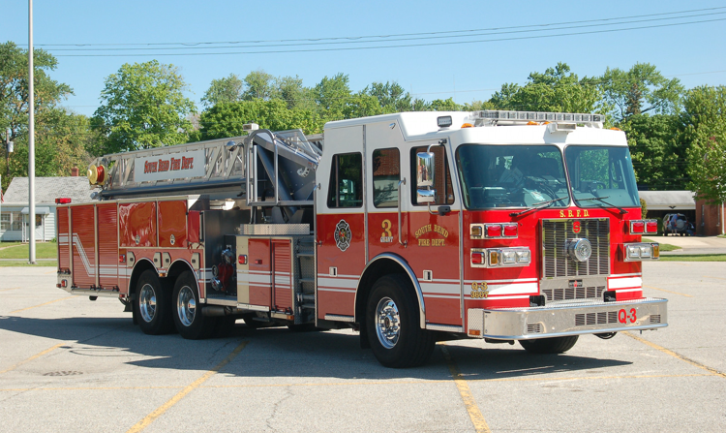
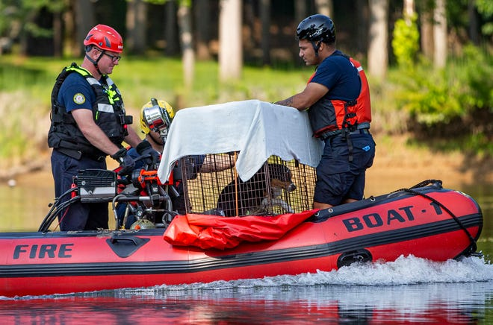
Background
What are fire assets?
Trucks - turntable ladder trucks (4)
Engines - pumper trucks (11)
Rescue - heavy rescue vehicle (1)
Boats (2)
Stations (11)
Need a 12th ?
Photo courtesy of Herb Fire Equipment
Photo courtesy of South Bend Tribune
Notes:
Fire assets for the purpose of this study are fire stations and vehicles. There are nine types of vehicles: conventional fire trucks, pumper trucks (SBFD call “engines”), turntable ladder trucks (SBFD call “trucks”), heavy rescue vehicles (SBFD call “rescue”), tiller trucks (have actuating pivot point), wildland fire engines, quints (firetrucks that carry out five functions of firefighting), A-wagons (hazardous material apparatus), and water tenders (water supply truck) (LemonBin, 2021). Since South Bend also has a major river running through it, boats are included on the list of assets in each fire house

Slide 5
Background
Things to consider:
Relocate assets
Build a new station
Are there significant overlaps
Notes:
The city may not move assets. This is just a suggestion. I assume the city fire dept know how to disperse their assets.
For example, is there a ladder truck stationed in an area that doesn’t have tall buildings? Using a 3D model of the city and showing the location of taller structures may assist in the deployment of this asset.
Urban Sprawl on the west side.

Slide 6
Goals & Objectives
Goal- Geospatial review of the SBFD assets.
Objective 1- Evaluate data as Parrot & Stutz suggest in their Urban GIS Planning article.
Objective 2- Display the City of South Bend National Fire Incident Reporting System (NFIRS) data as a heat, or as a hot spot map per Bennett, D'Acosta, & Vale, lecture.
Objective 3- Present the data in map form to the SBFD.
Notes:
Obj 1- Urban Planning study from 1991. Location of San Diego fire house.
Obj 2- NFIRS database is one of the primary resources for data relevant to fire statistics in the United States (Qualitative)
Obj 3- Multiple maps displaying each district.

Slide 7
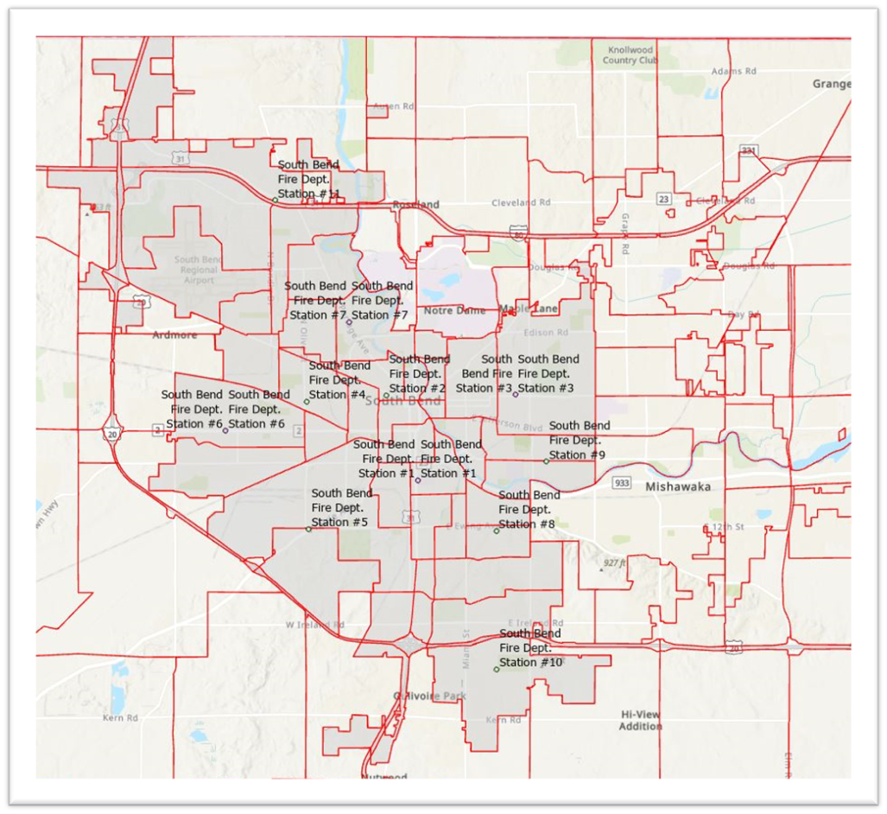
Proposed Methodology
Qualitative information per the National Fire Protection Association Standard 1710 (NFPA, n.d.).
Alarm handling (Day/Night)
Time/location of calls
FireCARES data.
City of South Bend, IN divided into the current fire districts.
Map layers provided by City of South Bend GIS Dept. (City of South Bend, 2022).
Notes:
It depicts: alarm handling (day/night), turnout time (day/night), and a combination of the two which is called mobilization time (day/night). Alarm handling is defined as the response time to a fire/EMS incident. Turnout time is defined as the time the station receives the alarm call to signaling “en route”. These two times are independent of each other, which is why there is a need for mobilization time that combines the two. (NFPA, n.d.).

Slide 8
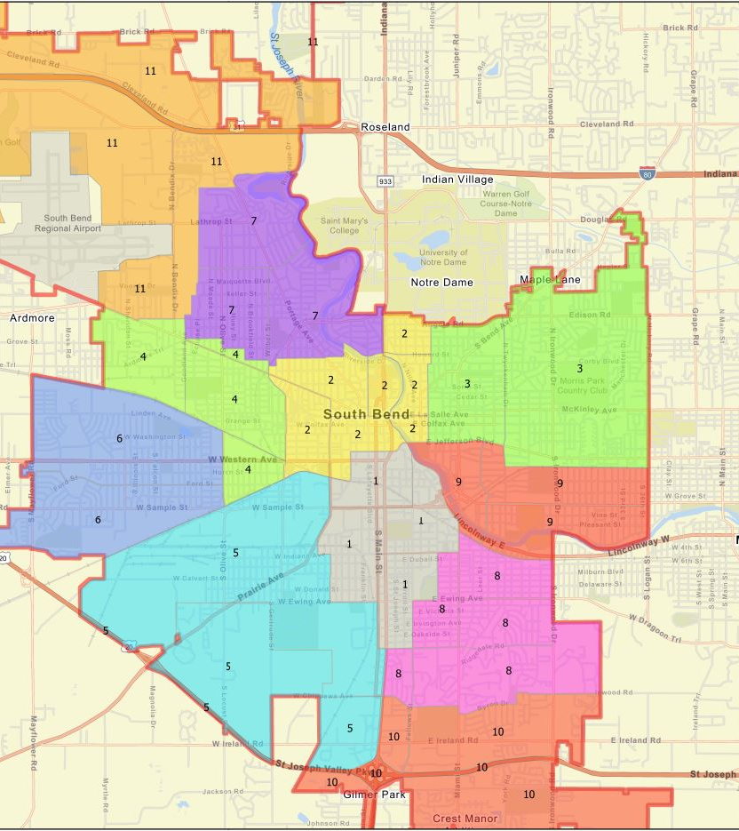
Proposed Methodology
Display call volume and response per station.
Help visualize gaps in coverage
City of South Bend, IN divided into the current fire districts.
Created by Cory M. Gehring, 2022).

Slide 9
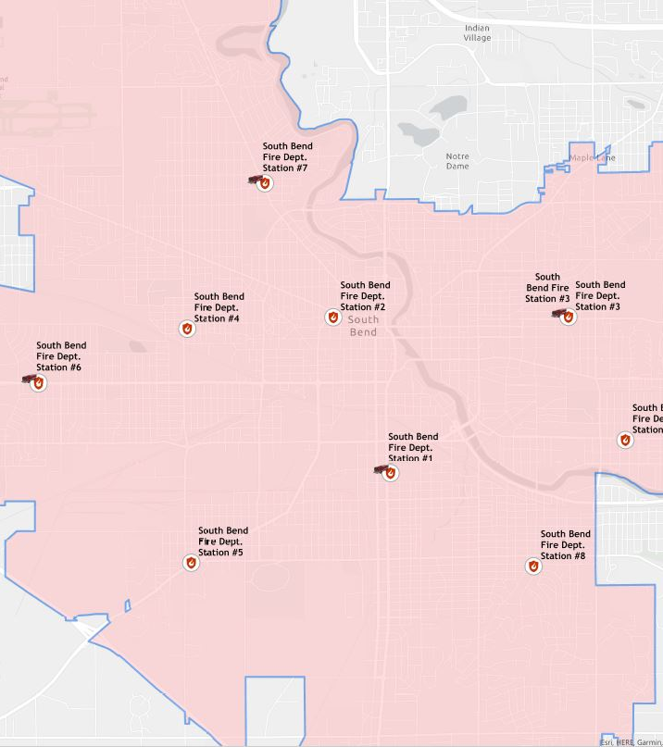
Proposed Methodology
Overlay on fire districts of the city.
Location of current stations.
Is there an identifiable gap?

Slide 10
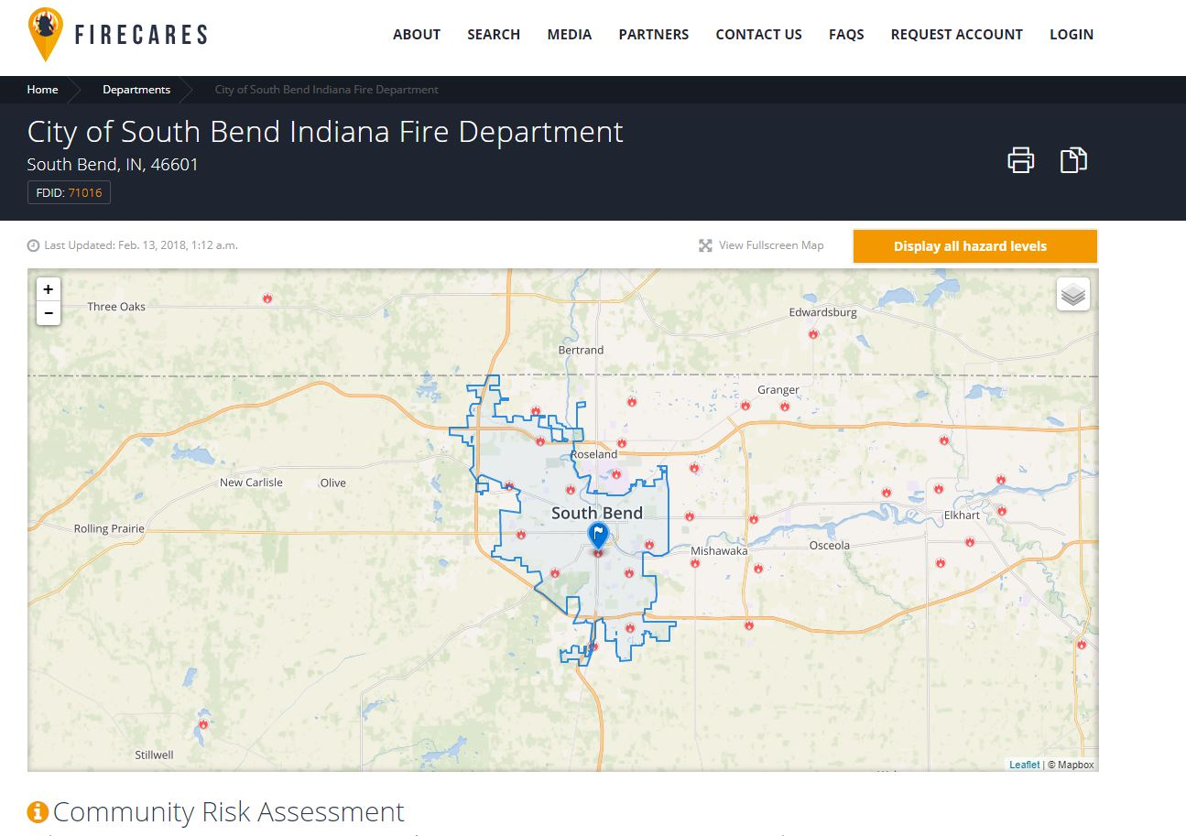
Proposed Methodology
Compare findings to the FireCARES tool.
Am I close?

Slide 11
Project Timeline
GEOG 596B
February 2023- Spring 2 Semester begins
January 2023- Begin project
February 2023- Sort Data and create maps.
March 2023- Build Presentation
April 2023- 596B concludes

Slide 12
Possible Presentation Venue
The ESRI Conference (SE) is in April, about the last week I have classes in the spring semester. It may be an option though as it is in Atlanta and not too far for me to drive in a day. (April 18-19th, 2023).
*No abstract due date published- I signed up to get an email when the schedule comes out.
The International Symposium on Web & Wireless Geographical Information Systems (W2GIS) is in June in Quebec, Canada. Since the project could be used in a web/mobile app, this could be relevant. (June 12-13, 2023).
* Submission Deadline: January 15th, 2023
Notes:
Ask a question?

Slide 13
Presentation Value
City of South Bend City Planner.
SBFD Leadership.
Other municipalities.
Notes:
What is the value of this study for the City of South Bend?

Slide 14
Anticipated Results
The anticipated results of the data will illustrate the location of the current fire services assets as well as show any gaps or overlaps in coverage that can be addressed in the future. Using a heat map will make it easier to see where assets are overworked or underutilized. The data will show a need for a new firehouse on the city’s northwest side and show suggested locations for it.

Slide 15
References
Anderson, A., & Ezekoye, O. (2018, January). Exploration of NFIRS Protected Populations Using Geocoded Fire Incidents. I-PSDI.org. Retrieved November 6, 2022, from https://i-psdi.org/assets/research/exploration-of-nfirs-protected-populations-using-geocoded-fire-incidents.pdf
Bennett, L., D'Acosta, J., & Vale, F. (2017). Spatial Data Mining I: Essentials of Cluster Analysis. Esri UC 2017 Tech Sessions. Retrieved November 21, 2022, from https://www.youtube.com/watch?v=qQNOlfOYtyw.
City of South Bend. (2022). Addresses, Centerlines, Structures, CityLimits, Parcels. [GIS Layers] SouthBend.maps.arcgis.com. https://southbend.maps.arcgis.com/home/item.html?id=0463540d3d884cd7b6e89ecae9bd68f2
De Sanctis, G., Ridder, A., Barth, U., & Fontana, M. (2015). A systematical Bayesian approach for outcome-oriented fire service data collection. Fire Safety Journal, 78, 219-228. https://10.1016/j.firesaf.2015.09.002
FireCARES (2018, February 13). City of South Bend Indiana Fire Department. FIRECARES.org https://firecares.nfors.org/departments/77889/city-of-south-bend-indiana-fire-department

Slide 16
References
Glinka, M., Dudziński, Ł, & Glinka, P. (2022). Geoprocessing as a contemporary tool for analyzing the data pertinent to medical interventions in the State Fire Service (SFS) – a 12-year retrospective study. Critical Care Innovations, 5(3), 1-13. https://10.32114/CCI.2022.5.3.1.13
Indiana Department of Homeland Security. (2022). EMS Data. IN.gov. https://www.in.gov/dhs/ems/ems-data/
LemonBin. (2021, November 23). 9 Different Types of Fire Trucks. LemonBin Vehicle Guides. Retrieved November 21, 2022, from https://lemonbin.com/types-of-fire-trucks/
Moore-Merrell, L. (2019, July 17). Understanding and Measuring Fire Department Response Times. Lexipol.com. https://www.lexipol.com/resources/blog/understanding-and-measuring-fire-department-response-times/
National Fire Protection Association (n.d.). Quantitative Evaluation of Fire and EMS Mobilization Times. https://www.nfpa.org/Assets/files/AboutTheCodes/1720/FAD-AAA_PreFDagenda_10-11_Part3.pdf
Parrot, R., & Stutz, F. P. (1991). Urban GIS applications. Google Scholar. http://lidecc.cs.uns.edu.ar/~nbb/ccm/downloads/Literatura/URBAN%20GIS%20APPLICATIONS.pdf
Public Safety and Homeland Security. (2022, November 1). 911 and E911 Services. Federal Communications Commission. Retrieved November 21, 2022, from https://www.fcc.gov/general/9-1-1-and-e9-1-1-services

Slide 17
QUESTIONS?

