Slide 1
Creating a Master Plan for Water Providers
A Case Study on Applying GIS Analysis for Growth Planning at Del-Co Water Company
Presenter: Andrew Gerberry
Adviser: Dr. Ida Djenontin
March 15, 2023

Slide 2
Outline
Project Background
Research Questions
Proposed Methodology
Expected Outputs
Proposed Project Timeline
Presentation Venue

Slide 3
Background
Access to water and sanitation are human rights – United Nations, 2010
  Physical presence is not the same as access
Water utilities face rising challenges to providing clean, reliable drinking water
  Population Growth and Demand
  Aging Infrastructure
  Source Water
  Climate Change
Notes:
Physical presence is not the same as access. A water or sanitation service does not serve the whole community if it is too expensive, unreliable, unhygienic, unsafely located, unadapted for less able groups or children, or non gender-segregated, in the case of toilets and washing facilities.
Water providers have always faced challenges to providing clean and reliable drinking water, from sourcing high quality and abundant source water, to delivering treated water through distribution networks. However, many regions today are facing increasing water scarcity challenges, exacerbated by the effects of climate change (Gosling et al, 2016). This is especially true for the rapidly growing urban populations throughout the world. Every year sees an additional 67 million new urban dwellers, especially in developing countries (Rosenzweig et al, 2018). By 2050, global water demand is expected to increase by 55 percent, while stream flow is predicted to decline by 10 percent due to climate change (Rosenzweig et al, 2018). While different regions will experience different impacts of climate change, overall, greater populations will be exposed to water scarcity than will become more water secure due to climate change (Gosling et al, 2016).
These climate-related issues only worsen the existing issues that water providers face, including population growth and demand, aging infrastructure, and source water management, among many others. With greater demand and lower quantities of source water, some utilities may need to increase their focus on improving system efficiency, water conservation, and/or creating dual reticulated water supply systems for recycled gray water.

Slide 4
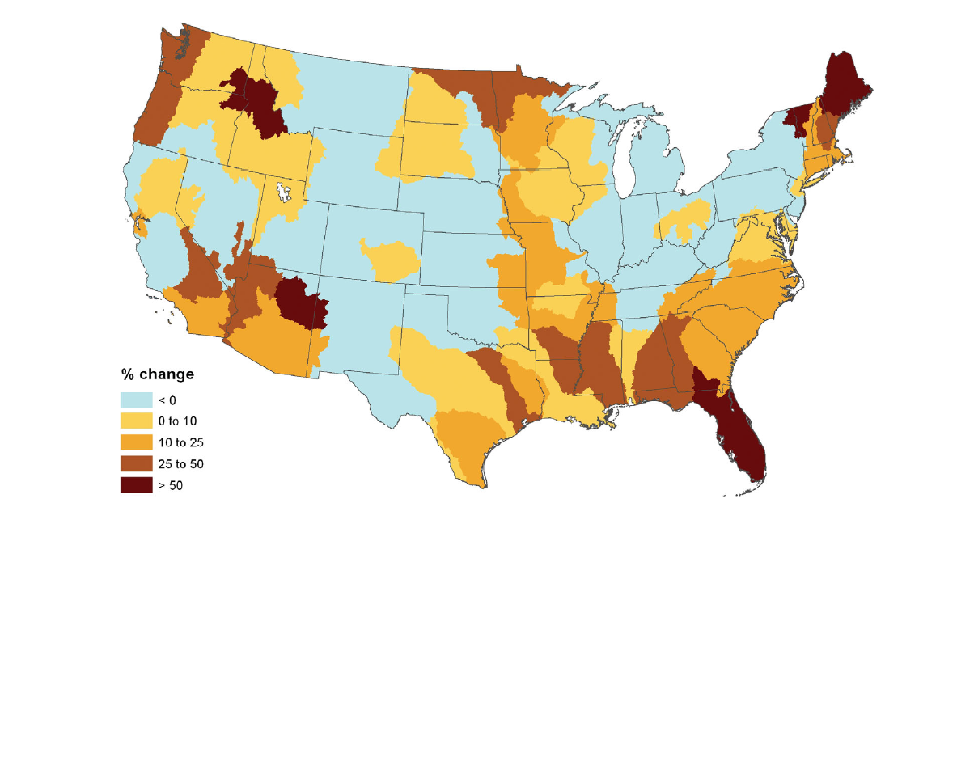
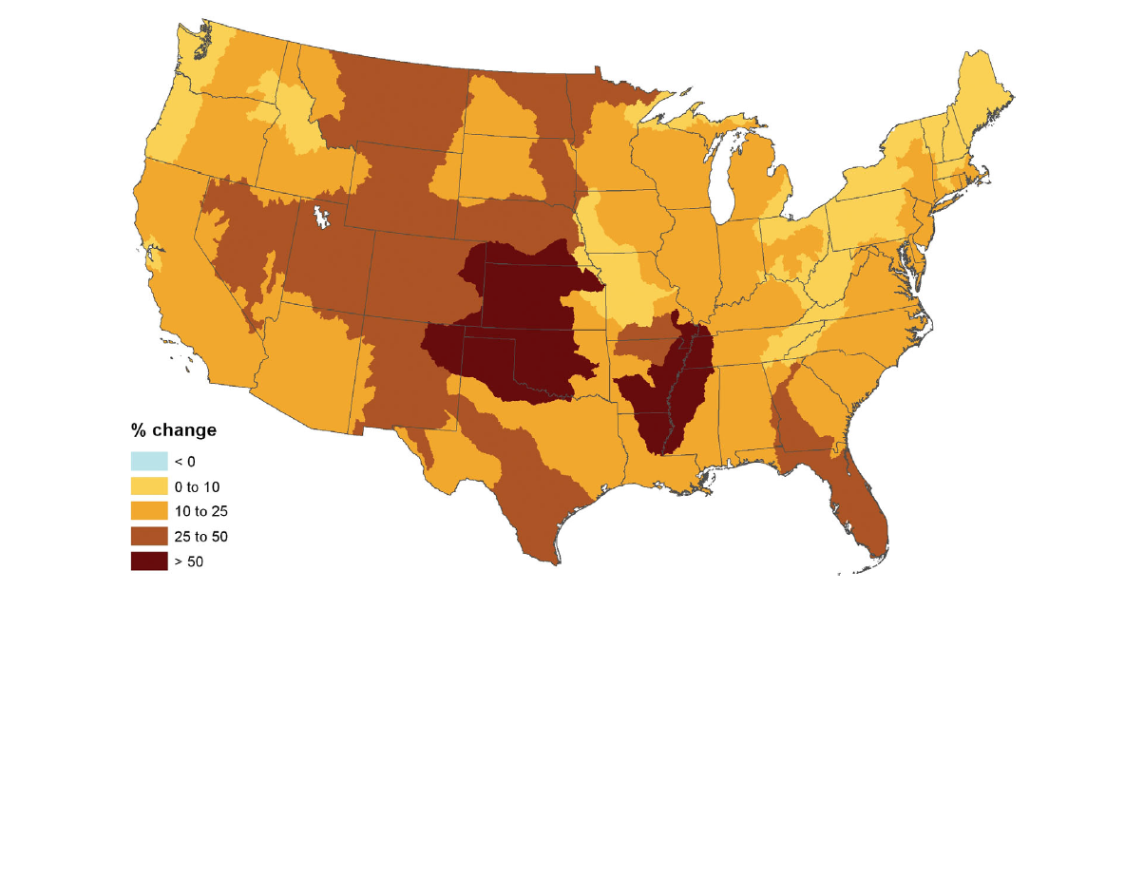
Water Withdrawal Rate Increases:
2005-2060
Without Future Climate Change
With Future Climate Change
Source: Brown et al, (2012)
Notes:
This is true in the United States as well. The map on the left shows the projected regional increases in water withdrawal due solely to population growth and economic development and no effects of climate change.
The map on the right factors in several climate models to show the effect that climate change will have on water withdrawal rates. Some regions end up seeing a smaller increase in water withdrawal rates due to climate change, such as Florida and Maine. However, overall, the United States is expected to see much higher rates of water withdrawal due to climate change, especially in the west and the Great Plains.

Slide 5
Background
What is a master plan?
Implementing a master plan to address challenges
  Specific to each water provider and region
  Scenario planning
  Iterative process
Notes:
Planning for these challenges is a challenge within itself. Many water providers have developed master plans to address specific challenges in their region. A master plan can be broadly described as a dynamic long-term planning document that provides a conceptual layout to guide future growth and development. Since each region is unique and variables are constantly changing, each master plan and what it should encompass is location specific.
Scenario planning – disaster response and recovery, leaks, contaminants, drought, etc.
It’s important to emphasize that a master plan will not be a one-time build, rather, it is an iterative process. Water providers will need to revisit and revise their master plans regularly to adapt for changing variables and new information.

Slide 6
Background
Challenges to Building a Master Plan
Range of available resources
Data Quality
  Geographic Information System (GIS) Data
  Computerized Maintenance Management System (CMMS) Data
  Hydraulic Modeling
  Water End-Use Data
Applications of Data
  Predictive Analysis
  Digital Twin of Water Distribution Network
Notes:
Range in size of water utility – small towns to large multi-state water providers, such as Aqua
Challenges:
Adequate resources to fund master planning – some utilities struggle to make it through day to day
In-house resources to collect and maintain data
Predictive analysis – staff requirements and/or consulting
Digital Twin – history of Apollo program
Difficulty of building a digital twin

Slide 7
Research Questions
What are the key components to a master plan, and how should they be prioritized?
How can a master plan be an iterative process, and how often should a master plan be revisited?
How can GIS be used to integrate projected population growth and development activities into a master plan and analyze its potential impact on an existing water distribution system?

Slide 8
Proposed Methodology
Conduct interviews with water providers
Extend literature review
Del-Co Water Case Study

Slide 9
External Data
Possible Master Plan Components from Literature Review and Interviews
Population Growth Models
Climate Change Models
Internal Data
GIS Data for Water System
Water Governance
Water Conservation
Water Usage Data
Hydraulic Model/ Digital Twin
Source Water Management
Pipeline Efficiency Improvements
CMMS Data for Water System
Disaster Planning
Water System Expansion

Slide 10
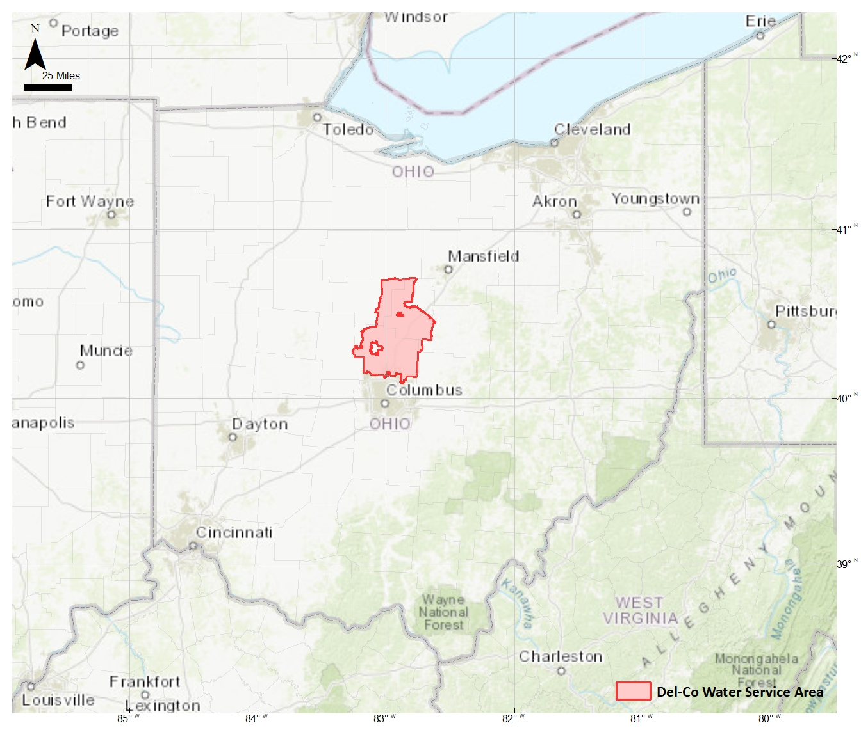
Del-Co Water Company, Inc.
Serves 54,000 connections across 8 counties in Central Ohio
Fast growing region
  2023: 2.2 million people
  2050: 3.15 million people
  Del-Co serves around 200,000 people
Private, non-profit → reactive to growth
Primarily residential, suburban
  Large seasonal variation in water consumption

Slide 11
Effects of Climate Change on Central Ohio
2015 Climate Change Study for Sustaining the Scioto River
  Mid-Ohio Regional Planning Commission (MORPC) with water utility cooperation
Ohio likely to experience:
  Increase in temperatures and heat waves
    Lower volume and quality of surface water
  More extreme weather events
    Damage to infrastructure
    Economic burden
For Del-Co → additional burden from outdoor water use
  Projections for climate change and water conservation variables

Slide 12
Del-Co Case Study Methodology
County Parcel Data > 5 acres
Climate Change Projections
Central Ohio Population Data
Projected Development by 5 Year Increments
Meter Route Projected Demands
Interactive Geocortex Web Map Application
Historical Development Data
Proposed Water Infrastructure Improvements
Del-Co GIS Data – Water Distribution System
Hydraulic Model
Iterative Process
Del-Co Billing System Data

Slide 13
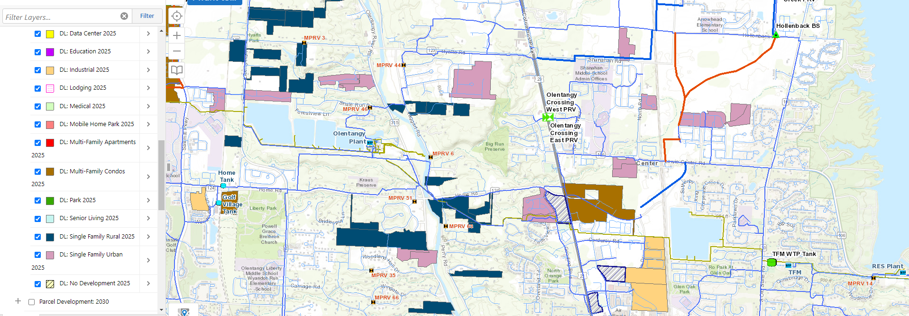
Population Growth Analysis
County parcel data
  Parcels > 5 acres
Development density
  Historical growth patterns
  Township/municipality regulations

Slide 14
Expected Outputs
Capstone Project Report
Interactive Web Map for Del-Co Case Study
WaterPro Conference Presentation

Slide 15
Proposed Project Timeline
Time Range | Action Item
January - March | Initial literature review
March | Project Proposal
April | Interview at least 5 water providers with master plans
 | Compile report of findings
 | Extended literature review
May - June | Import GIS data into WaterGEMS and build hydraulic model
 | Perform analysis on parcel data for projected growth
 | Build Del-Co's master plan model as outlined in Figure 2
 | Create a master plan report for Del-Co Water and Capstone Project
September | Present Capstone Project at 2023 WaterPro Conference
On-Going | Revisit and revise master plan

Slide 16
Possible Presentation Venue
WaterPro Conference – September 25-27, 2023
  National Rural Water Association
    Currently serves over 31,000 utility system members
  Primarily smaller, rural systems with fewer resources

