Slide 1
How might a reduction in transportation costs increase poor people’s effective income?
Michael Giangrande GEOG 596A Capstone Peer Review
Advisor: Dr. Lakshman Yapa 3/26/2012

Slide 2
Geography of Poverty
Traditionally mapped using US Census data
Data collected at place of residence
High correlation between poverty and “usual culprits”
Race
Employment
Family Structure

Slide 3
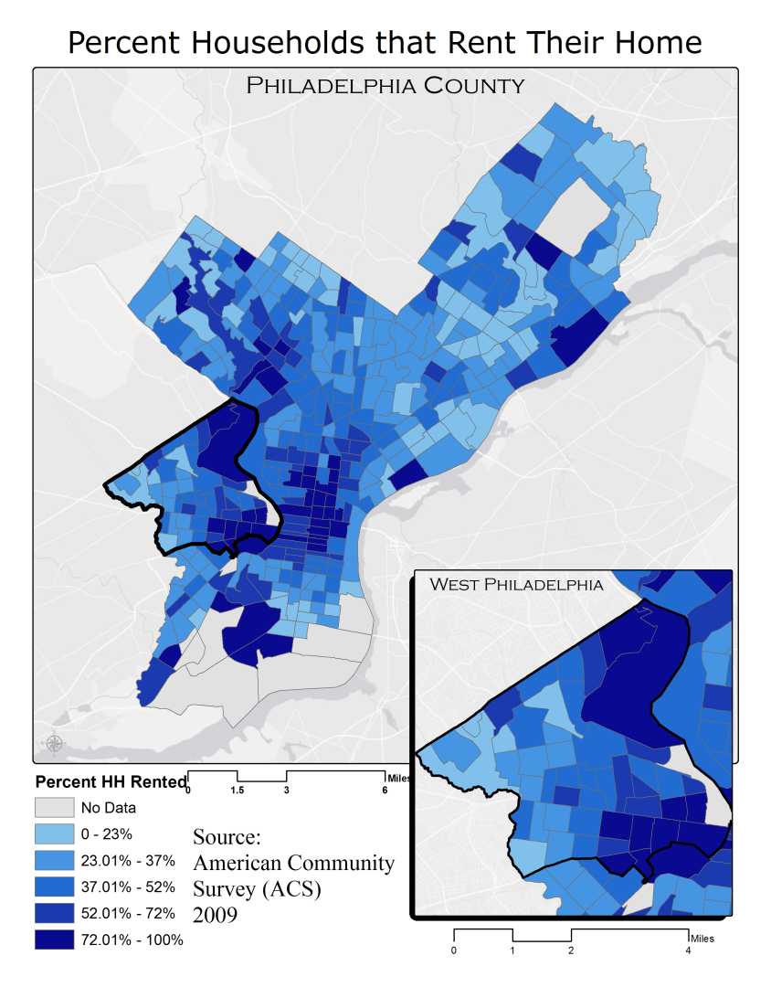
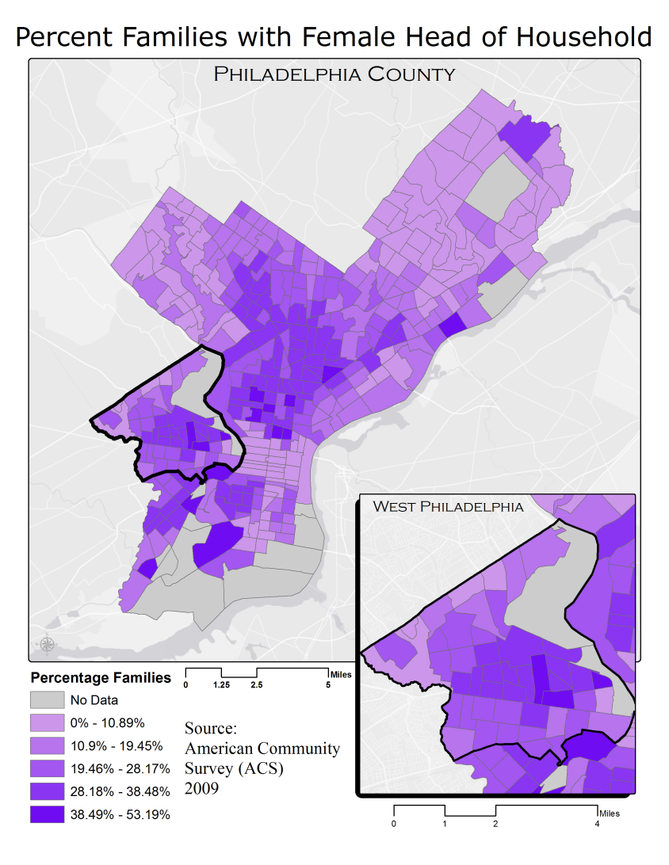

Slide 4
Income Production
4.3 % of Americans work from home (McKenzie & Rapino)
Traditional income “Consumption” vs. alternate income “Production”
Random distribution without correlation to traditional poverty measures

Slide 5
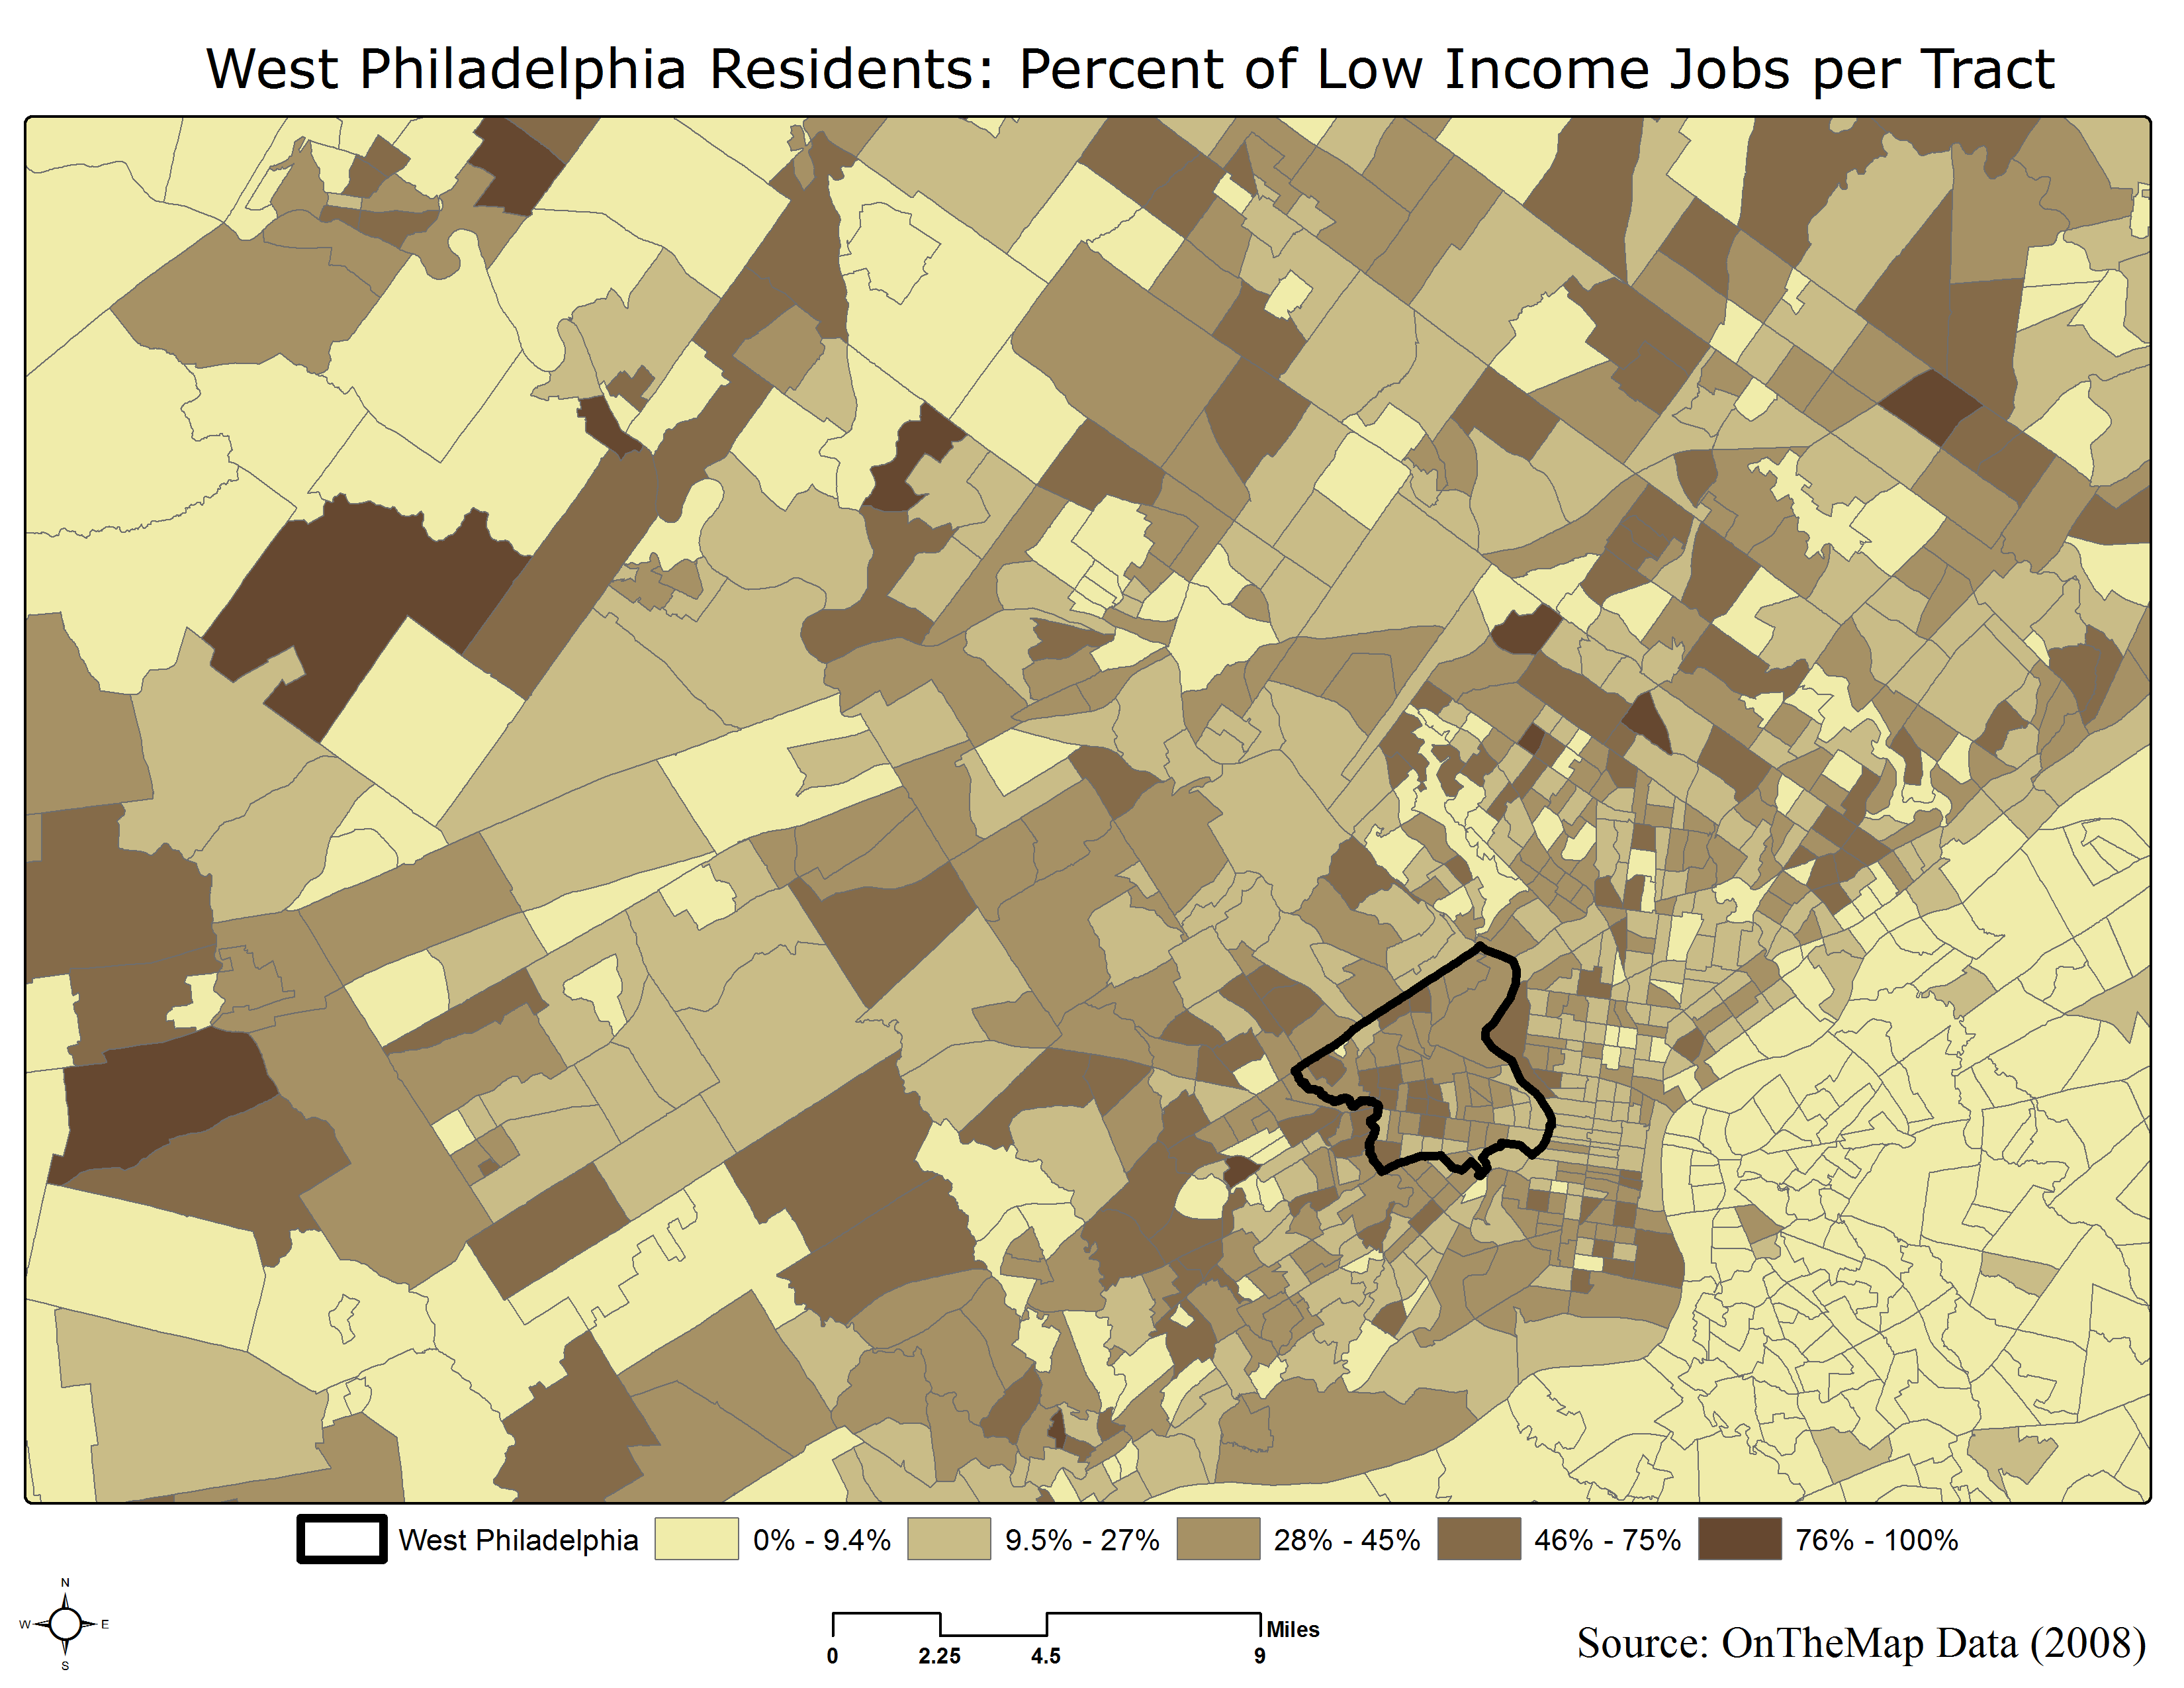

Slide 6
Motivation
Can we reduce the cost of living for poor people?
Transportation cost associated with commuting
Working poor can spend up to 21% of their income commuting (Bureau of Transportation Statistics)
Reduce transport costs = Increase effective income

Slide 7
Process Overview
Origin-destination data for poor commuters from West Philadelphia
Modes of transportation used by poor commuters
Calculate costs by mode for all analysis routes
Cost savings summed over all destinations will give us an estimate of the magnitude of poverty reduction

Slide 8
Goals and Objectives
To examine the standard way in which poverty is defined (i.e. US Census)
Explore the non-traditional, income production poverty mapping
Discuss why transportation to work with respect to poverty can be important
Make an argument the poor’s effective income can be increased by reducing transport cost
Offer information about the cost savings

Slide 9
Methodology

Slide 10
Methodology - Origin

Slide 11
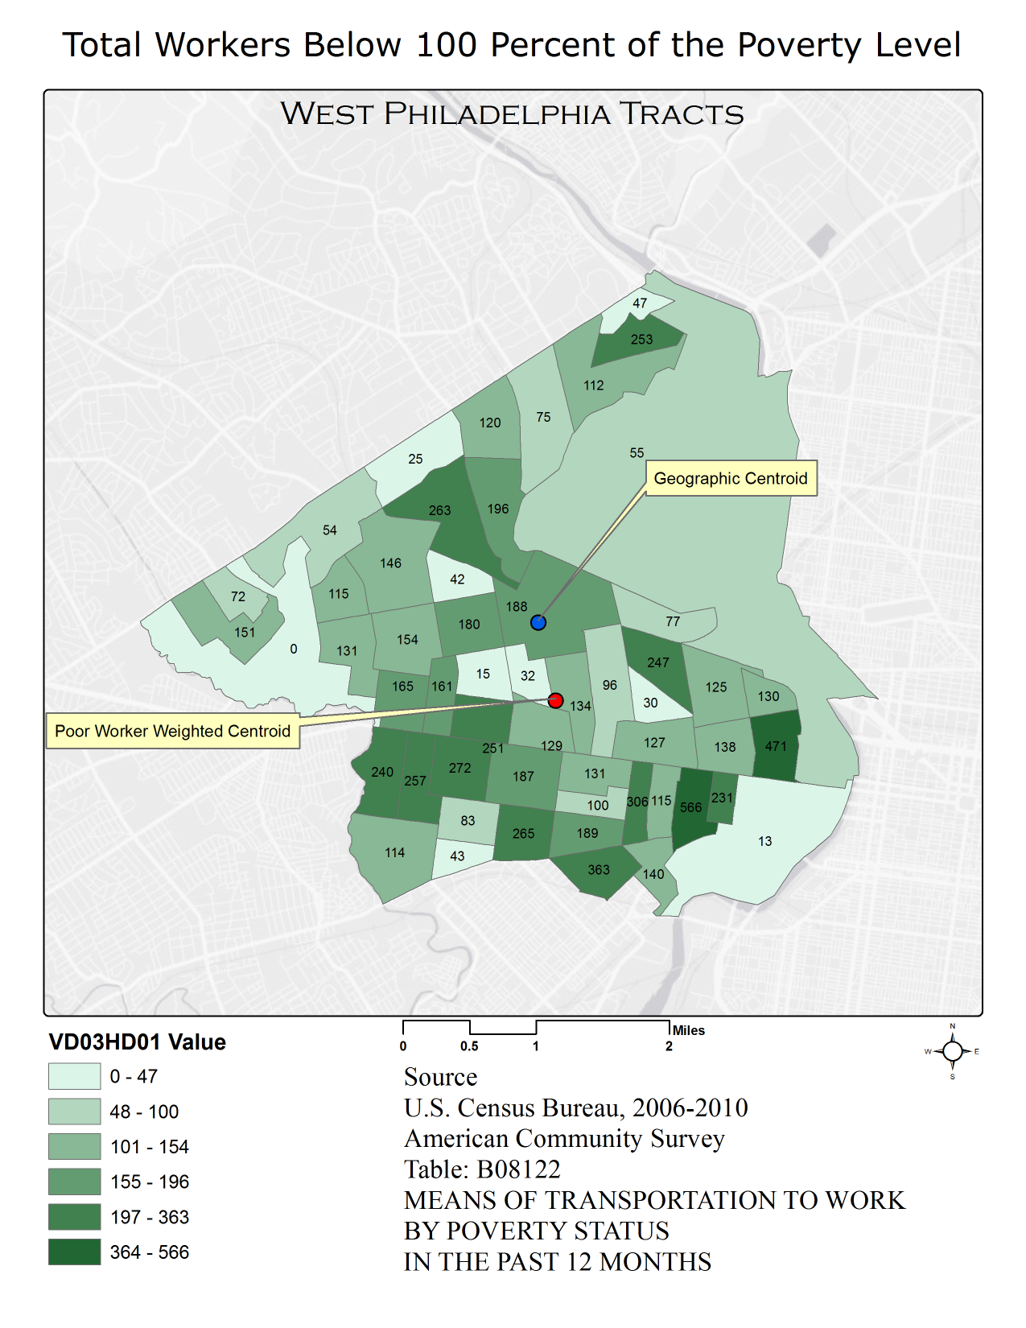

Slide 12
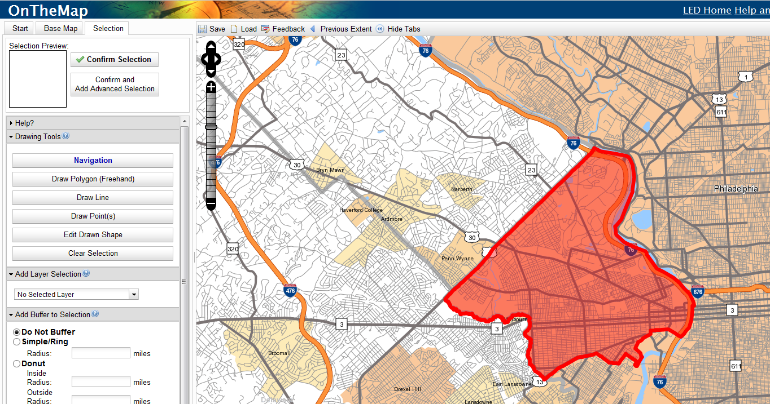
Methodology - Destination

Slide 13
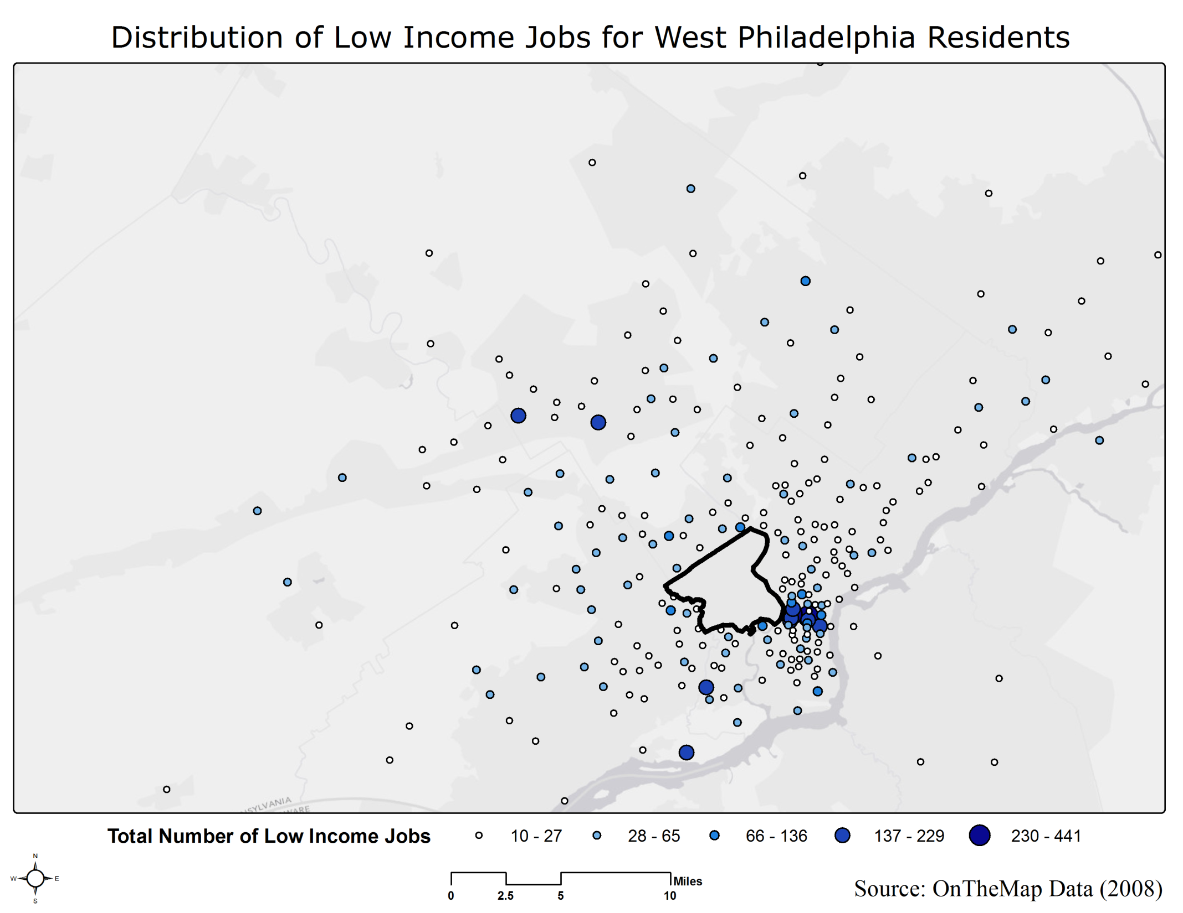

Slide 14
Methodology - Mode
ACS Modal Categories
Automobile alone
Automobile carpooled
Public Transportation
Walked
Other (Taxicab, motorcycle, bicycle, other means)
Worked at home

Slide 15
Methodology - Cost
Automobile Alone
Esri Network Analyst
Network dataset (e.g. NAVTEQ streets)
POV Reimbursement Rates
Automotive Aftermarket Expenditure
Carpooling
RideShareOnline.Com
Public Transportation
Google Transit

Slide 16
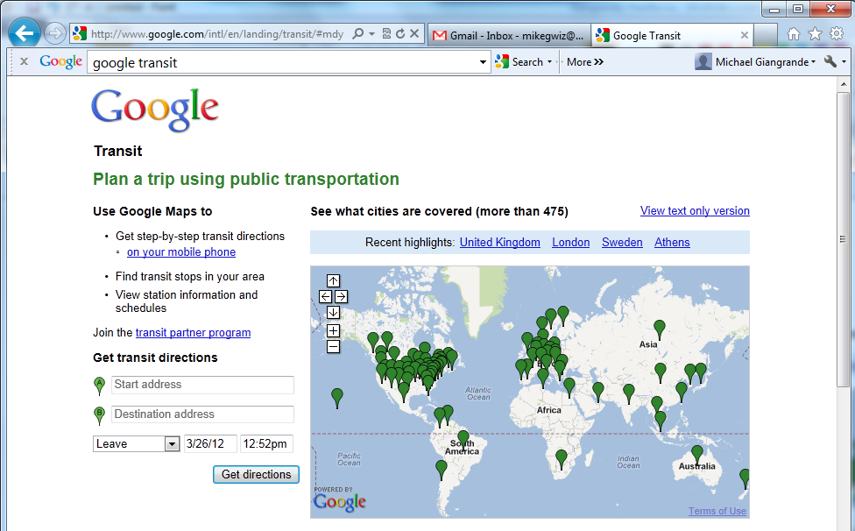
Methodology - Cost

Slide 17
Methodology - Cost
Google Transit URL format:
http://www.google.com/maps?ie=UTF8&f=d&dirflg=r&hl=en&saddr={LATo}%2C+{LONo}&daddr={LATd}%2C+{LONd}&ttype=dep&date={month}%2F{day}%2F{year}&time={hour}%3A {min}{am/pm}
Where: {LATo} = Latitude of the origin in decimal degrees
{LONo} = Longitude of the origin in decimal degrees
{LATd} = Latitude of the destination in decimal degrees
{LONd} = Longitude of the destination in decimal degrees
{month} = numeric month
{day} = numeric day
{year} = 2-digit numeric year
{hour} = numeric hour (EST)
{min} = numeric minute
{am/pm} = ‘AM’ or ‘PM’

Slide 18
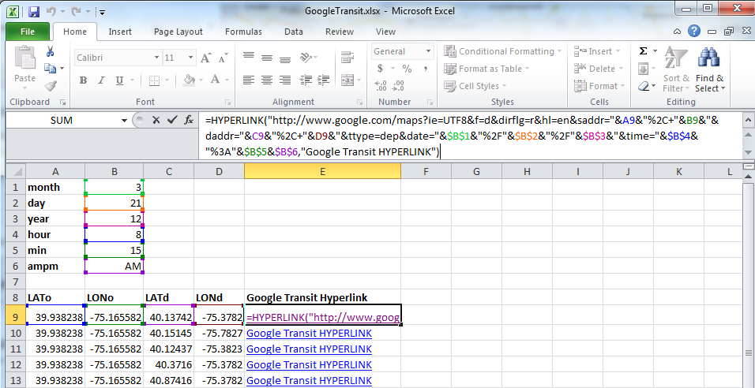
Methodology - Cost

Slide 19
Methodology - Cost
Walked (ZERO cost)
Other
Bicycle (ZERO cost)
Taxi
Motorcycle
Worked from home (ZERO cost)

Slide 20
Anticipated Results
Increase of effective income if a transition is made from driving alone to the other options
Carpooling and public transportation will be less expensive than driving alone
ACS modal category ‘Other’ will cause incomplete results
Time as an ancillary factor in “savings”

Slide 21
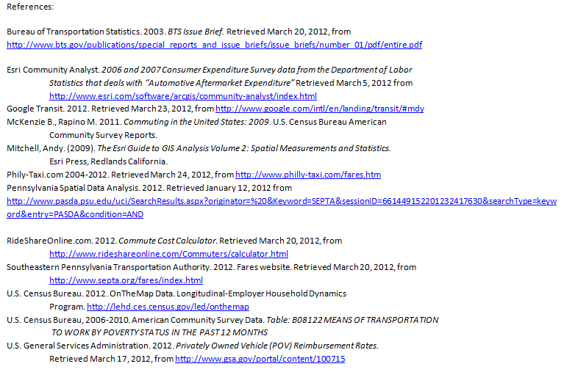
Acknowledgments/References
Dr. Lakshman Yapa and Michael Stryker

Slide 22
Questions?
Contact Information:
Michael Giangrande
mug161@psu.edu
Work Telephone 301.610.5107
Westat
Rockville, MD 20850

