Slide 1
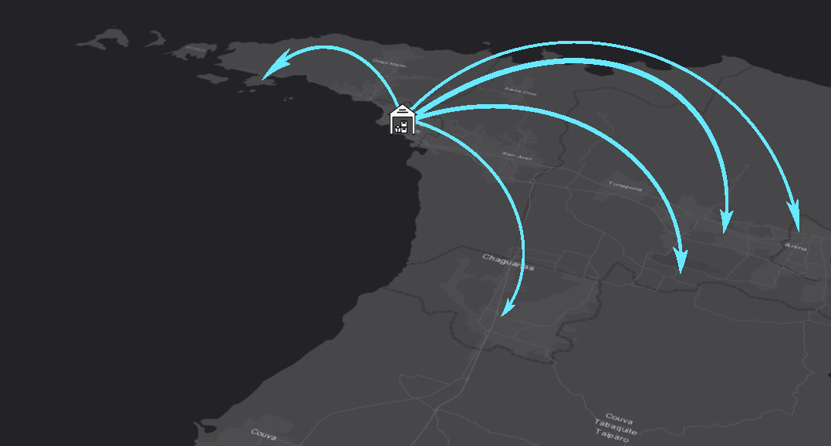
Predicting sales at convenience goods retailers in Trinidad using GIS and regression modelling:
A web application built on
the ArcGIS API for JavaScript
596A presentation| 7 May 2019
Project Proposal
Roman Gibbons
Advisor: Amy L. Griffin (PhD)

Slide 2
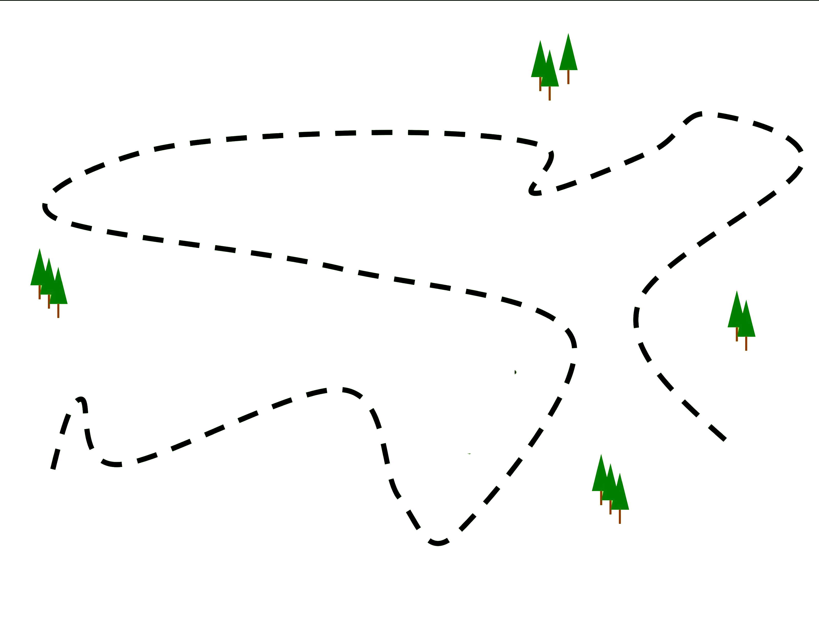
Overview
Background
Timeline
References
Questions
Methods
Problem
Background
Problem Definition
Methods
Selecting a model
Model implementation
Data requirements
Application development
Timeline
References
Questions

Slide 3
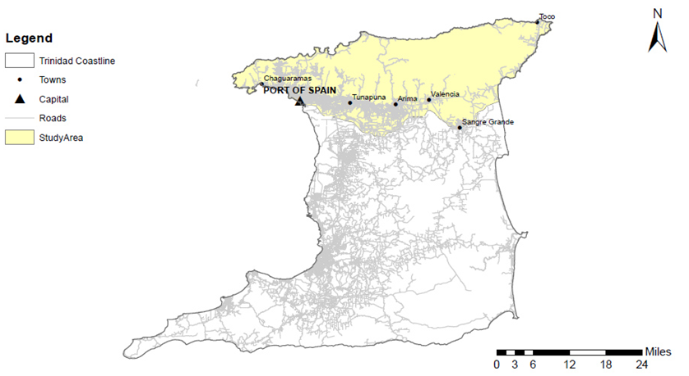
Background
Trinidad
1,864 sq. mi
~13,000 convenience goods retailers (CGRs)
Population 1.4M
1 CGR for every 105 people
58 listed food manufacturers
Study Area
East west corridor
~3000 convenience goods retailers in 192 communities
The island of Trinidad with study area highlighted. Created using ArcGIS Pro.

Slide 4
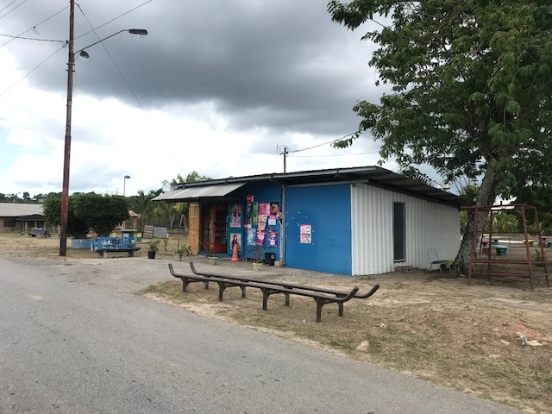
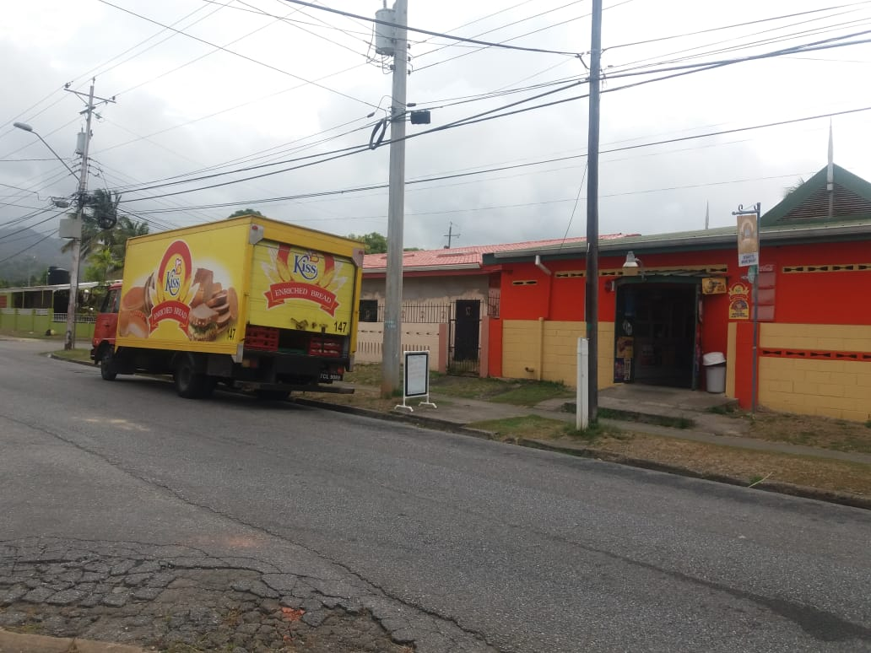
Background
Convenience goods retailers
Pharmacies
Bars
Mini marts
Eateries
The distribution process
Customers
Delivery zones
Prospective CGRs
A mid-sized roadside mini mart
A bread truck delivering to a
mini mart
Photo credits: Kristal Bailey

Slide 5
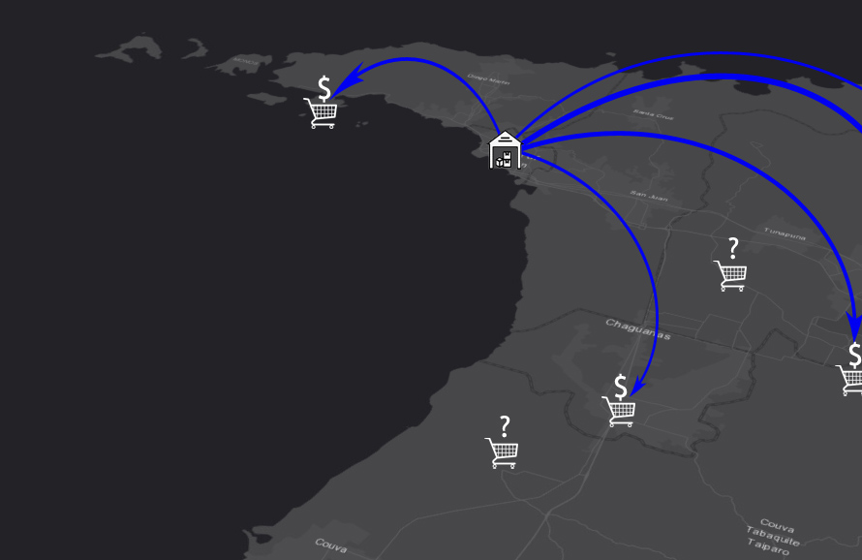
Problem Definition
Reliance on drivers to decide which retailers to target
Suppliers are unable to forecast sales other than using familiarity and managerial skill
Established distributors are interested in market dominance: capture as much of the market as possible
Smaller distributors are interested in growth: target retailers with higher sales potential

Slide 6
Existing solutions are limited
Option 1 : COTS packages that forecast at an existing outlet based on trends in historical data (lacking spatial consideration and nearby potential CGRs)
Option 2 : Site planning consultancy for estimating performance at a new location
based on sales (costly and time consuming)
Proposed solution: To model sales at prospective convenience goods retailers using an appropriate spatial model and incorporate the model in a user friendly software application targeted at users who need to predict sales at prospective retailer locations
Problem Definition

Slide 7
1939:
Gravitational models
1966:
Analogue methods
1968:
Linear regression models
Method – Selecting a Model
Gravitational models
Reilly (1939) : Determining the attractiveness of a city for a shopper. Based on population and distance.
Huff (1964) : Determining the probability of a consumer travelling to a store based on size, distance and other characteristics.
Analogue methods
Applebaum (1966): Creating a checklist of site requirements based on analogue data (performance at existing stores based on characteristics of the trade area).
Linear regression models
Megee (1968): Predicted the effect of employment sectors on economic growth.

Slide 8
1976:
Time series models
1990s:
Machine learning models
1999:
Spatially informed regression models
Method – Selecting a Model
Time series auto regressive models
Box and Jenkins (1976): Proposed an autoregressive moving average model (ARMA) to model a time series
Artificial neural networks (machine learning)
Applied to sales forecasting in the 1990s in combination with ARMA models
Spatially-informed regression models
Brunsdon et al. (1999): Investigated the relationship between population density and landscape characteristics. Foundations of geographically weighted regression.

Slide 9
Method – Selecting a Model
Model/method | Suitability
Gravitational model | Income/purchasing power data not available for converting probability of sales to sales values. Unable to determine customers of existing mini marts and by extension trade areas unknown.
Analogue method | Requires accurate trade area delineation and customer locations.
Linear regression model (OLS) | Provides good insight into relationships within study area. Good option provided that requirements are met.
Time series autoregressive model | Small data timespan available. Time constraints may prevent incorporation with spatially informed model.
Machine learning model | ‘Black box’ model provides little data insights. Lack of transparency of model.
Spatially informed regression model (GWR) | Best option given proven improvement over OLS when spatial dependence exists.

Slide 10
Method – Model Implementation (Overview)
Data
Application
Model
Determine and implement an appropriate statistical model
Regression model implemented as a GP Service
Source and map required data
Feature layers hosted on AGOL
Develop a web application
ArcGIS API for JavaScript
HTML, CSS, JS

Slide 11
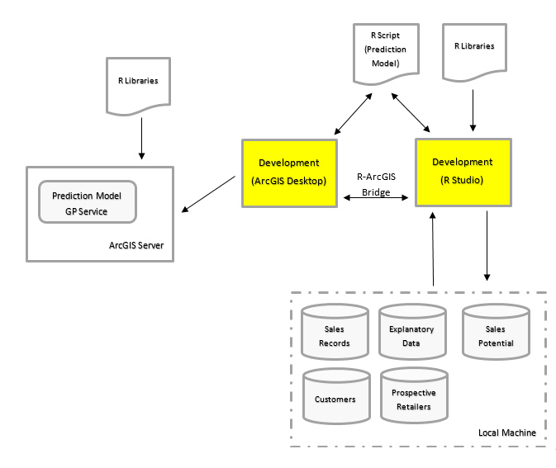
Method – Model Implementation
Development and analysis in R-Studio
Save script to external file
Format code for use as ArcGIS
ModelBuilder Tool
R-ArcGIS Bridge creates link to required
R libraries
Share the model as a GP service
Access using GP methods in web-app
Development of the statistical model

Slide 12
Method – Model Implementation (Variables)
Spatial variables
Number of CGRs within a fixed radius
Site variables
Class of access road
Social variables
Number of buildings/structures within a fixed radius
Proximity to a large CGR
Proximity to a school
Proximity to an arterial road
Proximity to a recreation ground
Proximity to a community center
Proximity to a city center
Class of CGR
Type of CGR
Approximate size/area of facility
% population employed
% households with AC units
% population living in owner occupied housing
% population living in rented/leased housing
% persons with secondary education
% persons with tertiary education
% persons with one or more unmet basic needs
% population attending an education institution
Sales
Dependent Variable
Independent Variables

Slide 13
Method - Data Requirements
Dataset | Description | Source | Usage
 |  |  | Model Training | Sales Prediction | Strategic Planning
Customers | CGRs already supplied by the distributor | Distributor fleet management system
Sales records | Total invoice values | Distributor daily delivery sheets
Rooftop outlines | Digitized using satellite imagery | Google Earth
Points of interest | Schools, community centers, recreation grounds, city centers | Local data vendor
Street centerlines | Paved streets in study area. Includes road class and name. | Local data vendor
Census data | Outlines of communities and associated socio-demographic data | CSO Census 2011
Prospective CGRs | All CGRs within study area | ArcGIS Collector/field mapping
Delivery zones | A delivery/sales area assigned to a particular truck | Distributor channel manager

Slide 14
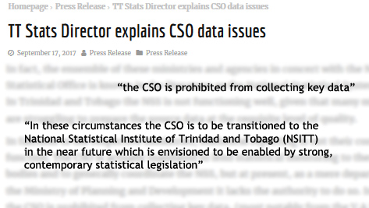
Method - Data Requirements (Challenges)
Unwillingness to share financial information
Distributor sales records
Population income data
No CGR database
No shopper records for CGRs
No addressing information
Dated independent variable data (2011 Census)
No segmentation coverage
Issues with socio demographic data collection in Trinidad (TnT&T, 2017)

Slide 15
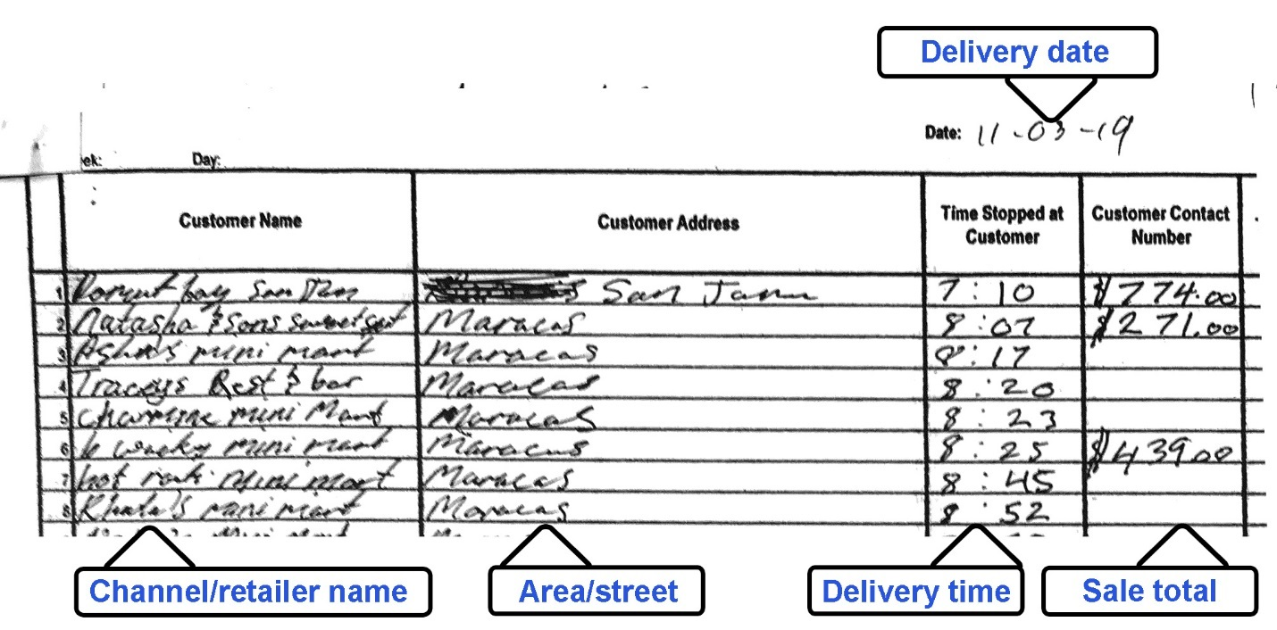
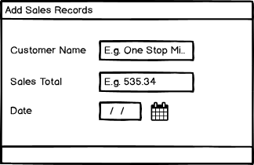
Method - Data Requirements (Sales Records)
Name
Sale total
Date
Sample entry widget
Sample delivery sheet
Notes:
Explain process. Mention need for customers to be added previously and autocomplete customer name field.

Slide 16
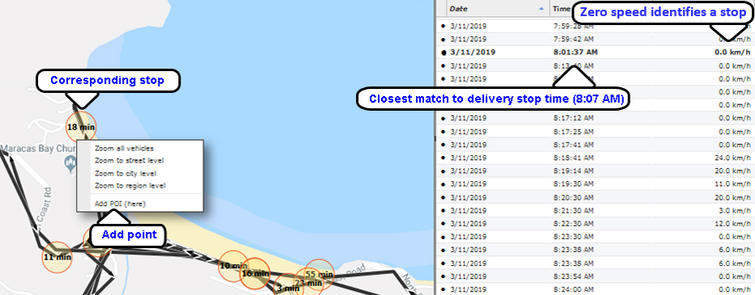
Method - Data Requirements (Customers)
Fleet management application
Delivery sheet

Slide 17
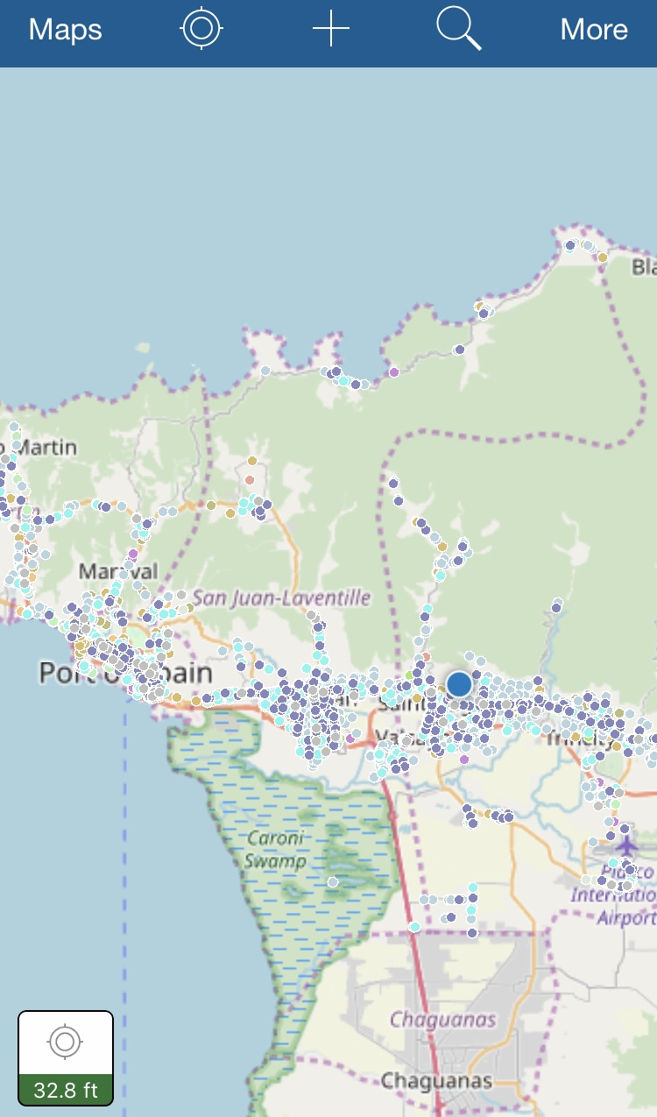
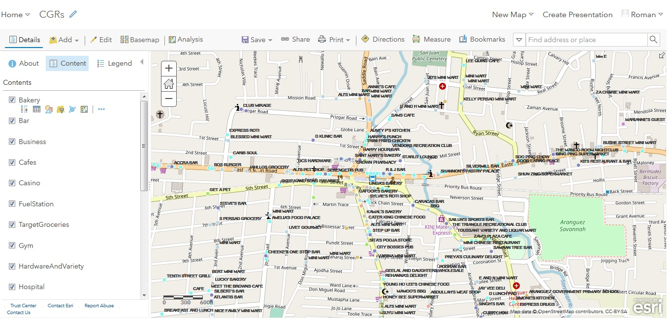
Method - Data Requirements (Prospective CGRs)
ArcGIS Online
ArcGIS Collector

Slide 18
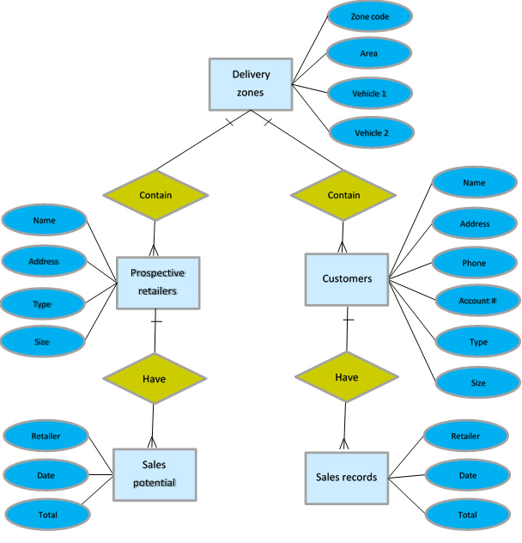
Method - Data Requirements (Database)
Designed in ArcGIS Pro
Hosted on AGOL
Organizational data
Delivery zones
Customers (CGRs already supplied by the distributor)
Sales records (table)
Vendor data
Prospective CGRs
Data model ER Diagram

Slide 19
Method – Application Development (ArcGIS API for JavaScript Overview)
“a powerful library that you can use to build applications that leverage the power of the ArcGIS Platform” (ESRI, 2019)
Imported in the webpage script using the require function
Symbology - render features in customer, delivery zone, prospective CGR layers
Map access and control – pan/zoom Trinidad basemap
Query tasks – query data for required as model inputs
Geoprocessing tasks - pass parameters to the prediction model geoprocessing service
Graphics layers – temporary layer for editing
Feature layers – access organization data layers and other supporting data layers
ESRI Widgets – Search layers
Simple integration with Dojo framework

Slide 20
Method – Application Development (User Interface Overview)
Manager Application
Dashboard Application
Manage organizational data:
delivery zones
customers
sales records
Users
Administrator user
View sales information:
Delivery zone performance
Delivery zone sales potential
Prospective CGR potential sales
Delivery zone monthly sales
Users
Standard User

Slide 21
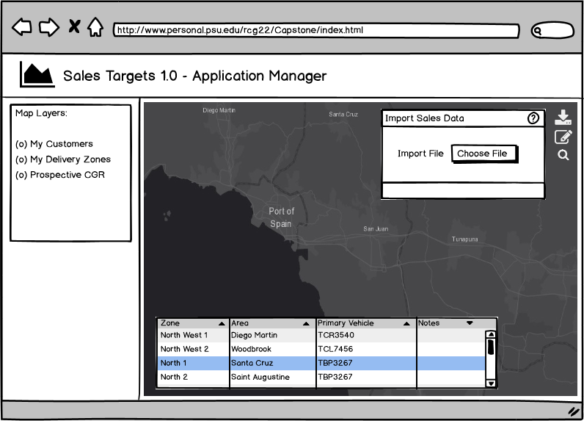
Method – Application Development (Manager)
Left Panel
Map Layers
Widgets
Edit (all layers except prospective CGRs)
Import Sales Data
Search
Popups with transition
Attribute tables
Application manager wireframe mock-up (created using Balsamiq Wireframes, https://balsamiq.cloud/)

Slide 22
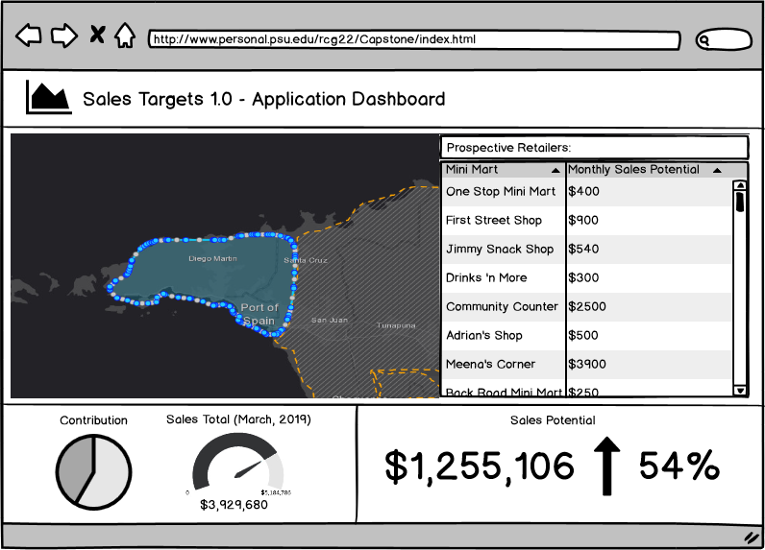
Method – Application Development (Dashboard)
Lower Panel
Contribution chart
Sales total
Sales Potential
Right Panel
Predicted sales
Layout, Datagrid and
gauges using Dojo
framework
Application dashboard wireframe mock-up (created using Balsamiq Wireframes, https://balsamiq.cloud/)

Slide 23
Timeline – Gannt Chart

Slide 24
References
ArcGIS (2018). Interpreting GWR Results. Retrieved 26 April 2019 from http://desktop.arcgis.com/en/arcmap/10.3/tools/spatial-statistics-toolbox/interpreting-gwr-results.htm
Blainey, S., & Mulley, C. (2013). Using Geographically Weighted Regression to forecast rail demand in the Sydney Region. Australasian Transport Research Forum 2013 Proceedings, 1–16. Retrieved from http://www.patrec.org/atrf.aspx
ESRI (2009). Regression Analysis Basics. Retrieved 26 April 2019 from http://webhelp.esri.com/arcgisdesktop/9.3/index.cfm?TopicName=Regression_analysis_basics
ESRI (2018). Using the R-ArcGIS Bridge. Retrieved from https://www.esri.com/training/catalog/
ESRI (2019). Using React with the ArcGIS API for JavaScript. Retrieved 25 April 2019 from https://www.esri.com/about/newsroom/arcuser/react-arcgis/
Fotheringham, A. S., & Charlton, M. (2002). Geographically Weighted Regression. Maynooth, Co Kildare, Ireland: John Wiley & Sons.
Mathur, S. (2019). Land Use Policy Impact of an urban growth boundary across the entire house price spectrum : The two-stage quantile spatial regression approach. Land Use Policy, 80(September 2018), 88–94. https://doi.org/10.1016/j.landusepol.2018.09.011

Slide 25
References
Mccord, M., Davis, P. T., Haran, M., Mcgreal, S., & Mcilhatton, D. (2012). Spatial variation as a determinant of house price Incorporating a geographically weighted housing market, 17(1), 49–72. https://doi.org/10.1108/13664381211211046
Murack, J. (n.d.). Regression Analysis Using GIS. Retrieved 26 April 2019 from https://libraries.mit.edu/files/gis/regression_presentation_iap2013.pdf
O’ Sullivan, D., & Unwin, D. J. (2010). Geographic Information Analysis (2nd ed.). Hoboken, New Jersey: John Wiley & Sons.
TnT&T (2017). TT Stats Director explains CSO data issues. Retrieved 26 April 2019 from https://technewstt.com/prplanning-cso/
Wikipedia (2019). Statistical Significance. Retrieved 26 April 2019 from https://en.wikipedia.org/wiki/Statistical_significance#cite_note-Dalgaard-4

Slide 26
Questions?

