Slide 1
Field Artillery Site Suitability Analysis
Captain Cody Gilham
ctg5225@psu.edu
Adviser: Dr. Fritz Kessler
Notes:
Good afternoon, I am Cody Gilham and my adviser is Dr. Fritz Kessler. My proposal is to conduct a field artillery site suitability analysis using ArcGIS.

Slide 2
Agenda
Professional Background
Howitzer Types
Video
Physical and Emplacement Limitations
Optimal Criteria for Emplacement
Current Site Selection Process
Research Objective
Problem Statement
General Workflow
Study Area
Data and Methods
Results
Analysis Improvements
Future Use
Timeline

Slide 3
Professional Background
Military Occupation Specialty
Career Path
Commander Responsibilities
The mission of the Field Artillery is to destroy, defeat, or disrupt the enemy with integrated fires to enable maneuver commanders to dominate in unified land operations (ADRP 3-09)
From this mission arises the emplacement problem
Notes:
About myself, I am a Captain in the Army. My MOS is… My career path has taken me from a <> to a <>. I am presently a <>.
As a field commander, my responsibilities are…
Explain the mission
Briefly explain the emplacement problem
I am a Field Artillery Officer. I have served for 9 years. I have been a Fire Support Officer at the Company, Battalion, and Brigade levels. I have been a platoon leader. I have also been a battery commander.

Slide 4
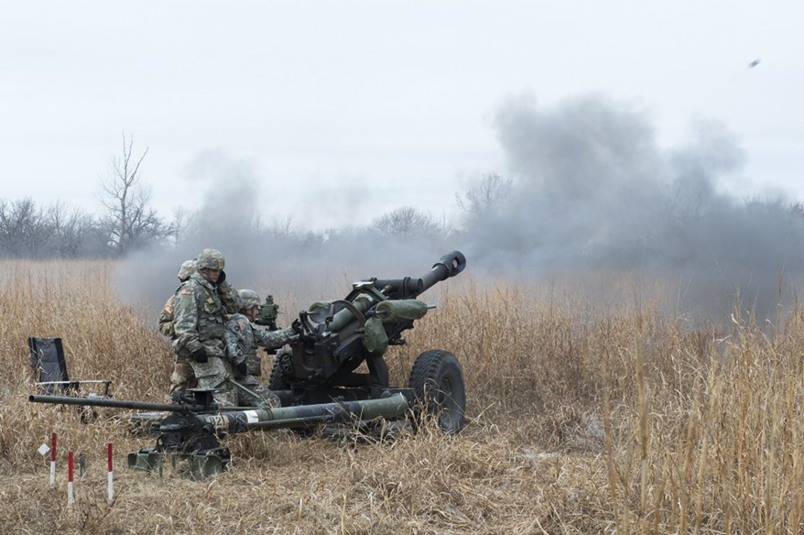
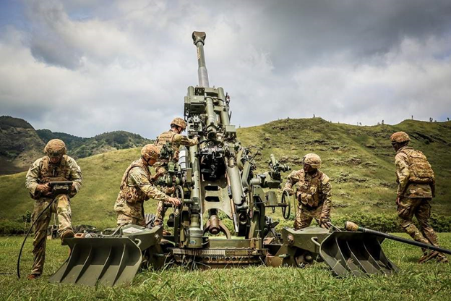
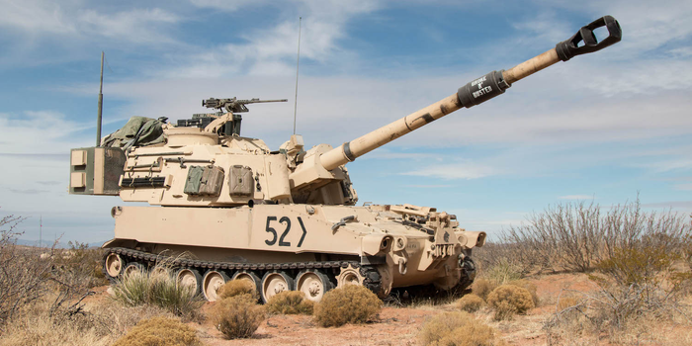
Howitzer Types
M119A2/A3 M777A2 M109A6/A7
Notes:
Here are the current howitzers used today by the Army. On the left is the M119A3. In the middle is the M777. On the right is the M109A6. The two on the left are towed by trucks. The M109A6 is self-propelled. The two on the right are essentially the same. They fire the same round.

Slide 5
Video
Notes:
Here is a video of an M119A3 firing.

Slide 6
Physical Limitations
Manufacturer’s Design
Baseplate
Rear Spade

Slide 7
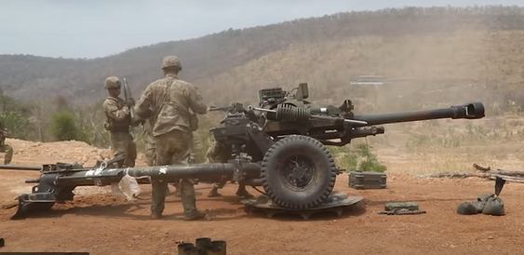
Emplacement Limitations
Side Slope
5-degrees or less side slope
Terrain and land cover

Slide 8
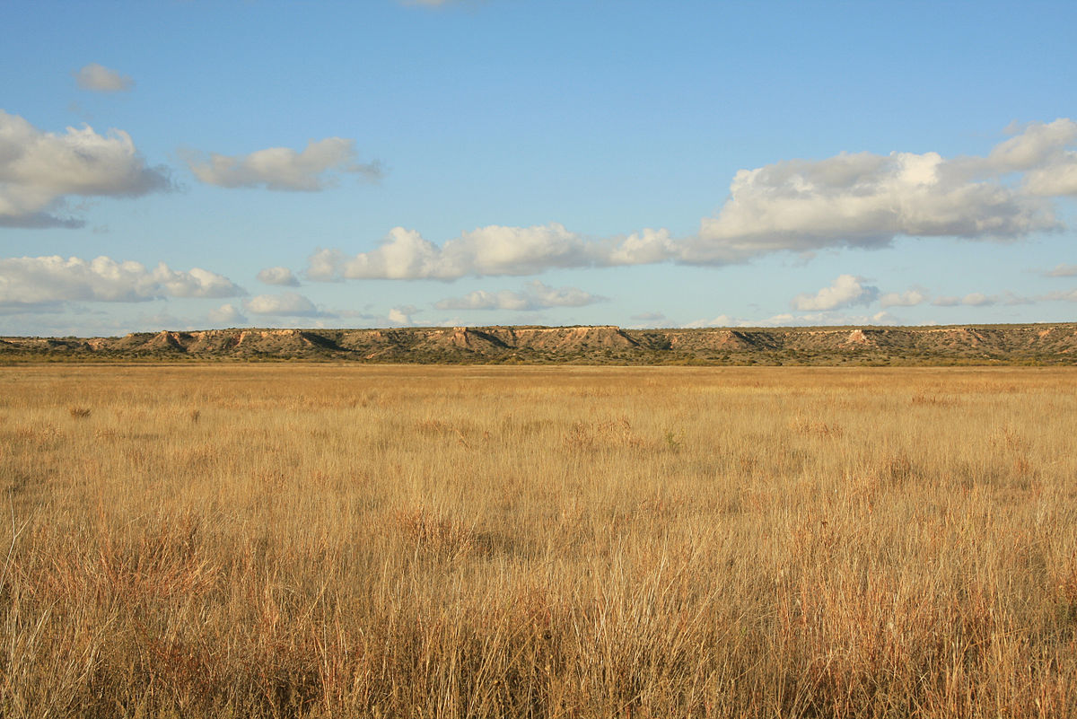
Optimal Criteria for Emplacement
Desired Land Cover
Bare earth
Grassland
Sparsely vegetated areas
Less than 5-degree side slope
Hilly
Open
Wooded
Flat

Slide 9
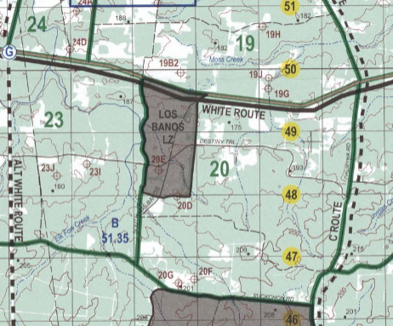
Current Site Selection Process
Current Site Selection Involves
Visual inspection
Paper maps
Paper and digital satellite imagery
Current Site Selection Limitations
Takes time
Prone to errors
Outdated maps
Requires eyes on for accuracy
Requires knowledge about geography

Slide 10
Research Objective
Identify areas suitable for emplacement based on:
Slope
Aspect
Land Cover
Notes:
The objective of this analysis is to identify sites suitable for emplacement based on slope less than 5 degrees, aspect facing north to south and east to west, that can be replicated in the remaining directions, and land cover classification (grass).

Slide 11
Problem Statement
Use ArcGIS to enable site suitability analysis for field artillery emplacements
Why I am doing this
What I am hoping to find
Notes:
Read problem statement. I am doing this because I have been frustrated using our current processes. I have made decisions knowing they aren’t accurate and am probably wasting time and putting people at risk. I am hoping to find an automated solution that enables rapid site selection, enables safe firing, saves time, and prevents putting people at unnecessary risk.

Slide 12
General Workflow
Download Data
Landsat 8
Sentinel-2
Create base layers from DEM
Slope
Use imagery to classify
Grass
Paved
Digital Elevation Model
Aspect
Water
Forest
Conduct the analysis
Meets aspect criteria
Meets slope criteria
Meets land cover criteria
Urban

Slide 13
Study Area
Fort Polk, Louisiana
Premier Training Center
Wooded and mixed terrain
Cody Gilham
GEOG 596A
July 14, 2022
Notes:
Study area overview.
Why choose this study area?
What does the study area provide?
Point out specifically where the study area is in Fort Polk

Slide 14
Data
Landsat Imagery – 30m x 30m
Used for general visual analysis
Sentinel-2 Imagery – 10m x 10m
Provides more accurate land cover classification
Used to identify grass land cover class that is suitable
Digital elevation model
Create of slope
Create of aspect
Create of hillshade
Notes:
Mention where, specifically, you obtained each dataset.

Slide 15
Methods
ArcGIS Pro Tools
Unsupervised Land Cover Classification
Slope analysis
Aspect analysis
Reclassify
Raster Calculator

Slide 16
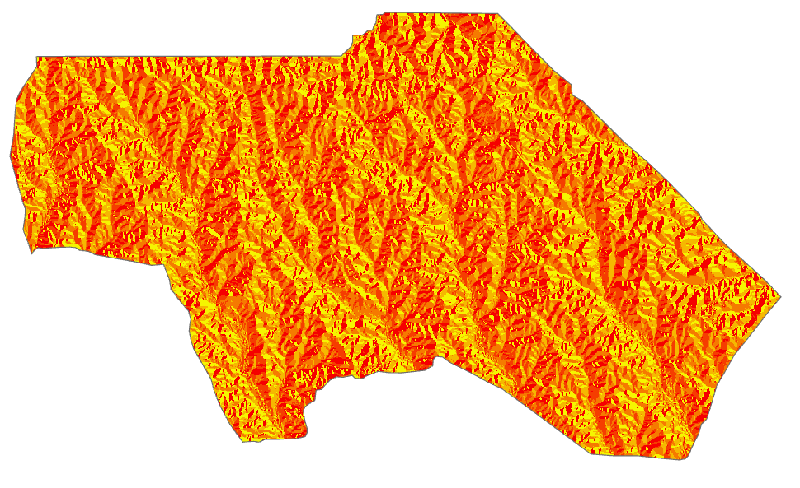
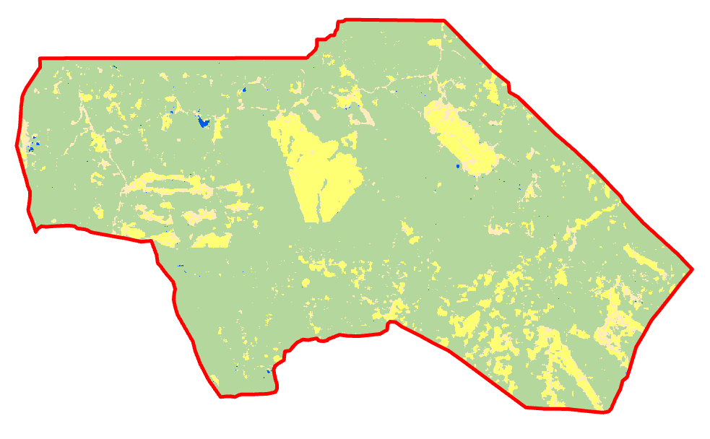
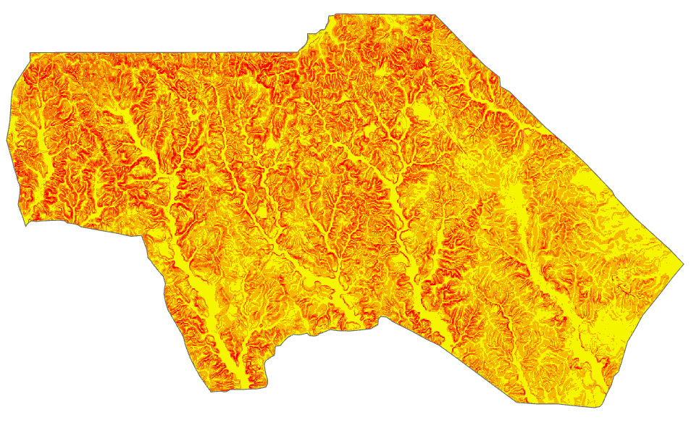
Intermediate Data Layers
Aspect
Land Cover
Classification
Slope
Legend
Grass
Water
Paved
Forest
Notes:
How does each image/result fit into the analysis. Describe each image and how it fits into the analysis.

Slide 17
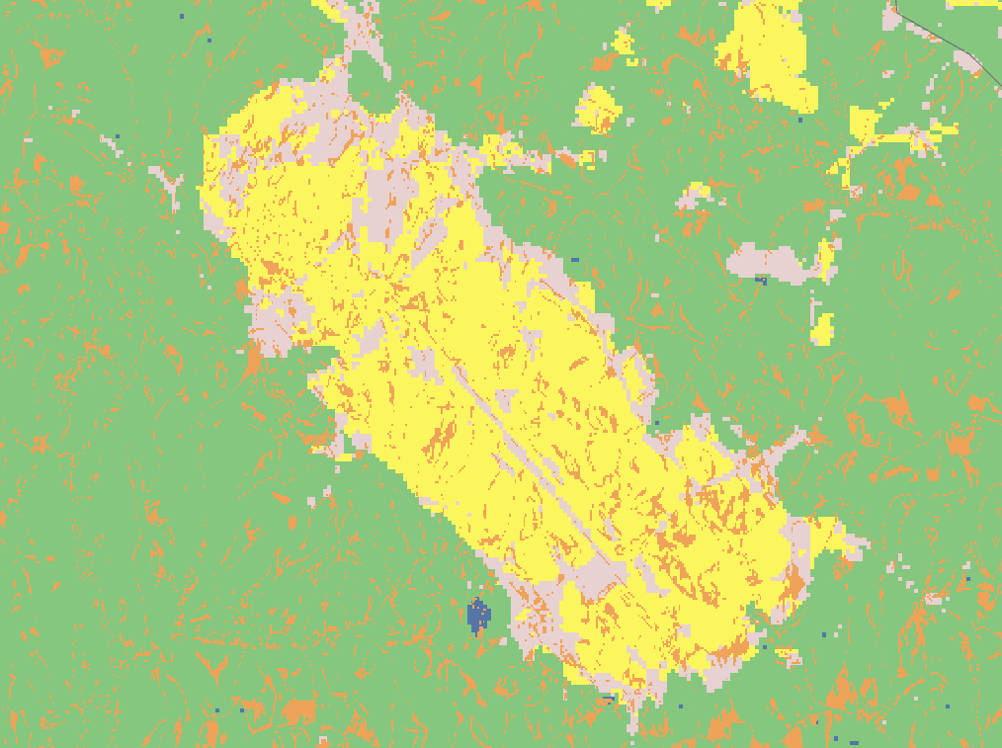
Preliminary Results
East-West Firing
Site Suitability
Legend
Grass
Water
Paved
Urban
Forest
Meets Criteria for East-West firing
Notes:
Make sure to explain the fact that the orange areas are only suitable for east-west firing and that you will produce another for north-south firing. You may get a question from the audience whether you will create a single layer that will provide all-direction firing. You may want to think about addressing that idea here too.

Slide 18
Analysis Improvements
LiDAR Data
To include tree height and other structures into analysis
Distance from objects
To include criteria based on distance from trees or objects
Other study areas
Fort Irwin, California which is mountainous and desert
Fort Campbell, Kentucky which is less wooded than Fort Polk but generally flat
Notes:
To improve the capabilities of this model, future improvements will include LiDAR data distance to objects. Trees and buildings block line of sight and must be considered as criteria for site selection.

Slide 19
Future Directions
Proof of concept converted into mobile web application
Removes operator from using ArcGIS Pro
Search for willing contractor for development
AOF: 5600
AOF: 5600
Step 1 Step 2 Step 3

Slide 20
Timeline
August 2022
Refine workflow and process
Conduct and finalize analysis on the three study areas
September 2022
Finalize paper
October 2022
Published in Field Artillery Journal

Slide 21
Questions?
Captain Cody Gilham
ctg5225@psu.edu

