Slide 1
Explaining Geographic variation in shelter DOG outcomes
GEOG 596A
Jenn Gillespie
Advisor: Lorraine dowler

Slide 2
Overview
Current State of Sheltering
Background
Goals/Objectives
Literature Review
Methodology
Anticipated Results
Project Timeline
Presentation/Publication

Slide 3
What’s happening in animal shelters
5.4 million dogs and cats enter shelters each year
Intake
Strays
Relinquished by their owner
Owner Intended Euthanasia
Transfer In
Outcomes
Return to owner
Adoption
Transfer Out
Euthanized each year:
1.5 million (ASPCA)
625,000 (BFAS)
Source: ASPCA, 2020 and BFAS, 2019

Slide 4
The good news
Source: Rowan & Kartal, 2018

Slide 5
Decreases in euthanasia over time
Increases in
adoption
Community specific programs
Spay/neuter campaigns

Slide 6
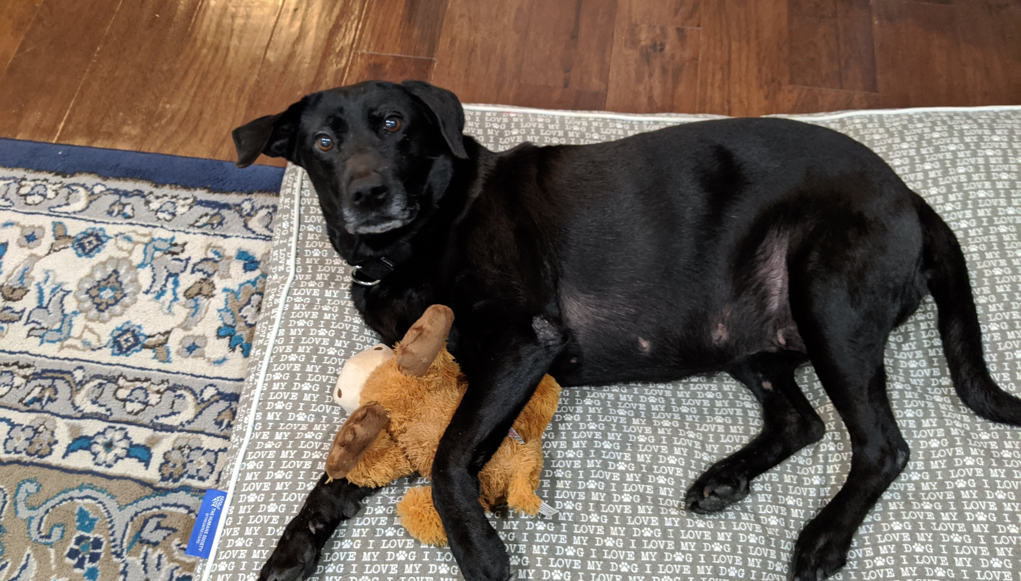
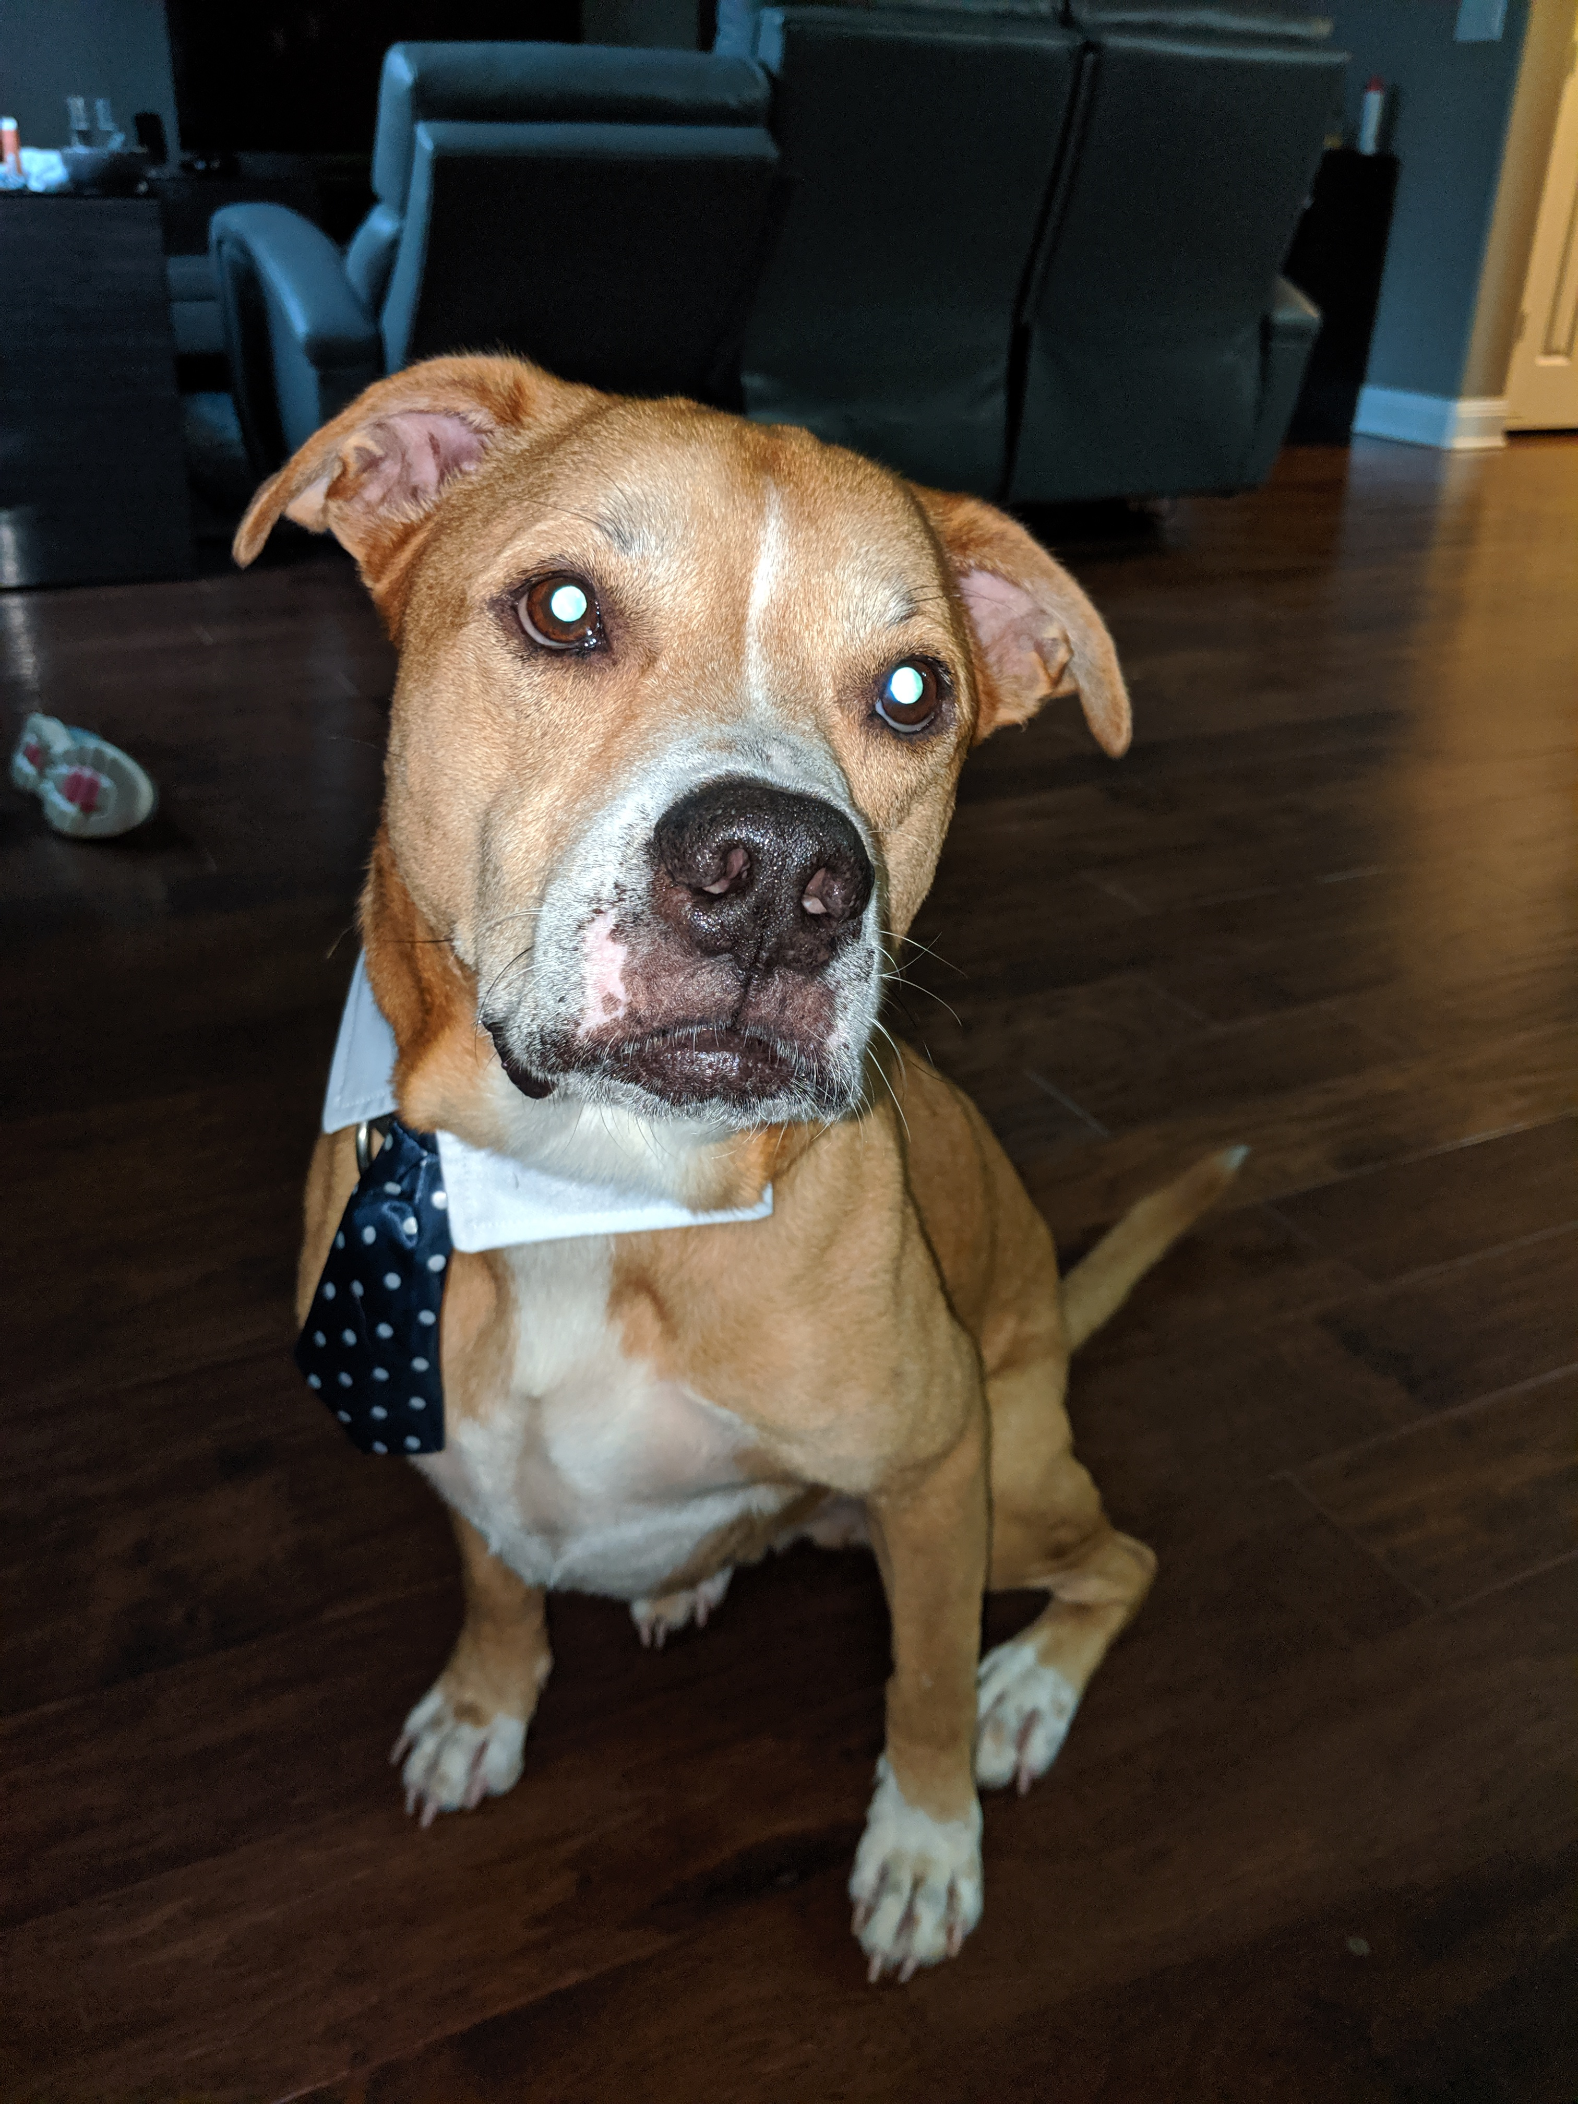
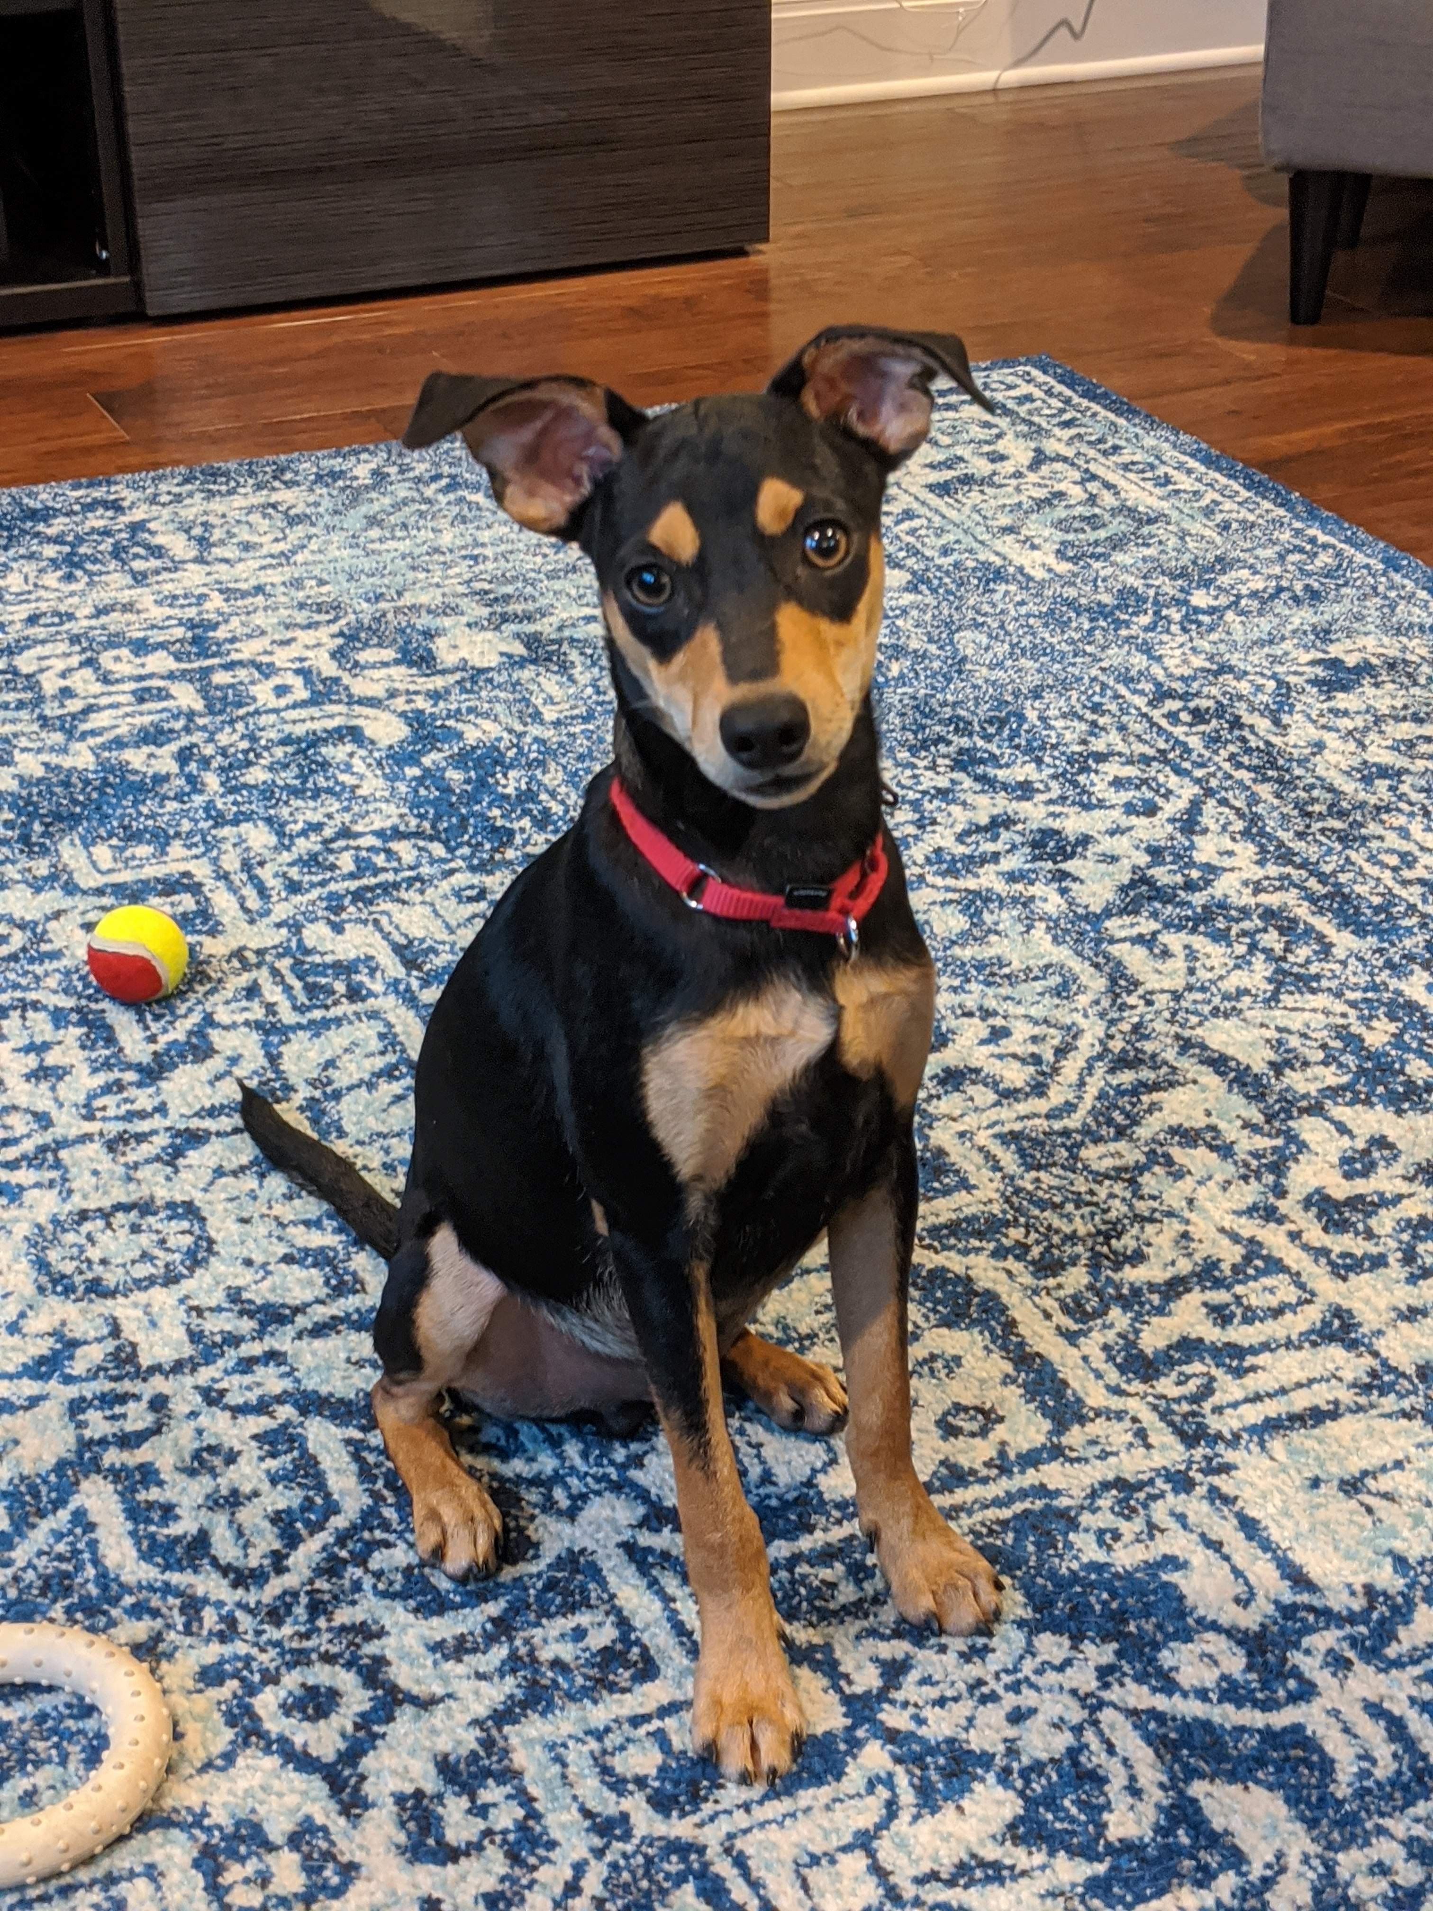
inspiration
Foster for Austin Pets Alive!
Dogs come to the shelter for various reasons
Adopted Oliver on Easter this year

Slide 7
Puzzling geography of animal shelter dog euthanasia

Slide 8
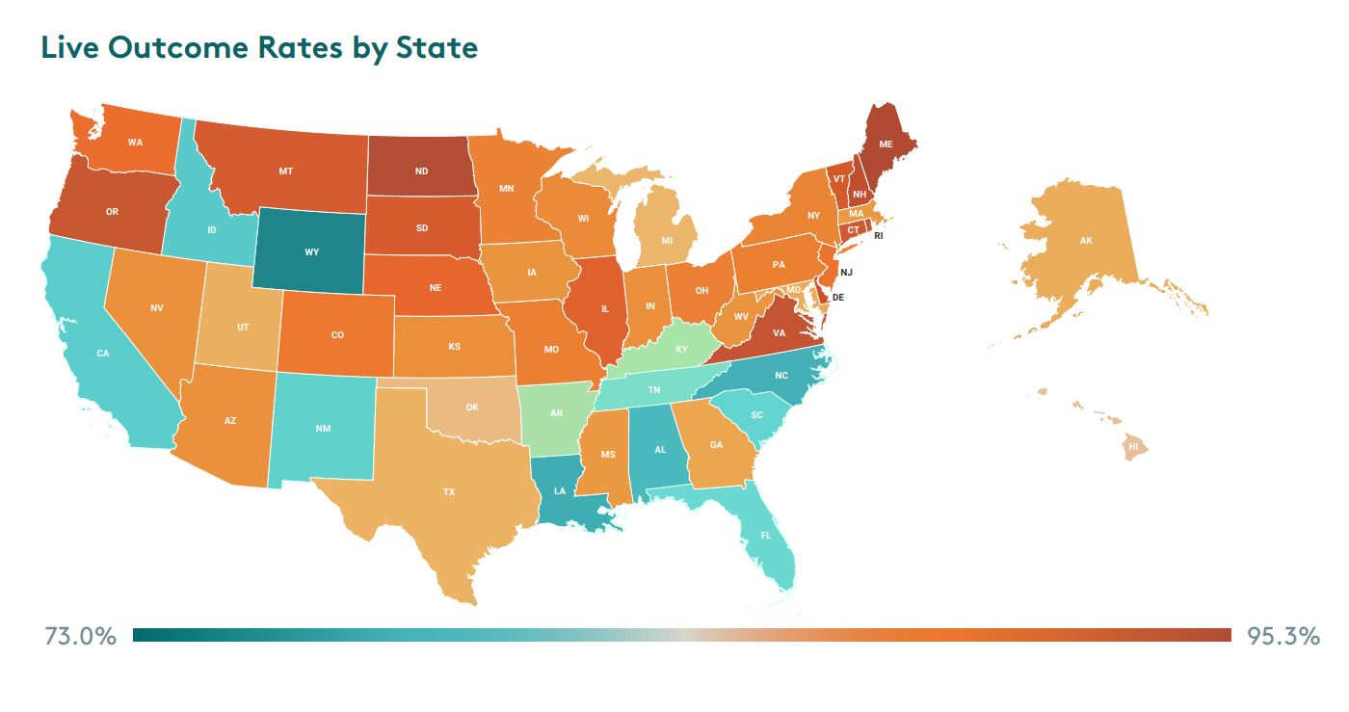
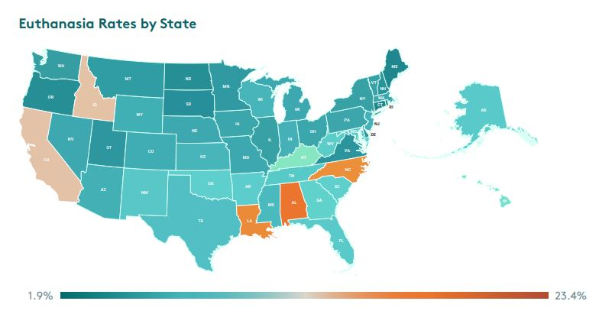
National Variations
Source: Shelter Animals Count, 2019

Slide 9
Interstate Variations
Source: Rowan & Kartal, 2018

Slide 10
NOT JUST MONEY SPENT
“Fresno County in California has a euthanasia rate of 35 per 1,000 whereas San Francisco’s is 1 or lower. If you look at expenditures, Fresno’s is around $15 per capita and San Francisco’s was around $30 per capita. But the five counties around Portland spend around $16 per capita and have a euthanasia rate one tenth that of Fresno.” - Andrew Rowan

Slide 11
Problem
Healthy adoptable animals die in shelters
Euthanasia rates vary nationally
No previous research
Goal
Identify human demographic factors which are correlated with community live release rates
Visualize how these demographic factors vary across the US
Why it matters
Community outreach and programs should be local and specific

Slide 12
Demographics
Where do the animals come from and where do they go?
Shelter Statistics
GIS Statistical Analysis

Slide 13
Animal shelter reporting
Shelter data is a “statistical black hole”
No national reporting requirement
No count of number of shelters until very recently – 4,850
Some states have their own requirements, but the type of data varies from state to state
Asilomar Accords created a standard data matrix

Slide 14
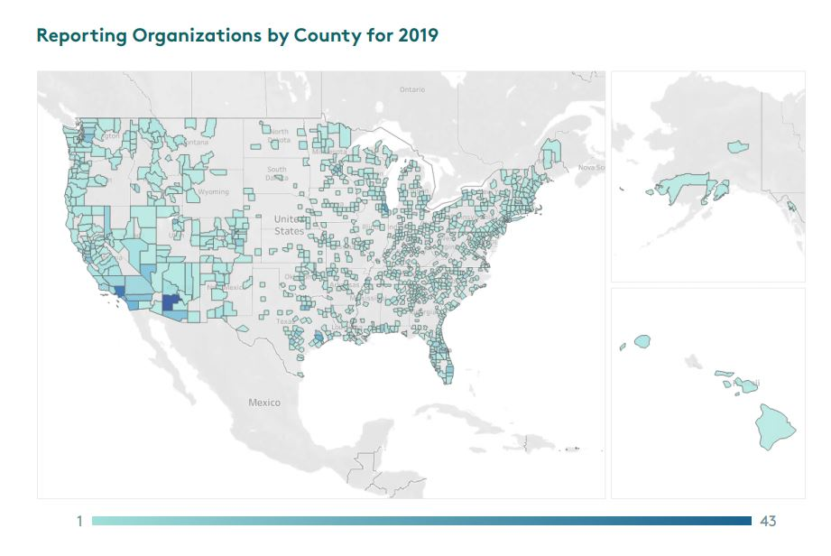
Self reported information from animal shelters and rescue organizations
Started in 2011
Obtained data for 2,269 locations in 2019

Slide 15
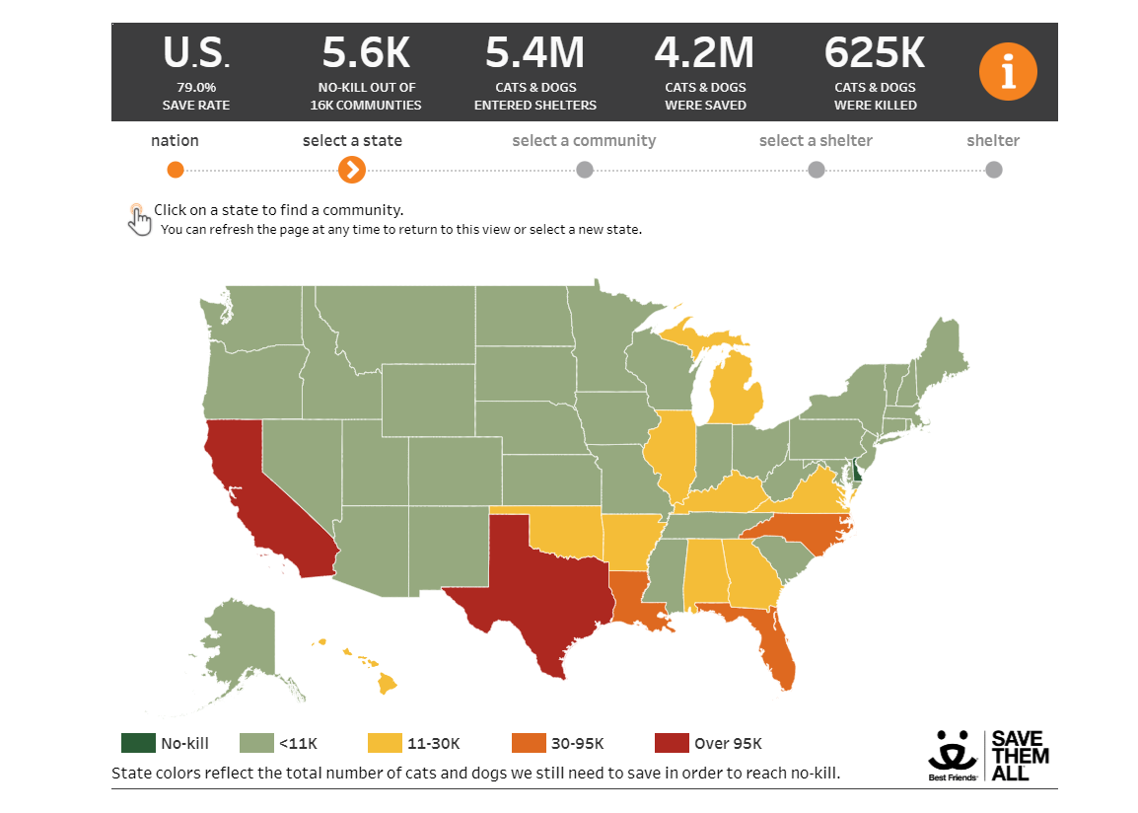
Best friends Lifesaving dashboard
https://bestfriends.org/2025-goal

Slide 16
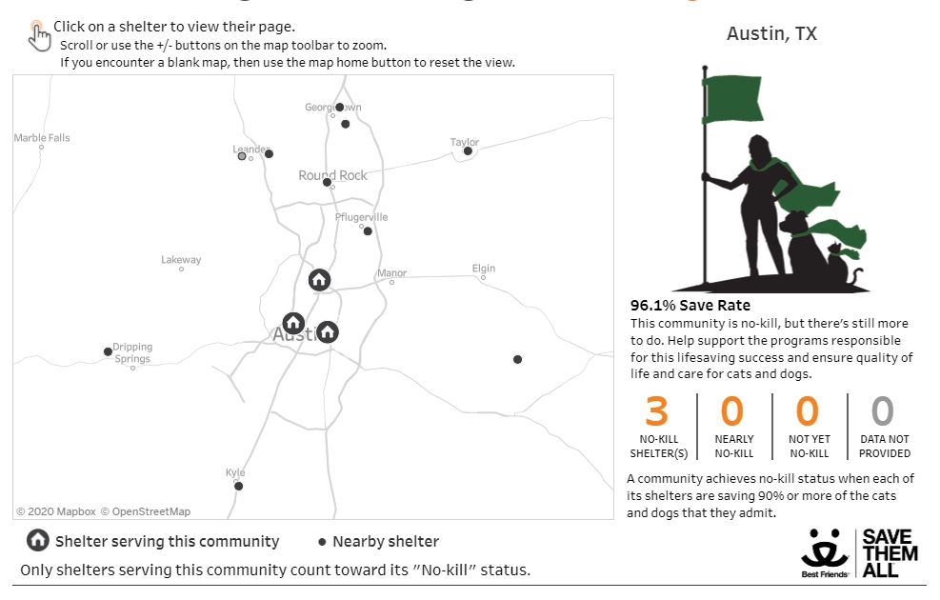

Slide 17
Who lives in a community
and owns/adopts animals?
Demographics
Shelter Statistics
GIS Statistical Analysis

Slide 18
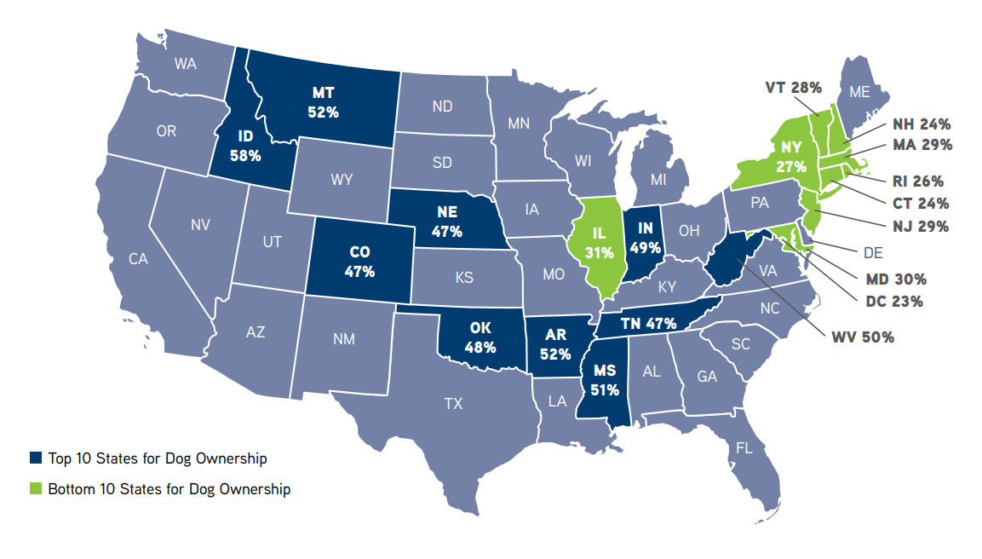
Demographics: Pet Owners vs Non-owners
Source: AVMA Pet Ownership and Demographics Sourcebook 2017-2018

Slide 19
DOG owner CHARACTERISTICS
Own their own home
Live in a house or mobile home
White
Have a high income
Live in rural areas
Live as a family – often with children

Slide 20
Stray intake
About half of all intakes
Demographic correlations:
Intake of dogs with medical and behavioral issues are correlated with Social Vulnerability Index
Intake hotspots in areas of higher poverty and child maltreatment
Correlation between poverty and increase intake rates (cats)
Source: Dyer & Milot, 2019

Slide 21
relinquishment
Second most common reason for intake
Common reasons
Housing
Instability
Moving
Restrictions
Cost of care (general or medical)
Personal reasons
Lack of time
Medical issues
Behavior
Source: Dolan, et al. 2015

Slide 22
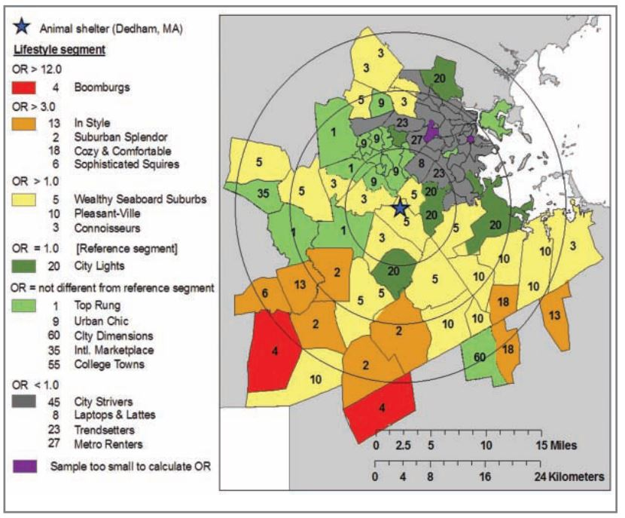
ADOPTIONS AND DEMOGRAPHICS
Patronek study from 2010
Comparison of adoption locations and market segmentation data
1 shelter in Massachusetts
Adoptions were correlated with:
Higher incomes
Families with children
Distance to the shelter
Source: Patronek, 2010B

Slide 23
Demographics
What are the spatial relationships between live release rate and demographics?
Shelter Statistics
GIS Statistical Analysis

Slide 24
Multivariate Linear regression

Slide 25
Data required – Independent variables
Demographics (US Census Bureau)
Race
Household income/poverty
Housing variables
Family structure
City population/growth rate
Social Vulnerability Index (CDC)

Slide 26
Data required – dependent variables
Live Release Rate $= \frac{Live Outcomes}{Total Outcomes −Owner Requested Euthanasia}$
Save Rate $= \frac{Live Intakes −Died in Care −Lost in Care −Shelter Deaths}{Live Intakes}$
Shelter Animals Count Dataset
Can calculate Live Release Rate or Save Rate
Best Friends Life Saving Dashboard
Save Rate only

Slide 27
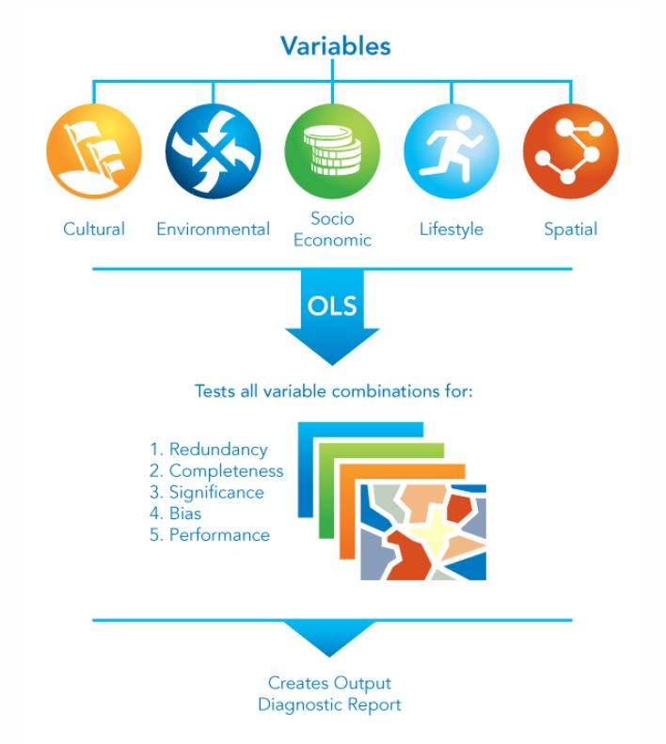
Exploratory regression
FEED DATA IN
GET REPORT OUT
Source: ESRI Tool Help

Slide 28
Geographically weighted regression (GWR)
California
Nonstationary data
GWR is local NOT global
Creates an equation for each data point
Performs better on large datasets (>1000)
Washington DC

Slide 29
Workflow
Data Preprocessing
Download data sets (SAC Dataset and Census Data)
Aggregate shelters into census units
Calculate save rate or live release rate for each census unit
Run Exploratory Regression/OLS
Identify independent variables of interest
Run GWR at a more granular level
Using identified independent variables run GWR across entire data set
Community
State

Slide 30
Challenges/Limitations
Data availability
Collinear
independent variables
Spatial autocorrelation

Slide 31
Anticipated results
Which demographic factors are most closely correlated with shelter outcomes?
How does the influence of demographic factors on shelter outcomes vary spatially?

Slide 32
Timeline
Spring 2021
Data acquisition
Data preparation
Summer 2021
Perform OLS and GWR
Identify independent variables
Fall 2021
Prepare project presentation
Write the project report
GEOG 596B
Submit paper to peer-reviewed journals
Present project results

Slide 33
Conferences
Journals
Animals
Anthrozoös
The Journal of Applied Animal Welfare Science
Association for Animal Welfare Advancement
Federated Humane Societies of PA
Spatial Data Science Conference

Slide 34
references
American Veterinary Medical Association (AVMA). (2018). Pet Ownership and Demographics Sourcebook: 2017-2018 Edition. American Veterinary Medical Association: Schaumburg, IL, USA.
American Society for the Prevention of Cruelty to Animals (ASPCA). (2020). Pet Statistics. Accessed October 24, 2020 at https://www.aspca.org/animal-homelessness/shelter-intake-and-surrender/pet-statistics
Best Friends Animal Society. (2020). Pet Life Saving Dashboard Application. Accessed online October 24, 2020 at https://bestfriends.org/2025-goal
Bir, C., Widmar, N. J. O., & Croney, C. C. (2017). Stated preferences for dog characteristics and sources of acquisition. Animals, 7(8), 1–19. https://doi.org/10.3390/ani7080059
Dolan, E. D., Scotto, J., Slater, M., & Weiss, E. (2015). Risk factors for dog relinquishment to a Los Angeles municipal animal shelter. Animals, 5(4), 1311–1328. https://doi.org/10.3390/ani5040413
Dyer, J. L., & Milot, L. (2019). Social vulnerability assessment of dog intake location data as a planning tool for community health program development: A case study in Athens-Clarke County, GA, 2014-2016. PLoS ONE, 14(12), 1–20. https://doi.org/10.1371/journal.pone.0225282
Gunter, L. M., Barber, R. T., & Wynne, C. D. L. (2016). What’s in a name? Effect of breed perceptions & labeling on attractiveness, adoptions & length of stay for pit-bull-type dogs. PLoS ONE, 11(3), 1–20. https://doi.org/10.1371/journal.pone.0146857
Hawes, S. M., Camacho, B. A., Tedeschi, P., & Morris, K. N. (2019). Temporal trends in intake and outcome data for animal shelter and rescue facilities in Colorado from 2000 through 2015. Journal of the American Veterinary Medical Association, 254(3), 363–372. https://doi.org/10.2460/javma.254.3.363
Herzog, Hal. (2018). The Puzzling Geography of Animal Shelter Dog Euthanasia. Accessed October 20, 2020 from https://www.psychologytoday.com/us/blog/animals-and-us/201805/the-puzzling-geography-animal-shelter-dog-euthanasia.
New, J. C., Salman, M. D., King, M., Scarlett, J. M., Kass, P. H., & Hutchison, J. M. (2000). Characteristics of Shelter-Relinquished Animals and Their Owners Compared With Animals and Their Owners in U.S. Pet-Owning Households. Journal of Applied Animal Welfare Science, 3(3), 179–201. https://doi.org/10.1207/s15327604jaws0303_1

Slide 35
References, cont.
Patronek, G. J. (2010)A. Mapping and measuring disparities in welfare for cats across neighborhoods in a large US city. American Journal of Veterinary Research, 71(2), 161–168. https://doi.org/10.2460/ajvr.71.2.161
Patronek, G. J. (2010)B. Use of geospatial neighborhood control locations for epidemiological analysis of community-level pet adoption patterns. American Journal of Veterinary Research, 71(11), 1321–1330. https://doi.org/10.2460/ajvr.71.11.1321
Patronek, G. J., & Crowe, A. (2018). Factors associated with high live release for dogs at a large, open-admission, municipal shelter. Animals, 8(4), 1–16. https://doi.org/10.3390/ani8040045
Protopopova, A., & Gunter, L. M. (2017). Adoption and relinquishment interventions at the animal shelter: A review. Animal Welfare, 26(1), 35–48. https://doi.org/10.7120/09627286.26.1.035
Rowan, A., & Kartal, T. (2018). Dog population & dog sheltering trends in the United States of America. Animals, 8(5), 1–20. https://doi.org/10.3390/ani8050068
Salman, M. D. (1998). Human and Animal Factors Related to Relinquishment of Dogs and Cats in 12 Selected Animal Shelters in the United States. Journal of Applied Animal Welfare Science, 1(3), 207–223.
Saunders, J., Parast, L., Babey, S. H., & Miles, J. V. (2017). Exploring the differences between pet and non-pet owners: Implications for human-animal interaction research and policy. PLoS ONE, 12(6), 1–15. https://doi.org/10.1371/journal.pone.0179494
Sinski, J. B., & Gagné, P. (2016). Give me shelter: the state of animal sheltering in Kentucky’s county shelter system. Contemporary Justice Review: Issues in Criminal, Social, and Restorative Justice, 19(2), 250–266. https://doi.org/10.1080/10282580.2016.1169706
Shelter Animals Count (SAC). (2019). Animal Sheltering Statistics 2019. Available for download at https://www.shelteranimalscount.org/data-reports
Weiss, E., Slater, M., Garrison, L., Drain, N., Dolan, E., Scarlett, J. M., & Zawistowsk, S. L. (2014). Large dog relinquishment to two municipal facilities in New York city and Washington, D.C.: Identifying targets for intervention. Animals, 4(3), 409–433. https://doi.org/10.3390/ani4030409
Woodruff, K., & Smith, D. R. (2020). An Estimate of the Number of Dogs in US Shelters in 2015 and the Factors Affecting Their Fate. Journal of Applied Animal Welfare Science, 23(3), 302–314. https://doi.org/10.1080/10888705.2019.1663735

Slide 36
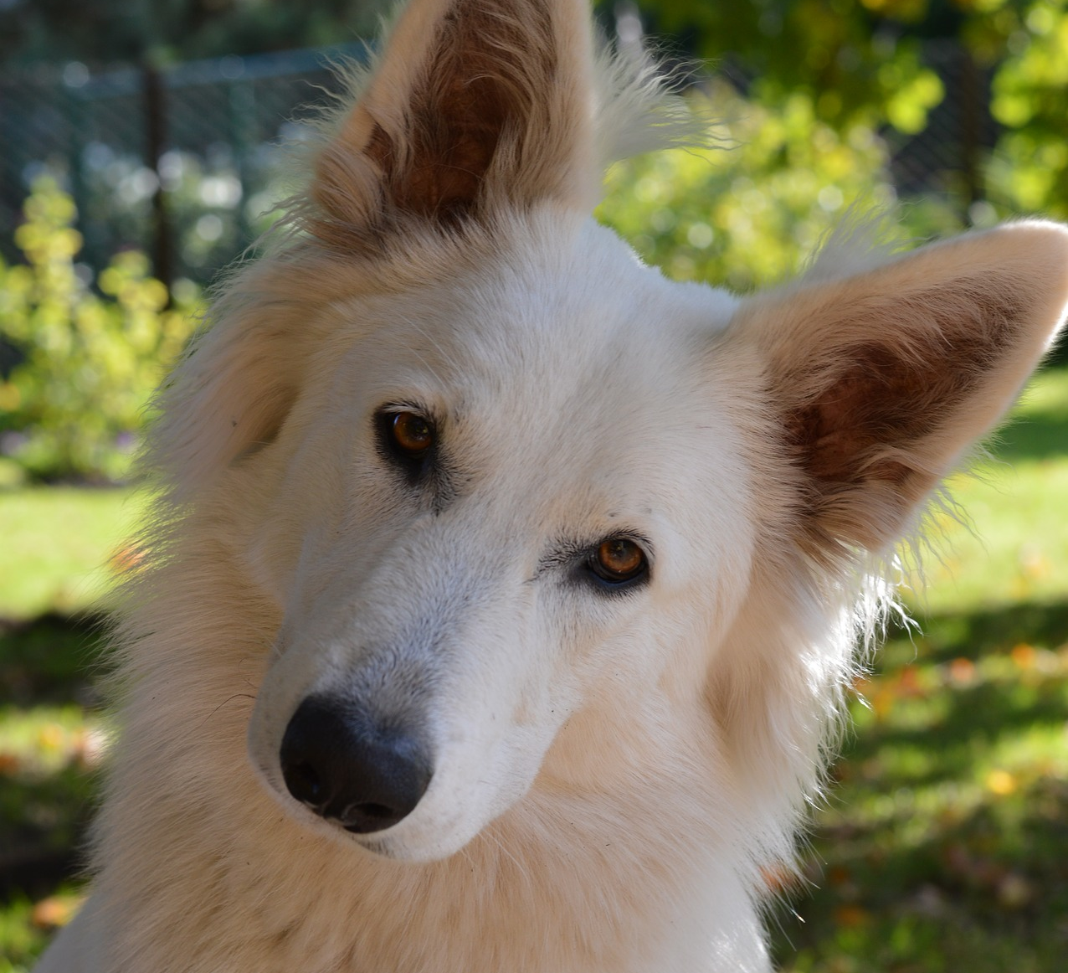
QUESTIONS?

