Slide 1

Integrating Point Cloud Data into Civil 3D
Christy Graves – GEOG 596 A – July 7, 2011
Project Proposal for Peer Review
Advisor – Karen Schuckman
Candidate for Master of Geographic Information Systems

Slide 2
Presentation Overview
Introduction & Motivation
Project Objectives
Background
Methodology
Software Comparisons
Office Workflow
Challenges

Slide 3
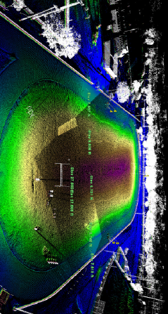
Introduction & Motivation
Introduction & Motivation Project Goals Background Methodology Software Comparisons Office Workflow Challenges
What is a Point Cloud?
  A set of vertices in a 3D coordinate system, usually defined by X, Y & Z coordinates
  Most often created by 3D laser scanner
  The scanner records millions of 3D points as the laser beam sweeps over a scene or object
  The point cloud represents the points that the laser scanner has measured
Benefits of Point Cloud Data:
Speed of data capture
Remote acquisition & measurement
High point density data
Provides direct measurement capability
Overlay with imagery for 3D visualization
Laser Scan Point Cloud, Plantation High School. Source: Craven Thompson & Associates, Inc., Fort Lauderdale, FL
How do you take a Point Cloud …

Slide 4
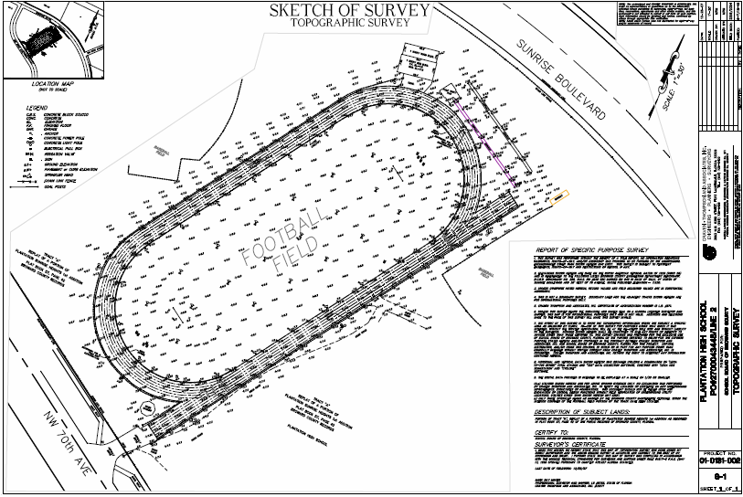
Introduction & Motivation
Introduction & Motivation Project Goals Background Methodology Software Comparisons Office Workflow Challenges
And end up with a Final Deliverable?
Why Civil 3D?
Leading software used by the civil/survey industry
3D Model Space Design
  Objects maintain their relationships to other objects in the design
  Dynamic updating
Topographic Survey, Plantation High School. Source: Craven Thompson & Associates, Inc., Fort Lauderdale, FL

Slide 5
Project Goals & Objectives
Introduction & Motivation Project Goals Background Methodology Software Comparisons Office Workflow Challenges
Identify surveying companies using ground-based laser scanning for large scale topographic mapping
Research software being used for post-processing point cloud data
Determine which software currently provides the best solution for point-cloud post processing
Learn effective techniques for point cloud feature extraction
Prepare educational video clips illustrating techniques for the office work-flow

Slide 6
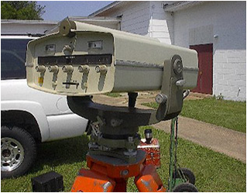
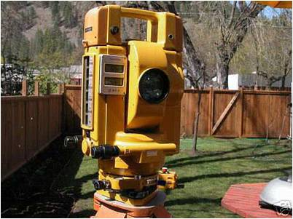
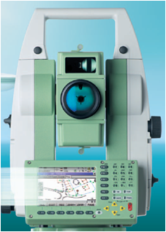
Lasers & Surveying
Introduction & Motivation Project Goals Background Methodology Software Comparisons Office Workflow Challenges
LASER
An acronym for Light Amplification by Stimulated Radiation
Electronic Distance Measuring (EDM)
Used by many surveyors in the 1970’s for measuring long distances & setting control points for surveys
Measures distance only (no angles)
HP3800B Distance Meter. Manufacture Date: 1969. Dates of Use: 1970's. Source: NOAA
Total Station
Electronic instrument capable of measuring distance & angles
Includes electronic data collection
Topcon ET-1 Total Station. Manufacture Date: 1985. Dates of Use: 1980's. Source: NOAA
Leica TPS1200+ Total Station. Manufacture Date: Current. Dates of Use: In use today. Source: Leica Geosystems

Slide 7
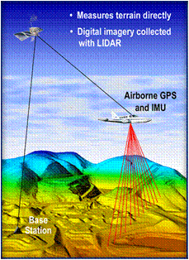
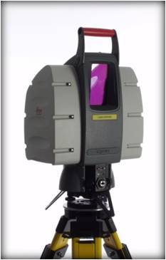
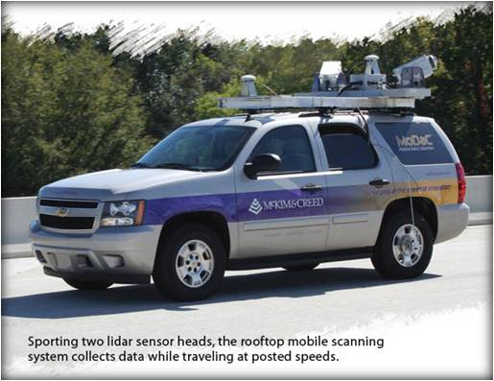
Lasers & Surveying
Introduction & Motivation Project Goals Background Methodology Software Comparisons Office Workflow Challenges
LIDAR
An acronym for Light Detection and Ranging
Static
Dynamic (Mobile Mapping)
Illustration showing the components for an aerial lidar system. Source: Spatial Resources
Aerial Lidar
Ground-based static laser scanner mounted on a tripod. Source: Nobles Consulting Group
Aerial Lidar System includes:
GPS
IMS (Inertial Measurement System)
Scanning Laser transmitter-receiver
Ground-based mobile laser scanning system. Source: Professional Surveyor Magazine
Terrestrial (Ground-Based) Lidar

Slide 8
Methodology
Introduction & Motivation Project Goals Background Methodology Software Comparisons Office Workflow Challenges
Conduct Interviews
  Surveying companies using laser scanning
Attend Professional Conferences
  Training Sessions
  Seminars
Perform Internet Research
  Point Cloud Software
  Work Flow Documentation

Slide 9
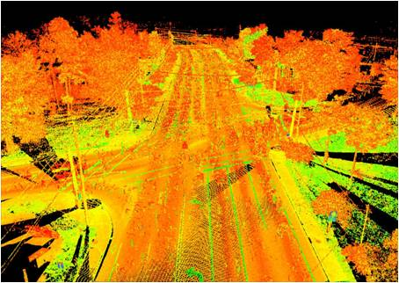
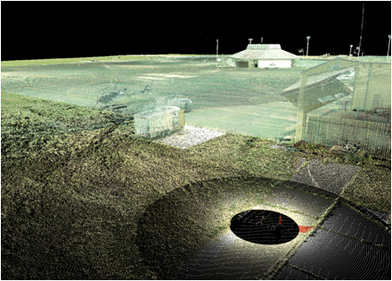
Introduction & Motivation Project Goals Background Methodology Software Comparisons Office Workflow Challenges
Allen Nobles, PSM
  President, Nobles Consulting Group, Inc. (NCG), Tallahassee, FL
  Company has worked with lidar data for nine years
  Use their own a Leica ScanStation C-10 for ground-based scanning
  Use Leica Cyclone & CloudWorx software to process point cloud data
Laser scan Intensity image of a roadway intersection NOTE: The intensity is the magnitude of the reflected pulse
Laser scan survey of an old local airport terminal in Tallahassee, Florida

Slide 10
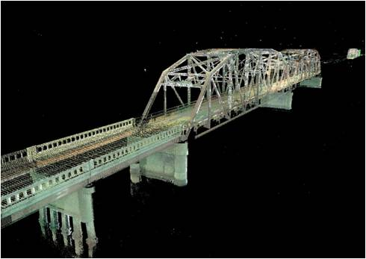
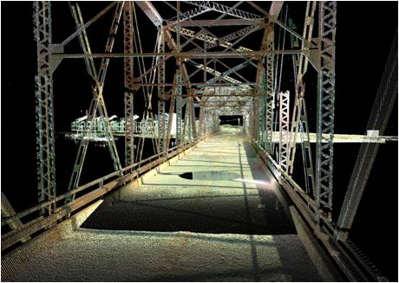
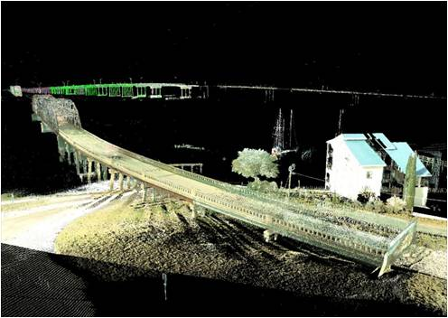
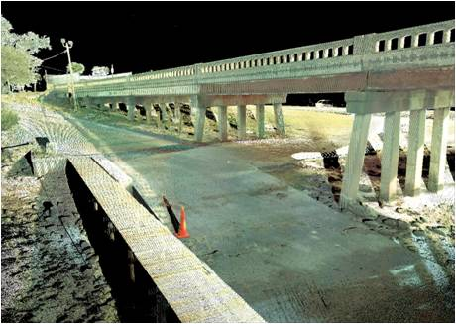
Introduction & Motivation Project Goals Background Methodology Software Comparisons Office Workflow Challenges
Laser scans of DuPont Bridge on US 98 east of Panama City, Florida Source: Nobles Consulting Group, Inc.

Slide 11
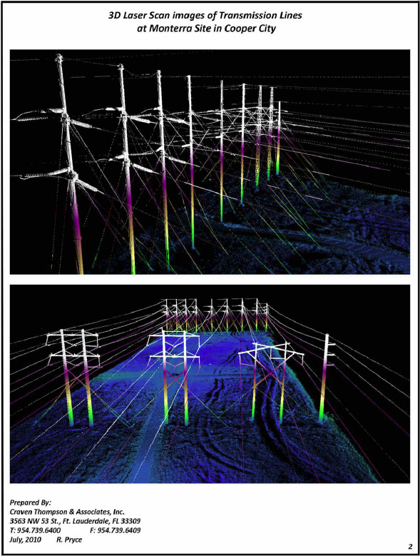
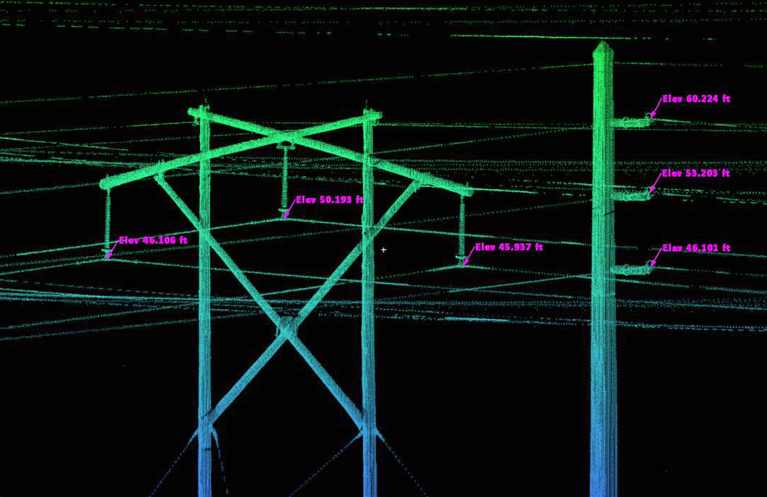
Introduction & Motivation Project Goals Background Methodology Software Comparisons Office Workflow Challenges
Richard Pryce, PSM
Vice President, Surveying & GIS, Craven Thompson & Associates, Inc., Fort Lauderdale, FL
Company has completed projects combining aerial lidar and terrestrial laser scanning
CAD & GIS software is used for surveying and engineering projects
Company uses their own a Leica ScanStation C-10 for ground-based scanning
They use Leica Cyclone & CloudWorx software to process point cloud data
3D Laser Scans for Monterra Site. FP&L Transmission Lines

Slide 12
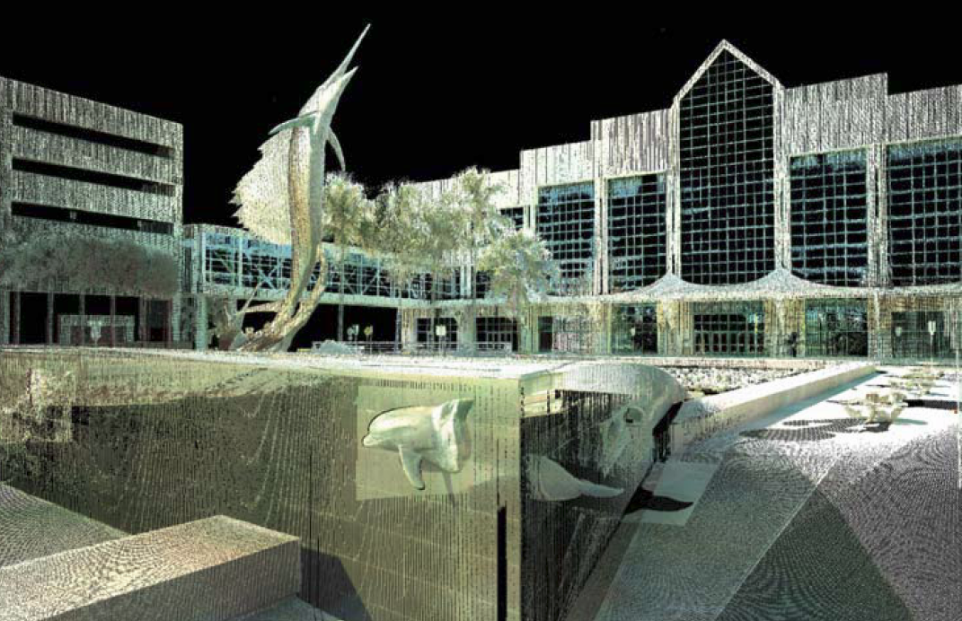
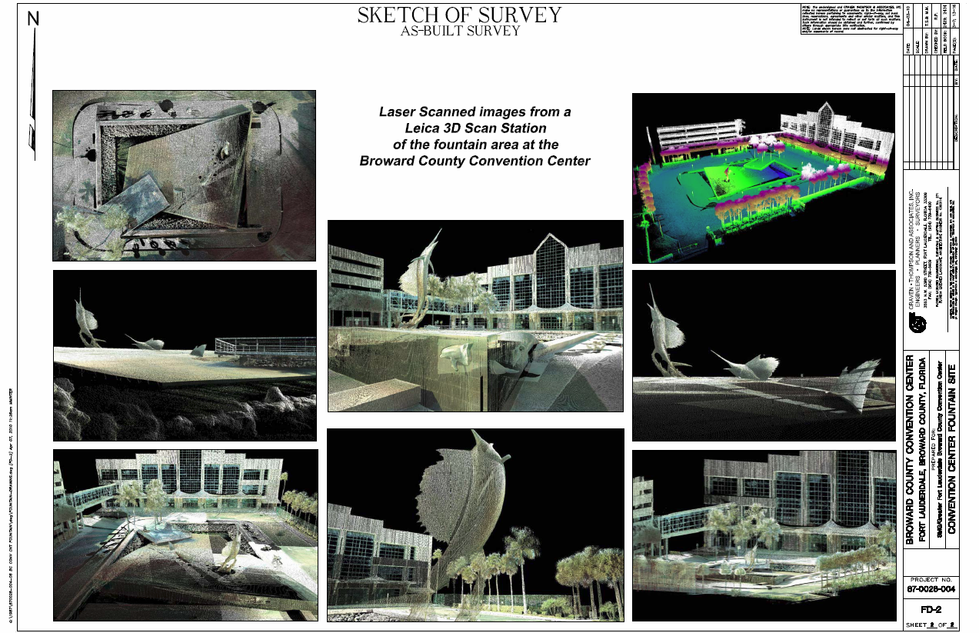
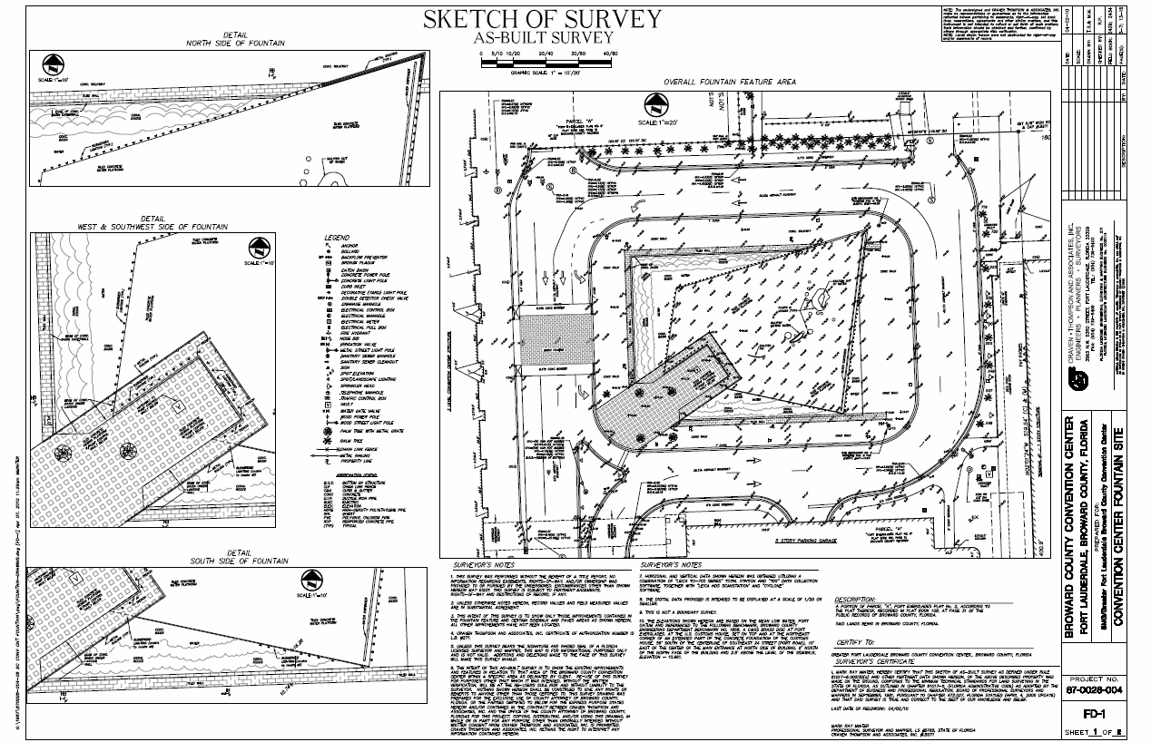
Introduction & Motivation Project Goals Background Methodology Software Comparisons Office Workflow Challenges
3D Laser Scans & As-Built Survey. Broward County Convention Center Fountain Site Source: Craven Thompson & Associates, Inc.

Slide 13
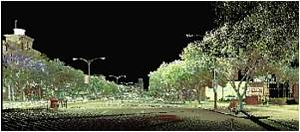
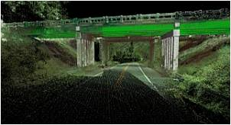
Introduction & Motivation Project Goals Background Methodology Software Comparisons Office Workflow Challenges
Tate Jones, PLS
  President, LandAir Surveying Company, Inc., Atlanta, Georgia
  Company has been a user of 3D laser scanning for over 6 years
  Company uses their own Leica HDS 3000 for ground-based scanning
  The software they use includes Leica Cyclone & CloudWorx for AutoCAD; TerraModel
  Their laser scanning services include: As-Builts, accident reconstruction for law enforcement, architectural building scanning (including historical preservation), catastrophic event mapping, & change detection
3D Laser Scan topographic & location survey of downtown Augusta, Georgia
The project will be used as a base map for a major downtown revitalization project. New streetscapes, traffic signals, and utilities will be designed from the scanned survey. Under- and above-ground utilities were also tied into the base mapping.
3D-Laser Scan survey of Webb Gin Road, Georgia
The project will be used to redesign the bridge underpass and roadway above. The survey limits were approx. 1,450’. Survey data included collecting visible surface utilities, location and contours of an existing detention pond.

Slide 14
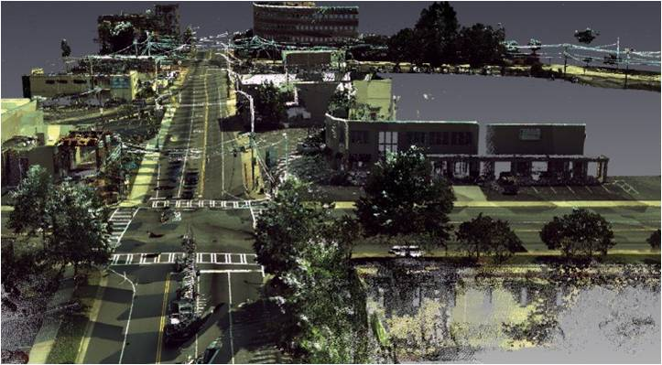
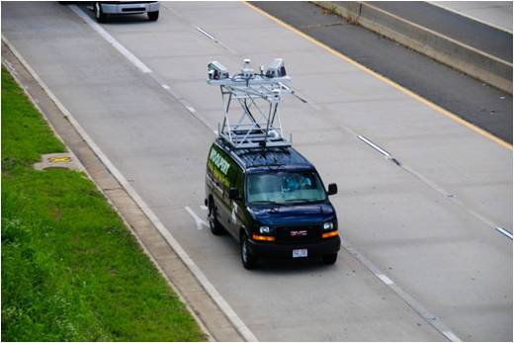
Introduction & Motivation Project Goals Background Methodology Software Comparisons Office Workflow Challenges
Jerry Allen
  Woolpert, Inc., Charlotte, North Carolina
  Company is a design, geospatial and infrastructure management firm with more than 20 offices nationwide.
  Other services include: airport design, LiDAR data collection, landscape architecture, 3-D laser scanning and mobile mapping, aeronautical obstruction surveys, and storm water utility development
  For post-processing point cloud data, the software they use includes Leica Cyclone, TerraSolid suite of tools, and Certainty 3D’s TopoDot software systems
Woolpert Mobile Mapping System in Charlotte, NC
Woolpert used their mobile mapping services to survey a 1.3 mile area of Tryon Street/I-277 overpass in Charlotte, NC. The project will be used by the city in support of more bike- and pedestrian friendly roads .
Mobile mapping point cloud imagery at intersections Tryon and Morehead, Charlotte, North Carolina

Slide 15


Introduction & Motivation Project Goals Background Methodology Software Comparisons Office Workflow Challenges
Attend Professional Conferences
  Geosystems Hexagon 2011 International Conference
    Information sessions: Introduction to 3D laser scanning basics
    Hands-on Training Workshops: Topographic office workflows for Laser Scanning
Perform Internet Research
  Training & Software Documentation
    Chad Studer – ADSK Solutions
    GeoMetaVerse
      Developed to serve as a source of workflows for data acquisition and processing 3D data
      Part of the National Science Foundation (NSF) funded CI-TRAIN project
      CI-TRAIN – partnership of institutions of higher education in Arkansas & West Virginal to transform the practice of information technology services for enabling scientific discovery

Slide 16

Software Considerations
Introduction & Motivation Project Goals Background Methodology Software Comparisons Office Workflow Challenges
Import/Export file formats
Desired Feature Extraction tools:
  Ground Finder tool with variables or built-in algorithms
  Cross-sections (by specifying the direction & a thickness)
  Elevation Grid
    Places spot shots on hard surfaces or ground areas at a specified interval
  Assign codes or insert symbols for object identification & location
    Trees, Light poles, Signs, Manholes, Property corner monumentation, etc.
  Break-line tool
    What is a breakline? A line in a triangulated irregular network (TIN) that represents a distinct interruption in the slope of a surface, such as a ridge, road, or stream. No triangle in a TIN may cross a breakline (in other words, breaklines are enforced as triangle edges). Z-values along a breakline can be constant or variable.
Illustration showing a breakline. Source: ESRI

Slide 17
Software Comparisons
Introduction & Motivation Project Goals Background Methodology Software Comparisons Office Workflow Challenges
Software: | Does the software have integrated tools for topographic feature extraction? | Are the topographic feature extraction tools user friendly & easy to work with? | Does the software work within a CAD environment? | Is the software efficient when using zoom, pan & 3D orbit commands? | Does the software effectively import calibrated images to match with the point cloud? | Does the software support many external scanner data formats?
Leica Cyclone II Topo | Yes | No | No | Yes | No | No
Civil 3D: Point Cloud Feature Extraction | Yes | No | Yes | No | No | No
Kubit PointCloud Pro | No | - | Yes | Yes | No | Yes
Certainty 3D TopoDOT | Yes | Yes | Yes* | Yes | Yes | Yes
* = Only designed to work within MicroStation (not Civil 3D/AutoCAD)

Slide 18
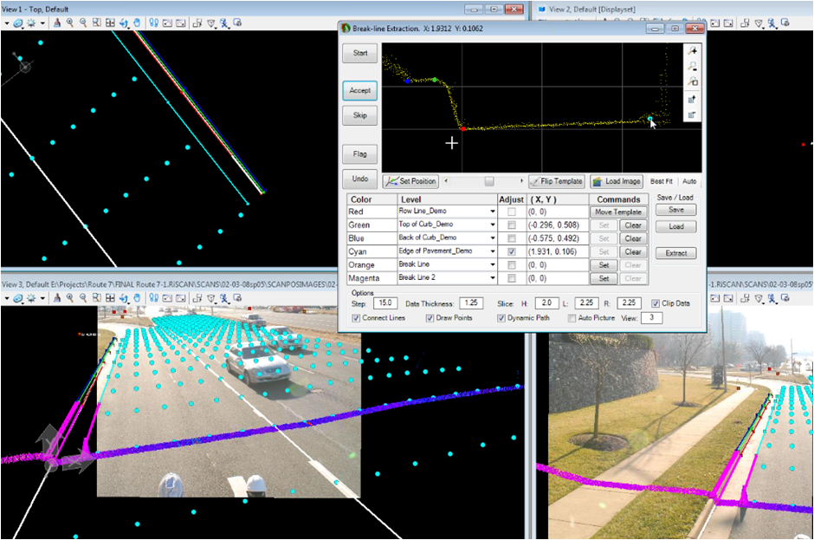
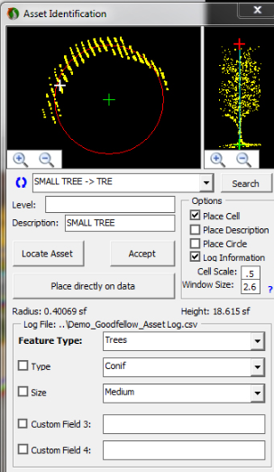
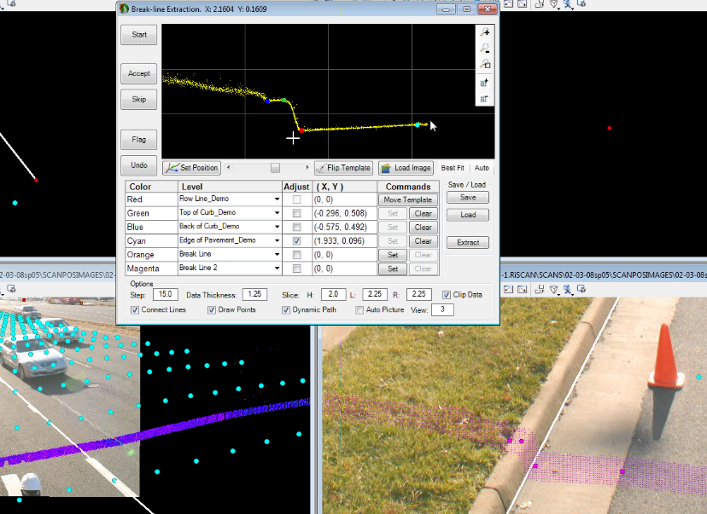
Introduction & Motivation Project Goals Background Methodology Software Comparisons Office Workflow Challenges
Screen shot showing the TopoDOT menu tools within MicroStation

Slide 19
Introduction & Motivation Project Goals Background Methodology Software Comparisons Office Workflow Challenges
Forums
3D Laser Scanning Forum
  Our mission is for this website is to become the worlds leading society for 3D laser scanning and modeling and their applications to education, science, research, industry, commerce and the public service.
  As an organization, its our mission to inform and educate our members and the public. We support networking between the university, business and government sectors. We also aim to become an international society, and become active around the world.
  The Laser Scanning Forum was created in 2007 to help promote the Terrestrial Laser Scanning community and to evolve the technology. The website is growing daily with thousands of professional registered members from all over the World. We are keen to promote the forum as a knowledge base for everyone.
  http://www.laserscanning.org.uk/index.php

Slide 20
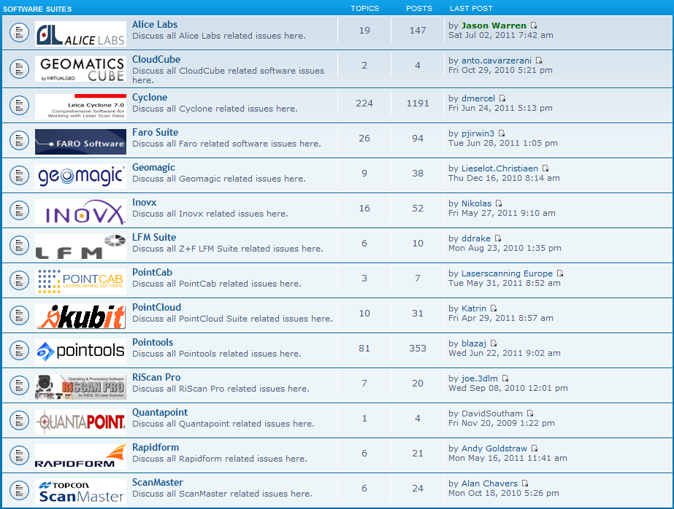
Introduction & Motivation Project Goals Background Methodology Software Comparisons Office Workflow Challenges
Screen shot showing the Software Suites Forum on the 3D Laser Scanning website

Slide 21
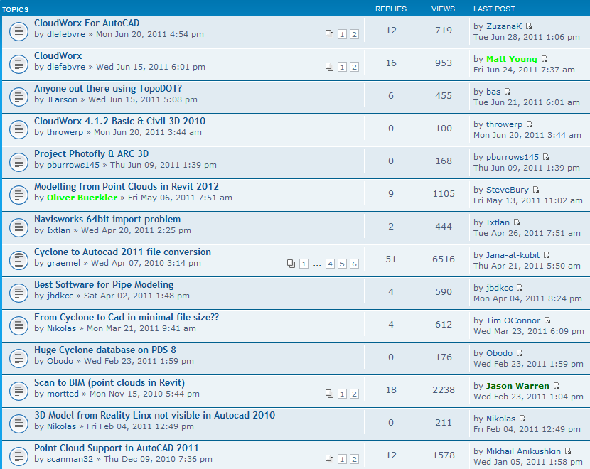
Introduction & Motivation Project Goals Background Methodology Software Comparisons Office Workflow Challenges
Screen shot showing the CAD Software Forum on the 3D Laser Scanning website

Slide 22
Point Cloud to Final Deliverable
Introduction & Motivation Project Goals Background Methodology Software Comparisons Office Workflow Challenges
What will the Office Workflow look like?
Perform Feature Identification & Extraction
Create DTM surface from points & breaklines
Digitize surface features for 2D mapping from point cloud & images
Create 2D map from digitized features
Import into MicroStation with the TopoDOT plug-in
QA/QC: Verify imported points have correct point descriptions
Deliver digital files & printed drawings to client
Export features & points
from MicroStation
Acquire
Point Cloud
and Digital Image files
Import into Civil 3D

Slide 23
Concerns & Potential Obstacles
Introduction & Motivation Project Goals Background Methodology Software Comparisons Office Workflow Challenges
  TopoDOT seems like the best tool … however, it doesn’t work inside Civil 3D
  Must acquire MicroStation software to use TopoDOT
    Learning curve if not familiar with MicroStation
    Must understand Export/Import issues from MicroStation to Civil 3D
  Calibrated images, used with point clouds, provide the most effective way of extracting feature data
  Field data must include a digital camera to capture the images
  Too many file formats for point cloud files!!!
  Causes problems when trying to import into other software programs
    Need industry standardization for file formats
  Computer hardware requirements are expensive!
  Extra RAM
  High-end graphics card to pan, zoom & orbit
  Lots & lots of storage space … point cloud files are really big!

Slide 24

Conference Presentation
Introduction & Motivation Project Goals Background Methodology Software Comparisons Office Workflow Challenges
Challenges
  Document the Office Workflow
  Acquire a case-study project
  Learn how to use TopoDOT feature extraction tools
  Research methods for export/import from MicroStation to Civil 3D
  Prepare short instructional videos
    Obtain Camtasia screen-cast software
    Learn how to use the software to record training sessions
  Present at the Florida Surveying & Mapping (FSMS) Annual Conference
  Saturday, August 13, 2011
  Renaissance Resort at World Golf Village, St. Augustine, FL

Slide 25
Many Thanks to:
  Allen Nobles, NCG, Inc.
  Richard Pryce, Craven Thompson & Associates, Inc.
  Tate Jones, LandAir Surveying Company, Inc.
  Jerry Allen, Woolpert, Inc.
  Karen Schuckman, Penn State Advisor
  Chad Studer, ADSK Solutions
  Geoff Jacobs, Leica Geosystems
  Scott Diaz, Kubit – USA
  Ted Knaak & Mauricio Terneus, Certainty 3D
  Jim Petersen & Gary Krick, Southeastern Surveying & Mapping, Corp.
Questions?

