Slide 1
A Geospatial Understanding of Geothermal Development on Northern Nevada Military Ranges
Pennsylvania State University
GEOG 596A, Capstone Proposal Peer Review
John Gray
Academic Advisor: Joseph A. Bishop, Ph.D.
Notes:
Hello, my name is John Gray and I work for the National Geospatial-Intelligence Agency as a Geospatial Analyst. I am externally assigned to the Nellis AFB, Nevada where I support training and testing within special use areas of Nevada. Prior to that I was located at the Fallon Range Training Complex (FRTC) in northern Nevada.
My capstone project advisor is Dr. Joseph Bishop with the Department of Geography at Penn State University.
I want to Thank you for your time to review my presentation.
And I look forward to your input.

Slide 2
Outline
Introduction to Geothermal Energy Development and Military Ranges
Study Area
Project Objectives
User Requirements
Methods
Anticipated Outcomes
Project Timeline
Acknowledgements
References
Notes:
Tonight I will start with a some background
Project Study Area
Project Objectives
User requirements
Methodology
Anticipated outcomes
Timeline
Future objectives
My presentation will highlight how I am using GIS to support military mission planning to increase safety. However, before I begin to describe this support, it is important for you to understand the National Geospatial-Intelligence Agency and how its support is relevant to this project. I will not get into the details about the products and services the Agency provides, but I will provide a general understanding of geospatial intelligence as I proceed through the slides.
I will tie this overview into the background for this project as I describe the study areas and then I will dive into the issue and how it evolved into the goals and objectives that required the use of a GIS workflow. I will describe the implications to safety of flight if this project is adapted for local use and how it could expand. Finally, I will go over my anticipated timeline that includes my participation in GEOG 588. I will then acknowledge those that have been key to my success in refining this project before taking your questions.

Slide 3
Background
Range Commanders Council Sustainability Group
Safety of Navigation Risks Associated With Geothermal Exploration Within Military Training Areas
Multiple Stakeholders
Historical Use of GIS on the FRTC
Situational Awareness and Coordination Using Centralized Geodatabase
Range Commanders Council Sustainability Group
The mission of the Range Commanders Council (RCC) is to serve “the technical and
operational needs of U.S. test, training, and operational ranges.” The SG’s goal is to equip its members with the tools necessary to address encroachment issues so that they are aware of the latest best practices. – Commanders Guide to Renewable Energy
Notes:
The purpose of this effort is to increase safety to those using military ranges in close proximity to geothermal development. Geothermal development has seen a dramatic increase based on executive order to use public lands for renewable energy.
Describe multiple users of ranges
Describe executive order on renewable energy
Outline prior use of GIS as successful tool for range management and mission planning
Describe the end state to visualize, manage and discover accurate geospatial data that increases safety of movement by all those that use the FRTC.

Slide 4
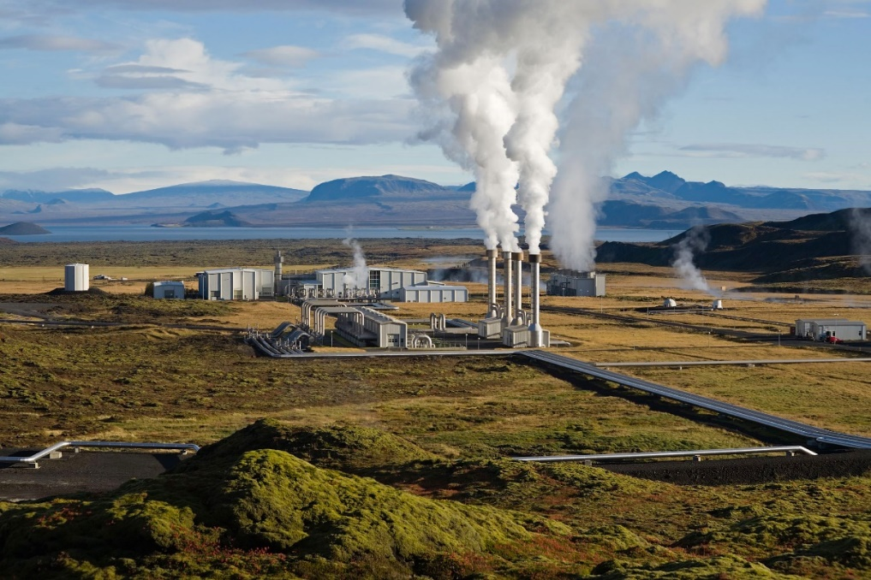
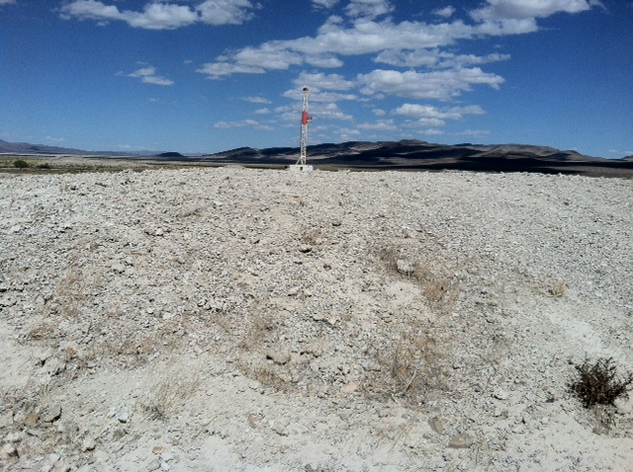
The Issue
Safety of Personnel
Safety of Navigation
Adverse impact to Stakeholders
Multiple Data Stewards
Lack of Visualizing Techniques
Range Management
Notes:
This project is directed towards military range lands.
Several stakeholders benefit from increased safety and management efficiencies. In particular, the Department of Navy and BLM would benefit most since it is primarily a safety of navigation issue. The geothermal development will go on, and with that comes data. It is this data that I want to standardize, make discoverable and visualize through multiple platforms being used on the range to navigate during times of limited visibility.
One issue that needs to be addressed is the requirement to visually identify through some type of technique. I found several vertical obstructions that were not illuminated and this might be a platform to identify and categorize that ensures these items are included in any type of range planning evolution.

Slide 5
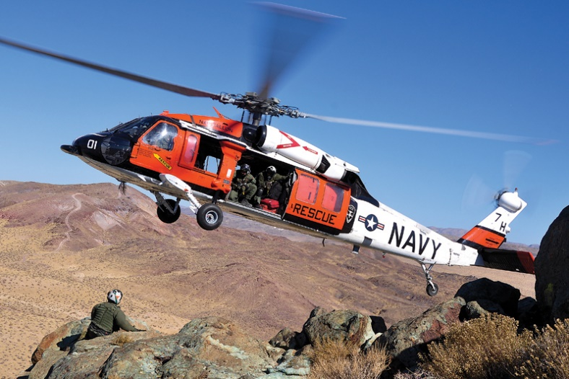
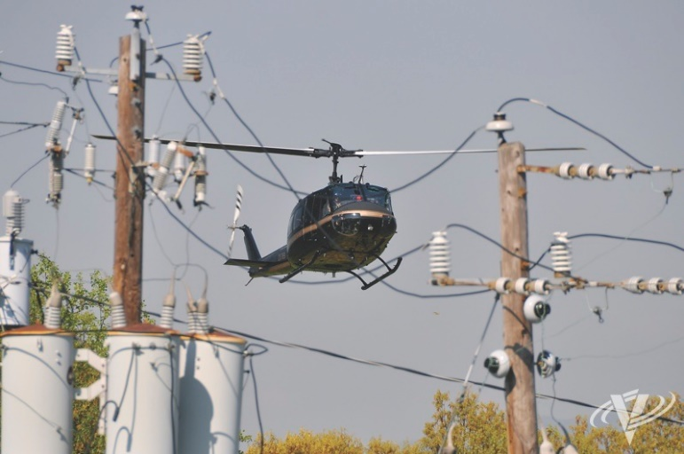
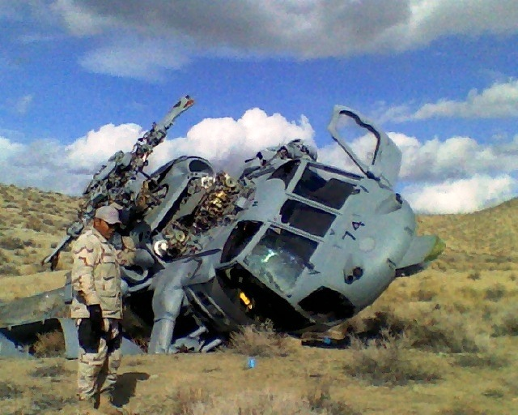
Incident Avoidance
Lack of situational awareness leads to accidents
Notes:
5
This issue is important because it concerns safety to personnel and property.
Another concern is that movement and placement of vertical obstruction without advanced notice. I refer to a case in 2007 where NV energy was found liable for placing a elevated line across a gorge without proper notification. This event caused the loss of 5 lives. This is the genesis for this project. To ensure vertical obstructions are accurately depicted, discoverable and visualized.
Geothermal energy development that includes GIS can be used to satisfy multiple users on public lands as a dual – use strategy.
Part of this dual-use strategy, the FRTC Range GIS Officer is to determine the vertical obstruction coverage model and ground use encroachment with military training areas. This is typically done during development of the Resource Management Plan. This document directs land management decisions for the area.
Planning documents list safety factors to consider that identify safety of ground and air navigation, two of these are vertical height and transportation.
Determining encroachment leads to determining the how to identify and notify personnel suing range lands for both energy development and military use to ensure safety.

Slide 6
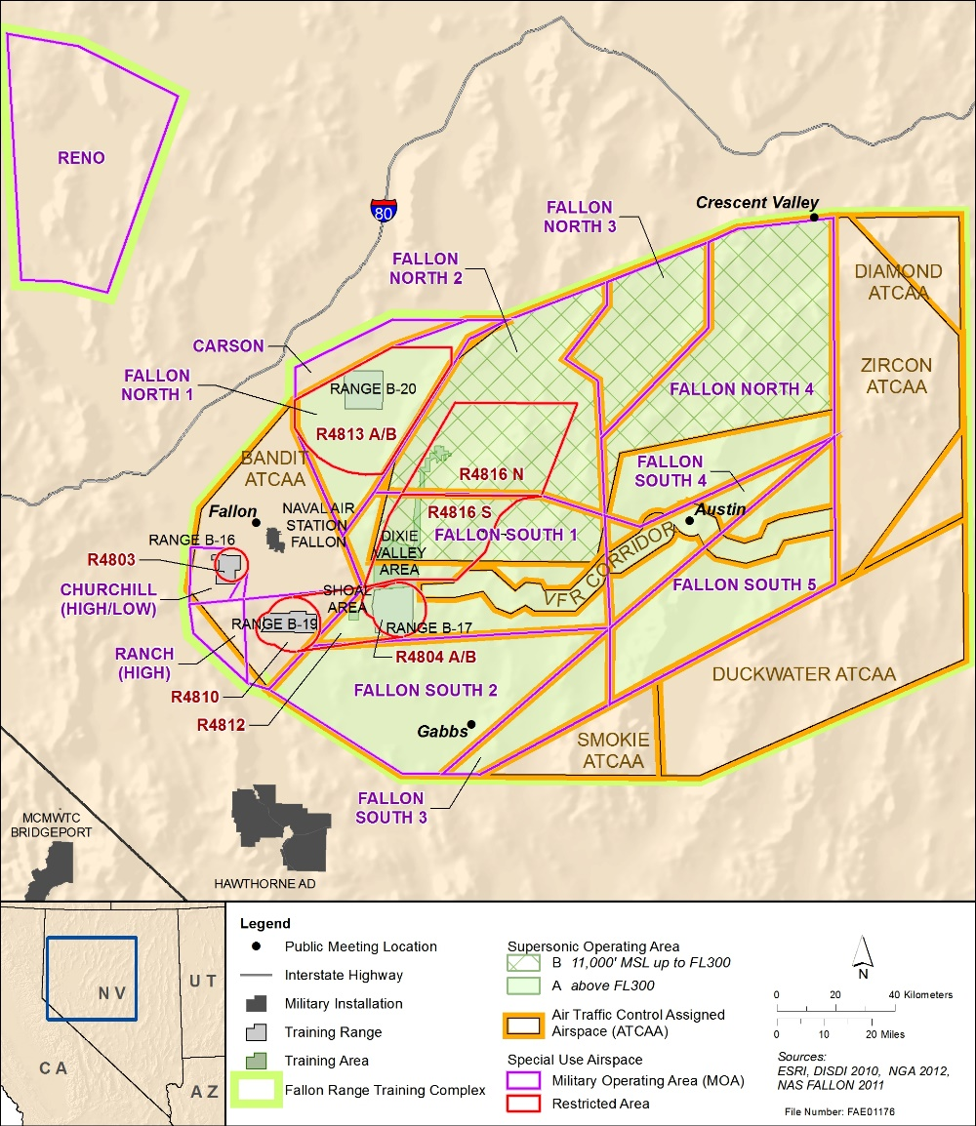
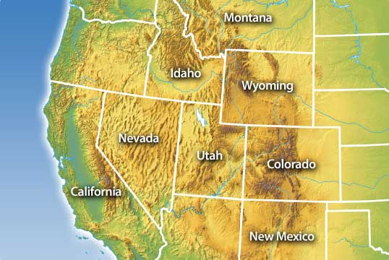
Study Area
Fallon Range Training Complex (FRTC)
Location: Churchill County, Nevada
65 miles East of Reno, Nevada
Within the Prehistoric Lake Lohontan
Elevation: ~ 3000 ft.
Part of Great Basin Range
High Geothermal Potential
Notes:
The project area is located in Churchill County, Nevada. The FRTC is located on BLM land in northern Nevada.
This project has the potential to support up to five other western regional military ranges where geothermal development is taking place.

Slide 7
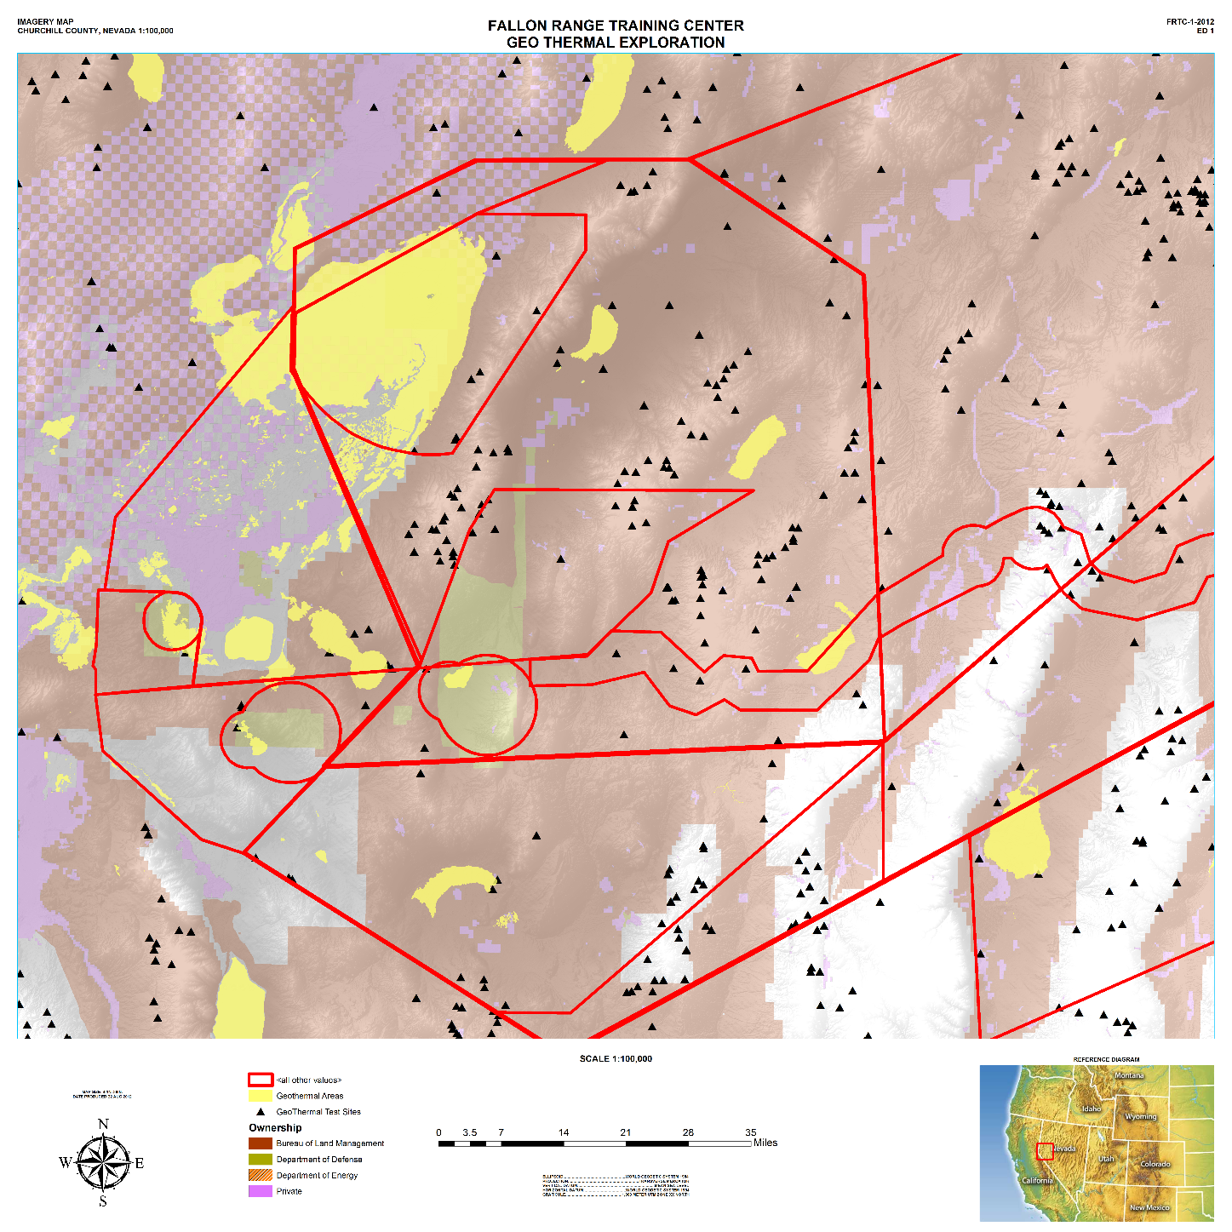
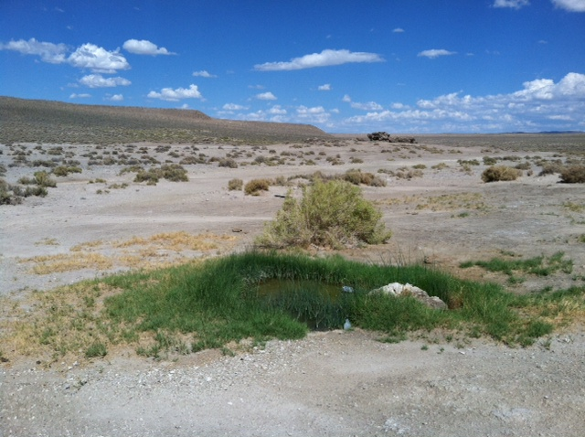
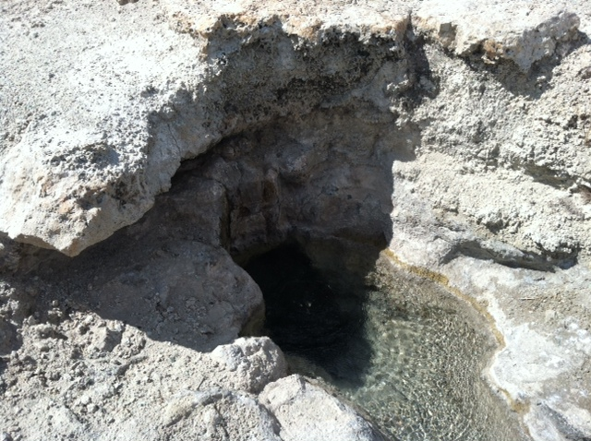
Study Area
Map shows
Land Ownership
Black=Test Sites
Yellow=High Geothermal Potential
Property of John Gray
Notes:
Specifically, the areas that I will focus on are called “bravo” ranges that house the electronic warfare complex and live munition drops zones. These areas are also of interest since it is where most of the low level flights take place when conducting ground exercises and search and rescue training.

Slide 8
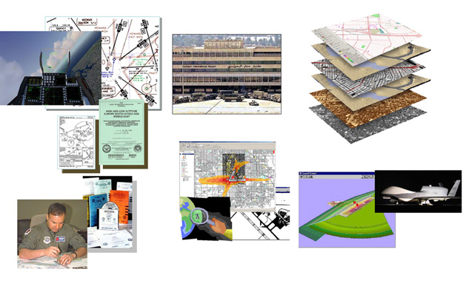
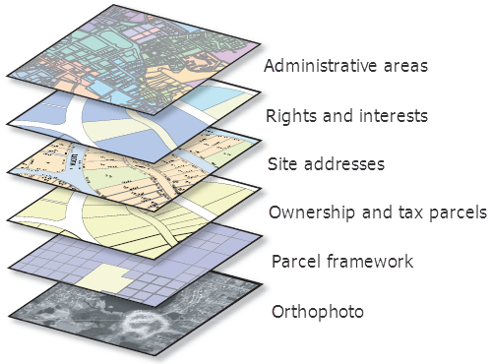
Goal and Objectives
The goal of this study is to map and characterize vertical obstructions in the FRTC for the Department of the Navy Geothermal Program Office's NAS Fallon Geothermal Exploration Project.
Objective: Develop a discoverable geodatabase that supports safety of navigation planning and the range management enterprise
Outcome: Visualized data that allows stake holder to plan and coordinate movement in close proximity to geothermal development
Build geodatabase using ArcGIS for Aviation Data Model schema
Notes:
The purpose of this project is to demonstrate the use of GIS as a tool to disseminate vertical obstruction data that is not included in the monthly DAFIF updates. This project will compile geospatial processes into a “workflow” that can be run as a single tool. This geoprocessing model will instruct ArcGIS to build encroachment buffers around vertical obstructions networked to the FRTC Geothermal geodatabase.
Factors typically used to determine if an area is within a danger zone is to use identify and catalog features that are geo-tagged for the system. These features are then incorporated into a master GIS that can be used to identify areas where low level flying should be prohibited or land are that are identified as being in close proximity to military activity.
The goal of my project is to use advanced GIS analysis using modeling to develop that supports geothermal safety of movement and navigation on the FRTC.

Slide 9
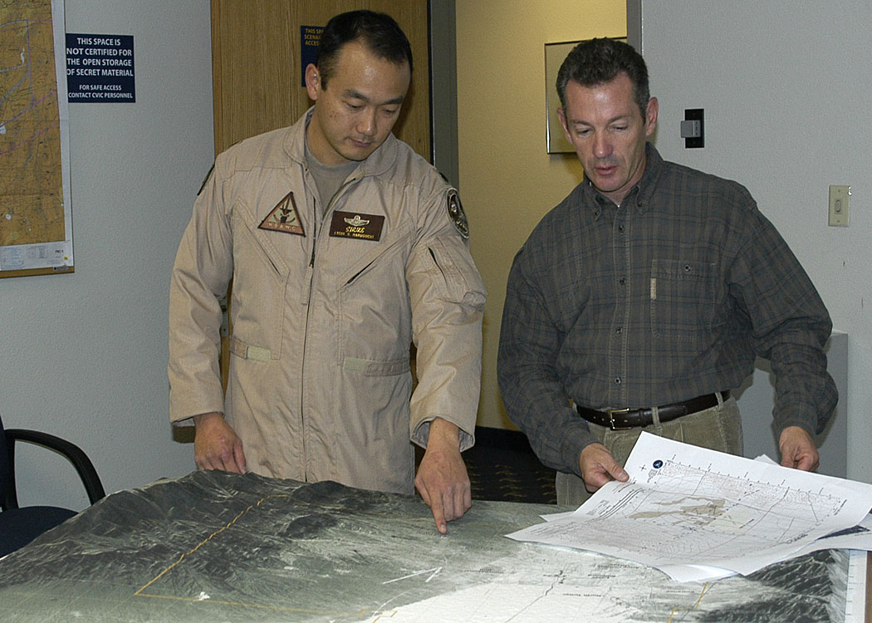
Why GIS?
Geographic component
Power of GIS as a Tool
Efficiency of Geodatabase
Visualized Through Multiple Platforms
Dual-use Strategy
Notes:
ArcGIS for Aviation: Charting helps air navigation service providers, civil and military aviation agencies, airlines, and commercial aviation businesses to streamline the production of aeronautical charts. It provides a true GIS-based platform to manage aeronautical data and information throughout the entire lifecycle. This enables you to rapidly create charts that adhere to industry and organization-specific requirements.
The geographic component is the credibility piece of the planning. This data can be verified through imagery analysis and field observation.
The ability to use this geodatabase in a number of mission planning-visualization platforms requires that it start as a geodatabase, then migrate to a shape file, and then can be converted into a number of layers to include KML for Google Earth, DRW for Falcon View, etc.
Making the source data a locally managed data set ensures there is a single point of entry. This layer can be updated more frequently than the standard Digital Elevation Flight File, which is monthly. Local management of the range data layer also provides for a more discoverable resource by those that are involved in a dual-use strategy and improves upon this partnership making range management local.

Slide 10
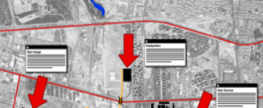
Accurate, Consolidate Geospatial Information Answers Critical Requirements
GIS Answers…
Where am I?
Where are the natural obstacles?
Where are the man-made structures?
How do I navigate them?
What activities are taking place there?
Where are my obstacles?
What did the area look like before?
What does the area look like now?
What might it look like after an event?
GIS Anticipates…
Where something will be
What may happen next
GIS Provides…
A foundation for decision-making
An ability to plan and execute
Information dominance
Decision superiority
Notes:
GIS answers critical questions, like:
Where am I?
Where are the obstacles?
What did the area look like before?
What does the area look like now?
It anticipates and helps us to better understand the environment.
Importantly, GIS provides a foundation for decision-making.

Slide 11
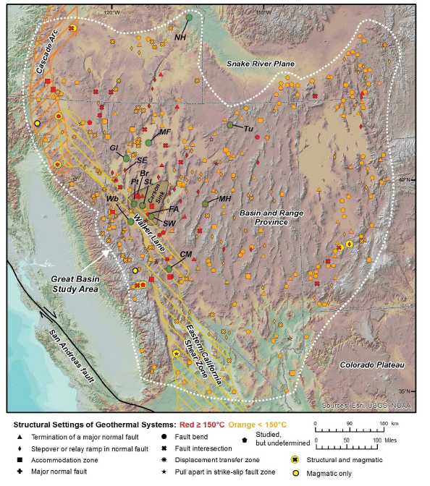
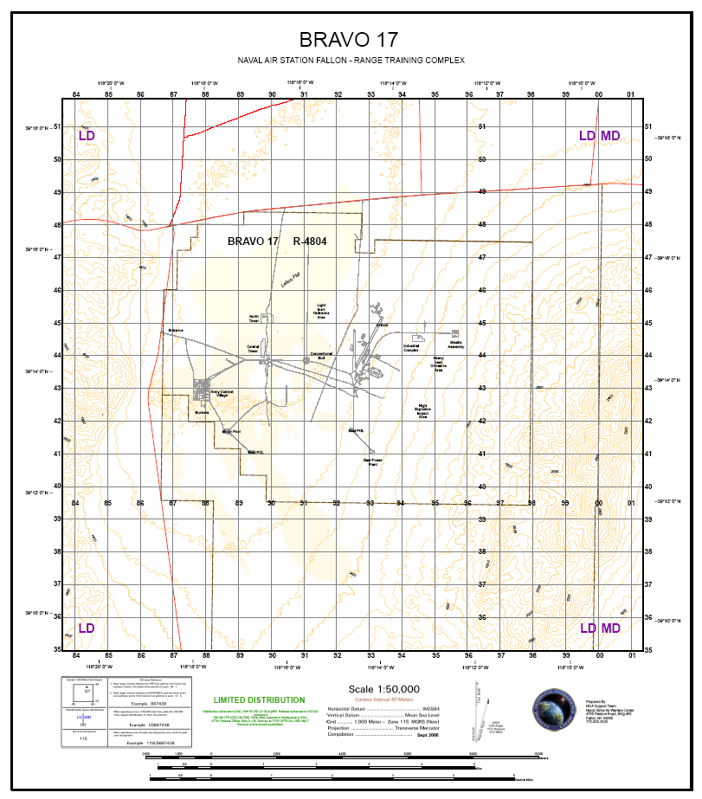
Current Situation
Courtesy University of Nevada, Reno and BLM
Database 1 + Database 2 =
Notes:
This is a depiction of the large amount of geothermal activity that is taking place in the western regions. This map on the left was compiled by the UNR and is meant show the rapid growth in the geothermal industry. The FRTC is in the center of this renewable resource.

Slide 12
Discoverable Geodatabase
Notes:
As we zoom in from the previous map, this is what I have compiled to illustrate low level flight activity combined with the geothermal development data. This maps is a good illustration of how closely geothermal systems are to active movement. Unless there is a discoverable data base that is recognized by all users, there is a high risk of encroachment. This encroachment is where violation in space inflicts a safety issue. In addition to a single source database, having geothermal systems identified through attribute ensures updates can be made efficiently. For example, if a well tower that is identified as yellow due to not having a beacon, then receives a beacon, it will still be a item in the shape file, but will now be annotated in green showing increased safety. This is the automated part of this project that is exciting to me.

Slide 13
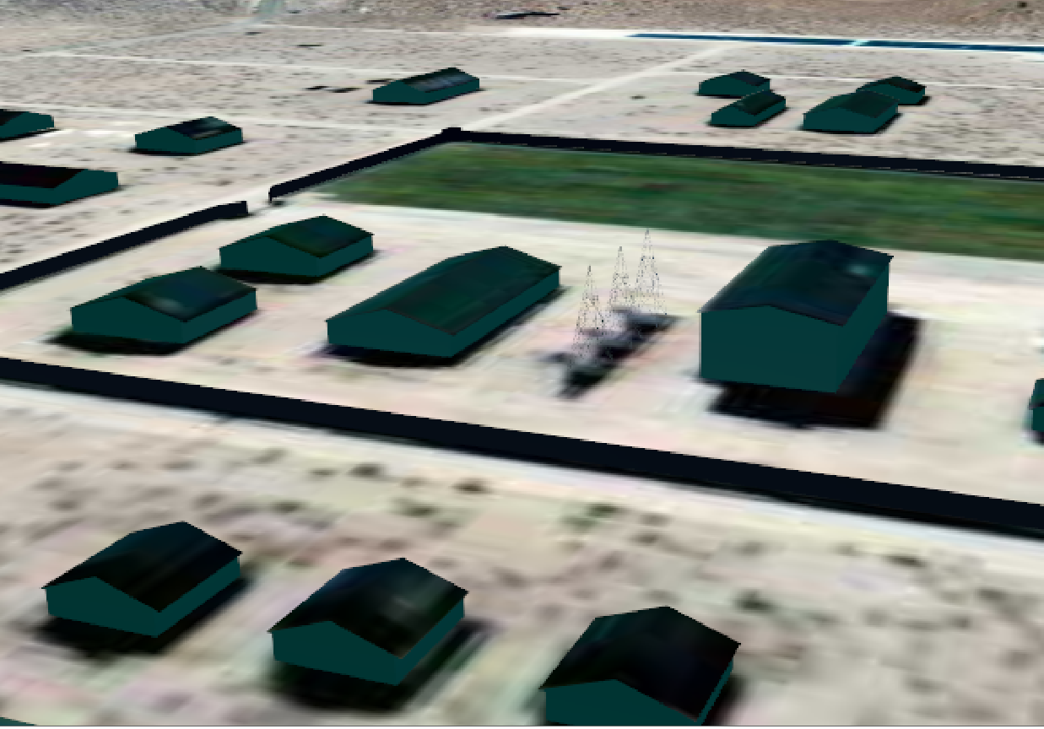
3D Modeling
Notes:
This is an example of how commercial exploration vertical obstruction would be displayed in 3rd party software for mission rehearsal. The towers in the center were added after being reported by field crews. This location has previously been identified as a helicopter extracting spot.

Slide 14
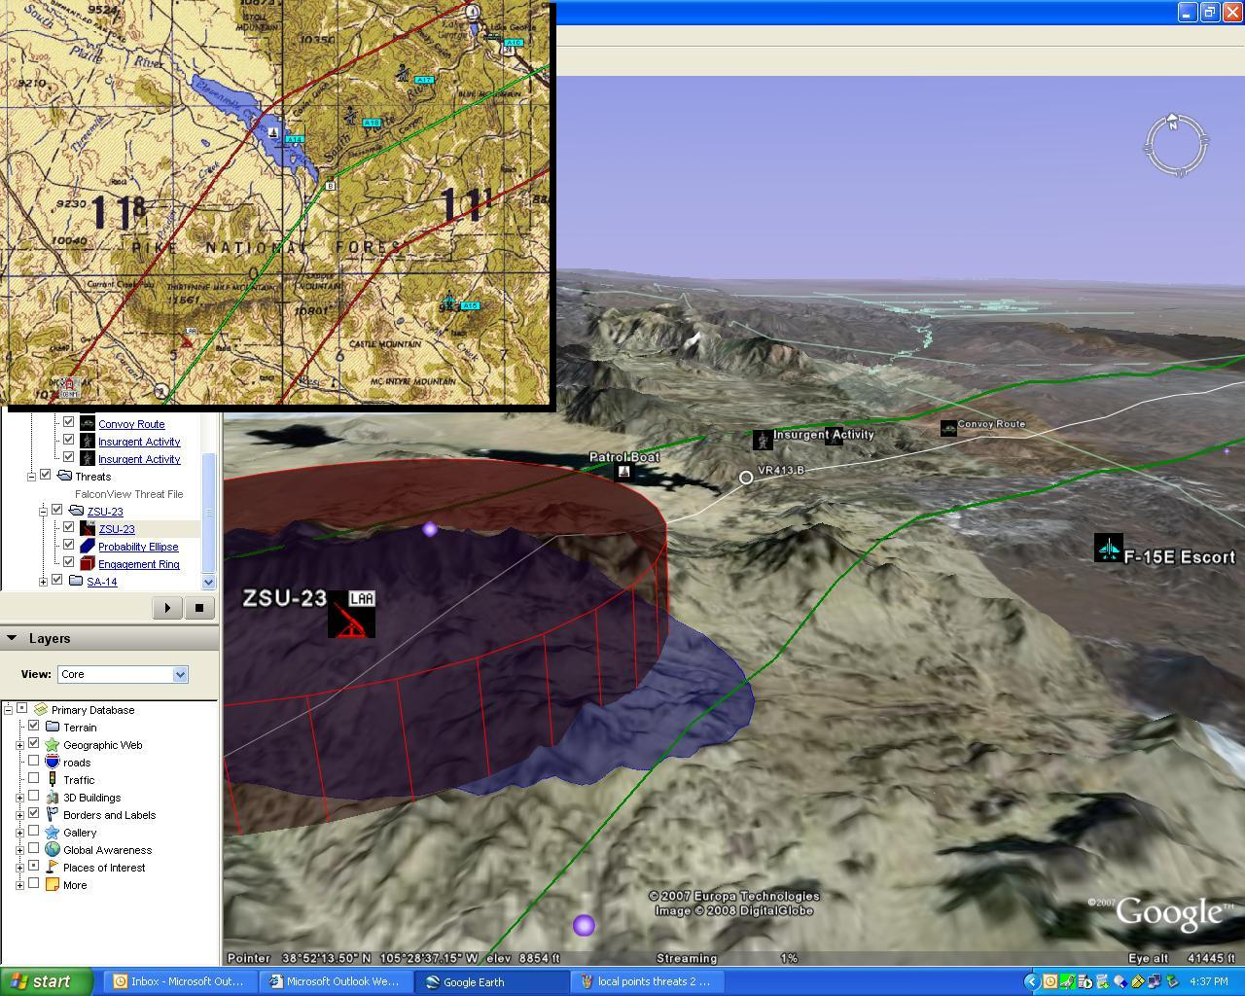
Shape2KML Visualizing
Courtesy Google Earth
Notes:
At the end of the day, the goal will be to take source data, catalogue and validate it, then eventually be able to export it into a representable software suite such as Google Earth.
Let me explain what this software does for those not familiar.
Here the Shape File has been converted into a KML through an automated process using the plug in PFPS2Google.

Slide 15
Data Resources
Geothermal System Geospatial Data Obtained From:
BLM Carson City Office
University of Nevada, Reno - Department of Geological Sciences and Engineering
Range Data Files Obtained From:
FRTC Range Management Office
NGA
Digital Airfield Flight Information File (DAFIF)
Chart Updating Method
Notes:
The source data for the most part has already been compiled through geological research, field investigation, and existing range training CAD files.

Slide 16
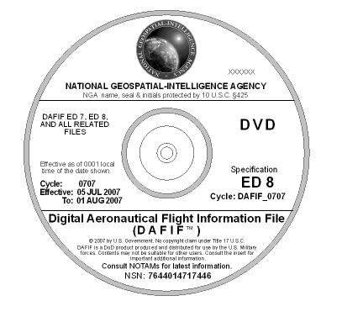
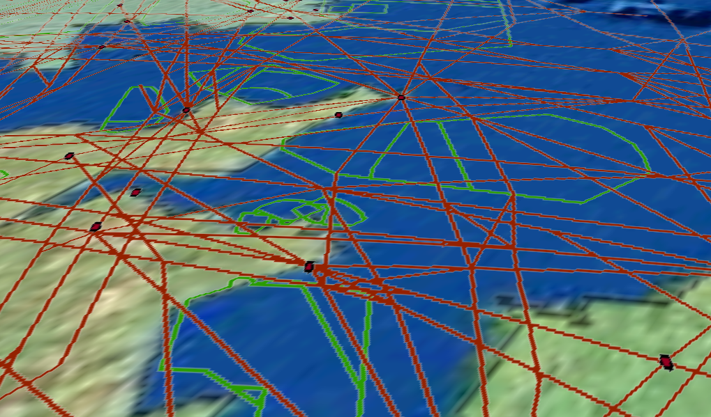
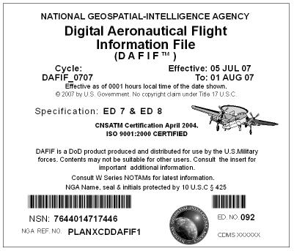
Digital Aeronautical Flight Information File (DAFIF)
“Ensure the quality of safety of navigation data”
Global Flight Planning Information
All flight planning products in digital format
Everything needed to globally plan a flight
Digital Vertical Obstruction File (DVOF) Initiatives
Database Verification Check (DVC)
Verify DAFIF/DVOF output to internal database
Configuration management feedback
Make users aware of DAFIF changes/issues
Publicly available
Notes:
The NGA DAFIF is still required, but the timeliness does not support local range ownership changes.
- Global Flight Planning Information
ALL Paper Flight Planning Products in Digital Format
Everything a pilot would need to globally plan a flight
- DAFIF Customers
DOD Mission Planning
US Military Pilots (DAFIF began with them)
US Government Pilots (Us Coast Guard, FBI, Forest Service, FAA, DEA, others)
Flight Management Systems
Current and Developing systems

Slide 17
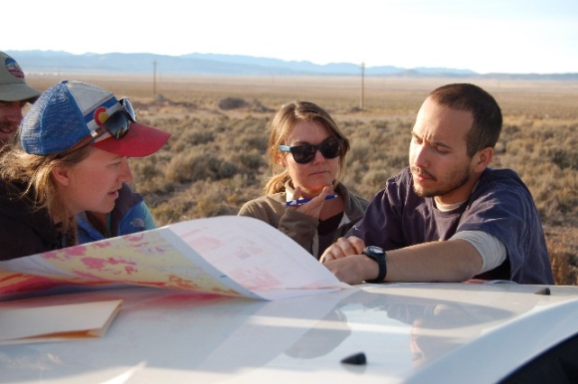
Methodology
Geothermal System Data
Geoprocessing Tool
Geodatabase
Data layer Discovery
Production Systems
Output (Derived Data) Field Validation
Geospatial Analysis and Product Updates
Production Systems
Notes:
Recommend developing a systematic computer-based model to incorporate multiple stakeholders GIS that support range management.
I will use ArcGIS Modelbuilder to create the geoprocessing model that will be used to build the safety of movement encroachment (buffers) around geothermal data.

Slide 18
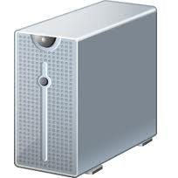
Discoverability
Web Application Server
FRTC Web Discovery
Range Stakeholders
Server Database
GIS Server
(ArcGIS for Server)
Military
Mapping Services
Geoprocessing
Other data hosting
Notes:
The geodatabase would reside on the server at the Naval Strike & Air Warfare Center since they already have a geospatial product library that is web-enabled.

Slide 19
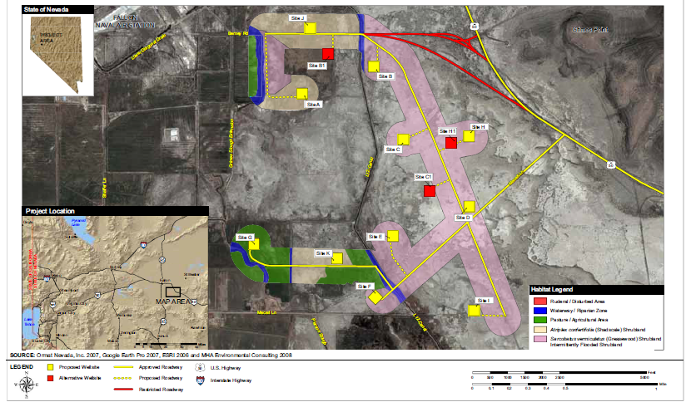
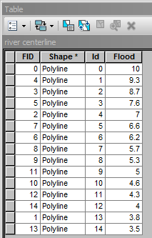
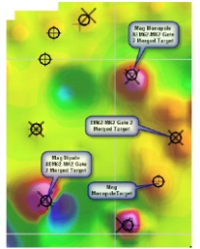
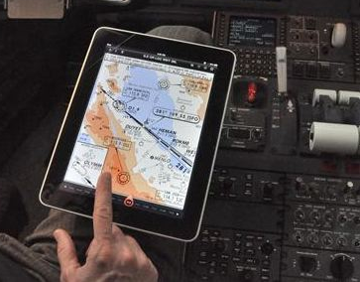
Anticipated Outcomes
Increased Accuracy
Based On …
Increased Functionality
Standardized Data Resource
Analysis
Open Source
GIS Production
Discovery
Notes:
The expected outcome will be products that visualize hazards to safety. It will supplement the DAFIF files and not replace them. The output layers will allow additional analysis depending on the software being used. I will discuss these different types of software now.
FRTC Range Management
Supplement FAA / NGA Data for Mission Planning
Discoverable at SharePoint Location
Stakeholder Coordination
Deconfliction
Multi-Use Strategies

Slide 20
Project Timeline
Aug: Meet with FRTC Staff
Adapt project based on feedback
Aug-Oct: Enrolled in GEOG 588 (GIS for Homeland Security)
Aug-Sept 2015: Update geodatabase
Demonstrate process and output to FRTC and NGA at NAS Fallon, NV
Sep: Refine data, production methods and modeling
Analyze and synthesize findings for presentation
Oct-Dec: Enrolled in GEOG 596B
Oct 12: Present at the Nevada GIS conference (Lake Tahoe, NV)
Demonstrate final process to Naval Strike & Warfare Center for review
Finalize application to FRTC range managers, write final report, and provide research to the Naval Strike & Air Warfare Center, FRTC Range Office
Dec: Compile results in full report to FRTC, BLM, UNR, PSU
Long term: Multi-range use, Incorporate into DAFIF and DVOF updates, Standardized

Slide 21
Acknowledgements
Dr. Joseph Bishop, Pennsylvania State University
Mr. Scott Tabor, M.Sc., University of Redlands, NGA
Mr. James Faulds, Research Professor, Department of Geological Sciences and Engineering, University of Nevada, Reno
Mr. Richard Gent, Naval Strike & Air Warfare Center
Ms. Cynthia Wirick, NAS Fallon, GIS Office
Department of the Navy Geothermal Program Office
Notes:
I wish to thank the following for guidance and support….

Slide 22
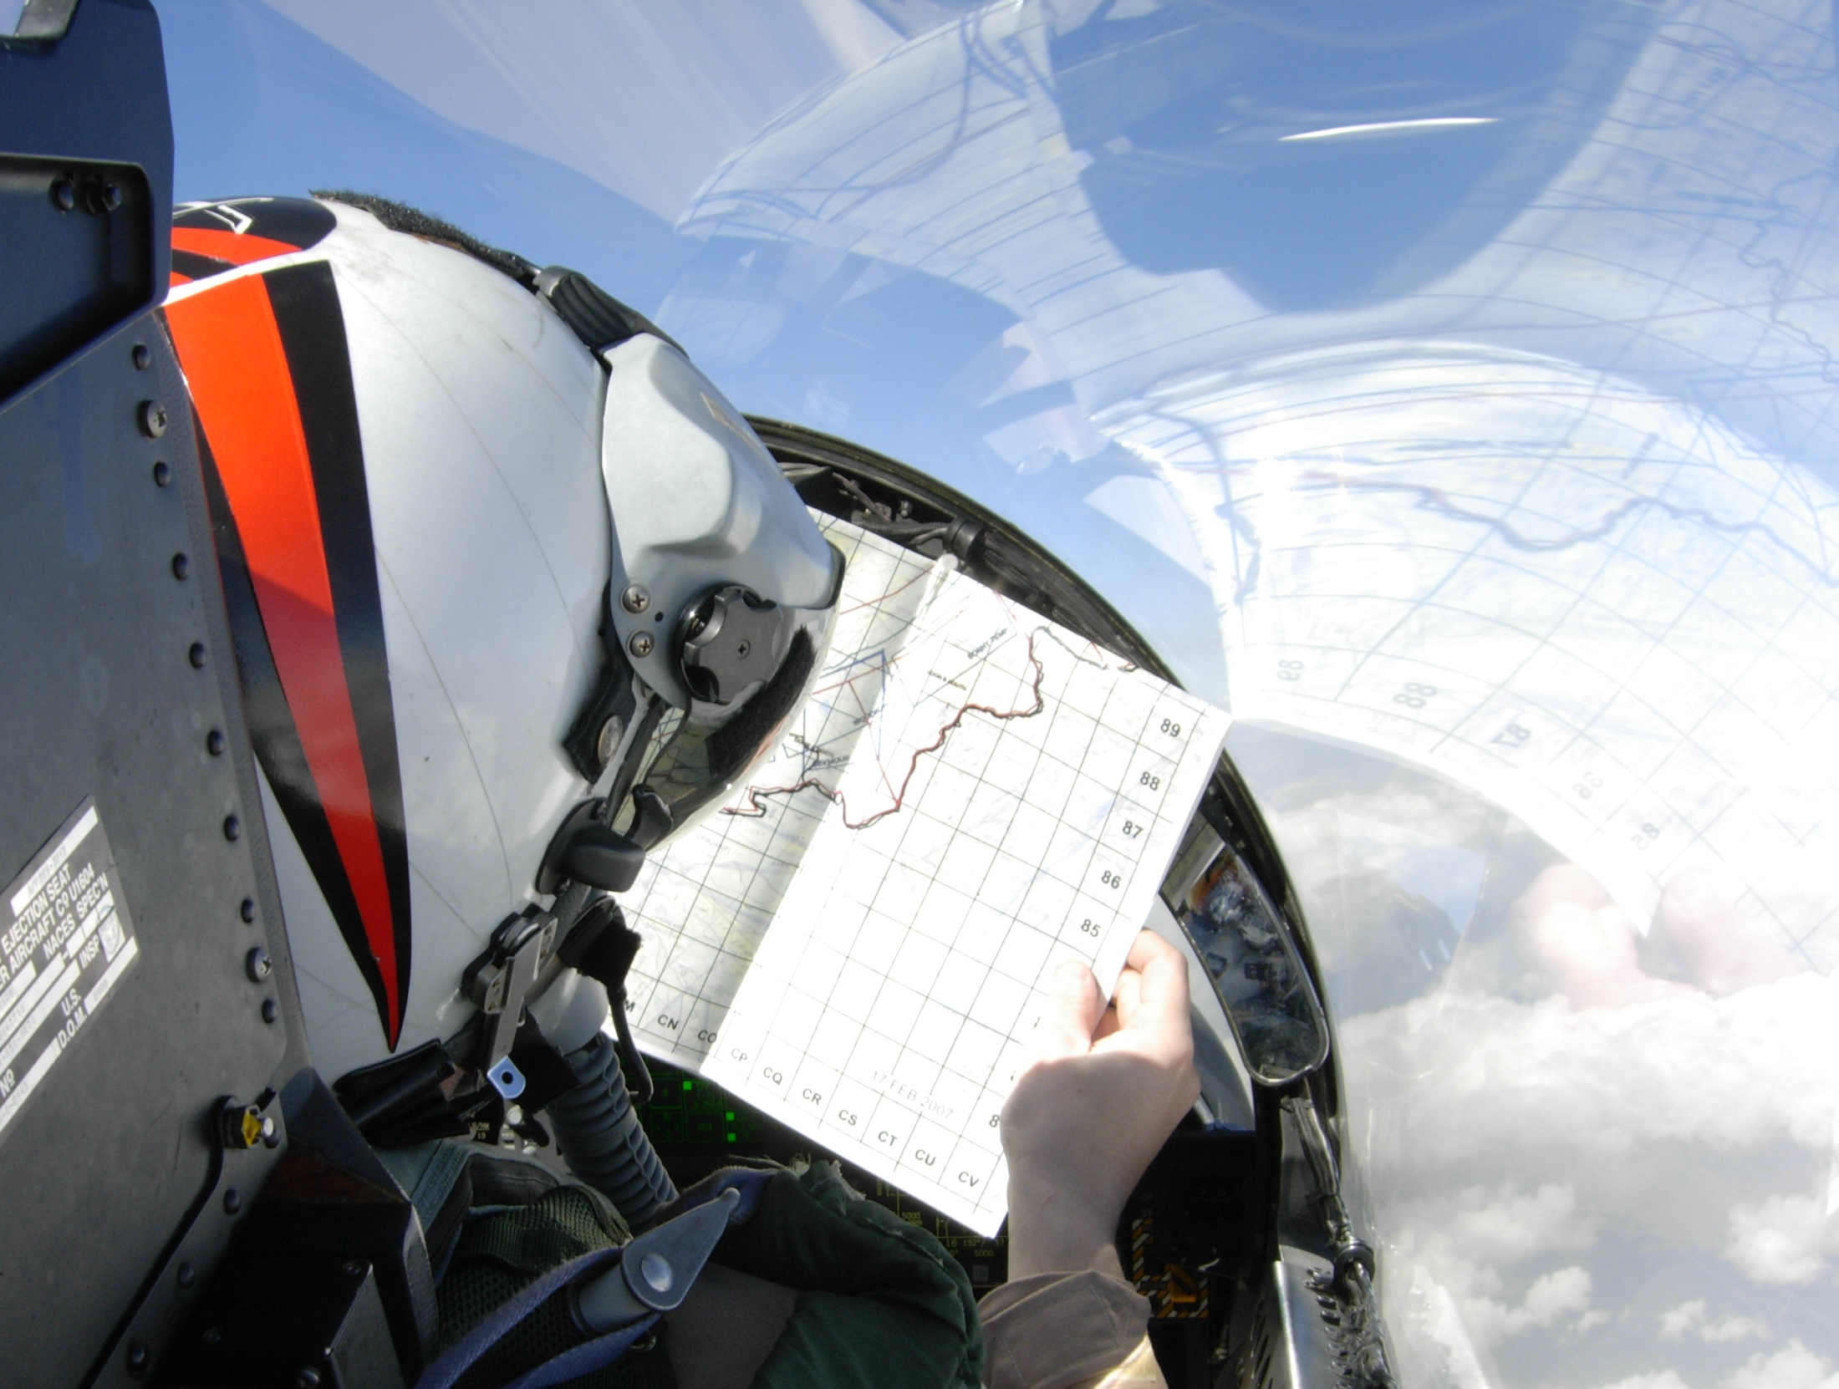
Questions?

Slide 23
References
Calvin, W. M., Coolbraugh, M., Kratt, C., and Vaughan, R.G. (2008). Application of Geographic Information Systems and Remote Sensing Technology to Geothermal Exploration, Great Basin Center for Geothermal Energy (GBCGE) and the Department of Geological Sciences, University of Nevada, Reno.
Monastero, Francis C. (2002). Model for Success, an Overview of Industry-Military Cooperation in the Development of Power Operations at the Coso Geothermal Field in Southern California. Geothermal Resources Bulletin Sep/Oct 2002. Geothermal Program Office, U.S. Naval Air Weapons Station, China Lake.
Nevada Bureau of Mines and Geology, University of Nevada, Reno, NV, (2015, February). Final Research Performance Report. Retrieved 15 March, 2015 from http://gdr.openei.org/files/354/Final%20Report-DE-EE0002748.pdf
Tabor, G.S. (2006). Wind Energy Development under Military Airspace. University of Redlands, Retrieved 15 March, 2015 from http://inspire.redlands.edu/gis_gradproj/110
United States Department of Defense. Readiness and Environmental Protection Integration Program. (2015, March). Retrieved 15 March, 2015 from http://www.repi.mil/Portals/44/Documents/Reports_to_Congress/2015REPI%20RTC_031215_v3.pdf
United States Department of Interior, Bureau of Land Management (2008, March). Carson Lake Geothermal Exploration Project, Environmental Assessment. Retrieved 12 June, 2015 from http://www.blm.gov/pgdata/etc/medialib/blm/nv/field_offices/carson_city_field/planning___environmental/geothermal/carson_lake_geothermal.Par.60302.File.dat/01Cover_TOC.pdf
United States Department of Interior, Bureau of Land Management (2005, February). Renewable Resources for America’s Future. Retrieved 15 March, 2015 from http://www.doi.gov/initiatives/renewable_energy.pdf.
United States Department of the Navy. (2015, July). Commander, Navy Installations Command (CNIC). Naval Air Station Fallon. Retrieved 6 July, 2015 from https://www.cnic.navy.mil/regions/cnrsw/installations/nas_fallon/about/nsawc.html
Notes:
References and Citations

