Slide 1
CareerMap™ Using VGI and external data to map the real careers of students and alumni for improved career planning and networking
Richard Greeley
MGIS
GEOG 596A
Advisor: Jim Detwiler

Slide 2
Agenda
CareerMap™
Problem
Literature Search
Project Definition
Methodology
Goals and Objectives
Timeline

Slide 3
Jobs
Careers
An individual’s career is a linked succession of education and jobs
Education
Major
School
Job 1
Company
Title
Industry
Job 2
Company
Title
Industry
Job 3
Company
Title
Industry
“These younger baby boomers held an average of 11.7 jobs from ages 18 to 48.”
Bureau of Labor Statistics
The Bureau of Labor Statistics (BLS) never has attempted to estimate the number of times people change careers in the course of their working lives. The reason we have not produced such estimates is that no consensus has emerged on what constitutes a career change.”
Bureau of Labor Statistics
https://www.bls.gov/nls/nlsfaqs.htm

Slide 4
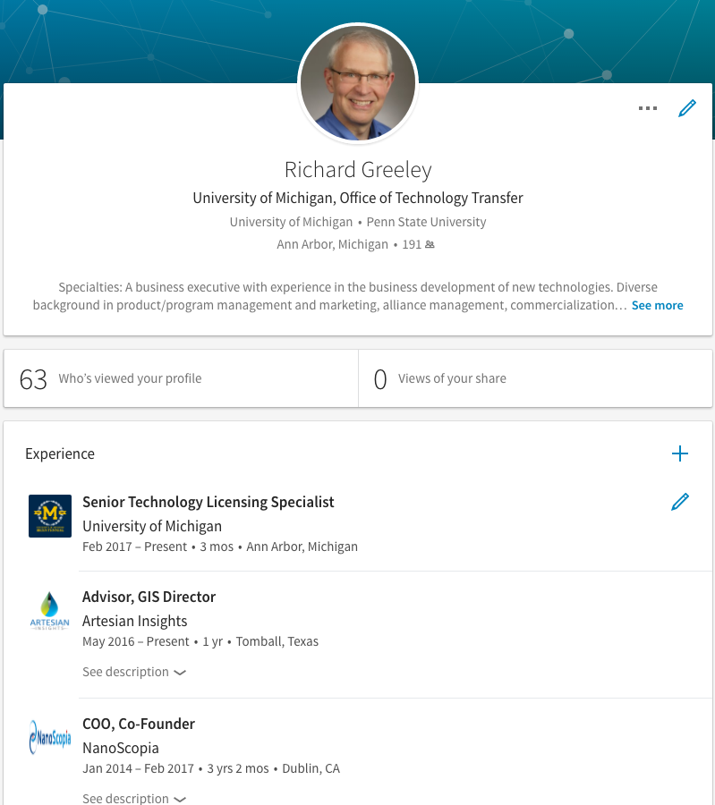
The LinkedIn Effect
The data is increasingly out there.
People are willing to share their information
But
It is not in a form to be easily consumed
Doesn’t allow for searching and visualizing to help plan and network
Doesn’t bring in other data about jobs that would provide a richer story
Doesn’t ask about the story behind why people shifted jobs

Slide 5
The Problem?
For the Students and Alumni
Career paths are too general, need specifics based on real people
College and career counseling is not specific enough with respect to time, major, location, or industry
Career information isn’t recent enough to reflect current job market and emerging trends – data is not real time
No clear path or data to show impact of additional education on career advancement
No way to connect to alumni with similar career experiences, especially past jobs
For the University
Lack of real-time information about students and alumni hinders decision making
How to stay relevant and connect alumni to ongoing education
How to design courses for the latest needs in the marketplace
Limited view does not allow for benchmarking with other universities
Hard to market to students and alumni without hard data about where alumni find jobs
The underlying problem is a lack of tools and data

Slide 6
Literature Search Thrusts
Spatial-Temporal Mapping of Careers
Longitudinal Career Studies
Event History Analysis
Volunteered Geographical Information

Slide 7
Research Thrust 1 – Career Mapping
Journal
Transactions in GIS
GIScience & Remote Sensing
Computers & Geoscience
Cartography and Geographic Information Science
Annals of the Association of American Geographers
Geoiformatics
ISPRS International Journal of Geo-Information (IJGI)
International Journal of Geographical Information Science (IJGIS)
International Journal of Health Geographics
Journal of Geographical Systems -- Geographical Information, Analysis, Theory and Decision
Journal of Spatial Science (TJSS)
Annals of GIS (TAGI)
Cartographica -- The International Journal for Geographic Information and Geovisualization
Geo-spatial Information Science
Geomatica
Journal of Location Based Services (TLBS)
Journal of Spatial Information Science (JOSIS)
Nobody has mapped careers through space and time that I have been able to find
This project therefore represents potentially new ground in geographic information research
The literature search was then focused on answering two questions:
How is CareerMap different?
What can be learned from related research and work?
And general online searching

Slide 8
Research Thrust 2 – Longitudinal Career Studies
Study Examples
After the JD (Law Degree), Wave 3: A Longitudinal Study of Careers in Transition, 2012-2013, United States (ICPSR 35480)
A longitudinal study of I/S careers: synthesis, conclusion, and recommendations
The Longitudinal Study of Astronomy Graduate Students
Workforce trends in general practice in the UK: results from a longitudinal study of doctors' careers
Lawyers at Mid-Career: A 20-Year Longitudinal Study of Job ...
Graduate Longitudinal Study New Zealand (GLSNZ)
From Student to Accounting Professional: A Longitudinal Study of the Filtering Process
Mobility Strategies and Career Outcomes: A Longitudinal Study of MBAs
Results from the Longitudinal Study of Astronomy Graduate Students
The promised path: a longitudinal study of managerial careers
Career trajectories of Dutch pop musicians: A longitudinal study
Longitudinal Study of Career Productivity of the Most Prolific Science Education Researchers
Predictors of Business Success Over Two Decades: An MBA Longitudinal Study
Longitudinal studies track populations through time.
Learnings for CareerMap
Study Structure:
Career studies are highly structured, manual labor intensive and take a long time.
CareerMap is real time analysis with a big data approach.
Extensibility: The specific information varies a great deal by institution - make sure the platform can import and integrate other information.
Demographic Information: Demographic information is very useful.
Trust and Response Rates: High response rates from trusted institutions (35-90%)
Benefit for the Subject: CareerMap gives something of useful to the subject of the study right away.

Slide 9
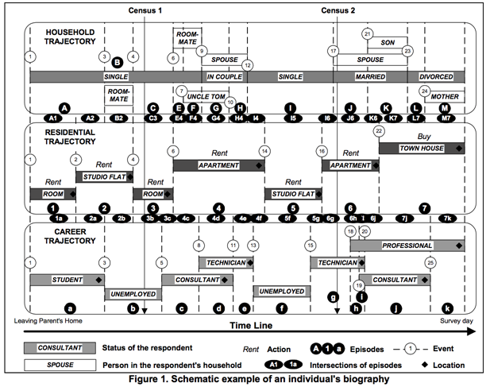
Research Thrust 3 – Event History Analysis
Marius Theriault advanced the use of GIS in event history analysis as a part of a study of urban mobility.
Event history analysis is a set of statistical methods for the analysis of data on the occurrence, inter-relatedness and timing of events.
Key Learnings
Events vs. Episodes: a point in time as opposed to a ongoing condition
Both are useful
Has an impact on temporal coding of data and how tools work
The extra detail creates the possibility for increased sophistication of queries
Find all people whose first job after graduation was a governmental job overseas.
Find people who switched industries between 2005 and 2010.
Impact on her career when a women has children
Non-GIS data analysis can be complementary and very useful

Slide 10
Research Thrust 4 – Volunteered Geographic Information (VGI)
CareerMap relies on user supplied information, therefore it falls into the general realm of VGI
VGI replaces the (GIS) expert and distributes the work.
A review of VGI projects and research about them (See, et al) showed they are mostly focused on using people to gather information about maps or external phenomenon.
Much of the literature research is focused about the accuracy of the spatial data and accurate coding.
Safety | Science | Mapping | Information | Transportation
Crime | Ecology | Feature mapping | Fishing | Transportation
Disasters | Environmental Monitoring | Land Cover | Gazetteer | Driving
Health Events | Sky Stars |  | Geocaching
 | Weather |  | Hiking Trails
 |  |  | Social Media
 |  |  | Mobile Data
 |  |  | Places of Interest Travel

Slide 11
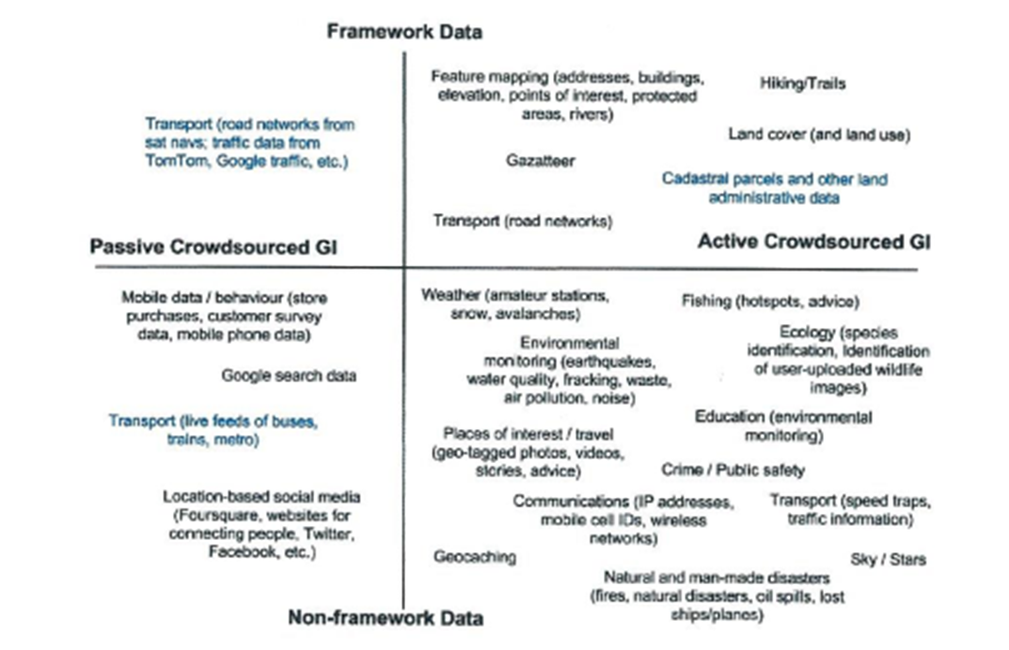
Career Mapping and VGI
The work of CareerMap is different in several important dimensions from these existing VGI projects:
The observer explicitly provides information about himself or herself, not external, measurable events which can be verified for accuracy
The requirements for the precision and accuracy of geographic and temporal information is comparatively very, very low.
There aren’t experts nor standard data to compare again (Framework Data)
People aren’t using VGI to study this specific area
CareerMap

Slide 12
VGI Quality Measures and Indicators
Senaratne, Mobasheri, Alli, Capineri and Haklay (“A review of volunteered geographic quality assessment methods”) reviewed current literature and documented 17 quality measures and indicators in the 56 papers they surveyed.
Spatial | Temporal | Point Attributes | User Attributes
Positional Accuracy | Temporal Accuracy | Content Quality | Credibility
Topological Consistency |  | Vagueness | Trustworthiness
Geometric Accuracy |  | Completeness | Experience
Thematic Accuracy |  | Semantic Accuracy | Reputation
 |  | Usage | Recognition
 |  | Data lineage (history) | Local knowledge
User is the only one with knowledge about their career
Can trust be managed by peer influence and trust in organization?
(as suggested by longitudinal career studies)
Trust is especially critical in light of incidents like Facebook
Not as important
for CareerMap

Slide 13
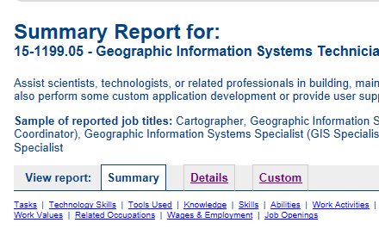
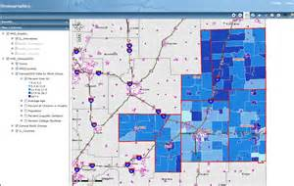
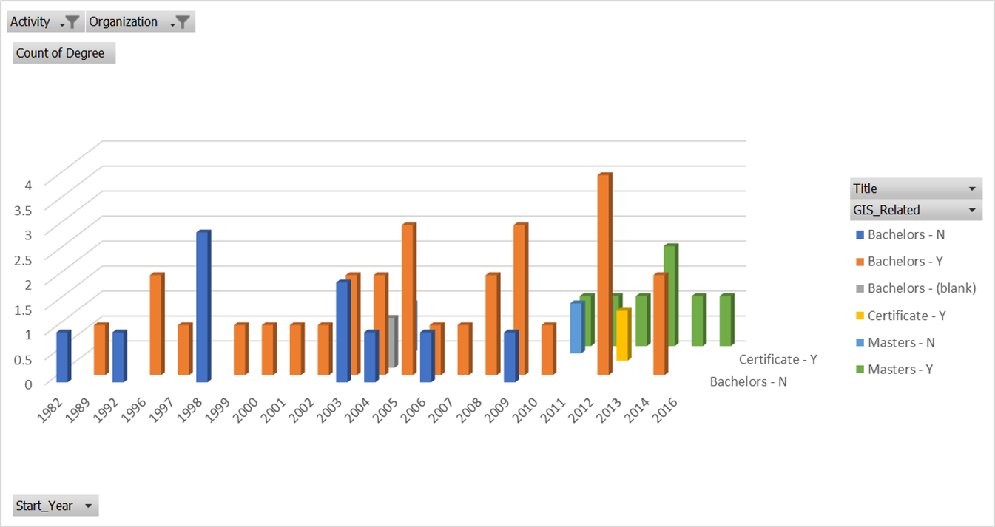
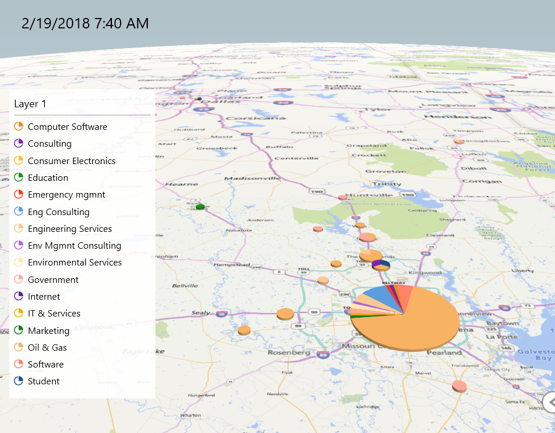
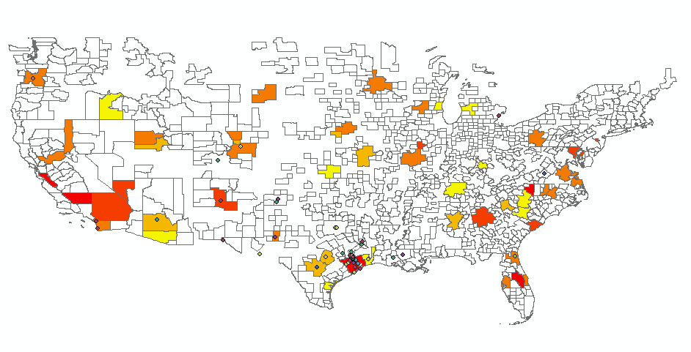
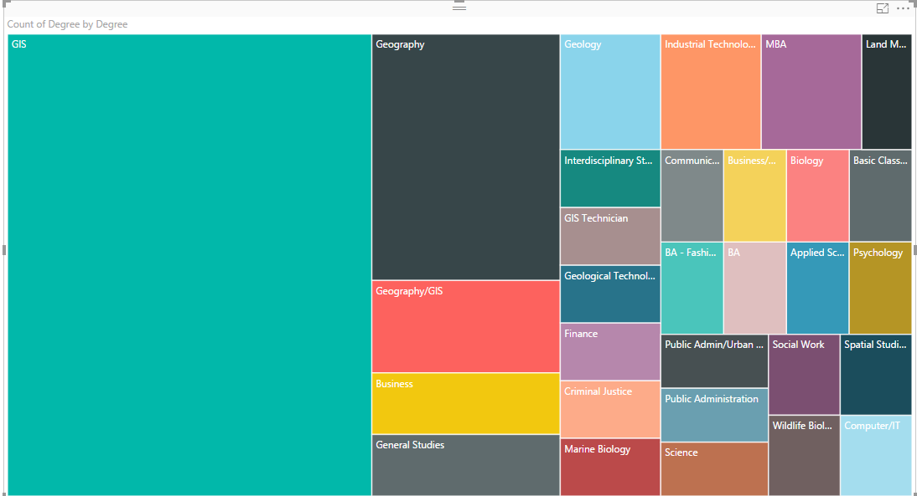
CareerMap System
University
Students
Courses
Alumni
Donations
University provides information about their students, courses, alumni, in return CareerMap provides unique conversion-retention-outcome analysis
Students, Alumni
Demographic Info
Educational History
Work History
External Data
Demographic
Economic
Jobs
Skills
CareerMap
Wash, Rinse, Visualize, Repeat
Find and Feed Virtuous Cycles: Everyone Wins
The more accurate, timely, and detailed the data provided, the richer the analysis.
Students / Alumni provide information about themselves, CareerMap in turn provides valuable career path and employment trends

Slide 14
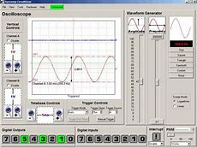
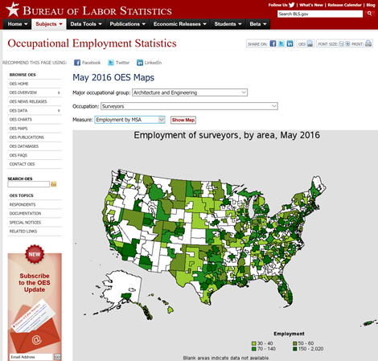
System Components
Web Site
Instrumentation
Login
Data Entry
Visualization
Time Aware
App Template
Additional User Information
(TBD)
Data Base
Spatial Database
Spatial Information
Longitudinal Career Studies
Event History Analysis
Longitudinal Career Studies

Slide 15
Cohorts
Users: Penn State Geography students and alumni
Administrator(s)
Note: CareerMap will require IRB training and approval
 | Certificate Students | Undergraduate Students | Masters Students | PhD Students | Alumni
Physical Campus | TBD | TBD | TBD | TBD | TBD
World Campus (Online) | 1500 | Not offered | 320 | Not offered | 4000
Goal = 500-1000
Possibilities
Geography Department Alumni Affairs
Penn State Alumni Affairs
World Campus Student Affairs
Geography Department
Career Counseling
Goal = at least one

Slide 16
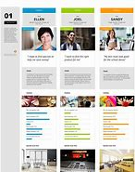
Personas
The purpose of personas is to create reliable and realistic representations of your key audience segments for reference.
Persona | Career Status | Primary Needs
40, 50 & 60 Year Olds | Enriching a career or considering new options | Help for career switching and enrichment
30 Year Olds | Established in a career | Support for career enrichment and advancement
20 Year Olds | Trying to get established in a career | Understanding career choices, major choice and options
College Administrator | Experienced administrator looking to advance the university’s mission | Understanding student outcomes, retention and conversion, and institutional effectiveness

Slide 17
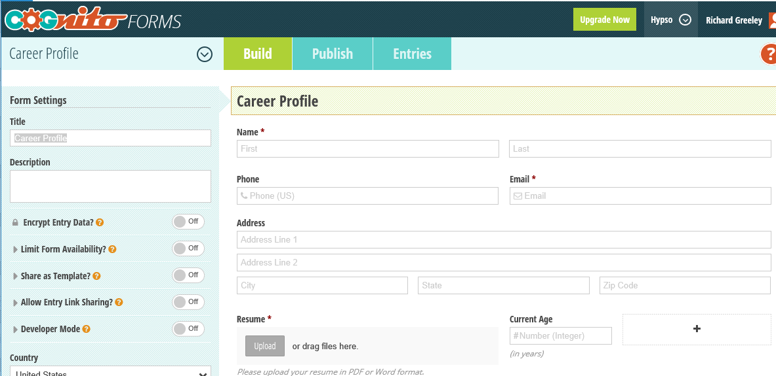
Data to Be Gathered
Demographic Information
Age
Sex
Other TBD
Education and Job Information
Location
Dates
Job Title, Company
Degree, Major, etc.
Attitudinal Information
Reason for job change
Reason for educational choice
Job Satisfaction
Are using GIS degree?
External Data Sources to Import
Bureau of Labor Statistics
ESRI Living Atlas

Slide 18
Data Analysis and Methods
Data Entry
Data Size
1000 students and alumni
10 episodes (jobs and degrees) per person
= 10,000 episodes/data points
Buttons and Pull-Down entries as much as possible
Free form fields may need clean up
Data Cleanup
Cleanup on company names, titles, etc.; missing data
Create meta-data, events, and linkages
Key challenge = automation
Geocoding
Timecoding
Geocode at city/town/postal level
Apply timecoding algorithm to fill gaps in temporal information
Key challenge = dealing with imprecise/ variable data
Map Layers
User Information
Create Map Layers
Update and export from database
Key challenge = automation
Externally Imported Information
Data Selection and Filtering
Spatial filtering via pinch and slide
Time filtering via slider bar
Key challenge = making robust attribute queries easy
Base Map Information
Data Visualization
Visualize individual entries
Key challenge = easy to understand visualizations with many data points connected together

Slide 19
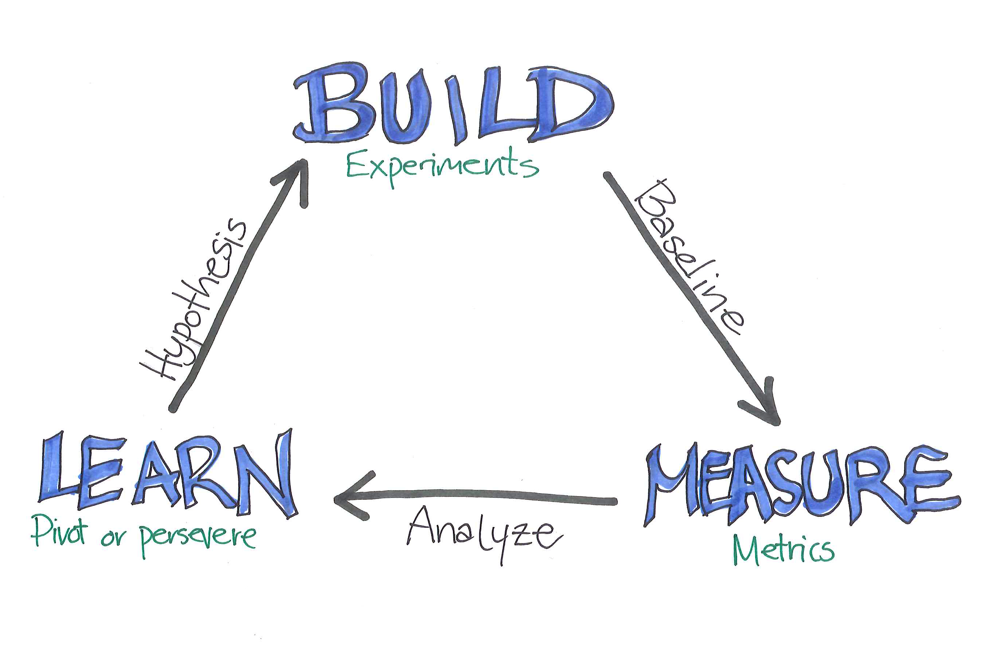
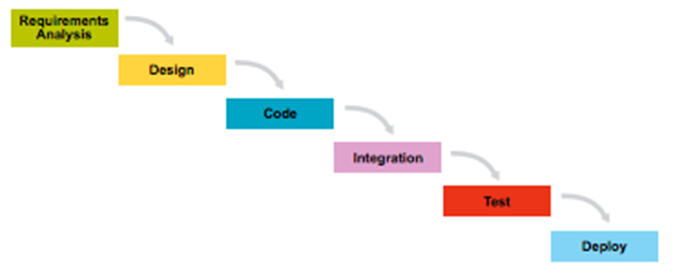
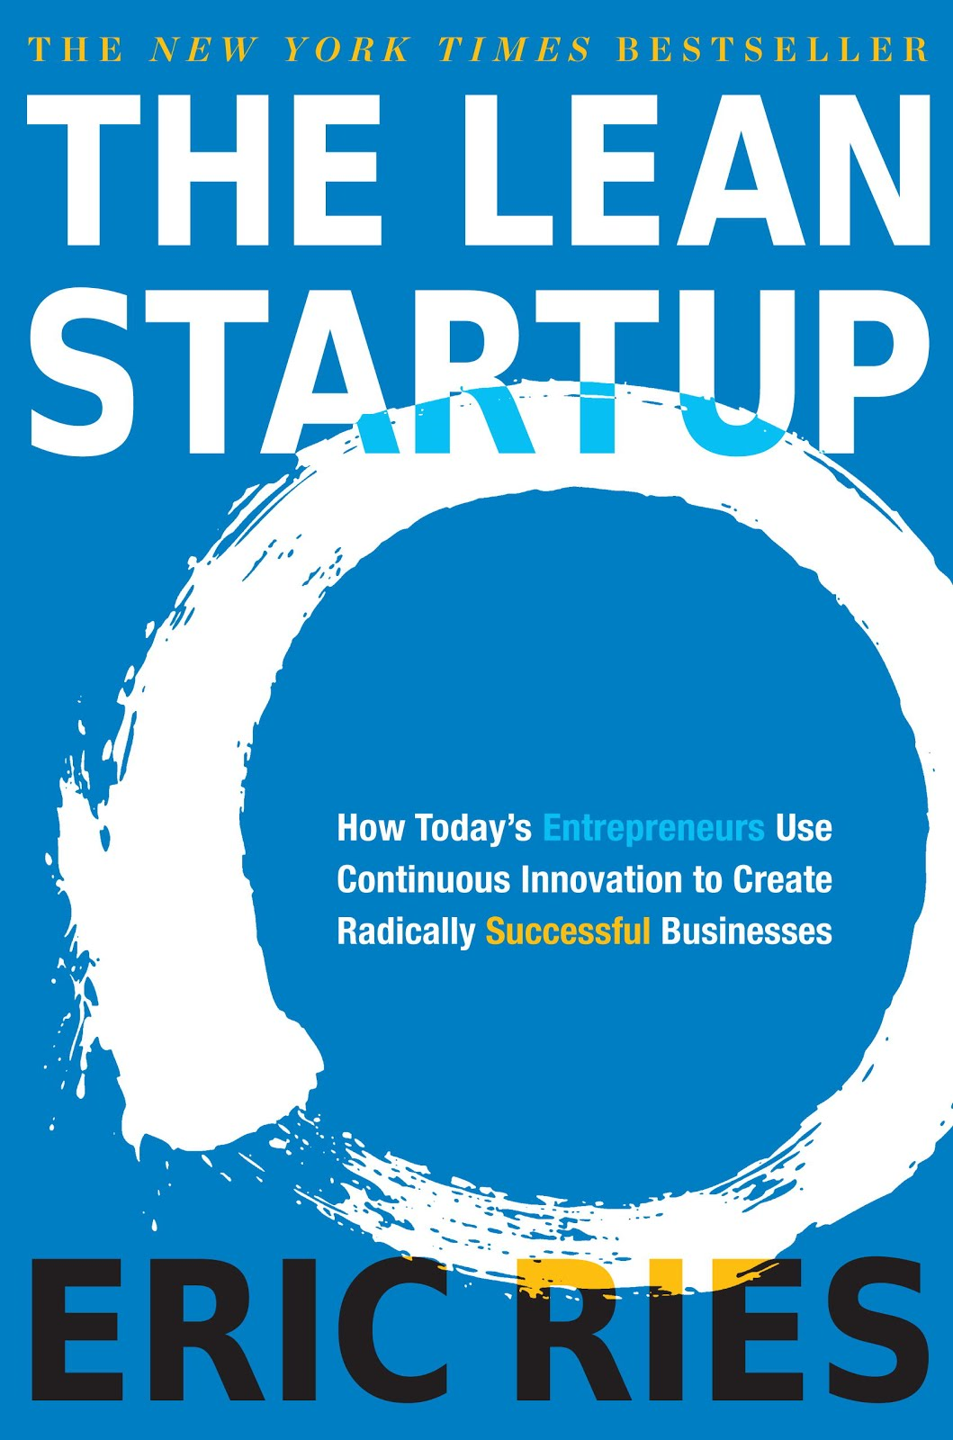
Development Methodologies
Business Development - Lean Startup
Technical Development - Agile

Slide 20
Goals
Long Term Goal = commercialization of the idea
Capstone Project Goals
Technical
System buildout complete
Automated
Acceptable performance
Data
Effective import and export of data
Assessment of data quality and impact on overall usability
Cohort
Understanding personas and use scenarios
Successful recruitment of at least 500 (hoping for 1000)
Detailed feedback from a representative set of users
The administrator would use this tool for decision making
Business
At least 50% of user cohort would want to use this tool on an ongoing basis

Slide 21
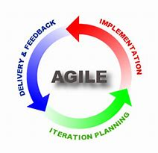
Timeline
May/June
July/September
October/February
Spring 2019
Visualization Mockups Develop & Test
Capstone Presentation
Phase Exit Review
Define Phase Exit Criteria
Develop Personas & Scenarios
Web Site & Data Entry Develop and Test
Visualization Develop & Test
Import External Data Develop & Test
Presentations
User Cohort
Admin Cohorts
AAG and/or ESRI
Questions to Ask
DB (Geocode, Metadata, etc.) Dev & Test
IRB Approval
Start Cohort Recruitment
More Customer Discovery
Friends/Early Adopters Cohort
MGIS Cohort
PSU Cohort

Slide 22
Next Step
Would you be willing to be an early stage participant in the CareerMap project by providing your career information and giving feedback?
Email me at rkg5191@psu.edu
Thank you!

