Slide 1
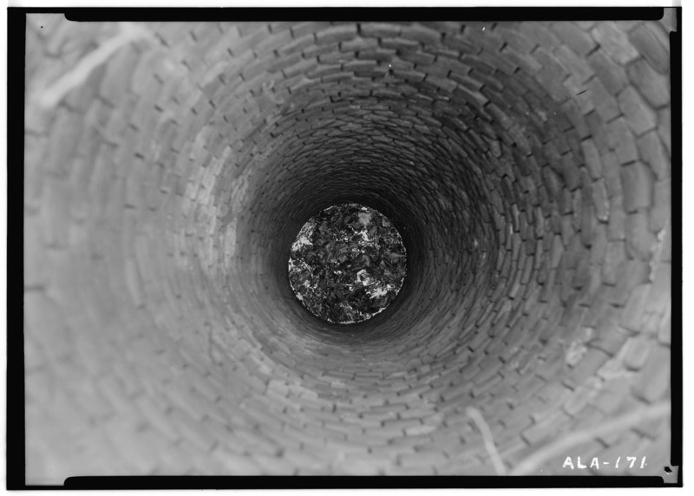
Well View
A Web Mapping Application for the Visualization of Horizontal Wells in Pennsylvania
Vera Green
May 11th, 2016
Penn State MGIS Theses project, Geog 596A
http://thebusiness.duedil.com/wp-content/uploads/2015/08/Historic_American_Buildings_Survey_Alex_Bush_Photographer_January_8_1937_LOOKING_DOWN_INTO_WELL_-_Block_House_101_Hill_Street_Camden_Wilcox_County_AL_HABS_ALA66-CAM11-6.tif.jpg
Notes:
Hello, my name is Vera Green and welcome to my presentation on Well View, A Web Mapping Application for the Visualization of Horizontal Wells in Pennsylvania.

Slide 2
Overview
Project Overview
Feature Focus
Directional Surveys
OCR
Python Automation
Dev. Platform
Scope
Project Goals
https://www.scrumalliance.org/getattachment/Community/Articles/Newly-Submitted/Agilossary/Im10.jpg.aspx
Notes:
I will start off this presentation by reviewing the main project milestones to date as seen in this classic waterfall diagram starting with the initial idea and moving through to the conceptual development design.
After this general project overview I will discus some specific features including OCR, python automation and the development platform.
I will touch briefly on some scope challenges and then conclude the presentation by reviewing the final project goals.

Slide 3
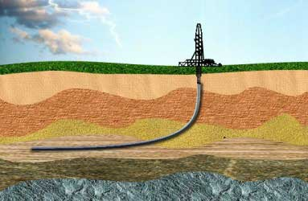
Project Overview: Idea
Visualize Horizontal Wells
https://www.scrumalliance.org/getattachment/Community/Articles/Newly-Submitted/Agilossary/Im10.jpg.aspx
http://www.harrisonoilngas.com/p7composer-pages/img/Pic-Horizontal_Drilling-01.jpg
Notes:
The core project idea provided by the project spencer, Dr. Sue Brantley was centred around the desire to visualize horizontal well paths on the surface and subsurface.
This idea was coupled with my interest in GIS procedure automation and web mapping. The project did not start out with a clear set of parameters but rather, was shaped through the data discover and analysis phases. However, some core concepts guided the project from the beginning, mainly the desire to build a publically accessible low cost resource.

Slide 4
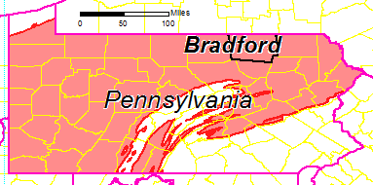
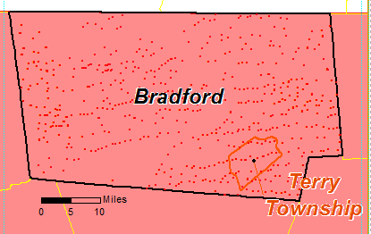
Project Overview: Idea
Visualize Horizontal Wells
1336 Horizontal Wells
https://www.scrumalliance.org/getattachment/Community/Articles/Newly-Submitted/Agilossary/Im10.jpg.aspx
http://www.harrisonoilngas.com/p7composer-pages/img/Pic-Horizontal_Drilling-01.jpg
Notes:
For a bit more background, Pennsylvania is almost completely covered by the petroleum rich Marcellus Shale as seen by the pink extent on the state map. Bradford County is one of the most heavily drilled counties in the state with over 1336 horizontal wells. And several wells in terry township were featured in a recent paper by the project sponsors discussing groundwater contamination attributed to gas development of horizontal wells in the area.

Slide 5
Project Overview: Analysis
Visualize Horizontal Wells
EDWIN Exploration and Development Well Information Network
https://www.scrumalliance.org/getattachment/Community/Articles/Newly-Submitted/Agilossary/Im10.jpg.aspx
Notes:
The analysis stage of this project was somewhat non traditional in the sense that it involved data discovery and usability analysis rather than a geospatial analysis.
The primary data source for horizontal well records is the Exploration and Development Well Information Network which provides an online database of completion records and directional surveys for horizontal wells in Pennsylvania. Records are submitted by companies following state regulations and made publically available at a nominal cost intended to maintain the database. The initial chapter of this project aimed to evaluate this data source and it’s potential use. Details regarding these records and a methodology for their processing will be discussed later on in the presentation.
Additional data discovery focused on well information and geological data.
At the end of this phase it was evident that sufficient data existed to support the project goals.

Slide 6
Project Overview: Design
Visualize Horizontal Wells
EDWIN Exploration and Development Well Information Network
Web Map and Tools
https://www.scrumalliance.org/getattachment/Community/Articles/Newly-Submitted/Agilossary/Im10.jpg.aspx
Notes:
Based on the initial assessment of available data from Exploration and Development Well Information Network as well as other sources lead to the decision that a web map and several custom built tools would be best suited to meet the long term project objectives. Specific tools include python scripts, excel macros, and a web mapping application capable of accepting new database entries.

Slide 7
Project Overview: Design
Visualize Horizontal Wells
EDWIN Exploration and Development Well Information Network
Web Map and Tools
Site Design
https://www.scrumalliance.org/getattachment/Community/Articles/Newly-Submitted/Agilossary/Im10.jpg.aspx
Notes:
Based on these initial requirements, a preliminary site design was created.

Slide 8
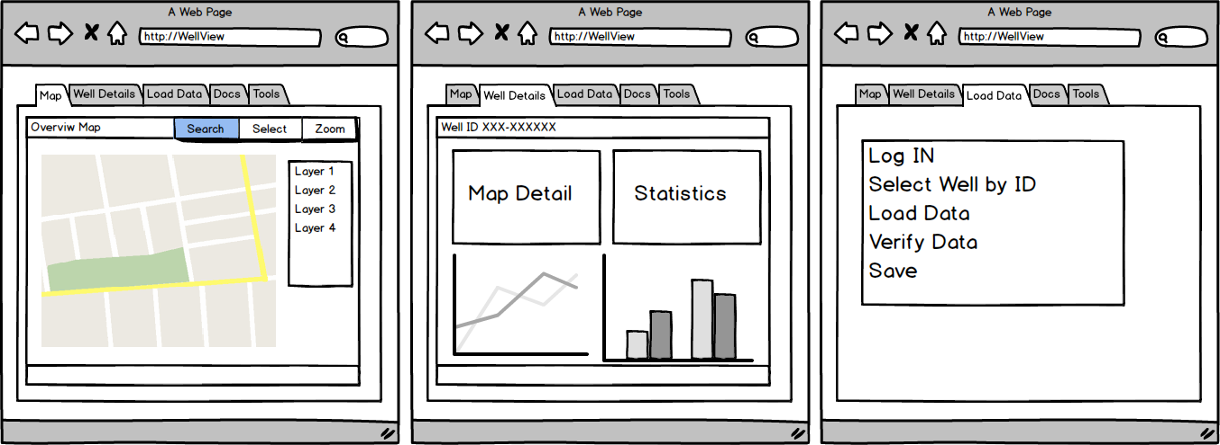
Project Overview: Site Design Mock-up
Notes:
This slide illustrates the main features of the Well View application. Including:
A web map with standard mapping controls such as pan, zoom, and layer switching.
Ability to search for well records and view a detailed well page
Ability to upload a new well record to the database.
Access to download tools for data pre-processing
Project Documentation

Slide 9
Project Overview: Development
Visualize Horizontal Wells
EDWIN Exploration and Development Well Information Network
Web Map and Tools
Site Design
Open Source Web Application
https://www.scrumalliance.org/getattachment/Community/Articles/Newly-Submitted/Agilossary/Im10.jpg.aspx
Notes:
Based on the site design and overall project goals a list of requirements for the application includes:
Low maintenance cost
Public access
GIS capabilities
Access to procedure documentation
Geospatial database capabilities
These goals aim to preserve longevity of the final product and promote use by other groups and organizations.
Based on these requirements the decision was made to utilize open source tools to build a web mapping application in a virtual environment. More details to follow . . .
Now that you have an idea of the overall project, I will discuss some of the project components in more detail.

Slide 10
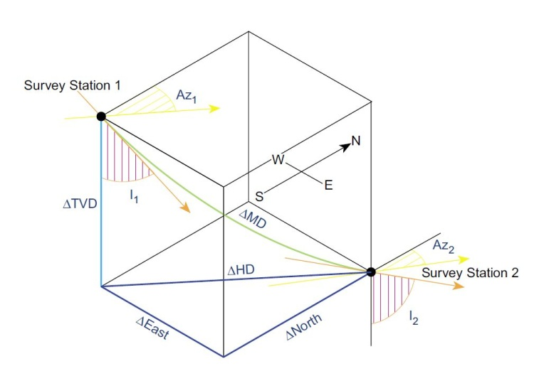
Feature Focus: Directional Surveys
Heading | Full Heading | Description | GIS Application
MD (Ft) | Measured Depth | Distance along the bore hole
Incl (◦) | Inclination | The inclination of the bore where 0 would be straight down
Azim (◦) | Azimuth | The angle of horizontal deviation, measured clockwise, where True North is 0
TVD (ft) | True Vertical Depth | The depth of the bore hole as measured straight down | Change in Z
VSec (Ft) | Vertical Section | The length of the along ground section
N/S (Ft) | North South feet | the distance north or south, relative to the surface hole, with no false northing added (positive for north, negative for south) | Change in Y
E/W (Ft) | East West Feet | the distance east or west, relative to the surface hole, with no false easting added (positive for east, negative for west) | Change in X
DLS(◦/100ft) | Dog leg severity | the rate at which a well path changes direction in degrees/100ft
Directional Survey Record Headers
Minimum Curvature Method
http://info.drillinginfo.com/directional-drilling-surveys-paper-to-web/
Notes:
A directional survey is a standard survey report produced by a drilling operator at the time a well is drilled.
According to standardized government regulations.
The survey consists of standard data as described by the headings in this table.
The minimum curvature calculation as illustrated by this diagram is the current standard accepted method for calculating the cumulative change in X, Y and Z position.
Luckily for us, the results of the minimum curvature calculation are typically included in the directional survey and do not need to be calculated from the source variables.
“The Minimum Curvature calculations compare each point to the one after it and reference the change in azimuth, inclination and measured depth in order to compute a change in X, Y and Z position measured in feet between the two points. These changes can then be summed to give the total change in position from the origin for each point” http://info.drillinginfo.com/directional-drilling-surveys-paper-to-web/

Slide 11
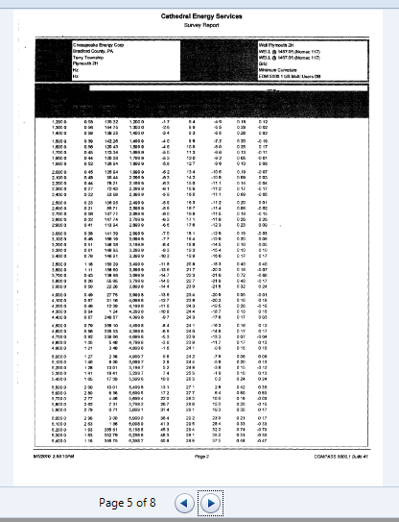
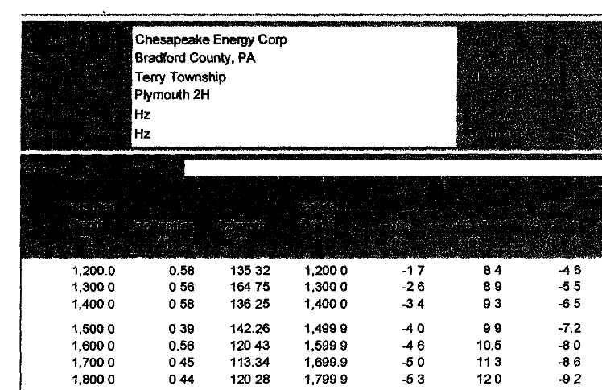
Feature Focus: Directional Surveys
Typical Record from EDWIN
Notes:
This slide shows a typical directional survey document downloaded from the Exploration and Development Well Information Network. As you can see it is a moderate quality scan of a typed document. Records are stored as tif files.

Slide 12
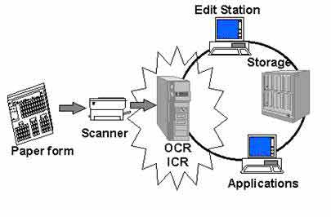
Feature Focus: OCR
Optical Character Recognition
http://www.mayainfosystems.com/themes/maya/images/ocr.JPG
http://www.irislink.com/c2-1342-189/Readiris-15-for-Windows---OCR-Software.aspx?gclid=CPq1n6aB0cwCFYqDfgodb2sC6g
Notes:
Optical character recognition is the recognition of printed or written text characters by a computer. Basically an automated way to read a scanned document
The general steps in OCR are illustrated in this graphic:
Scan paper document
Load the document into OCR
OCR software translates the document
User checks and corrects the converted document
The converted document is ready for further uses
Several OCR software packages were evaluated including:
OpenOCR
FreeOCR
SimpleOCR
Microsoft Office 2013 One Note
ReadIRIS 15 - selected for it’s multipage capabilities, ease of use and conversion accuracy.

Slide 13
Feature Focus: OCR
Raw Record from EDWIN
Notes:
Now for a practical demonstration, this slide shows a typical record downloaded from the Exploration and Development Well Information Network

Slide 14
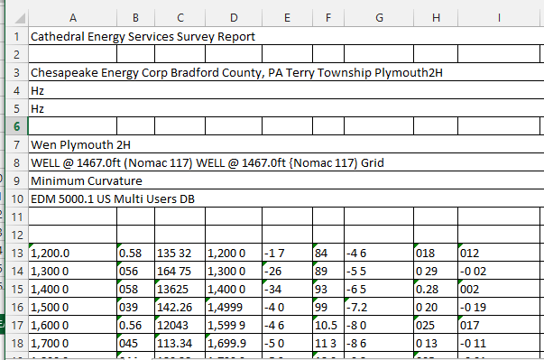
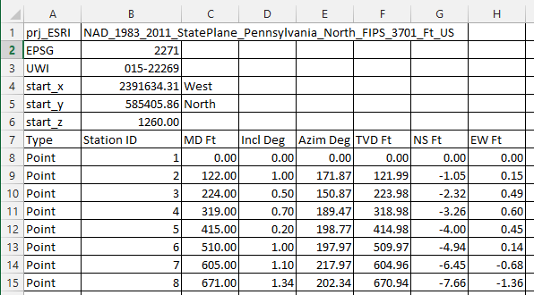
Feature Focus: OCR
Raw OCR Output
Corrected OCR Output
http://www.mayainfosystems.com/themes/maya/images/ocr.JPG
Notes:
And on this slide we see the OCR results before and after manual correction.
There are several characteristic errors including:
Spaces instead of decimals
Missing decimals
Misinterpretation of periods as comas (two commas in a number)
Many of these errors can be corrected en mass with standard excel functions. One of the project goals is to build excel macros for automating the correction of common errors.
The corrected record has a standardized header and column headings. These components are critical for further processing but before we have a look at that step, let’s have a closer look at a typical directional survey.

Slide 15
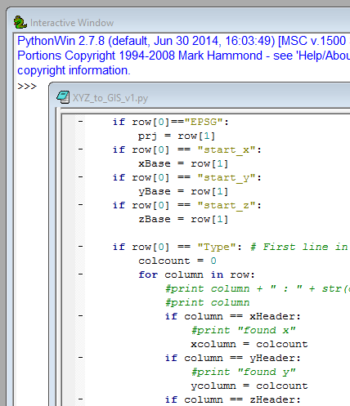
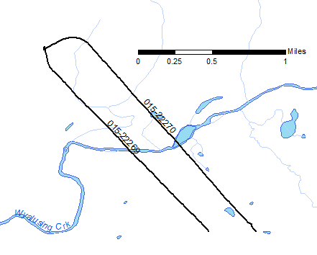
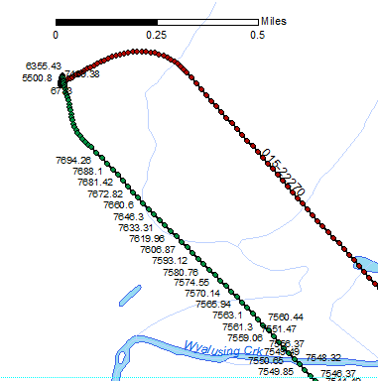
Feature Focus: Python Automation
Notes:
The cleaned well record is saved as a csv file with a standard header and column titles
A python script reads this file and generates a point and line shapefile
Both the point and line shapefiles include elevation (depth) data which will enable vertical views such as 3D modeling.
Python scripting was seen as appropriate and necessary due to the repetitive nature of the task.
The usability of the Exploration and Development Well Information Network records was greatly increased through the use of OCR and python, allowing an efficient path for converting the directional survey records to GIS data.

Slide 16
Feature Focus: Dev. Platform
Database
Server
Server
Desktop
Web Map Library
Web App Build Kit
Web Map Client
http://suite.opengeo.org/dashboard/
https://i.ytimg.com/vi/YbXWljOxA9U/maxresdefault.jpg
Notes:
Overview of OpenGeo suite tools. Slide talks about technical infrastructure.

Slide 17
Scope
Time
Initial Conceptual Scope
Final Scope
Initial Idea
Notes:
We had a lot of ideas and I would identify project scope as one of the challenges we faced during the planning process . . .
After our data discovery and analysis phase we had a hard look at what was feasible in a reasonable timeframe.

Slide 18
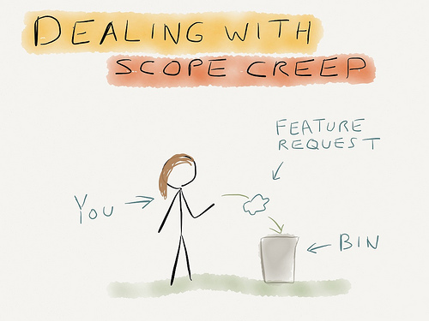
Scope
http://2.bp.blogspot.com/-dWIq0VigmzE/UBtQAd8gTAI/AAAAAAAAHtU/bfaxGN8i4bU/s1600/dealingwithscopecreep.jpg
Notes:
This approach to scope creep is sometimes appropriate . . . But instead of throwing away all of our good ideas . . .

Slide 19
Future Plans
http://tranceattack.net/wordpress/wp-content/uploads/2013/08/aboveandbeyondencorebeach.jpg
Notes:
We added a section on future development, or as is often referred to in the MGIS program, an above and beyond section.
Optional Goals/Future Development
Generate 3D visualizations using ArcScene or other software for well bores for which GIS data was created
Q-GIS/PostGIS tool for converting corrected well directional survey data to GIS
Automated 3D modeling using gaming software
Automated background data updates
Automated process for loading directional survey data directly to the site without first converting to GIS.

Slide 20
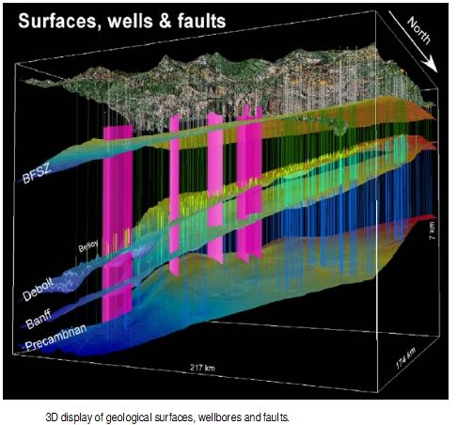
Future Plans
3D Visualization
http://tranceattack.net/wordpress/wp-content/uploads/2013/08/aboveandbeyondencorebeach.jpg
https://www.google.ca/url?sa=i&rct=j&q=&esrc=s&source=imgres&cd=&cad=rja&uact=8&ved=0ahUKEwiI4MfTpdDMAhVE9GMKHZM9CmcQjRwIBw&url=http%3A%2F%2Fwww.inigis.org%2F259%2F3d-modelling-of-subsurface-geology-using-arcgis-and-well-log-data.html%2F&psig=AFQjCNHdI_-AnZRu8UY6B3XcduKek3wHmg&ust=1462996607771224
Notes:
Discuss 3D visualization and add image example

Slide 21
Future Plans
3D Visualization
Incorporating Frac Focus Chemical Disclosure Registry
http://fracfocus.org/
http://tranceattack.net/wordpress/wp-content/uploads/2013/08/aboveandbeyondencorebeach.jpg
Notes:
Discuss Frac Focus DB

Slide 22
Future Plans
3D Visualization
Incorporating Frac Focus Chemical Disclosure Registry
Enhanced Automation
http://tranceattack.net/wordpress/wp-content/uploads/2013/08/aboveandbeyondencorebeach.jpg
http://img.wonderhowto.com/img/39/53/63472081896019/0/write-basic-encryption-program-using-java.1280x600.jpg
http://img07.deviantart.net/3115/i/2013/303/6/a/wallpaper_python_programming_by_artgh-d6sf9dw.jpg
Notes:
Discuss enhanced automation

Slide 23
Summary
Visualize Horizontal Wells
EDWIN Exploration and Development Well Information Network
Web Map and Tools
Open Source Web Application
Site Design
Project Goals
https://www.scrumalliance.org/getattachment/Community/Articles/Newly-Submitted/Agilossary/Im10.jpg.aspx
Notes:
Initial Development Goals
Develop a workflow for generating well bore GIS data from well directional survey data (completed)
Gather existing background GIS data layers
Develop tools for workflow optimization including:
Microsoft Excel macros for semi-automation of well directional survey data correction after conversion with OCR
Esri toolbox for converting corrected well directional survey data to GIS (shapefile)
Generate GIS data for a minimum of 10 (maximum of 44) wells in Terry Township. Priority will be given to the following wells if data can be obtained: 015-20242, 015-20244, 015-20314, 015-20315, 015-20334, 015-20335, 015-20416, 015-20417, 015-20418, 015-20419
Create a web site consisting of:
Project description
Interactive 2D web map showing bore locations and related data with standard web map options (zoom, pan, turn layers on/off). General background data will have a maximum spatial extent covering Pennsylvania. Specific, high resolution data such as high resolution DEM data will be limited to Bradford County or Terry Township depending on disc space required.
User can select or search for each well with bore information and obtain detailed information about that well.
The following will be available for download:
tools (excel macros, Esri toolbox, etc.)
full procedure documentation (instructions on how to use tools and add a new record)
full development and administrative documentation (instructions on how to maintain the site)
User will be able to upload new records. New records will automatically show on the map, be added to the search lists, and be available for detailed view exploration. Note that the detailed view will be limited to the data uploaded by the user for that record.

Slide 24
Timeline
Dec. 2015
Jan. – March 2016
March – April 2016
May to Dec. 2016
Jan. – Feb. 2017
Spring 2017
https://www.scrumalliance.org/getattachment/Community/Articles/Newly-Submitted/Agilossary/Im10.jpg.aspx
Notes:
Conference Options: Geological Society of America annual meeting or FOSS4G (Free and Open Source Software for Geospatial) 2017 held in Boston.

Slide 25
Questions?
Thank You
Project Sponsors:
Susan Brantley
Dave Yoxtheimer
https://www.google.ca/imgres?imgurl=http%3A%2F%2Fimg.memecdn.com%2Fphilosophical-cat-is-philosophical_c_3333277.jpg&imgrefurl=http%3A%2F%2Fwww.memecenter.com%2Fsearch%2Fphilosophical%2520questions&docid=fUamdwqavZptMM&tbnid=Tz8PP_T5XTrowM%3A&w=500&h=700&bih=570&biw=1348&ved=0ahUKEwi_zezOmsPMAhVE0GMKHbuiBEw4ZBAzCGMoYDBg&iact=mrc&uact=8
Notes:
Thank you and questions

