Slide 1
A METHODOLOGY AND PYTHON SOFTWARE PACKAGE FOR EVALUATING ROUTABILITY OF ROAD NETWORKS
Kyle Grimsley
May 2021

Slide 2
Problem Description
Introduction Literature Review Methodology Challenges Anticipated Results Timeline
How can the routability of a feature dataset road network be efficiently and effectively assessed?
Road network datasets are often missing a large amount of routing information including:
Size and weight restrictions
Speed limits
Street directionality
Steep gradients
Road network validation tends to focus on geometries and topology
An existing approach might involve using manual selections in a GIS
Assuming that the available data is sufficient for generating reliable routes can lead to potentially disastrous consequences.

Slide 3
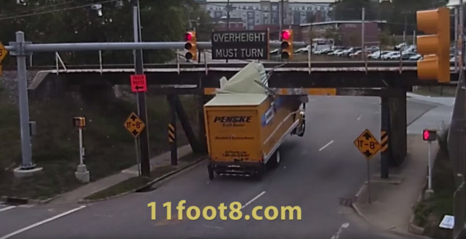
Introduction Literature Review Methodology Challenges Anticipated Results Timeline
archpaper.com – Copyright Jürgen Henn – 11foot8.com

Slide 4
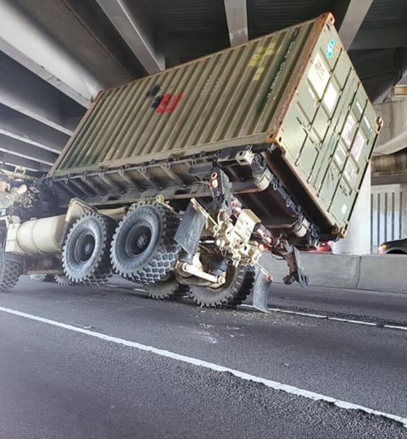
Introduction Literature Review Methodology Challenges Anticipated Results Timeline
wavy.com
wavy.com

Slide 5
Proposed solution
Introduction Literature Review Methodology Challenges Anticipated Results Timeline
Scripted evaluation of key attributes in a dataset to report completeness metrics statistically and geographically.
Define a set of routing attributes such as road width, road pavement type, max speed, bridge/tunnel height limit, bridge width and bridge capacity.
Identify and check each feature in a dataset to determine if each attribute was populated or empty.
Flag geometries of features with unpopulated attributes to guide data collection efforts.
While this would not address the accuracy of individual attribute values, it could still provide a meaningful step toward gauging the reliability of routing solutions for a dataset.

Slide 6
Goals and objectives
Introduction Literature Review Methodology Challenges Anticipated Results Timeline
Develop a script which runs on a dataset to report completeness metrics on aspects of geometry and attribution which support routing, to include identifying the locations of missing attribute values.
Apply the script to a sample of available datasets to determine how suitable they are for vehicle routing and what common deficiencies they may have.

Slide 7
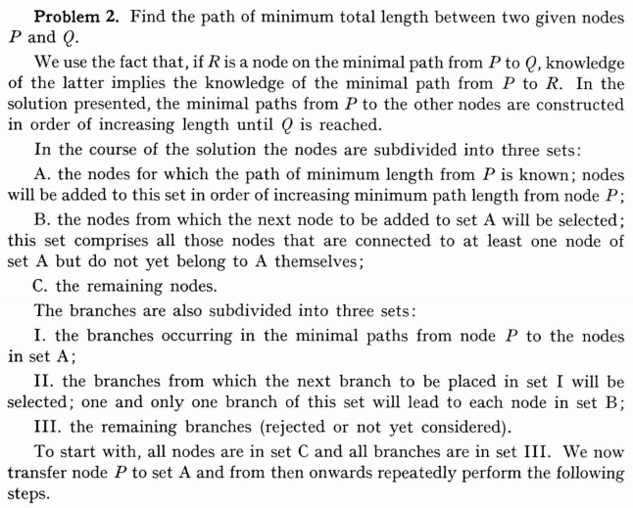
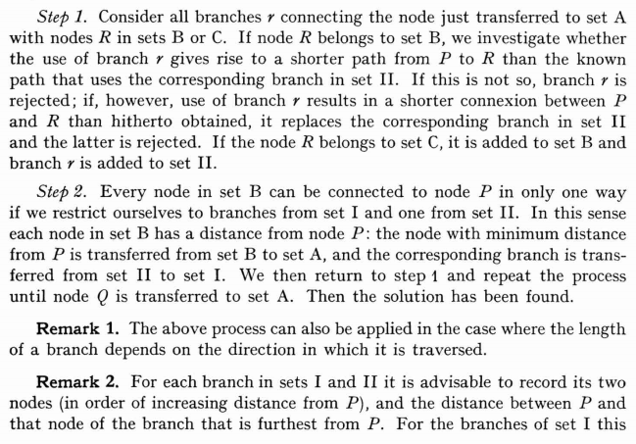
Literature review: Dijkstra’s Algorithm
Introduction Literature Review Methodology Challenges Anticipated Results Timeline
Dijkstra, 1959

Slide 8
Literature review: Dijkstra applications
Introduction Literature Review Methodology Challenges Anticipated Results Timeline
Classic Vehicle Routing Problem (VRP) scenarios of delivery route optimization (Bertsimas & Simchi-Levi, 1996; Tarantilis et al., 2004)
Fire-fighting in Turkish forests (Akay et al., 2012)
Planning snow plow routes in Pittsburg (Kinable et al., 2020)
Optimizing mail delivery in Botswana (Moreri et al., 2017)
The majority of applications studies are of a principally mathematical nature, and often don’t consider the real-world limitations of road networks.
Some of the more recent studies incorporate road network attributes such as road surface type, turn constraints, and speed limits.

Slide 9
Literature review: Gis-T Integration
Introduction Literature Review Methodology Challenges Anticipated Results Timeline
Prevalent integration of GIS in transportation studies did not occur until the late 1980’s (Thill, 2000).
By the late 1990’s there was an ongoing push to expand GIS support for data analysis tasks related to transportation modeling (McCormack & Nyerges, 1998) and to include a spatial component in vehicle routing (Keenan, 1998).
Integration of GIS into transportation analysis encountered a number of challenges as described by Thill (2000):
Wide variety of data models and standards
Very large datasets
Lack of homogeneity of network links used to represent roads and other linear features

Slide 10
Literature review: Routing Restrictions
Introduction Literature Review Methodology Challenges Anticipated Results Timeline
Peter Keenan’s 2008 paper “Modelling vehicle routing in GIS” provides an apt summary of real-world routing limitations and the importance of restrictions.
“Traditional views of the routing problem have tended to emphasise the vehicle and location constraints, without paying much attention to path constraints.”
GIS-based path characteristics should include:
Street directionality
Turn restrictions
Vehicle size limits
Road width restrictions
Bridge weight limits
Steep gradient constraints
In addition to accounting for these factors, the data related to them needs to be complete and accurate for an optimal solution.

Slide 11
Literature review: real-world routing
Introduction Literature Review Methodology Challenges Anticipated Results Timeline
Commercial trucking companies and military organizations
Both tend to keep their data and methods private.
Oversize and Overweight (OS/OW) vehicle routing
States have permitting processes for OS/OW vehicles.
“Highway networks in a state include roads of varying widths, turns that may be infeasible for large or long vehicles, bridges with insufficient weight carrying capacities for very heavy trucks, and underpasses that limit the height of tall trucks” (Zhu et al., 2014).
OS/OW route analysis was historically done using engineering diagrams, but software solutions allow bridges to be automatically evaluated along route options (Ray, 2007).
Information required for bridge evaluations ranges from full engineering diagrams to simpler approximations based on bridge span lengths and superstructure type (Vigh & Kollár, 2007).

Slide 12
Methodology: data
Introduction Literature Review Methodology Challenges Anticipated Results Timeline
Open Source
Open Street Map (OSM)
TIGER/Line Shapefiles –TIGER/Line data was previously loaded en masse into OSM and has sense been improved upon.
Utah Automated Geographic Reference Center (AGRC) Street Network
Proprietary
ArcGIS StreetMap Premium
HERE Map Data (formerly NavStreets) – Sample dataset available for download which covers Ramsey County, Minnesota.

Slide 13
Methodology: data
Introduction Literature Review Methodology Challenges Anticipated Results Timeline
Open Street Map

Slide 14
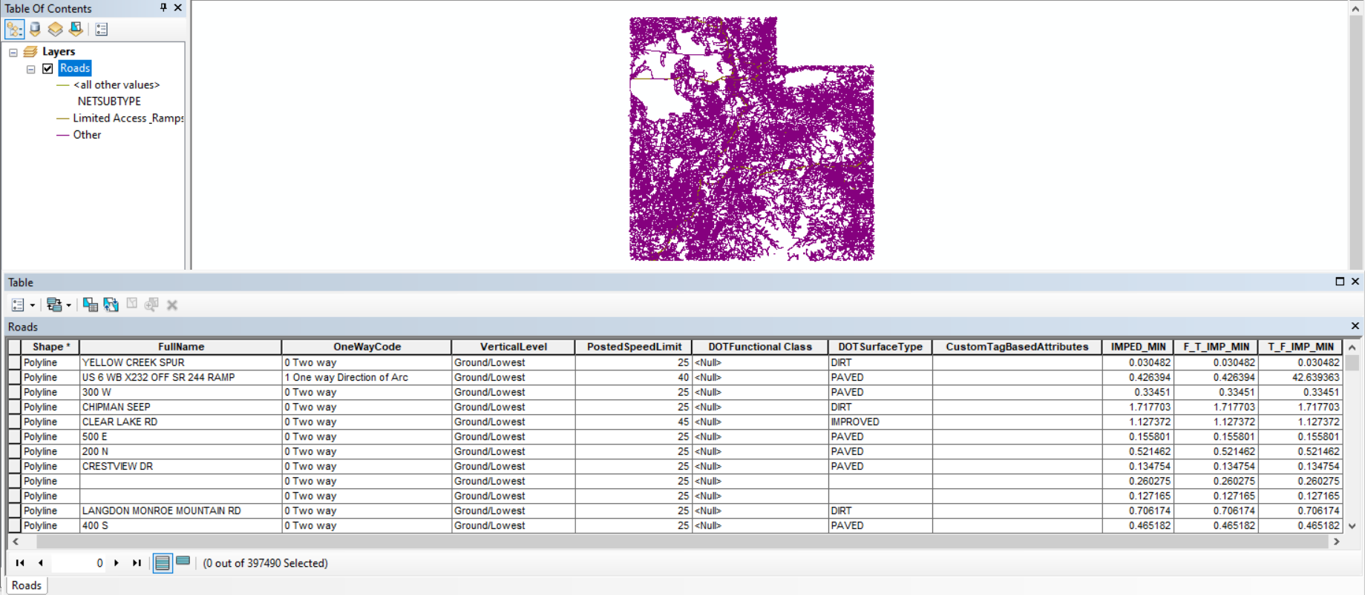
Methodology: data
Introduction Literature Review Methodology Challenges Anticipated Results Timeline
Utah AGRC Street Network

Slide 15
Methodology: data
Introduction Literature Review Methodology Challenges Anticipated Results Timeline
HERE Map Data

Slide 16
Methodology: analysis
Introduction Literature Review Methodology Challenges Anticipated Results Timeline
Data Exploration (ArcMap)
How is routing information stored?
Working toward flexibility to support untested schemas.
Coding (Python)
Sample Data Evaluation
OSM vs. Utah AGRC Street Network
OSM vs. HERE Map Data

Slide 17
Methodology: Concept diagram
Introduction Literature Review Methodology Challenges Anticipated Results Timeline
Display attribute population
Identify routing attributes
User adjust
Build attribute dictionary
Input dataset
Report attribute
%s
Assess data structure
Propose identified attributes
Apply regular expressions
Process changes

Slide 18
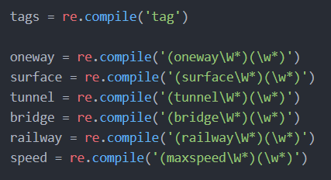
Methodology: regular expressions
Introduction Literature Review Methodology Challenges Anticipated Results Timeline
Regular expressions are used to identify sequences of characters in a string.
Basic key word or abbreviation matching for field names
More complex matching using groups and symbol sequences

Slide 19
challenges
Introduction Literature Review Methodology Challenges Anticipated Results Timeline
Geospatial data schemas vary significantly:
Are bridges and tunnels split out as separate features or associated with road segments?
How are attributes named?
It may be unrealistic to design a tool to seamlessly work across a broad range of schemas.
The highest-quality routing data, such as from commercial trucking and military routing information may be proprietary in many cases.
High probability that available datasets will rate poorly in terms of routing attribute completeness.

Slide 20
Anticipated results
Introduction Literature Review Methodology Challenges Anticipated Results Timeline
Functioning script
Able to fully process all sample data at a minimum
Able to create shapefile outputs and attribution report
Low overall routing attribute population
Speed limits and street directionality may be fairly consistently populated
Bridge/tunnel size and weight restrictions are likely to be scarce
Major roads and urban areas may have more complete attribution

Slide 21
timeline
Introduction Literature Review Methodology Challenges Anticipated Results Timeline
May to September 2021: Data exploration and tool development
October to December 2021: Data analysis and tool refinement
January to April 2022: Case study evaluation, writeup and presentation
ESRI Dev Summit Spring 2022?

Slide 22
References
Akay, A. E., Wing, M. G., Sivrikaya, F., & Sakar, D. (2012). A GIS-based decision support system for determining the shortest and safest route to forest fires: A case study in Mediterranean Region of Turkey. Environmental Monitoring and Assessment, 184(3), 1391–1407. https://doi.org/10.1007/s10661-011-2049-z
Bertsimas, D. J., & Simchi-Levi, D. (1996). A new generation of vehicle routing research: Robust algorithms, addressing uncertainty. Operations Research, 44(2), 286–304. https://doi.org/10.1287/opre.44.2.286
Dijkstra, E. W. (1959). A Note on Two Problems in Connection with Graphs. Numerical Mathematics, 1, 269–271. https://doi.org/10.1007/BF01386390
Keenan, P. (2008). Modelling vehicle routing in GIS. Operational Research, 8(3), 201–218. https://doi.org/10.1007/s12351-008-0021-7
Keenan, P. B. (1998). Spatial decision support systems for vehicle routing. Decision Support Systems, 22(1), 65–71. https://doi.org/10.1016/S0167-9236(97)00054-7
Kinable, J., van Hoeve, W. J., & Smith, S. F. (2020). Snow plow route optimization: A constraint programming approach. IISE Transactions, 0(0), 1–19. https://doi.org/10.1080/24725854.2020.1831713
McCormack, E., & Nyerges, T. (1998). What transportation modeling needs from a GIS: A conceptual framework. Transportation Planning and Technology, 21(1–2). https://doi.org/10.1080/03081069708717599
Moreri, K. K., Maphale, L., & Nkhwanana, N. (2017). Optimizing dispatch and home delivery services utilizing GIS in Botswana: Botswana Post case study. Spatial Information Research, 25(4), 565–573. https://doi.org/10.1007/s41324-017-0123-5
Ray, J. J. (2007). A web-based spatial decision support system optimizes routes for oversize/overweight vehicles in Delaware. Decision Support Systems, 43(4), 1171–1185. https://doi.org/10.1016/j.dss.2005.07.007
Thill, J. C. (2000). Geographic information systems for transportation in perspective. Transportation Research Part C: Emerging Technologies, 8(1), 3–12. https://doi.org/10.1016/S0968-090X(00)00029-2
Vigh, A., & Kollár, L. P. (2007). Routing and Permitting Techniques of Overweight Vehicles. Journal of Bridge Engineering, 12(6), 774–784. https://doi.org/10.1061/(asce)1084-0702(2007)12:6(774)
Zhu, X., Garcia-Diaz, A., Jin, M., & Zhang, Y. (2014). Vehicle fuel consumption minimization in routing over-dimensioned and overweight trucks in capacitated transportation networks. Journal of Cleaner Production, 85, 331–336. https://doi.org/10.1016/j.jclepro.2013.10.036

