Slide 1
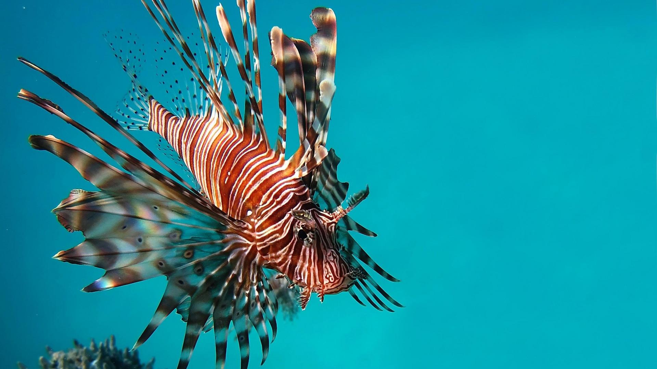
Using Spatial Analyses to Understand Lionfish Invasion in the Gulf of Mexico and Identify Areas to Focus Conservation Efforts
GEOG 596A Capstone Project Proposal by:
D. Lance Hackelton, GISP, CFM
July 30, 2014
Advisor: Joe Bishop, Ph. D.

Slide 2
Personal Info
Bachelor’s in Health Science – University of North Florida, 2004
GIS Certificate – Pennsylvania State University, 2009
GIS Professional Certificate 63320 – GIS Certification Institute, 2013
Taylor Engineering, Inc. – 2005 – present
Geospatial Scientist
Creekside High School – 2009 – present
Academy of Environmental and Urban Planning Advisory Board Member
Employed in the field of GIS for almost 12 years

Slide 3
Outline
Invasive Species
Lionfish Intro
The Problem
Goals & Objectives
Data
Methods
Implications
Timeline
Acknowledgements
Q&A

Slide 4
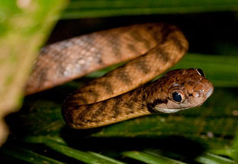
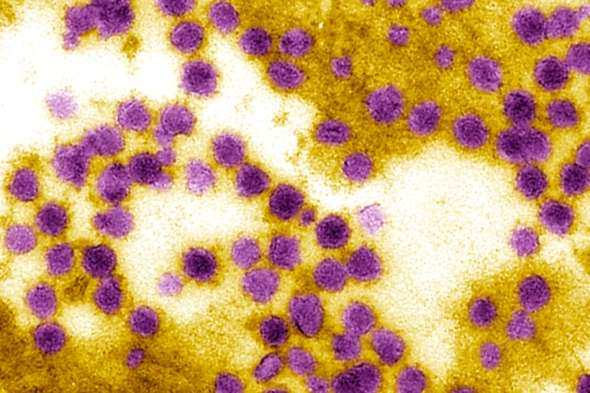
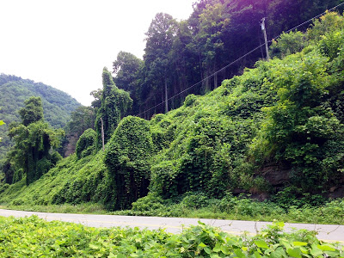
What are Invasive Species?
Defined by the National Invasive Species Council as:
“an alien species whose introduction does or is likely to cause economic or environmental harm or harm to human health”

Slide 5
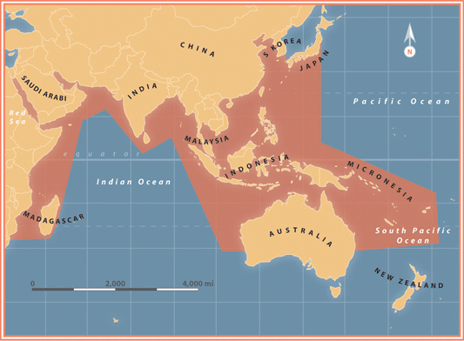
Where do lionfish come from?
Map Credit: NOAA

Slide 6
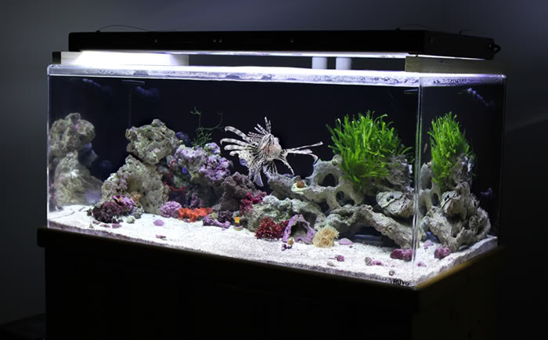
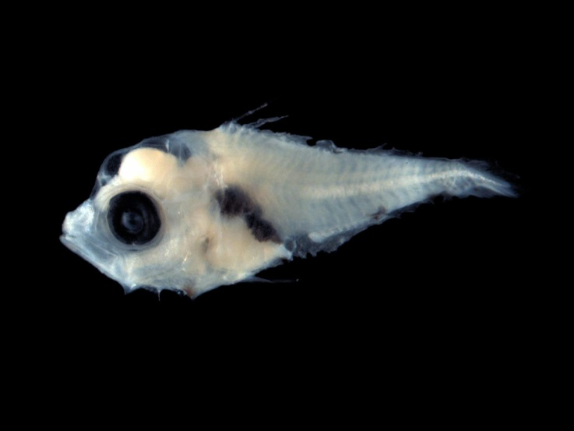
How did they get here?

Slide 7
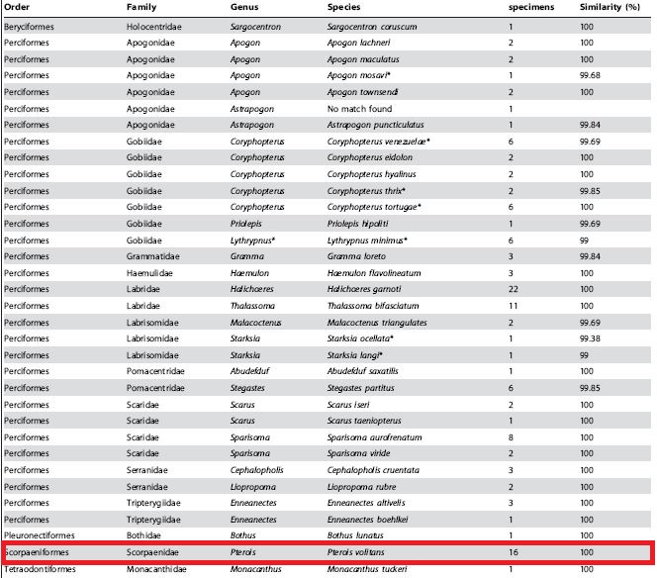
Why is this a problem?

Slide 8
Efforts to Eradicate

Slide 9
Why is it important?
Reef ecosystems are in jeopardy
Adverse impacts to stakeholders
Snowballing
Understanding the invasion on a regional scale is an important first step

Slide 10
Why use spatial analysis?
Geographic component
Power of GIS
A tool, not a solution

Slide 11
Goals and Objectives
Goal: Develop an understanding of the lionfish invasion of the Gulf of Mexico and to predict where it is likely to spread

Slide 12
The Invasion

Slide 13
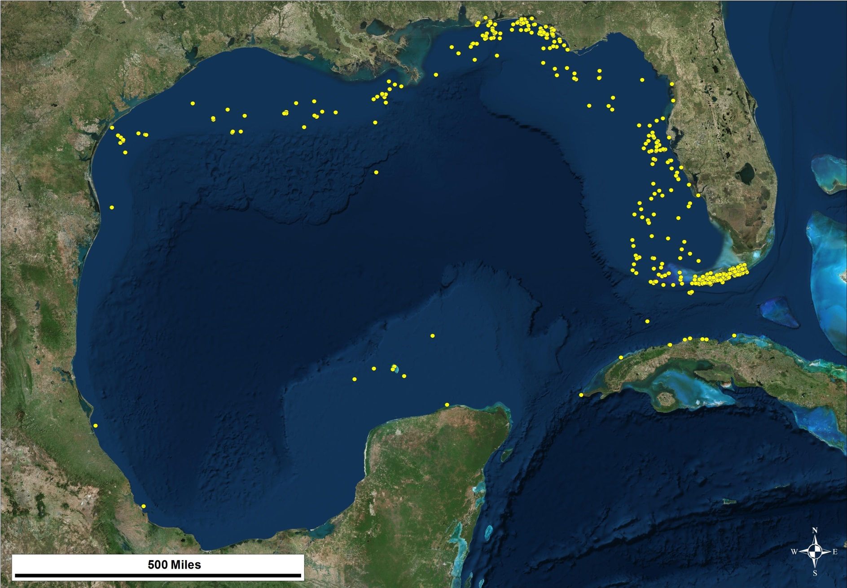
Data Sources
Reported lionfish sightings

Slide 14
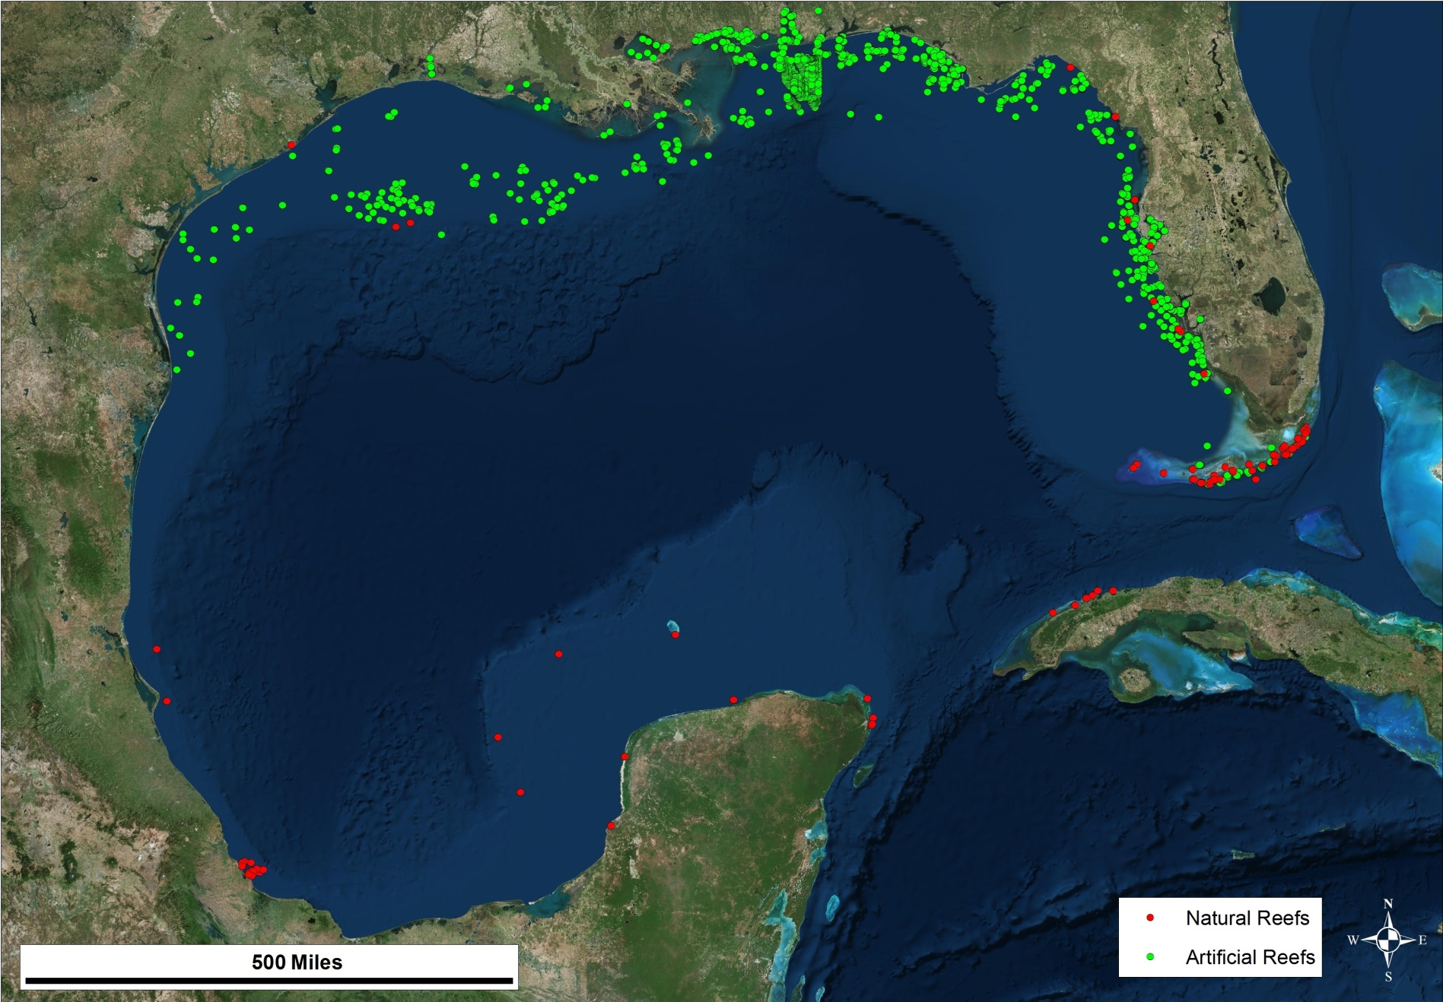
Data Sources
Reef locations

Slide 15
Data Sources
Bathymetry
NOAA
Wish list
Salinity
Currents
Reef fish distribution

Slide 16
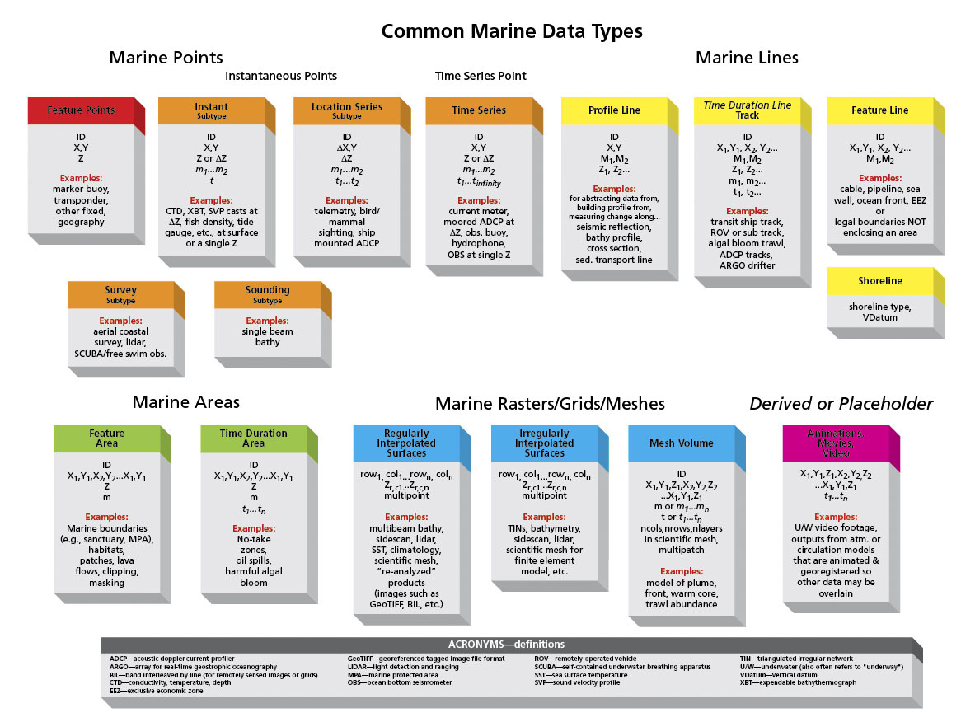
Objective: Build geodatabase using Arc Marine Data Model schema

Slide 17
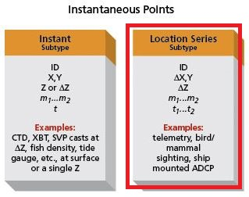
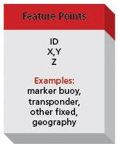
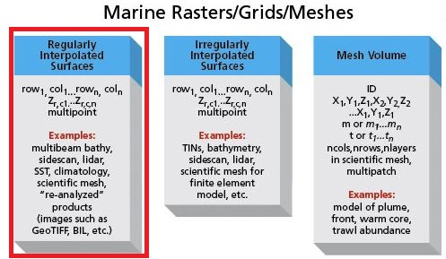
Methods
Location series points of lionfish sightings
Feature points of reef locations (coral, hard substrate, artificial)
Bathymetric raster data

Slide 18
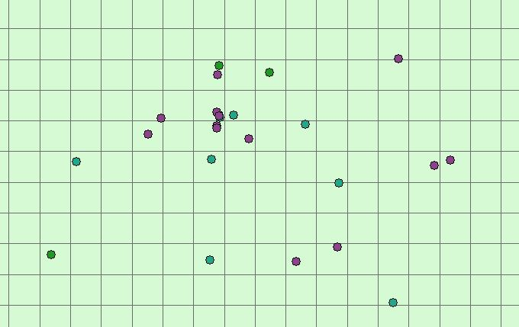
Objective: Use Inverse Distance Weighted (IDW) analysis combined with cellular automata to perform temporal analysis
Time + number of occurrences per cell

Slide 19
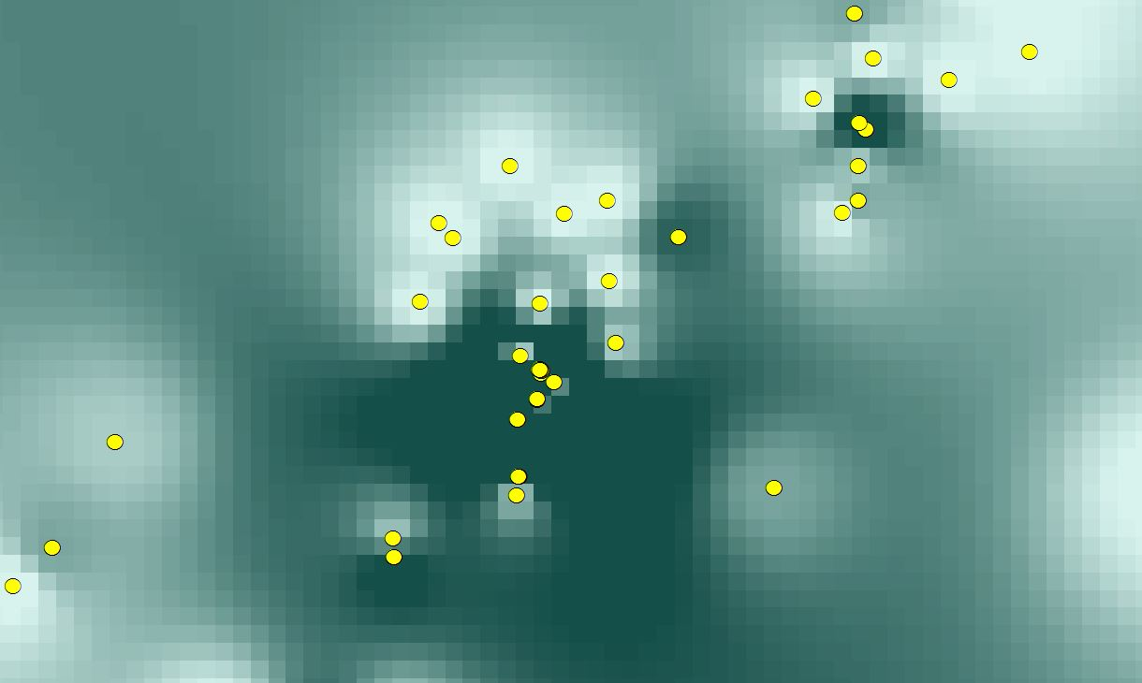
Methods
Apply values to cells based on cumulative number of occurrences
Inverse Distance Weighted Analysis

Slide 20
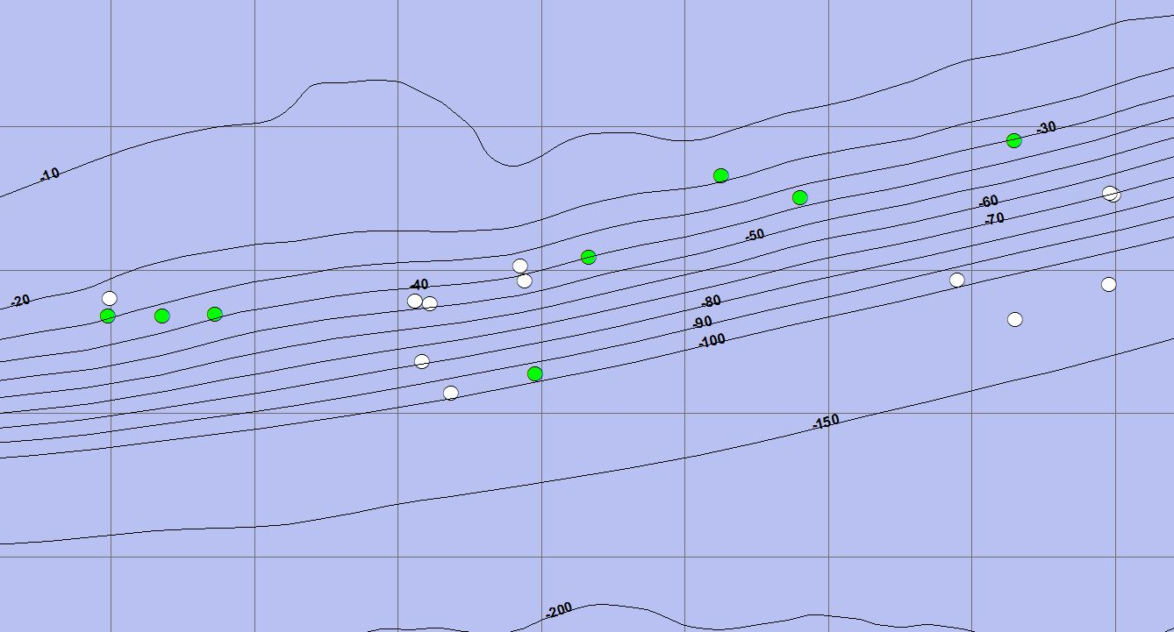
Objective: Use cellular automata to model habitat vulnerability
Reef location + bathymetry

Slide 21
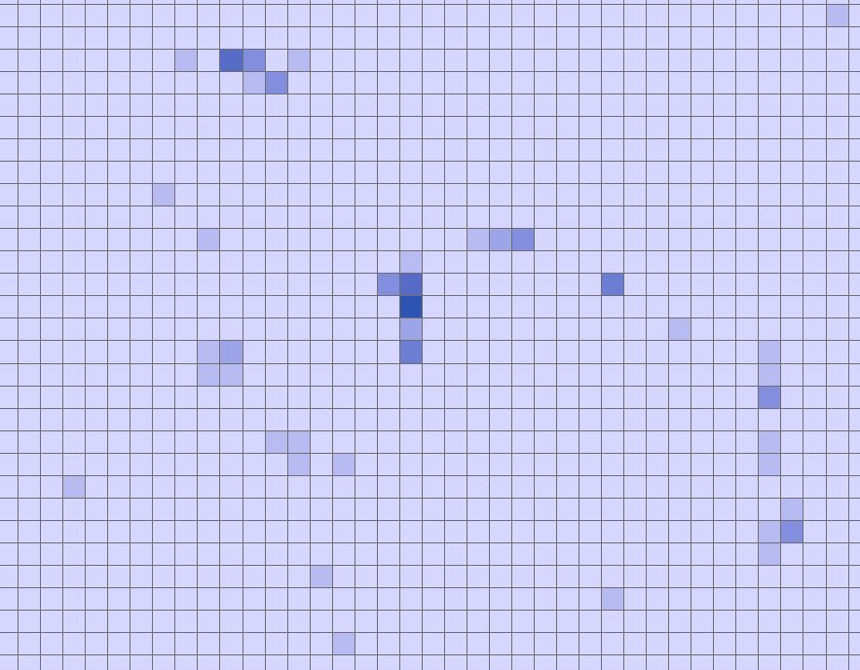
Methods
Apply weighted values to cells based on sum of qualifying criteria

Slide 22
Implications
Regional fisheries management plans
Reef fish
Corals
Areas to focus conservation efforts

Slide 23
Timeline
July 2014: Complete proposal
August thru October 2014: Conduct further research and perform analysis
October thru December 2014: Compile results in full report, present findings at conference

Slide 24
Where to present?
ESRI Ocean GIS Forum, November 2014
NSGIC Midyear Meeting, February 2015
ESRI Southeast User Conference, May 2015
UCGIS Symposium, May 2015
ESRI International User Conference, July 2015
Society For Conservation GIS, July 2015
Suggestions?

Slide 25
Special Thanks to:
Joe Bishop, Ph.D., PSU
Jorge Brenner, Ph.D., The Nature Conservancy
Michael Thompson, M.Sc., The Nature Conservancy
Alexandra Carvalho, Ph.D. GISP, CMAR Consulting, LLC
Ken Craig, P.E., Taylor Engineering, Inc.
Matthew Johnston, Nova Southeastern University

Slide 26
Questions?

