Slide 1
Increasing Safety and Mitigating Production Loss in Hydrocarbon Exploration
and Development Using Volunteered Geographic Information
Adam Nathaniel Hale
Capstone Project Presentation
GEOG 596A
October 27, 2014

Slide 2
Presentation Outline
Goal of Capstone Project
Describe problem and its origin
Discuss density of drilling/completions activity & resulting
safety hazards and risks to hydrocarbon production
Introduce horizontal drilling and completion concepts
Explain hazard avoidance and mitigation of production loss
Propose solution to problem
Identify and target operators to affect change
Discuss how I will deliver message
Anticipated results
Logistics

Slide 3
Goals of Capstone Project
Goal of My Capstone Project:
The goal of my project is to use the knowledge and skills I acquired in the MGIS
program to identify a problem and propose geospatial-related solution for it.

Slide 4
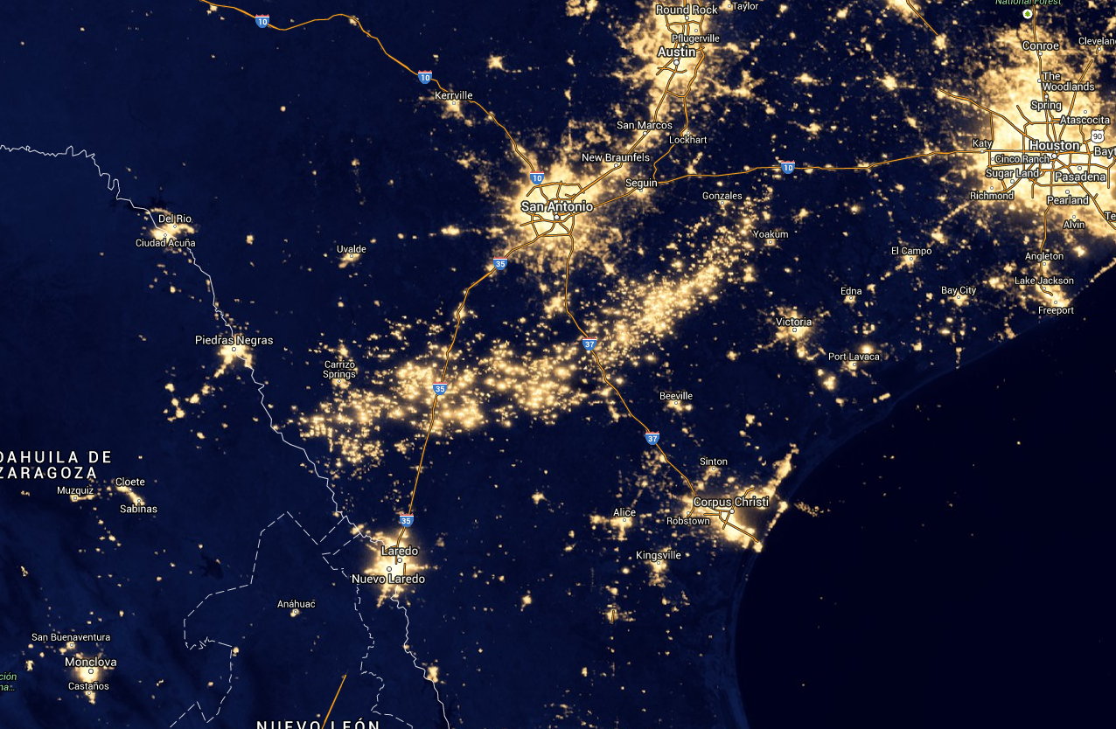
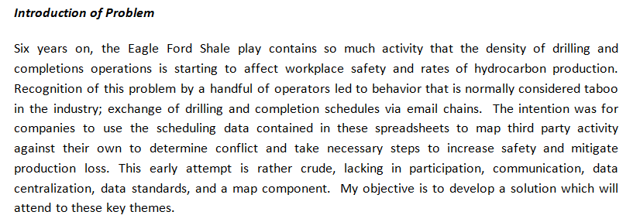
Timeline
Texas
Mexico
Gulf of
Mexico
Describe Problem and its Origin

Slide 5
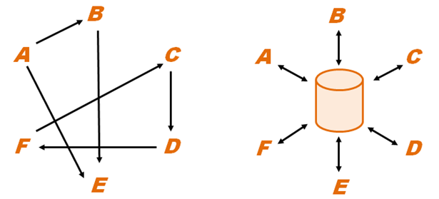
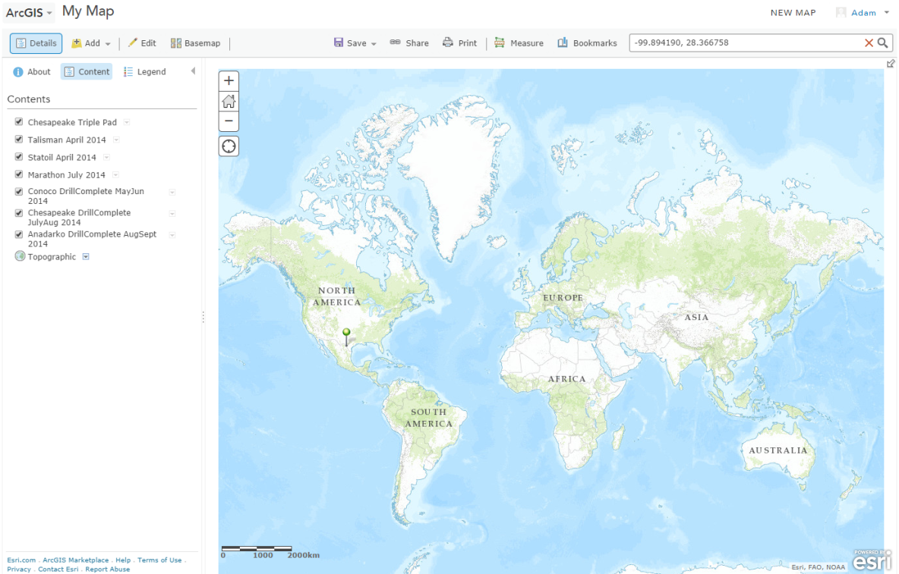
Describe Problem
Lack of Data Centralization
Low participation
Varying or Missing Spatial References
And Data Standards
Hello!
…
Low communication
Geospatial Visualization Component
**Map**
Components Missing From Current Data Sharing Program

Slide 6
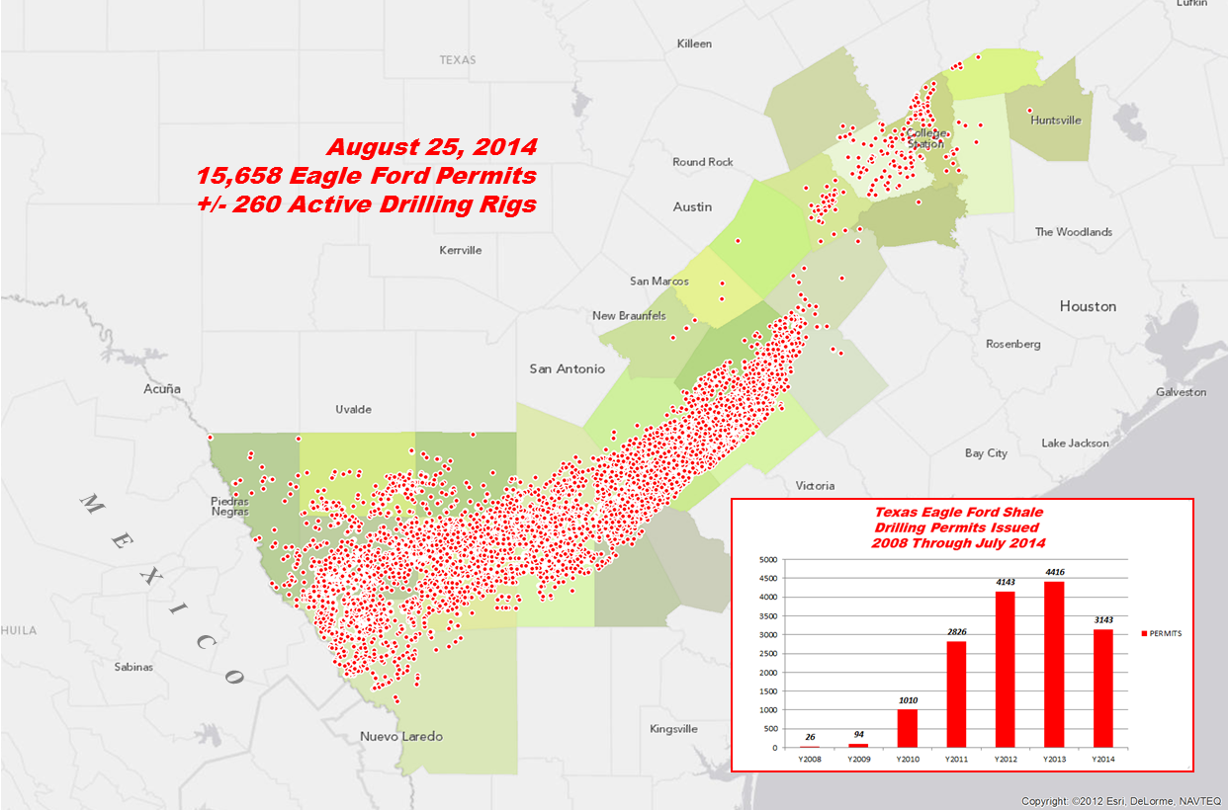
Discussion of Density

Slide 7
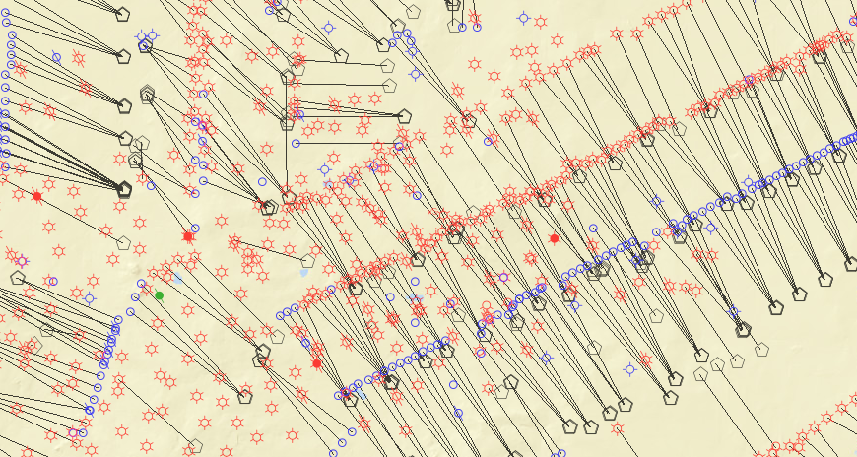
Drilling Wells:
Surface
Hole
Horizontal Drilling and Completion Concepts
“Triple Pad” – 3 Wells
Bird’s Eye View
As seen on map
Drilling
Rig
Surface
Hole
3 Wells:
Triple Pad
X,Y
Surface Holes
Surface
Hole
Drill
Vertical
Section
X,Y
1
Bottom
Hole
X,Y
X,Y
Bottom Holes
Bottom
Hole
Build
Curve
Bottom
Hole
2
3
Drill Horizontal Section
Drill Vertical Section
Build Curve
Drill Horizontal Section
Nature of Pad Drilling

Slide 8
Completing Wells:
Horizontal Drilling and Completion Concepts
Surface
Hole
Surface
Hole
Surface
Hole
Step 2:
Liquids/Solids forced
through perforations
at high pressure to
Create spaces in rock
through which
gas/oil can pass
Step 3:
Flow back of
liquids/solids.
Gas then rises
to surface
Bottom
Hole
Bottom
Hole
Bottom
Hole
Step 1:
Holes created in casing to interface
with hydrocarbon reservoir

Slide 9
Horizontal Drilling and Completion Concepts
Surface
Hole
Bottom
Hole
FRACTURING
DRILLING
PERFORATION
PERFORATION
DRILLING
FLOWBACK
FLOWBACK
DRILLING
Multiple Operations Occurring Simultaneously

Slide 10
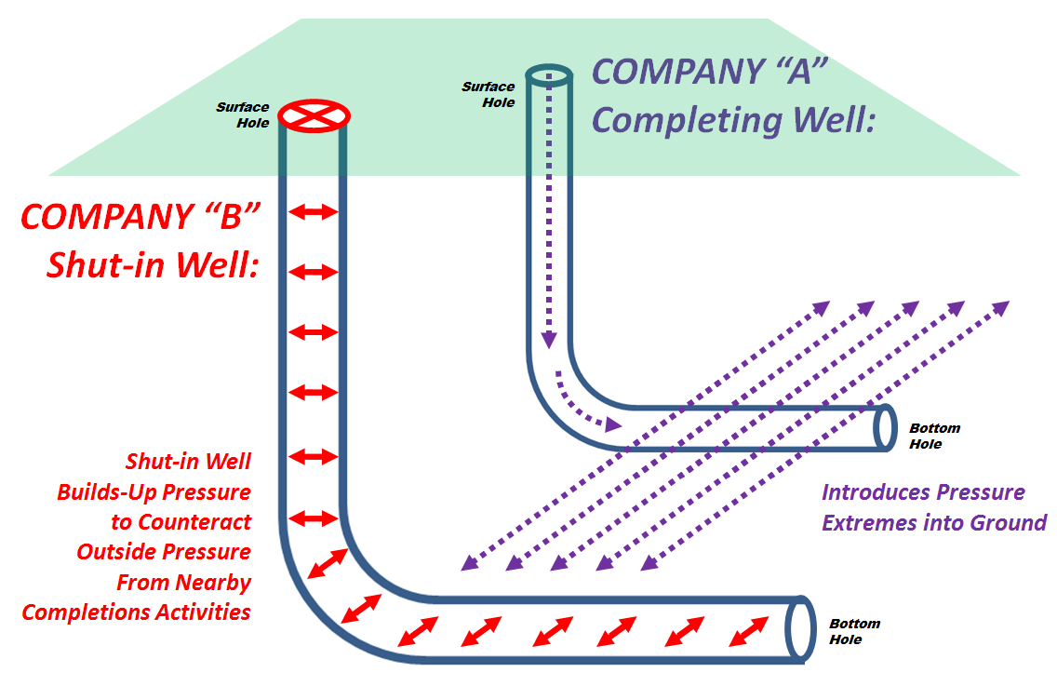
Surface
Hole
Horizontal Drilling and Completion Concepts
FRAC HITS
Dangers and Consequences
Bottom
Hole
Injection of matter into wellbore
introduces pressure
Pressure waves travel through rock
Can collapse well casings
Cease flow of production
Counteract by “shutting-in” well
Worst Case Scenario: Well Blowout
Deadly/Injurious to people
Damage to environment
Damage to property
Impact Revenues $$$

Slide 11
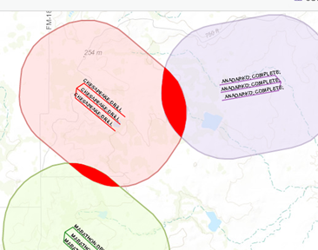
Hazard Avoidance to Mitigate Production Loss
Having spatial awareness of surrounding operations helps avoid frac hits
Awareness beings with mapping wellbore locations
Knowledge of drilling/completion dates allows optimal timing of operations
A company can avoid frac hits from their own activity because they know their schedules
Avoiding frac hits from third-parties is harder
Law requires well locations to be made public , but…
Law does not require well drilling/completions schedules to be made public
Spatial data manipulation helps achieve spatial awareness
A horizontal well’s surface and bottom hole coordinates can be processed into lines (X,Y to Line)
Buffers are created around lines (engineers in Eagle Ford normally prescribe one-mile stimulation buffers)
Buffer intersects are generated to locate areas of intersect
Are there conflicting operations?
If yes, shut-ins initiated or schedules delayed
X,Y
Surface Holes
DRILLING
MAY 2014
Spatial Data (wellbores)
Spatial Data Manipulation
Drilling/Completion Dates
+
PRODUCING
MAY 2014
Situational and
Spatial Awareness
CONFLICT
DELAY OR
SHUT-IN
X,Y
DRILLING
JUNE 2014
X,Y
NO CONFLICT
NO ACTION
X,Y
Bottom Holes

Slide 12
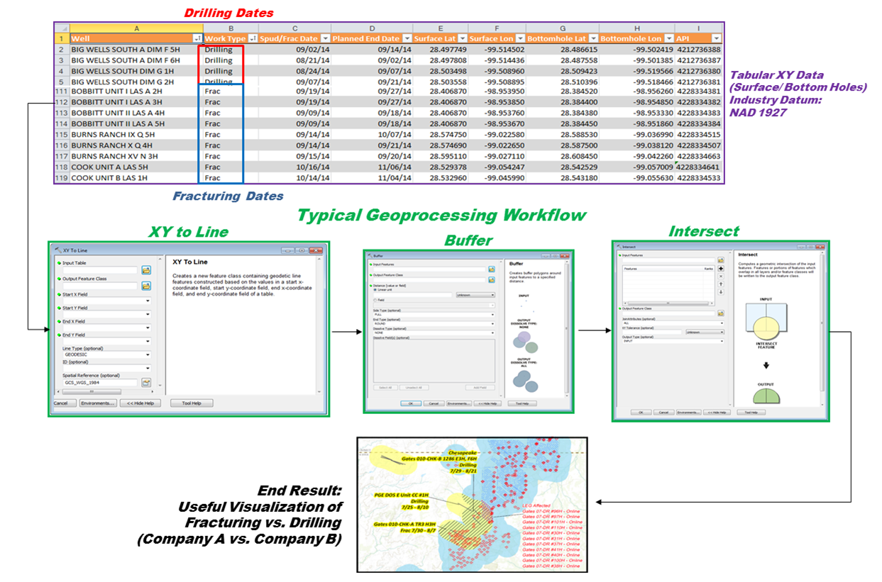
Current Workflow to Determine Activity Intersect
Amongst Operators
Hazard Avoidance to Mitigate Production Loss
1
Workflow is time-consuming
Workflow is labor-Intensive
Poor data results in confusion
All of this delays decision-making
2
3
4
Surface
Hole
5
Bottom
Hole

Slide 13
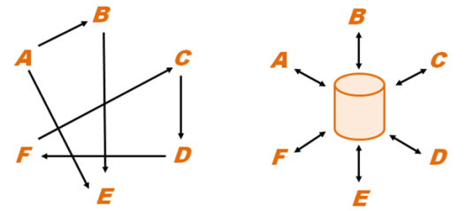
This is the core issue…
Data/Schedule Sharing
Although the chain emails containing “crowd-sourced”/Volunteered Geographic Information having the minimally required information…
SHL/BHL XYs
activity types (drill/complete)
activity dates
identifying information (name/well number)
…this early attempt at data sharing is crude
No data centralization
No data standards
no formatting
fraught with errors
varying or undefined spatial references
Low communication
No geovisualization component (Map!)
LOW PARTICIPATION
Industry culture - infrequent sharing
Intellectual/labor efforts
Be first to drill/complete - don’t divulge when
Sharing only relaxes when leasing is not rampant (established drillable areas)
…
Hello!
Low participation
Low communication
Lack of Data Centralization
Geospatial Visualization Component
**Map**
Varying or Missing Spatial References
And Data Standards

Slide 14
Propose Solution
Why did I choose it?
Other GIS software packages don’t have the features I need (ex. MapInfo, Intergraph)
I know it works – we use it for company-wide GIS and effective internal frac hit avoidance
Popularity; haven’t met an Oil & Gas GIS counterpart who doesn’t use Esri products
Ease of use; can be used by GIS operators of varying maturities
Trumps competitor platforms in terms of help resources
strong user community
communication forums
Esri knowledge base
Customizable
Provides data management functionality necessary for typical workflows
Line creation
Buffers
Intersects
Locating
Measuring
Includes a map interface
known spatial reference
critical for proper overlay and analysis
Provides data centralization
Provides communication forum
messaging
metadata
alerts
Secure log-in credentials
run from behind firewall if needed
Enables creation of Groups
provides sense of belonging
encourages participation
Identified a platform which
can solve problems:

Slide 15
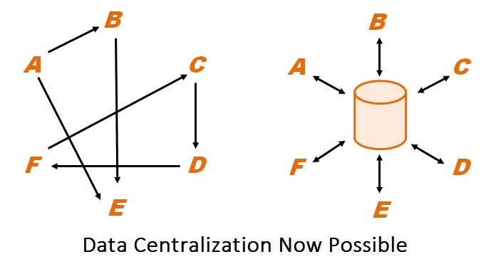
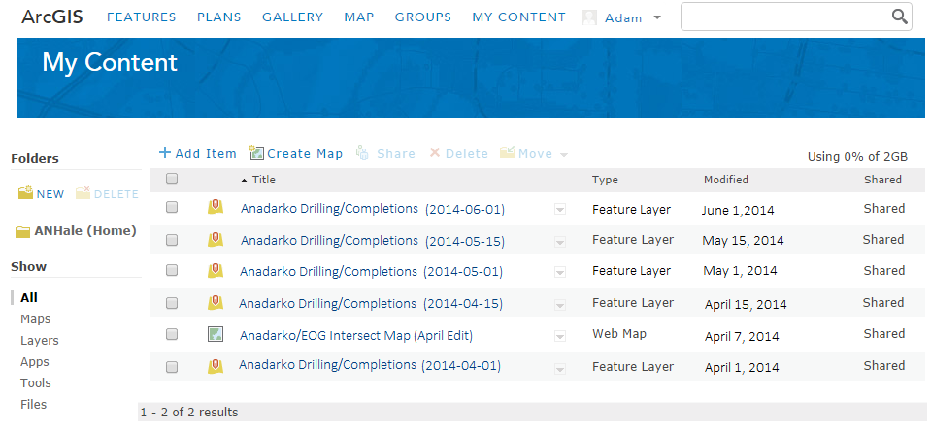
Propose Solution
Data Centralization
ArcGIS Online’s ‘My Content’ feature provides a content manager.
From this centralized data storage hub data can be published
and shared with Groups
Example:
Anadarko Energy
can use My Content to
store, publish data and
make it available to
other operators

Slide 16
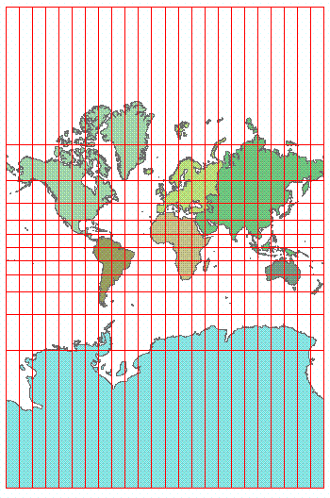
ArcGIS Online features a map display with a known spatial
reference to be used in conjunction with data stored in and
published from My Content
Propose Solution
Map Environment
Web Mercator Projection
Varying Spatial References Encountered
Datums-
WGS 1984
NAD 1927
NAD 1983
NAD 1927 MEXICO
Reference Systems-
GCS
UTM
US State Plane
Data projection on-the-fly?*
(Talk to Fritz Kessler!)

Slide 17
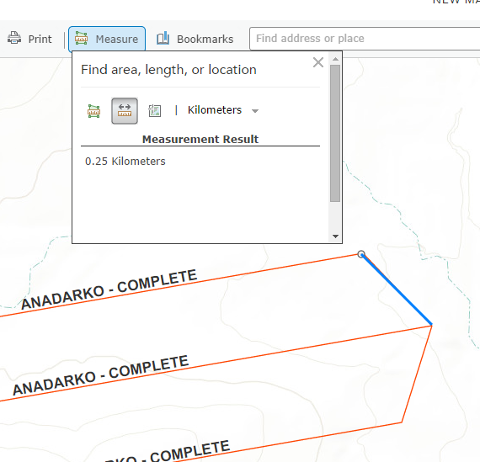
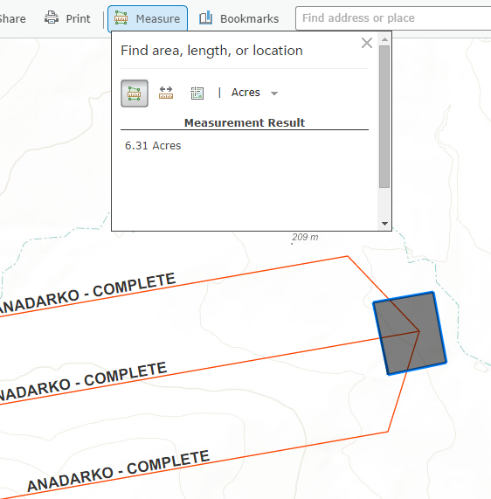
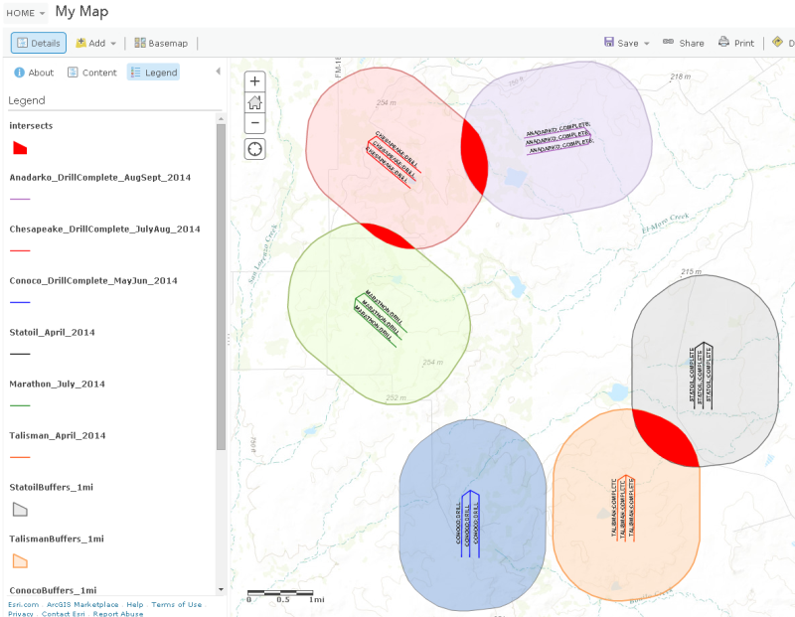
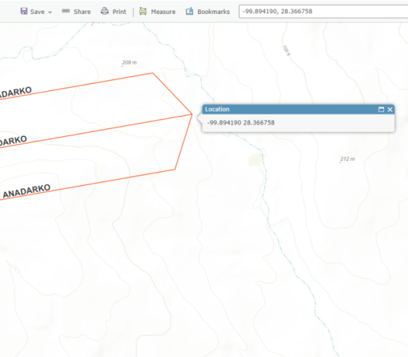
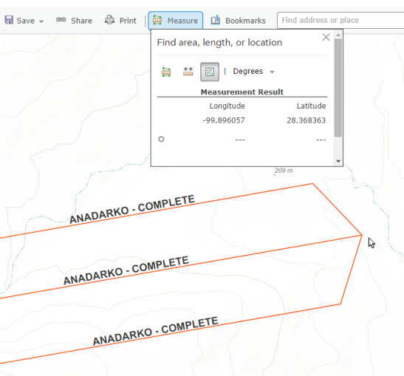
Propose Solution
Analysis Tools
Distance Tool
Area Tool
Buffer Tool
The same JPEG of the FFL is attached.
Locate Coordinates
Determine Coordinates

Slide 18
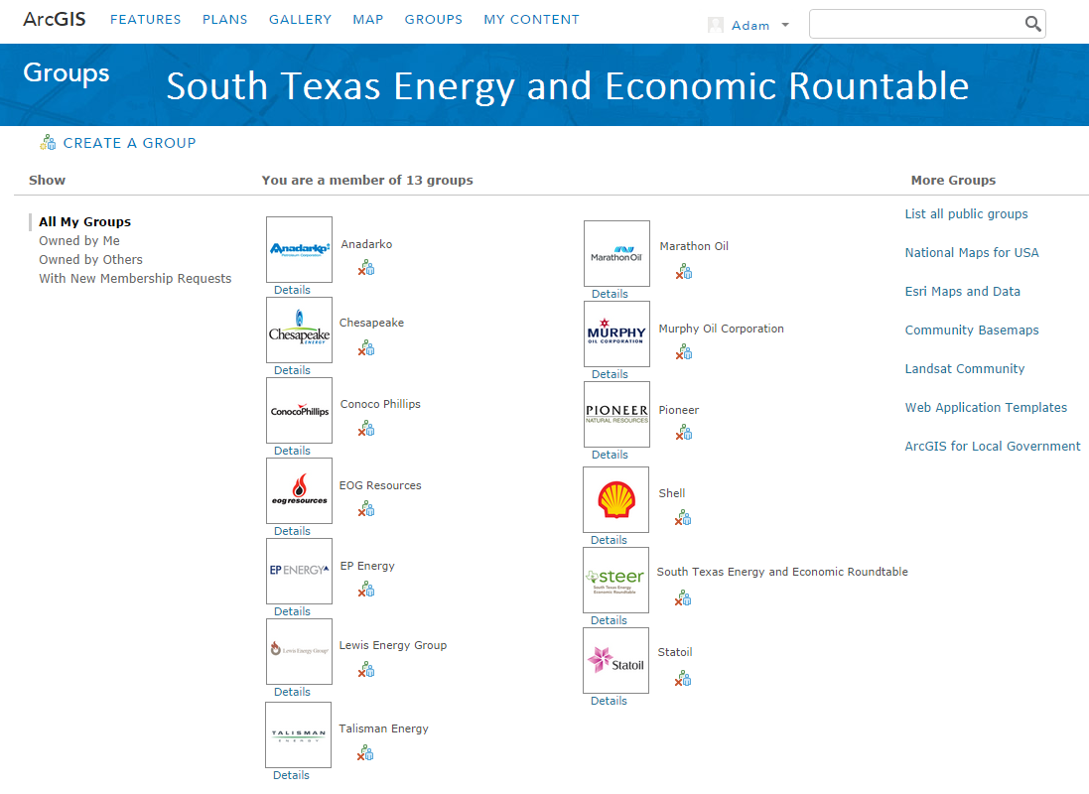
Propose Solution
Addressing Participation: Groups
Groups Encourage Participation
Provide a sense of belonging
The New Zealand Ministry of Education points out that when people feel they belong to a local community
(such as the one I am attempting to create), it can “influence (their) sense of identity and the extent to which they participate in society...
A strong sense of belonging also contributes to…community well-being”

Slide 19
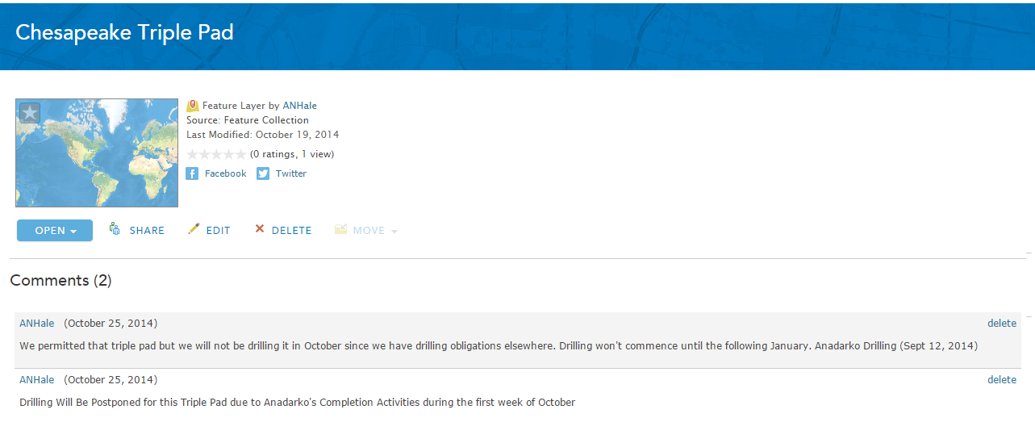
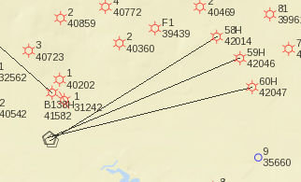
Propose Solution
Addressing Communication: Comments
Editable dialog spaces functioning as communication forums for hierarchical threaded discussions and submission of information

Slide 20
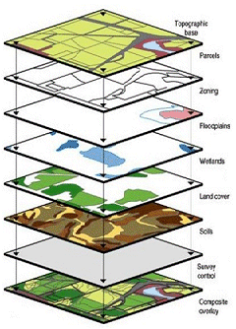
Propose Solution
It may seem like a very obvious (and very late) choice to select such a platform
but compared to other industries the Oil and Gas Industry has been slow
to adopt GIS technology.
The industry is switching over from platforms like CAD, which cannot
enrich spatial data by integrating it with non-spatial data.
The rate of drilling and completions in U.S. shale booms makes it difficult
to ensure that operations don’t outpace adoption of helpful technologies

Slide 21
Identify and Target Operators
To increase participation and improve the data sharing process I need look at the companies
that are active in the shale play.
My intention is to target those operators and convert them to users of the ArcGIS Online platform
I researched well permitting from the beginning of the play’s development (2008 ) to find that as of
Summer 2015, 155 operators were drilling and completing wells
Creation of a Pareto chart helped visualize who was doing the majority of the work
users

Slide 22
Identify and Target Operators
A grouping of 143 operators are doing 39% of the work
The remaining nine companies are doing 61% of the work
N U M B E R O F P E R M I T S
C U M U L A T I V E P E R C E N T A G E
Member of

Slide 23
Identify and Target Operators
STEER
A roundtable, not administrative body
Eleven largest members of EF Play
Correlates well with results of Pareto chart
Seats occupied by Public Relations Professionals
Mission statement aligns with my goals

Slide 24
Ready to convert a collection of entities into Users
I have to become an evangelical champion of the application
Deliver Message
How do I do this?
Clearly understand and describe the tool in terms of the data it contains
Prepare me to deal with questions
Fight off misconceptions from people who will not understand
Be an entrepreneur to gain user-ship of it; transition to marketing/sales role
Deliver a message
“I have a system that companies can use to improve
current data sharing practices related to well scheduling”
Even though more is at stake, I must appeal to the bottom line
Revenue

Slide 25
Deliver Message
Deliver Message
Imply that my way of doing things is superior to the current way of doing things
Demonstrate Functionality
When asked “How many users do you already have”
Must NOT have a ZERO answer
Adopted at my workplace with 70 users to avoid internal frac hits
Enter the Shark Tank
Presentation to Peers is fundamentally different to one given at STEER
STEER is not academia
If I use an academic title I will not last 30 seconds (lose interest)
I must tactfully appeal to their business sensibilities
“Increasing Safety and Mitigating Production Loss in Hydrocarbon Exploration
and Development Using Volunteered Geographic Information”
Or
“Do you want money to continue hemorrhaging out of the ground?
This means I must
Quantify CO$T of consequences

Slide 26
Deliver Message
What is consensus?
Another word for ‘agreement’
Consensus already exists to some extent: operators are already sharing information
Is consensus within STEER necessary?
Consensus has little utility outside an administrative body
You may need consensus if you are a member of Parliament voting for/against war
STEER is not an administrative body
Members act independently
Consensus is not necessary for members to take action
STEER is more like a ‘marketplace’; how is consensus quantified in a marketplace?
By the amount of the market that uses the system (1 company - 70 users)
By the amount of the market that says they would like to use it
I can demonstrate consensus by getting some indication of interest within the group in using the system
Must first appeal to their interests; what are they?
Purely related to revenue
☑
☑
☒
$$$

Slide 27
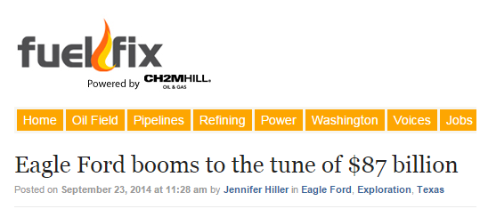
Quantifying CO$T of consequences
Deliver Message
The very first thing I must do is quantify the Monetary value of the Eagle Ford shale play
University of Texas at San Antonio (UTSA): $87 Billion economic impact across South Texas in 2013

Slide 28
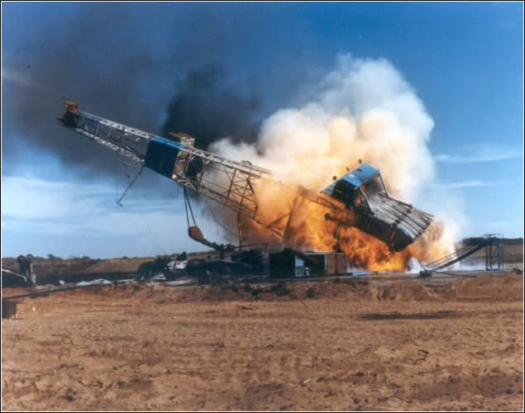
Quantifying CO$T of consequences
Deliver Message
The second thing I must do is quantify value of financial losses due to accidents
Worst Case Outcome of frac hit, but less likely: Rig Blowout
I will show video of a flaming rig burning down
I will ask, “How many of you agree that this is unacceptable?”
Hands will be raised; this will be the FIRST form of consensus
A more likely scenario is production loss from frac hit without warning
I must quantify the losses for a typical EF well
Revenue lost - $7 Million drilling and completion costs
Damaged Casing? Re-drill costs: $7 Million
Production lost – 20%-%80 loss
(may or may not be permanent, cost is nebulous)
If sand/water pulled in from nearby completion
cleanout costs: hundreds of thousands to millions of dollars
Conservatively:
Of the 16,000 permitted Eagle Ford wells (each worth ~$3M); if only
half of those (8,000) were producing and only 5% of them were
affected by frac hits, there would be a loss of $1.2 BILLION
Frac Hit
…I will then introduce ArcGIS Online

Slide 29
Deliver Message
After this, I will ask:
“How many of you agree that this platform advances the current data sharing program?”
Many hands will likely be raised; this will be the SECOND form of consensus
Suggest the adoption of this tool
They cannot agree to take action, they will ‘take it back to their companies for discussion’
These people will carry my message to those who can affect change

Slide 30
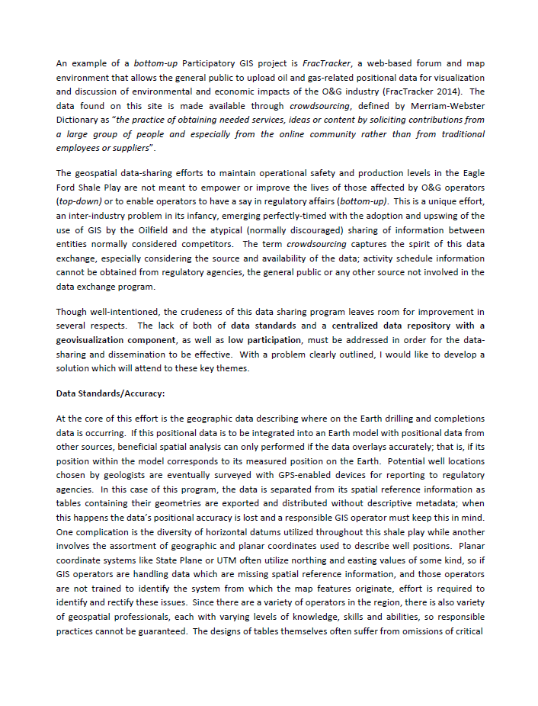
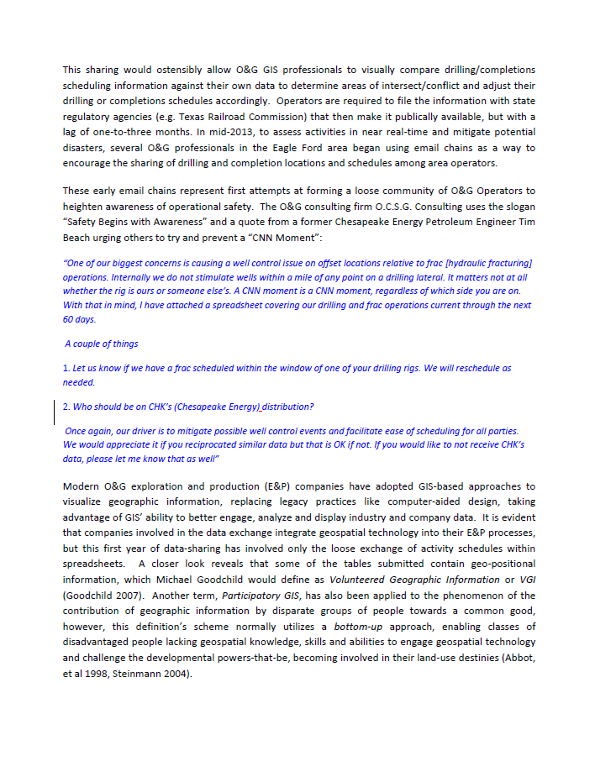
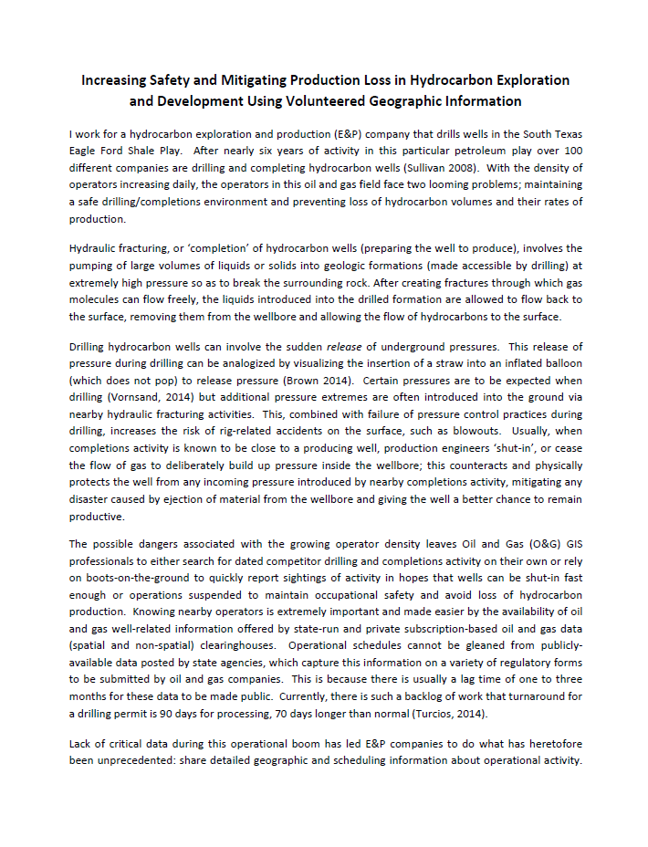
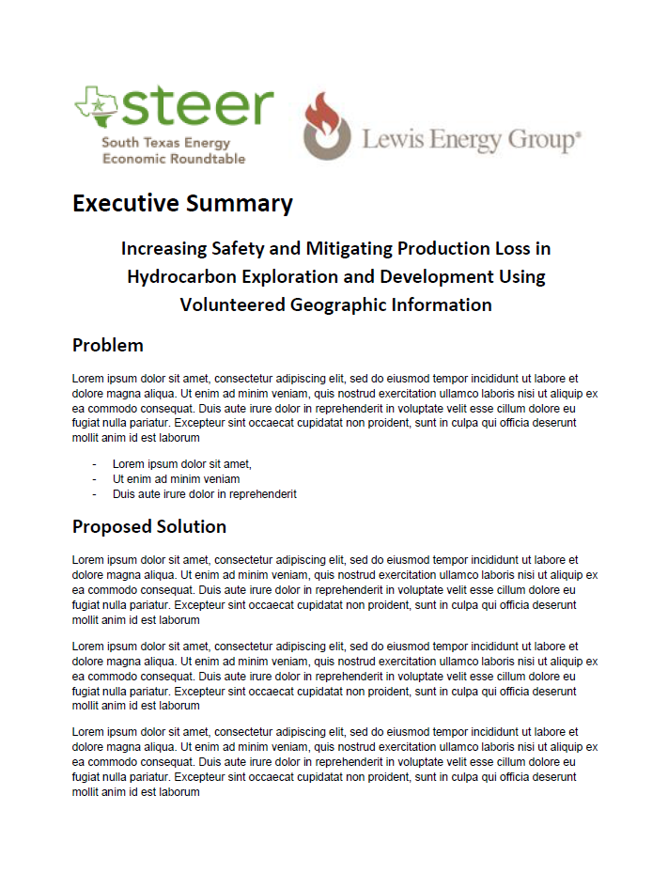
Deliver Message
Prepare Information Campaign
write an executive summary
Encapsulates project
Introduces topic for discussion
Problem/solution format
Entices them to read following paper
Blanket e-mail to send to all other
operators

Slide 31
Deliver Message
Prototype workflows for demonstration
Additionally:
prepare demo video with help of PR team

Slide 32
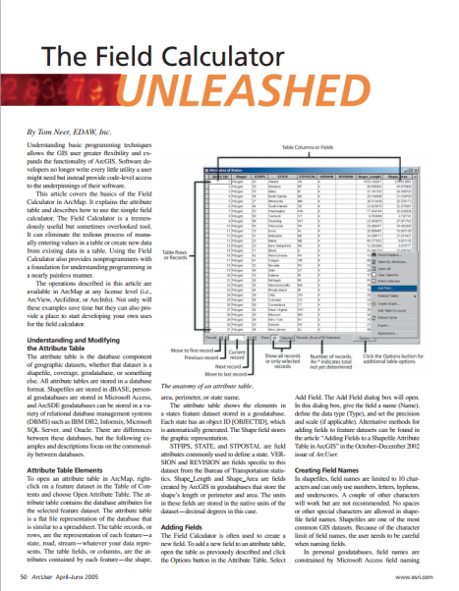
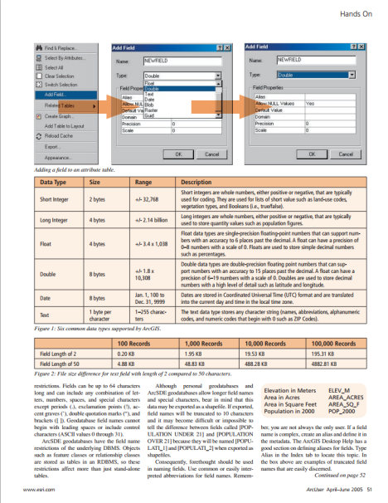
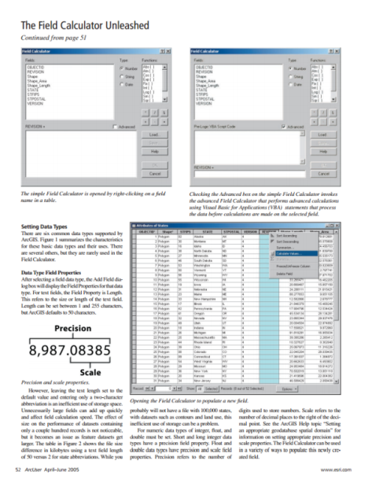
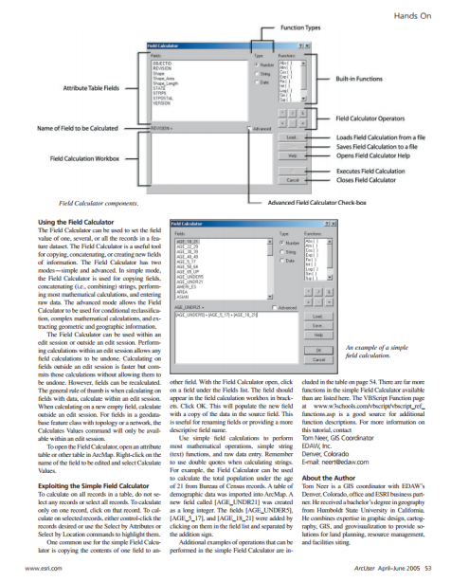
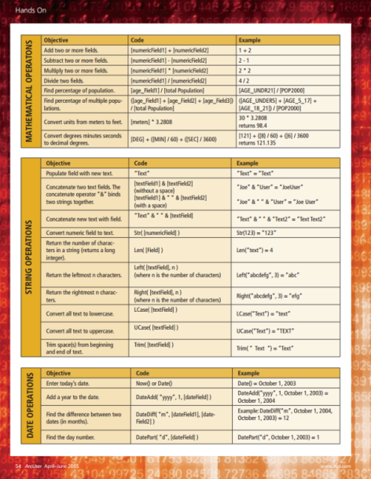
Deliver Message
Create a brochure like Tom Neer’s
“The Field Calculator Unleashed”
(ArcGIS Field Calculator)
Instructional/Informative
Great go-to reference
Illustrations explain usage
PDF Can be disseminated easily e-mail
attachments

Slide 33
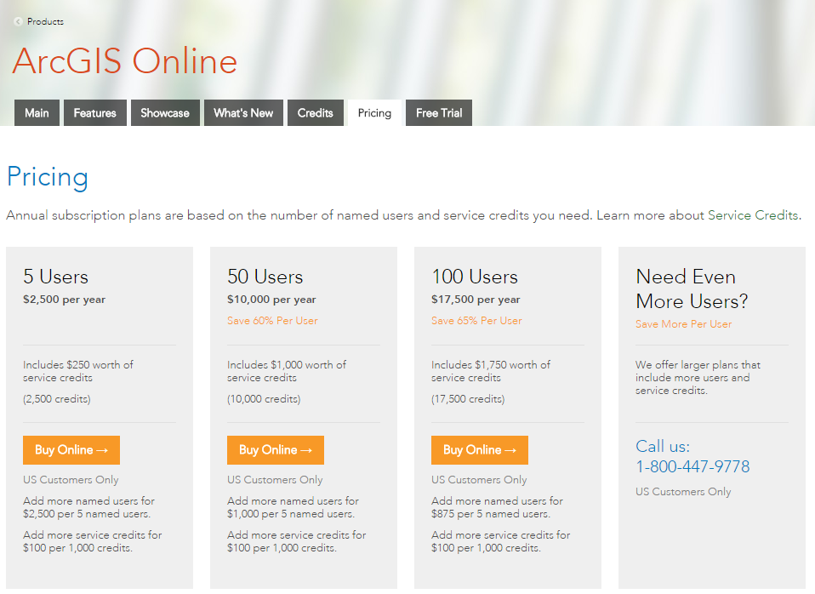
Deliver Message
Provide ArcGIS Online licensing options
Provide ArcGIS Online licensing options
Ask first, they may already have a few
seats if they have ArcGIS for Server
1. Option tailored for non-profit entity
ArcGIS for Home Use account
2. Option tailored for for-profit entity
ArcGIS Organizational account

Slide 34
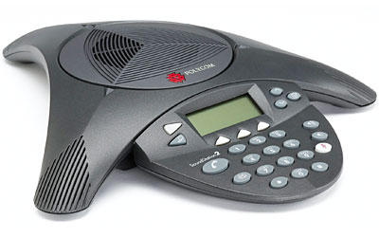
Deliver Message
Arrange opportunities to discuss outside of STEER environment
to make them feel comfortable with data sharing
Meetings
Anticipated Results?
Hard to tell, but…
Hard to deny it’s not an improvement
If I appeal to the revenue side, I may get converts
Have 100% Buy-in from my company’s Executives
And Public Relations assets
Phone Calls
One-on-One

Slide 35
Logistics
STEER Meets every month; plenty of opportunities to present
Won’t stop after 596B; will remain engaged with STEER
Form personal relationships with PR from other STEER members
Timeline – Start November 3
Discuss approach with company’s PR Department (2 weeks;1 meeting per week)
Write speech/create presentation (2 weeks concurrent with above)
Create Mock-up (3 weeks)
Create Brochure (2 weeks)
Write Blanket e-mail (1 week)
Present at STEER Meeting (January or February 2015)

Slide 36
QUESTIONS?

Slide 37
http://www.soi.wide.ad.jp/class/20090061/slides/05/12.html
http://www.esri.com/software/arcgis/arcgisonline
http://support.esri.com/cn/knowledgebase/techarticles/detail/39410
http://steer.com/
http://discussions.texasbowhunter.com/forums/showthread.php?t=88608
http://www.blue-marble.de/night.php
http://www.oilandgasbmps.org/resources/gis.php
http://blog.codinghorror.com/are-you-an-evangelist-too/
http://www.nationmultimedia.com/technology/Steve-Jobs-in-his-own-words-30166979.html
http://www.bluenose.com/6-ways-to-increase-revenue-with-product-usage-data/
http://kobusm.travellerspoint.com/163/
http://pdxretro.com/2011/09/world-war-ii-began-on-this-date-in-1939/
http://fuelfix.com/blog/2014/09/23/eagle-ford-booms-to-the-tune-of-87-billion/
http://www.news.cyprus-property-buyers.com/2011/03/25/majority-of-cypriot-planning-amnesty-laws-passed/id=007222

