Slide 1
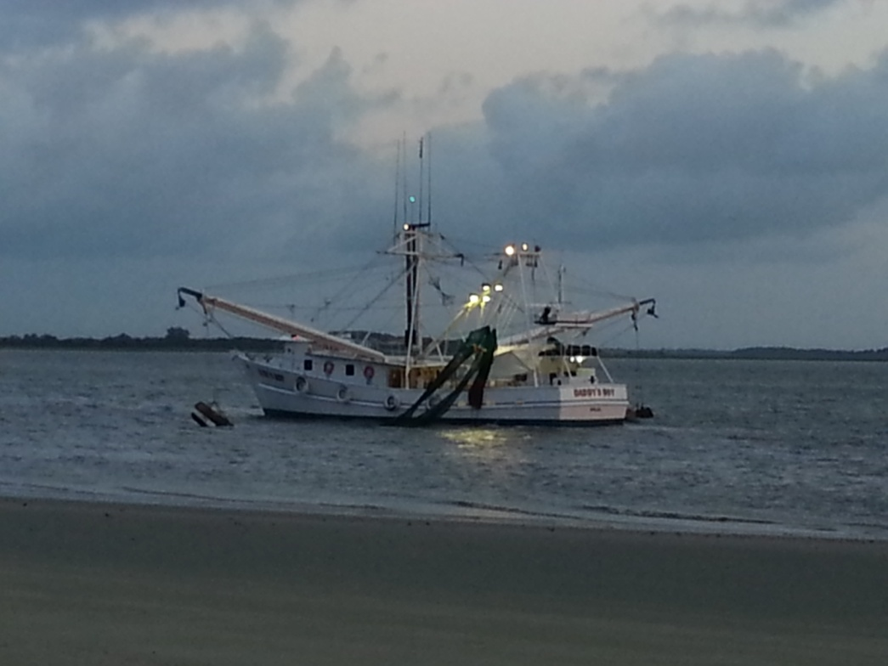
SPATIAL ANALYSIS OF SHRIMP TRAWLER
SURVEYS & SEA TURTLE STRANDINGS
ON THE GEORGIA COAST
LARA HALL ∙ CAPSTONE PROPOSAL ∙ DECEMBER 2013

Slide 2
Presentation Outline
Project Background & Literature Review
Research Objectives
Data sets
  Shrimp Trawler Locations
  Sea Turtle Strandings
  Boat Boardings and TED Violations
Methodology
  Data Preparation
  Density Analysis
  Temporal Analysis
  Distance Analysis
Expected Outcomes

Slide 3
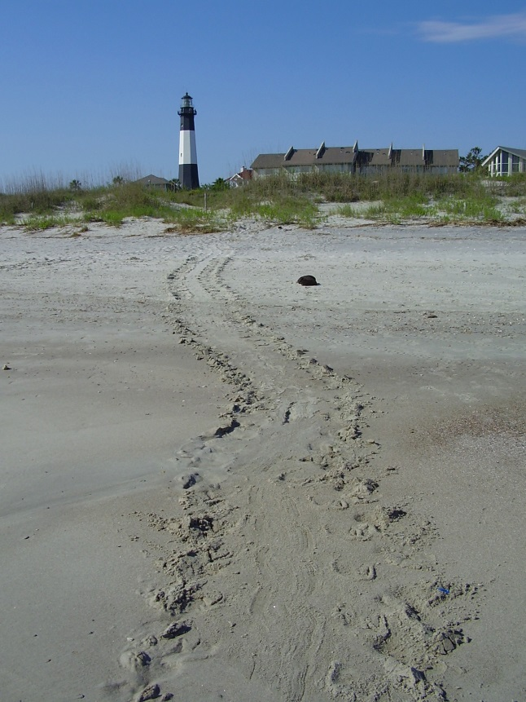

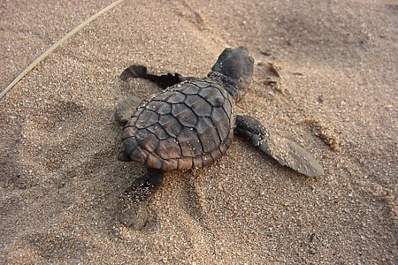
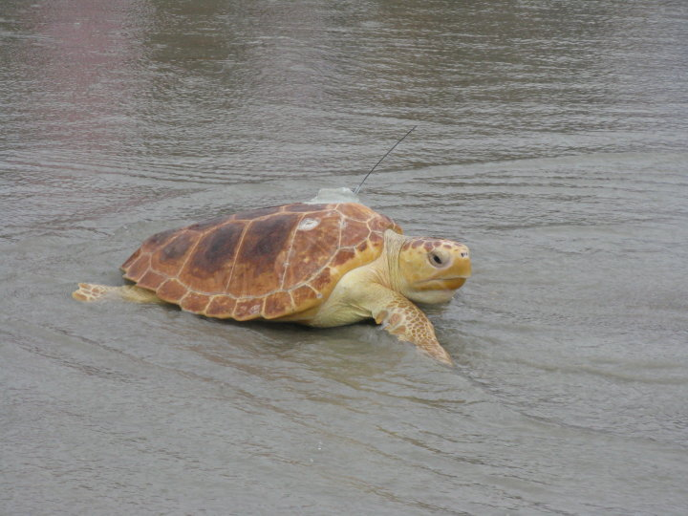
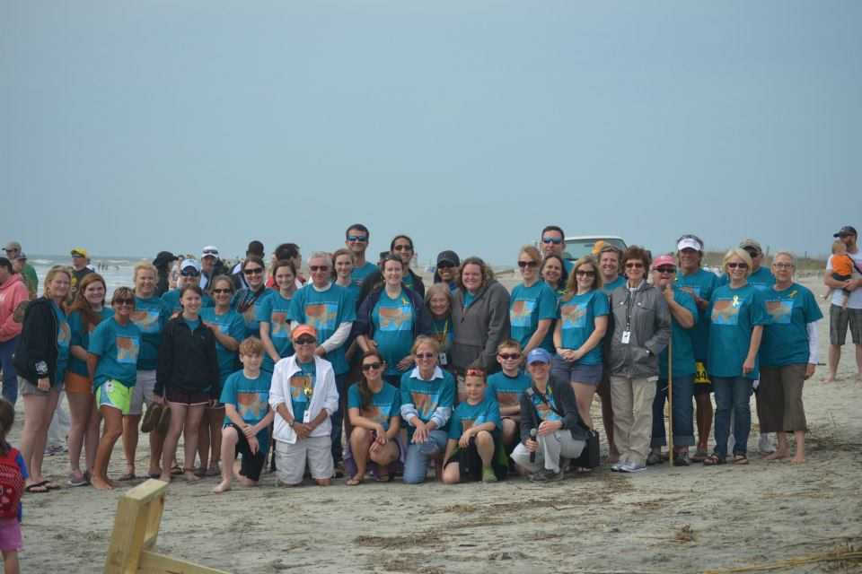
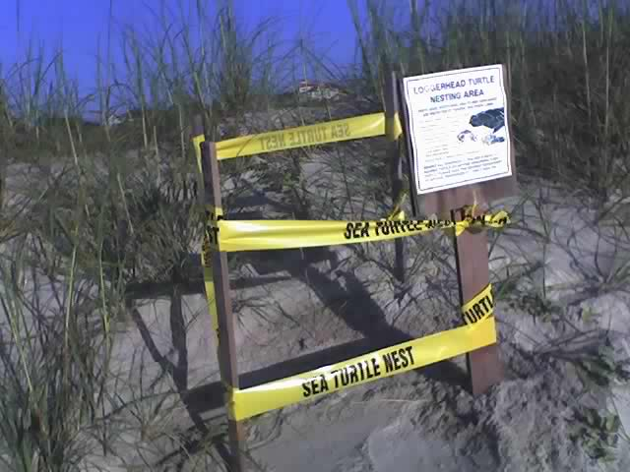
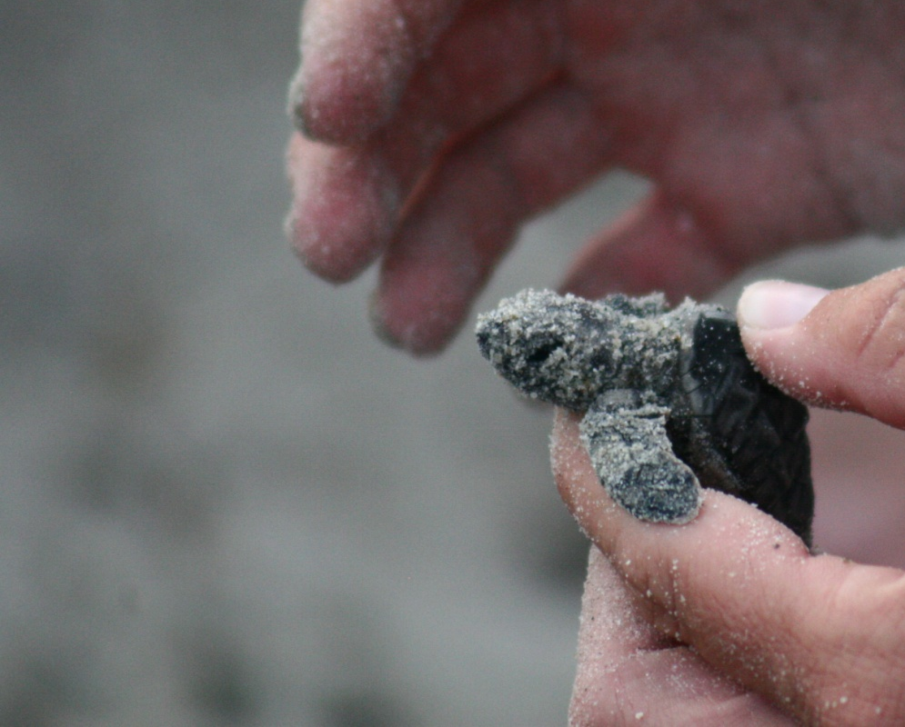
Georgia Sea Turtle Project

Slide 4
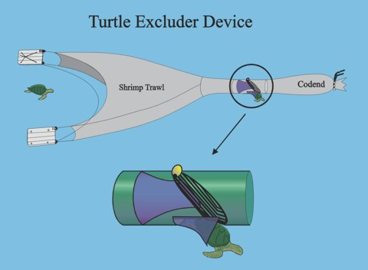
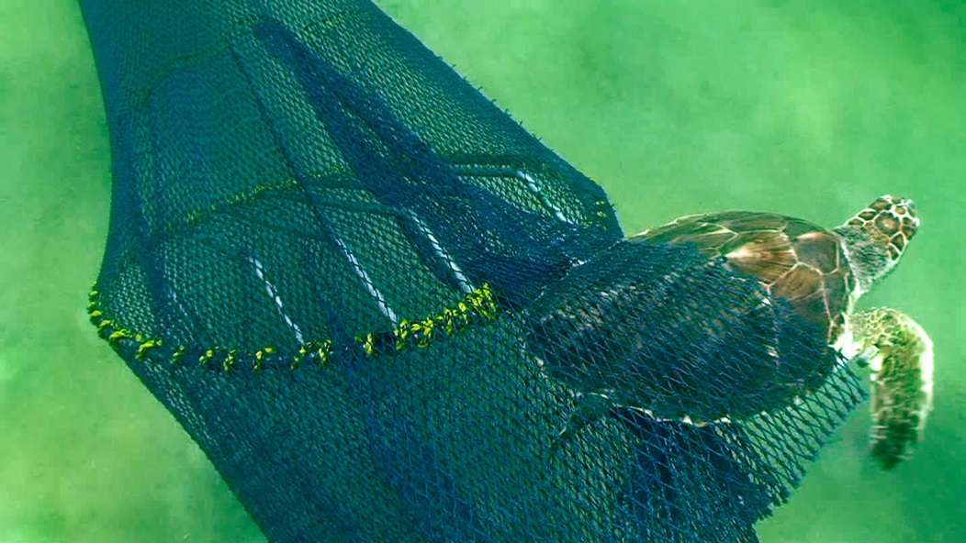
Literature Review
TED – A Turtle Excluder Device is a grid of metal bars that attaches to a trawl net, creating an opening that allows sea turtles and larger fish to escape. Small animals such as shrimp go between the bars and are caught in the end of the trawl.

Slide 5
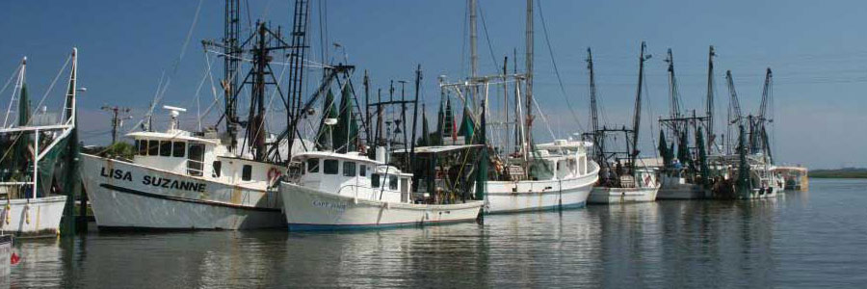
Literature Review
Trawling activities by the fishing industry continue to be one of the most common non-natural causes of death for sea turtles, accounting for more than 80% of deaths between 1990 and 2007 (Finkbeiner et al. 2011).

Slide 6
Literature Review
Use fleet communication systems to respond to real-time bycatch hotspots
Use of predictive modeling to identify areas for closure
Identify combinations of environmental factors to predict sea turtle hotspots
Setting maximum adult bycatch limits
Reducing the size of the fishing fleet
Using strandings to understand the spatial and temporal patterns of the mortality events

Slide 7
Research Objectives
What spatial patterns are present in the location of shrimp trawlers and sea turtle strandings on the Georgia coast from 1999 to 2013?
Do these patterns change as a function of covariates, such as boat size or cause of death?
How have the patterns changed over time? Do they vary with season?
Are sea turtle strandings correlated with shrimping intensity or to TED violations?

Slide 8
Presentation Outline
Data sets
  Shrimp Trawler Locations
  Sea Turtle Strandings
  Boat Boardings and TED Violations

Slide 9
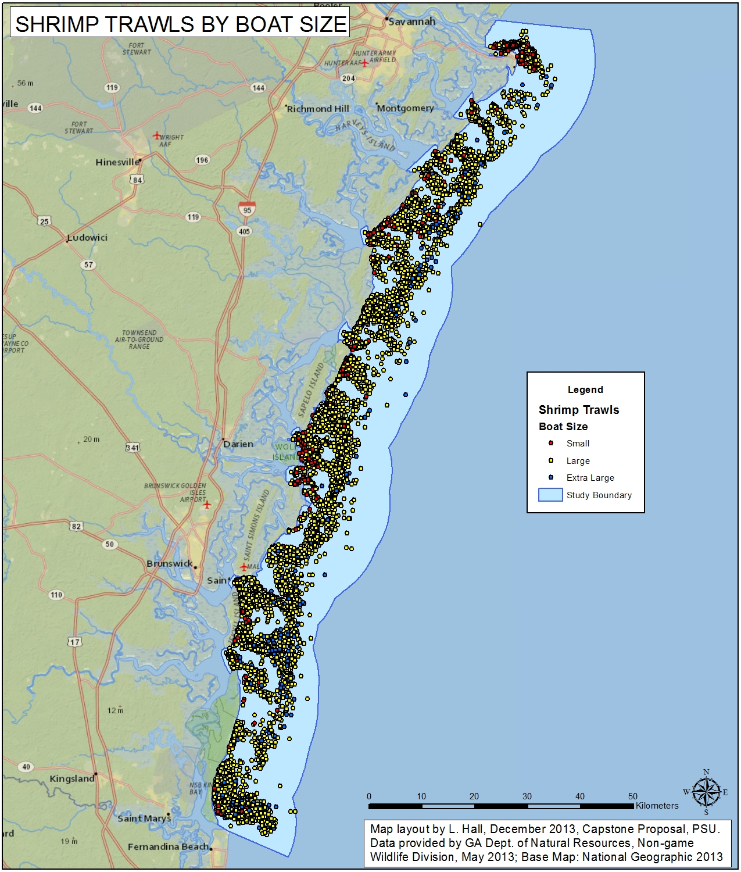
Data: Shrimp Trawler Surveys
Recorded from 1999 to 2012
A total of 7,906 locations for analysis
Grouped by seasons: early, mid and late
Also categorized by boat size: small, large, and extra-large
Most records fall into the early season and large boat categories

Slide 10
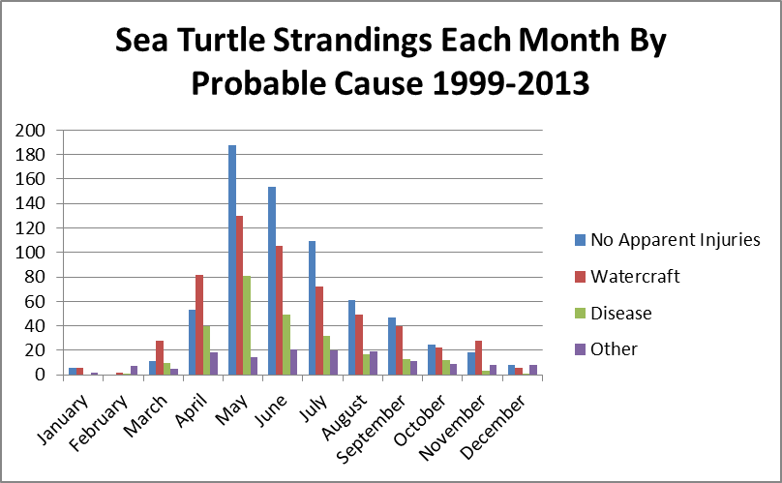
Data: Sea Turtle Strandings

Slide 11
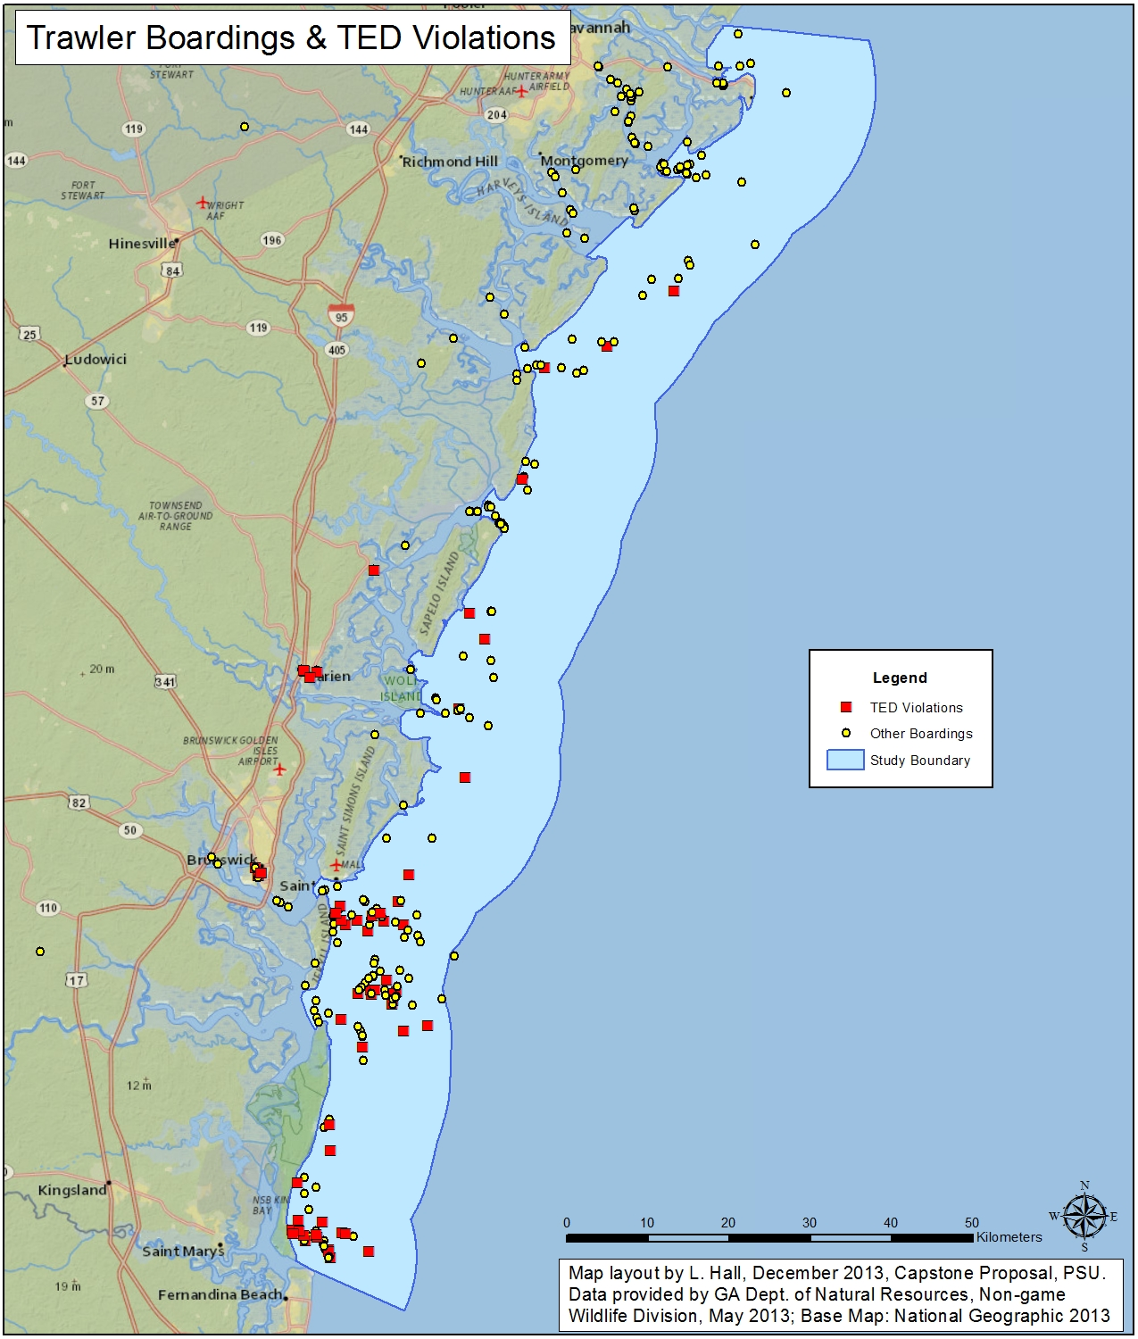
Data: TED Violations
309 records
72 violations
42 significant violations

Slide 12
Presentation Outline
Methodology
  Data Preparation
  Density Analysis
  Temporal Analysis
  Distance Analysis

Slide 13
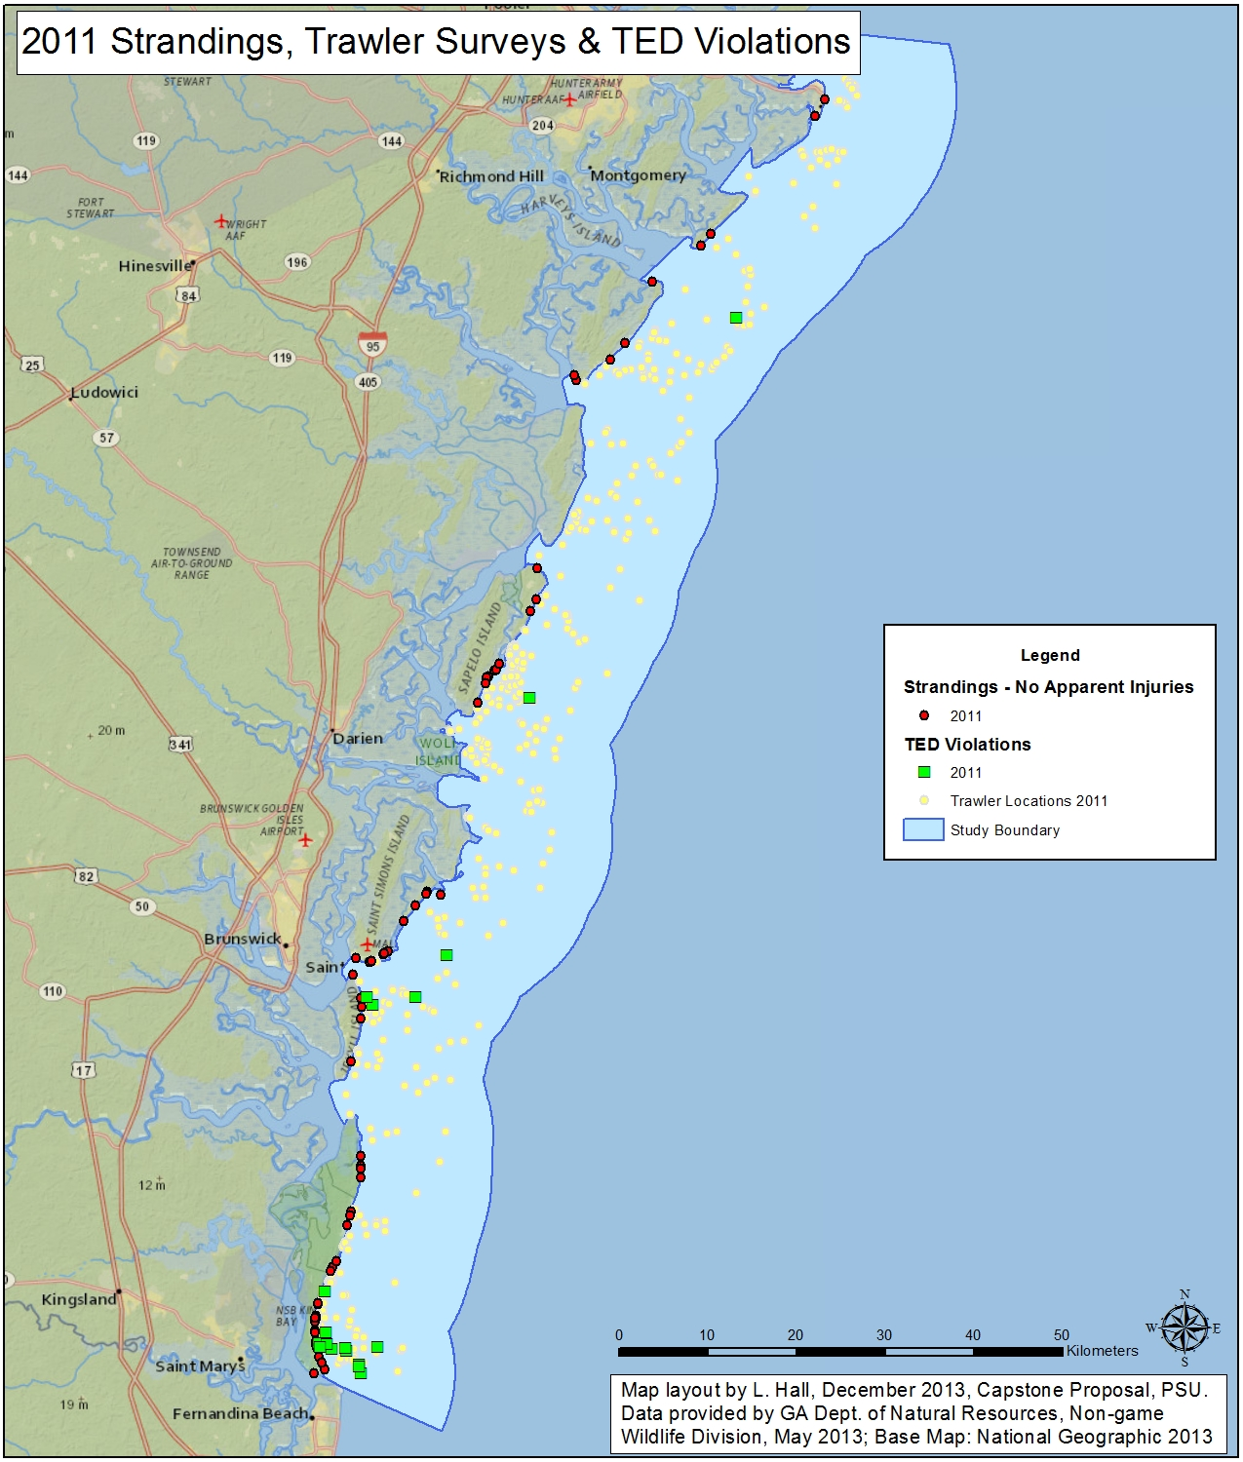
Methodology: Data Preparation
Create feature classes
Remove records
Create additional fields
Create feature classes from subsets of data
Create study area

Slide 14
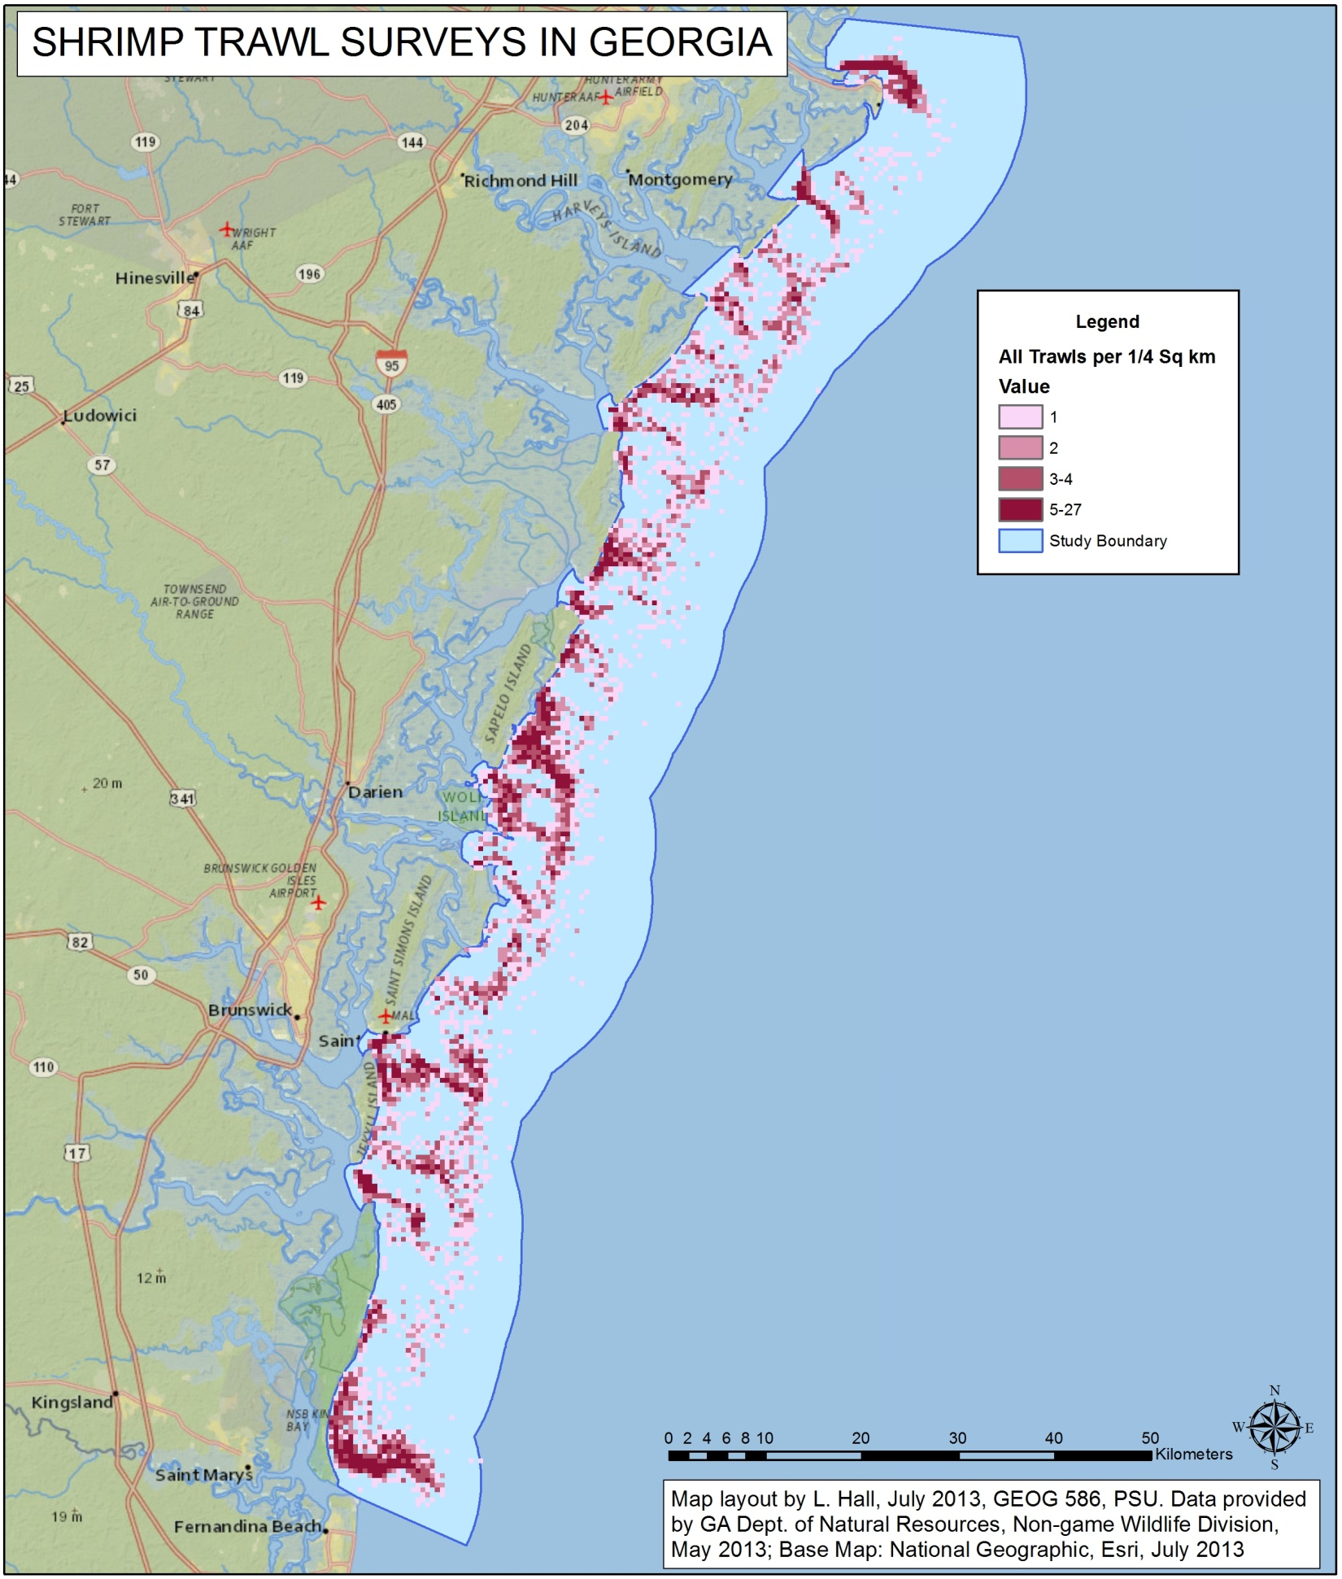
Methodology: Data Preparation
Determine appropriate cell size
Create raster layers from feature classes

Slide 15
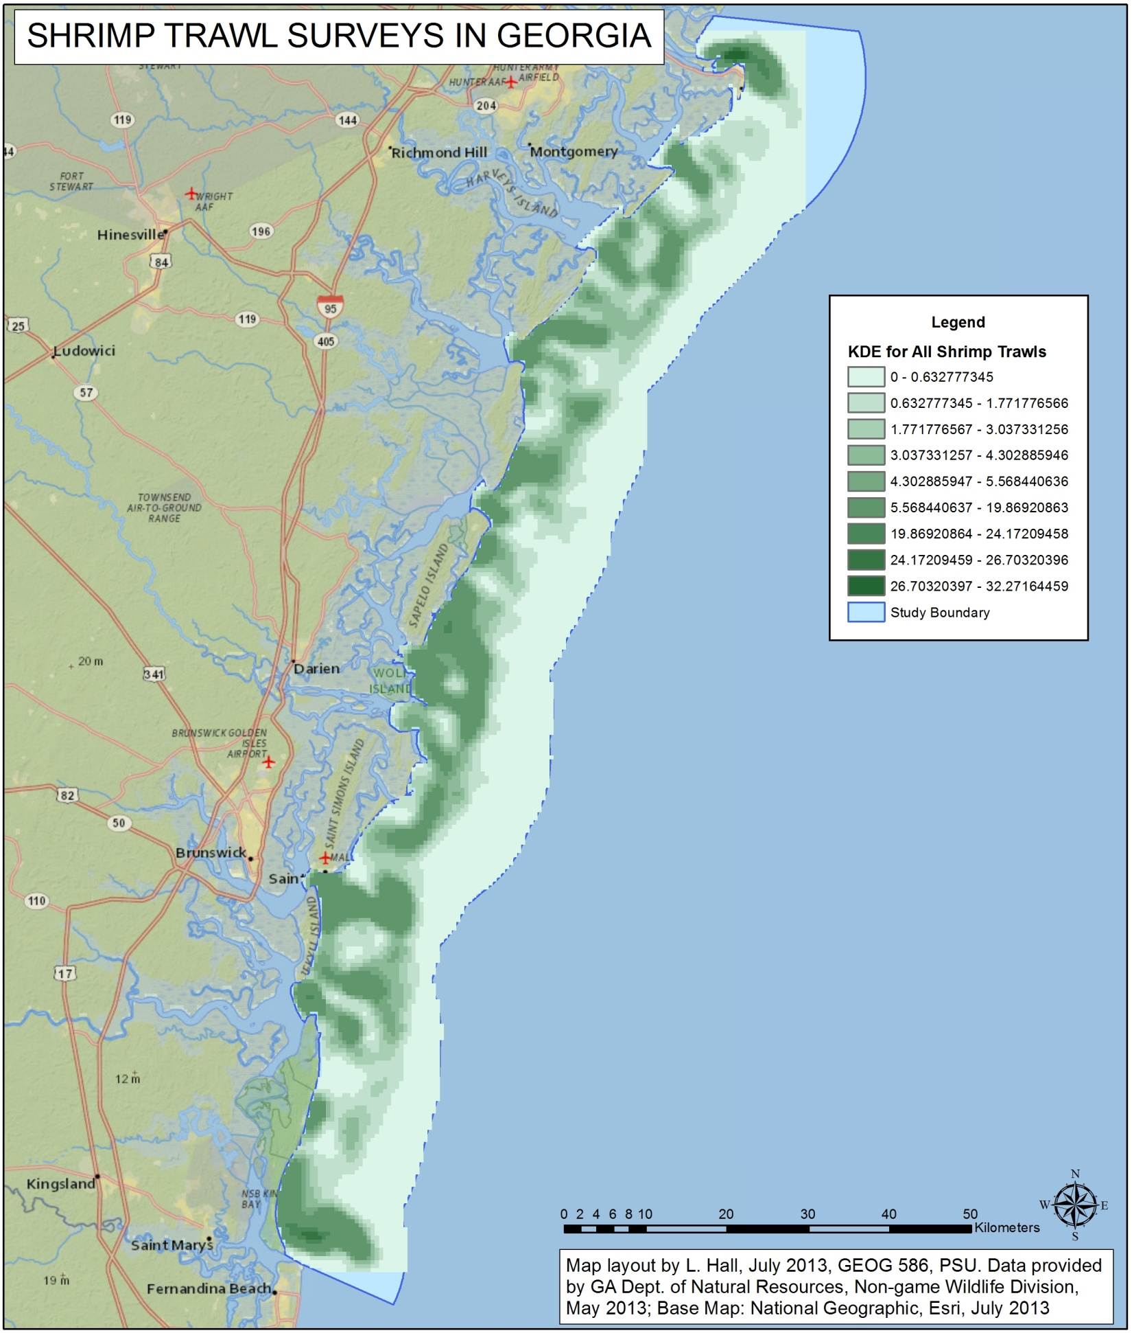
Methodology: Density Analysis
Kernel Density Estimation or KDE analysis provides a way to distribute individual counts over the study area to better understand the distribution.

Slide 16
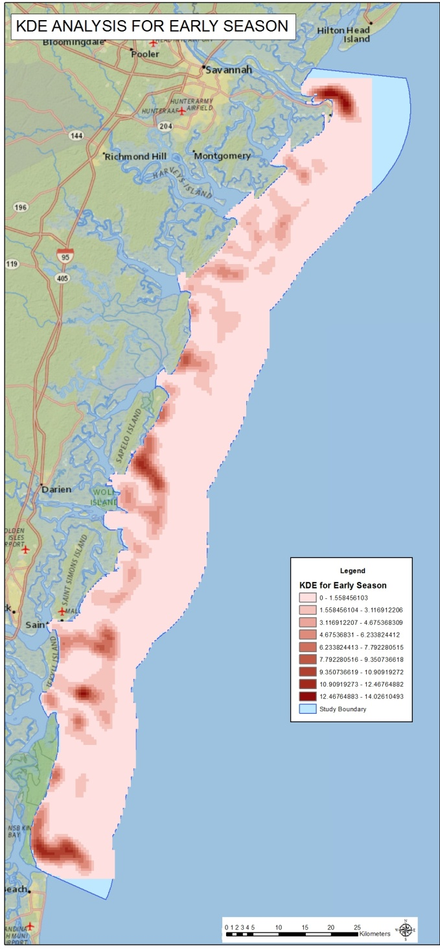
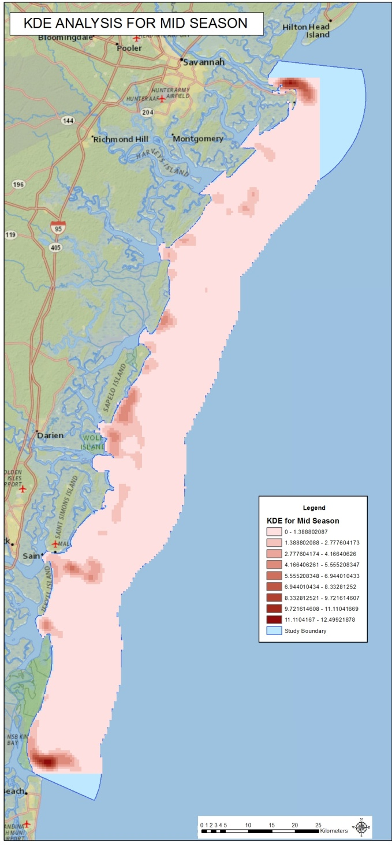
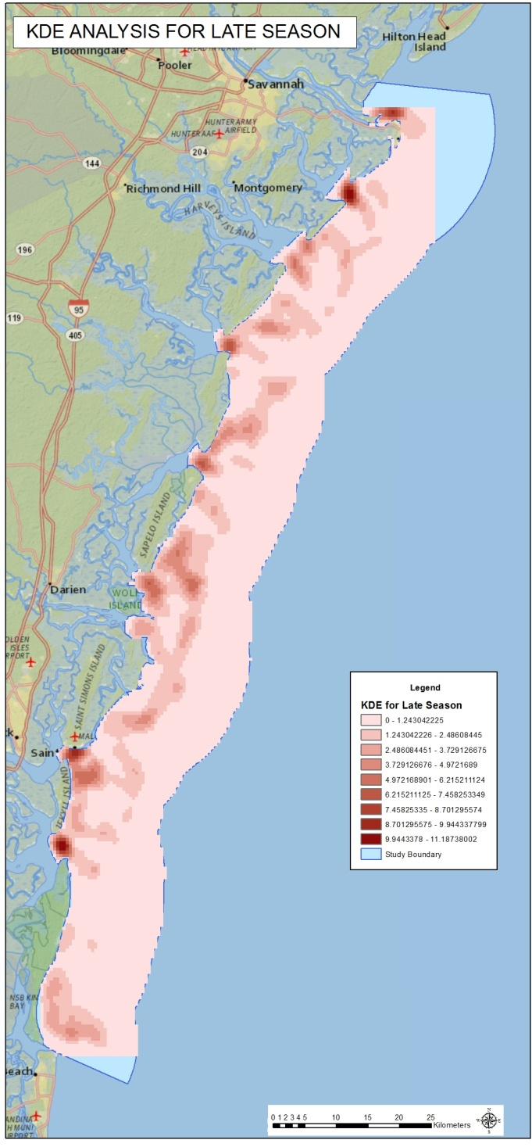
Methodology: Density Analysis

Slide 17
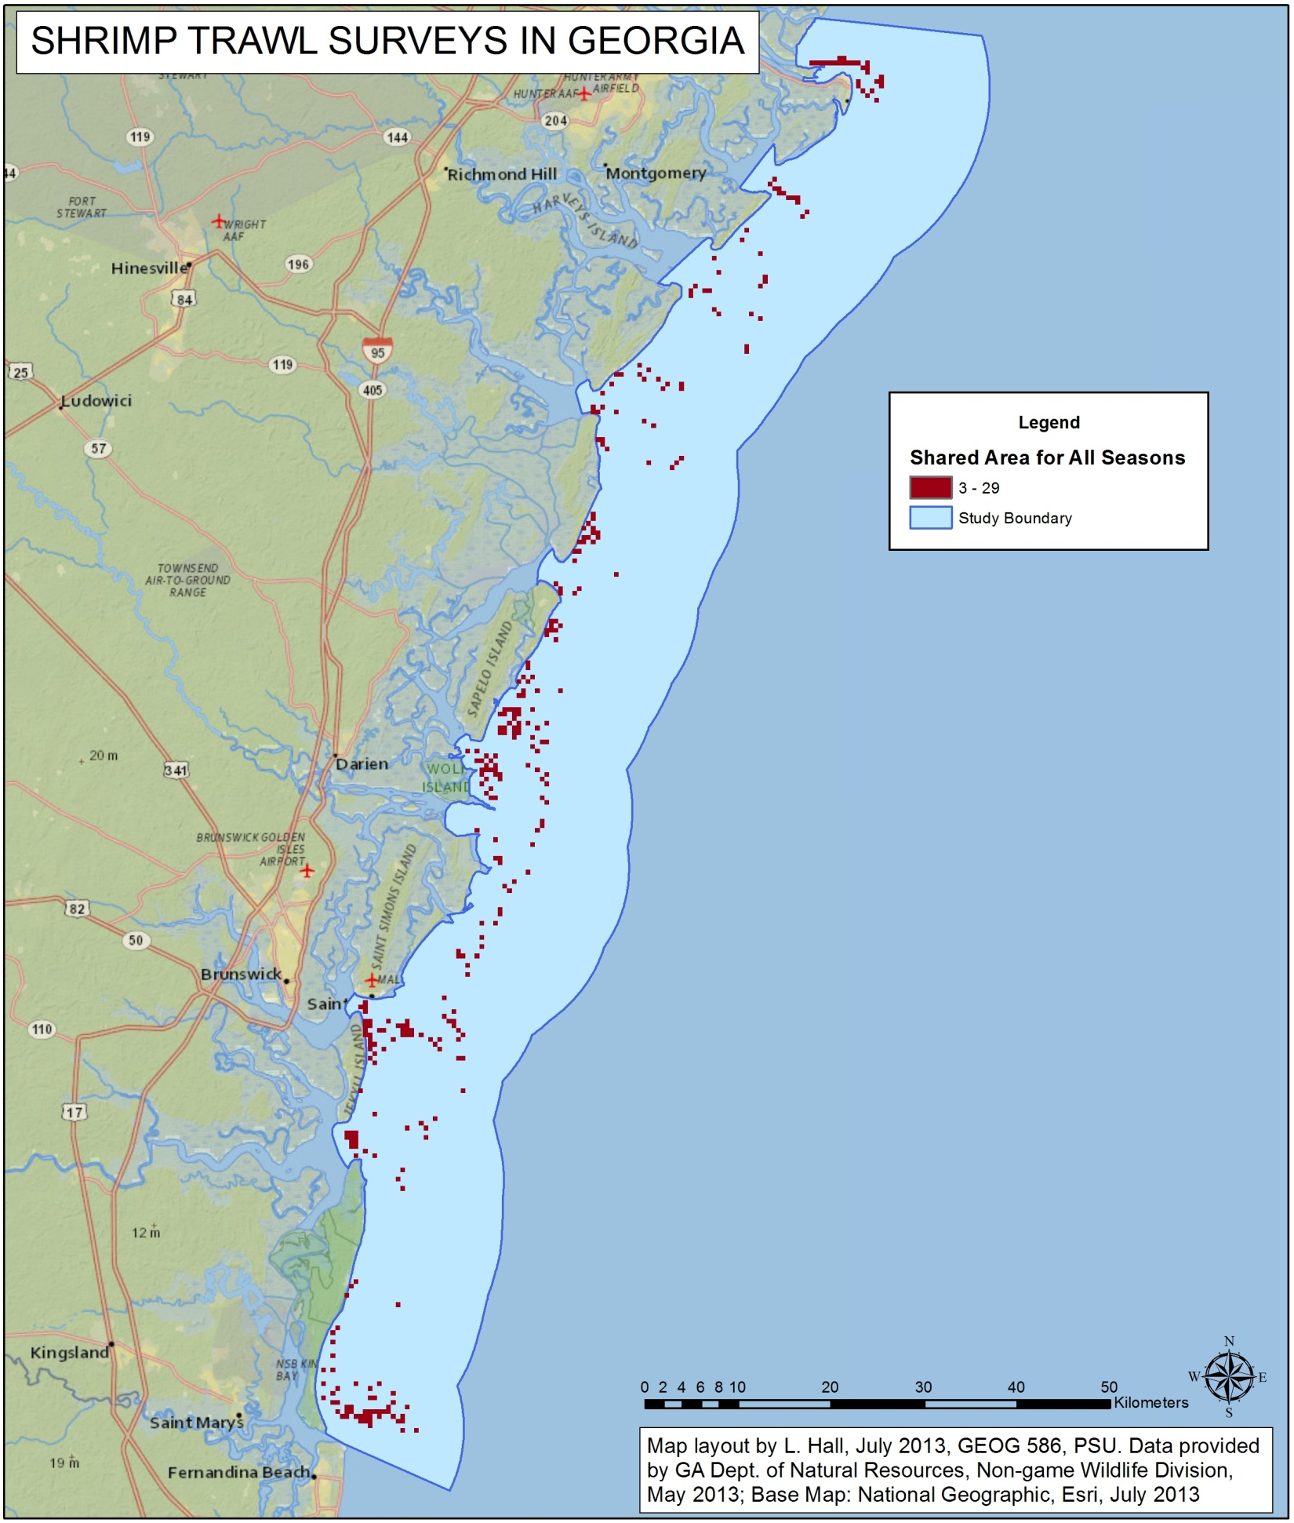
Methodology: Temporal Analysis
Map Algebra | Cells | Sq Km | % of Area
None | 3214 | 803.5 | 100.00%
Early + Mid | 653 | 163.25 | 20.32%
Mid + Late | 504 | 126 | 15.68%
Early + Late | 856 | 214 | 26.63%
All Seasons | 338 | 84.5 | 10.52%

Slide 18
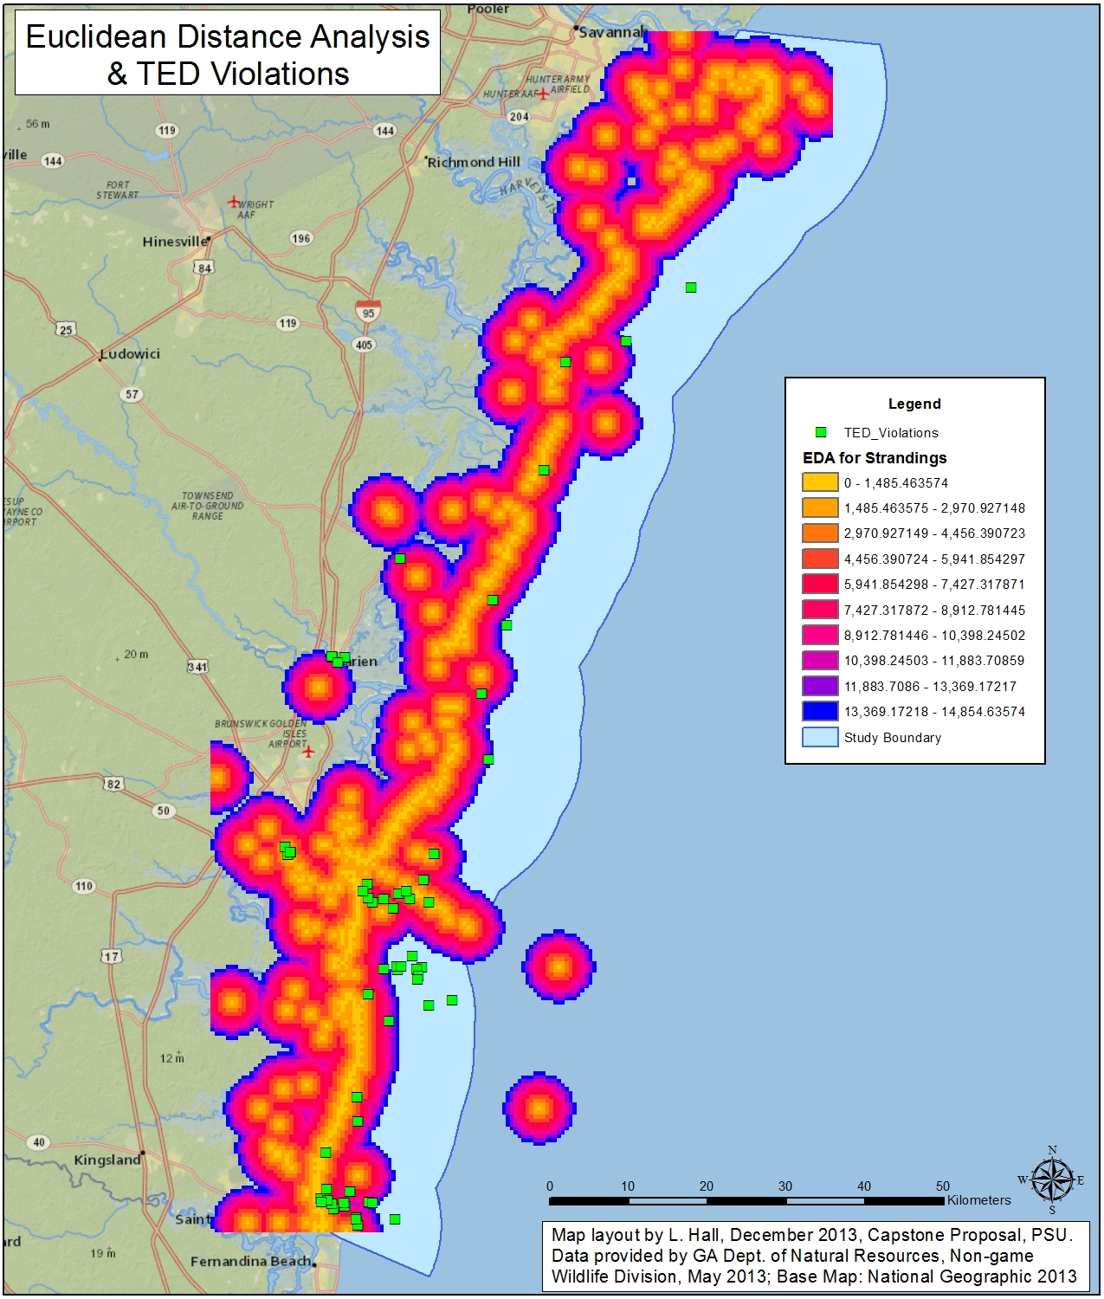
Methodology: Distance Analysis
Feature-based proximity toolset
  Near Tool
  Point Distance
Euclidean distance analysis
  Distance
  Direction
  Allocation

Slide 19
Expected Outcomes
Shrimp trawler locations will be clustered and will vary according to season and boat size.
Sea turtle strandings will not be clustered, with the exception of the subset for no apparent injuries.
Both trawler locations and strandings will vary with time.
Strandings from no apparent injuries will correlate with TED violations but not with high shrimp boat density.
Improved understanding of best management practices for the Georgia Sea Turtle Conservation Program

Slide 20




QUESTIONS?
Thank you to all of the agencies supporting this research.

