Slide 1
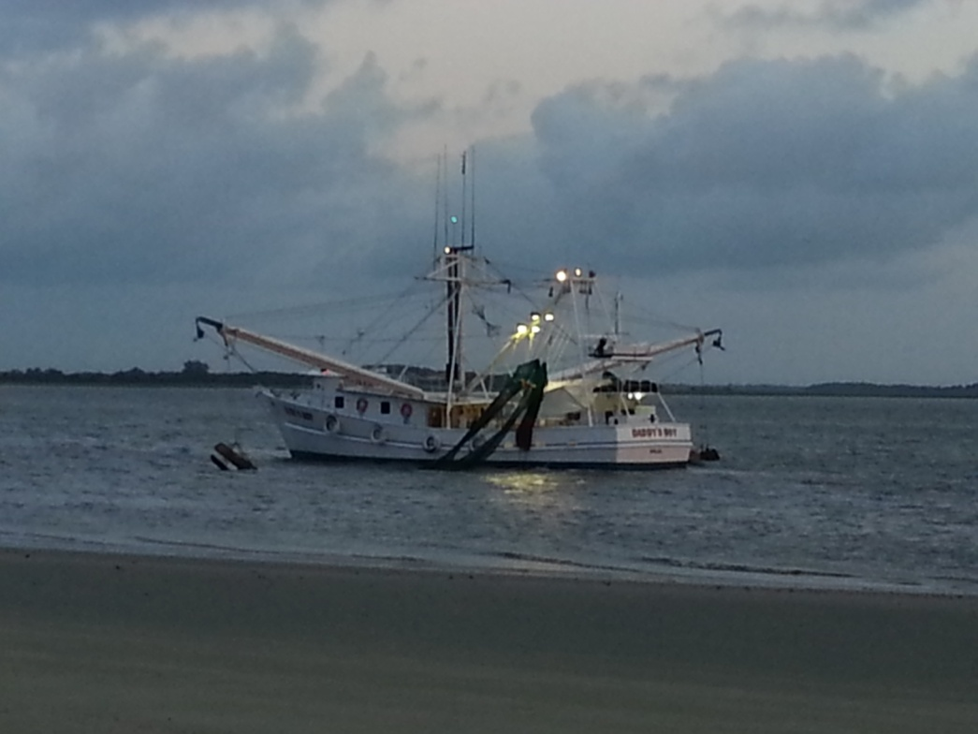




SPATIAL ANALYSIS FOR SEA TURTLE CONSERVATION IN GEORGIA
Esri Southeast User Conference • Lara Hall • May 5, 2014

Slide 2
Presentation Outline
Project Introduction
Research Objectives
Data sets
  Shrimp Trawler Surveys
  Sea Turtle Strandings
  Trawler Boardings
Methodology & Results
  Data Preparation
  Density Analysis
  Distance Analysis
Applications for Research

Slide 3
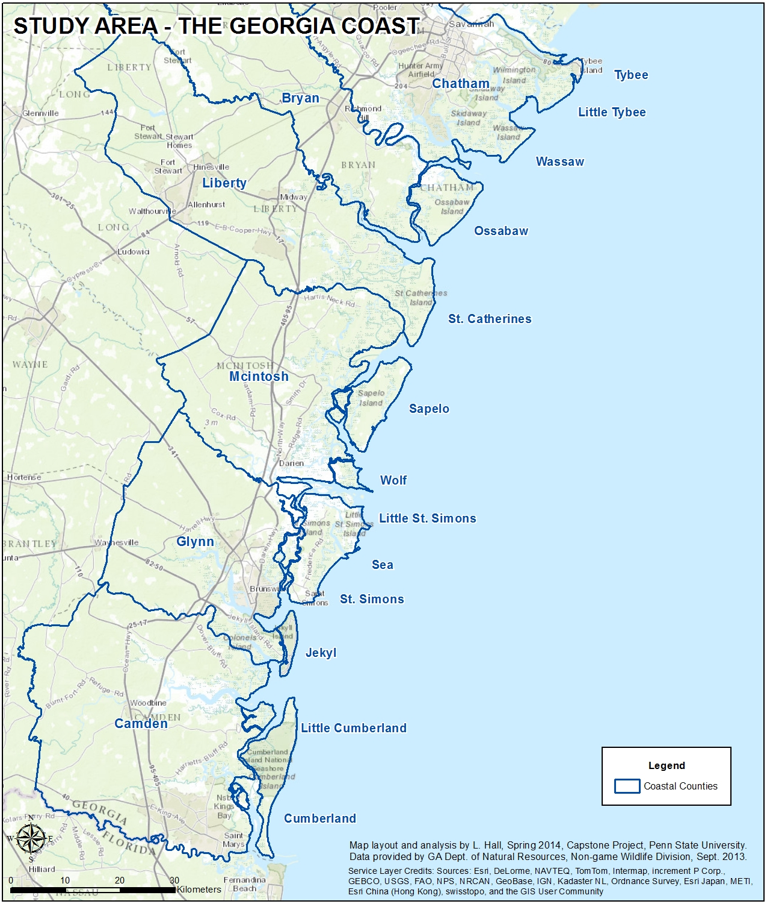
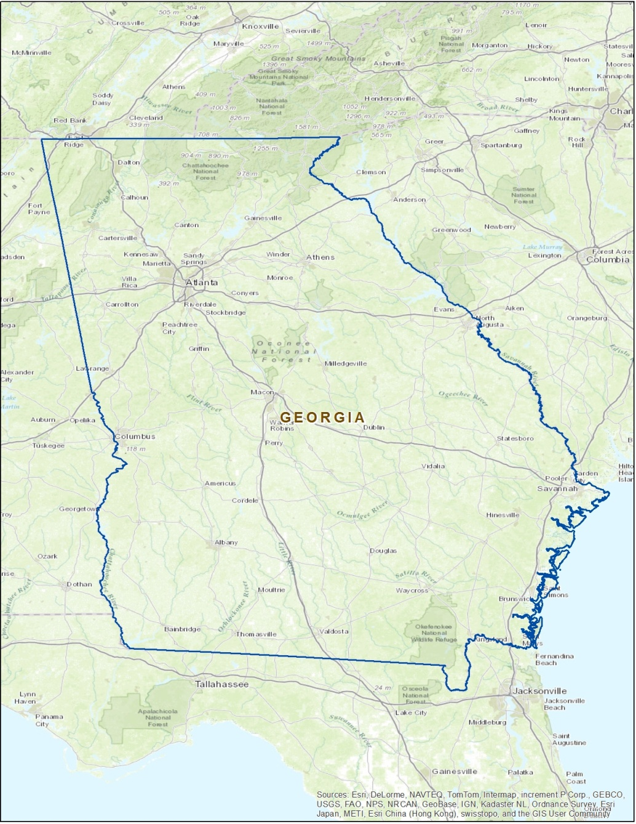
Geography of the Georgia Coast

Slide 4
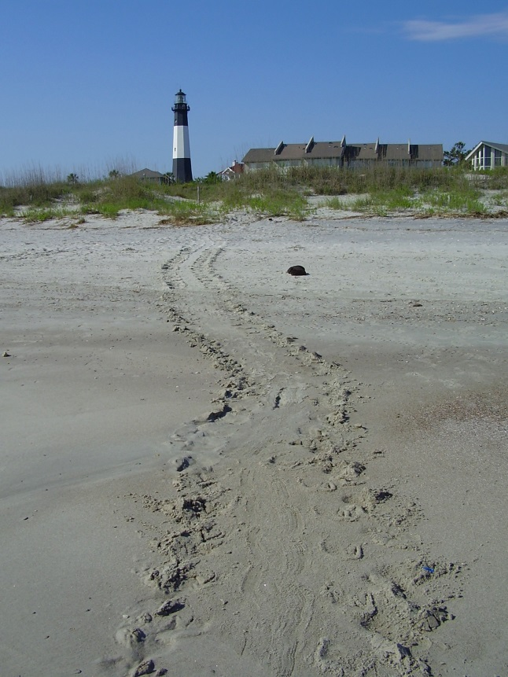

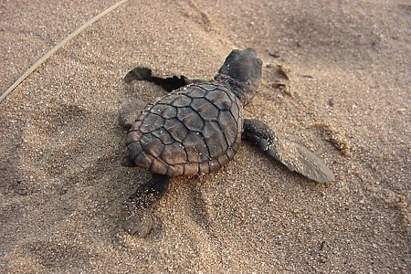
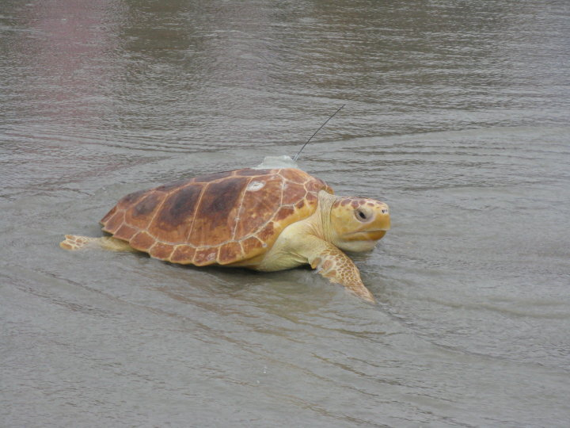
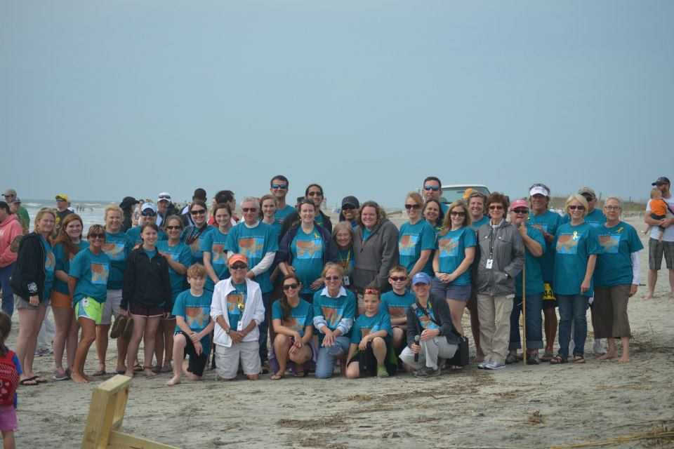
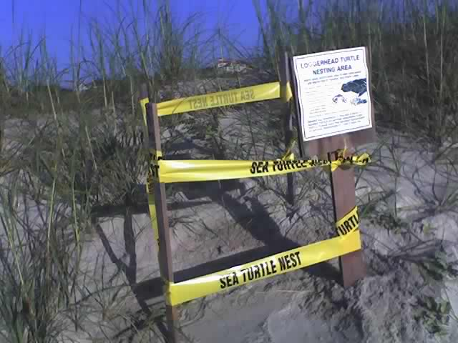
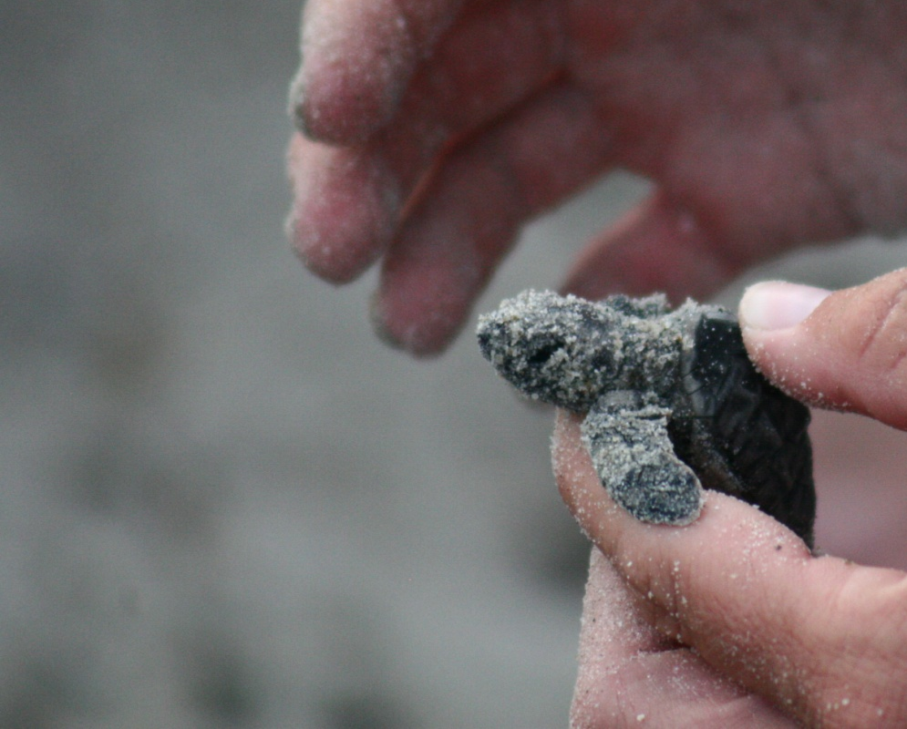
Georgia Sea Turtle Project

Slide 5
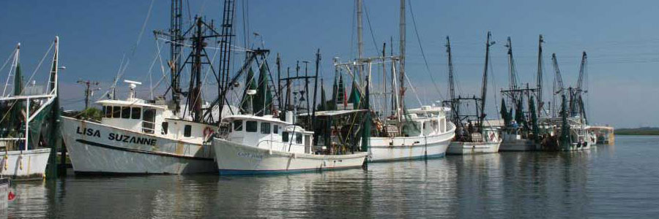
Shrimp & Sea Turtles
Trawling activities by the fishing industry continue to be one of the most common non-natural causes of death for sea turtles, accounting for more than 80% of deaths between 1990 and 2007 (Finkbeiner et al. 2011).

Slide 6
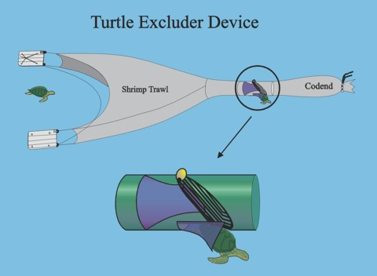
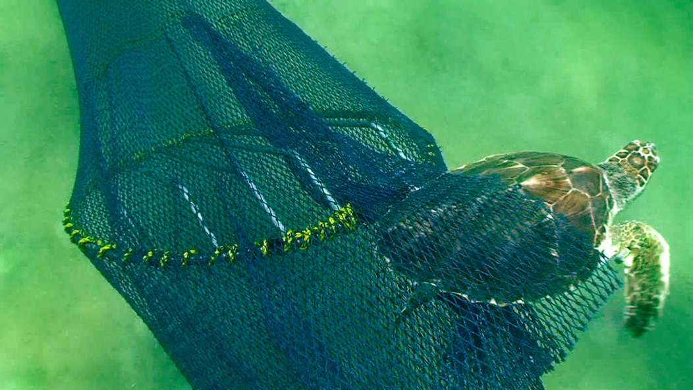
Turtle Excluder Device
TED – A Turtle Excluder Device is a grid of metal bars that attaches to a trawl net, creating an opening that allows sea turtles and larger fish to escape. Small animals such as shrimp go between the bars and are caught in the end of the trawl.

Slide 7

Literature Review
Use fleet communication systems to respond to bycatch hotspots
Use predictive modeling to identify areas for closure
Identify environmental factors to predict sea turtle hotspots
Set maximum adult bycatch limits
Reduce size of the fishing fleet
Use strandings to understand the spatial and temporal patterns of the mortality events

Slide 8
Research Objectives
What spatial patterns are present in the location of shrimp trawlers and sea turtle strandings on the Georgia coast?
Do these patterns change as a function of covariates, such as boat size or cause of death?
How have the patterns changed over time? Do they vary with season?
Are sea turtle strandings correlated with shrimping intensity or to TED violations?

Slide 9
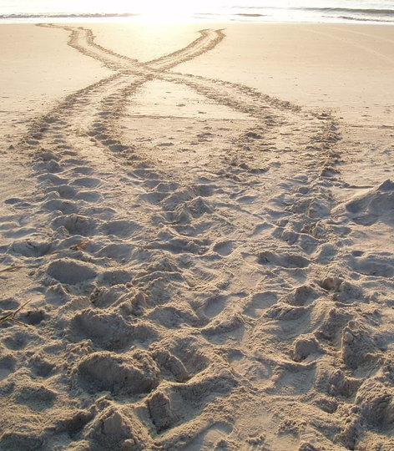
Expected Outcomes
Shrimp trawler locations will be clustered and will vary according to season and boat size.
Sea turtle strandings will not be clustered, with the exception of the subset for no apparent injuries.
Both trawler locations and strandings will vary with time.
Strandings from no apparent injuries will correlate with TED violations but not with high shrimp boat density.

Slide 10
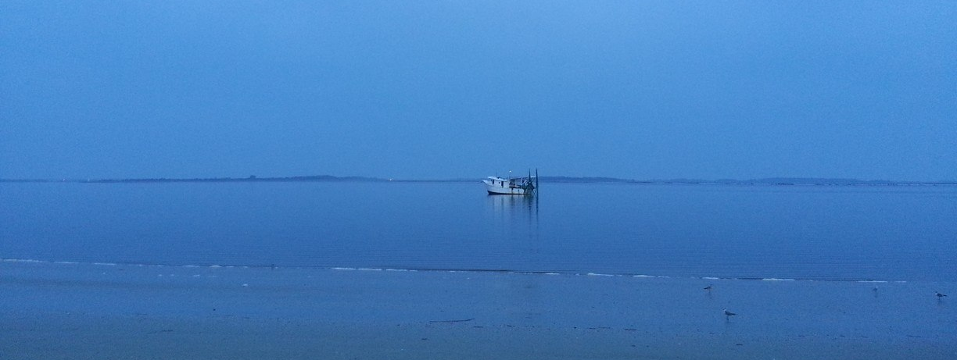
Data Available for Analysis
  Shrimp Trawler Locations
  Sea Turtle Strandings
  Boat Boardings and TED Violations

Slide 11
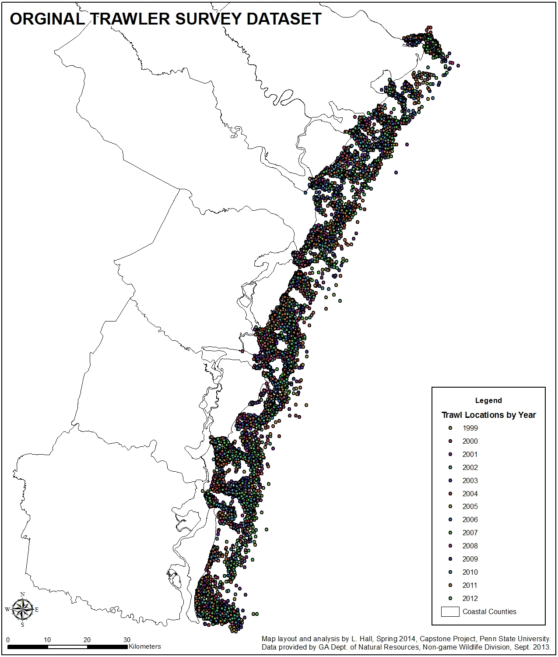
Data: Shrimp Trawler Surveys
Recorded from 1999 to 2012
A total of 7,906 locations for analysis
Grouped by seasons: early, mid and late
Also categorized by boat size: small, large, and extra-large
Most records fall into the early season and large boat categories

Slide 12
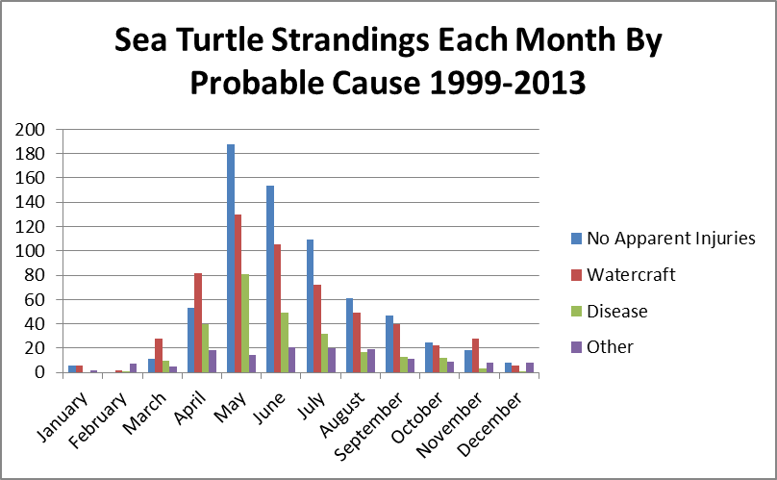
Data: Sea Turtle Strandings

Slide 13
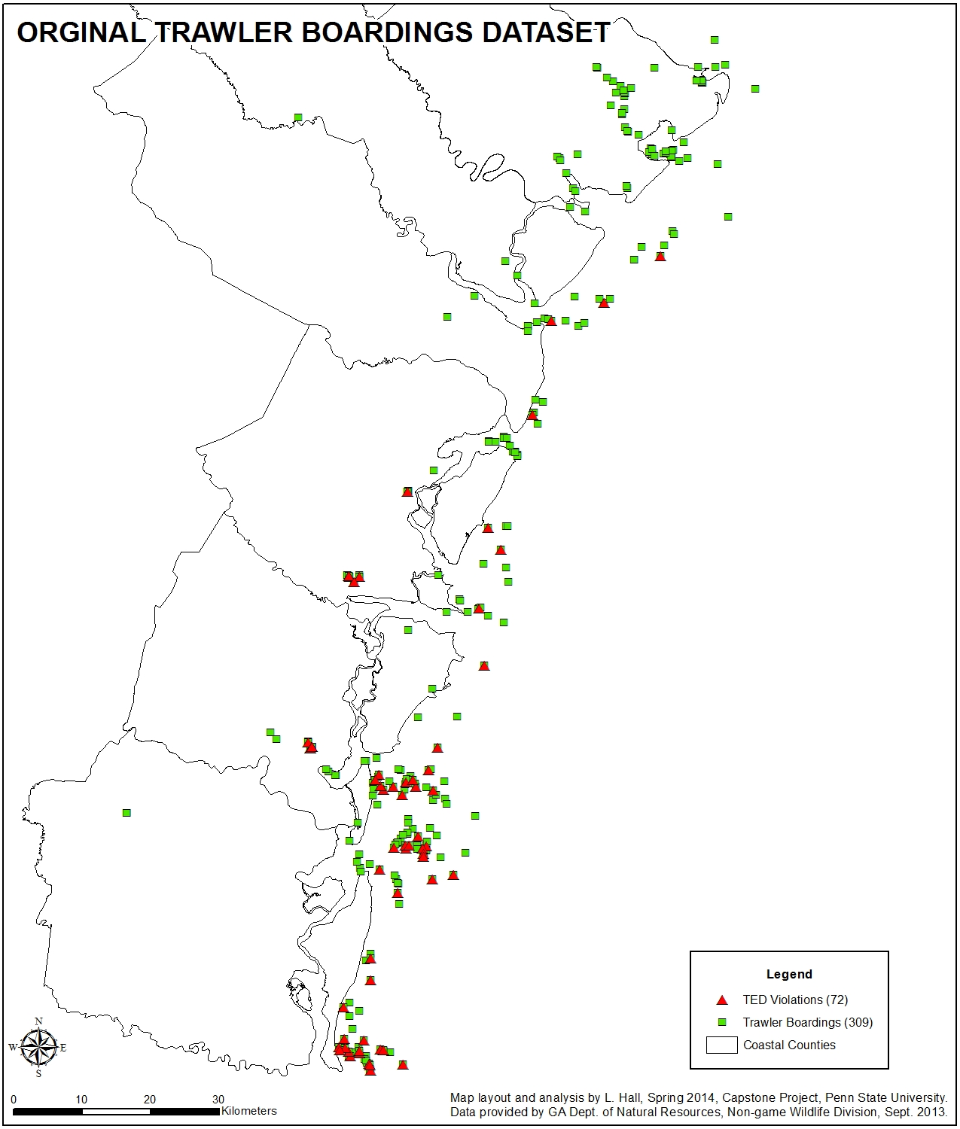
Data: TED Violations
Collected from 2006-2011
309 records with 72 violations
For the distance analysis, inland boardings were removed leaving 51 violations out of 196 boardings.
Violations are found on about 25% of the boats boarded.

Slide 14
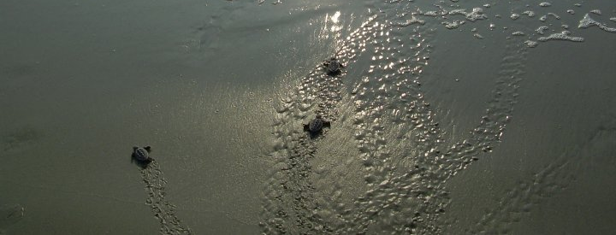
Methodology & Results
  Density Analysis
    Kernel Density Estimation (KDE)
    Hot Spot Analysis
  Distance Analysis

Slide 15
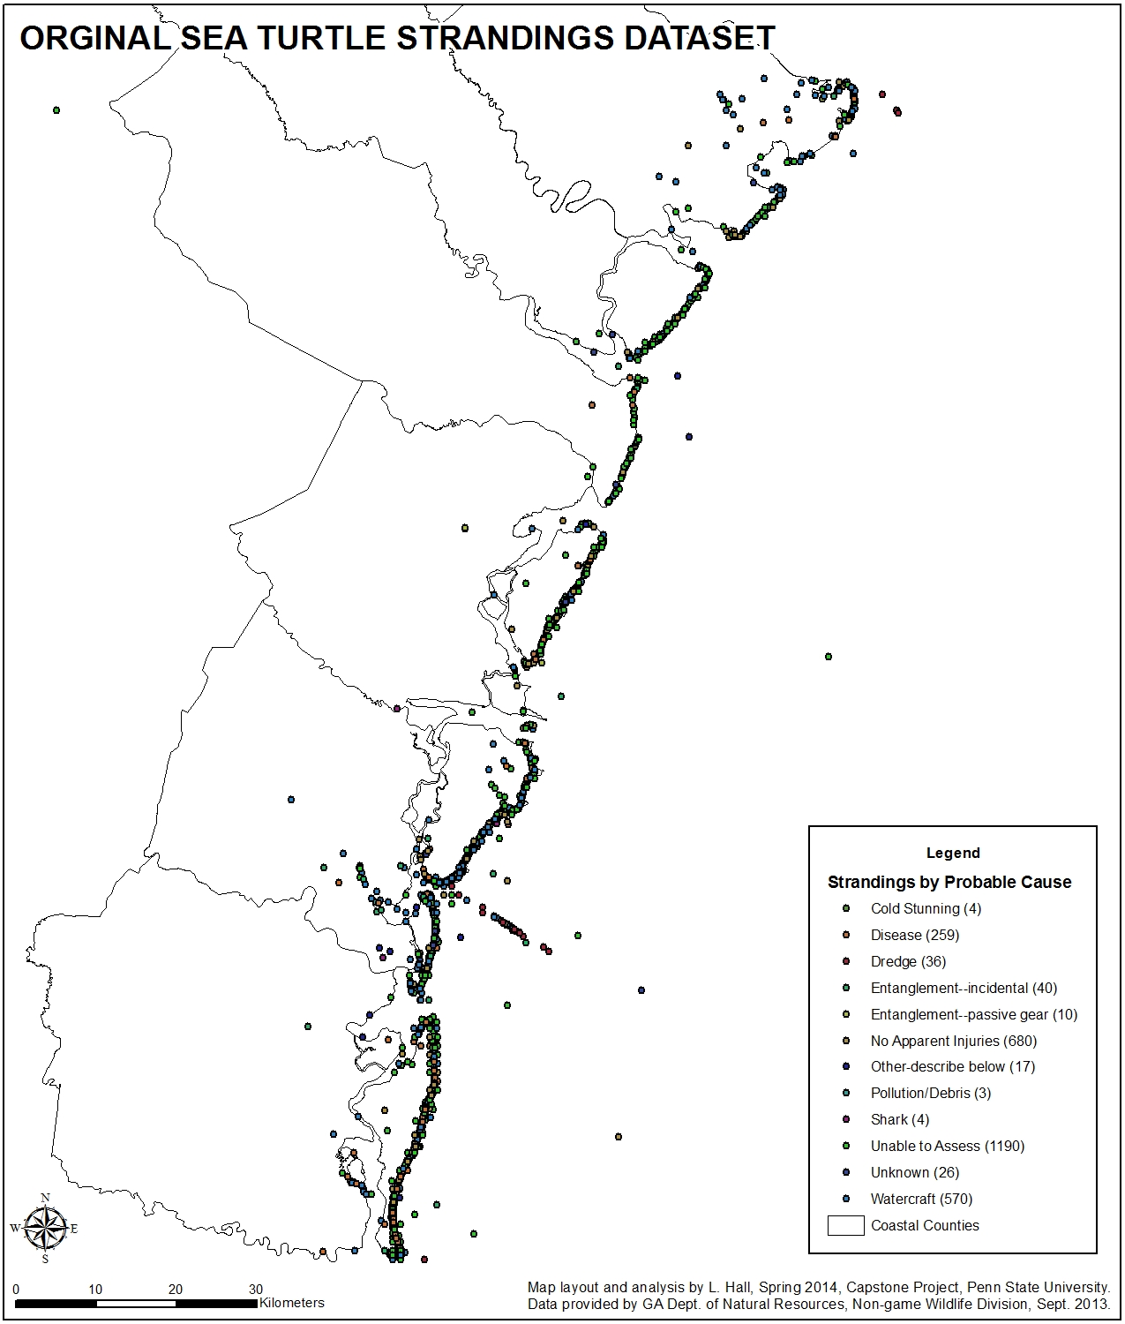
Data Preparation
Create feature classes
Remove records
Create additional fields
Create feature classes from subsets of data
Create study area boundary
Online publication of data to share with colleagues

Slide 16
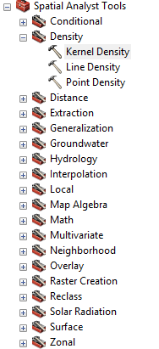
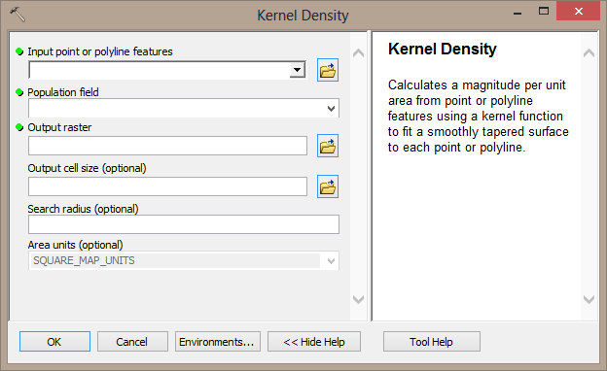
Kernel Density Analysis
Kernel Density Estimation or KDE analysis provides a way to distribute individual counts over the study area to better understand the distribution.

Slide 17
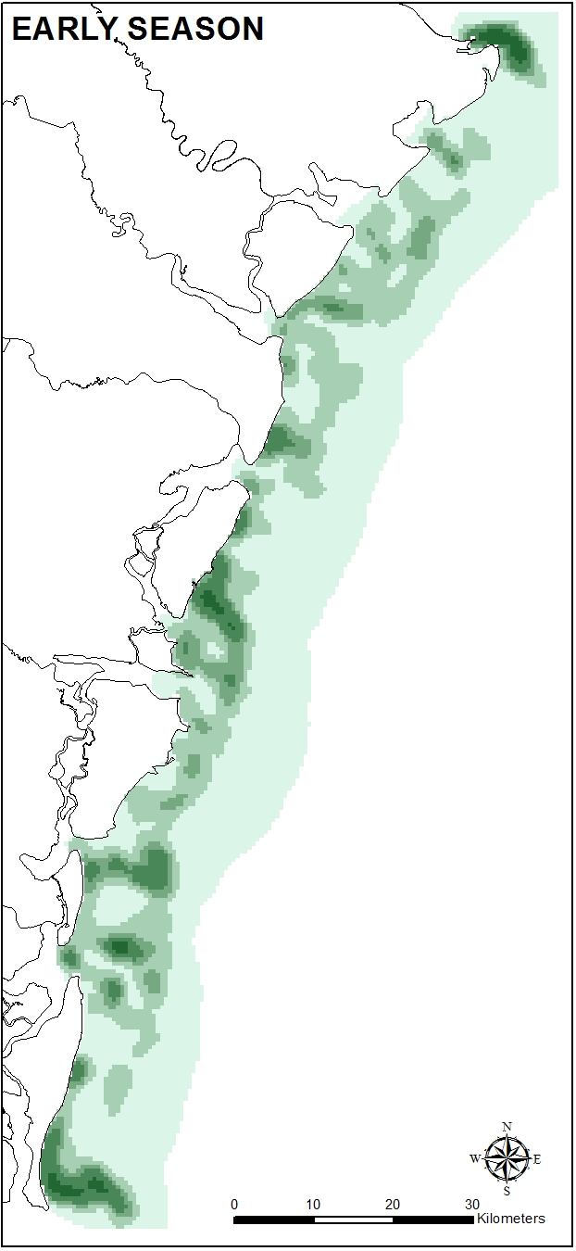
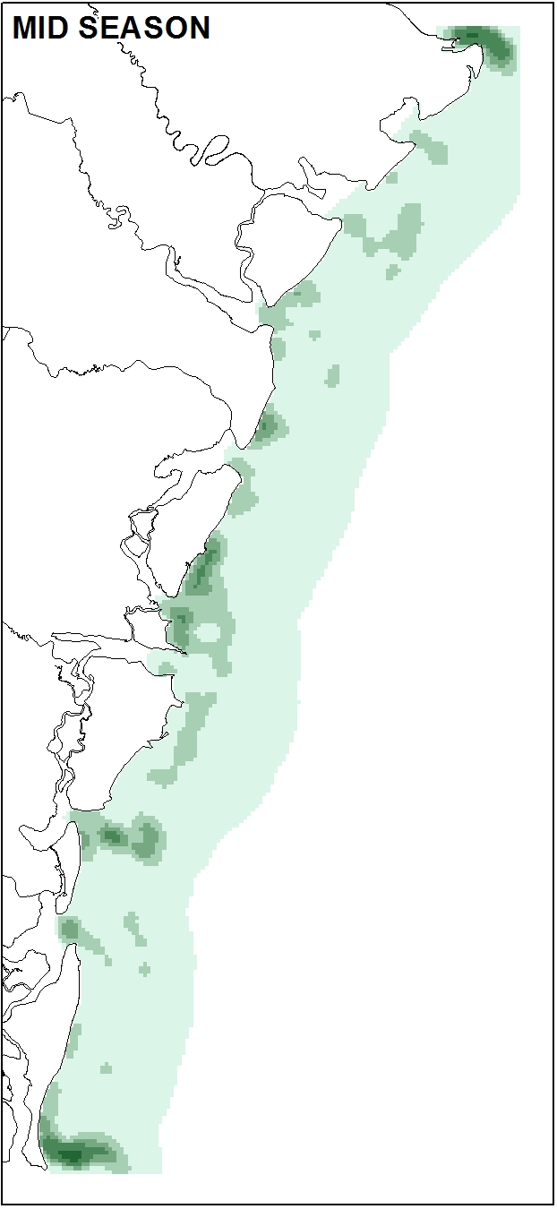
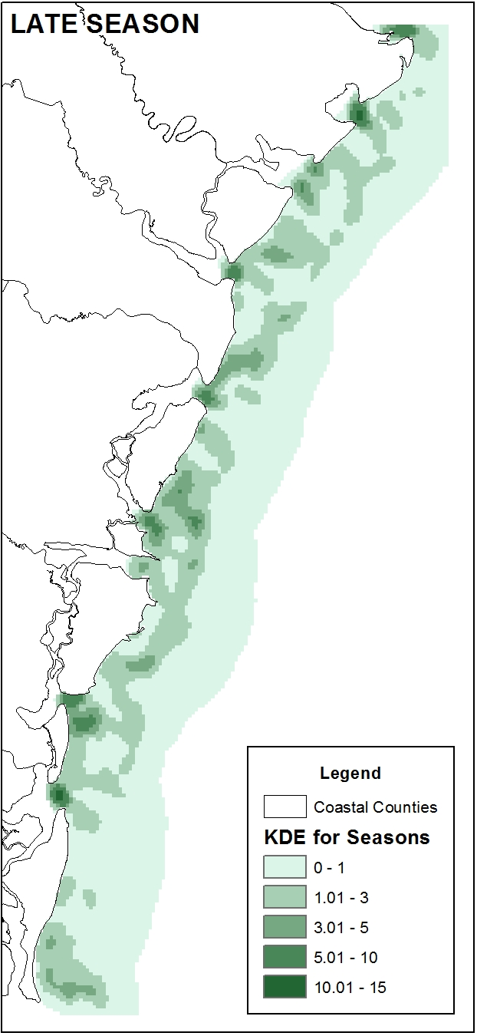
Density Analysis
KDE ANALYSIS FOR THE DIFFERENT SHRIMP SEASONS

Slide 18
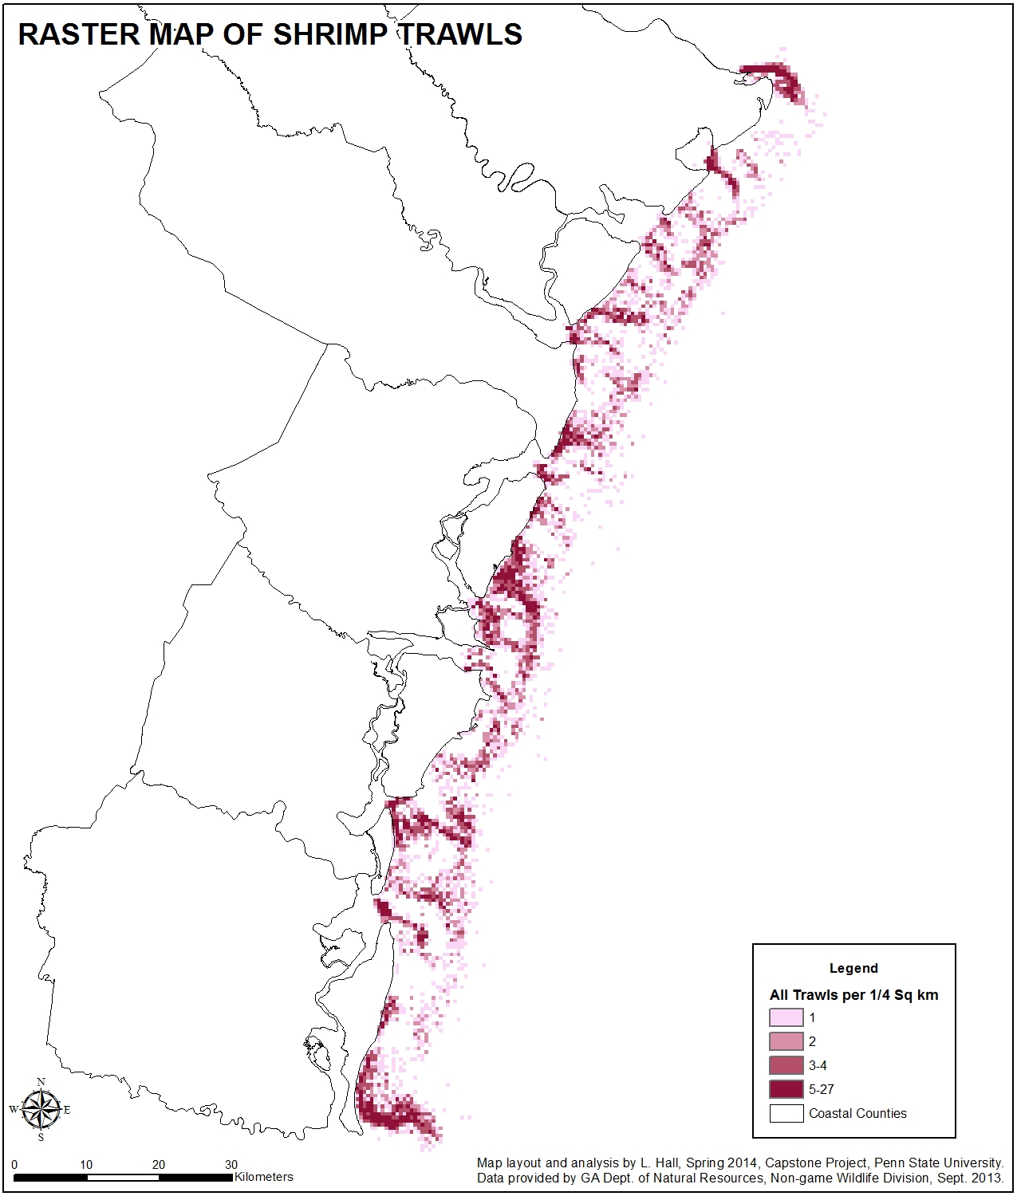
Spatial Analyst:
Map Algebra
Map Algebra | Cells | Sq Km | % of Area
None | 3214 | 803.5 | 100.00%
Early + Mid | 653 | 163.25 | 20.32%
Mid + Late | 504 | 126 | 15.68%
Early + Late | 856 | 214 | 26.63%
All Seasons | 338 | 84.5 | 10.52%

Slide 19
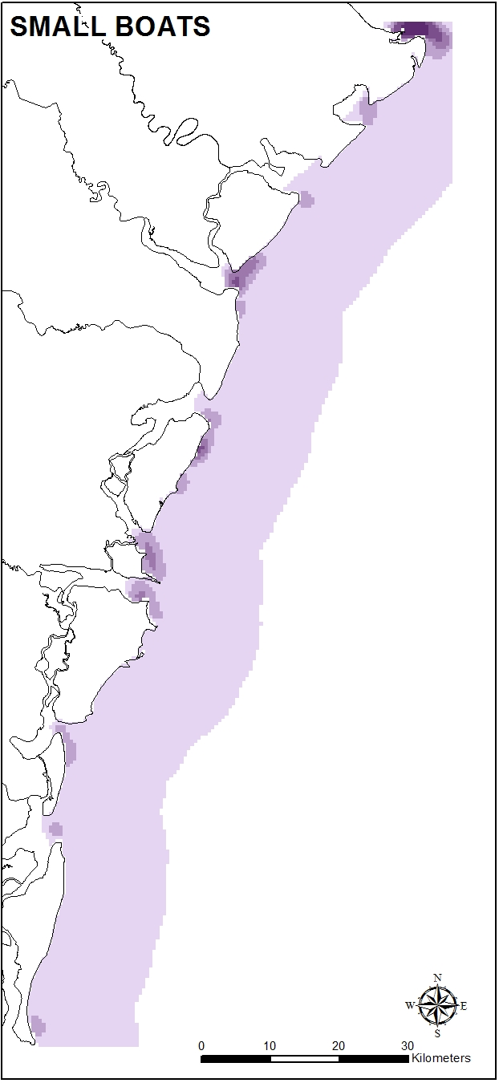
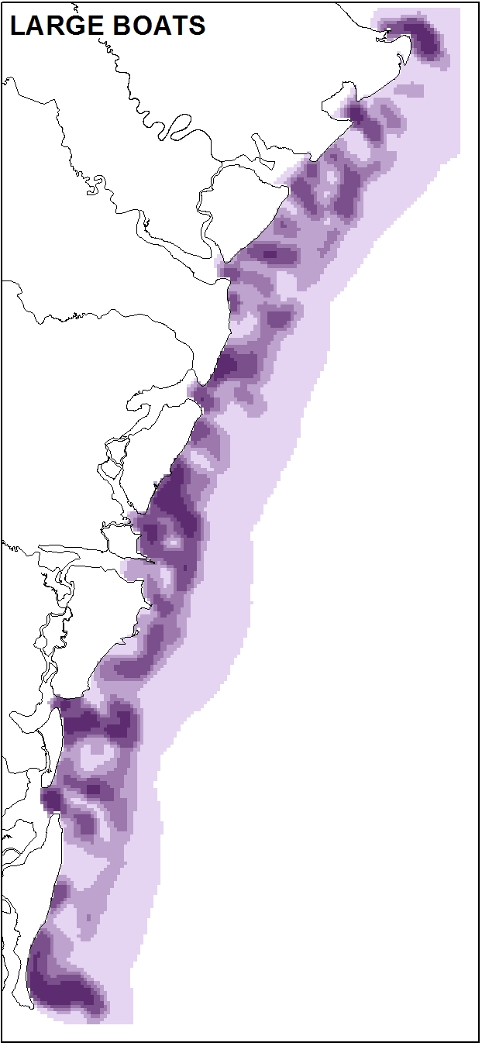
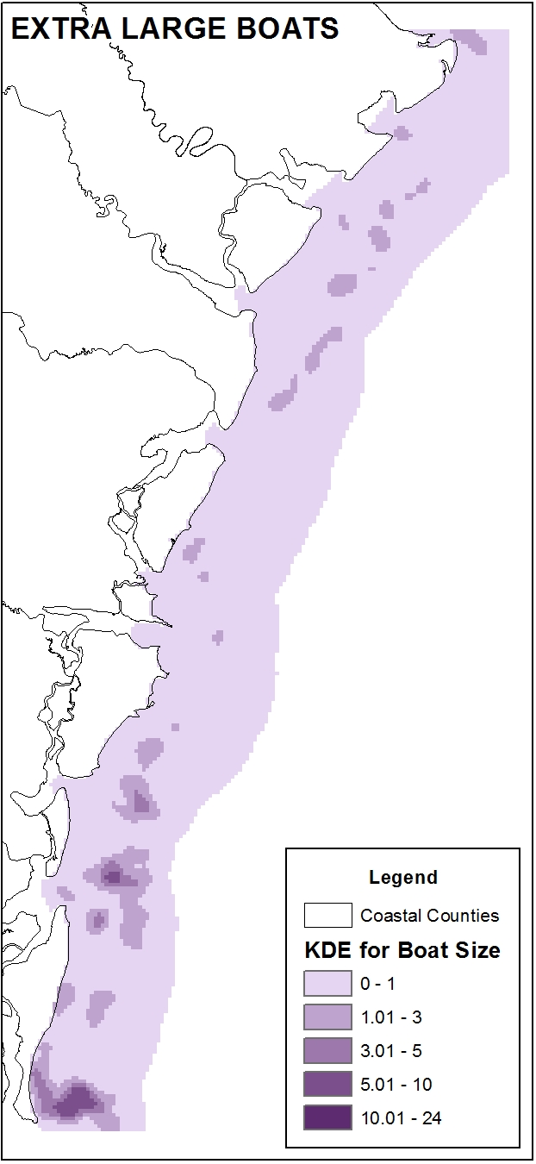
Density Analysis
KDE ANALYSIS FOR THE DIFFERENT BOAT SIZES

Slide 20
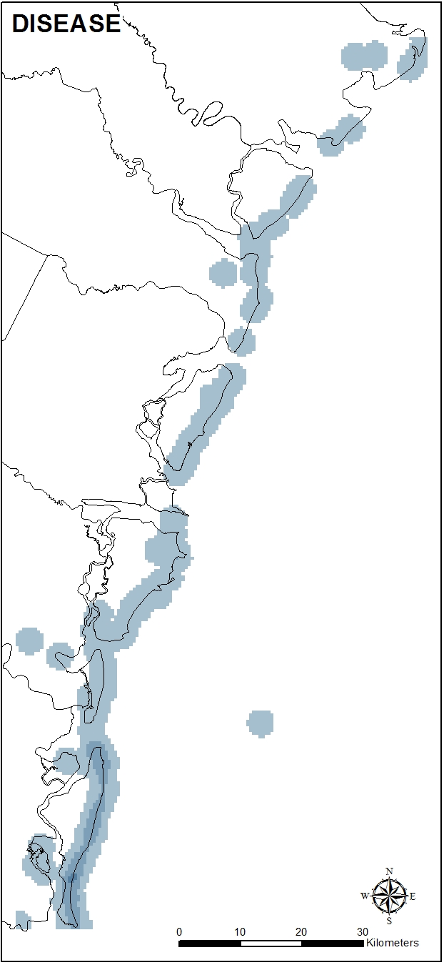
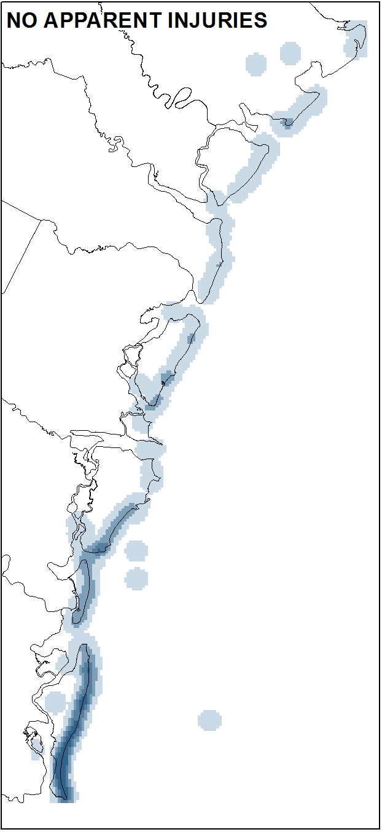
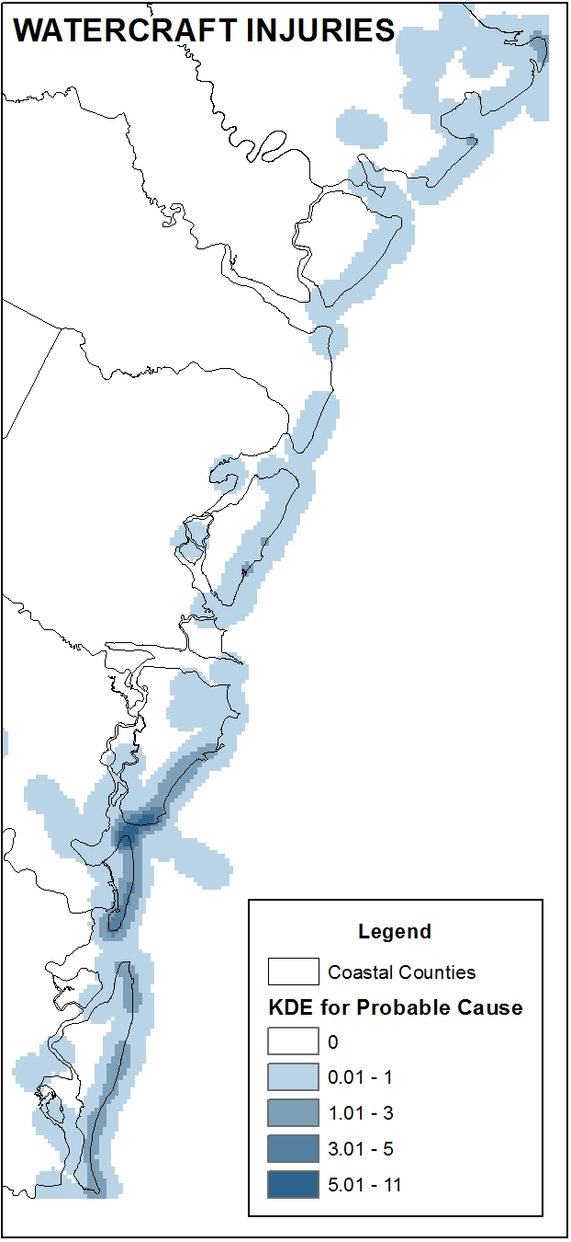
Density Analysis
KDE ANALYSIS FOR THE PROBABLE CAUSE OF STRANDINGS

Slide 21
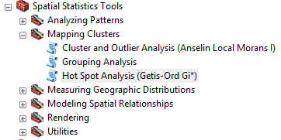
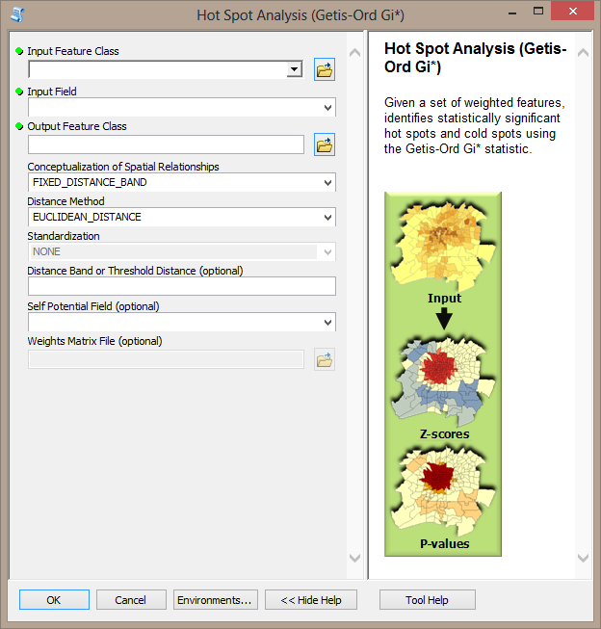
Hot Spot Analysis
Hot Spot Analysis provides a way to identify statistically significant clustering for events with a count field.

Slide 22
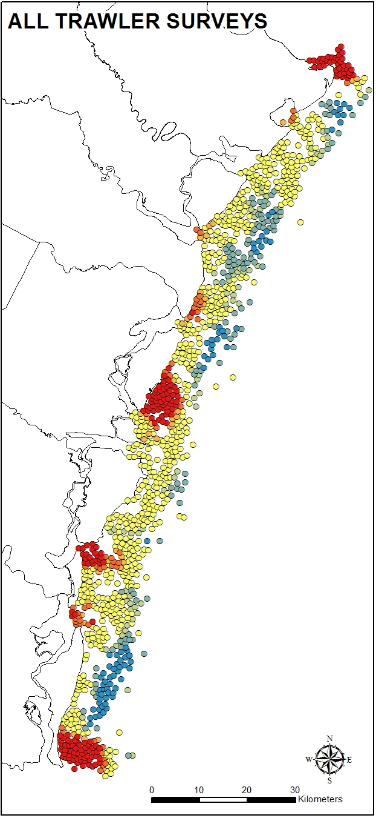
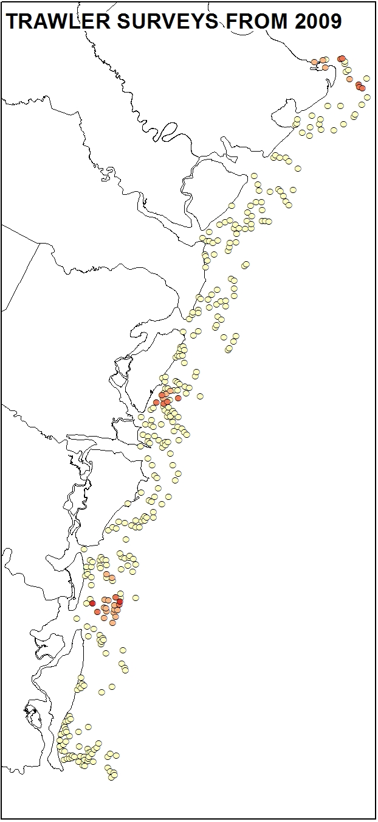
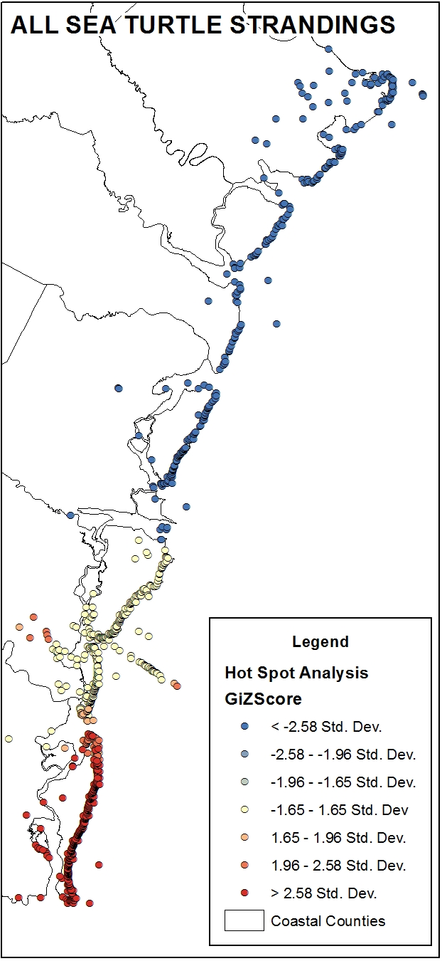
Density Analysis
HOT SPOT ANALYSIS FOR TRAWLER SURVEYS AND ALL STRANDINGS

Slide 23
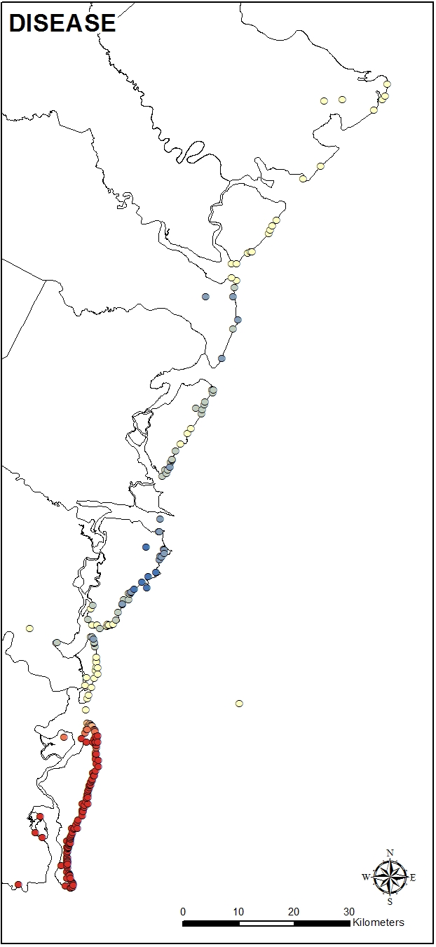
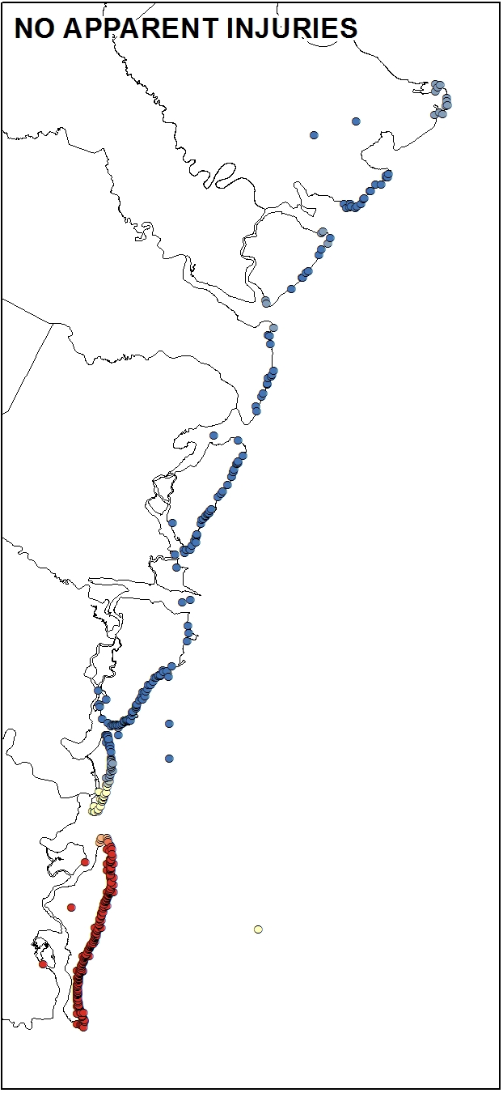
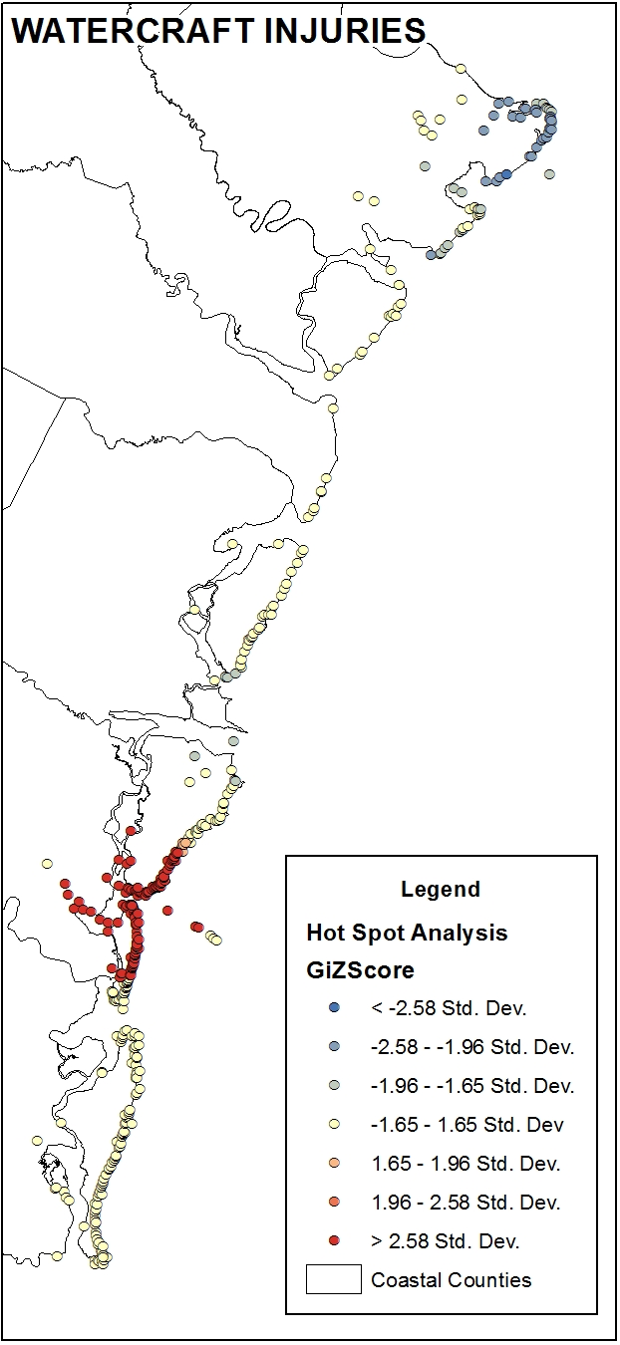
Density Analysis
HOT SPOT ANALYSIS FOR PROBABLE CAUSE OF STRANDINGS

Slide 24
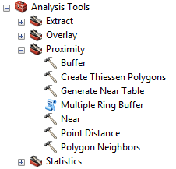
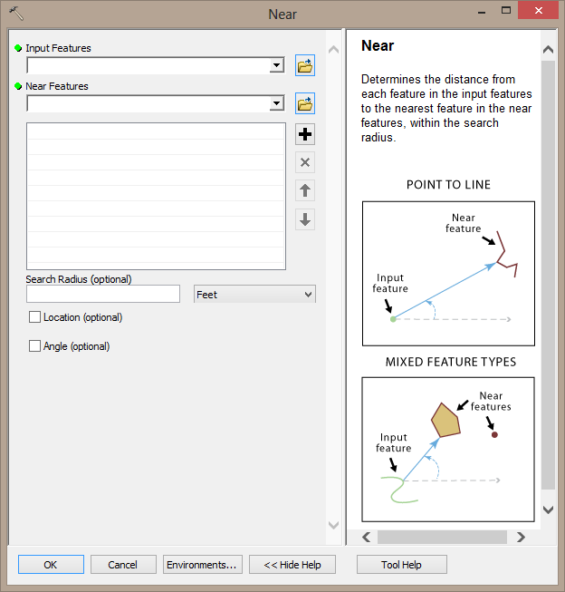
Distance Analysis: Near Tool
The Near tool identifies the closest target feature and calculates the distance for each record in a dataset.

Slide 25
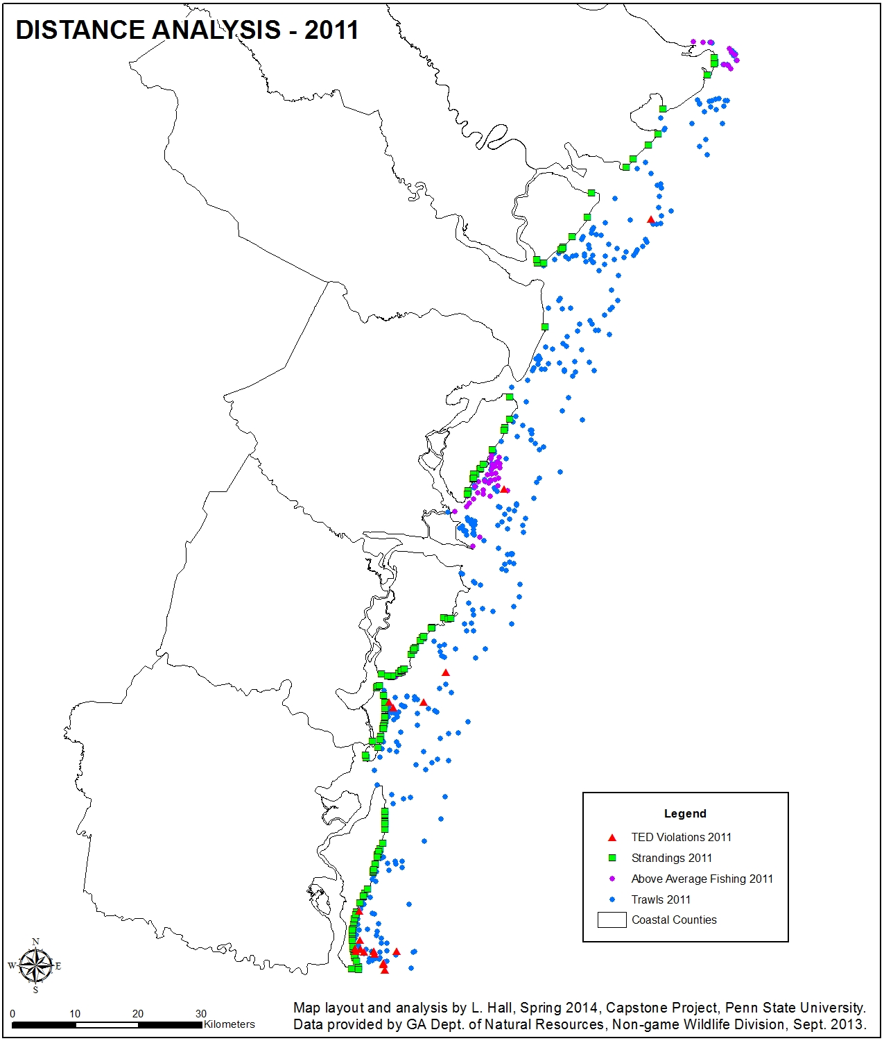
Statistical Model
Bayesian hierarchical logistic model
Calculated the relative probability of stranding near the predictor variables
Variables included the nearest trawler observation, the above average fishing locations, and the TED violations

Slide 26
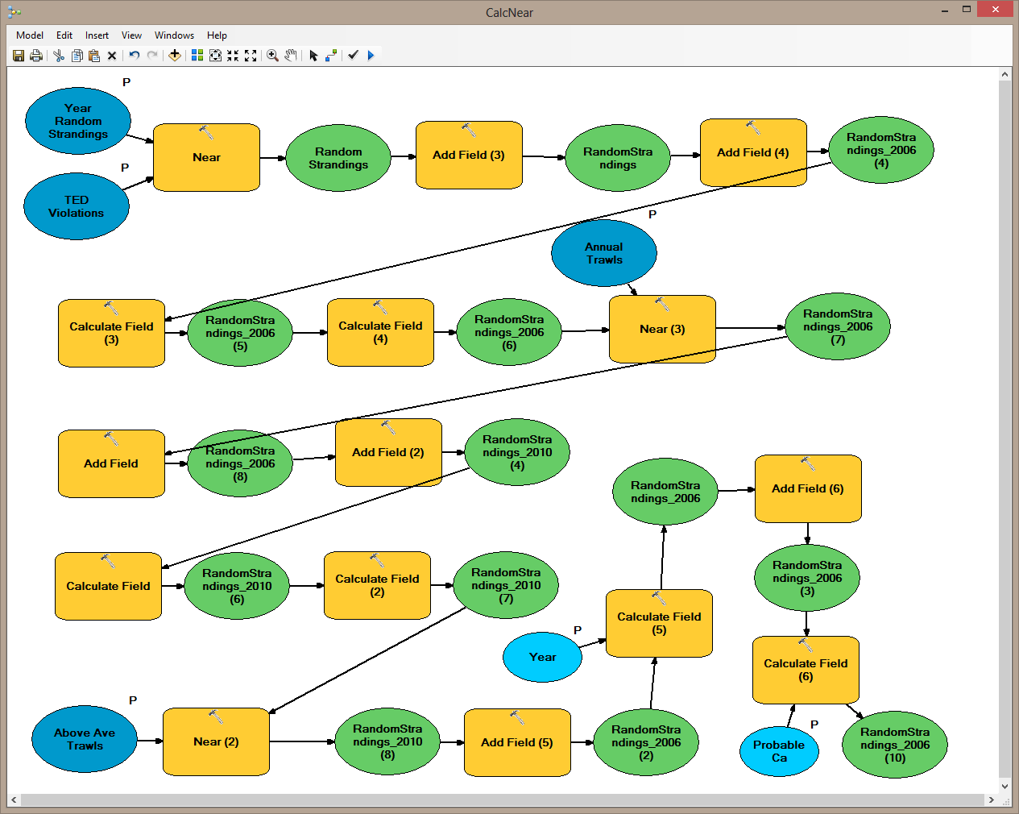
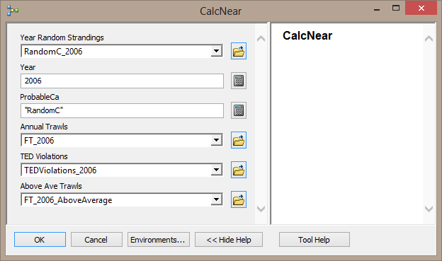
Model Builder to Create a Custom Tool
The custom tool ran the Near tool, created new fields and populated the fields for each step of the distance analysis.

Slide 27
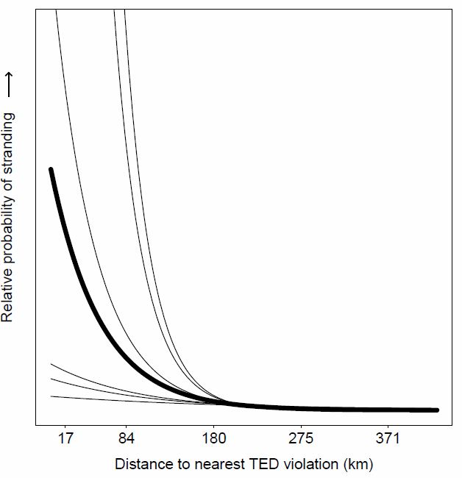
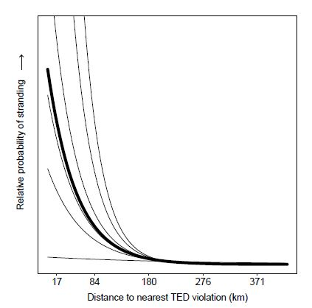
Statistical Model Results
All Sea Turtles with No Apparent Injuries
Loggerheads with No Apparent Injuries
For all probable death categories, there was a significant negative relationship between being stranded and the nearest TED violation.

Slide 28
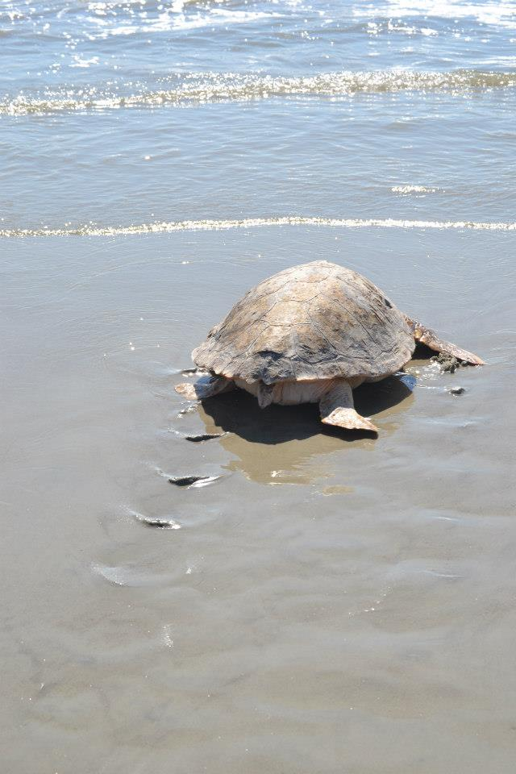
Application of Results
Strengthen the argument for TED regulations and compliance
Density maps will identify areas to target for trawler boardings through the shrimping season
Confirm the importance of collecting accurate spatial data for events impacting sea turtle conservation
Additional analysis to look at correlation at different spatial scales and potential natural causes of the strandings hotspots on the southern islands

Slide 29
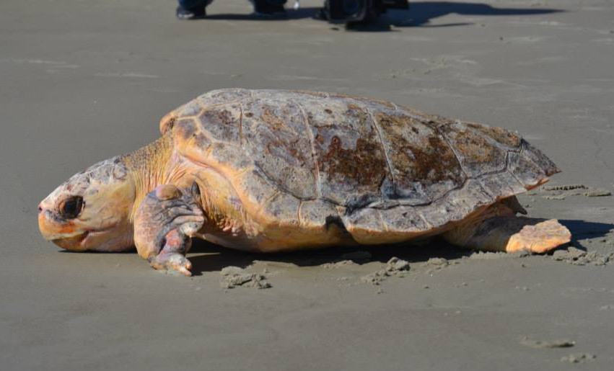
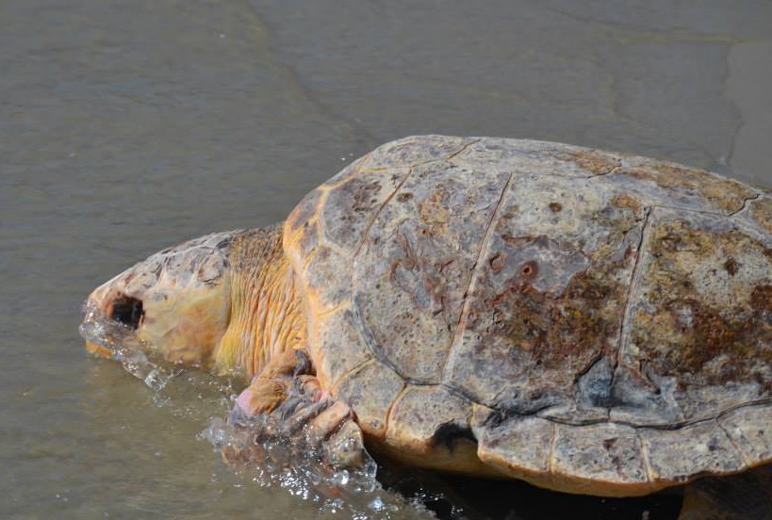
QUESTIONS?
Thank you to all of the agencies supporting this research.

