Slide 1
An Epidemiological Method For An Ecological Question
Heidi Harris
Dr. Margaret Brittingham
The Common Raven in Eastern U.S. Urban Environments, 1950-2010
Spring II 2013

Slide 2
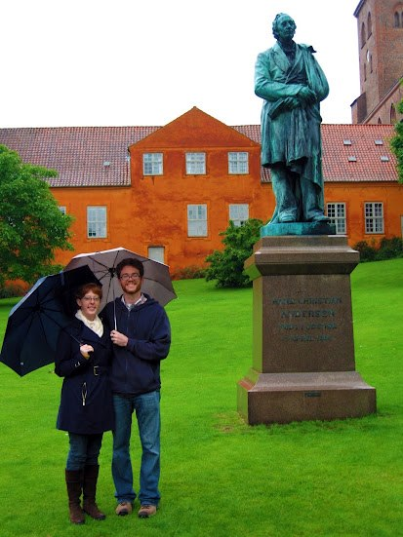
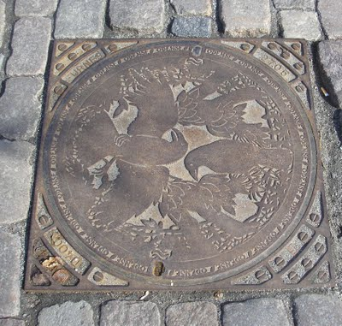

Slide 3
Introduction
New Application
Ecological Question
Can the Geographical Analysis Machine be applied to species surveys?
Are raven populations spreading into urban areas?
Capstone Project

Slide 4
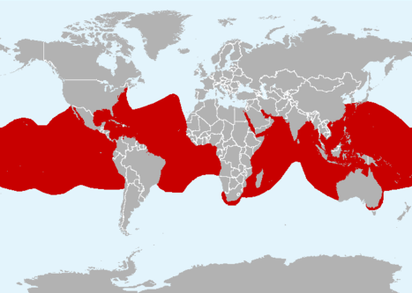
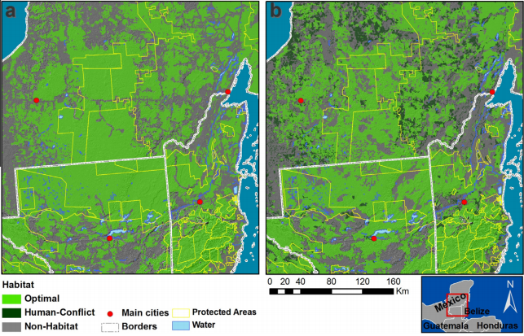
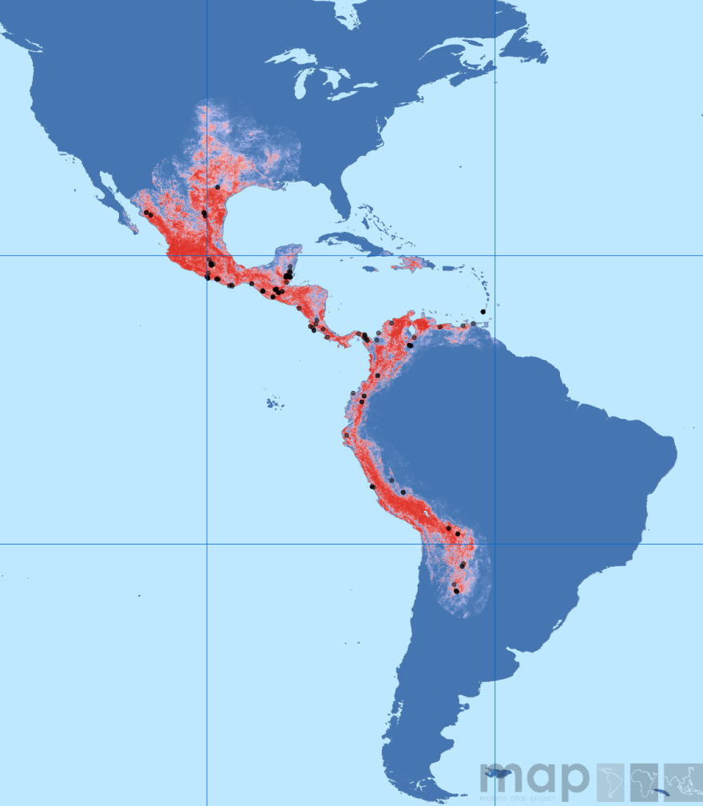
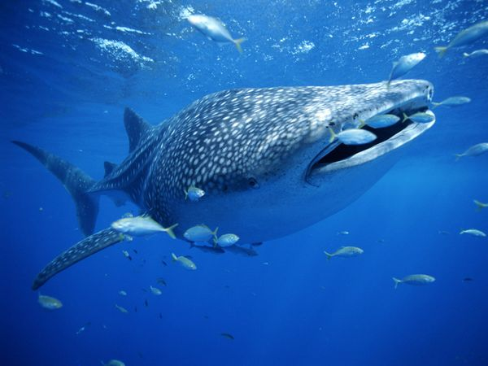
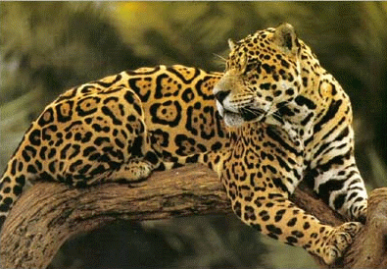
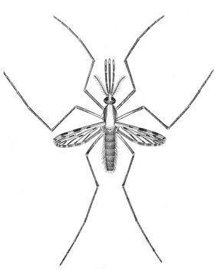
Species Surveys

Slide 5
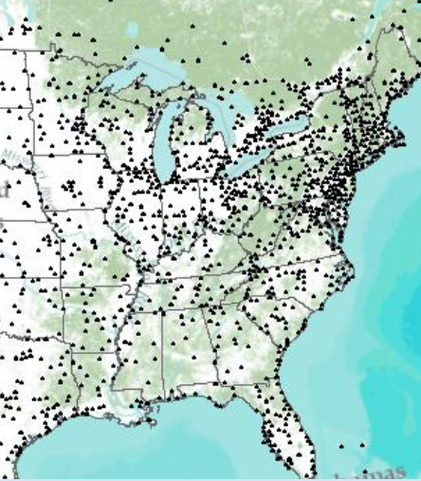
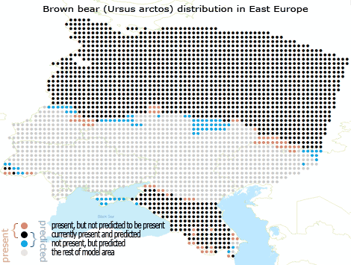
Species Survey Design

Slide 6
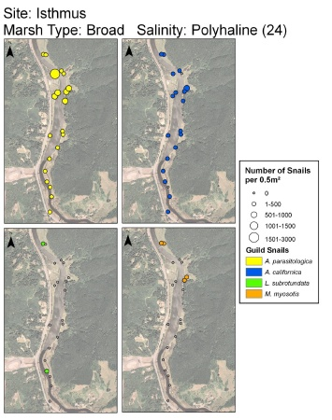
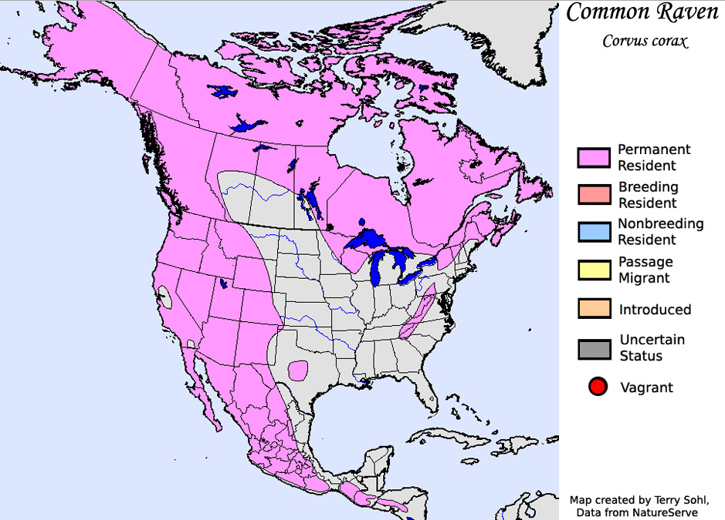
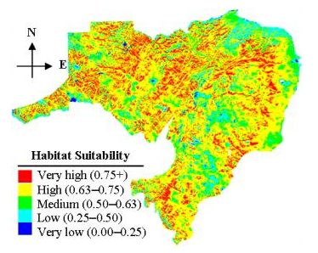
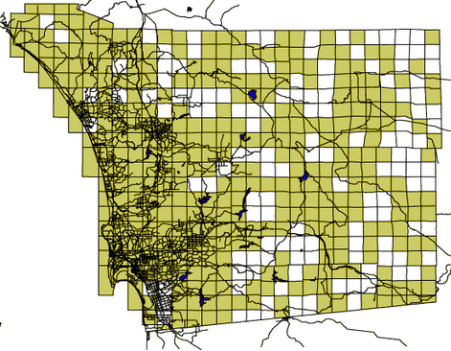
Four Ways Species Survey Data are Spatially Analyzed
Raw data mapping
Interpolation
Species Distribution
Models
Atlases

Slide 7
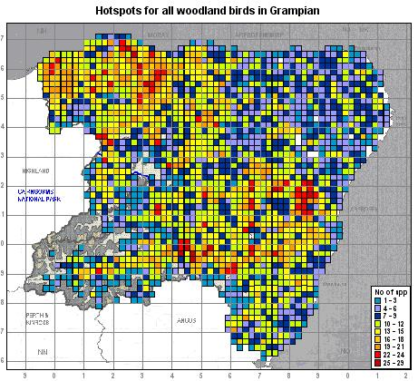
Statistical Spatial Results on the Actual Surveyed Data?

Slide 8
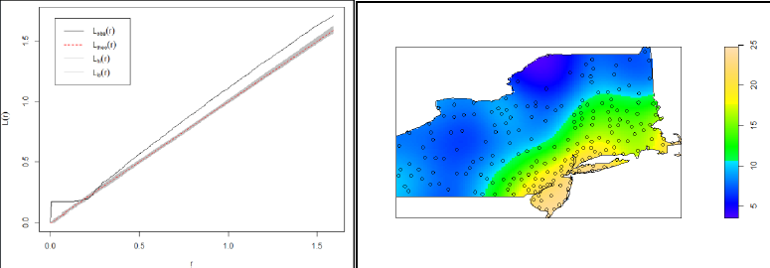
A Potential Solution
Geographical Analysis Machine
Adjusts for the common problem of:
“the underlying spatial inhomogeneity of a background population” (first-order effects)

Slide 9
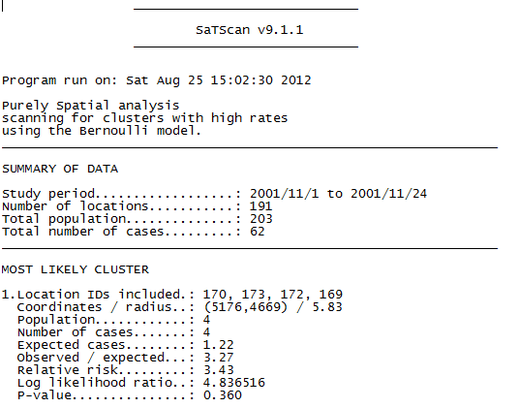
SaTScan/GAM
Bernoulli Method
Survey Data
p < 0.05
Absence
Presence

Slide 10
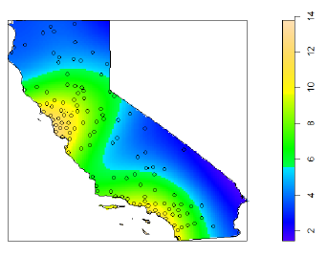
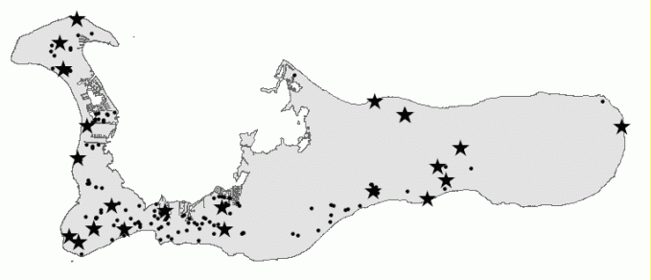
Applying SaTScan to Species Surveys: 2 Criteria
Clustered data points
Survey data that include absence and presence/abundance data.

Slide 11
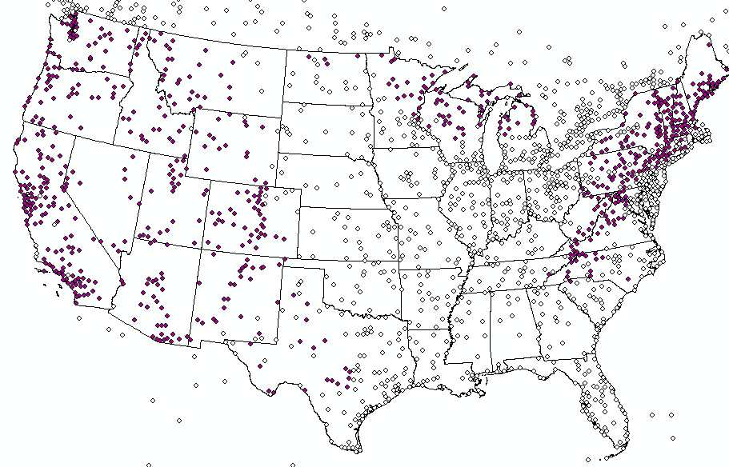
Project Experiment
Using the National Audubon Society’s
Christmas Bird Count
Clustered sampling points
Presence, Absence, and Abundance data
“Point” observations
Yearly
Long-term, well established

Slide 12
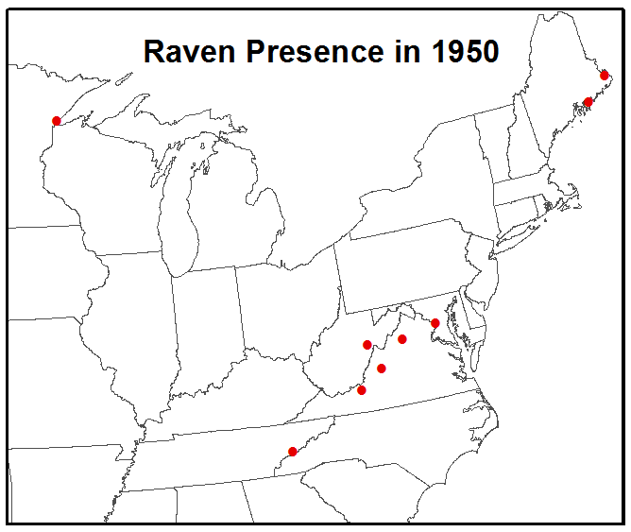
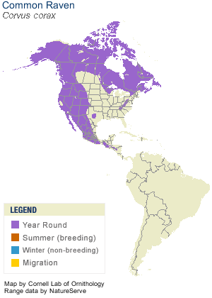
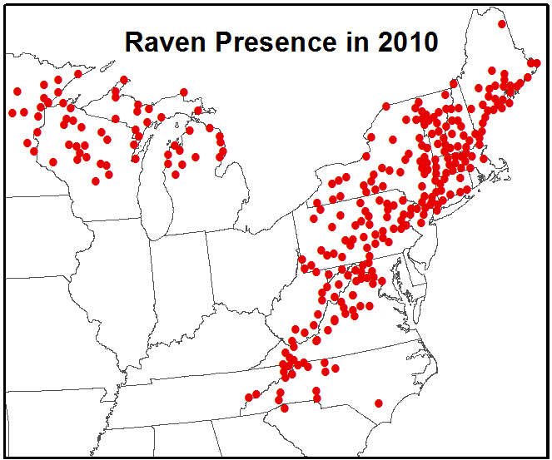
And Why Ravens?

Slide 13
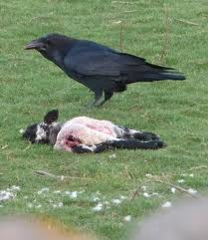
And Why Ravens?
Almost eradicated by 1900
Poisoned, shot, trapped
Forests cut down as settlement advanced
Scavenging decreased
Endangered in Kentucky, North Carolina, and Tennessee
Nevermore?

Slide 14
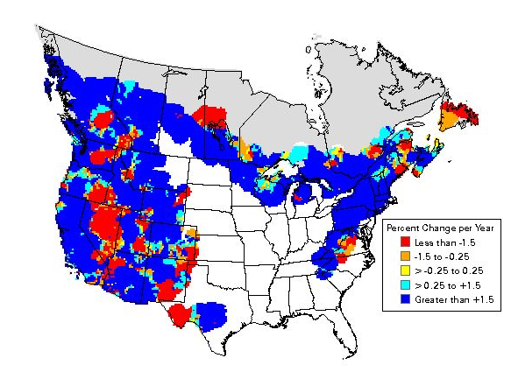
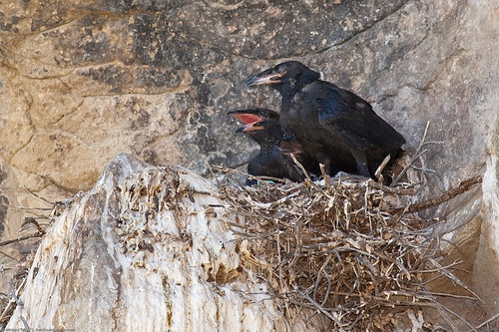
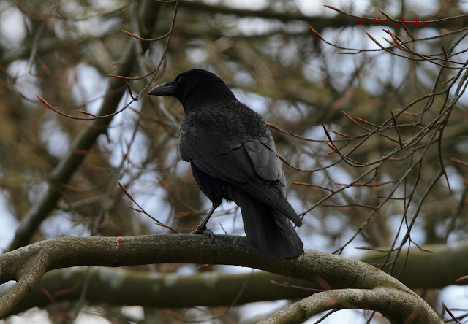
And Why Ravens?

Slide 15
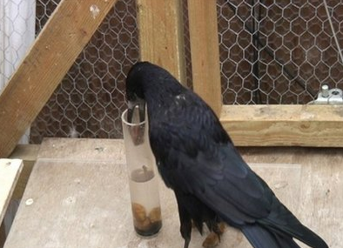
And Why Ravens?

Slide 16
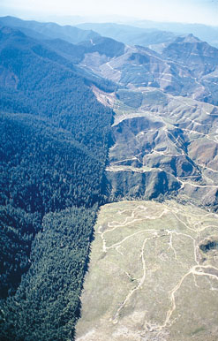
Ravens in Urban Areas?
Ornithologist Walter B. Barrows, 1912:
“A bird which disappears when settlement advances.”
The Academy of Natural Sciences, 1999:
“In the east and northeast U.S. [the raven] prefers wilderness and often avoids areas with human activity.”

Slide 17
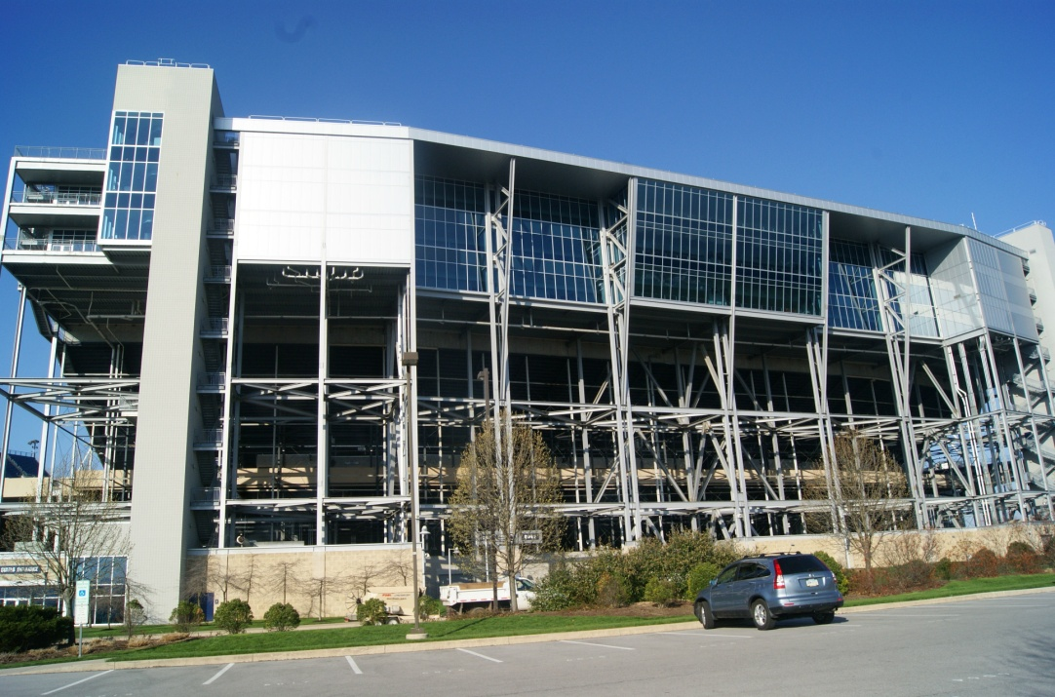
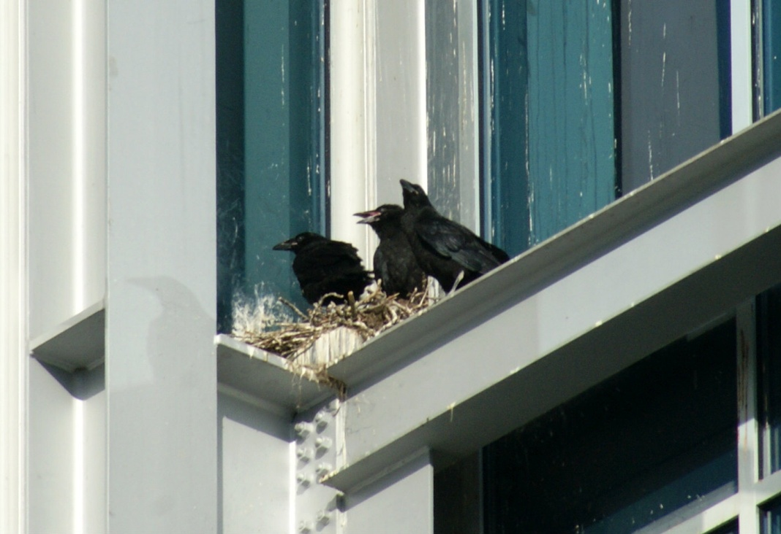
Project Experiment
However…
Photos: Dr. Margaret Brittingham, Penn State University

Slide 18
Hypotheses
Habitat-neutral
Expanding and adapting successfully
No longer abandoning

Slide 19
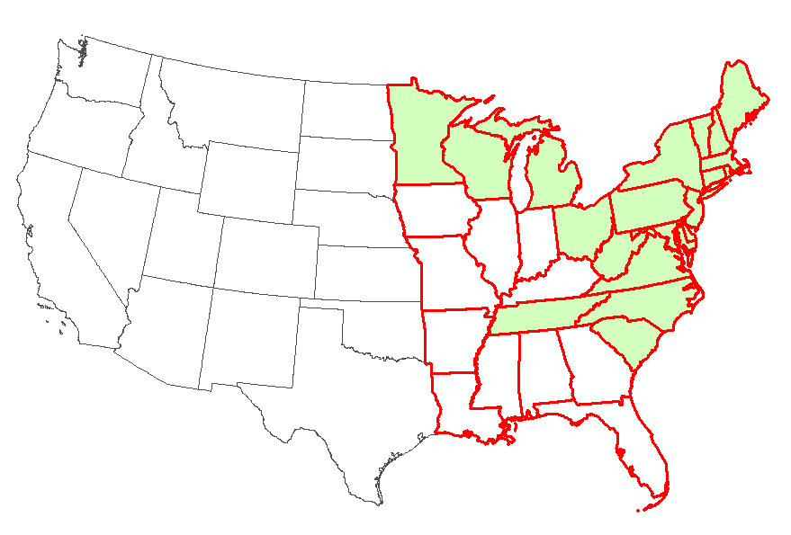
Methods
Study Area

Slide 20
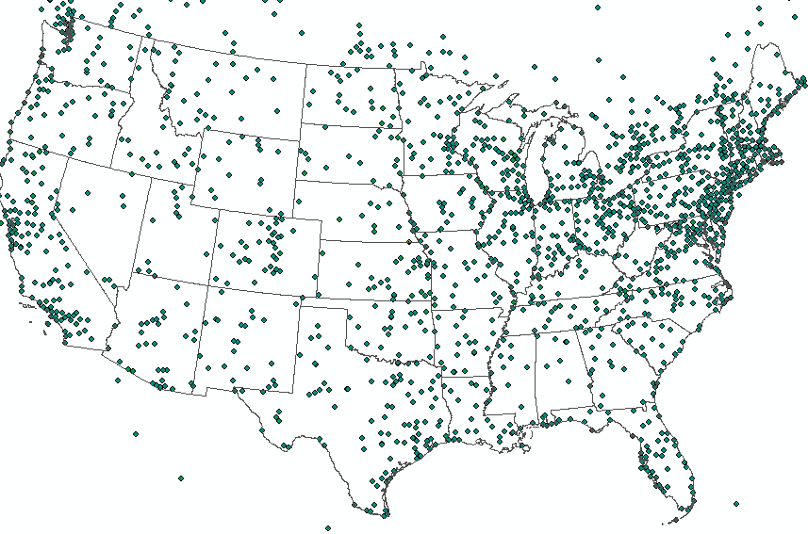
Methods
Data: Christmas Bird Count
Yearly common raven (Corvus corax) counts, 1950-2010
Raven counts normalized by # observer hours
High n-value for each year
Some Canadian data, edge effects
“Points” = 24 km diameter

Slide 21
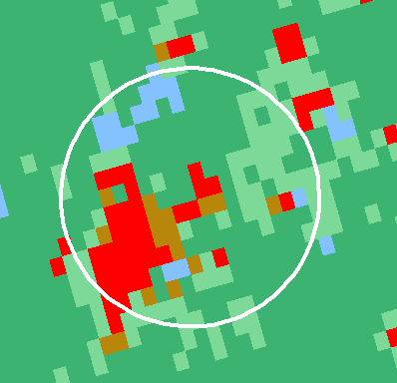
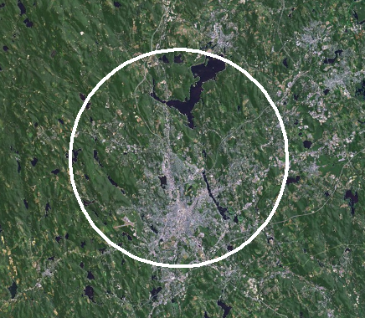
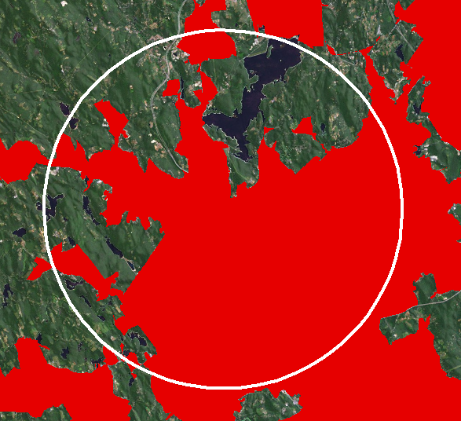
Methods
Data: Urban/Rural
USGS/Landsat
1970-1985
1992- 2006
%
U.S. Census
Mun. Stat. Areas
1950-1980
Urban Areas
1990-2010

Slide 22
Methods
Software
Microsoft Access
R Statistical Package
ArcGIS, ArcMap
SaTScan
GeoDa

Slide 23
Methods
General Methodology
Format all raw data for analysis
Test CBC data for first-order effects
Run SaTScan Analyses
ID significant presence/absence clusters over time in relation to generalized urban/rural land cover
Test CBC data for spatial autocorrelation, compare to SaTScan results
Compare final results to Breeding Bird Atlas

Slide 24
Project Experiment
Potential and Limitations
Potential
Significant presence/absence, 50+ years
Expansion, shrinkage, and/or movement
Ravens in long-established cities?
Ravens in newly-established cities?
Limitations
Answer the “why?”

Slide 25
Expected Outcomes
First study on potentially changing habitat for east-coast common ravens.
First study done with species surveys using SaTScan, and only the fourth in general ecology.
Submission to a peer-reviewed journal by July 30
Collaboration between Penn State University and the Max Planck Center for Biodemography

Slide 26
Timeline
May
June
All Analysis and Visualization of Results
July
April
Completion of Geog 596A
Testing for autocorrelation and against atlas. First draft
Final approval of draft. Complete Geog 596B. Submit to Ecography

Slide 27
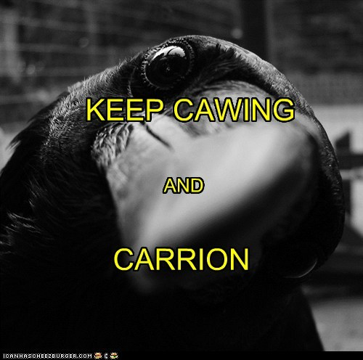
Thanks to…
Dr. Margaret Brittingham,
Dr. Daniel Levitis,
The entire MGIS advisory committee,
And, of course, my husband, Paul.

Slide 28
Works Cited
Heinrich B. Ravens in Winter. Vintage Books: New York, 1989.
Kristan WB, Boarman WI. 2007. Effects of anthropogenic developments on common raven nesting biology in the west Mojave Desert. Ecological Applications 17:1703-1713
Kristan W B, Boarman WI, Crayon JJ. 2004. Diet composition of common ravens across the urban-wildland interface of the west Mojave Desert. Wildlife Society Bulletin 32:244-253.
Radis R. 2012. “The Return of the Raven.” New Jersey E-Bird News, National Audubon Society. Published October 16. 2012 at http://ebird.org/content/nj/news/the-return-of-the-raven.
Sauer JR, Hines JE, Fallon JE, Pardieck KL, Ziolkowski DJ, Jr., Link WA. 2013. The North American Breeding Bird Survey, Results and Analysis 1966 - 2011. Version 12.13.2011. USGS Patuxent Wildlife Research Center, Laurel, MD.
Hepinstall, J. A., Alberti, M. and Marzluff, J. M. 2008. Predicting land cover change and avian community responses in rapidly urbanizing environments. - Landscape Ecology 23(10): 1257-1276.
Franklin, J. 2009. Mapping Species Distributions: Spatial Inference and Prediction. Cambridge: Cambridge University Press.
Donald, P. F. and Fuller, R. J. 1998. Ornithological atlas data: a review of uses and limitations. - Bird Study 45: 129-145.
Butcher, G. S., Fuller, M. R., McAllister, L. S. and Geissler, P.H. 1990. An Evaluation of the Christmas Bird Count for Monitoring Population Trends of Selected Species. - Wildlife Society Bulletin 18(2): 129-134.

Slide 29
Works Cited
Leu, M., Hanser, S. E. and Knick, S. T. 2008. The human footprint in the west: A large-scale analysis of anthropogenic impacts. - Ecological Applications 18(5): 1119-1139.
Link, W. A., et al. 2008. Combining Breeding Bird Survey and Christmas Bird Count data to evaluate seasonal components of population change in Northern Bobwhite. J. of Wild. Mngmt. 72(1): 44-51.
Link, W. A. and Sauer, J. R. 1999. Controlling for varying effort in count surveys: an analysis of Christmas Bird Count data. - Journal of Agricultural, Biological, and Environmental Statistics 4(2): 116-125.
Marzluff, J. M. and Neatherlin, E. 2006. Corvid response to human settlements and campgrounds: Causes, consequences, and challenges for conservation. – Biol. Conserv. 130(2): 301-314.
Kristan, W. B. and Boarman, W. I. 2007. Effects of anthropogenic developments on common raven nesting biology in the west Mojave Desert. - Ecological Applications 17:1703-1713.
Kristan, W. B., Boarman, W. I. and Crayon, J. J. 2004. Diet composition of common ravens across the urban-wildland interface of the west Mojave Desert. - Wildlife Society Bulletin 32:244-253.
Kulldorff, M. 1997. A Spatial Scan Statistic. - Communications in Statistics-Theory and Methods 26(6): 1481-1496.
Kulldorff, M. 2005. SaTScan: Software for the Spatial, Temporal, and Space-Time Scan Statistics. <http://www.satscan.org/>.
Laferriere, A. M., et al. (2010). Early detection of a new invasive mesogastropod, Assiminea parasitologica, in Pacific Northwest estuaries. Charleston, OR: South Slough National Estuarine Research Reserve with the Confederated Tribes of the Coos, Lower Umpqua and Siuslaw Indians.

Slide 30
Works Cited
Steenhof, K., Kochert, M. N. and Roppe, J. A. 1993. Nesting by raptors and common ravens on electrical transmission line towers. - J. Wild. Mngmt. 57:271-281.
Segurado, P., et al. 2006. Consequences of spatial autocorrelation for niche-based models. – J. of Appl. Ecol. 43: 433–444.
O’Sullivan, D. and Unwin, D.J. 2010. Geographic Information Analysis, 2nd ed. John Wiley & Sons, Inc.: Hoboken, NJ.
Oikos Editorial Office. 2012. Ecography-Journal Information. <http://www.oikos.ekol.lu.se/ecojrnl.html>.
Openshaw, S., Charlton, M., Craft, A. W. and Birch, J. M. 1988. Investigation of leukemia clusters by use of a geographical analysis machine. - The Lancet 331(8580): 272-273.
Openshaw, S., Charlton, M., Mymer, C. and Craft, A. 1987. Developing a mark 1 Geographical Analysis Machine for the automated analysis of point data sets. - International Journal of Geographical Information Systems 1: 335-358.
Amar, A., Redpath, S., Sim, I. and Buchanan, G. 2010. Spatial and temporal associations between recovering populations of common raven Corvus corax and British upland wader populations. –J. Appl. Ecol. 47: 253-262.
Webb, W. C., Boarman, W. I. and Rotenberry, J. T. 2004. Common raven juvenile survival in a human-augmented landscape. - Condor. 106(3): 517-528.

