Slide 1

Stewardship Governance Model Analysis for Pesticides Management: Assessing Potential Pesticides Exposure to Communities
Chamille Hartman, MGIS Candidate
Notes:
Hello, my name is Chamille Hartman and I am a graduate student at Penn State University in the GIS program. I will be presenting on Stewardship Governance Model Analysis for Pesticides Management: Assessing Potential Pesticides Exposure to Communities.

Slide 2
Presentation OUTLINE
Background
Research Questions
Goals and Objectives
Methodology
Conclusion
Notes:
I am proposing a project that brings together the themes of Environmental Justice, Governance, community and pesticides. My presentation will start with a background on Environmental Justice, the on-going fight for environmental or climate justice, and the top-down governance approach. Then, I will introduce my research questions before talking about my goals and objectives. I will also be discussing my proposed methodology using GIS tools and a stewardship analytical framework.
After which, I will end with a conclusion before taking any questions.

Slide 3
Background
Notes:
Let’s start with the background.

Slide 4
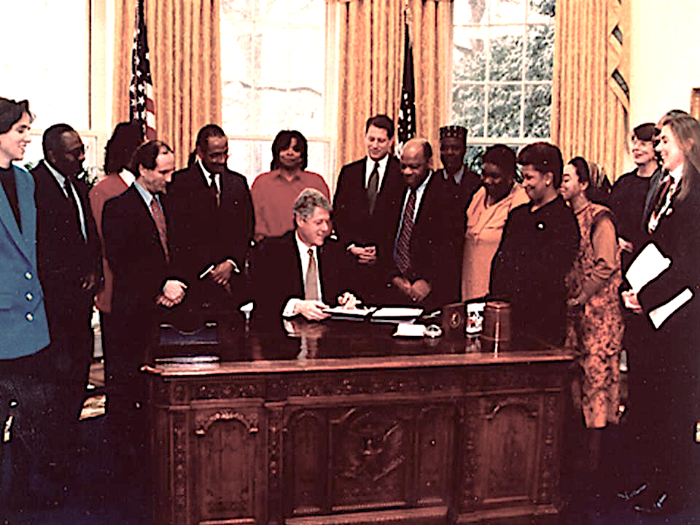
Executive Order 12898
Federal Actions To Address Environmental Justice in Minority Populations and Low-Income Populations
Government agencies are now responsible
Environmental Justice Mandate
source: https://www.nrdc.org/experts/albert-huang/20th-anniversary-president-clintons-executive-order-12898-environmental-justice
Background
Notes:
In 1994, President Clinton signed the first major federal action addressing the disproportionate environmental impacts on communities of color and low-income populations. This was momentous because Environmental Injustices were given a spotlight on a national level. It also placed the responsibility to government agencies to ensure the safety of all communities.

Slide 5
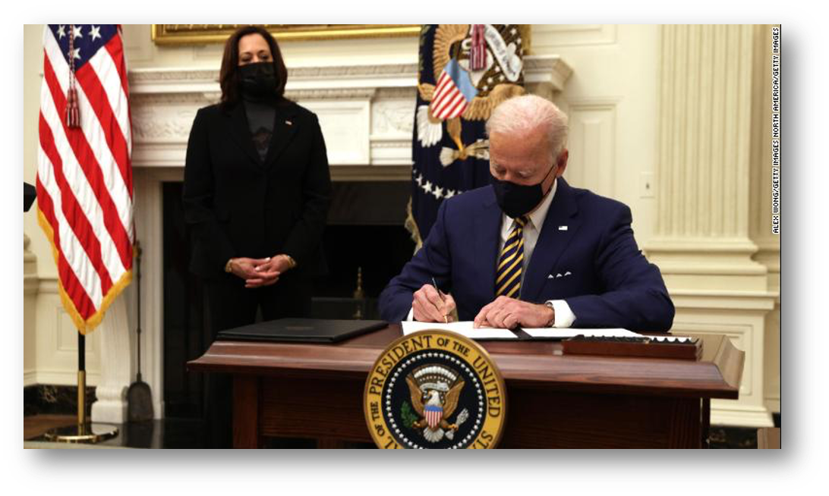
Executive Order 14008
Signed January 2021
“Tackling the Climate Crisis at Home and Abroad”
Sec. 219 “Securing Environmental Justice and Spurring Economic Opportunity”
Creation of White House Environmental Justice Advisory Council
Environmental Justice mandate again for “every agency.”
source: https://www.cnn.com/2021/01/26/politics/executive-orders-equity-joe-biden/index.html
Background
Notes:
Almost 3 decades since the Clinton Administration’s first Environmental Justice Executive Order, the Biden-Harris Administration, signs the EO 14008, otherwise known as “Tackling the Climate Crisis at Home and Abroad.”
The new Executive Order not only addresses future environmental challenges from the changing climate, but it also shows explicit intent of the administration to address Environmental injustices as a component of addressing climate change. It signals a path to not only consider the future of certain populations but also, communities of color and low-income communities who are most susceptible to the effects of climate change.

Slide 6
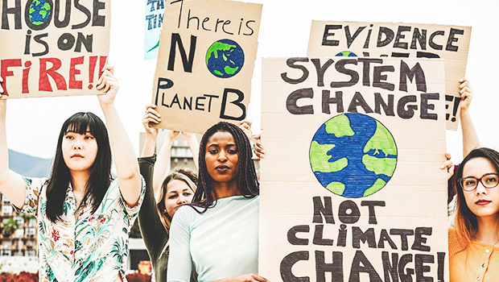
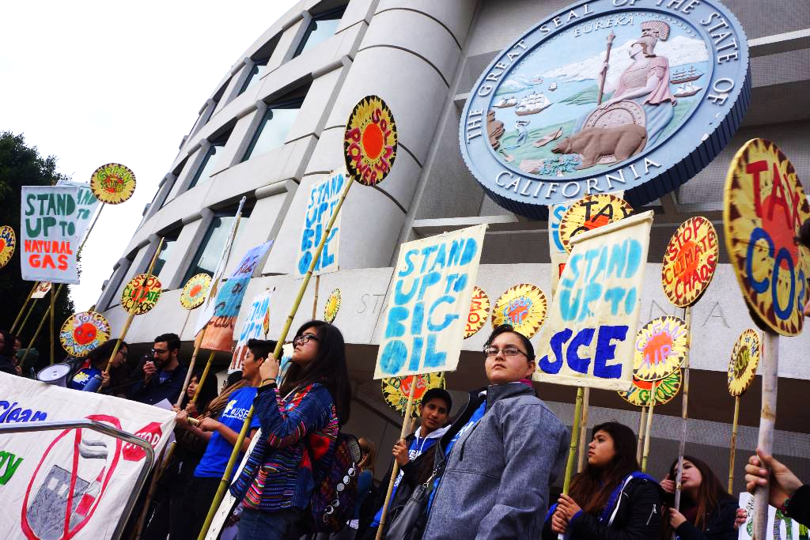
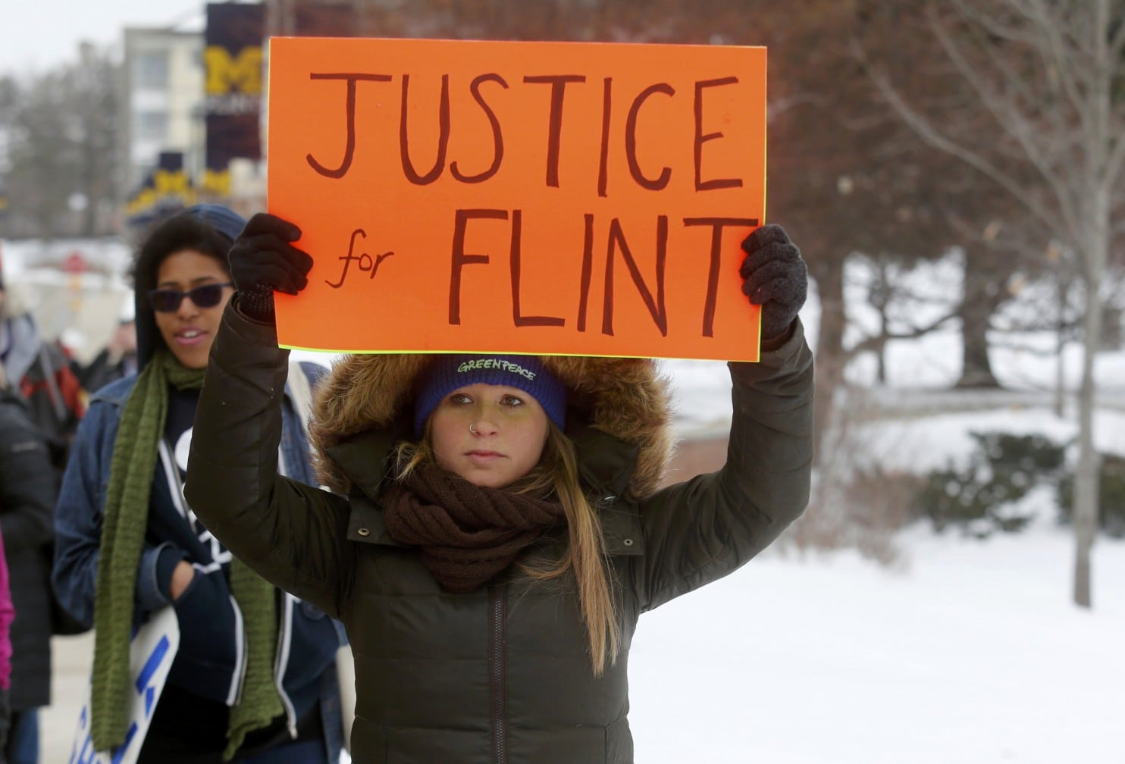
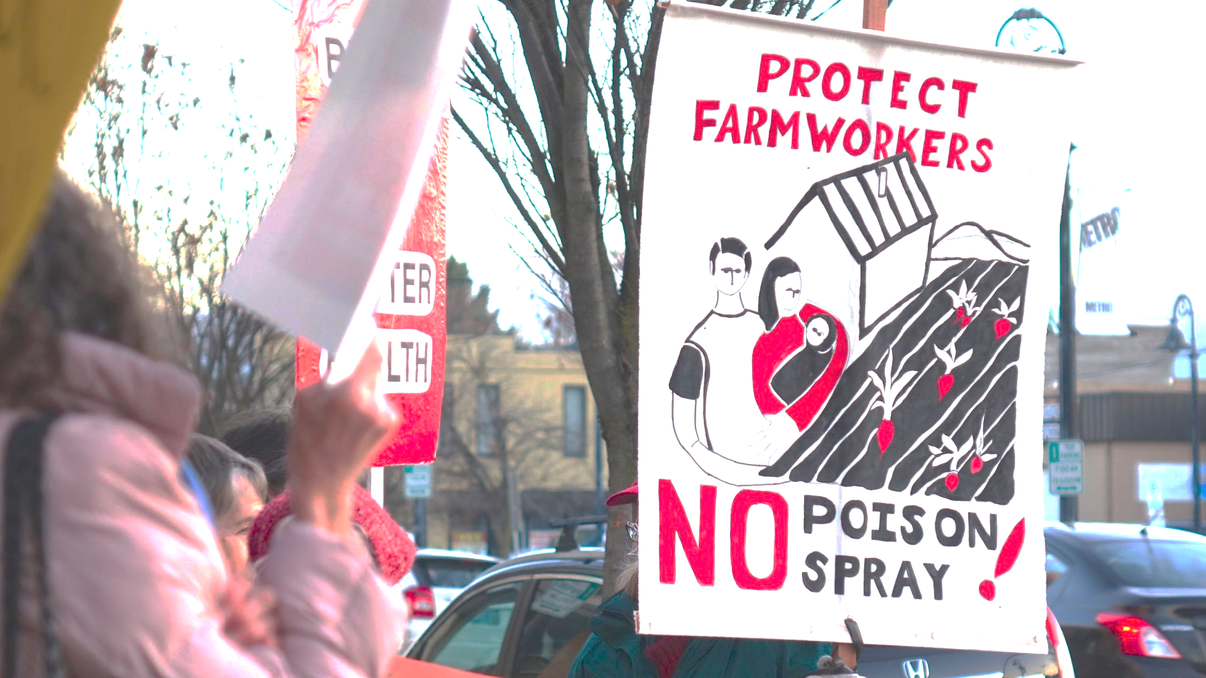
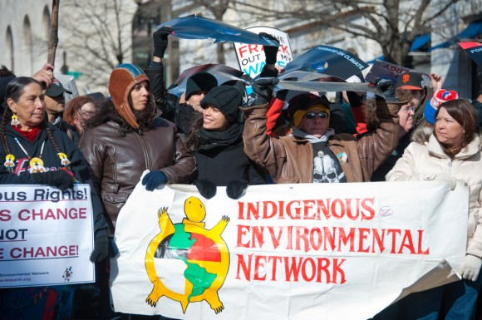
Background
Source for all images are in a separate slide at the end of the presentation.
Notes:
The renewed interest in Environmental Justice, is now enveloped within a global environmental phenomena caused by climate change. However, it is just as imperative, to ensure that communities of color and low-income communities are not left out of future policies. Between the Clinton Executive Order to the current Executive Order, people have continued to experience disparate impacts due to environmental pollution. Young people, are especially motivated in ensuring the health of their environment as well as recognizing the intersection of climate change and social justice.
The question remains, Despite the mandates from the executive branch, why has the government not been able to introduce environmental justice policies that truly addresses the disproportionate impacts to communities?

Slide 7
Top-Down Government
Executive Order
Policy
Regulation
Background
Notes:
Which brings me to the theme of governance. Although, Environmental Justice is truly a grassroots movement at heart, where it lacks its reach is in policies and regulations enacted by government agencies. Rather, it is not often the case that policies are made from input or needs of specific communities and is often created as a blanket policy. However, social movements can and often are the catalyst of change in policies. Environmental governance is still very much, a top-down approach. This means, that mandates come from a smaller subset of the population to create policies and regulations that affect the greater community.

Slide 8
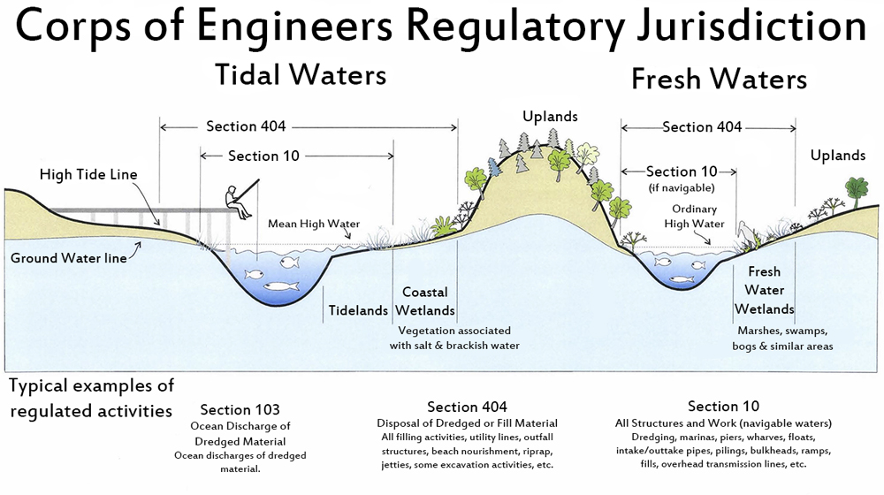
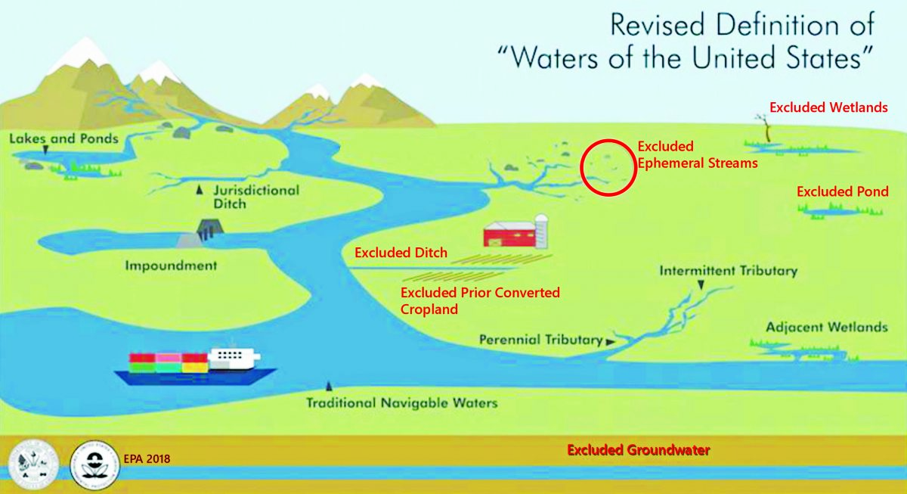
Executive Order
Policy
Regulation
source: https://www.nwp.usace.army.mil/portals/24/siteimages/regulatory/Corps_Regulatory_Jurisdiction.jpg
Background
source: http://wetlandsconservancy.org/wp-content/uploads/2020/06/Federal-InfoGraphic-scaled-e1593100401263.jpg
Notes:
We can see this in practice by looking at the political actions to roll-back environmental protections. For example, the previous administration narrowed the definition of what is considered a WOTUS. WOTUS are federally protected waters, such as a river or a wetland, and prohibits impacts due to human activities. This is meaningful to communities whose waters, according to the new rule definition, is now vulnerable to development and pollution discharge. How this translates into state governance and eventually local and community impact, is through programs, such as Oregon’s 401 Certification Program. 401 is a section in the Clean Water Act that gives states and tribal government the authority to grant, waive, or deny federal permits for projects that may impact a WOTUS. Unfortunately, this means that what was previously an uncertifiable project within certain waters, could now be a non-jurisdictional water. This leads to degradation of not only water resources, but potential ecological protection from climate change effects such as flooding.
The top-down approach is not always effective and hinges on the decisions of political leaders. It is, therefore, accurate to say that communities lack the political weight to influence policies from the beginning and lack trust in environmental agencies to act on behalf of the people.
This leads me to wonder about other governance models where community input is built in.

Slide 9
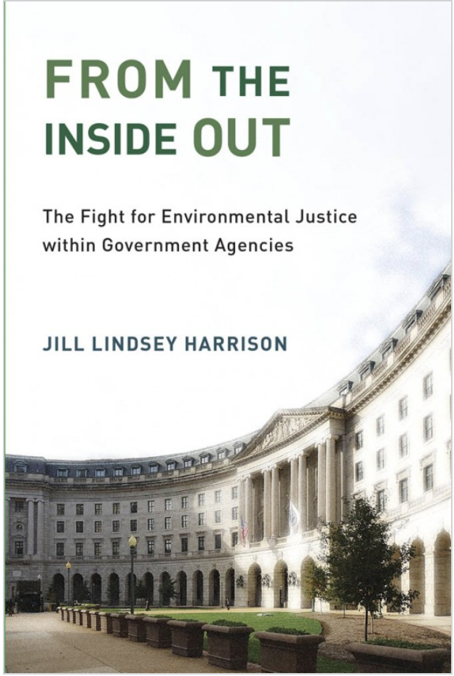
Inserting Communities in Government
EO
Policy
Community Input
Regulation
source: https://mitpress.mit.edu/sites/default/files/styles/large_book_cover/http/mitp-content-server.mit.edu%3A18180/books/covers/cover/%3Fcollid%3Dbooks_covers_0%26isbn%3D9780262537742%26type%3D.jpg?itok=7gzYlelc
Background
Notes:
Communities hold a unique perspective into environmental concerns as the ground truth to, often, a generalization of issues. However, communities lack trust in environmental agencies and are often hesitant to work with officials. Rightfully so, government agencies have historically fallen short on environmental justice efforts. In her recent book, “From the Inside Out,” Harrison interviewed government employees from different agencies to evaluate the general attitude towards environmental justice efforts within government. Among the responses are sentiments such as, “We are a regulatory agency not an advocacy group,” or not all leadership are supportive of the effort. Therefore, employees are left with little resources and time to develop an ej action plan.
An important sentiment from Harrison’s book is the concept of expertise. For example, government agencies hire specialized scientists and engineers to make informed decisions based on data. Some, according to Harrison, are reluctant to take public narratives as viable information sources because “they are often lacking in sufficient expertise” (pp. 879). This perhaps, could be one reason for mistrust between public and government agencies. Additionally, it provides context into motivations of community-based organizations to authorize themselves to bring policy-change instead of working with the government.

Slide 10
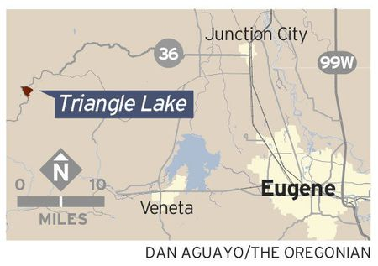
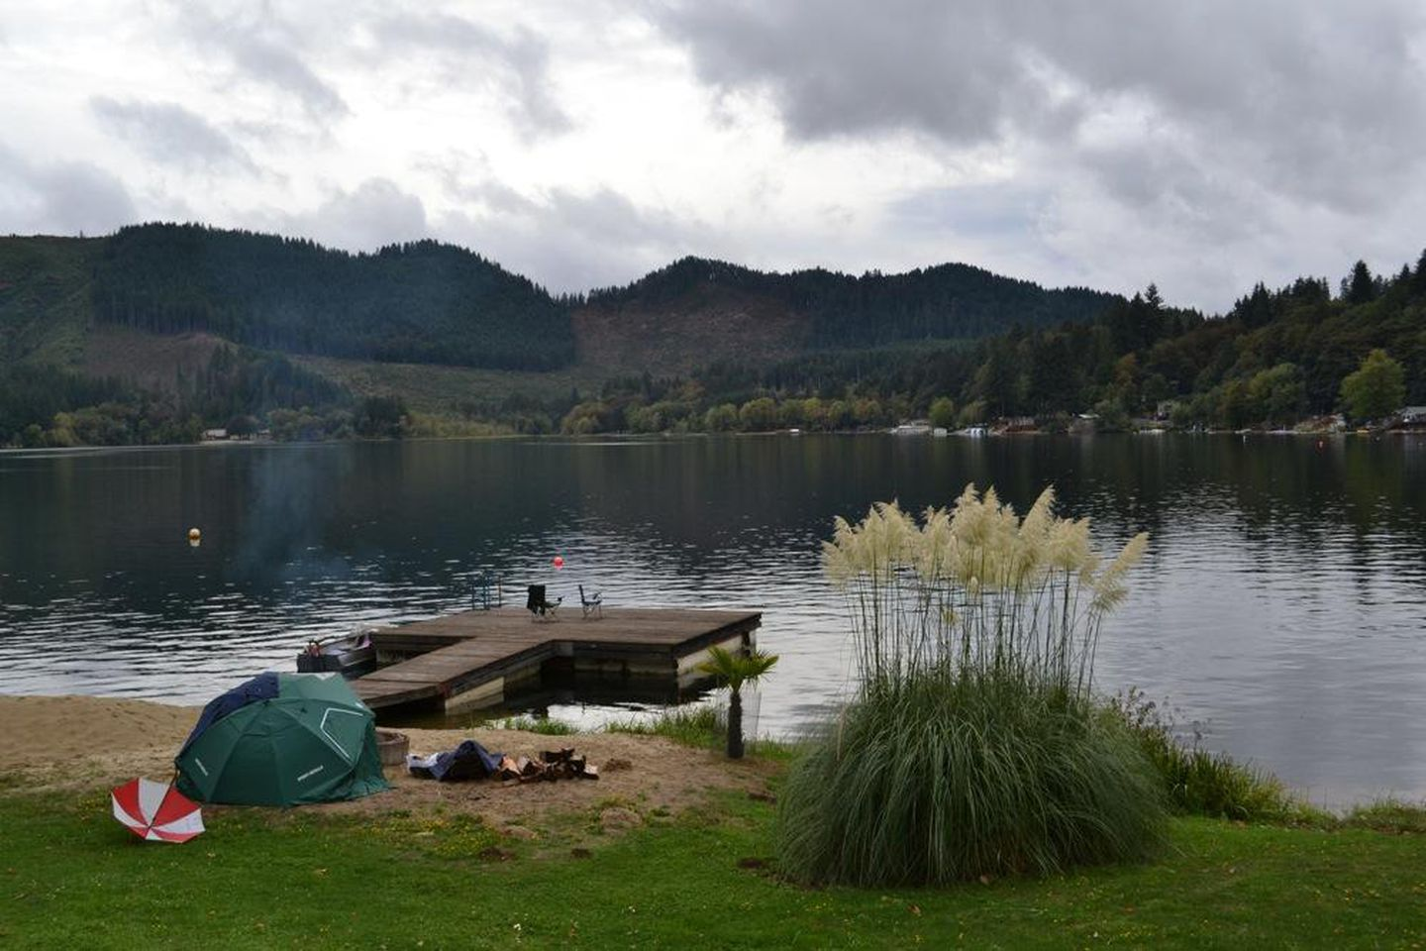
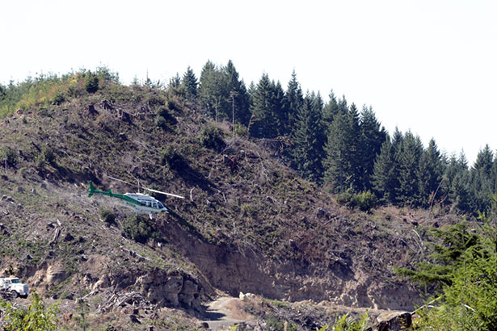
The Case of Triangle Lake/HWY 36
source:https://www.oregonlive.com/image.oregonlive.com/home/olive-media/width2048/img/oregonian/photo/2013/05/gs51lake130-02jpg-8fa3aceced8c230a.jpghtml
source:https://opb-opb-prod.cdn.arcpublishing.com/resizer/-SA1cUcs6b_VVDvU8SH4SFzvsls=/1440x0/smart/cloudfront-us-east-1.images.arcpublishing.com/opb/KBWWHTNOKZBDLHKJGPQKO2RJYA.jpg
source:https://www.eugeneweekly.com/wp-content/uploads/2015/09/20150917shorts-spray.jpg
Notes:
A great example of community effort enacting change in government is the case of Triangle Lake or Highway 36 Corridor. Triangle Lake is located along the coastal range in Oregon, where timber harvesting is a big industry. According to Oregon Health Authority, community members were concerned over exposure to aerial application of pesticides after a clear-cutting event. In 2005, a group of community members urged Oregon Department of Agriculture to address their suspicions of pesticide drift. By 2011, the community group, acting on their own, sent urine samples to a researcher from Emory University in Georgia to test for presence of pesticides. Results came back positive which then prompted government agencies to work together to conduct an exposure investigation. The intention of the investigation was to assess the degree of exposure to pesticides, and answer questions such as potential pathways, type of pesticides, and health risks. The design of the study was to collect baseline samples during a time when pesticides are not applied and compare it to another set of samples collected during pesticides application time. Unfortunately, factors deemed outside of the agency’s control inhibited the comparison of samples. The second samples were scheduled on a specific day when aerial spray was thought to be on schedule. However, without the knowledge of the investigators, the day and location of pesticides spray was changed. The investigation team was not able to collect accurate samples.
Nevertheless, this is case study in the impact of community action to activate government response. Although, external factors limited the ability of the government agency to conduct the investigation as it was intended, it shows the possibility of communities working with government agencies.

Slide 11
Research questions

Slide 12
What does a pesticides governance structure with an EJ mandate, look like in Oregon?
How can government agencies ensure that they are engaging communities for input?
Do communities (both landowners and other members) have differing motivations to achieve an environmental goal?
Research Questions
Notes:
Focusing on Oregon as my study area, my research questions are:

Slide 13
Goals and objectives

Slide 14
Identify communities who are most likely at risk of pesticides exposure in Oregon.
Conclude if Stewardship outcomes are effective in bringing community level change, especially one that is in service of bringing environmental justice.
Translate the stewardship governance model onto a map.
Goals and objective
Notes:
My goals and objectives

Slide 15
Methodology
Notes:
Here are my proposed methodology

Slide 16
Map potential pesticides sources
Evaluate communities living near pesticide sources
Determine risks by pesticides application
Insert into a stewardship governance model
Map Stewardship Outcomes
methodology
Notes:
My approach is to

Slide 17
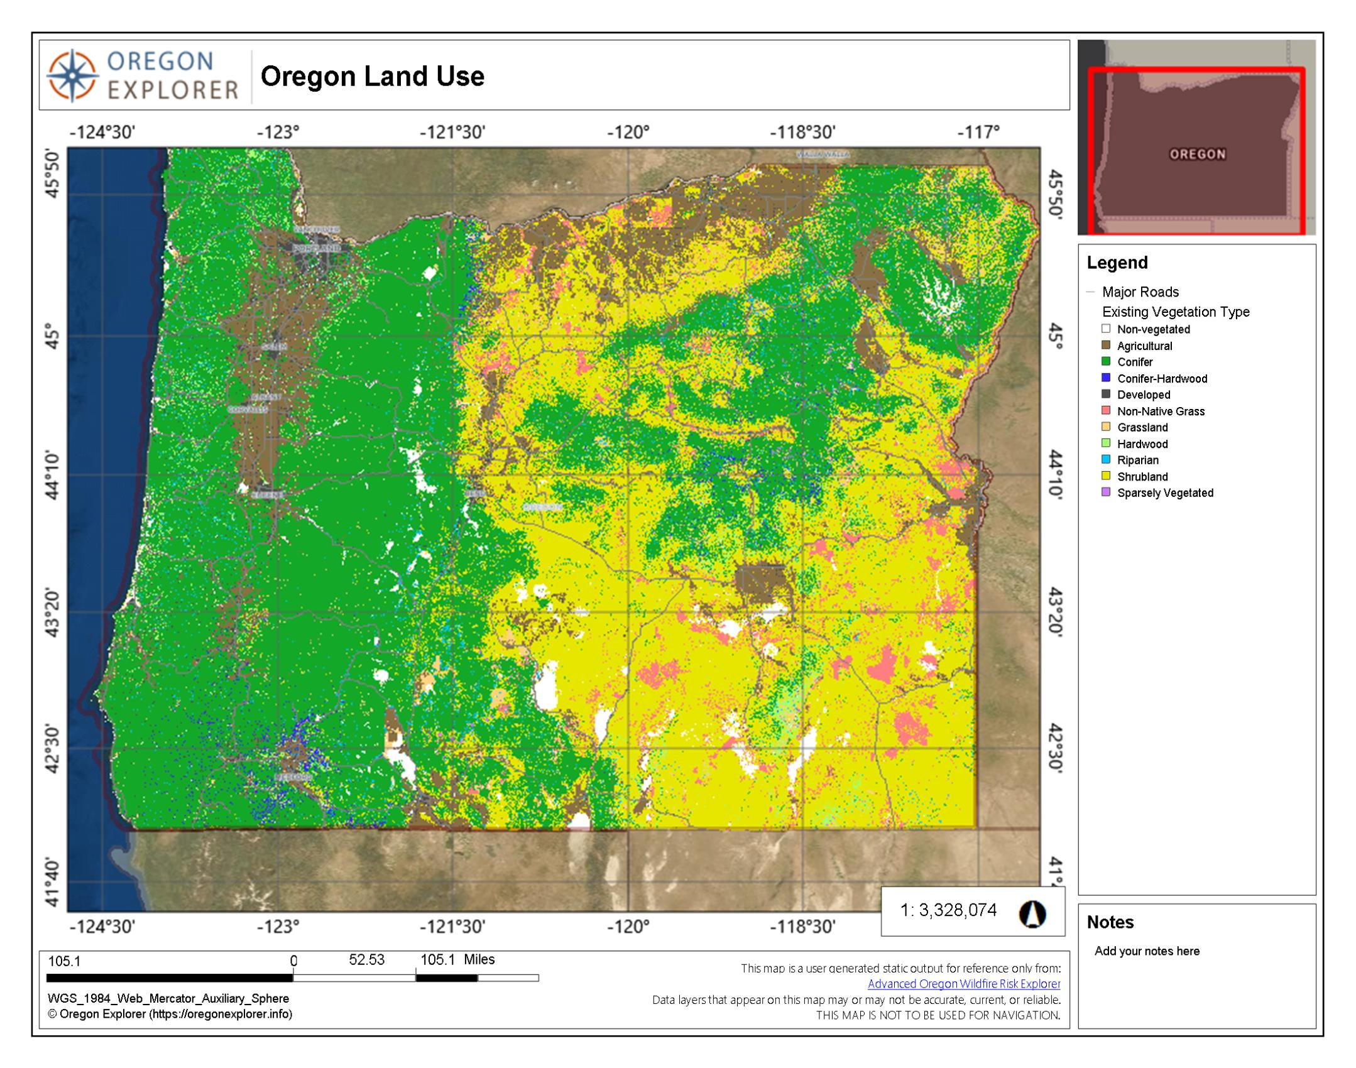
NASS USDA Crop data to map agriculture lands by crop type:
https://www.nass.usda.gov/Statistics_by_Subject/index.php?sector=CROPS
Designated Management Agency by taxlot dataset from Oregon Department of Environmental Quality.
methodology
Notes:
I’ve compiled my data source from the National Agriculture Statistics Service at the USDA to obtain land use categorized by different crop types. It is my belief that crop type values will help to parse the different types of pesticides application method. Additionally, I’ve gathered a dataset published by the Oregon Department of Environmental Quality which compiles taxlot parcels and assign it to a designated management agency. This dataset, will aid in categorizing forestry lands into private and public spaces.

Slide 18
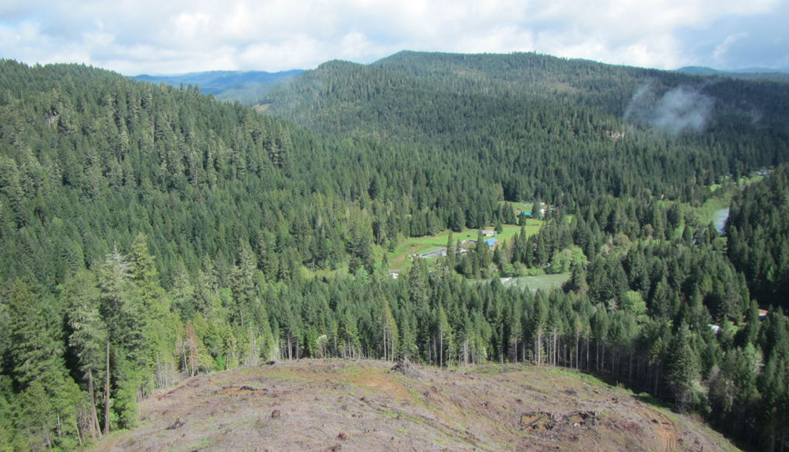
Use spatial analysis to determine proximity to pesticides sites
Census Block Group Data
source: https://www.opb.org/news/article/oregon-forest-practices-rules-fail-to-prevent-pest/
methodology
Notes:
I will then bring in census block group data from the U.S Census Bureau to calculate population percentage by race. Then perform an attribute join to combine the calculated percentage to the census block group polygons. I will use spatial analysis to determine proximity to pesticide sites.

Slide 19
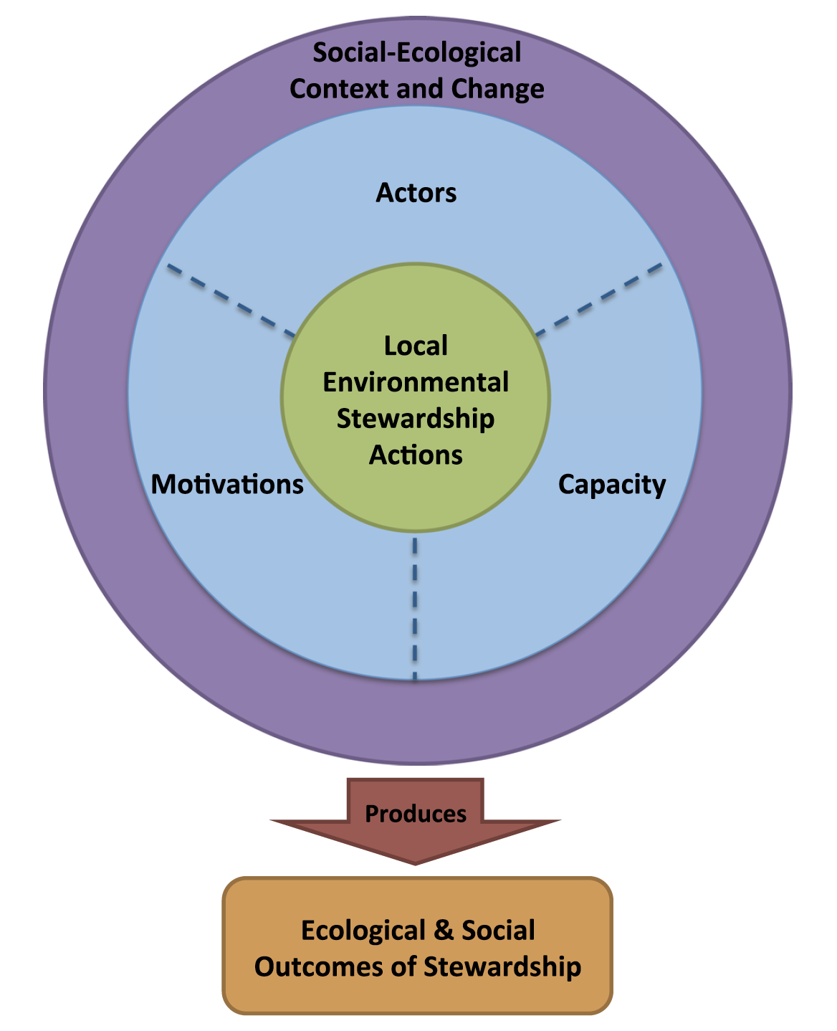
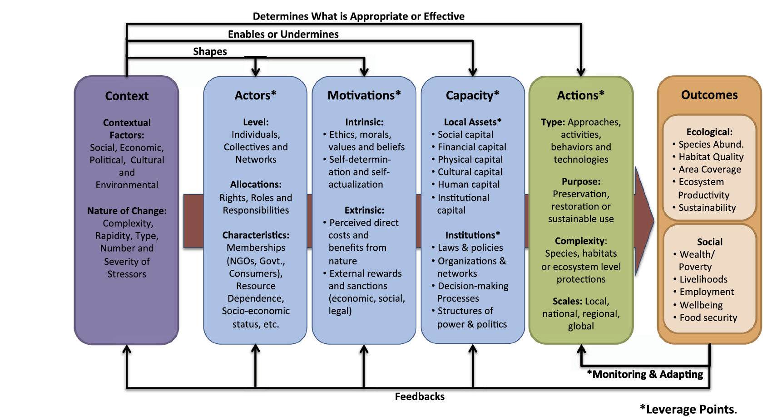
Stewardship Analytical Framework
source: Bennett, N. J., Whitty, T. S., Finkbeiner, E., Pittman, J., Bassett, H., Gelcich, S., & Allison, E. H. (2018). Environmental stewardship: A conceptual review and analytical framework. Environmental Management. Figures.. https://doi.org/10.1007/s00267-017-0993-2
methodology
Notes:
Finally, drawing from the analytical framework by Bennett et. al., to gather the core components that make up a stewardship. The components proposed in this model are actors, motivations, and capacity. Actors carry out the actions and is identified as either an individual, community-based organization, or government agency. Each actor will have varying motivations and capacity. This can be asserted based on their relation to pesticides. For example, timber landowners may oppose stricter regulations to pesticides use, and therefore, have an extrinsic motivation to prevent potential regulation fee increase, while having institutional capacity to influence policy making. On the other hand, motivations and capacity would be quite different for a resident living near pesticides application sites. Bennet et. al.’s framework, therefore, would be useful in creating context as to why an outcome may favor one actor over the other. This would also provide attributes that can be visualized on a map as a web tool or in a storymap.

Slide 20
Conclusion
Notes:
We’ve now come to the conclusion, where I would like to reiterate my goals for this research. It is to ultimately make observations on patterns of the potential pesticides risks to communities of color and low-income communities. Given the lack of actions from government agencies to address on-going environmental justice, it is in my interest to also evaluate an alternative governance model from a top-down approach to a stewardship network where communities can utilize the resources of government to influence policy change.

Slide 21
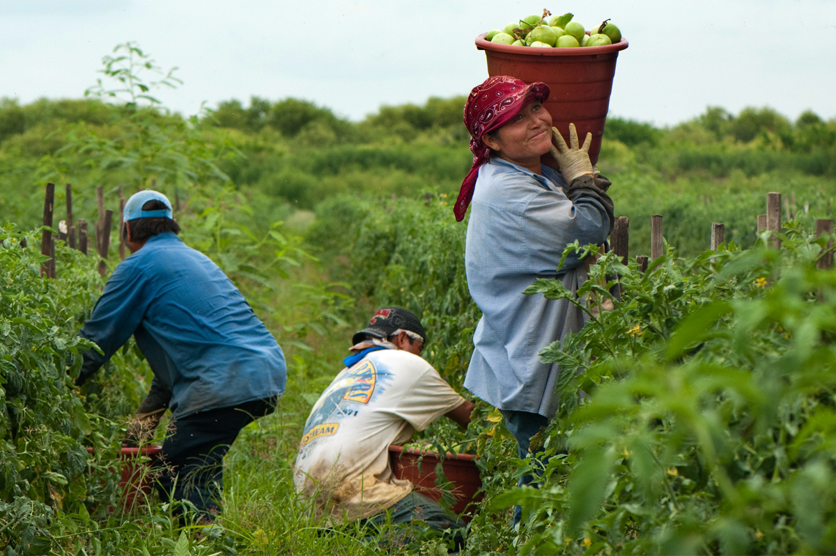
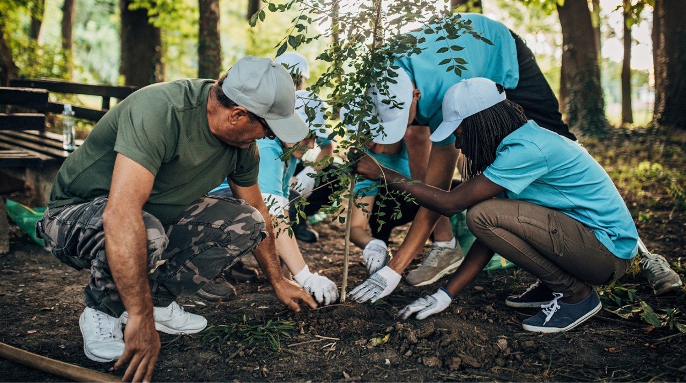
Anticipated Results:
Communities of color and low-income communities are highly susceptible to pesticides exposure due to their proximity to pesticide sources.
An environmental stewardship is an effective way of integrating community voices
However, I am uncertain if this will result in stricter regulations for landowners or corporations.
Above source: https://civileats.com/wp-content/uploads/2020/04/200421-pesticide-application-exclusion-zone-aez-epa-rule-change-spray-shape-farm-labor-3-immokalee-worker.jpg
conclusion
source: https://www.southerncompany.com/content/dam/southerncompany/images/clean-energy/Clean%20Energy_Hero_Environmental%20Stewardship_People%20Plant%20Trees.jpg.imgw.1280.1280.jpg
Notes:
With that said, my anticipated results are that:
By visualizing a stewardship network and all its components, it could provide valuable insight into where to focus stricter regulations.

Slide 22
Alexander, S. M., Andrachuk, M., & Armitage, D. (2016). Navigating governance networks for community-based conservation. Frontiers in Ecology and the Environment, 14(3), 155–164. https://doi.org/10.1002/fee.1251
Bennett, N. J., Whitty, T. S., Finkbeiner, E., Pittman, J., Bassett, H., Gelcich, S., & Allison, E. H. (2018). Environmental stewardship: A conceptual review and analytical framework. Environmental Management, 61(4), 597–614. https://doi.org/10.1007/s00267-017-0993-2
Bullard, R. D. (1983). Solid Waste Sites and the Black Houston Community. Sociological Inquiry, 53(2–3), 273–288. https://doi.org/10.1111/j.1475-682x.1983.tb00037.x
Connolly, J. J., Svendsen, E. S., Fisher, D. R., & Campbell, L. K. (2014). Networked governance and the management of ecosystem services: The case of urban environmental stewardship in New York City. Ecosystem Services, 10, 187–194. https://doi.org/10.1016/j.ecoser.2014.08.005
Department of Land Conservation & Development. (2020, November). Oregon farm and forest land use report 2018–2019. https://www.oregon.gov/lcd/Publications/2018-2019_Farm_Forest_Report.pdf
Executive Office of the President. (2021, February 1). Tackling the climate crisis at home and abroad. Federal Register. https://www.federalregister.gov/documents/2021/02/01/2021-02177/tackling-the-climate-crisis-at-home-and-abroad
Harrison, J. L. (2019). From the Inside Out: The Fight for Environmental Justice within Government Agencies (Urban and Industrial Environments). The MIT Press.
Lee, C. (2021). Confronting disproportionate impacts and systemic racism in environmental policy. The Environmental Law Reporter, 51, 10207–10225. https://www.eli.org/sites/default/files/docs/elr_pdf/51.10207.pdf
McCauley, L. A., Lasarev, M. R., Higgins, G., Rothlein, J., Muniz, J., Ebbert, C., & Phillips, J. (2001). Work characteristics and pesticide exposures among migrant agricultural families: A community-based research approach. Environmental Health Perspectives, 109(5), 533–538. https://doi.org/10.1289/ehp.01109533
Mohai, P., Pellow, D., & Roberts, J. T. (2009). Environmental Justice. Annual Review of Environment and Resources, 34(1), 405–430. https://doi.org/10.1146/annurev-environ-082508-094348
Oregon Health Authority. (2014, October). Highway 36 exposure investigation: Final summart. https://www.oregon.gov/oha/PH/HEALTHYENVIRONMENTS/TRACKINGASSESSMENT/ENVIRONMENTALHEALTHASSESSMENT/HWY36/Documents/Highway_36_PHA_final_summary.pdf
Gibbens, S. (2021, February 10). 15 ways the trump administration has changed environmental policies. National Geographic. https://www.nationalgeographic.com/environment/article/15-ways-trump-administration-impacted-environment
Scott, M. (2014). Re-theorizing social network analysis and environmental governance. Progress in Human Geography, 39(4), 449–463. https://doi.org/10.1177/0309132514554322
Taylor, D. (2014). Toxic Communities: Environmental Racism, Industrial Pollution, and Residential Mobility. NYU Press.
The White House. (2021, January 27). FACT SHEET: President Biden Takes Executive Actions to Tackle the Climate Crisis at Home and Abroad, Create Jobs, and Restore Scientific Integrity Across Federal Government. https://www.whitehouse.gov/briefing-room/statements-releases/2021/01/27/fact-sheet-president-biden-takes-executive-actions-to-tackle-the-climate-crisis-at-home-and-abroad-create-jobs-and-restore-scientific-integrity-across-federal-government/
USDA. (n.d.). USDA - National Agricultural Statistics Service - Research and Science - CropScape and Cropland Data Layers. United States Department of Agriculture National Agricultural Statistics Service. https://www.nass.usda.gov/Research_and_Science/Cropland/sarsfaqs2.php#Section1_4.0
References
Notes:
Here are the references I used for this presentation as well as in my proposal paper.

Slide 23
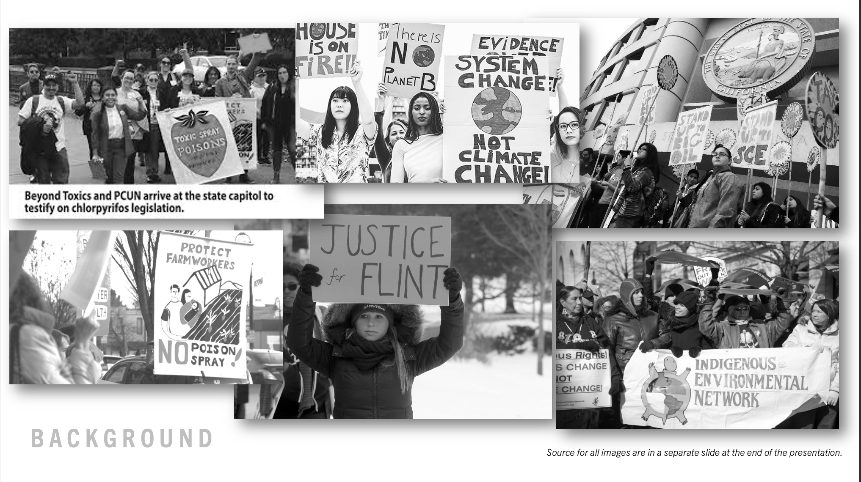
Slide 9: Environmental Justice Movement Collage
https://www.aspeninstitute.org/wp-content/uploads/2020/11/solidarity_card.jpg
https://causenow.org/sites/default/files/Environmental-Justice-new.jpg
https://www.momscleanairforce.org/wp-content/uploads/Indigenous-580x385.jpg
https://www.washingtonpost.com/rf/image_1484w/2010-2019/WashingtonPost/2016/03/14/Editorial-Opinion/Images/2016-03-07T020253Z_01_FLT547_RTRIDSP_3_USA-ELECTION-1381.jpg?t=20170517
https://encrypted-tbn0.gstatic.com/images?q=tbn:ANd9GcQa5zqYeKjwKysEJd1gIUlGHhKs5TBxkenoUA&usqp=CAU
https://opb-opb-prod.cdn.arcpublishing.com/resizer/ryA-ZbxAX-b7BlK8vTDlun__EcA=/767x0/smart/cloudfront-us-east-1.images.arcpublishing.com/opb/BCV3LWRDQ5APLHBFE2HYHFTPEA.jpg
5
1
2
6
4
3
Image source

Slide 24
Thank you

Slide 26
Environmental Justice
What is it?
Where is it?
Who is it?
Background
Notes:
I’d like to take a moment to provide context on environmental justice. The what, where, and who.

Slide 27
Environmental Justice
What is it?
Where is it?
Who is it?
Environmental justice (EJ) is the fair treatment and meaningful involvement of all people regardless of race, color, national origin, or income with respect to the development, implementation and enforcement of environmental laws, regulations and policies.
Background
Notes:
Environmental Justice as defined by EPA is [read definition on screen]. This helps to provide language to the phenomena that people of color were experiencing from their environments. EPA’s definition also provides a framework from which government agencies can evaluate or create policies.

Slide 28
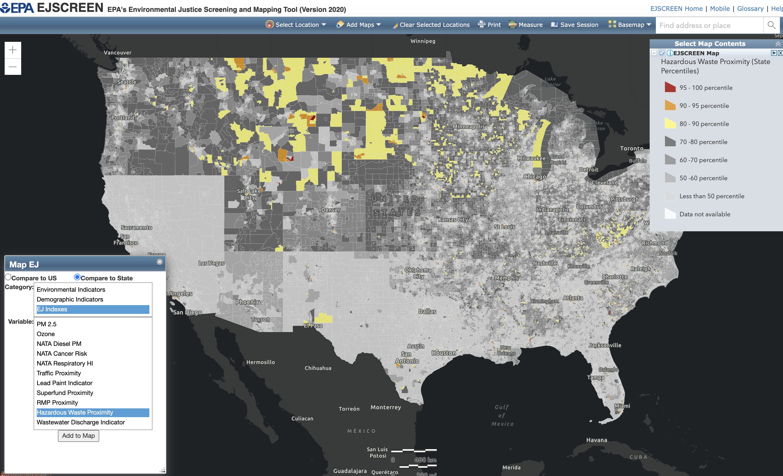
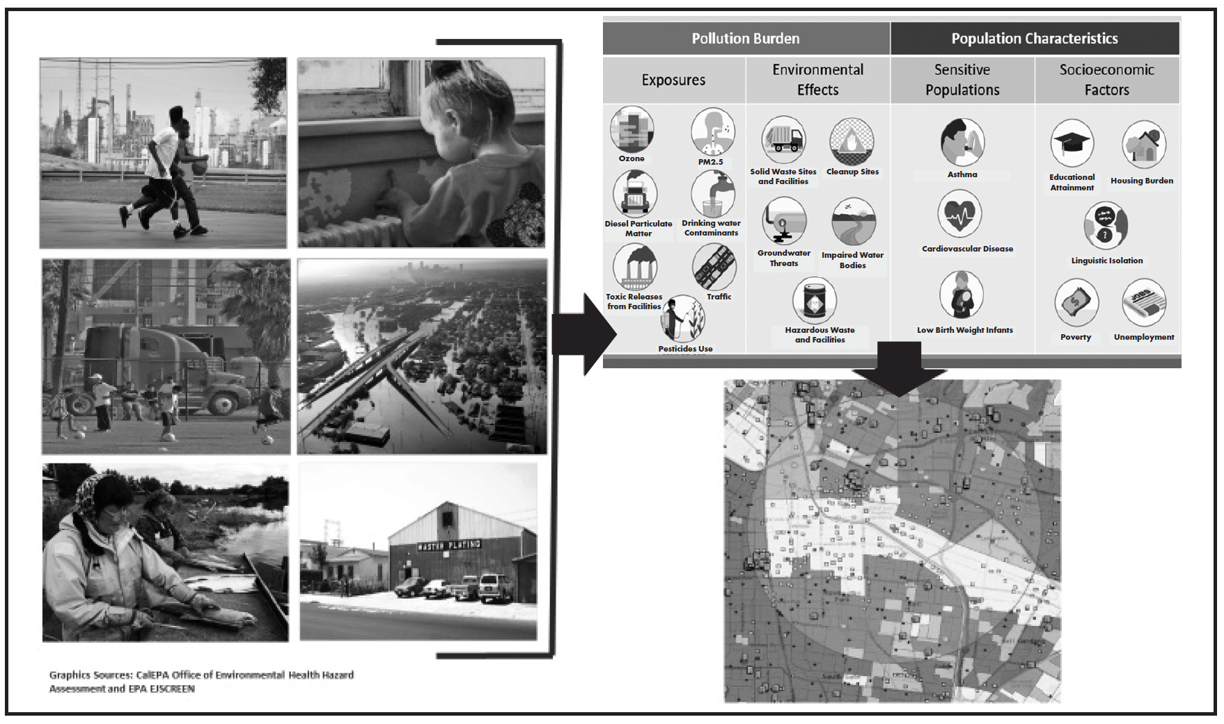
Environmental Justice
What is it?
Where is it?
Who is it?
source: Lee, C. (2021). Confronting disproportionate impacts and systemic racism in environmental policy. Image.https://www.eli.org/sites/default/files/docs/elr_pdf/51.10207.pdf
Background
Notes:
Environmental Injustice is measured by taking significant environmental variables, such as highways or hazardous waste sites and calculating the potential risks to the population living near these variables. Communities who live near an environmental variable are most likely to be impacted by the negative health effect associated with that variable. For example, children living near a major highway are most likely to develop asthma compared to children living in a suburban neighborhood. The health risks associated with environmental pollution becomes an injustice when considering the demographic factors that inhibit an individual from affecting their environmental situation. Low-income communities are not likely able to move away from environmental hazards. Likewise, locations of chemical waste dumps are often located near communities of color.

Slide 29
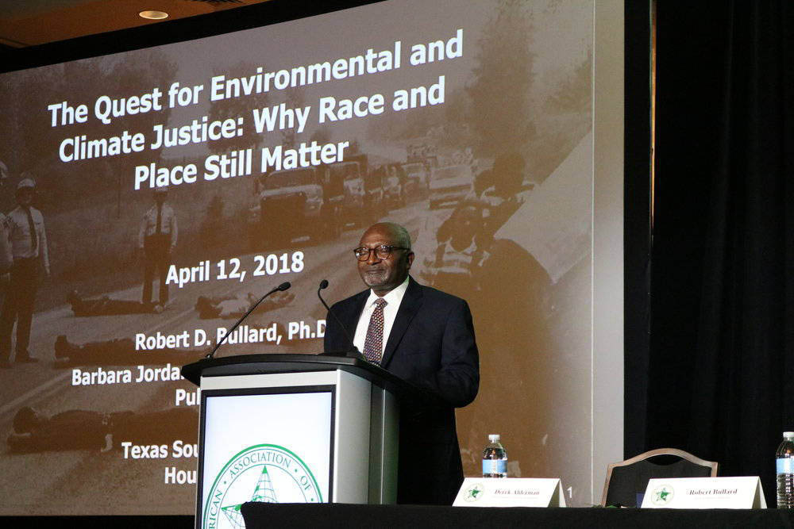
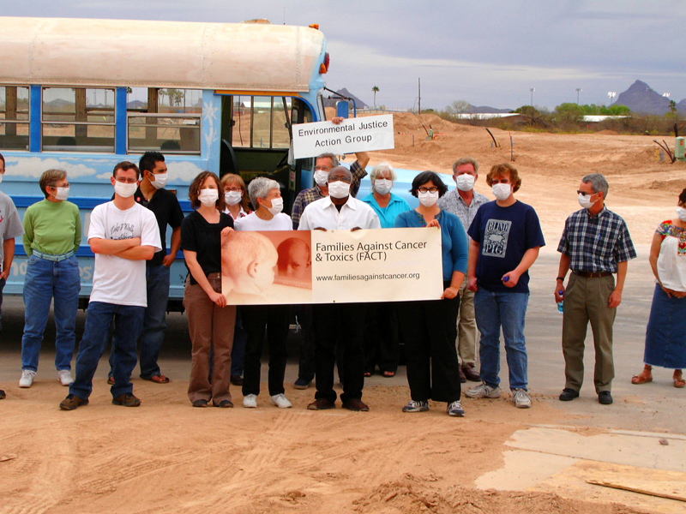
Environmental Justice
What is it?
Where is it?
Who is it?
source: “Dr. Robert Bullard Gives Keynote at American Geographers Association Conference in New Orleans March 2018”. https://drrobertbullard.com/photos/.
Background
Notes:
Although becoming a household name today, Environmental Justice movement began in late 1970s. Dr. Bullard is credited as being the “Father of Environmental Justice” In 1980’s Bullard published a research in hazardous waste sites, where he looked at patterns in where the Houston government has permitted solid waste locations. 80% of the city’s waste disposal site incinerators were in predominantly black neighborhoods, while 100% of landfills were in predominantly black neighborhoods. This was the first to show evidence of disproportionate impacts to communities of color due to an environmental hazard. Other researchers such as Dr. Bunyun and Dr. Paul Mohai were also monumental in the Environmental Justice movement. These earlier works helped to shape and advocate for policy changes that affect communities of color and low-income communities.

Slide 30
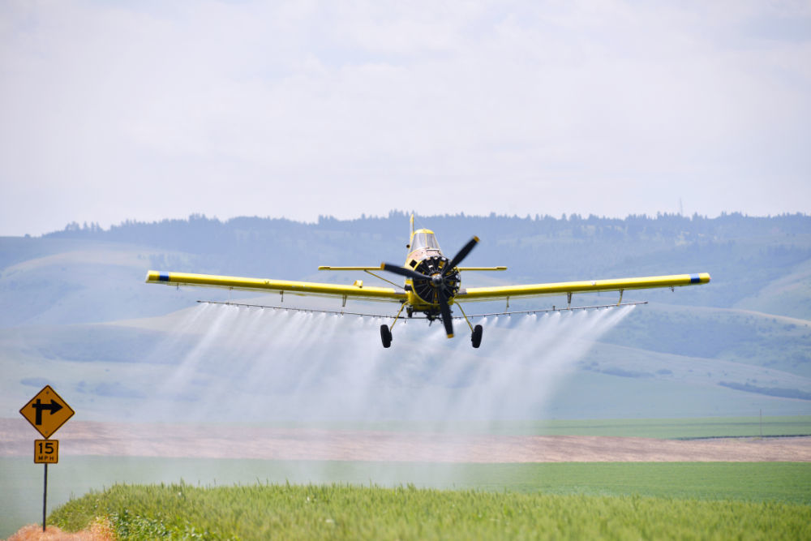
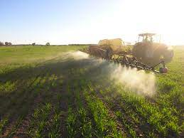
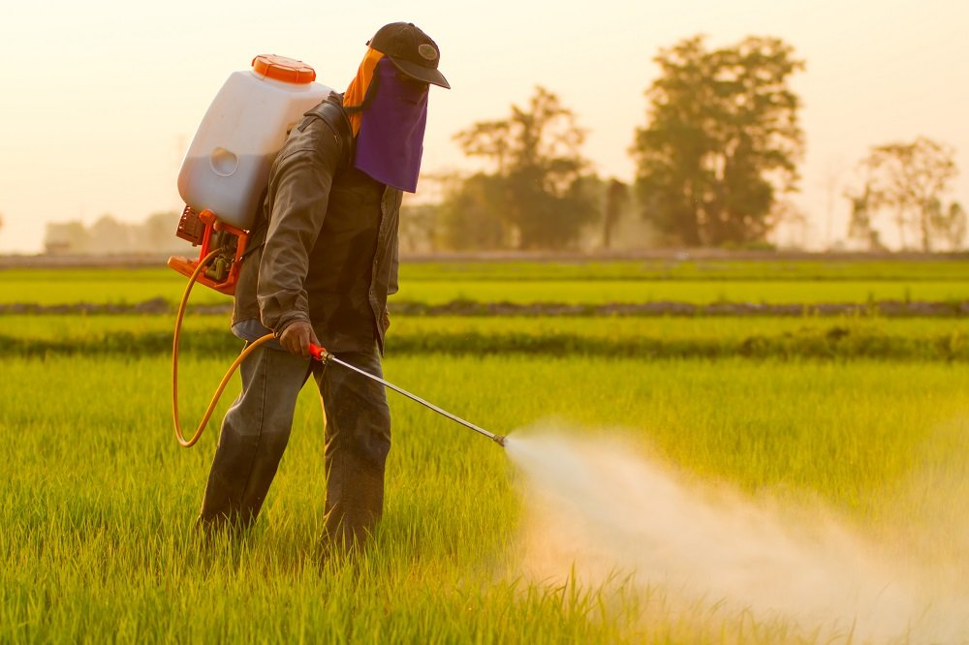
Qualify land use based on potential pesticides application type
source:https://www.agric.wa.gov.au/sites/gateway/files/sprayer.jpg
source:https://bloximages.newyork1.vip.townnews.com/eastoregonian.com/content/tncms/assets/v3/editorial/8/7c/87cdb3c9-1c3a-5709-a849-21b0a5460773/5c12e45872616.image.jpg
methodology
source:https://www.selectscience.net/images/articles/79_76_Pesticides%20-%20Copyright%20PigginFoto%201000.jpg
Notes:
Once I’ve completed classifying land-use, I will gather pesticides application methods and assert the most likely methods based on crop type.

