Slide 1
New City at Ten: Demographic and Economic Change in Sandy Springs, Georgia a Decade after Incorporation
William Hartnett
Capstone Proposal
December 18, 2015
Dr. Anthony Robinson, Advisor
Notes:
Hi, I’m William Hartnett, and my capstone proposal is “the new city at ten, demographic and economic change in Sandy Springs, Georgia, a decade after incorporation.”

Slide 2
1
Summary
Topic
Sandy Springs, a decade-old city in the Atlanta area
Research Question
What are the demographic and economic effects of municipal incorporation?
Goal
Profile of demographic and economic change in Sandy Springs, a baseline for further study of the effects of new city formation
Notes:
I’d like to begin with a summary of my project.
Sandy Springs is a city in Georgia that was formed 10 years ago. It’s representative of a wave of municipal incorporation in the Atlanta area that has seen eight new cities form during the past decade, and that continues today.
Despite ongoing incorporation efforts in the Atlanta area, little or no research exists on the demographic or economic changes that take place in these new cities after they’re up and running. What little research does exist on newly incorporated municipalities focuses instead on how, why, and where new cities form.
By compiling a profile of demographic and economic change in the Atlanta region’s model new city, I hope to provide a topical and methodological baseline for further study of the post-incorporation effects of the cityhood movement here and elsewhere.

Slide 3
Overview
2
Background
Sandy Springs and the social and political history that led to its incorporation
Research on New Cities
Review of the scholarship on newly incorporated municipalities
Proposed Methods
Focus, data sources, and analytical approach
Conclusion
Review, looking ahead, and questions
Notes:
Here’s an overview of what we’ll cover today.
I’ll begin by describing the long social and political history that led to the incorporation of Sandy Springs, a process that dates back to the mid-20th century.

Slide 4
Overview
2
Background
Sandy Springs and the social and political history that led to its incorporation
Research on New Cities
Review of the scholarship on newly incorporated municipalities
Proposed Methods
Focus, data sources, and analytical approach
Conclusion
Review, looking ahead, and questions
Notes:
I’ll review research on the formation of cities such as Sandy Springs, which are known in the literature as newly incorporated municipalities, or NIMs.

Slide 5
Overview
2
Background
Sandy Springs and the social and political history that led to its incorporation
Research on New Cities
Review of the scholarship on newly incorporated municipalities
Proposed Methods
Focus, data sources, and analytical approach
Conclusion
Review, looking ahead, and questions
Notes:
I’ll talk about my proposed methods, including the focus of the analysis, the anticipated data sources, and of course the analytical approaches themselves.

Slide 6
Overview
2
Background
Sandy Springs and the social and political history that led to its incorporation
Research on New Cities
Review of the scholarship on newly incorporated municipalities
Proposed Methods
Focus, data sources, and analytical approach
Conclusion
Review, look ahead, and questions
Notes:
And I’ll conclude by reviewing everything we’ve discussed, and take any questions that might come up.

Slide 7
3
Why Sandy Springs?
Notes:
Let’s start with a basic question: Why Sandy Springs? What, in other words, makes this seemingly run-of-the-mill suburban Atlanta city worth studying in detail? Hopefully by the end of this presentation you’ll agree with my personal opinion that its history alone makes it just plain interesting.
But its position in the vanguard of the ongoing movement in metro Atlanta to form new cities and new governments in previously unincorporated areas, with all the changes affecting the current and future populations of those communities that doing so may or may not entail, is what truly makes Sandy Springs worth studying.

Slide 8
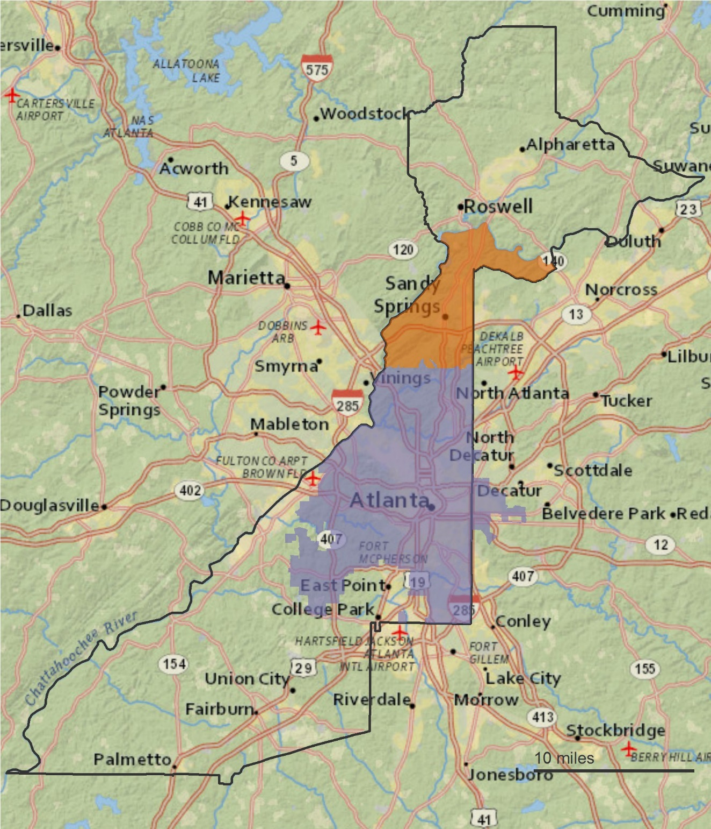
Background
4
Sandy Springs
Population: 100,000
Area: 38 square miles
Incorporated 2005
Fulton County
Population: 1 million
Area: 527 square miles
Borders result of 1932 merger with two neighboring counties
Notes:
Some basic facts: Sandy Springs is situated just north of the city of Atlanta, in the heart of the greater Atlanta metro area. You can see it highlighted in orange in this map, with incorporated Atlanta just below it shown in purple.
Sandy Springs is home to about 100,000 residents, covers roughly 38 square miles, and was of course incorporated as a city only 10 years ago in 2005.

Slide 9
Background
4
Sandy Springs
Population: 100,000
Area: 38 square miles
Incorporated 2005
Fulton County
Population: 1 million
Area: 527 square miles
Borders result of 1932 merger with two neighboring counties
Notes:
Sandy Springs is in Fulton County, which is outlined in gray here on the map. The county is home to about 1 million residents across 527 square miles.
And as you can also see on the map, Fulton County is unusually shaped. Travelling by car from its southeastern-most point to its northern tip is a trip of more than 70 miles and 90 minutes. This unusual shape is a result of Fulton County’s merger in 1932 with two other counties, Milton to the north and Campbell to the south.

Slide 10
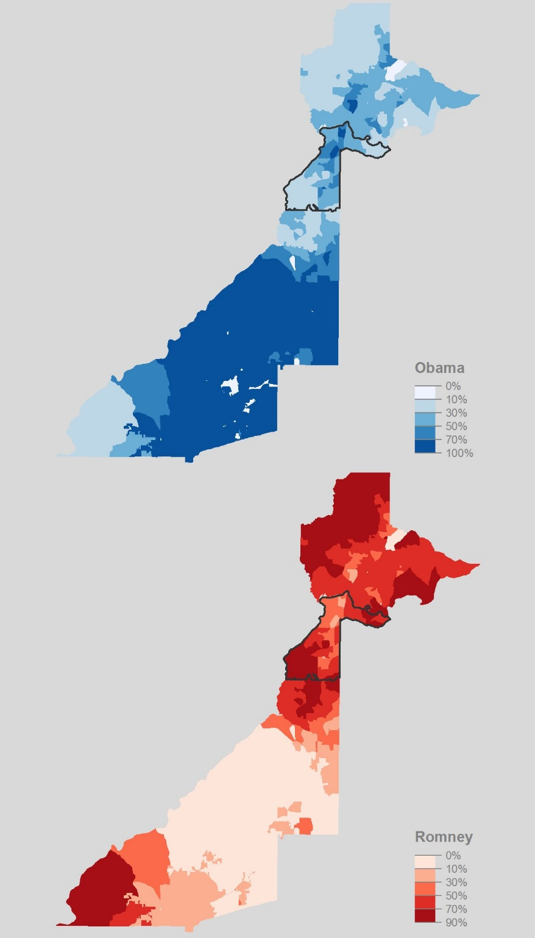
Background
5
North-South Political Divide
Countywide 2012 presidential election result
Barack Obama: 64.1%
Mitt Romney: 34.4%
North Fulton County
Barack Obama: 36.4%
Mitt Romney: 61.8%
South Fulton County
Barack Obama: 80.9%
Mitt Romney: 17.9%
Notes:
Despite the intervening decades, the geographic legacy of the old Milton County is still evident in modern Fulton County’s demographic and political landscape.
Here you can see the political divide between north and south Fulton as illustrated with results from the 2012 presidential election. While President Obama received 64% of the countywide vote, he received only 36% of ballots cast by north Fulton residents, and 81% of those cast by south Fulton voters.
The Republican Mitt Romney received only 34% of the countywide vote, but only 18% in south Fulton, and 62% in north Fulton.

Slide 11
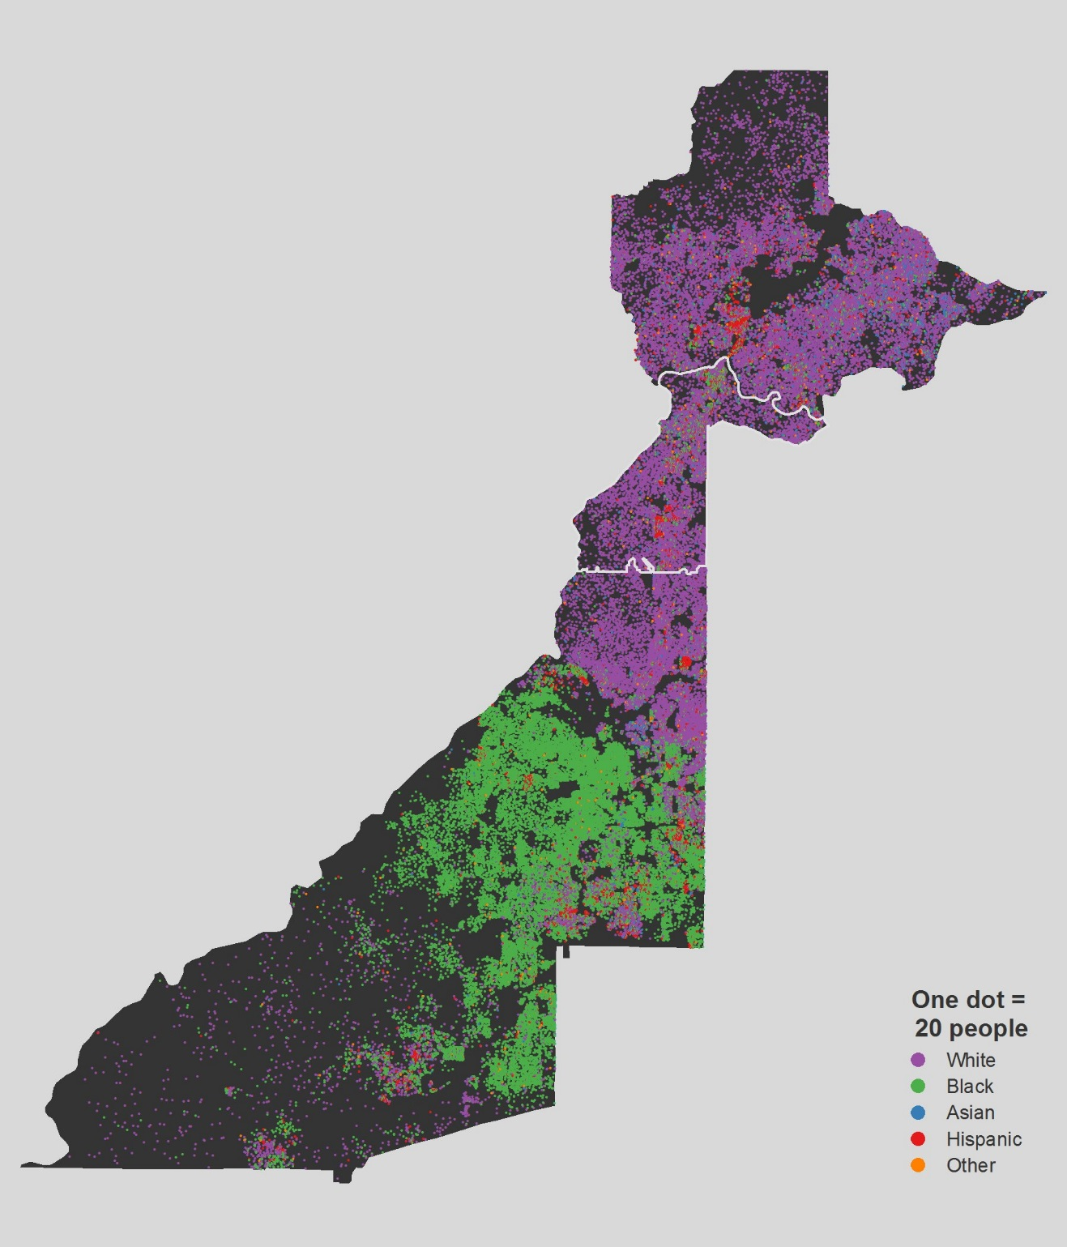
Background
6
North-South
Demographic Divide
Countywide population
Black: 43.5%
White: 40.6%
North Fulton County
Black: 13.5%
White: 62.2%
South Fulton County
Black: 62.0%
White: 27.2%
Notes:
The north-south divide is also evident along demographic lines. The map here shows the racial and ethnic population distribution in Fulton County in 2000, before the incorporation of Sandy Springs, with each purple dot representing 20 white residents, and each green dot representing the same number of black residents.
As of the most recent Census Bureau estimates, the county as a whole is 43.5% black and 40.6% white. North Fulton, however, is 62% white and just 13.5% black, while south Fulton is 62% black and only 27% white.
88% of the county’s black residents live in south Fulton, and just 12% in north Fulton.

Slide 12
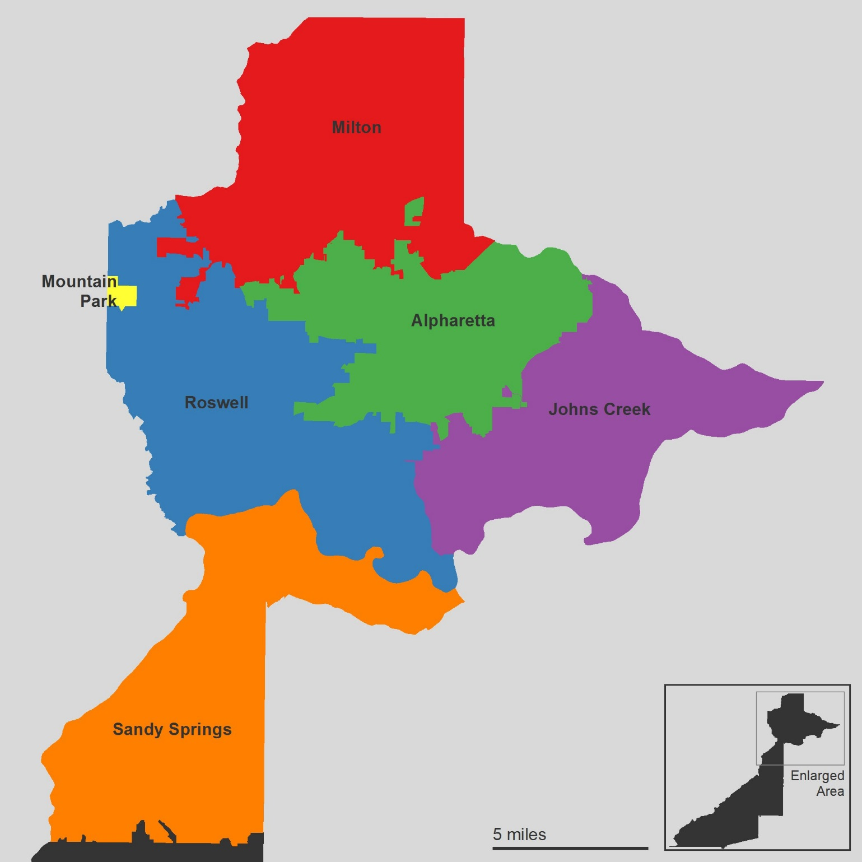
Background
7
North Fulton County
No unincorporated areas
Alpharetta, incorporated 1858
Johns Creek, 2006
Milton, 2006
Mountain Park, 1927
Roswell, 1854
Sandy Springs, 2005
Notes:
Here’s a closer look at the region I’ve been referring to as north Fulton County. It’s comprised mainly of historic Milton County, and today is home to roughly 370,000 residents, or about 38% of the county’s total population.
There are no remaining unincorporated areas governed by Fulton County, as new cities formed during the past decade and existing cities annexed the remaining areas. The area includes:
Alpharetta, which was incorporated in 1858
Johns Creek and Milton, both formed in 2006
Mountain Park, formed in 1927
Roswell, incorporated in 1854
And of course Sandy Springs

Slide 13
Background
8
1965 Atlanta Annexation Effort
Dilute growing influence of Atlanta’s black electorate
Reaction at times overtly racist, typical of white-flight era
1970s Fulton County Conflict
Unresponsive to concerns such as zoning
Redistributive tax policies to “subsidize” south Fulton
1975-2005 Incorporation Fight
30-year political stalemate in Georgia General Assembly
94% approve June 2005 referendum, formed Dec. 2005
Notes:
Given the political and demographic differences between north and south Fulton County, it should come as little surprise these divisions set the stage for the decades-long effort in Sandy Springs to first prevent its annexation by the city of Atlanta, and later to incorporate the community as a new municipality.
The 1965 effort to annex Sandy Springs and several other mostly white northern suburbs was advocated by former Atlanta mayor William Hartsfield as a way to dilute the growing influence of the city’s black electorate. Annexing the area, he wrote, was essential to [quote] “preserve the proper white balance which is necessary for amicable relations between both races.” Of failing to do so, Hartsfield wrote [quote] “we have only five or six more years until the racial balance is 50-50 and then on its way to further racial imbalance at an accelerated pace. What are we waiting on?”
If the motivation for the annexation effort was cynically bigoted, the reaction in Sandy Springs was at times equally overt in its racism. The response was typical of the era’s white flight narratives, raising concerns such as the forced integration of housing and schools, and outright fear of being governed by black elected officials.
The annexation proposal was rejected by a 2-to-1 margin.

Slide 14
Background
8
1965 Atlanta Annexation Effort
Dilute growing influence of Atlanta’s black electorate
Reaction at times overtly racist, typical of white-flight era
1970s Fulton County Conflict
Unresponsive to concerns such as zoning
Redistributive tax policies to “subsidize” south Fulton
1975-2005 Incorporation Fight
30-year political stalemate in Georgia General Assembly
94% approve June 2005 referendum, formed Dec. 2005
Notes:
By the 1970s many in Sandy Springs had become as frustrated by the government of Fulton County as they had been by the earlier Atlanta annexation efforts. County officials were perceived to be unresponsive to the concerns of Sandy Springs, particularly on planning and zoning issues, such as the growth of rental apartment housing.
The county was also seen as all too willing to subsidize south Fulton through redistributive tax policies resented by the wealthier northern suburban communities. As one Sandy Springs organizer later wrote [quote] “we could almost hear the whooshing sound of funds being sucked out of the area.”

Slide 15
Background
8
1965 Atlanta Annexation Effort
Dilute growing influence of Atlanta’s black electorate
Reaction at times overtly racist, typical of white-flight era
1970s Fulton County Conflict
Unresponsive to concerns such as zoning
Redistributive tax policies to subsidize south Fulton
1975-2005 Incorporation Fight
30-year political stalemate in Georgia General Assembly
94% approve June 2005 referendum, formed Dec. 2005
Notes:
This new suburban populist resentment and the old fear of annexation motivated a growing movement to incorporate a new city of Sandy Springs. No new cities had been formed in Fulton County since 1927, and none with more than a few hundred residents since 1895.
A 30-year stalemate followed thanks to Democratic control of state government, and only after Republican lawmakers won control of both houses of the Georgia General Assembly in 2005 was the deadlock broken in favor of the new city advocates.
94% of Sandy Springs voters approved incorporation in the resulting referendum in June 2005, and the city was officially formed on December 1, 2005.

Slide 16
Research on New Cities
9
Newly Incorporated Municipalities (NIMs)
Small body of scholarship by geographic researchers
Focus on how, why, and where new cities are formed
Absence of research on what effects incorporation has
Useful for formulating topical and methodological approach
Clustering
Studies dating to 1950s find new cities form in clusters
Sandy Springs first new city in Fulton County in 80 years
Seven others have since formed in suburbs north of Atlanta
Notes:
Sandy Springs is an example of what is known in the academic literature as a newly incorporated municipality, or NIM. Though NIMs are the subject of a dedicated if relatively small body of geographic and economic research by a handful of scholars, the focus of such work has long and all but exclusively focused on how, why, and where new cities form.
Studies of the effects, if any, that incorporation has on the demographic and economic landscape of NIMs is absent from this literature. Reviewing it is nevertheless instructive for the purpose of formulating a topical and methodological approach to studying Sandy Springs, as the factors that led to the incorporation of new cities there and elsewhere suggests particular research avenues.

Slide 17
Research on New Cities
9
Newly Incorporated Municipalities (NIMs)
Small body of scholarship by geographic researchers
Focus on how, why, and where new cities are formed
Absence of research on what effects incorporation has
Useful for formulating topical and methodological approach
Clustering
Studies dating to 1950s find new cities form in clusters
Sandy Springs first new city in Fulton County in 80 years
Seven others have since formed across Atlanta region
Notes:
Much of NIMs research dates to or references mid-20th century studies inspired by the wave of more than 1,000 new cities that formed in America during the 1950s. This early work was the first to identify the geographic clustering phenomenon, the tendency of one new city to lead to the formation of others nearby. More recent research indicates that such clustering continues today, with Sandy Springs itself being a notable example.
Since Sandy Springs incorporated, seven other new cities have formed in the Atlanta region, the most recent of which was approved by voters only last month.

Slide 18
Research on New Cities
10
Race and Income Homogeneity
Leon-Moreta (2015) found pursuit of income homogeneity had clearer effect on incorporation probability than race
Cities form to avoid class diversity, redistributive tax policies
Effects of race and class are not mutually exclusive
Dearth of Geographic Scholarship
Smith and Debbage (2006) advocate more spatial study
City formation viewed as a political not geographic process
Absence of research on demographic and economic effects of municipal incorporation a significant gap in literature
Notes:
Of particular note in the NIMs literature is the finding that the pursuit of income homogeneity has a clearer effect on the probability of new city formation nationally than race and ethnicity. In this view, more affluent cities form to short-circuit growing economic or class-based diversity, and to avoid the kind of redistributive local tax policies bemoaned in Sandy Springs.
Of course, the effects of race and ethnicity and income are not mutually exclusive, intertwined as they are in the United States in general and the Atlanta area in particular.

Slide 19
Research on New Cities
10
Race and Income Homogeneity
Leon-Moreta (2015) found pursuit of income homogeneity had clearer effect on incorporation probability than race
Cities form to avoid class diversity, redistributive tax policies
Effects of race and class are not mutually exclusive
Dearth of Geographic Scholarship
Smith and Debbage (2006) advocate more spatial study
City formation viewed as a political not geographic process
Absence of research on demographic and economic effects of municipal incorporation a significant gap in literature
Notes:
NIMs literature is also notable for a certain self-awareness of its own narrow focus, with some calling for greater geographic research in the field.
One reason suggested for the lack of such research is that the at times narrow scope of academic disciplines has left NIMs research to political scientists and public administrators rather than geographers, since the formation of new cities is still viewed as a primarily political rather than geographical process.
Another striking gap in the literature is of course the absence of studies of the basic demographic and economic effects of incorporation inside new cities.

Slide 20
Proposed Methods
11
Primary Topics
Race and ethnicity: More or less diverse or diversified differently than surrounding communities? Segregation?
Income: Increased economic homogeneity, inequality, or class-based segregation?
Foundation in History and Research
Mid-20th century roots of incorporation in Sandy Springs were unquestionably racial in nature
Latter-day issues of political representation and service provision are inextricably linked to race and class
NIMs scholarship highlights pursuit of income uniformity
Notes:
The literature on NIMs and the specific history of Sandy Springs suggest two main areas of inquiry: Race and ethnicity, and income.
The goal of this analysis is to assess whether a city founded on conceptions of local political power that in the Atlanta region are so strongly tied to race and class has over time become significantly more or less diverse, or changed more or less rapidly than surrounding communities.

Slide 21
Proposed Methods
11
Primary Topics
Race and ethnicity: More or less diverse or diversified differently than surrounding communities? Segregation?
Income: Increased economic homogeneity, inequality, or class-based segregation?
Foundation in History and Research
Mid-20th century roots of incorporation in Sandy Springs were unquestionably racial in nature
Latter-day issues of political representation and service provision are inextricably linked to race and class
NIMs scholarship highlights pursuit of income uniformity
Notes:
The choice to focus on race and aspects of class is rooted in Sandy Springs’ own history. The mid-20th century case for and fight against Atlanta annexation was unquestionably racial in nature, and the latter-day issues of political representation and service provision by the county were inextricably linked to race and class.
Findings on the pursuit of income uniformity from the NIMs literature also support a research focus on post-incorporation economic issues.

Slide 22
Proposed Methods
12
Data Sources
U.S. Census Bureau
2000 and 2010 decennial censuses
American Community Survey
Geographic boundary data
Multi-agency Fulton County geospatial data portal
American Community Survey (ACS)
1-year estimates: More current, less reliable, large area
5-year estimates: Less current, more reliable, small area
Notes:
The primary source of demographic and economic data for this study is the U.S. Census Bureau, particularly the 2000 and 2010 decennial censuses, and the American Community Survey, or ACS.
The Census Bureau also is the main source of geographic data, such as tract, block group, and block boundary files. Additional information on other administrative boundaries such as municipal maps is available from the multi-agency Fulton County geospatial data portal.

Slide 23
Proposed Methods
12
Data Sources
U.S. Census Bureau
2000 and 2010 decennial censuses
American Community Survey
Geographic boundary data
Multi-agency Fulton County geospatial data portal
American Community Survey (ACS)
1-year estimates: More current, less reliable, large area
5-year estimates: Less current, more reliable, small area
Notes:
The ACS presents options that require analysts to weigh the relative importance of timeliness versus precision to their work, with data available as either 1-year or 5-year estimates.
1-year estimates offer more current but less reliable information on geographic units with populations of at least 65,000 people, while 5-year estimates include less current but more reliable data for all geographic units down to the block group level.

Slide 24
Proposed Methods
13
5-year ACS Estimates
Combine five years of data collection into a rolling average
Most recent period is 2010-2014
Reduced timeliness offset by availability of data at the census tract and block group level
Boundary Changes
Reporting units are added and removed due to population growth and decline
To resolve mismatch, make areal units conform to earlier vintage by aggregating spilt areas
 | 2000 | 2010
Tracts | 15 | 22
Block groups | 40 | 58
 | Boundaries
ACS 2005-2009 | 2000
ACS 2006-2010 | 2010
ACS 2007-2011 | 2010
ACS 2008-2012 | 2010
ACS 2009-2013 | 2010
ACS 2010-2014 | 2010
Notes:
As the name suggests, 5-year estimates combine five years of data collection into a rolling average, the most current of which encompasses the years 2010 to 2014.
For the purposes of this study, the reduced currency of the resulting estimates is offset by their availability at the census tract and block group level, so 5-year ACS estimates will be my main source for inter- and post-decennial census data.

Slide 25
Proposed Methods
13
5-year ACS Estimates
Combine five years of data collection into a rolling average
Most recent period is 2010-2014
Reduced timeliness offset by availability of data at the census tract and block group level
Boundary Changes
Reporting units are added and removed due to population growth and decline
To resolve mismatch, make areal units conform to earlier vintage by aggregating spilt areas
 | 2000 | 2010
Tracts | 15 | 22
Block groups | 40 | 58
 | Boundaries
ACS 2005-2009 | 2000
ACS 2006-2010 | 2010
ACS 2007-2011 | 2010
ACS 2008-2012 | 2010
ACS 2009-2013 | 2010
ACS 2010-2014 | 2010
Notes:
Sub-city level comparisons over time are complicated by boundary changes, as new census reporting units such as tracts are created or consolidated to account for population growth or decline.
For example, the table here shows that the number of tracts in Sandy Springs increased from 15 at the time of the 2000 decennial census to 22 by the 2010 count, and block groups increased from 40 to 58.
A common approach to resolving these mismatches, and one that is adequate for this study, is to simply make the areal units from both periods conform to the earlier vintage by aggregating data in the units that were split.

Slide 26
Proposed Methods
14
Racial and Ethnic Indicators
Black population of Sandy Springs doubled from 2005-2009 to 2010-2014 periods
White proportion down from 68% to 57%
Cities can be both very diverse and very segregated, or homogenous but integrated
Measures of Segregation
Dissimilarity index, a measure of the evenness of a group’s spatial distribution
Isolation index, a measure of the exposure a group has to others
Notes:
Analyzing the racial and ethnic composition of the population of Sandy Springs from year to year is merely a starting point for studying demographic changes in the community, but even this basic step yields some insight.
For example, in the top chart we can see that the black population of the city has roughly doubled, and the bottom chart highlights an approximately 11 percentage point decline over the same period in the proportion of the city that is white.
It’s clear, then, that Sandy Springs as a whole has grown more racially diverse since incorporation, but from this information alone nothing can be concluded about how well integrated the population might be. A city can be both extremely diverse and extremely segregated, after all, or all but racially homogeneous but well integrated.

Slide 27
Proposed Methods
14
Racial and Ethnic Indicators
Black population of Sandy Springs doubled from 2005-2009 to 2010-2014 periods
White proportion down from 68% to 57%
Cities can be both very diverse and very segregated, or homogenous but integrated
Measures of Segregation
Dissimilarity index, a measure of the evenness of a group’s spatial distribution
Isolation index, a measure of the exposure a group has to others
Notes:
To determine whether increasing racial diversity at the city level has translated into greater integration at a more local level, the spatial distribution of racial and ethnic groups over time must be analyzed. Fortunately, the literature on residential segregation offers numerous widely used indicators to analyze this issue.
Two that will be used in this study are the dissimilarity index, which is a measure of the evenness of a given group’s spatial distribution, and the isolation index, a measure of a given group’s exposure to others.

Slide 28
Proposed Methods
15
Dissimilarity Index
Most common measure of residential segregation
Quantifies % of a group that would have to move for each sub-area measured to have same proportion as overall area
Evenness not dependent on relative size of groups compared
Isolation Index
Very common measure of residential segregation
Measures extent to which a group is exposed only to one another, rather than to members of other groups
Exposure is dependent on relative size of groups compared
Notes:
The dissimilarity index is the most widely used measure of residential segregation.
Conceptually, it quantifies the percentage of a given group that would have to move residence for each areal sub-unit being measured to have the same proportion of that group as the overall area.
As an indicator of evenness, dissimilarity is not dependent on the relative size of the groups being compared.

Slide 29
Proposed Methods
15
Dissimilarity Index
Most common measure of residential segregation
Quantifies % of a group that would have to move for each sub-area measured to have same proportion as overall area
Evenness not dependent on relative size of groups compared
Isolation Index
Very common measure of residential segregation
Measures extent to which a group is exposed only to one another, rather than to members of other groups
Exposure is dependent on relative size of groups compared
Notes:
Like dissimilarity, the isolation index is also a common measure of residential segregation.
Conceptually, it measures the extent to which members of a given group are exposed only to one another, or the likelihood of a typical minority group member sharing the same neighborhood with a member of the majority group.
As an indicator of exposure, the isolation index is dependent on the relative size of the groups being compared.
While dissimilarity measures the departure from the abstract ideal of evenness, isolation in a way attempts to measure the experience of segregation for the typical minority or majority group member.

Slide 30
Proposed Methods
16
Economic Indicators
White median household income in Fulton County 2.5 times figure for black households
1-in-10 black households in Fulton have income of $100,000 or more
Becoming more diverse racially but less diverse economically?
Measures of Income Inequality
Gini coefficient
Quintile shares
Percentile limit ratios
Notes:
As with race and ethnicity, basic citywide measures of income and wealth, while useful starting points, lack important information about the economic standing of various groups and the spatial distribution of prosperity.
We can see in the top chart, for example, that the median income of white-headed households in Fulton County is double that of Hispanic households and 2 1/2 times the figure for black households.
But while black household earnings tend to lag those of white households overall, the bottom chart shows that about 1-in-10 black households in Fulton County have annual incomes of $100,000 or more.
If a significant number of the 9,400 black households in Sandy Springs are also among the 17,500 with six-figure incomes in the county as a whole, the city might be becoming more diverse racially but less diverse economically.

Slide 31
Proposed Methods
16
Economic Indicators
White median household income in Fulton County 2.5 times figure for black households
1-in-10 black households in Fulton have income of $100,000 or more
Becoming more diverse racially but less diverse economically?
Measures of Income Inequality
Gini coefficient
Quintile shares
Percentile limit ratios
Notes:
Three measures of income inequality will be used to assess this possibility: The Gini coefficient, quintile shares, and percentile limit ratios.

Slide 32
Proposed Methods
17
Gini Coefficient
Most common measure of income inequality
High median income and low Gini, uniformly high earnings
Quintile Shares
Comparison of aggregate proportion of household income received by each fifth of the income distribution
Consistently measures earnings distribution across time
Percentile Limit Ratios
Comparison of income at selected percentiles, such as the household at the 95th percentile to household at 20th
Notes:
The Gini coefficient is the most common measure of income inequality, having been used, for example, by the Census Bureau itself since 1947.
A high median household income and little inequality as indicated by a low Gini coefficient suggests a community in which earnings are uniformly high, while a community in which median income is more typical and the Gini value is high suggests a city of haves and have-nots, with a concentration of households at both extremes of income.

Slide 33
Proposed Methods
17
Gini Coefficient
Most common measure of income inequality
High median income and low Gini, uniformly high earnings
Quintile Shares
Comparison of aggregate proportion of household income received by each fifth of the income distribution
Consistently measures earnings distribution across time
Percentile Limit Ratios
Comparison of income at selected percentiles, such as the household at the 95th percentile to household at 20th
Notes:
Another common approach to measuring income distribution and inequality, and another primary indicator in the Census Bureau’s own studies, is quintile shares, or comparisons of the aggregate proportion of household income received by each fifth of the income distribution.
Quintile analysis has the advantage of consistently measuring how earnings are distributed across time.

Slide 34
Proposed Methods
17
Gini Coefficient
Most common measure of income inequality
High median income and low Gini, uniformly high earnings
Quintile Shares
Comparison of aggregate proportion of household income received by each fifth of the income distribution
Consistently measures earnings distribution across time
Percentile Limit Ratios
Comparison of income at selected percentiles, such as the household at the 95th percentile to household at 20th
Notes:
The ratio between selected percentile limits also can be used to track changes in household income inequality over time by, for example, comparing the household at the 95th percentile to the household at the 20th, or the 20th percentile household to the median.

Slide 35
Proposed Methods
18
Economic Segregation
Dissimilarity and isolation indexes
At tract or block group level, proportion of households in citywide top quintile of income vs. all others
Proportion of households in citywide bottom quintile of income vs. all others
Proportion of households that own residence vs. renters
Notes:
The dissimilarity and isolation indexes also can be used to assess the extent of economic segregation in Sandy Springs.
At the tract or block group level, this analysis will compare:
The proportion of households in the citywide top quintile of income to all others.
The proportion of households in the citywide bottom quintile of income to all others.
And the proportion of households that own their residence to those that rent.

Slide 36
Conclusion
19
Background
Sandy Springs incorporated 2005 following decades of effort
Started a wave of municipal incorporations that continues
Research on New Cities
NIMs research focused on how, why, where new cities form
Pursuit of class uniformity more pronounced effect than race
Notes:
To review before I wrap up:
Sandy Springs is a city in Georgia that was incorporated in 2005 following a decades-long, often racially charged battle first against the annexation attempts of the city of Atlanta, and later to wrest control of the community from the government of Fulton County.
It was the first new city in Fulton County in nearly 80 years, and set off a wave of municipal incorporations in the mostly prosperous, majority-white suburbs north of Atlanta that continues today.

Slide 37
Conclusion
19
Background
Sandy Springs incorporated 2005 following decades of effort
Started a wave of municipal incorporations that continues
Research on New Cities
NIMs research focused on how, why, where new cities form
Pursuit of class uniformity more pronounced effect than race
Notes:
The relatively small body of geographic and economic scholarship on newly incorporated municipalities, or NIMs, is almost exclusively focused on how, why, and where new cities form, rather than what happens to them after they actually do so.
Particularly noteworthy is evidence that suggests the pursuit of class-based uniformity has a more pronounced effect on the probability that a community will seek municipal incorporation than race or ethnicity.

Slide 38
Conclusion
20
Proposed Methods
Decennial census and American Community Survey data
Dissimilarity, isolation to measure residential segregation
Gini, quintile shares, percentile limits to measure inequality
Dissimilarity, isolation to assess economic segregation
Next Steps
Demographic and economic profile of Sandy Springs
January and February: Analysis
March and April: Writing and production
Venue and data of final report to be determined soon
Notes:
Given this information and the history of Sandy Springs, a focus on indicators of race and ethnicity, and income and wealth, was proposed.
The main source of data for this study will be the 2000 and 2010 decennial censuses, and 5-year estimates from the American Community Survey.
In addition to spatially and temporally analyzing basic citywide tallies of the racial and ethnic population distribution in Sandy Springs, use of the dissimilarity and isolation indexes was proposed to measure residential segregation and determine whether increasing overall diversity has led to changes in the extent of integration.
Similarly, common economic indicators such as median household income over time and space, and by race, will be considered alongside the Gini coefficient, a widely used indicator of income inequality. An analysis of quintile shares and percentile limits, two other common approaches to measuring income distribution and inequality, also was proposed.
And the dissimilarity and isolation indexes will be used to assess the extent of economic segregation.

Slide 39
Conclusion
20
Proposed Methods
Decennial census and American Community Survey data
Dissimilarity, isolation to measure residential segregation
Gini, quintile shares, percentile limits to measure inequality
Dissimilarity, isolation to assess economic segregation
Next Steps
Demographic and economic profile of Sandy Springs
January and February: Analysis
March and April: Writing and production
Venue and date of final report to be determined soon
Notes:
The result of this analysis will be a demographic and economic profile of Sandy Springs, emphasizing spatial and temporal visualization with maps and other graphics.
It’s my hope this can serve as a topical and methodological baseline for further, more detailed studies of the effects of municipal incorporation here in Atlanta and elsewhere.
I’ve already started collecting the necessary data, and some basic analysis is already complete. I plan to finish the remainder in January and February, with March and April set aside for writing, production, and revision of the final report and presentation.
I haven’t settled on a venue or date to present my final report, but hope to have that sorted out by the end of January.

Slide 40
Slides with Notes tiny.cc/WMH_slides Report with References tiny.cc/WMH_report
Notes:
Thank you for watching and listening, and I’ll be happy to take questions. If you’d like to download this presentation, including my notes, or my full report with references, you can do so at the URLs shown here.

