Slide 1

Evaluating Predictors of Breeding Waterfowl Distribution
Exploring Species Distribution and Abundance Models for the Central Interior Plateau of British Columbia
GEOG 596A Capstone Proposal
Advisor: Dr. Julian D. Avery
Yuriko Hashimoto
April 30, 2018

Slide 2




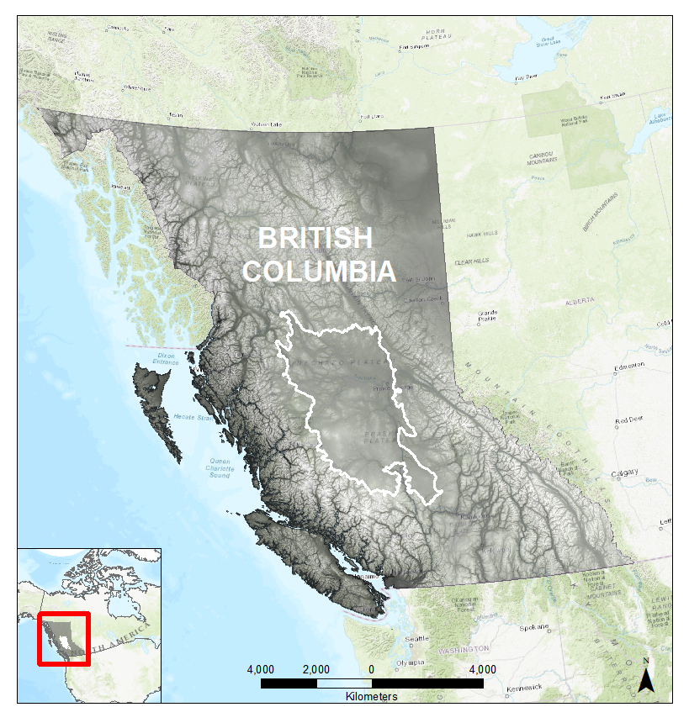
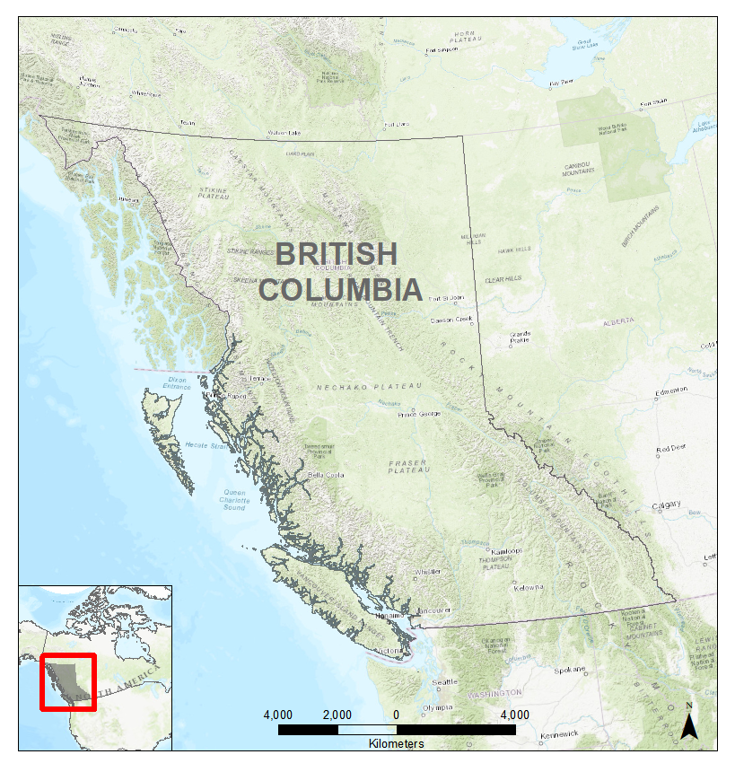
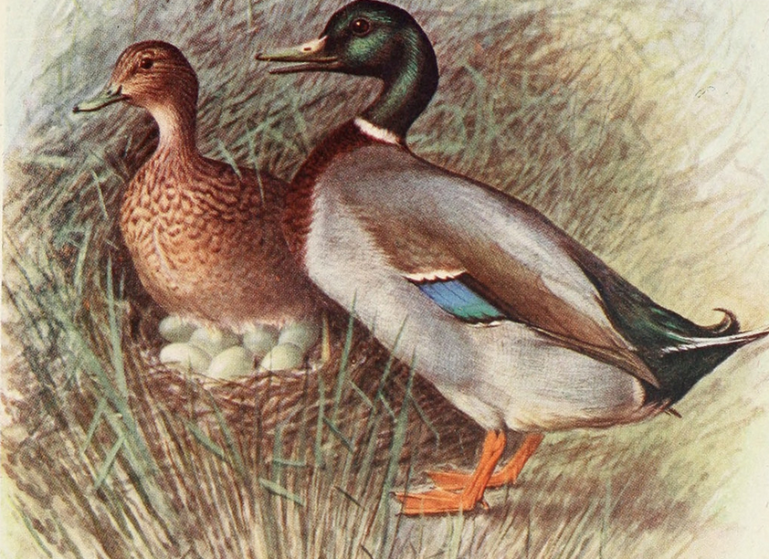
Introduction
Who am I?
Why am I here?
Where are we going?
Canadian Wildlife Service
Migratory Birds, SAR, Protected Areas
Breeding Waterfowl Surveys (2007-17)
  North American Waterfowl
  Management Plan (NAWMP)
  Hunting Regulations
https://www.biodiversitylibrary.org

Slide 3
Outline
1. Background/Purpose
2. Breeding Waterfowl Survey Design
3. Breeding Waterfowl Data
4. Data Sources and Inputs (Predictor Variables)
5. Methodology
6. Preliminary and Anticipated Results
7. Timeline

Slide 4
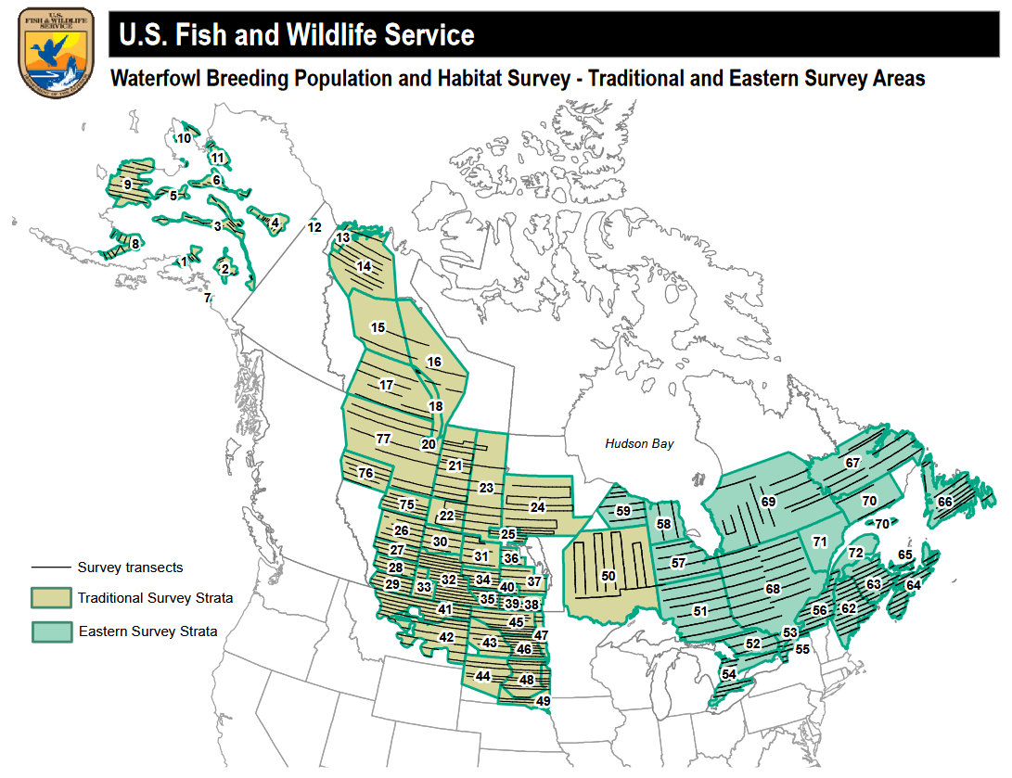
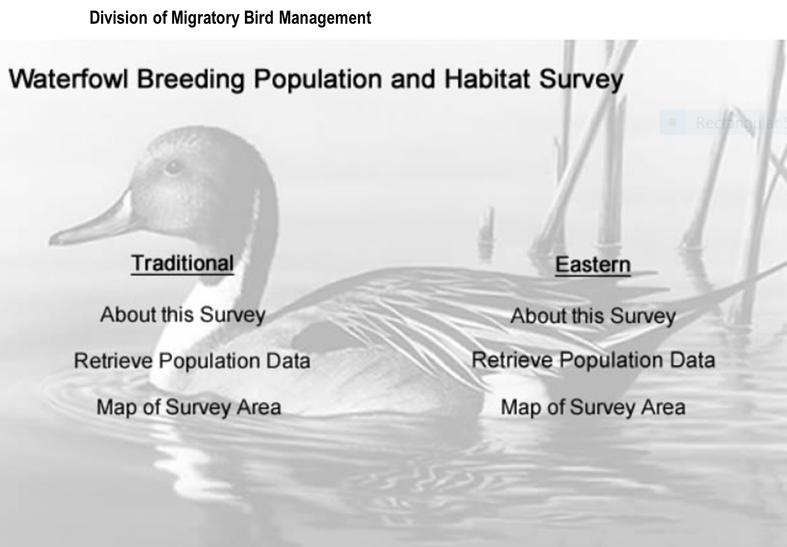
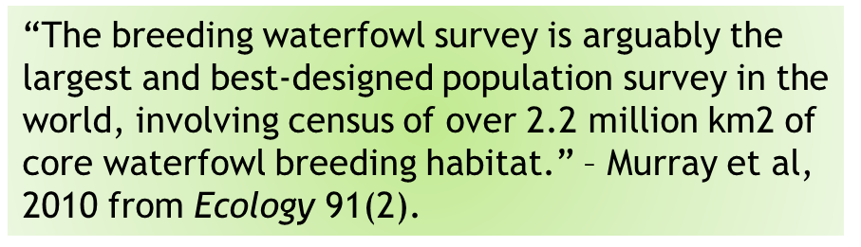
Breeding Waterfowl Population & Habitat
https://migbirdapps.fws.gov/mbdc/databases/mas/maydb.asp
https://migbirdapps.fws.gov/mbdc/databases/mas/maydb.asp

Slide 5
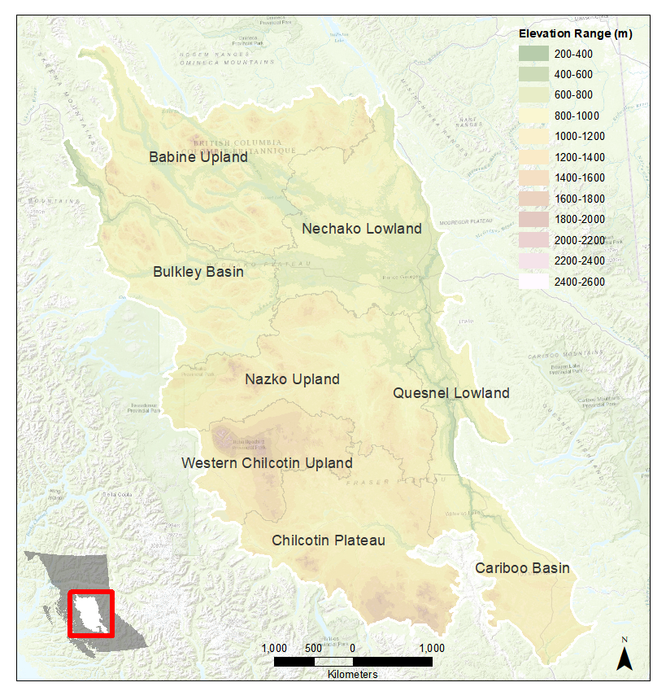
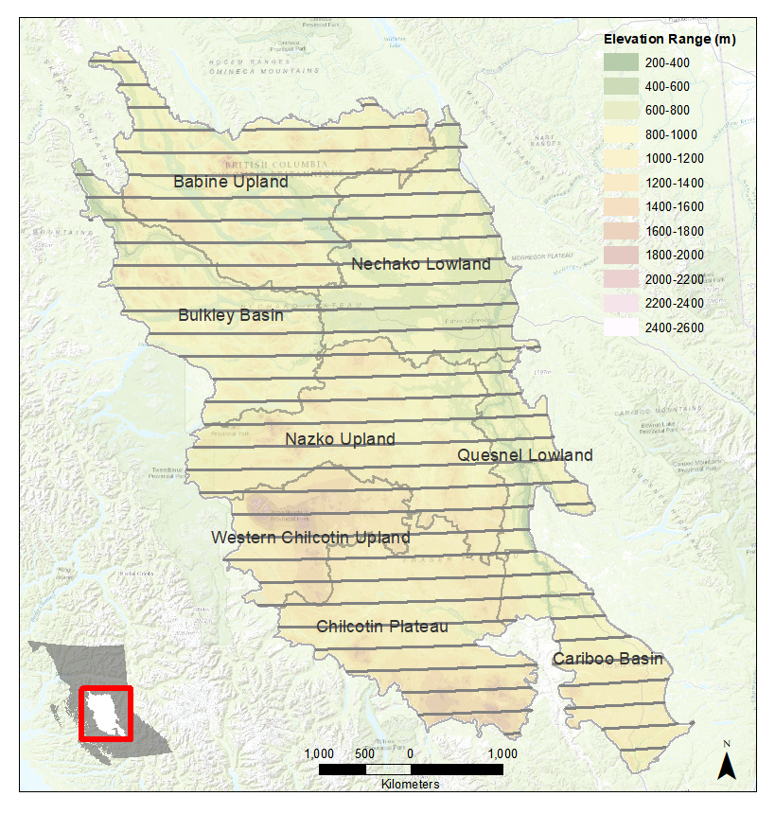
Central Interior Plateau - Survey Area
E–W transects, 400m wide, 10 mi apart
Early–Late May ~ 22 days
Distance – 6,624 km (4,107 mi)
8 Ecosections—regions of similar:
  climate
  physiography
  hydrology
  vegetation
  wildlife
Total Area
  ~10,714,000 ha (26,474,000 acres)
Total Strip Transect Area (~2.47%)
  264,904 ha (654,590 acres)

Slide 6
Central Interior Plateau - Survey Design
Compare/Contrast Traditional BWPHS
Habitat Assessment: Pond counts—Not observed vs Observed
Helicopter Survey vs Fixed-Wing
Ecosection-based vs High/Low Density Strata
Operational since 2006 vs 1955 to present (study period 2007-2017)
Ground Observations: Visibility Correction Factor—None vs Complementary Ground Surveys
All transects vs Sub-sample of Transects/Strata each year
Both survey methodologies subject to technological change

Slide 7

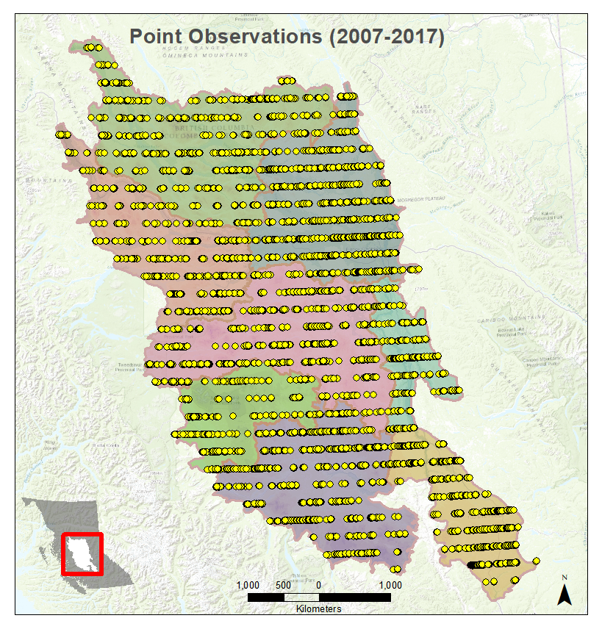
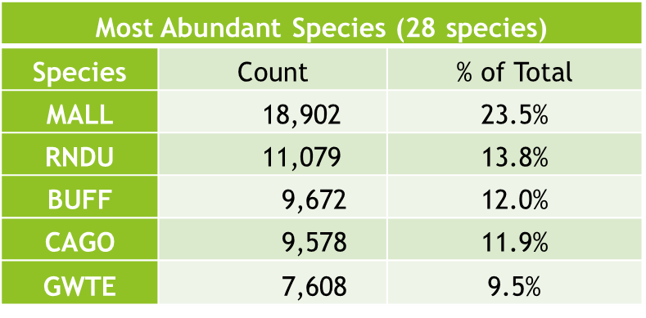
Central Interior Plateau—Survey Data
Occurrences — species, count, sex (Smith, 1995)
Total # of records: 36,228
Total Waterfowl-only records: 35,671
Waterfowl – cumulative TIBP surveyed: 80,454
Top 5 Abundant Species

Slide 8
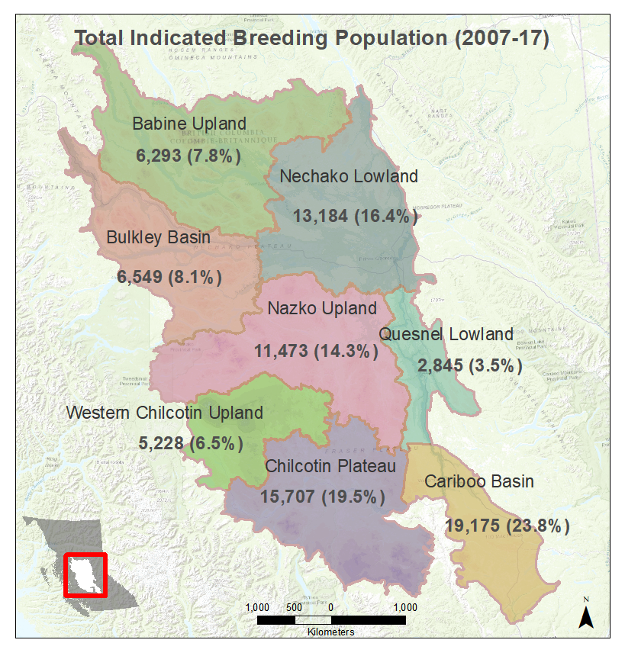
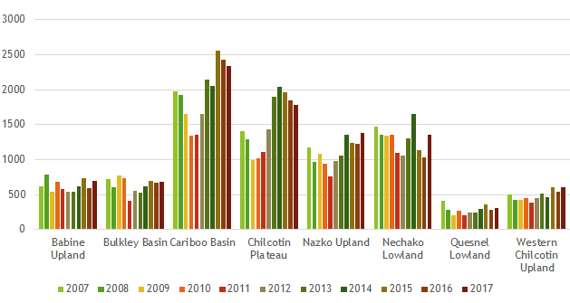
Ecosection — TIBP (Total Indicated Breeding Population)
Density of Total Indicated Breeding Population (TIBP)
Ecosection | Total Pop per sqkm
Babine Upland | 12.9
Bulkley Basin | 20.2
Cariboo Basin | 86.0
Chilcotin Plateau | 38.7
Nazko Upland | 25.7
Nechako Lowland | 31.4
Quesnel Lowland | 22.4
Western Chilcotin Upland | 24.6

Slide 9
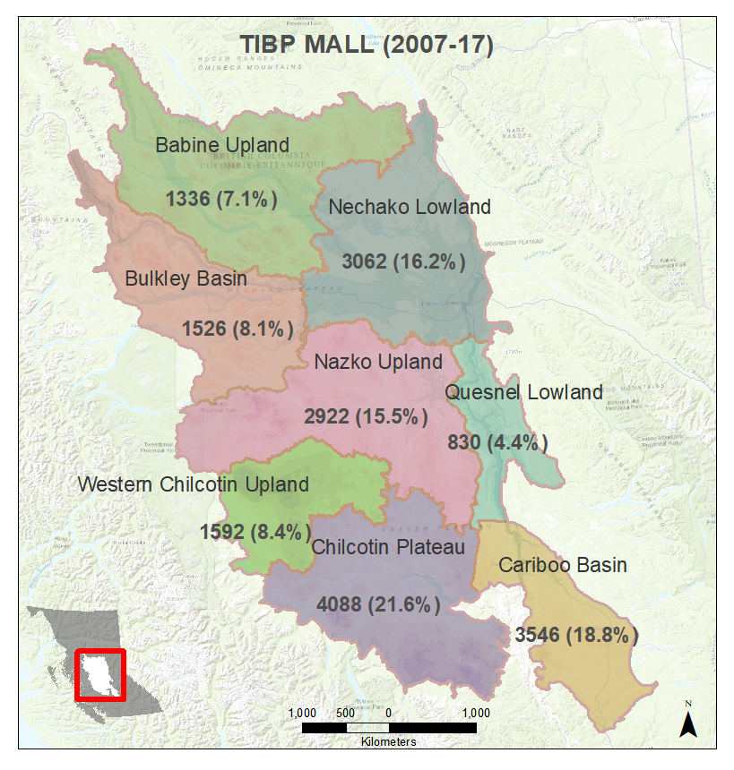
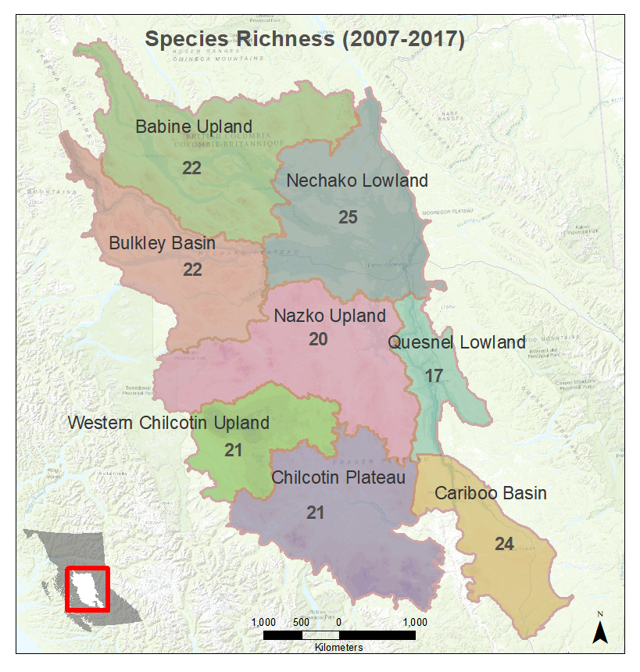



Ecosection — Observation Summaries
Top 5 Abundant Species within Ecosection
Species Richness – comparable across survey
MALL – Habitat Generalist, Opportunistic
GADW – Philopatric, primary range Dakotas
REDH – Philopatric, semi-permanent
CANV – least populous, stable permanent ponds
Top 5 Abundant Species
Ecosection | sp_1 | sp_2 | sp_3 | sp_4 | sp_5
Babine Upland | BAGO | MALL | RNDU | BUFF | GWTE
Bulkley Basin | MALL | CAGO | RNDU | BUFF | BAGO
Cariboo Basin | MALL | BUFF | CAGO | RNDU | SCAU
Chilcotin Plateau | MALL | BUFF | GWTE | RNDU | CAGO
Nazko Upland | MALL | BUFF | RNDU | CAGO | GWTE
Nechako Lowland | MALL | RNDU | BUFF | CAGO | GWTE
Quesnel Lowland | MALL | CAGO | BUFF | RNDU | BAGO
Western Chilcotin Upland | MALL | GWTE | BUFF | RNDU | CAGO

Slide 10
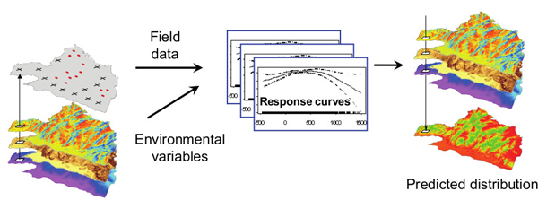
Modeling—Environmental Predictors*
Climate: Temperature, Precipitation, Snow depth (April 1st), ClimateBC predictions
Freshwater Atlas: Lakes, Rivers, Wetlands, Streams
Land Cover - Landsat
Roads—index of development
Census area—population
Biogeoclimatic Zones
Terrestrial Ecosystem Mapping - Vegetation Resource Inventory
Agriculture, Forestry Cut-blocks, Mountain Pine Beetle Kill
Boundaries: Sub-drainage Basin, Snow Basin, Watershed, Ecosection
Figure: Antoine Guisan
* DataBC – BC Data Catalogue

Slide 11
Modeling Species Distribution/Abundance
Weaknesses, Uncertainties & Potential Problems*
  Scale and resolution
  Positional accuracy
  Timeliness – Temporal Accuracy
  Completeness
  Attribute Accuracy
  Classification
Model—A simplified description, especially a mathematical one, of a system or process, to assist calculations and predictions. – Oxford English Dictionary
Strengths
  Embrace complexity, plan for uncertainty
  Inform Environmental Assessment, conservation planning
*(Thapa et al, 1992):

Slide 12
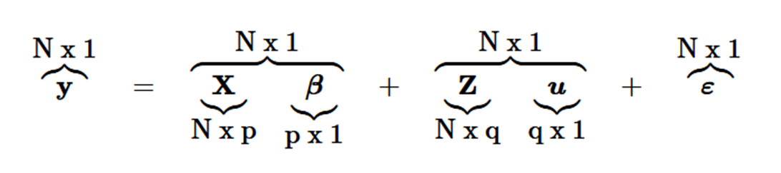

Modeling Species Distribution/Abundance
Methods*
  1. Data preparation in ArcGIS
    Ecosection by ecosection basis
  2. Model fitting – GLMM, bootstrapping regression models
  3. Model predictions
  4. Model evaluation
    Evaluate if reasonable, ecological
R packages:
  raster, spatial, MASS
  Mixed modeling: glmm, lme4, glmmPQL
*(Hijman & Elith, 2017):

Slide 13
Cariboo Ecosection
Anticipated results
  1. Species-specific habitat relationships
    e.g. ↑ Forest cover and forest age correlated with ↑ cavity-nesting species
  Positive correlation between wetland density (esp <2 ha) and abundance
  Lower elevation wetlands positively correlated with abundance
    Autocorrelation (greater # wetlands at lower elevations due to hydrology)
    Implications for climate change—increased vulnerability
*(Hijman & Elith, 2017):

Slide 14
Climate Trends and Change
Historical data from 1900-2013*
Temperature —↑↑ seasonal variability
    Overall avg annual +1.4°C (+3.1°C night time temperatures)
    Spring thaw earlier
Precipitation — ↓↑ trends highly variable spatially and temporally**
    Overall avg annual +12%
    Last 50 yrs in Southern: ↓ winter, ↑ spring; Northern: little change
    Precipitation falling as snow — ↓↔
    Snowpack drives hydrology
    Overall ↓ in snow 1900 - 1970 ↑ in snowfall, marked ↓ until early 1980s
Climate Predictions —2020s, 2050s **
    Greater precipitation / High seasonal variability
    Warmer temperatures / Less precipitation as snow
    Overall ↓ in snow pack / ↑ Uncertainty
            (*BC Ministry of Environment, 2016; **Pike et al, 2010)
* BC MOE (2016), **Wang et al (2012)

Slide 15
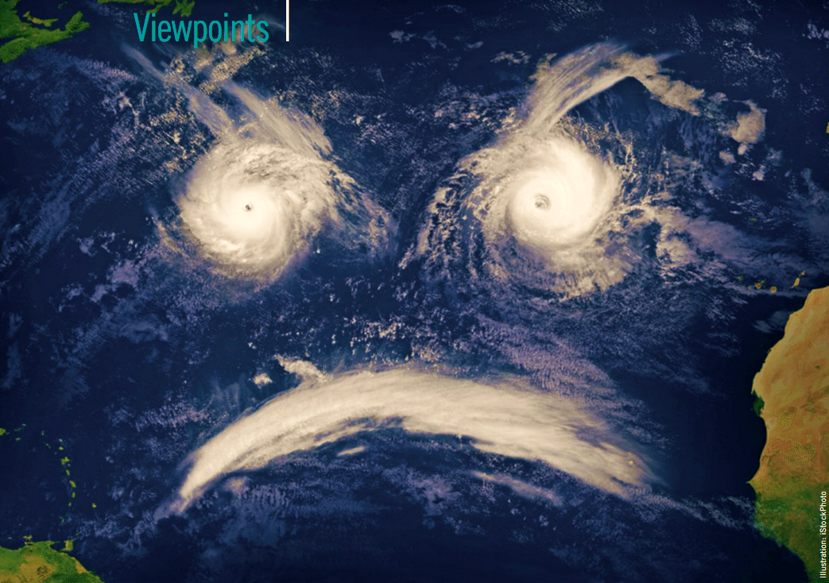
Climate Change Predictions
“I prefer the term ‘global weirding,’ … because the rise in average global temperature is going to lead to all sorts of crazy things…” (Friedman, 2007)

Slide 16
Project Timeline
2018
May — continue data identification, collation, preparation
June – July — explore different SDM/SAM methods and approaches
Aug - Sept — Refine the methodology
Oct - Dec — GEOG 596B write-up
Nov 8 — ESRI Regional Users Conference

Slide 17
References
BC MOE. (2016). Climate Change Indicators for British Columbia 2016 Update.
Islam, S. ul, Déry, S. J., Werner, A. T., Islam, S. ul, Déry, S. J., & Werner, A. T. (2017). Future Climate Change Impacts on Snow and Water Resources of the Fraser River Basin, British Columbia. Journal of Hydrometeorology, 18(2), 473–496. https://doi.org/10.1175/JHM-D-16-0012.1
Pike, R. G., Bennett, K. E., Redding, T. E., Werner, A. T., Spittlehouse, D. L., Moore, R. D. D., … Tschaplinski, P. J. (2010). Climate Change Effects on Watershed Processes in British Columbia. In Compendium of Forest Hydrology and Geomorphology in British Columbia (Vol. 3). https://doi.org/10.5194/nhess-12-1-2012
Smith, G. (1995). A Critical Review of the Aerial and Ground Surveys of Breeding Waterfowl in North America. Biological Science Report (Vol. 268). https://doi.org/10.1126/science.268.5215.1262
Wang, T., Hamann, A., Spittlehouse, D.L., Murdock, T., 2012. ClimateWNA - High-Resolution Spatial Climate Data for Western North America. Journal of Applied Meteorology and Climatology, 51: 16-29.

Slide 18
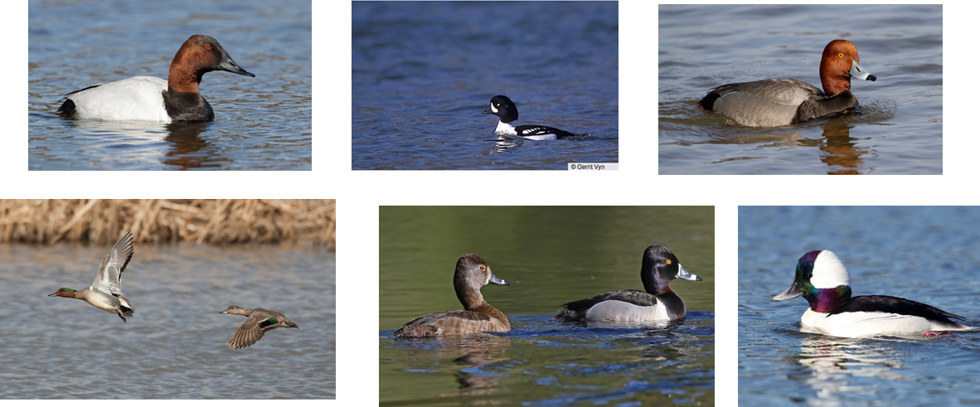
Questions, Comments, Advice?
Images: © Macaulay Library

