Slide 1
Payday Lenders and the Military: A Study of Hampton Roads, Virginia
Karen J. Hastings
Advisor: Gregory Thomas
Pennsylvania State University
GEOG 596A, Fall 2 2015

Slide 2
Introduction
Payday Lenders have long been identified as targeting military populations
Area of concern to leadership due to security risks
Hampton Roads has unique military and civilian makeup, making it an ideal area to study
Large Military Population: Army, Navy, Air Force, and Coast Guard (arguably the most militarized region in the US)
Varied Civilian Population: income, rural/urban, ethnic groups
Notes:
Failure to Pay Debts can result in loss of security clearance, disciplinary action, loss of rank, confinement, and separation
Military can go to prison for failing to pay debts
Military can have debts seized from paycheck by commanders (easy process)
Hampton Roads has unique makeup in a small area: for example, as reported in the 2010 Census, the City of Hampton is 49.6% black, while York county is 95.1% white. Household incomes vary from $55,170 (City of Williamsburg) per year to $101, 801 (Poquoson)

Slide 3
Background
Payday Lenders charge extremely high interest rates and have historically preyed on junior service members
2005 Graves and Peterson “Predatory Lending and the Military: The Law and Geography of ‘Payday’ Loans in Military Towns”
Looked at 20 states, 109 military installations, and 15,000 payday lenders
Found greater concentrations of payday lenders per capita near military installations

Slide 4
Federal Measures
Congress passes Military Lending Act in 2006
Caps interest rate at 36%
Requires rights disclosure
Prohibits arbitration
Can’t waive Service member’s Civil Relief Act (2015)
Service Response
Varies by Service
Air Force
Briefings to new personnel
No interest/low interest loans
Offers free financial readiness classes
Notes:
In trying to curb payday lending, federal, military and state measures were put into action
SCRA prevents military from being pursed by debtors while serving overseas in a contingency operation and caps interest rates at 6% for all debts incurred prior to that time
Congress has actually passed this in three phases, the last of which was in 2015, which closed loopholes in the original act after a 3 year study

Slide 5
State Measures
Virginia (2009)
Restricted loans to one at a time per borrower
Established tracking database to determine eligibility
Created mandatory longer repayment times
Capped interest rate at 36%
Limited fees to 20% of loan
May not make loans to military members, spouses or dependents
$1,000 fine per violation
29.41% decrease in Payday Lenders in 2009
Notes:
Repayment times must be 2x the borrowers pay cycle for example if a borrower has a pay cycle of 2 weeks, a minimum repayment period must be 4 weeks.

Slide 6
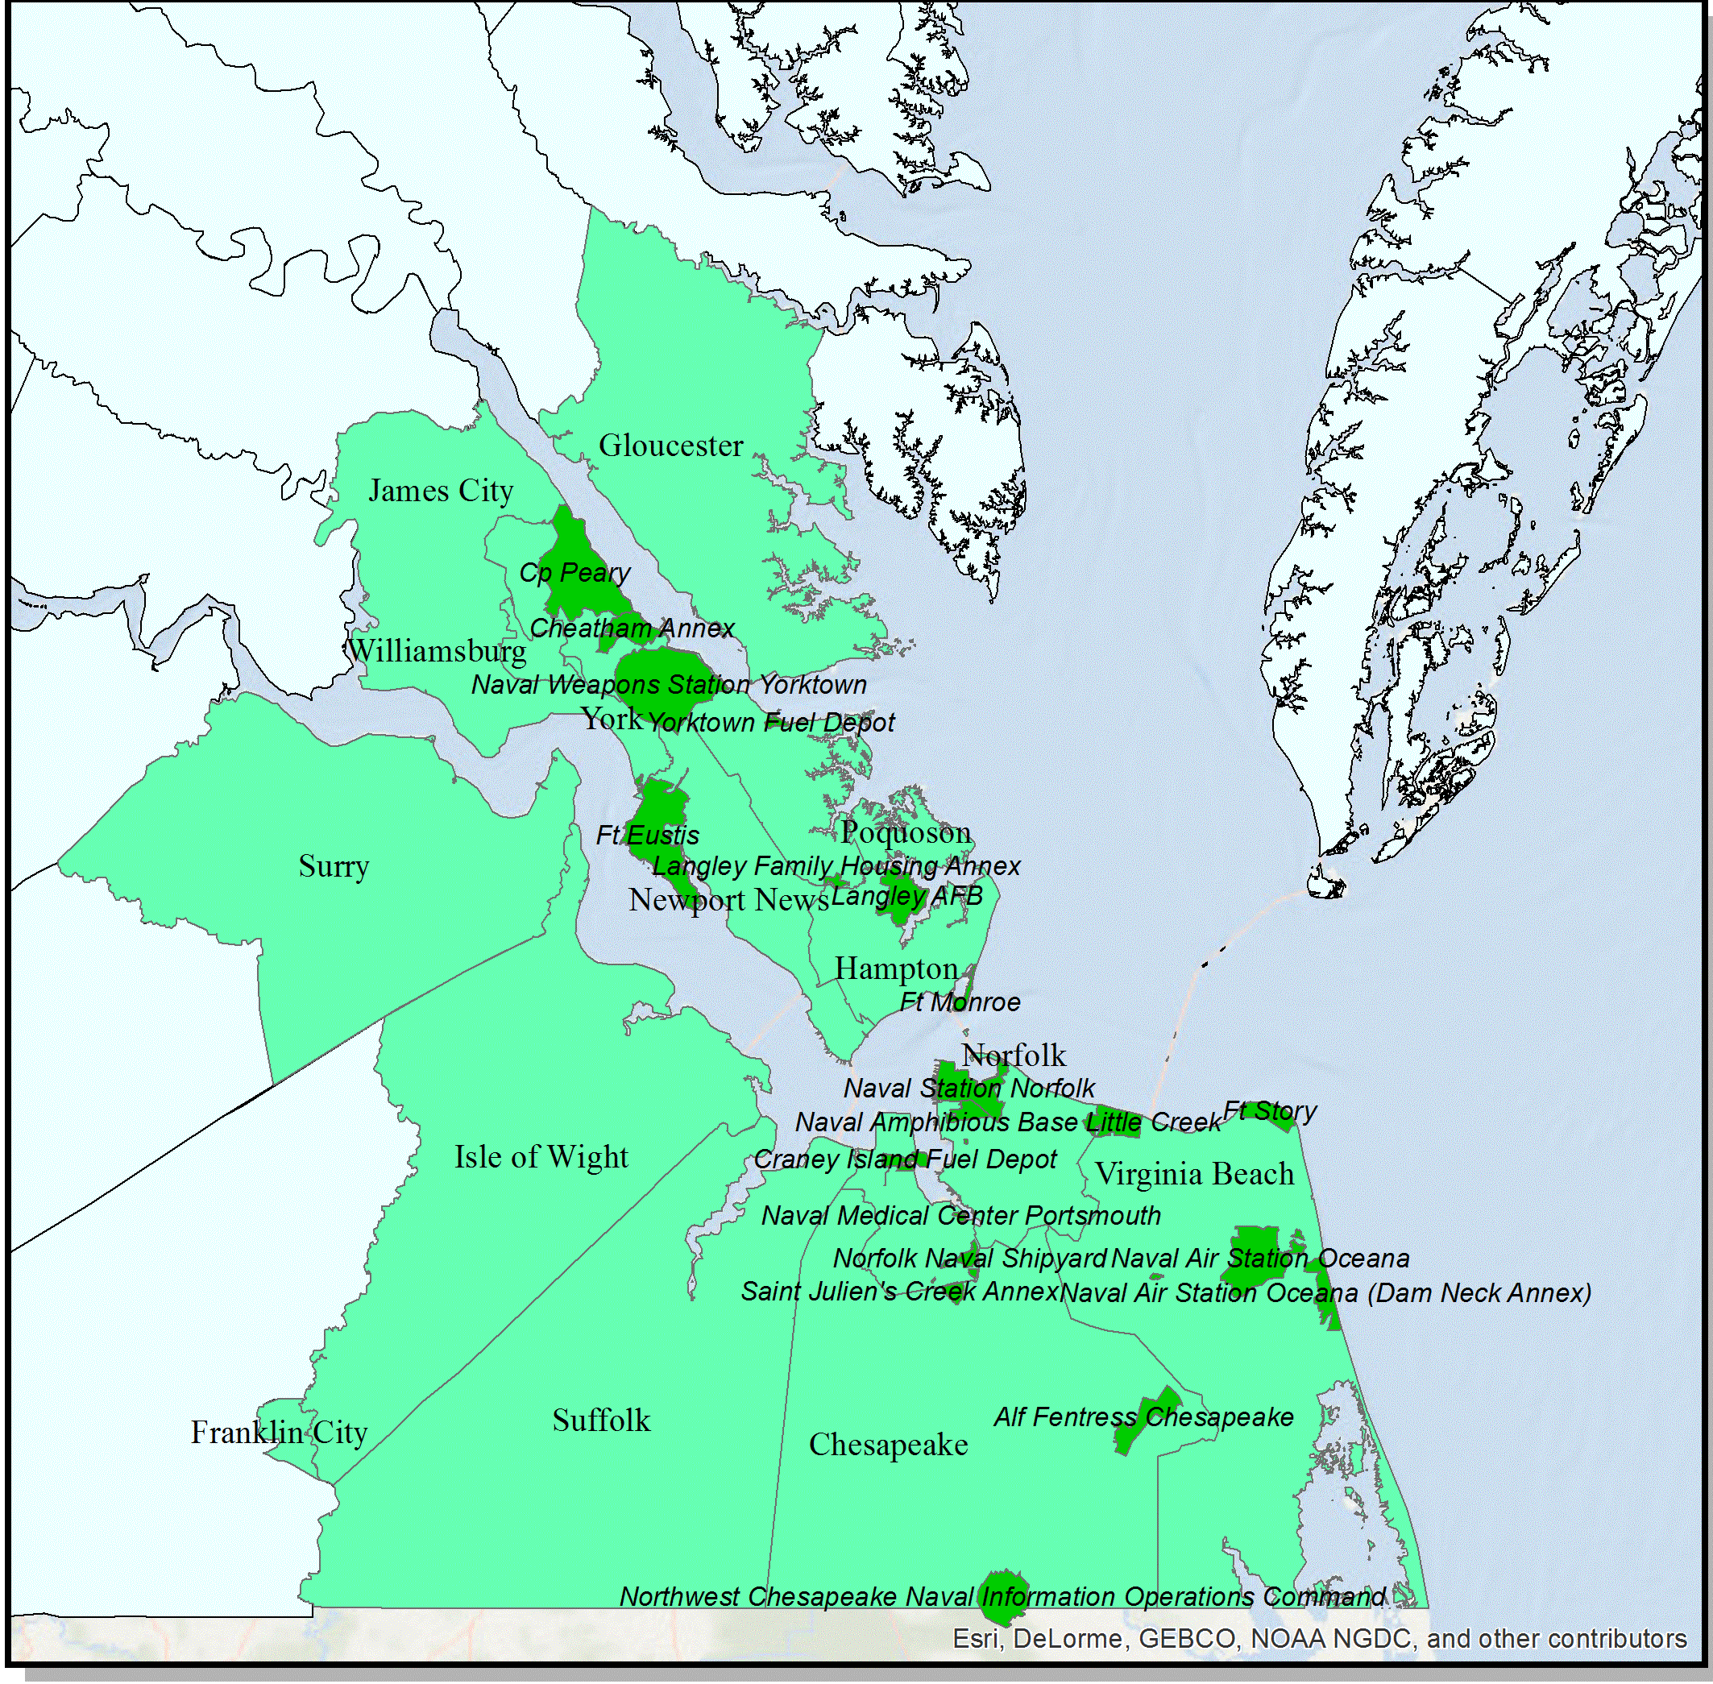
Hampton Roads
Notes:
Talk through where in USA Hampton Roads is. Mid-Atlantic states, south of Washington, DC.

Slide 7
Goals and Objectives
Determine if numbers of payday lenders have decreased since 2005
Determine if Military has continued to be a target
Notes:
Graves and Peterson found in 2005 the 4 counties (Newport News, Hampton, Norfolk, and Portsmouth) in Hampton Roads that house the majority of the military population all ranked among the 10 worst counties in Virginia

Slide 8
Proposed Methodology

Slide 9
Proposed Methodology: Phase I
Obtain Data
Background data
US Census Bureau TIGER
US Geological Survey
ESRI ArcGIS Online
Payday Lenders/Banks
American Factfinder (historical numbers)
Virginia State Corporation Commission
Geocode

Slide 10
Proposed Methodology: Phase II
Compare Raw Counts
Compare historical numbers and current numbers of payday lenders and banks
Accomplished by census block and ZIP code
Table and/or map showing trends
Overlay 3, 6, 9 mile buffers from military installations
Why? Payday lending industry wants locations w/in 3 miles of the populations they serve
Counts of payday lenders, people, and banks in the zones
Notes:
Why census block and ZIP code? Businesses select locations primarily on ZIP code data. Census blocks show areas of equal population.
Why consider banks: banks offer alternative to payday lenders.

Slide 11
Phase II: Complete Hot Spot Analysis
Aggregate current point data by census block & ZIP code
Will identify statistically significant clusters of high and low values of payday lenders
Overlay 3, 6, 9 mile buffers from military installations

Slide 12
Phase II: Complete Anselin Local Moran’s I Analysis
Aggregate current point data by census block & ZIP code
Identify any spatial clusters of features with high or low values
Only tool that will identify statistically significant outliers
Overlay 3, 6, 9 mile buffers from military installations

Slide 13
Recreate Graves and Peterson Study
Calculate Statewide Average of Payday Lenders Per 100K people
Enables prediction of payday lenders per unit (county or ZIP code)
Allows comparison of predicted numbers vs. actual numbers in any given area
Data presented by ZIP Codes and Counties
Rank Payday Lenders
Rank Payday Lenders Per Capita

Slide 14
Recreate Graves and Peterson Study
Calculate Location Quotient
ZIP Code $LQ=\left[ \frac{X}{\left(X+Y\right) x 100\}}\right]+(X−Y)$
County $LQ=\left[ \frac{X}{Y }\right]x 100$
LQ= Location Quotient, X and Y = Banks and Payday Lenders
* Not standard LQ formula but ones developed by Graves and Peterson
Notes:
Location Quotient is a ratio that compares a region to a larger reference region according to a characteristic.

Slide 15
Recreate Graves and Peterson Study
Calculate Composite Index
Average of Rank of Payday Lenders, Payday Lenders per Capita Rank, and Location Quotient for each county and ZIP code
This creates a method for showing proximity of payday lenders to bases with a single number
Create 3, 6, 9 mile buffer zones around military installations
Rank & Present results by County and ZIP code

Slide 16
Graves & Peterson Virginia Results

Slide 17
Phase III and Anticipated Results
Compile results
Finish Report and Visual Aids
Anticipated Results
Reduction In Payday Lenders
Move away from Military Installations
Banks will have remained stable

Slide 18
Project Timeline and Presentation
Jan | Feb | Mar | Apr | May | Jun | Jul | Aug | Sep | Oct
Phase I
 |  |  | Phase II
 |  |  |  |  |  | Phase III
 |  |  |  |  |  |  |  | Present
Virginia GIS Conference
Backup Conference
ESRI 2017

Slide 19
Sources
10 VAC-200. “Payday Lending (Final Regulation)”. The Virginia Register, 1 June 2012. Web. 15 November 2015.
ArcGIS Online. “USA Counties”. Esri, TomTom, U.S. Department of Commerce, U.S. Census Bureau. 28 November 2015.
ArcGIS Online. “World Ocean Base”. Esri, GEBCO, NOAA, DeLorme, HERE and other contributors. 28 November 2015.
“Department of Defense Issues Final Military Lending Act Rule”. U.S. Department of Defense Press Release No: NR-289-15: 21 July, 2015. Web. 11 October 2015.
Graves, Steven M. and Peterson, Christopher L. “Predatory Lending and the Military: The Law and Geography of ‘Payday’ Loans in Military Towns.” Ohio State Law Journal vol. 66, no. 4 (2005): 653-832. Web. 11 October 2015.
“Notice to Virginia Payday Loan Customers”. Commonwealth of Virginia State Corporation Commission. Web. 15 November 2015.
U.S. Census Bureau, Geography Division. “Military Installations”. TIGER/Line Shapefiles 2015. Web. 28 November 2105.
Vertiec Solutions, LLC, on behalf of the Bureau of Financial Institutions State Corporation Commission, “Report on Virginia Payday Lending Activity For the Year Ending December 31, 2009 “. Web. 17 November 2015.

